Slide 1
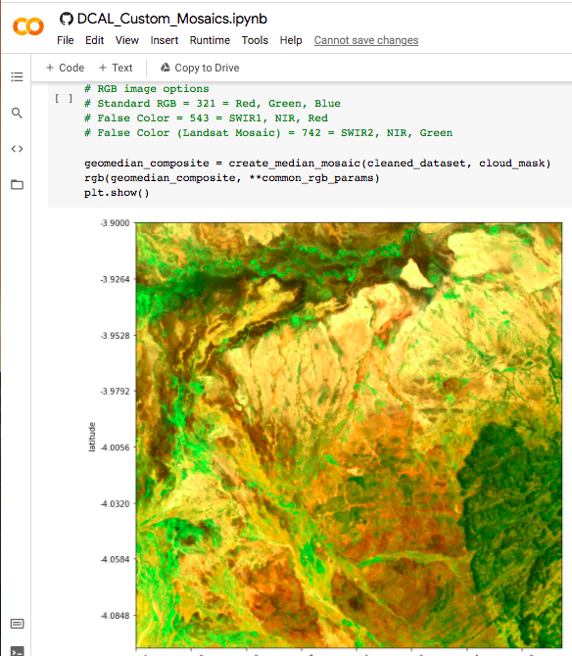

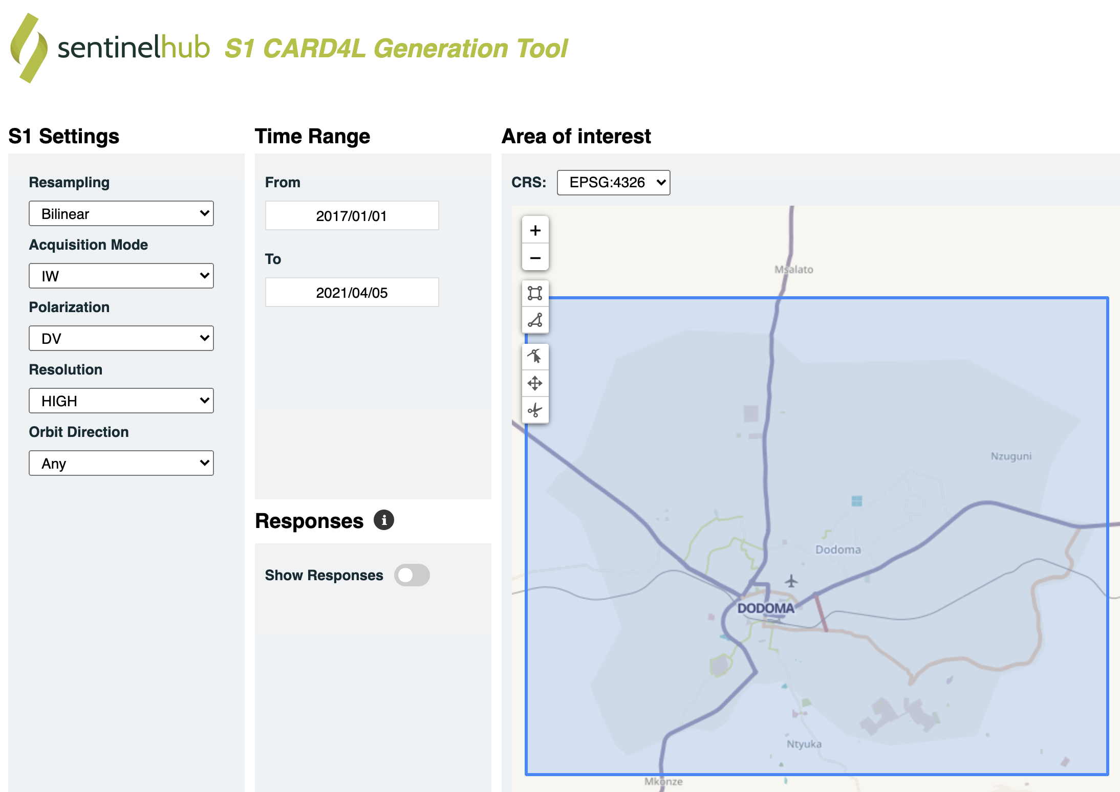
SEO Report to WGISS-51
Brian Killough, CEOS SEO
Google Colab Sandbox ... The SEO recently completed the first beta (internal) release of an Open Data Cube sandbox that runs on Google Colab and connects to Earth Engine datasets. This free/open tool can be used for Python notebook training as it can scale to unlimited users.
Earth Analytics Interoperability Lab ... The SEO is working with Rob Woodcock (CSIRO) to support data and algorithm testing for CEOS initiatives (COAST, Disasters, Rice Monitoring, GHG, DEM evaluation).
Regional Data Cubes ... The SEO is working closely with stakeholders in the Americas (ECLAC, AmeriGEO) and the Pacific Islands (SPC) to pursue regional data cubes similar to what was accomplished in Africa.
Open Earth Alliance (OEA) ... A new non-profit entity linked to GEO (community activity) that can expand the impact of the Open Data Cube and other data technologies (https://openearthalliance.org). The OEA recently released a new user forum to support the growing list of ODC users (https://www.openearthalliance.org/forum)
AWS Cloud ... Landsat Collection-2 is now on AWS-West along with Sentinel-2 (processed by Element-84). Both analysis-ready datasets take advantage of Cloud-Optimized GeoTIFF (COG) data formats and Spatio-Temporal Asset Catalog (STAC) metadata formats. This will support a number of global data cube projects and provide an efficient cloud-based solution.
Sentinel-1 Data Flows ... The SEO worked with DE-Africa to co-fund (via Sinergise) the development of a Sentinel-1 Data Cube processing pipeline that complies with ARD specifications and uses COG format and STAC metadata. This is only for backscatter intensity data cubes. This tool allows the generation of global S1 data cubes anywhere in the world. Contact the SEO if you want to create and test S1 cubes using this tool. https://apps.sentinel-hub.com/s1-card4l/

Slide 2

SEO Report to WGISS-51
Brian Killough
NASA Langley Research Center
CEOS Systems Engineering Office (SEO)
WGISS-51 Meeting (virtual)
April 20, 2021

Slide 3
SEO Highlights
Google Colab Sandbox ... Recently completed the first beta (internal) release of an Open Data Cube sandbox that runs on Google Colab and connects to Earth Engine datasets. Free/open access with a Google account and Earth Engine credentials. Limited (70GB memory), but it is possible to run algorithms anywhere in the world. This could be an excellent tool for Python notebook training as it can scale to unlimited users.
Earth Analytics Interoperability Lab ... Working with Rob Woodcock (CSIRO) to support data and algorithm testing for CEOS initiatives (COAST, Disasters, Rice Monitoring, GHG, DEM evaluation).
Regional Data Cubes ... Working closely with stakeholders in the Americas (ECLAC, AmeriGEO) and the Pacific Islands (SPC) to pursue regional data cubes similar to what was accomplished in Africa.
Open Earth Alliance (OEA) ... A new non-profit entity linked to GEO (community activity) that can expand the impact of the Open Data Cube and other data technologies.
https://openearthalliance.org. One of the first outputs of the OEA is a new ODC user forum, based on the Sentinel Hub: https://www.openearthalliance.org/forum.

Slide 4
Update on Data Flows
  AWS Cloud ... Landsat Collection-2 is now on AWS-West along with Sentinel-2 (processed by Element-84). Both analysis-ready datasets take advantage of Cloud-Optimized GeoTIFF (COG) data formats and Spatio-Temporal Asset Catalog (STAC) metadata formats. This will support a number of global data cube projects and provide an efficient cloud-based solution.
  Sentinel-1 ... The SEO worked with DE-Africa to co-fund (via Sinergise) the development of a Sentinel-1 Data Cube processing pipeline that complies with ARD specifications and uses COG format and STAC metadata. This is only for backscatter intensity data cubes. This tool allows the generation of global S1 data cubes anywhere in the world. Contact the SEO if you want to create and test S1 cubes using this tool.
  https://apps.sentinel-hub.com/s1-card4l/

