Slide 1
QC-MMS Project: Experience with Quality Metadata, Catalog and Jupyter Notebooks
Y. Coene (Spacebel, ESA)
A. Della Vecchia (Randstad, ESA)
teleconference, 20 April 2021

Slide 2
Outline
Introduction
Overall approach
QI Catalogue component
Metadata and quality indicators
Catalogue interfaces
QA Report Manager component
Jupyter Notebooks
Conclusion

Slide 3
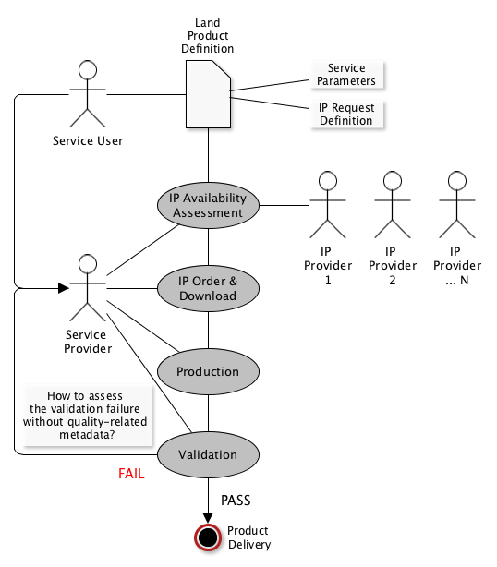
Introduction
Quality Control Metadata Management System (QC-MMS)
ESA Technology Project (completed May 2021)
Spacebel (B) with MapRadix (CZ) as subcontractor.
Land Monitoring Service (LMS) Use Case and processing steps

Slide 4
Introduction
Project Objectives:
Address technology needs for QCMMS system
Retrieval of metadata from multi-mission image catalogs/archives
Harmonisation of multi-mission metadata
Compilation of QA related Land MS production metadata
Analysis of characteristics at scene and pixel level
Analysis of quality indicators (QI)
Deliver open-source software implementation for land monitoring campaign
Apply standards

Slide 5
Overall Approach
Assumes a typical production process
land monitoring (LMS) product production process
Quality metadata fragments (i.e. Quality Indicators QI) corresponding to each step: MD1, MD2, MD3, …
Three major building blocks
QC Manager: orchestrates processing steps and produces metadata and metadata fragments (related to Quality)
QI Catalogue: persists metadata and QI
QA Report Manager: presentation and visualisation of metadata
Metadata flow
QC Manager -> QI Catalogue -> QA Report Manager

Slide 6
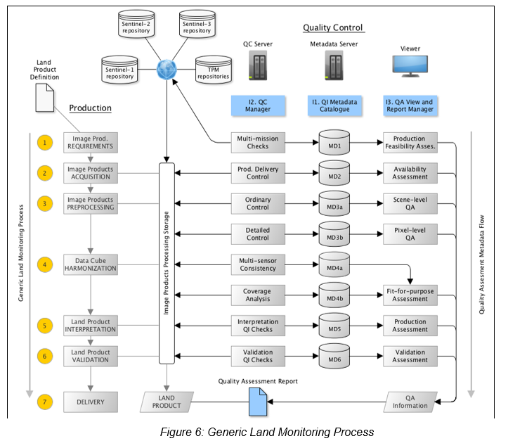
Overall Approach – Functional View
Metadata including QI (“MD1”..”MD6”) persisted by the catalogue
Metadata for
input products
Metadata for
(Land) output
product

Slide 7
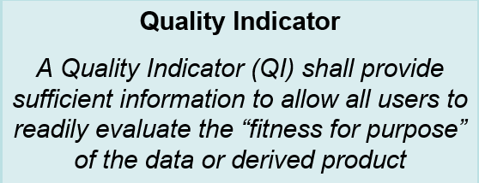
Overall Approach
QCMMS Quality Indicators (QI) proposed as per QA4EO guiding principles.
Scope of this presentation: QI Catalogue & QA Report Manager components.
Notes:
http://www.qa4eo.org/

Slide 8
Outline
Introduction
Overall approach
QI Catalogue component
Metadata and quality indicators
Catalogue
QA Report Manager component
Jupyter Notebooks
Conclusion

Slide 9
QI Catalogue - Purpose
QI Catalogue
Persistent and incremental storage of metadata and quality metadata used and produced during generation of derived (land) products
Support multiple products and product types in parallel.
Metadata for input products and resulting (output products).
Standards-based Catalogue interfaces
Support Create, Read, Update and Delete (CRUD) methods on metadata records or (QA-related) metadata fragments.
Demonstrate with land product use cases:
HRL Imperviousness (Use Case-1),
HRL Forest Change (Use Case-2)

Slide 10
Catalogue – Functional View
MD for
input products
Processing steps (QC Manager) generate/update metadata fragments “MD1”..”MD6” persisted by the catalogue
MD for
output product

Slide 11
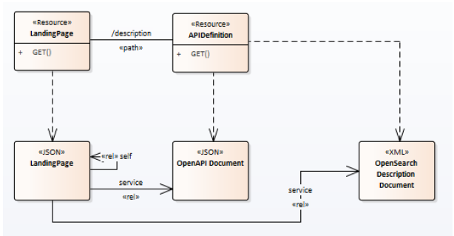
QI Catalogue – Interfaces
OpenSearch (R)
OGC 13-026r8 – Extension for EO
eo:specificationTitle + eo:degree queryables mapped to QI for products.
OGC 17-047: OpenSearch GeoJSON(-LD) Response Encoding Standard
Service Management Interface (CRUD)
OpenAPI
OGC API Common, i.e. subset of OGC API Features – Part 1: Core (OGC17-069r3)

Slide 12
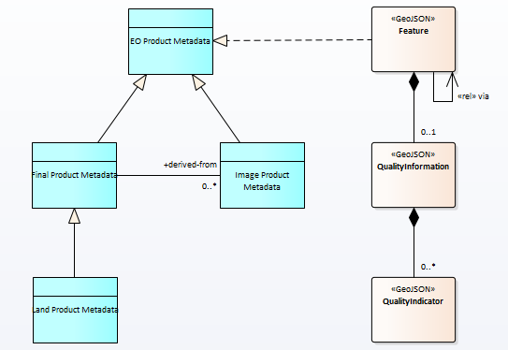
QI Catalogue - Product Metadata
QI Catalogue allows to Store, Update, Retrieve metadata and quality information computed during generation of land products.
OGC 17-003/OGC 17-084 (GeoJSON) product metadata adopted extended with Quality Indicator (QI) information.
Same product metadata as supported by future version of FedEO and EO-CAT.

Slide 13
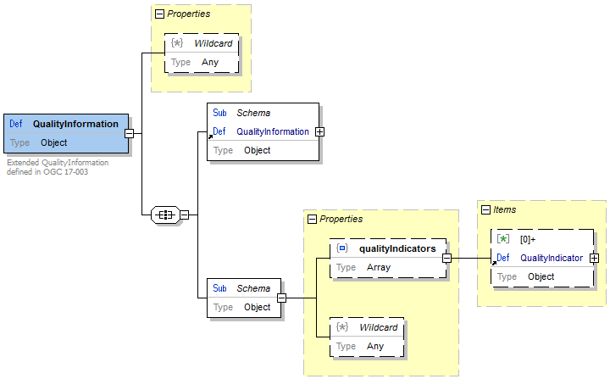
QI Catalogue - Product Metadata
Quality Metadata
Included in OGC 17-003: GeoJSON(-LD) EO Product Metadata
$properties.productInformation.qualityInformation properties extended for purposed of this project.
QualityInformation object extended with list of QualityIndicators.
Notes:
The OGC 17-003r2 specification defines a QualityInformation object which is part of the metadata. The QCMMS project extended this object with a set of QualityIndicators corresponding to the different quality metadata generated by the QC Manager component. Quality indicators are related to the input products or to the resulting “land product”. The project defined a list of quality indicators (identified by a URI), but the approach is applicable with different lists of quality indicators as well, thus applicable beyond the “land monitoring” use case.

Slide 14
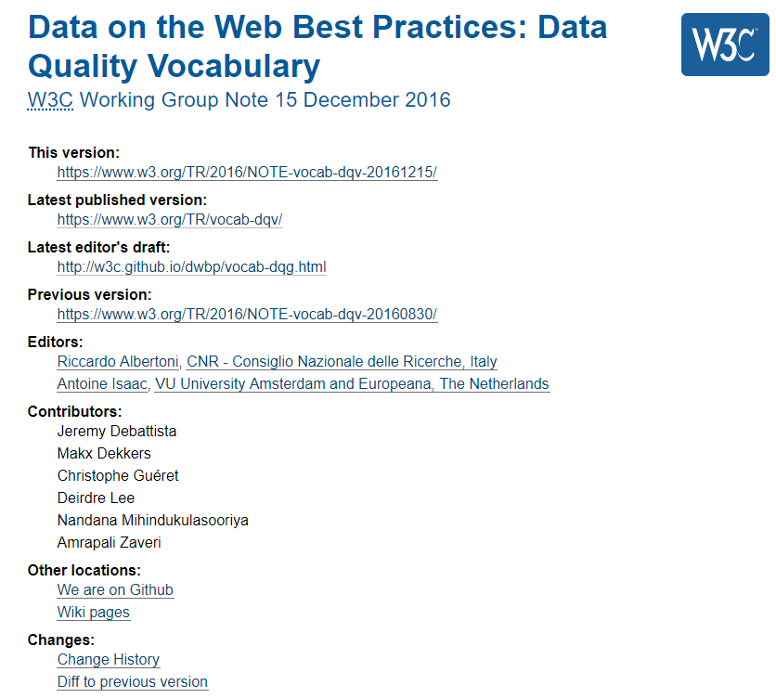
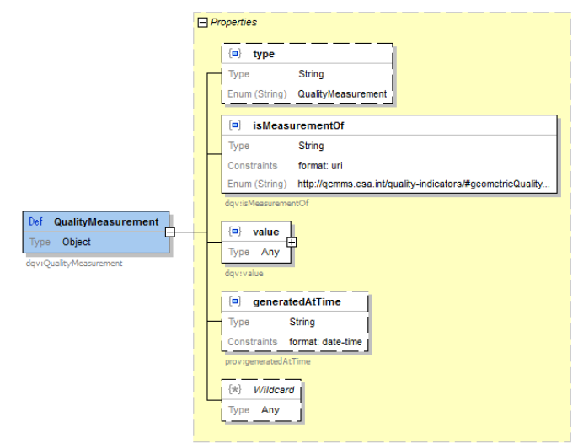
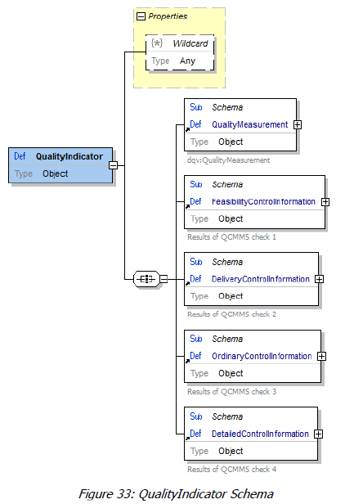
Quality Metadata
W3C Data Quality Vocabulary (DQV)
Each QualityIndicator extends QualityMeasurement class and isMeasurementOf a Metric
Also used in DCAT v2.
Notes:
https://www.w3.org/TR/vocab-dqv/#dqv:QualityMeasurement

Slide 15
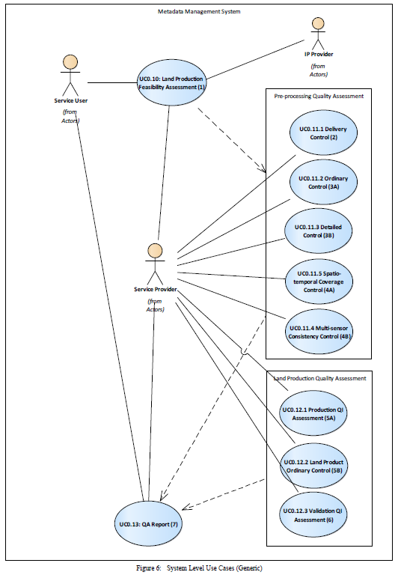
Quality Metadata
Each quality assessment step performed by the QC Manager (processors) produces a metadata fragment corresponding to a “QualityMeasurement” added to the product metadata.
Quality reports produced are based on product metadata and QualityMeasurements available in the Catalogue.
Quality information returned in regular OpenSearch responses.

Slide 16
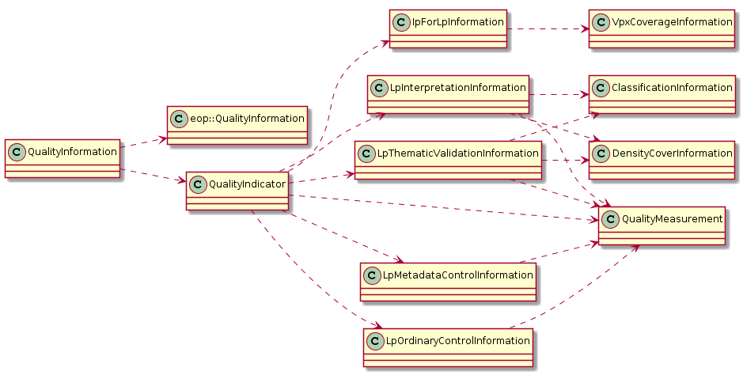
Quality Metadata (Output products)
Quality Metadata for Land Products
Inherits from eop:QualityInformation (OGC 17-003r2)
5 specialisations of DQV QualityMeasurement (QualityIndicator)

Slide 17
Quality Metadata (Input products)
Quality Metadata for Input Products for multi-sensor case
Class dependencies (JSON Schema): 21 classes
JSON Schema for each “QualityIndicator”
6 specialisations of DQV QualityMeasurement (QualityIndicator)

Slide 18
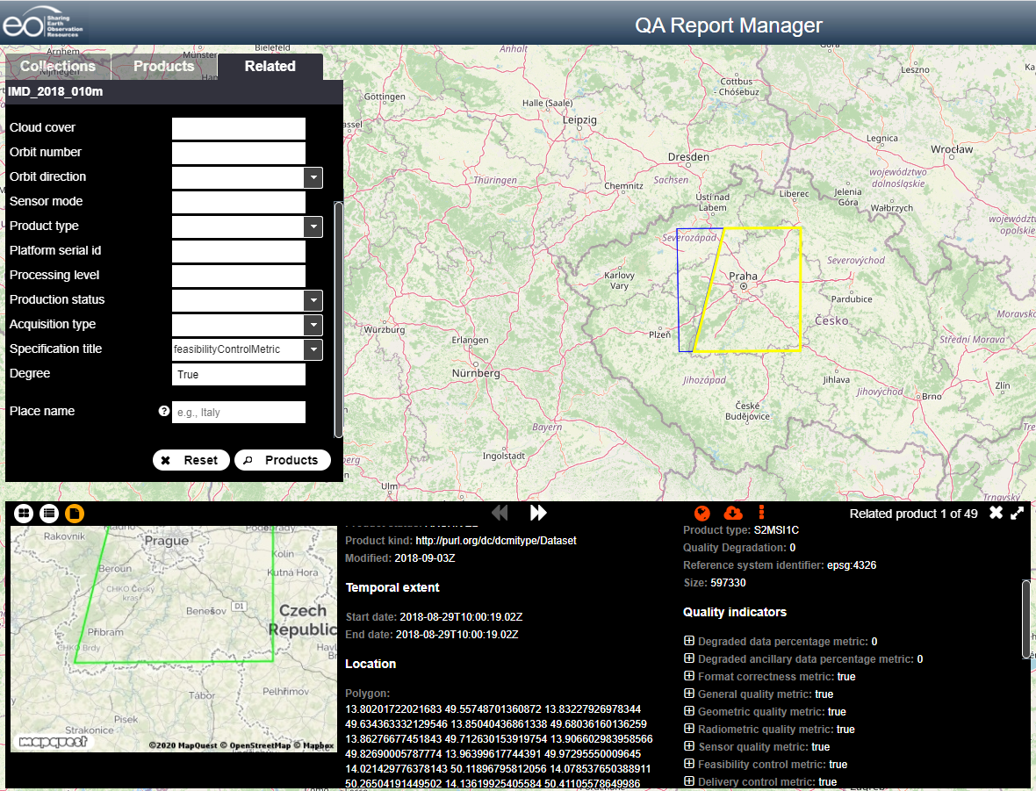
QI Catalogue (OpenSearch Client)
OpenSearch Client extended to allow finding input products used to create a given Land Product.
Retrieve products
used to build the Land Product
“IMD_2018_010“
filtering product with FeasibilityControlMetric is True

Slide 19
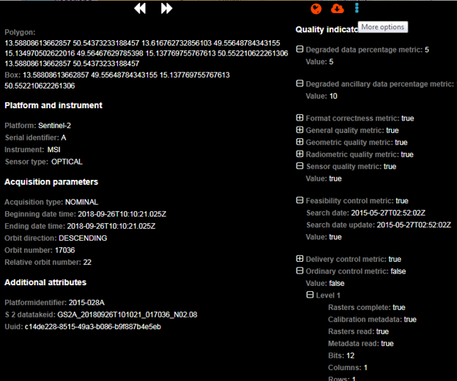
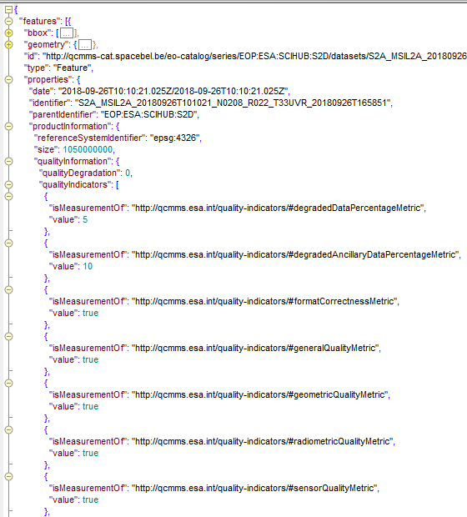
QI Catalogue (OpenSearch Client)
QualityInformation available per product in OpenSearch client…

Slide 20
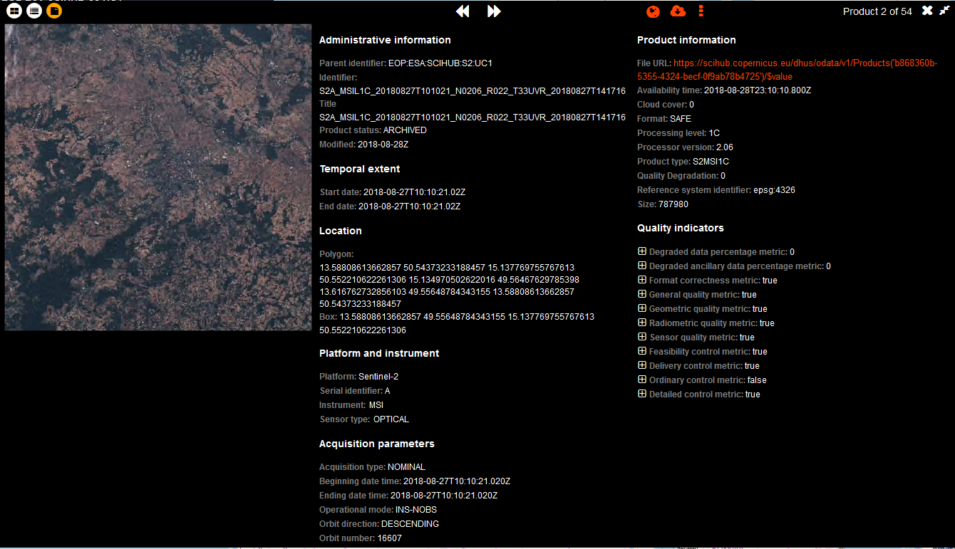
QI Catalogue (OpenSearch Client)

Slide 21
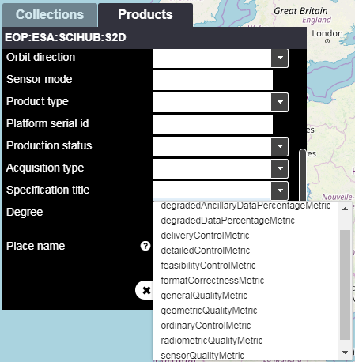
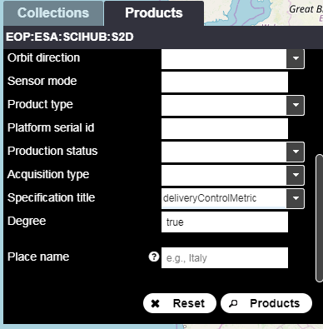
QI Catalogue (OpenSearch Client)
OGC 13-026r9 search parameters (eo:specificationTitle and eo:degree) to filter products based on QualityMeasurement (quality metric) summary value.
Notes:
https://docs.opengeospatial.org/is/13-026r9/13-026r9.html

Slide 22
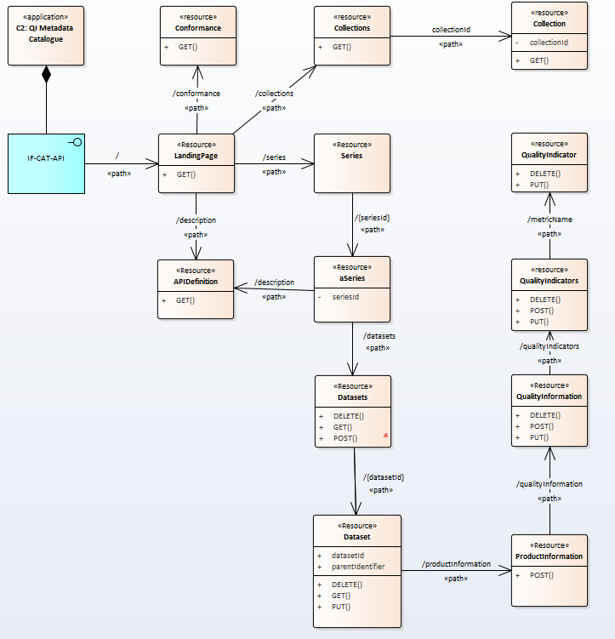
QI Catalogue – resources overview
Interfaces
OpenAPI
RESTful
OpenSearch
Main resources
Dataset (granule)
Quality Indicators (QI)
Other resources
aSeries (collection)
APIDefinition
…
«CRUD» methods
GET,
PUT,
DELETE,
POST
Notes:
At time of definition and implementation of the interfaces, the OGC API Features specification was not yet available. Interfaces were based on older versions of OGC API Common., but can be easily aligned with OGC API Features.

Slide 23
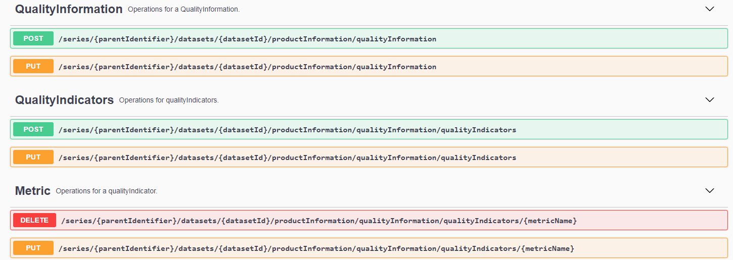
QI Catalogue - Quality Metadata
Catalogue interface (OpenAPI) supports CRUD operations on Quality indicators (QualityMeasurements) available in the catalogue.
Paths correspond to OGC 17-003 GeoJSON paths…
Notes:
CRUD: Create, read, update, delete.

Slide 24
Outline
Introduction
Overall approach
QI Catalogue component
Metadata and quality indicators
Catalogue
QA Report Manager component
Jupyter Notebooks
Conclusion

Slide 25
QA Report Manager
Purpose
Client application allowing to browse and view above metadata during and after processing runs.
Generation of partial/complete “quality report” for a particular derived product of a particular product type, based on content of QI Catalogue.
Implementation
OpenSearch/GeoJSON Web Client visualizing (textual) QI information for input and output (land) products.
“live” Jupyter Notebook displayed by Voilà (read-only Web client), or downloadable.
Notes:
https://pypi.org/project/voila
A partial quality report is an intermediate quality report that can be generated based on the quality indicators already available in the catalogue while not all processing step results are available yet in the catalogue.

Slide 26
QA Report Mgr – Functional View
MD for
input products
QA Report Mgr visualized metadata (MD) returned by the Catalogue through an OpenSearch client or a Quality Assessment Report generated by dedicated Jupyter notebook consuming the catalogue interfaces
MD for
output product

Slide 27
QA Reports – Quality Report Formats
QI Catalogue supports Land Product Quality Report generation supporting two formats:
ISO Quality Report (ISO19157-2)
Jupyter Notebook
To be downloaded and executed to generate a (HTML) report
When executed, will perform OpenSearch requests to the catalogue to populate the report with current data.
QI Catalogue configured with (additional) Notebook report templates (one per product type) without SW change. Loose coupling between catalog and report templates (collection ID and product ID).

Slide 28
QI Catalogue – Quality Report Formats
Both reports are provided as:
Direct Catalogue search responses (see httpAccept query parameter below)
In GeoJSON search results via links returned by the Catalog in the Land Product metadata with distinct media types (using OGC 17-003 link syntax).

Slide 29
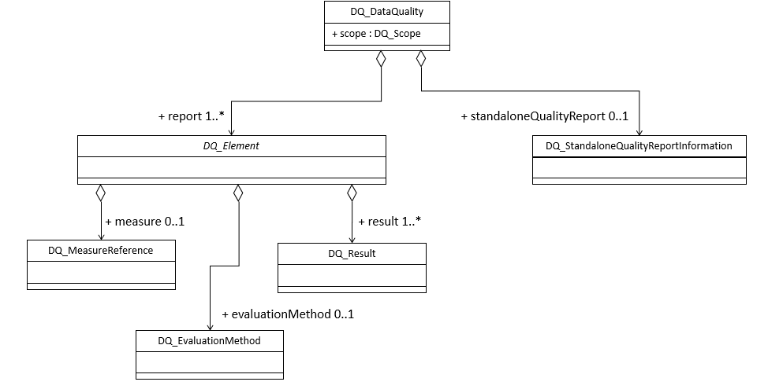
QI Catalogue - ISO 19157-2 Report
The Land Product ISO 19157-2 Quality Report is composed of
standaloneQualityReport element that points to the QCMMS Quality Report (Jupyter template)
report/DQ_Elements that provide for each quality check the status of the check.
The generation of the
ISO report is based
on a template to easily modify
the DQ_Element (many subclasses)
associated to a Quality check.
Notes:
DQ_Element is specialized in many different subclasses. So there are many possibilities to map a QCMMS QI on a DQ_Element.

Slide 30
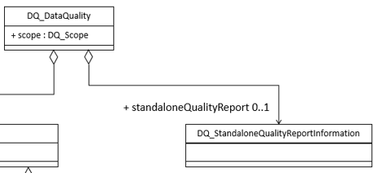
QI Catalogue - ISO 19157-2 Report
Report generated by the Catalogue includes a standaloneQualityReport element
Link to the Jupyter notebook generating the land product quality report

Slide 31
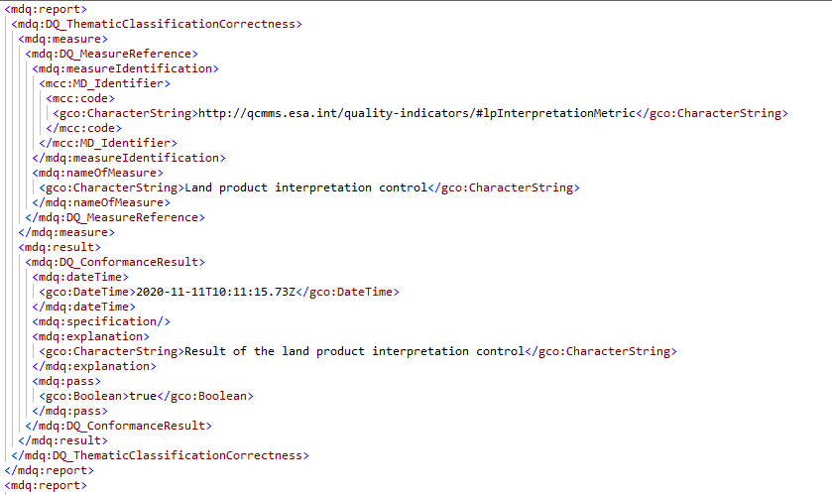
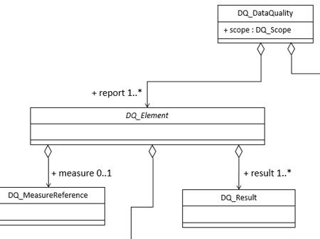
QI Catalogue - ISO 19157-2 Report
ISO 19157-2 Report generated by the Catalogue includes a report element for each quality check associated to a processing step
DQ_Element
Quality Indicator indicating the quality check
Quality check result

Slide 32
QA Reports – Jupyter format
Metadata for “land product” includes (download) link to Jupyter Notebook implementing the Quality Report for the product instance.
User can also download the Notebook and execute on his preferred Jupyter environment (e.g. Google colab) to view the content of the report.
Report is a “live” report requesting up-to-date info from the catalogue via OpenSearch.
More info is included when more steps have been executed. No new download needed.
Alternatively, user navigates from OpenSearch client (next slide) to a deployed run-time environment called “QA Report Viewer” implemented with “Voilà”.

Slide 33
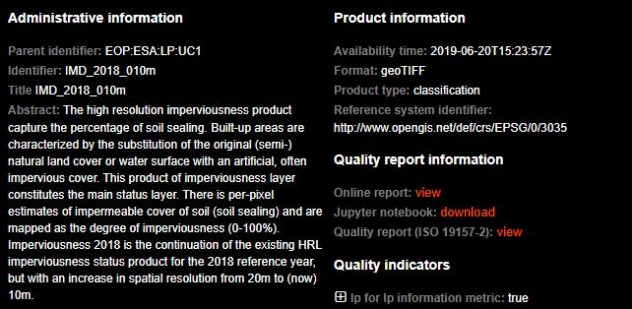
QA Reports (via OpenSearch Client)
OpenSearch Client:
Make the quality report information provided by the catalogue accessible via its user interface in the land product metadata (ISO19157-2 and Jupyter Notebook)
Retrieve a quality report (Jupyter Notebook) from the link returned by the catalogue to allow it to be “viewed” (executed by Voilà).

Slide 34
QA Reports - Jupyter
QA Report is structured as a document with a section corresponding to each processing step.
Notebook(s) can be modified independently of the rest of the software (e.g. more text, different text etc…) to match a new use case.
Catalogue can be configured to return a different template (I.e. Notebook) for each product type (i.e. parentIdentifier)
Templates are “instantiated” and populated with (quality) metadata information obtained from the catalogue.

Slide 35
QA Reports – Jupyter (Colab)
QA Report can be downloaded and viewed/edited in user’s favorite Jupyter environment, e.g. Google Colab.
Google Colab Env
Text cell
Code cell
Processing
Steps
Output cell
Search in catalogue
presented as a table

Slide 36
QA Reports – Jupyter (OpenSearch Client)
OpenSearch client communicates with (local) Voilà server.
Jupyter notebook executed in Voilà (code cells are hidden).
Report is generated with the current status of the processing in the QI Catalogue: (e.g. steps 3A to 6 not yet executed).
During the project: quality report template based on example for covered use case provided by MapRadix. Approach completely generic and applicable to other use cases.

Slide 37
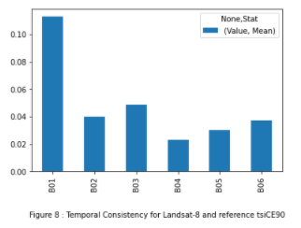
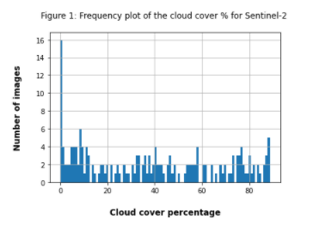
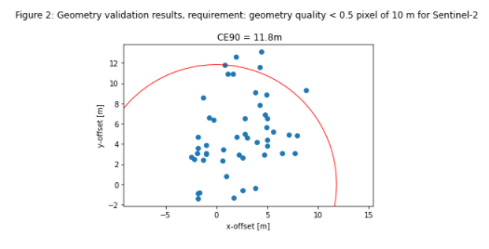
QA Reports - Jupyter
Report template (Jupyter Notebook) can use any Python (visualization) libraries supported by notebooks to provide a customized report.

Slide 38
Conclusion
Concept demonstrated with QI Catalogue containing metadata inserted by the MapRadix QC Manager LMS processing chains for:
UC-1: HRL Imperviousness land product
Sentinel-2 Products (54 input products)
UC-2: HRL Forest Change land product
Sentinel-2 Products (185 input products)
Landsat-8 Products (59 input products)
Generic standard-based mechanism extending standards-based metadata and catalogue environment.
Quality indicators (QI) based on W3C DQV representation are domain specific but can be replaced by other QI using same representations.

Slide 39
Conclusion - Lessons learned
Lessons learned
Steep learning curve to interact with QI Catalogue from Python-based processor software (QC Manager), adopted OGC metadata formats etc.
Learning curve to interface from Jupyter notebook (report template) to Catalogue.
JSON Schema-based metadata validation much less precise than XML Schema-based validation. JSON payload validations too limited (extensible by default) to avoid integration issues.

Slide 40
Conclusion – Future work
Future work:
Align catalogue interface with final OGC API features specification.
Generalise QCMMS Tooling: Make catalogue and QI metadata definitions independent. QI metadata definitions (JSON fragments) to be treated as configuration data allowing to replace with other definitions to support other processing processes beyond Land (LMS) without software changes.
Allow Jupyter report to be executed by a configurable environment (e.g. https://jupyter.pdgs.eo.esa.int/ instead of a dedicated Voilà instance).
Allow drill-down from inside Jupyter report to individual products
Apply the approach for different use cases: e.g. quality information already available for specific EO-CAT collections.

Slide 41
Conclusion – Future work
Future work:
Flatten learning curve by providing processor-side library (Python / R) encapsulating complexity of standard metadata and QI metadata for use by processing chain developers.
QI info to catalogue
Flatten learning curve by providing report-side Python/Jupyter library for QA/QI metadata and catalogue access for use by report (template) developers.
QI info from catalogue to report
Compare/align/contribute proposed QI metadata fragments/attributes (JSON) with/to STAC extension (JSON) for CARD4L at https://github.com/stac-extensions/card4l when JSON schemas are available.

Slide 42
Conclusion
More information on GitHub
https://github.com/spacebel/QC-MMS
https://github.com/mapradix/qcmanager
Contact
Yves.Coene@spacebel.be

