Slide 1
EOSDIS STAC briefing
WGISS-51
<date and time>
Matt Hanson
Sr Software Engineer
mhanson@element84.com
Amy Steiker
EED Transformation Product Manager
amy.steiker@nsidc.org
Doug Newman
NASA EOSDIS System Architect
douglas.j.newman@nasa.gov
This document does not contain technology or Technical Data controlled under either the U.S. International Traffic in Arms Regulations or the U.S. Export Administration Regulations.

Slide 2
STAC and CMR

Slide 3
STAC Status (March 31, 2021)
stac-spec
1.0.0-rc.2
(March 31, 2021)
stac-api-spec
1.0.0-beta.1
(December 10, 2020)
Extensions
21
Contributors
47
(19 w/ 10+ commits)
Public Catalogs
25
OS Projects
30
Notes:
Quote Slide

Slide 4
CMR-STAC
https://cmr.earthdata.nasa.gov/stac
https://cmr.earthdata.nasa.gov/cloudstac
STAC Version: 1.0.0-beta.2
Serverless (API Gateway + Lambda)
Proxy to CMR
  STAC query parameters -> CMR parameters
  CMR response -> STAC response
CMR Queries Used
  provider_holdings.json
  collections.json
  granules.json
  granules.umm_json
  facets (for temporal aggregation)

Slide 5
STAC Spec
Catalogs
  There’s always a root catalog
  Contains other catalogs and collections
Collections
  Can contain other catalogs (called sub-catalogs) to group Items further
    e.g., For Landsat-8 there might be sub-catalog by Landsat Path and Row
  Ultimately contains Items which are similar in some way(s)
    e.g., same instrument, same region containing data from different instruments, etc.
Items
  A single scene or set of datafiles for a specific location at a specific date and time (when/where)

Slide 6
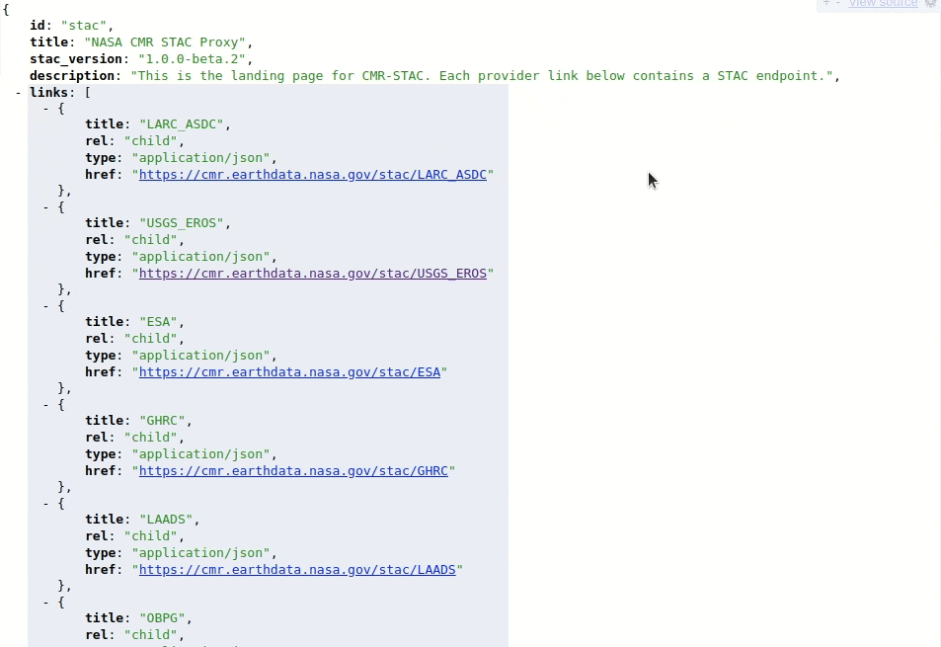
CMR-STAC Catalog

Slide 7
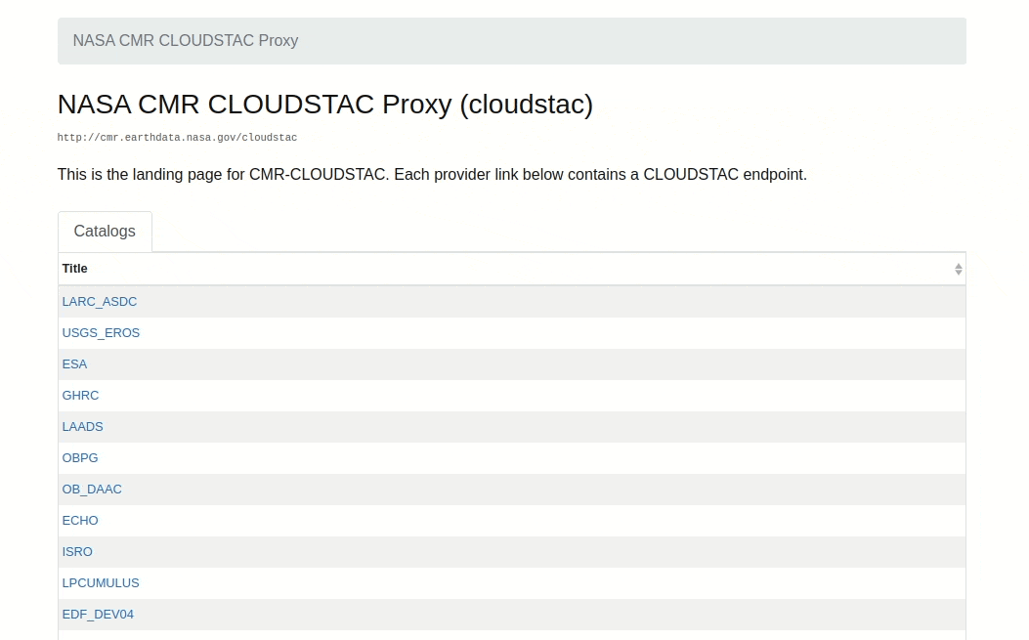
CMR STAC Browser

Slide 8
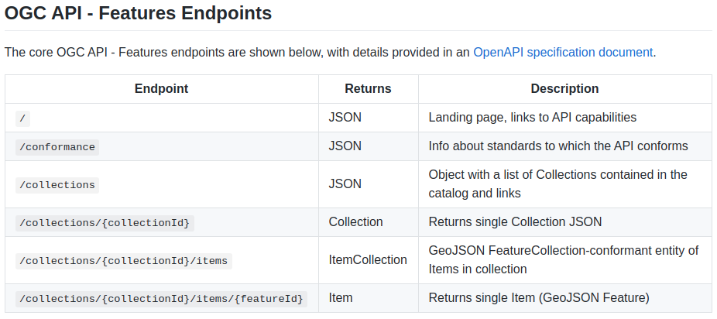
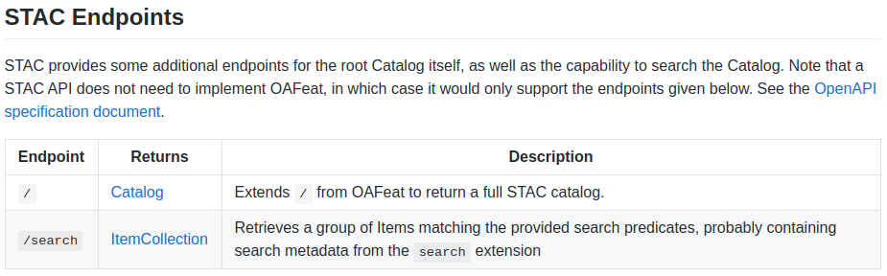
STAC API Spec
STAC API spec
https://github.com/radiantearth/stac-api-spec
OGC API: Features
+
STAC Extensions
OpenAPI Doc: https://stacspec.org/STAC-ext-api.html
Search endpoints

Slide 9
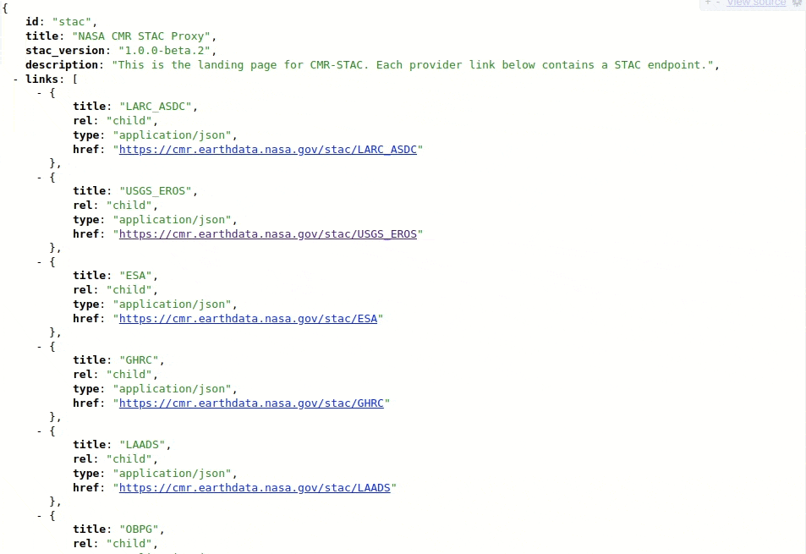
CMR-STAC API

Slide 10
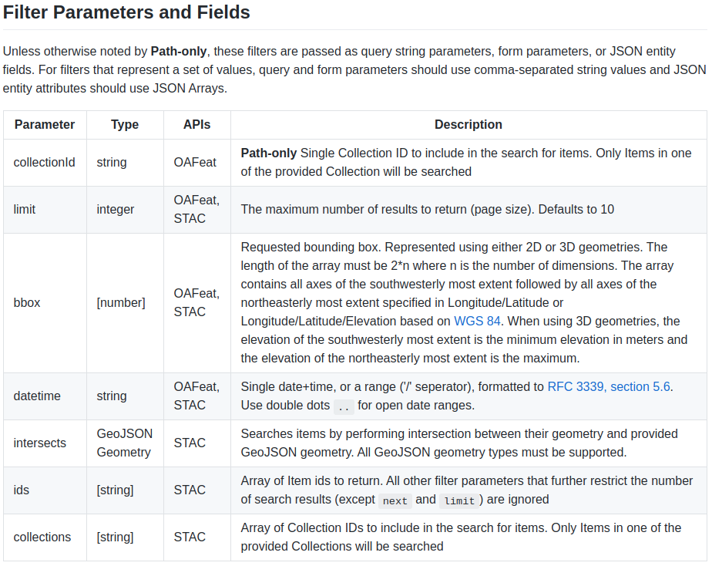
STAC API Parameters

Slide 11
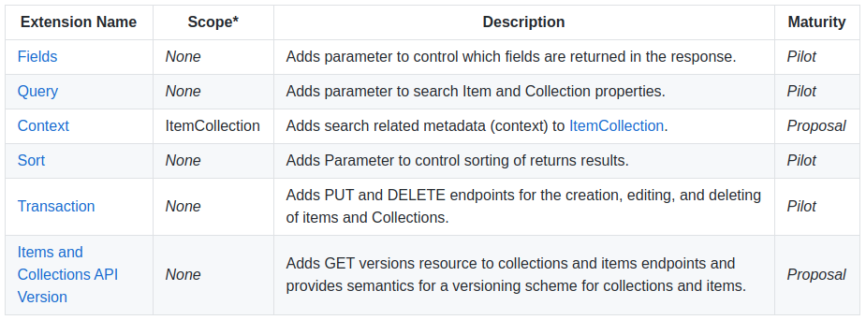
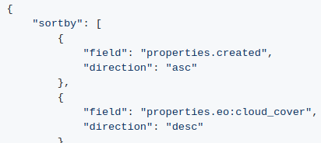
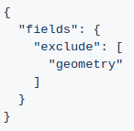
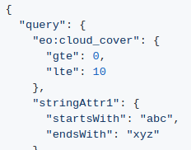
STAC API Extensions
Alternate shortcut
sortby=-properties.datetime
sortby=+collection
Alternate shortcut
fields=-geometry
fields=properties.eo:cloud_cover

Slide 12

Search API

Slide 13
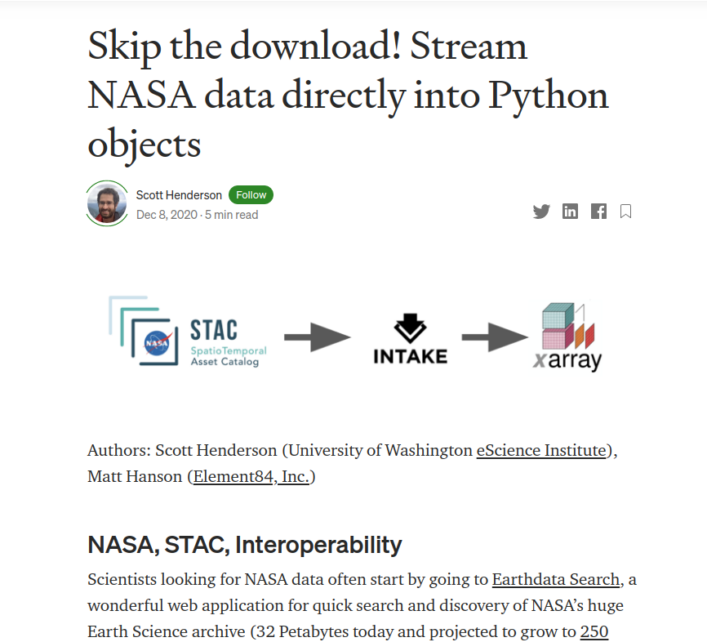
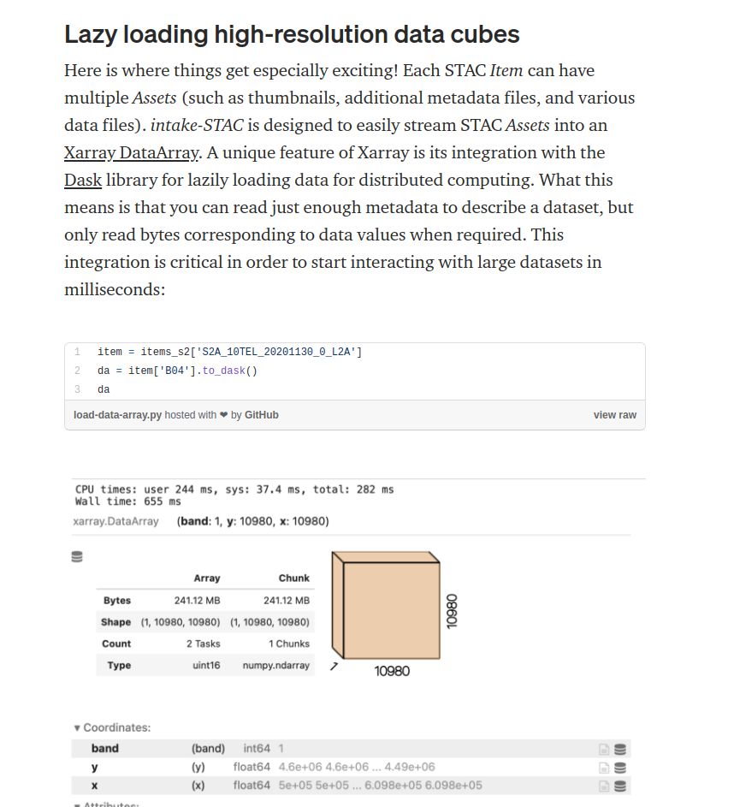
Analytics

Slide 14
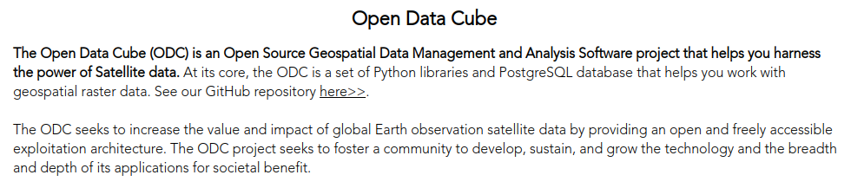
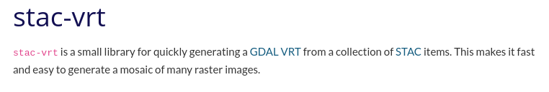
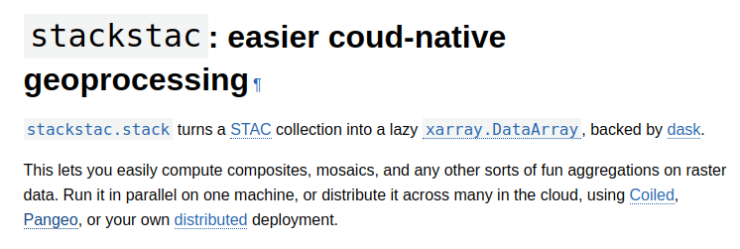
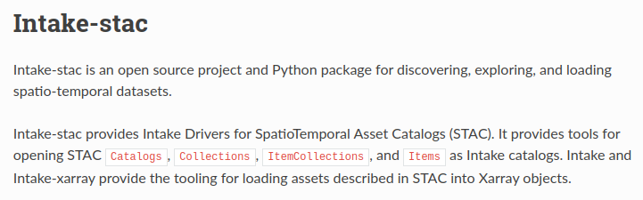
Datacubes

Slide 15
STAC and Harmony

Slide 16
Harmony
Opportunities made possible by cloud-accessible data:
  Consistent access patterns to EOSDIS holdings
  Data reduction services allow users to request only the data they want, in the format and projection they want
  Analysis Ready Data and cloud access will help reduce time-to-science
  Community Development helps reduce the barriers for re-use of code and sharing of domain knowledge
https://harmony.earthdata.nasa.gov/

Slide 17
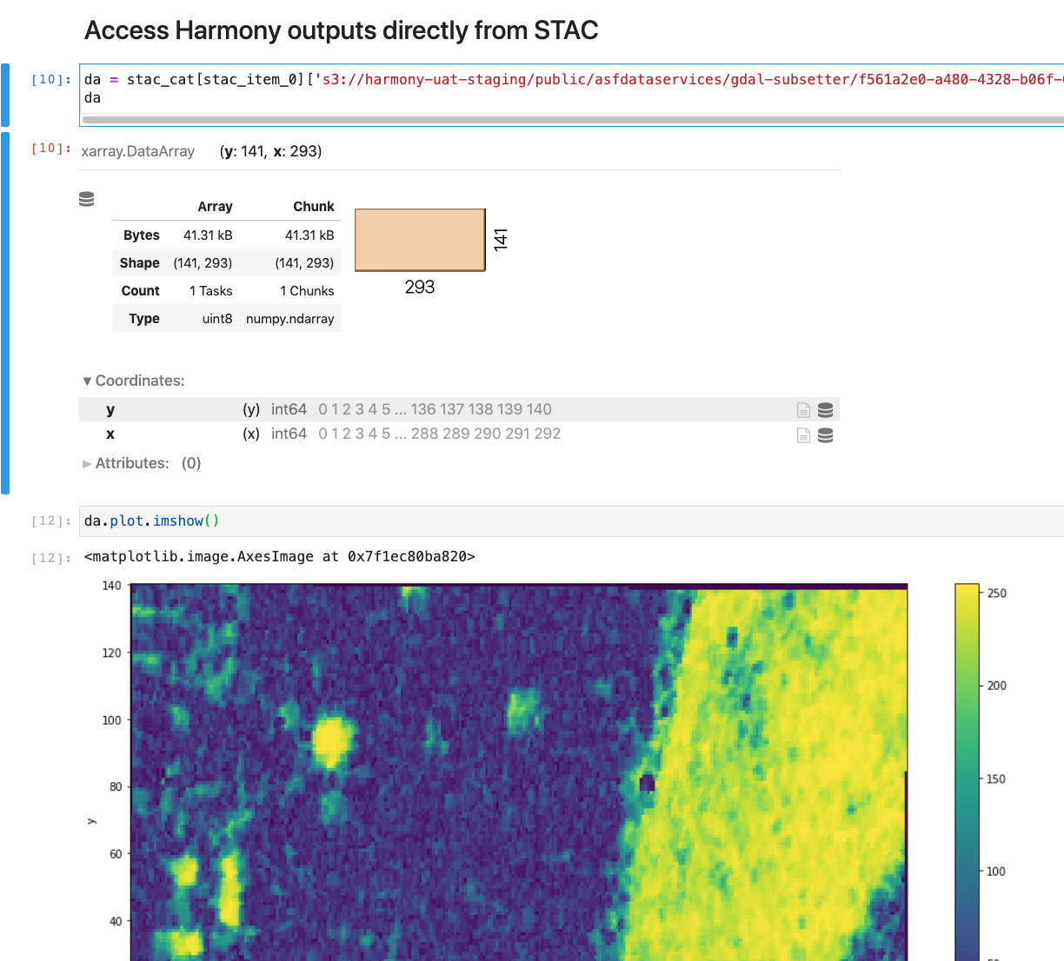
Harmony STAC catalog
STAC catalog generated for each Harmony asynchronous request
STAC items contain metadata reflecting transformed output extents
Direct access to Harmony outputs utilizing STAC libraries

Slide 18
STAC’s potential for federated search

Slide 19
The idea
Open Search is losing traction
STAC is gaining a lot of traction
Embedding links to distributed catalog APIs in the CMR STAC API should be really simple to do

Slide 20
Example
https://cmr.earthdata.nasa.gov/stac/ISRO/collections
collections:
[
{
id: "IMS1_HYSI_GEO.v1.0",
stac_version: "1.0.0-beta.2",
license: "not-provided",
title: "IMS-1 HYSI TOA Radiance and Reflectance Product",
description: "The data received from IMS1, HySI which operates in 64 spectral bands in VNIR bands(400-900nm) with 500 meter spatial resolution and swath of 128 kms.",
links:
[
...
{
rel: "items",
href: "https://uops.nrsc.gov.in/stac/collections/IMS1_HYSI_GEO.v1.0/items",
title: "Granules in this collection",
type: "application/json"
}
...
},
]
Much like CMR OpenSeach injects OSDDs into collection results, CMR STAC could do the same for our CWIC providers with STAC APIs

Slide 21
Rewards
INPE may deprecate their Open Search API in favor of STAC
Federated search becomes ‘cloud-friendly’
Simpler to coordinate

Slide 22
Risks
Less flexible to develop
  No OSDD concept
Best practices and guidelines need to be established
STAC-adherence of federated APIs (similar risk to Open Search)

