Slide 1
NASA Cloud Data Access
Christopher Lynnes*
*U.S. Civil Servant at NASA

Slide 2
Overview
Hosting data in the Cloud enables users to analyze the data in place, with no data movement or management required.
Hosting the data in one virtual place facilitates multi-dataset studies and scientist collaboration.
NASA is developing a framework to support both analysis-in-place and traditional data download access to data.

Slide 3
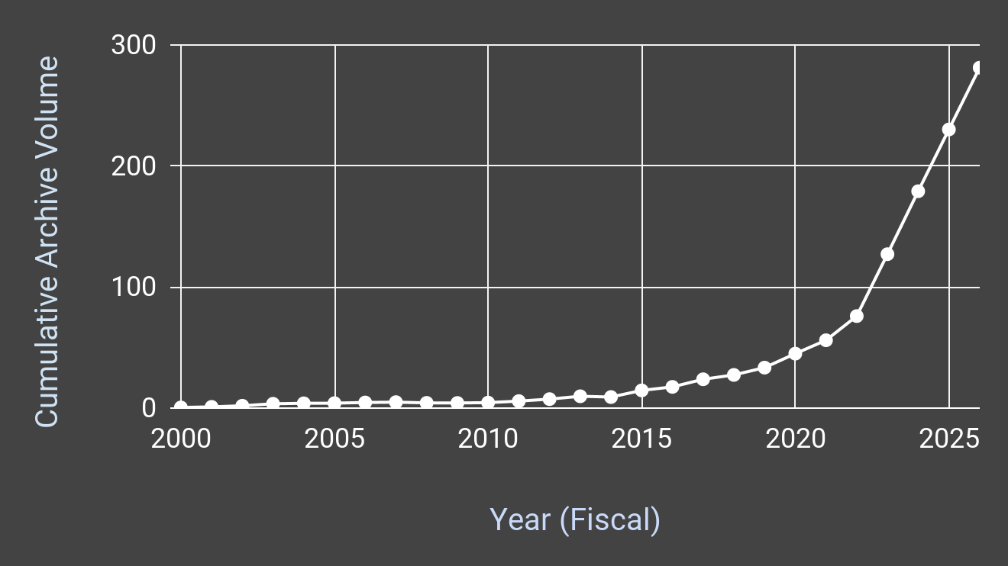
Projected Data Volume Rise
Notes:
NASA is expecting its Earth Observation data volumes to rise significantly over the next several years. This was the trigger for our efforts to host data in commercial cloud. But it is not chiefly for our own data management benefits. Rather the main drivers are end user benefits.

Slide 4
Data Usage Benefits of Cloud Computing for End Users
Scale
Availability of compute power
Non-necessity to move or manage (lots of) data
Togetherness
Datasets
Users
Notes:
The end user benefits fall into two main categories. The first is scale: there is virtually infinite computing power available immediately adjacent to the data. And a less-appreciated aspect is that Big Data do not need to be moved or rehosted if the user analyzes them in place. The second category is togetherness: the scalability of cloud storage makes it easy to host them in the same virtual “location”, making it easier to work with multiple datasets together. Another aspect of this is that cloud processing makes it easier for users to work together in the cloud as well.

Slide 5
The main benefit from the Enterprise perspective:
Hosting data in the cloud allows users to Analyze in Place
Power: Any user can access big processing power “next to” Big Data.
Performance: Data can be offered in a form enabling high-performance analysis.
Freedom from Data Transfers: Users need not move Big Data.
Freedom from Data Management: Users need not store and manage Big Data.
Data Co-location: Users can easily work with multiple EOSDIS datasets together, without moving them to a common location.
Choice: Users can still download data if they prefer.
*Specific benefits will vary with use case.
Notes:
Let’s take a closer look at the Analysis in Place aspect. The computing power next to cloud storage is an obvious benefit. But cloud also gives us an opportunity to organize the data in a form that can boost performance.
On the data management front, the obvious advantage is not having to shlep data across networks or through routers. But in addition, if users can leave the data where they are, in the cloud archive, they also don’t need to manage all the data they are using.
Also, the data are in the same virtual space, so multi-dataset studies become easier.
And with all that, we still give them the choice of downloading the data for traditional analysis styles.

Slide 6
EOSDIS Data Access
Cloud
analysis ready data
Harmony data transformations
Cloud Optimized “Format”
cloud optimized format
results
Cumulus
Archive
end-user cloud-native analysis
Cumulus
archive
OPeNDAP
egress throttle
‹#›
OPeNDAP = Open-source Project for a Network Data Access Protocol
Notes:
Here’s an overall diagram of our basic architecture. We store the data in an archive system called Cumulus, designed to run in the cloud. I’m now going to walk through the different access paths data can follow between Cumulus and the end user.
But in order to analyze data in place, the data need to ready to analyze. So we provide a framework called Harmony for a variety of data transformation services. We originally gave Harmony this name to signify that our various organizations were producing services that could work together in a single framework. But it also works in the sense that the services help harmonize datasets that users want to use together. Also, since Harmony is already fussing with the data in order to transform it, it is an opportune time to reformat the data into cloud optimized formats, like zarr. The idea is for the end user to transform the data
As I mentioned

Slide 7
Analysis In Place
Cloud
analysis ready data
Harmony data transformations
Cloud Optimized “Format”
cloud optimized format
results
Cumulus
Archive
end-user cloud-native analysis
Cumulus
archive
‹#›
Notes:
Let’s look at the main Analysis-in-Place scenario. In order to analyze data in place, the data need to ready to analyze. So we provide a framework called Harmony for a variety of data transformation services. We originally gave Harmony this name to signify that our various organizations were producing services that could work together in a single framework. But it also works in the sense that the services help harmonize datasets that users want to use together. Also, since Harmony is already fussing with the data in order to transform it, it is an opportune time to reformat the data into cloud optimized formats, like zarr. The idea is for the end user to transform the data into analysis-ready form, analyze still within the cloud, and then download the results, which are typically much smaller than the input data.

Slide 8
Analysis In Place
Cloud
results
Cumulus
Archive
end-user cloud-native analysis
Cumulus
archive
range-get
OPeNDAP
‹#›
OPeNDAP = Open-source Project for a Network Data Access Protocol
Notes:
A similar situation occurs for data that are offered through an OPeNDAP server. OPeNDAP is an off-the-shelf, interoperable technology that provides robust, performant subsetting, subsampling, time aggregation and reformatting services, primarily for gridded data. So for gridded data, it often suffices to make the data ready for analysis, and is optimized for access in the cloud.

Slide 9
Download Scenario
Cloud
Cumulus
Archive
Cumulus
archive
range-get
OPeNDAP
egress throttle
‹#›
OPeNDAP = Open-source Project for a Network Data Access Protocol
Notes:
Finally, we have the cases where users download the data out of the cloud, either as subsets through OPeNDAP, or as is. In both cases, we pass the data through a custom egress throttle, which prevents us from going over our cloud budget.

Slide 10
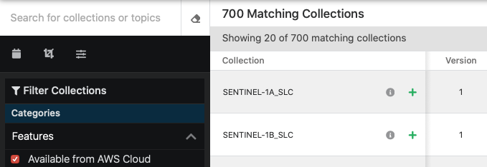
Cloud Facet in Earthdata Search
Notes:
As of April 12, EOSDIS have 700 of our datasets, about 10% in the cloud, with many more on the way.

Slide 11
Multi-Mission Algorithm and Analysis Platform (MAAP)
Prototype innovative data system to enable open science in cloud
Implemented initially for Biomass: Lidar, Synthetic Aperture Radar
Adaptable to other disciplines
Provide seamless access to satellite, airborne and field data from European Space Agency and NASA
Scale user algorithms from small regions to global scale
Enable collaboration on calibration and validation of higher-level science products
Notes:
We have a sibling project in NASA which is working on the Analysis in Place aspect. The Multi-Mission Algorithm and Analysis Platform is being built as a joint effort with the European Space Agency. The emphasis is on analysis and algorithm development in the cloud. At present it is designed for Biomass, mostly Lidar and SAR data. It is still in development, but is already being used by scientists on both sides of the Atlantic for analysis in plae in the cloud.

Slide 12
NASA Cloud Data Access Status
Cumulus Archive | Operational: 1 complete archive, 4 partial archives 685 datasets
Egress throttle / cutoff | Operational
Cloud-Optimized Datasets | Two Harmonized-Landsat Sentinel in Cloud-optimized GeoTIFF
OPeNDAP | Operational in mid-April
Direct Access URLs in catalog | In progress
Harmony | Operational for a few datasets Convert to zarr, spatial subset, regrid
End-User Training | Primer, workshops, Openscapes underway
MAAP | Almost operational
Notes:
This table summarizes our status for the main features from the previous slides.

Slide 13
Lessons
Commercial cloud works…
...mostly
Keep a catalog in the same region as the data
Putting datasets in the cloud enables:
Processing at scale (MAAP, Pangeo)
Combination dataset usage (EOSDIS)
Collaboration on data transformation services (EOSDIS)
End-user science collaboration (MAAP)
Users could benefit from some assistance in moving their analysis to the cloud
Notes:
So what are our lessons? Commercial cloud works most of the time, but has rare outages. In those cases, it can be helpful to have at least a copy of your data catalog in the same region as your data, so that users are still able to access the data.
Also, putting datasets in the cloud appears to be realizing our original goals: we have processing at scale demonstrated both in MAAP and by Pangeo scientists; datasets being used together in EOSDIS; collaboration by developers on data transformation services, and collaboration by end users on science. Nonetheless, many users could benefit from some assistance in understanding how to do their analysis in the cloud.

