Slide 1
International Directory Network (IDN) Report
CEOS WGISS-51
Remote Meeting, April 20 to 22, 2021
Michael Morahan
IDN Coordinator
Michael.P.Morahan@nasa.gov

Slide 2
Outline
CEOS/IDN Collaborations
NOAA_NCEI collection and granule OSDD integration
Reconciling NOAA TPIO and GCMD keywords
ESA/FedEO addition of new ESA, DLR, and VITO collections
ISRO new collections
IDN Metric
IDN Homepage Usage
IDN Search Portal
Draft Metadata Management Tool (MMT)
Adding Data Usage Policy
GCMD Keyword Viewer Updates

Slide 3
I. CEOS/IDN Collaborations

Slide 4
Current NOAA-IDN Activities
IDN is working with NOAA OneStop to register all NOAA NCEI Ocean datasets (~10500).
IDN will pull the datasets’ metadata records directly from the NOAA Web Accessible Folder and ingested them into CMR for the IDN.
The datasets’ granule OpenSearch Description Documents (OSDD) will be registered for granule searches for CMR OpenSearch and IDN Search Portal.
IDN has already started pulling some of the NOAA records into a CMR test server for testing.

Slide 5
Reconciling NOAA TPIO and GCMD keywords
The GCMD/IDN Team has been working with the NOAA Technology, Planning, and Integration for Observation (TPIO) Team and USGS to align their keywords more closely with the GCMD Keywords.
There are several science keywords sets that will go through cross-team review. These include: Atmosphere, Oceans, Sun-Earth Interactions, Terrestrial Hydrosphere, Cryosphere, Solid Earth, Human Dimensions, Land Surface, Biosphere, Spectral/Engineering, Agriculture, Climate Indicators
The first set are the Atmosphere Keywords release as 10.0 version on March 15, 2021. The next set for review are the Ocean Keywords.
Based on the review of the Atmosphere Keywords conducted through NASA's Earth Science Data and Information Systems (ESDIS) Standards Office (ESO), there were 28 new keywords and 4 revised keywords. The revised keyword paths included adding a modifier of 'ATMOSPHERIC' to Variable Level 2 to indicate that the measurements are being taken in the Atmosphere. This is part of the 10.0 version release of the keywords (pending this sprint).

Slide 6
ESA FedEO New Datasets in the IDN
FedEO dataset records were ingested into CMR for the IDN:
ESA FedEO: 137 dataset records.
IDN Search Portal: https://search.earthdata.nasa.gov/portal/idn/search?fpj=FedEO
DLR: 53 dataset records.
IDN Search Portal: https://search.earthdata.nasa.gov/portal/idn/search?fdc=DE%2FDLR
VITO: 45 dataset records.
IDN Search Portal: https://search.earthdata.nasa.gov/portal/idn/search?fdc=VITO
Continue to add new FedEO keywords to the GCMD Keyword catalog
GCMD Keyword Viewer: https://gcmd.earthdata.nasa.gov/KeywordViewer/

Slide 7
ISRO Datasets requested by WGClimate
ISRO will register the Oceansat-2 SCAT metadata records into the IDN:
Level 2B (Wind Vector)
IDN Search Portal: https://search.earthdata.nasa.gov/portal/idn/search?q=OS2_SCAT_L2B
Level 3W (Global Wind vector)
Level 3SH (Global Sigma-0)
https://search.earthdata.nasa.gov/portal/idn/search?q=OS2_SCAT_L3SH
Level 3SV (Global Sigma-0)
https://search.earthdata.nasa.gov/portal/idn/search?q=OS2_SCAT_L3SV
ISRO contact started adding metadata records in Draft MMT.

Slide 8
II. IDN Metrics

Slide 9
IDN Homepage Usage (February 2020-2021) (https://idn.ceos.org/)
GCMD decommission
Links redirected to IDN
Sessions
Trend
User: An individual person browsing the website.
Sessions: A single visit to the website, consisting of one or more pageviews.
Pageviews: A pageview is reported when a page has been viewed by a user on the website.
Pages/Session: the average number of pageviews in each session.
Avg. Session Duration: how long users are spending on your website.
Bounce Rate: is the percentage of sessions with only one interaction

Slide 10
IDN Homepage Usage (continue) (February 2020-2021) (https://idn.ceos.org/)
Direct Traffic: includes people who typed your website’s URL into their browser or clicked a link in an email application.
Referral Traffic: A referral is reported when a user clicks through to your website from another third-party website.
Organic Traffic: refers to people clicking on a free link from a search results page. For example, people clicking through to your website from a free result on a Google search results page.
How are users finding the IDN?
Direct
Referral
Organic

Slide 11
Where does IDN forward users? (February 2020-2021) (https://idn.ceos.org/)
https://search.earthdata.nasa.gov/portal/idn/
4.6%
IDN Header
https://draftmmt.earthdata.nasa.gov/
https://wiki.earthdata.nasa.gov/
https://earthdata.nasa.gov/
Rest of the links on the IDN Homepage.

Slide 12
IDN Search Portal Usage (https://search.earthdata.nasa.gov/portal/idn/search)
Sessions
Trend
GCMD decommission
Links redirected to IDN

Slide 13
IDN Search Portal Usage (https://search.earthdata.nasa.gov/portal/idn/search)
Page | Users | Pageviews | Sessions
search.earthdata.nasa.gov/portal/idn/search | 8465 | 16709 | 9904
search.earthdata.nasa.gov/portal/idn/search/granules | 3331 | 5581 | 389
search.earthdata.nasa.gov/portal/idn/search/granules/collection-details | 980 | 898 | 143
search.earthdata.nasa.gov/portal/idn/projects | 647 | 842 | 52
search.earthdata.nasa.gov/portal/idn/downloads | 590 | 741 | 60
search.earthdata.nasa.gov/portal/idn/search/granules/granule-details | 214 | 33 | 14
search.earthdata.nasa.gov/portal/idn/ | 58 | 68 | 45
search.earthdata.nasa.gov/portal/idn/preferences | 17 | 11 | 0
search.earthdata.nasa.gov/portal/idn/contact_info | 9 | 2 | 0
search.earthdata.nasa.gov/portal/idn/subscriptions | 1 | 1 | 0
Total | 14312 | 24886 | 10607

Slide 14
IDN Search Portal Usage (https://search.earthdata.nasa.gov/portal/idn/search)

Slide 15
Draft MMT Usage: September 2020 to February 2021 https://draftmmt.earthdata.nasa.gov
DraftMMT Usage from September 2020 to February 2021.
User | Unique Login | Total Logins
IDN Metadata Author | 53 | 208
IDN Approver | 2 | 154
Break down of Drafts created, submitted, and approved.
 | Created | Submitted | Approved
New Draft Proposals | 57 | 57 | 57
Update Collections | 31 | 31 | 31
Draft MMT will only save unsubmitted collection metadata for 30 days.

Slide 16
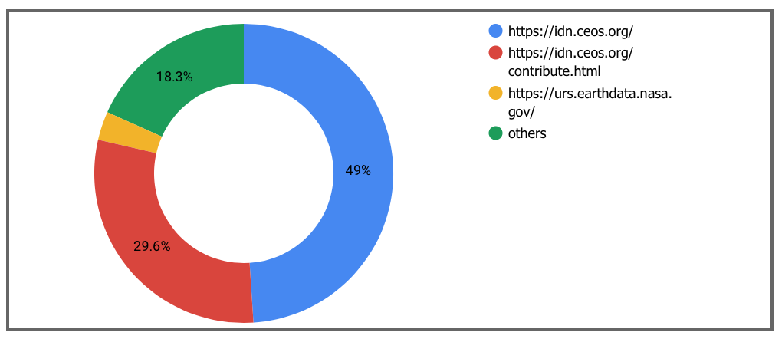
How are users finding Draft MMT? September 2020 to February 2021 (https://draftmmt.earthdata.nasa.gov)
3.1%

Slide 17
III. Adding Data Usage Policy

Slide 18
Adding Data Usage Policy
NASA EOSDIS has started in the first quarter of the calendar year adding Data Usage Policy links to all NASA Earth Science collection records.
The links are being added to the UseConstraints field within the LicenseURL sub-fields.
These link to a Data Usage Policy statement, or the statement itself (via the Use Constraints License Text field) provide data users with permission/license constraints and copyright policy for data and/or services.
All Providers are encouraged to add Data Usage Policy information, as a link or text, to their datasets in the CMR for the IDN.

Slide 19
Data Usage Policy Metadata Example
"UseConstraints" : { "LicenseURL" : { "Description" : "ODbL with Database Contents License (DbCL)", "Linkage" : "https://opendefinition.org/licenses/odc-odbl", "MimeType" : "text/html", "Name" : "Data Use Policy" }

Slide 20
V. Keyword Viewer Updates

Slide 21
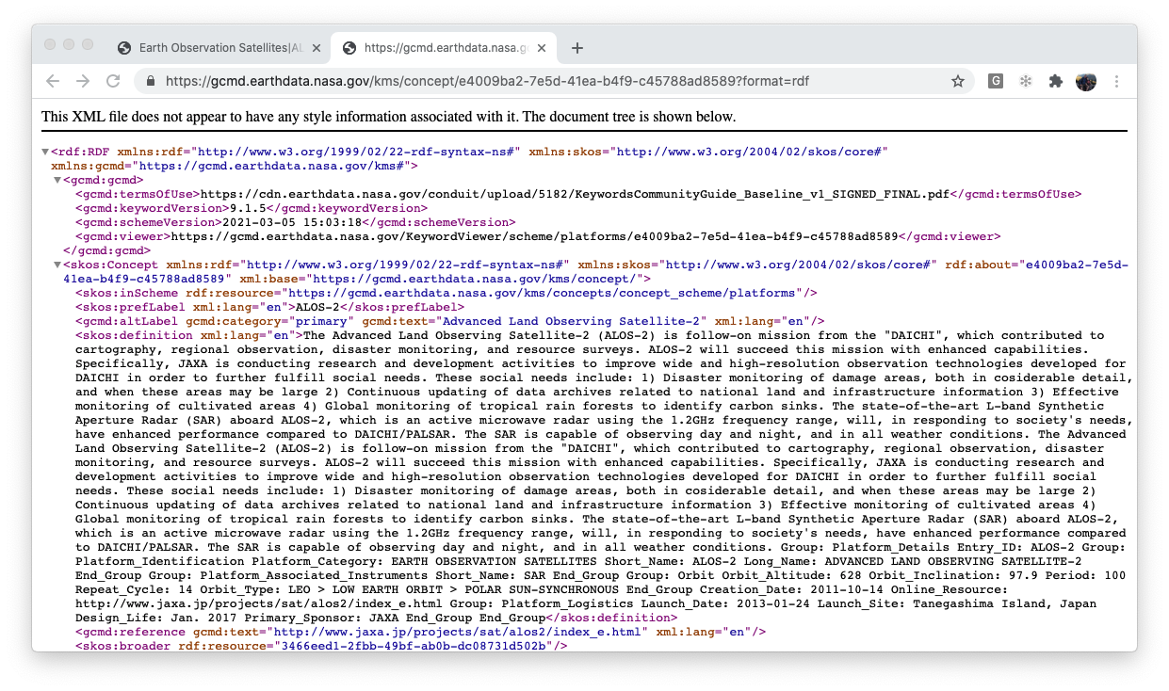
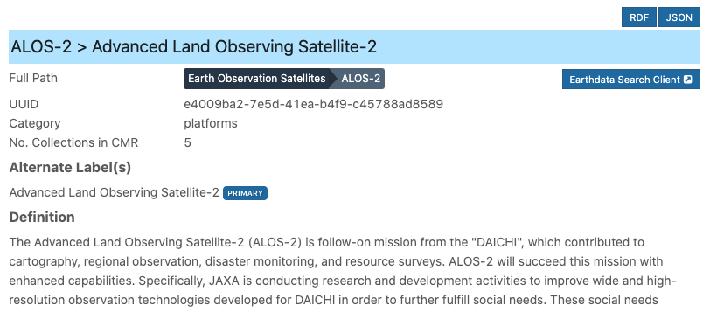
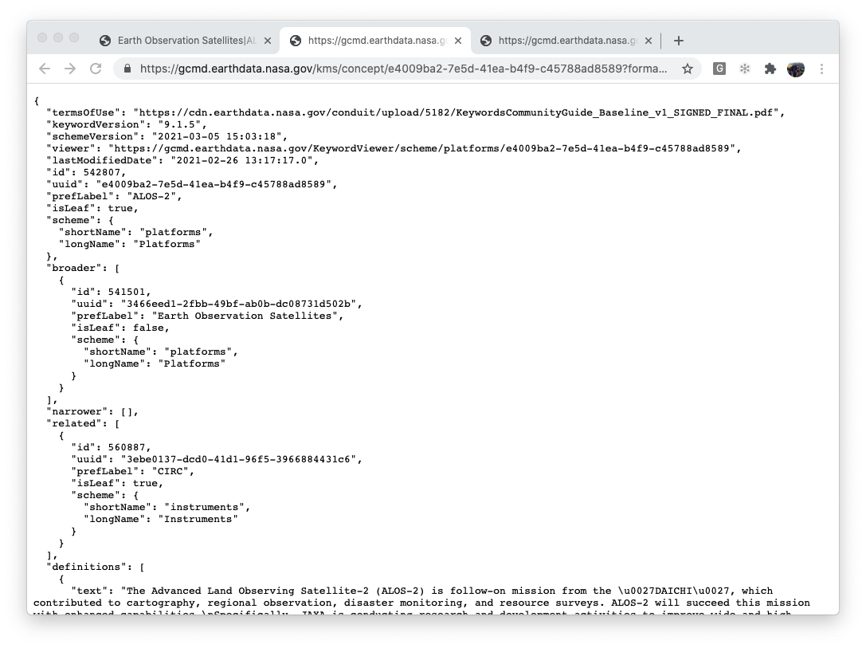
Links to RDF and JSON KMS Entries

Slide 22
KMS RDF/JSON entries links to Keyword Viewer entry
RDF Entry
JSON Entry

Slide 23
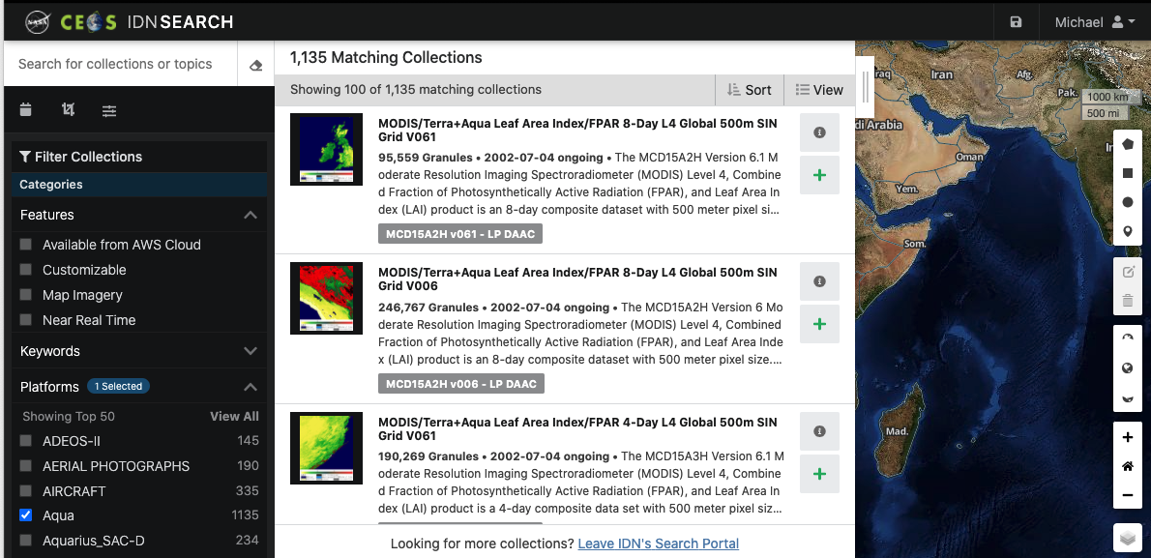
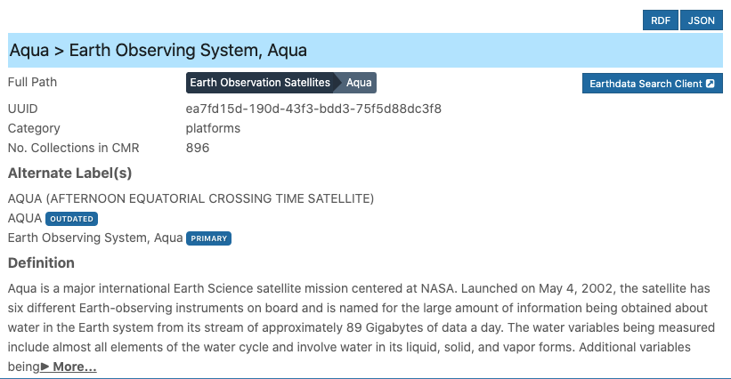
Direct Keyword Viewer Query to IDN Search Portal

Slide 24
Questions
Please provide questions/comments to:
michael.p.morahan@nasa.gov (KBR)
valerie.dixon@nasa.gov (NASA)
christopher.s.lynnes@nasa.gov (NASA)

Slide 25
Background Slides

Slide 26
Useful Links
International Directory Network (IDN)
https://idn.ceos.org/
International Directory Network (IDN) Search Portal
https://search.earthdata.nasa.gov/portal/idn/search
EarthData Login
https://urs.earthdata.nasa.gov/home
Draft MMT
https://draftmmt.earthdata.nasa.gov/
Draft Metadata Management Tool (dMMT) User's Guide
https://wiki.earthdata.nasa.gov/display/CMR/Draft+Metadata+Management+Tool+%28dMMT%29+User%27s+Guide

Slide 27
Useful Links (continue)
GCMD Keywords
https://earthdata.nasa.gov/earth-observation-data/find-data/gcmd/gcmd-keywords
GCMD Keyword Viewer
https://gcmd.earthdata.nasa.gov/KeywordViewer/
New KMS URLs
GET Capabilities
https://gcmd.earthdata.nasa.gov/kms/
All Science Keyword in CSV format
https://gcmd.earthdata.nasa.gov/kms/concepts/concept_scheme/sciencekeywords?case=native&format=csv

Slide 28
Useful Links (continue)
UMM-C, UMM-G, UMM-S, UMM-T, UMM-V Documents
https://wiki.earthdata.nasa.gov/display/CMR/CMR+Documents
CMR Collection Metadata Schemas
https://git.earthdata.nasa.gov/projects/EMFD
CMR Search API
https://cmr.earthdata.nasa.gov/search/site/docs/search/api.html
CMR OpenSearch Documentation
https://cmr.earthdata.nasa.gov/opensearch/home/docs

