Slide 1
Federated Earth Observation (FedEO)
Yves Coene (Spacebel), Andrea Della Vecchia (Randstad),
Damiano Guerrucci (ESA), Mirko Albani (ESA)
CEOS WGISS#51
20 April 2021

Slide 2
Outline
FedEO current metrics and DIF-10 export status
STAC interface evolution since WGISS-50
FedEO evolution activities
EOVOC status update

Slide 3
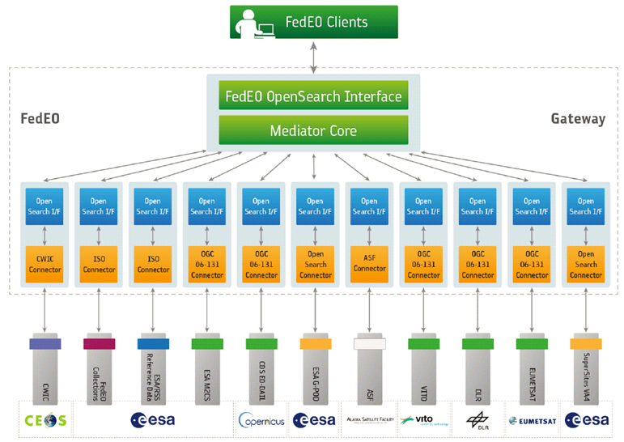
FedEO: Federated Earth Observation Gateway System
FedEO = Federated Earth Observation missions access
The FedEO system provides a unique entry point to a growing number of scientific catalogues and services.

Slide 4
WGISS Connected Data Assets

Slide 5
FedEO Metadata Mediator
Automatic Procedure – Available on FedEO reference environment, on Operational environment at ESA since Oct 2019
Partner Metadata repository
Metadata Import
Harvester tool
Metadata Preparation
Metadata Mediator
IDN
Complementary
Information gcmd keyword
Metadata Preparation
IDN guideline for Information Content completeness and consistency (HERE)
ESA Thesauri Service
FedEO Collection Catalogue
FedEO Gateway
ISO to DIF-10
DIF-10 Validator
(HERE)
DIF-10 Validation
Metadata Export
DIF-10 Encoding
IDN
repository

Slide 6
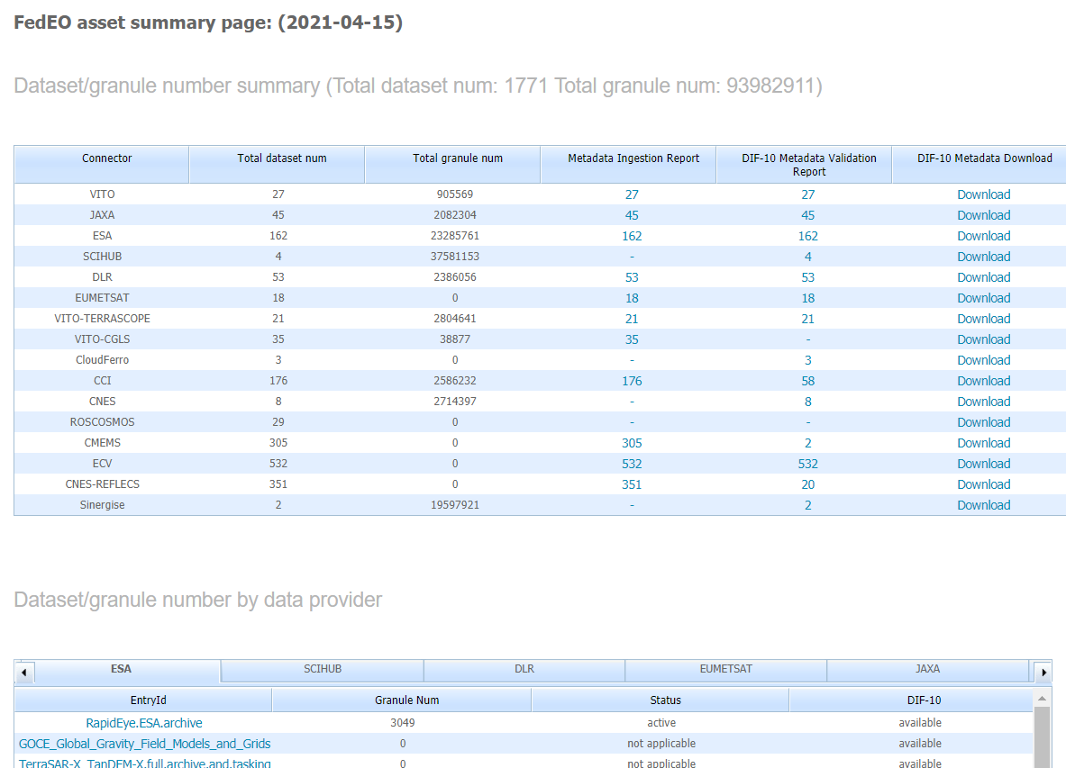
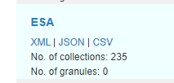
DIF-10 Metadata Export
https://geo.spacebel.be/opensearch/asset/index.html
Many harvested collections have been ingested into IDN in past period, e.g.
ESA 136, DLR 53, VITO 45
See:
https://cmr.earthdata.nasa.gov/search/collections.umm_json?provider_id=ESA&data_center=DE/DLR&pretty=true
https://cmr.earthdata.nasa.gov/search/collections.umm_json?provider_id=ESA&data_center=VITO&pretty=true
https://cmr.earthdata.nasa.gov/search/collections.umm_json?provider_id=ESA&data_center=ESA/ESRIN&pretty=true
DIF-10 collections are ready for being ingested into IDN, from
https://fedeo.esa.int/asset/index.html
Notes:
https://cmr.earthdata.nasa.gov/search/collections.umm_json?provider_id=ESA&data_center=DE/DLR&pretty=true
https://cmr.earthdata.nasa.gov/search/collections.umm_json?provider_id=ESA&data_center=VITO&pretty=true
https://cmr.earthdata.nasa.gov/search/collections.umm_json?provider_id=ESA&data_center=ESA/ESRIN&pretty=true
https://access.earthdata.nasa.gov/holdings

Slide 7
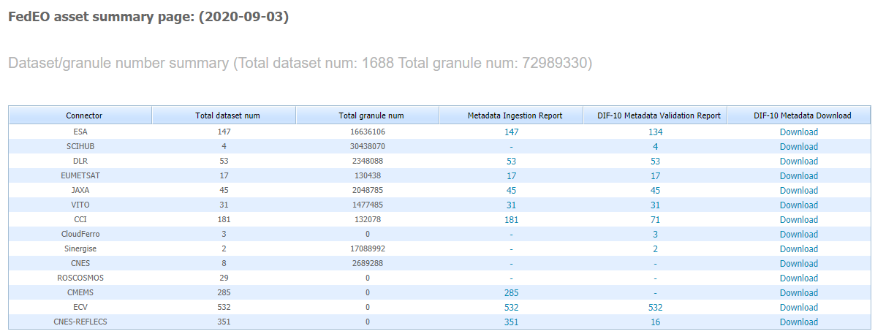
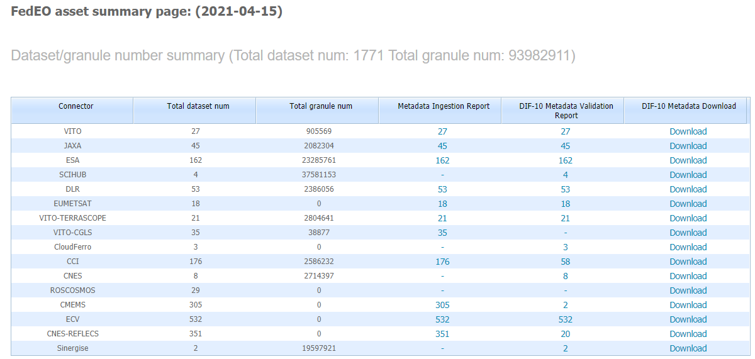
Metrics evolution
FedEO: 73 million to 94 million granules (+28%) since WGISS-50 (Sept. 2020)
ESA: 147 to 162 collections (+10%), 16 to 23 million granules (+39%).

Slide 8
Ongoing integration activities
ESA CCI integration in FedEO updated
2.58 million granules available via two-step search
DIF-10 generation and IDN insertion to be completed after ISO metadata update planned by CEDA/STFC to migrate from Gemini 2.1 to 2.3 and add platform/instrument information to metadata records currently missing this info (expected July 2021).

Slide 9
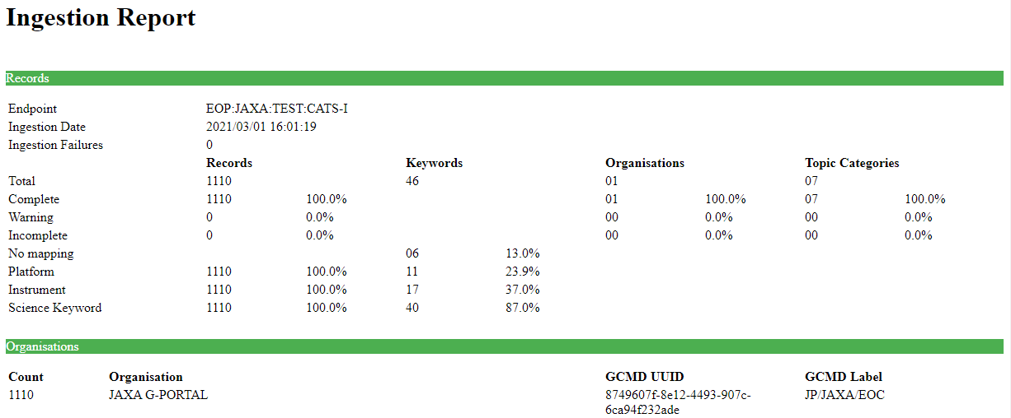
Ongoing integration activities
JAXA G-Portal integration
1110 additional collections with complete and valid DIF10 files.
Next steps: integration of JAXA granule search in FedEO when ready at G-Portal side.

Slide 10
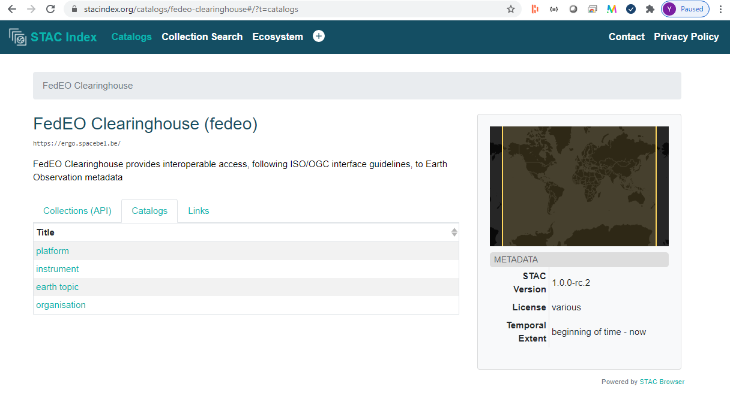
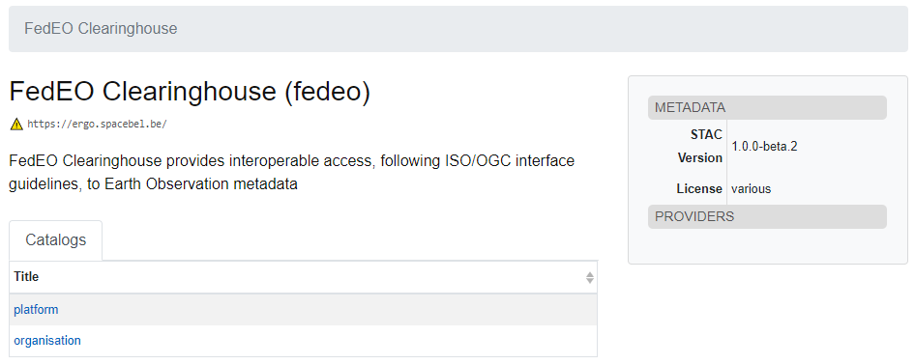
STAC Interface evolution
Main improvements since September 2020 (WGISS-50)
drill-down in STAC catalogues via instruments and earth topics (as per SKOS concept hierarchies) added to identify collections.
drill-down per year/month/day with number of products indicated
migration to STAC 1.0.0-rc.2

Slide 11
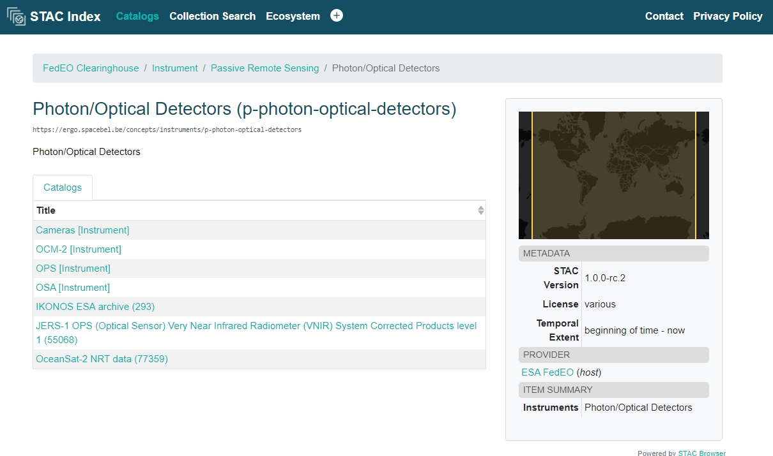
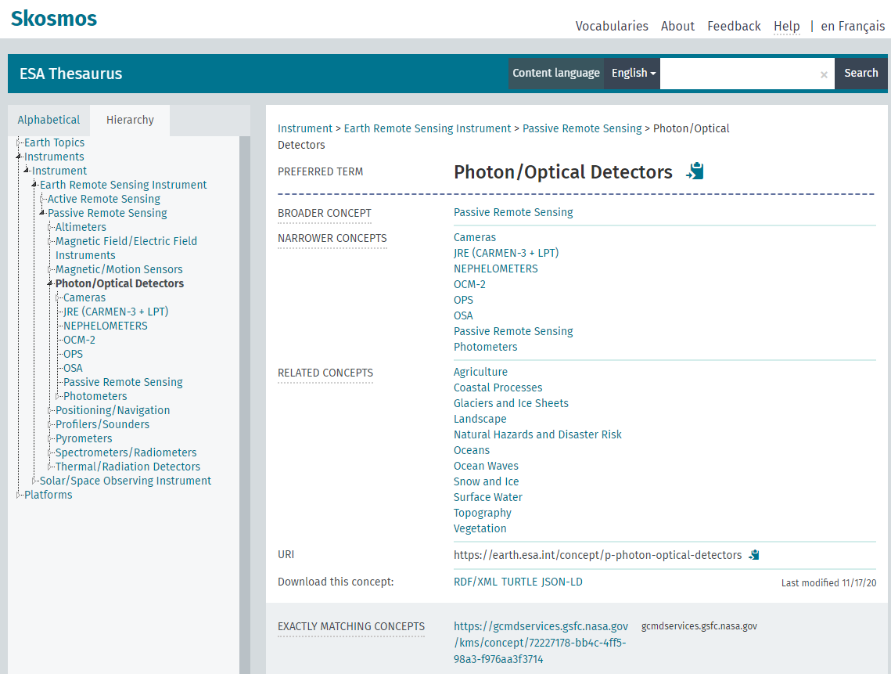
STAC implementation improvements
Drill down according to SKOS concept hierarchy (e.g. instruments) to find collection
Only includes branches leading to (STAC) collections…

Slide 12
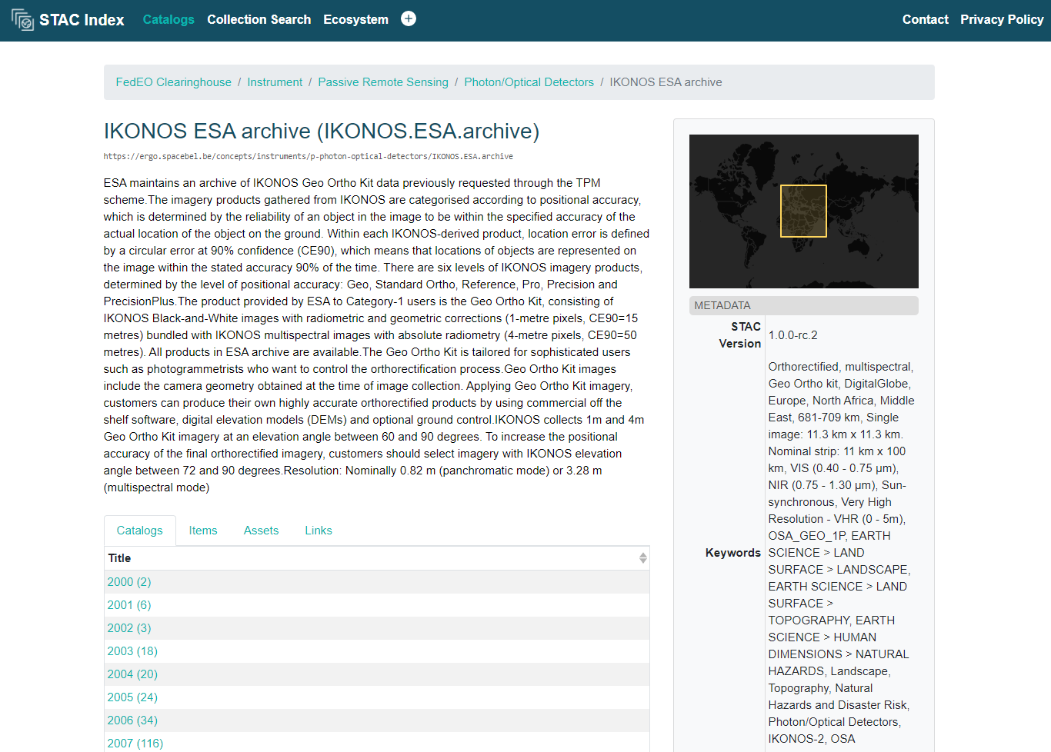
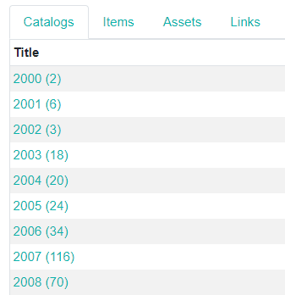
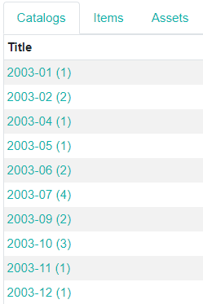
STAC implementation improvements
Drill-down per year/month/day with number of products indicated
Only includes subcatalogs (year, month, day) leading to granules (for ESA collections only).

Slide 13
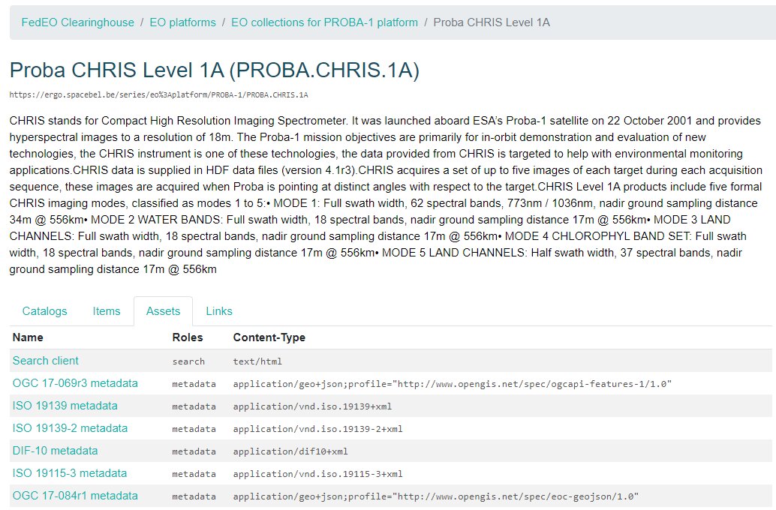
STAC implementation improvements
Collection level assets now available
Access to alternative collection metadata formats
Access to external search client application, e.g. IDN or FedEO search client (future work)
Notes:
https://stacindex.org/catalogs/fedeo-clearinghouse#/?t=catalogs

Slide 14
STAC Progress since WGISS-50
Some issues identified previously are now resolved/ improved/completed.

Slide 15
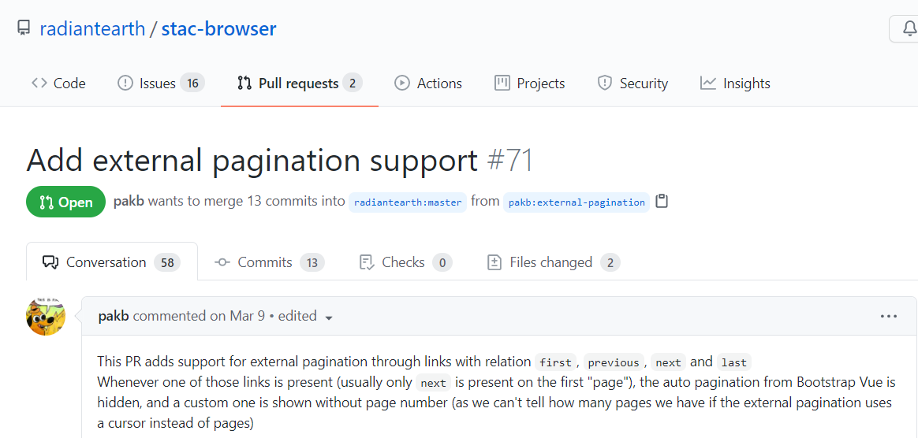
STAC implementation
Future work
Check ongoing work on STAC-BROWSER related to “external paging” once available.

Slide 16
Outline
FedEO current metrics and DIF-10 export status
STAC interface evolution since WGISS-50
FedEO evolution activities (EOVOC)

Slide 17
FedEO Evolution – EOVOC Status Update
Status update of FedEO evolution project “EOVOC” presented at CEOS WGISS#50 (22 September 2020)

Slide 18
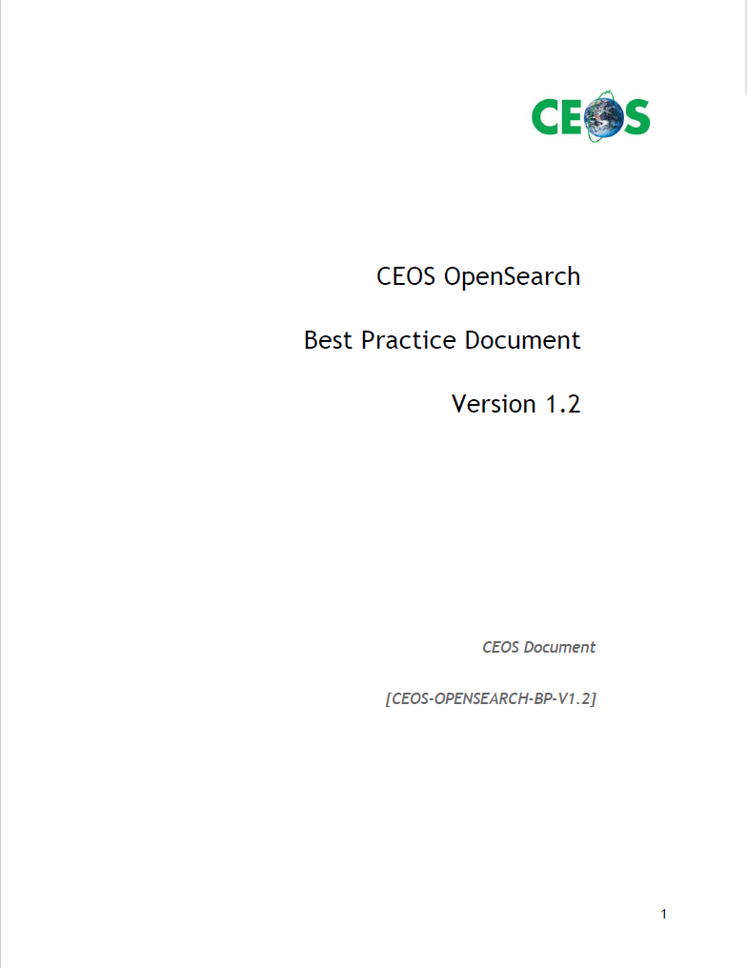
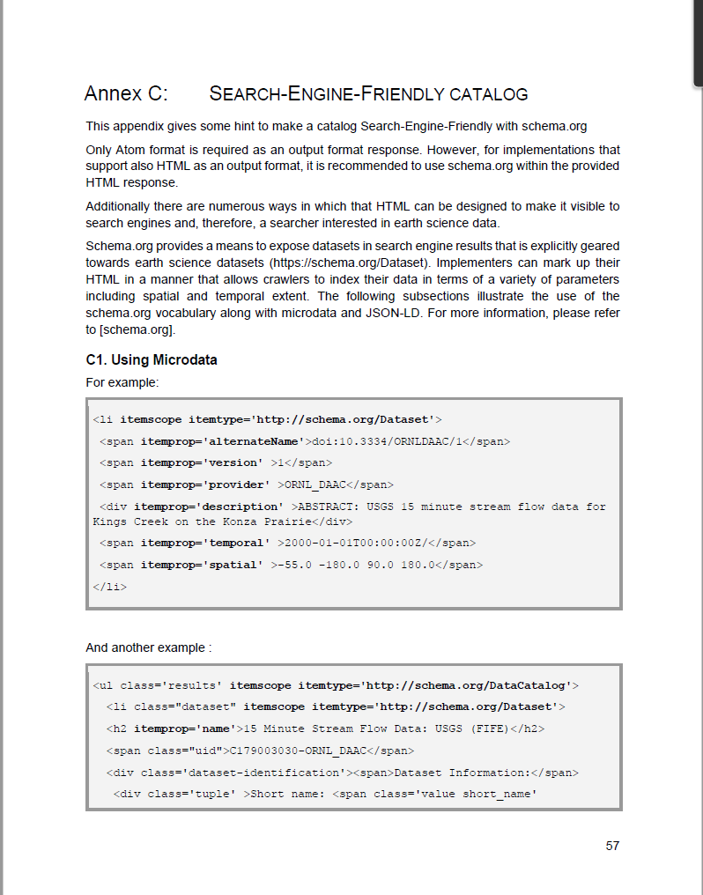
Context
Extends previous CEOS WGISS work:
CEOS OpenSearch Best Practice 1.2
« search-friendly catalog » - Annex C (schema.org)...

Slide 19
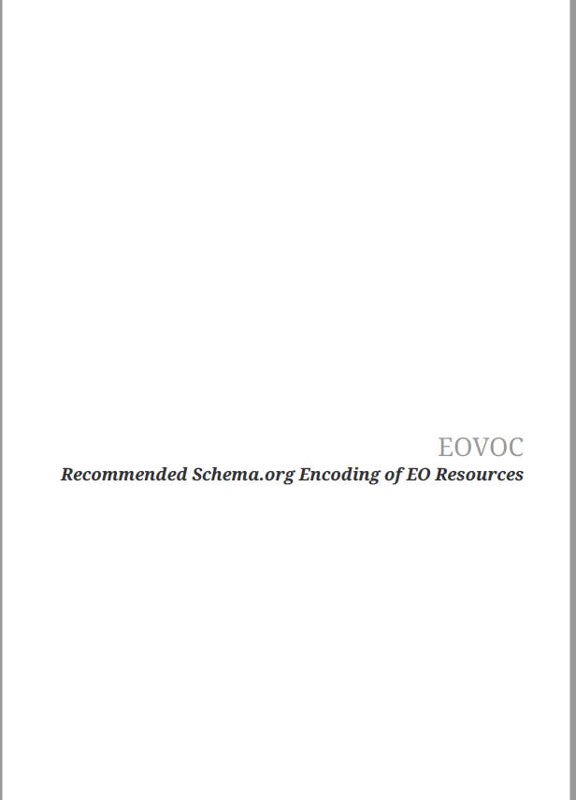
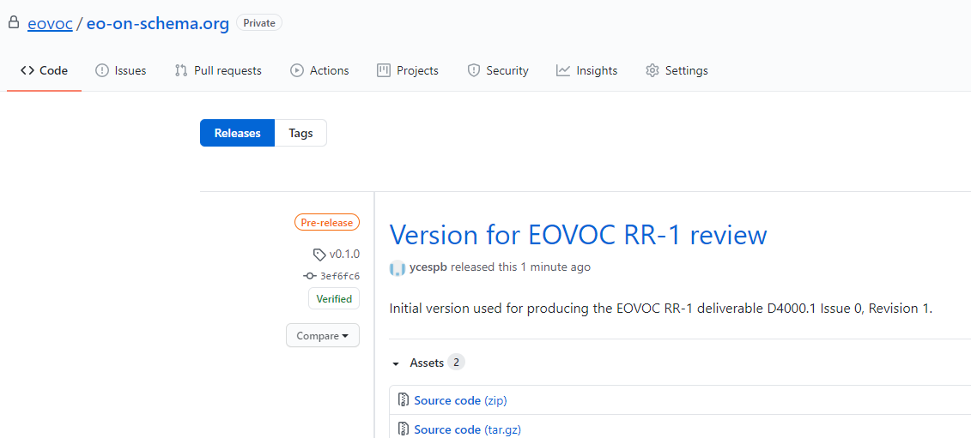
EOVOC Engineering Report (ER)
First EOVOC project review held February 2021
First version of proposed Data Model Engineering Report available for comments and feedback: heavily based on https://github.com/ESIPFed/science-on-schema.org

Slide 20
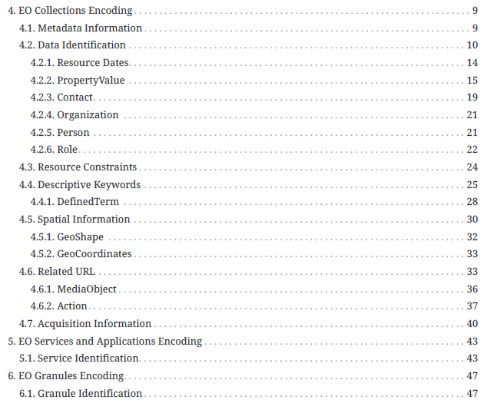
EOVOC Engineering Report – Table of content
Covers 3 resource types:
Collections
Services/applications
Granules
§4-6 assume schema.org as-is.
Similar TOC as OGC specs (derived from UMM TOC).
Traceability planned to OGC 17-084r1, OGC 19-020 and OGC 17-003r2.

Slide 21
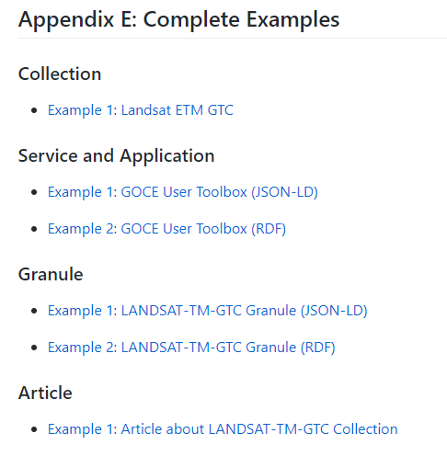
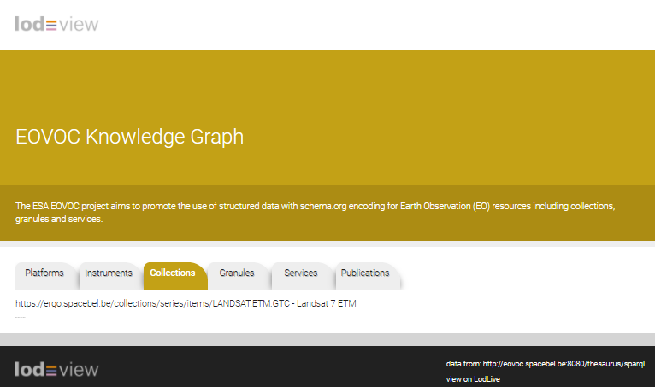
Engineering Report – Appendix E
Preliminary encoding examples (JSON-LD –> RDF)
In appendix E of Engineering Report
Loaded RDF/XML in SPARQL endpoint (Fuseki) and accessible at https://eovoc.spacebel.be/lodview (open-source Linked Data viewer)

Slide 22
Example (served via SPARQL)

Slide 23
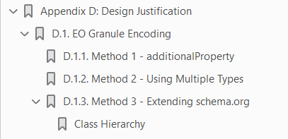
Engineering Report – Appendix D
Addresses 3 ways to cover more granule metadata properties than currently available in schema.org.
Only method 3 requires extending the schema.org vocabulary with additional classes and properties.

Slide 24
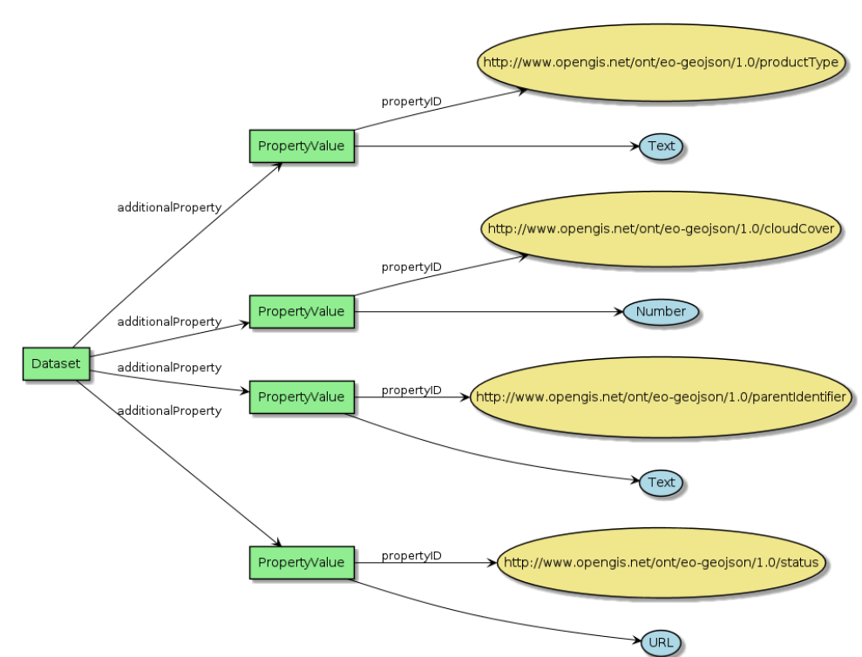
Granule metadata
Method 1: Exploits “additionalProperty” relation to include OGC17-003r2 properties.

Slide 25
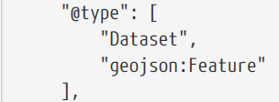
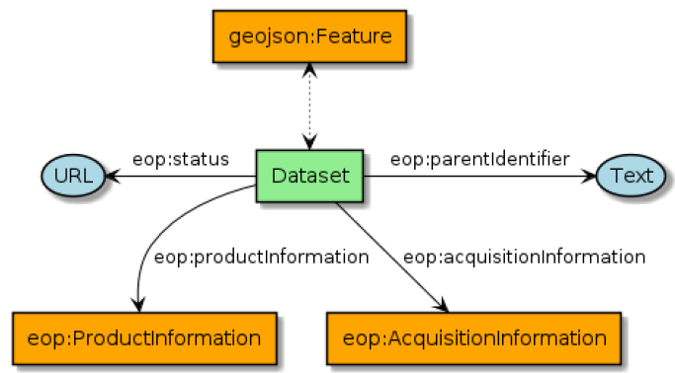
Granule metadata
Method 2: Use multiple types and mix properties.

Slide 26
Granule metadata
Method 3:
Extend (https://schema.org/docs/extension.html) schema.org when existing vocabulary is insufficient:
Classes
Properties
Work done:
Verify how to use the schema.org toolset and how to include “changes”.
Syntax conversion of OGC OWL model to schema.org format.
Deployment with schema.org toolset to validate approach.
Notes:
The schema.org toolset can be reused to document extensions to schema.org (for EO) using the similar Web pages as the original schema.org web site.

Slide 27
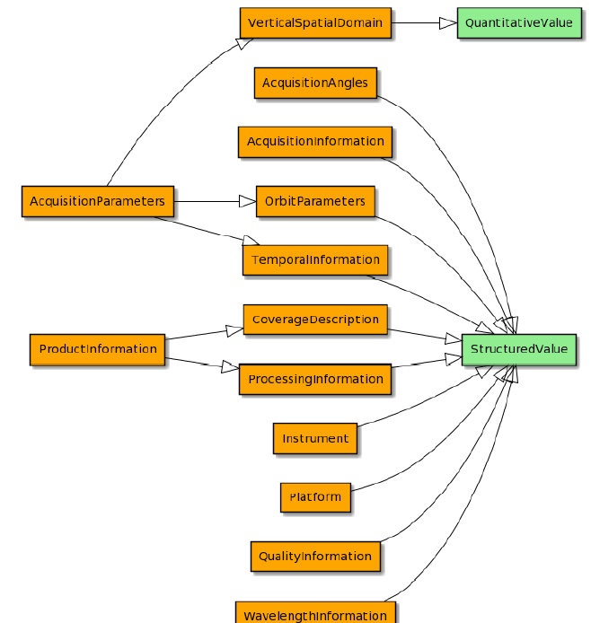
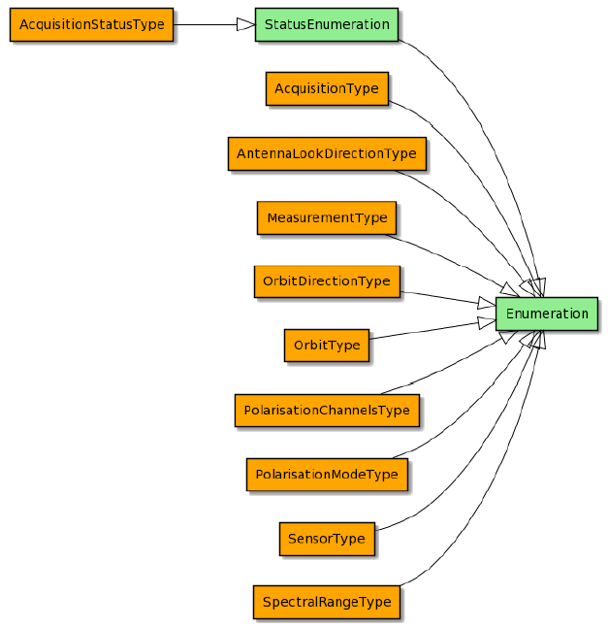
Granule metadata
Method 3: Try to fit OGC 17-003r2 classes with schema.org class hierarchy (very preliminary)

Slide 28
Conclusion
Current EOVOC results:
Draft Engineering Report (work in progress) to collect feedback, comments, and prototype implementation feedback.
https://github.com/eovoc/eo-on-schema.org (private)
https://eovoc.spacebel.be/lodview (public) hosting examples.
Next steps:
Taking into account CEOS WGISS SLT partners’ feedback
Completion and refinement of models
Parallel implementation by adding RDF HTML and JSON-LD response types to FedEO catalogue interfaces.

Slide 29
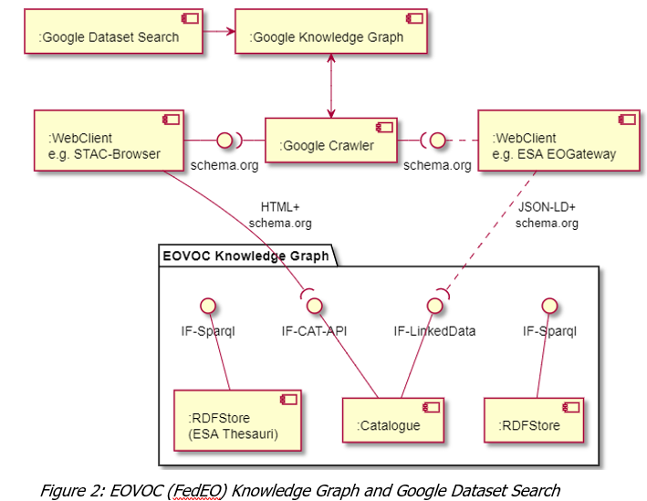
Conclusion
Proposed encodings to be used in a prototype implementation

Slide 30
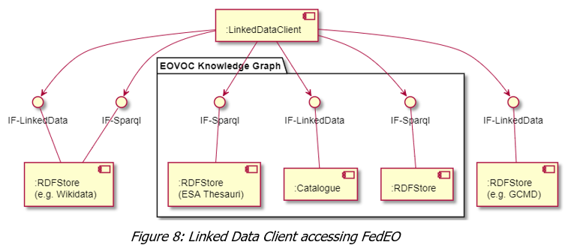
Conclusion
Proposed encodings to be used in a prototype implementation
Example clients:
Linked Data: “LODView”
SPARQL: Jupyter notebook, “LODView”

