Slide 1
ESA Extended Data Access
G. Troina (ESA), A. Della Vecchia (Randstad)
ESA/ESRIN
CEOS WGISS 51 Virtual Workshop
20-22/04/2021

Slide 2
Summary
Data Portfolio
ESA Heritage Missions
ESA Earth Explorers
Third Party Missions
Description of the architecture
Layered architecture
EO-CAT and FEDEO
PDGS Datacube
Evolution
ESE-ERGO
3D interfaces (3dFlus)
VRE (Aeolus)

Slide 4
ESA Heritage Missions

Slide 5
Earth Explorers

Slide 7
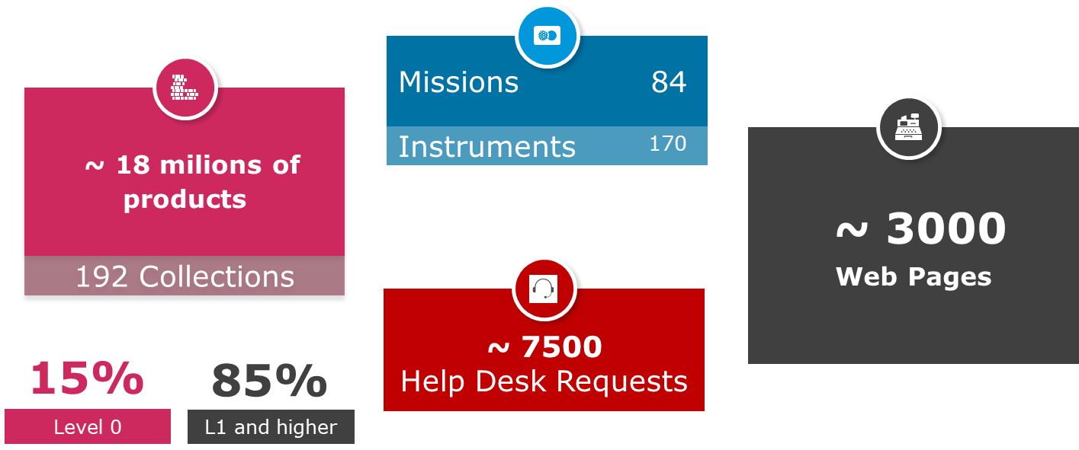
EO Data Dashboard

Slide 8
THE ARCHITECTURE

Slide 9
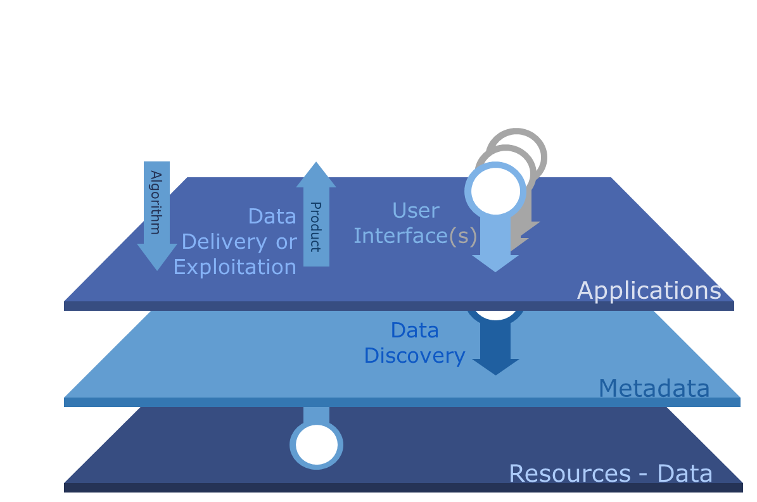
LAYERED ARCHITECTURE FOR DATA ACCESS

Slide 10
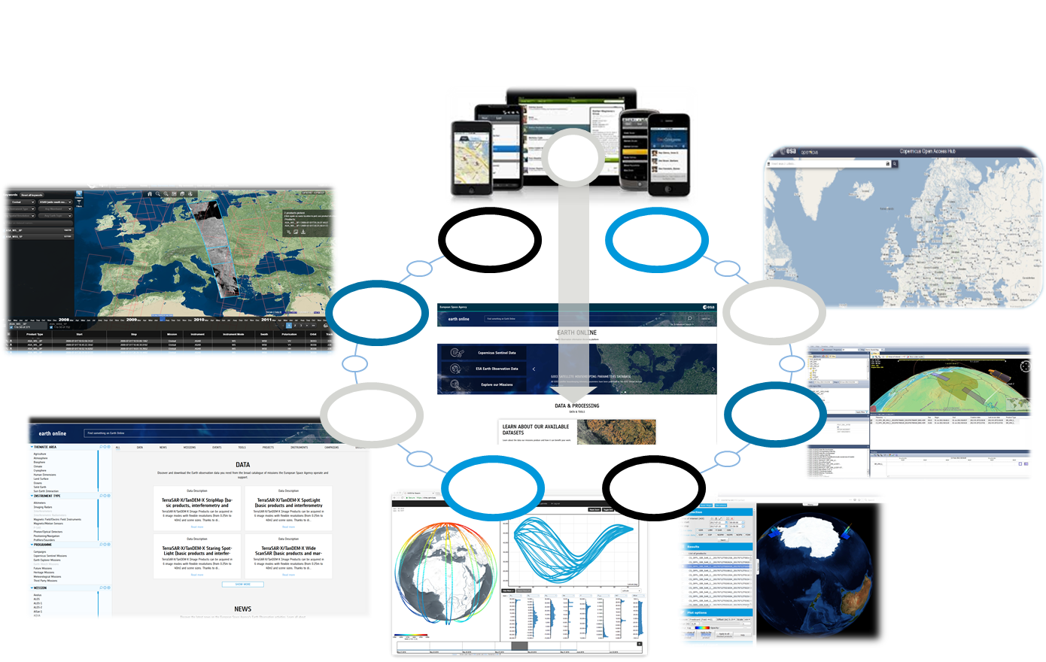
APPLICATION LAYER

Slide 11
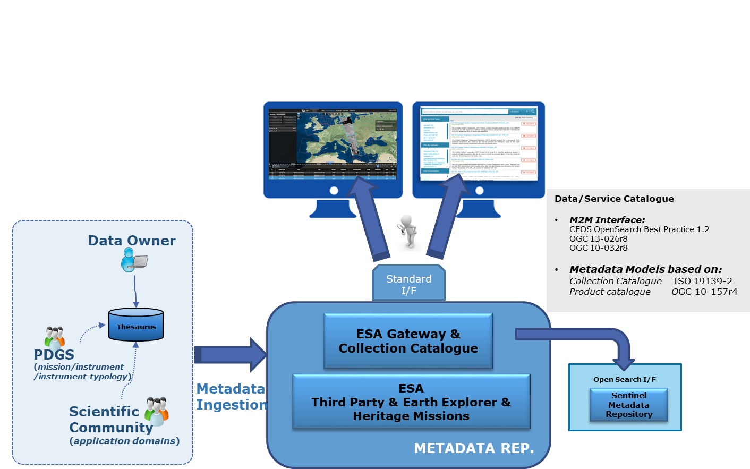
Metadata Layer

Slide 12
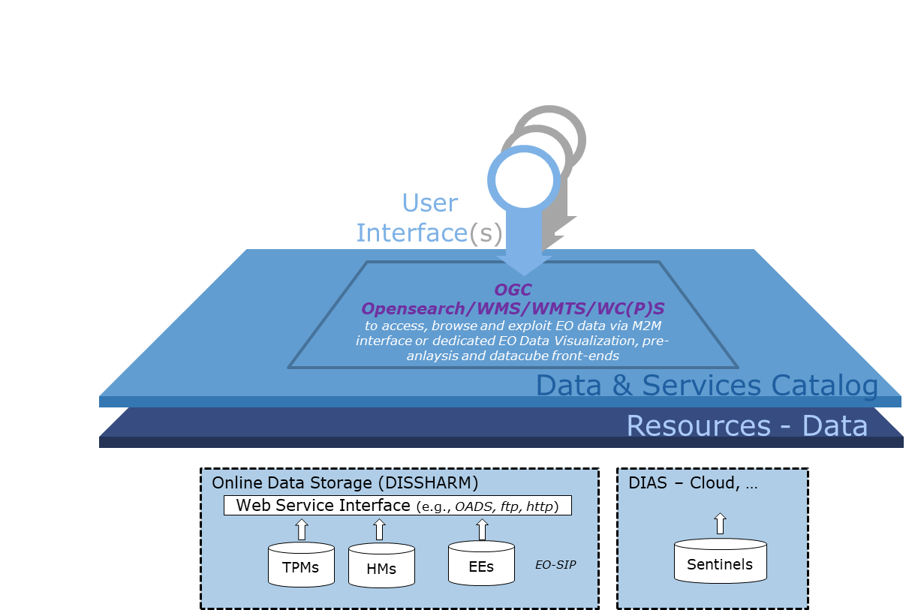
Standard services to access DATA LAYER

Slide 13
Adopted Standards

Slide 14
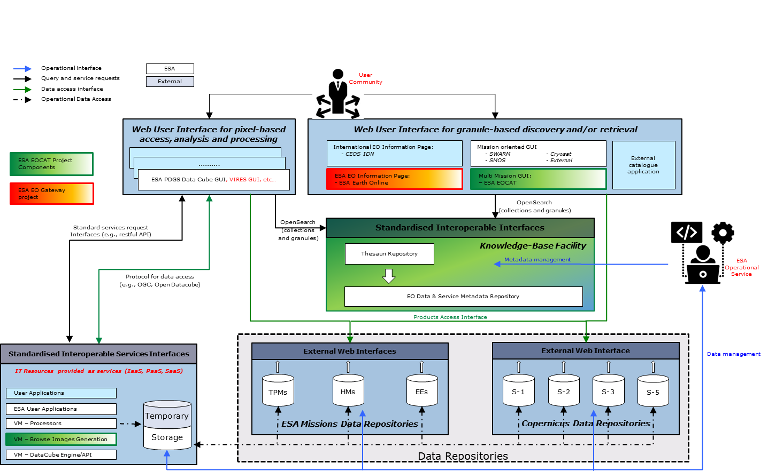
Common Services Layered Architecture

Slide 15
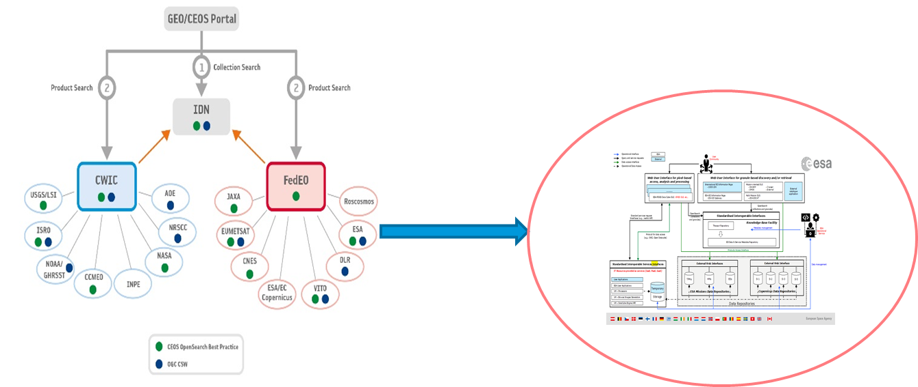
EOCAT/FedEO within CEOS-WGISS

Slide 16
ESA PDGS DataCube Service

Slide 17
Dataset
Mission | Dataset | Temporal coverage | Data format | Status
Third-Party | LANDSAT.TM.GTC | 1984-04-06 / 2011-11-16 | EO-SIP (2 nested ZIP: TIF (single bands)) | Operation
Third-Party | LANDSAT.ETM.GTC | 1999-07-09 / 2003-12-31 | EO-SIP (2 nested ZIP: TIF (single bands)) | Operation
Third-Party | TropForest | 2009-01-27 / 2011-08-09 | EO-SIP (2 nested ZIP: CEOS format) | Operation
Third-Party | SPOT1-5 | 1986-04-01 / 2015-09-15 | EO-SIP (2 nested ZIP: CEOS format) | Operation
Third-Party | IKONOS.ESA.Archive | 2000-12-25 / 2008-12 | EO-SIP (2 nested ZIP: TIF) | Operation
Third-Party | SeaSat.ESA.Archive | 1978-07-13 - 1978-10-10 | EO-SIP (ZIP: TAR: CEOS format) | Operation
Earth Explorer | MIR_BWSF1C | 2010-01-12 / present | ZIP: ZIP: HDB + DBL | Planned for 2021
Earth Explorer | MIR_BWSD1C | 2010-01-12 / present | ZIP: ZIP: HDB + DBL | Planned for 2021
Earth Explorer | MIR_BWLF1C | 2010-01-12 / present | ZIP: ZIP: HDB + DBL | Planned for 2021
Earth Explorer | MIR_BWLD1C | 2010-01-12 / present | ZIP: ZIP: HDB + DBL | Planned for 2021
Earth Explorer | MIR_SMUDP2 | 2010-01-12 / present | ZIP: nc | Planned for 2021
Earth Explorer | MIR_OSUDP2 | 2010-01-12 / present | ZIP: nc | Planned for 2021
Earth Explorer | MIR_SOILF3 | 2010-07-01 / present | ZIP: nc | Planned for 2021
Earth Explorer | MIR_SIT_M4 | 2010-11-15 / present | ZIP: nc | Planned for 2021
Heritage Mission | MER_RR_1P | 2002-04-29 / 2012-04-08 | ZIP: ZIP: nc (single bands) | Planned for 2021
Heritage Mission | MER_FRS_1P | 2002-05-17 / 2012-04-08 | ZIP: ZIP: nc (single bands) | Planned for 2021
Heritage Mission | MER_RR_2P | 2002-04-29 / 2012-04-08 | ZIP: ZIP: nc (single bands) | Planned for 2021
Heritage Mission | MER_FRS_2P | 2002-05-17 /2012-04-08 | ZIP: ZIP: nc (single bands) | Planned for 2021

Slide 18
Evolution

Slide 19
ESE/ERGO
OGC API – Features, OpenAPI and OpenSearch compliant (landing page).
Full support for GeoJSON, including faceted search responses.
Preservation of Atom responses.
Changed request parameters “limit”, “datetime” (transparent when OSDD is used)
Multiple feature collections:
Series (collections) – OGC 17-084r1
Datasets (products) – OGC 17-003r2
Services (services and applications) – OGC 19-020r1
Metric Server / Client
Metadata editor service with Semantic annotation via ESA Thesauri

Slide 20
3D over time series interfaces
Interactive and efficient visualization of data in 3D space over time-series is particularly important for operational services, for instance:
urban areas & infrastructures monitoring
forestry monitoring
space debris monitoring
The objective of the project is to develop and deliver new Open Source Software APIs for:
providing interactive visualization mechanisms of 3D fluid surfaces in web-browsers
supporting data-driven analysis
simplifying the use for the scientists without the 3D graphics library knowledge

Slide 21
Virtual Research Environment
The objective of the VRE project is to deliver an environment that provides:
a processing platform for each user to design and execute computations on the cloud
an easy interface to access ESA mission data
The VRE for the SWARM Mission is available already
The VRE for the Aeolus Mission is planned

Slide 22
Conclusions
Modular, layered, common architecture ready to fulfil requirements of new missions (e.g. EarthCARE, Biomass, Flex,…)
Standardization and interoperability
Common catalogue in order to increase visibility throughout discovery services
Evolution towards improved data visualisation and processing:
ESE/ERGO
3D over time series
VRE
AI

