Slide 1
ESA EO Identity and Access Management
EO IAM
Damiano Guerrucci, Véronique Amans, ESA
Marco Leonardi, Rhea
CEOS WGISS-51, Virtual Meeting, April 20-22, 2021

Slide 2
Outline
EO IAM is the new ESA Earth Observation Identity and Access Management system
Improving the user experience when accessing ESA EO data and related services
Compliant with GDPR
Based on a core an open-source product, the WSO2 Identity Server
Allowing implementation of federations
Offering strong potential for extensions and interoperability

Slide 3
Introduction of EO IAM in EOP-G
Why EO IAM (EO Identity and Access Management) ?
    To replace the old EO-SSO authentication system (Shibboleth based) requiring ad-hoc software customizations to support ESA requirements and only supporting the SAML protocol
    To implement Personal Data Protection regulations
    To support the creation and management of federations
    To implement actual acceptance of Privacy Notice and Terms & Conditions for EO data use, and the possibility to trigger a new acceptance in case of change
    To implement extended functionalities for users’ self management of their data access account
    To facilitate operator’s activities in the management of users’ accounts, creating new ones, forcing password reset, locking an account, deactivating automatically idle accounts, etc.
    To facilitate the setting of access rights (simple EO Sign In authentication for more EO data collections)
Development by ATOS, followed by acceptance on reference platform and transfer to operations within 15 months.

Slide 4
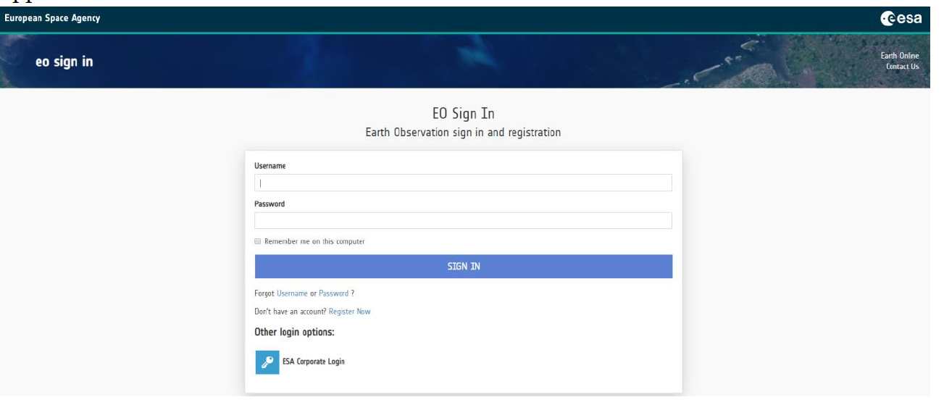
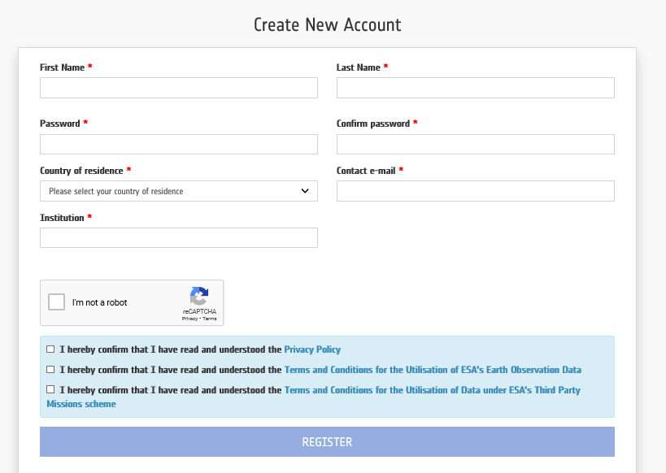
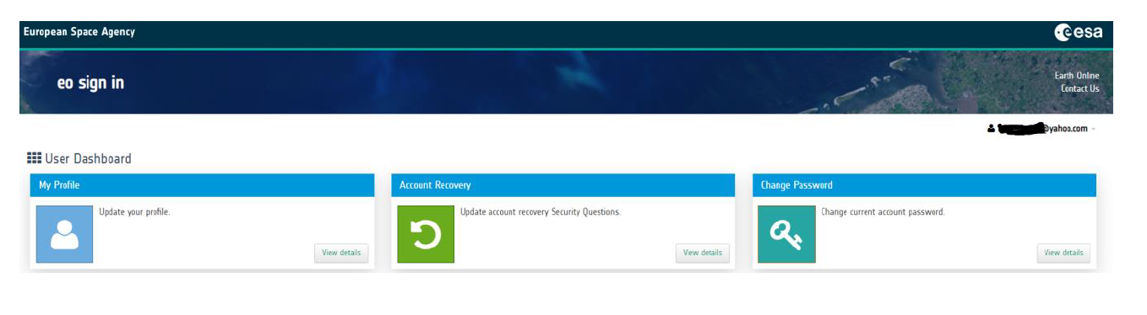
New user interface
Federation with
ESA Corporate

Slide 5
Common Services System View
Application Layer
Data Search
(direct + standard APIs)
Data Access Authorisation
Data Search
Users
Data Search
(standard APIs)
Data Discovery
Authentication (EOIAM)
ESA TellUS
Earth Online
Thesauri Web App
EO-CAT Client
SO-CAT
SM-CAT
EOCAT Backend
METADATA Layer
Collection Catalog
Thesauri Backend
Data Download
(HTTP, FTP)
Product Catalog
Metadata
Authentication/Authorisation (EOIAM)
Metadata
Accounting (ESA TellUS)
OADS + Integrated Processing Facilities
DATA Layer
Online Data Storage (DISSHARM/ELVIS)
EO-SIP
Third Party Missions
Heritage Missions
Earth Explorers

Slide 6
EO IAM benefits (1/2)
ESA/Maintainer side
    EO IAM System has at its core an open-source product, the WSO2 Identity Server, on top of which a separate plugin component has been developed to comply with ESA’s needs
    Provides all the authentication functionalities towards ESA Service Providers along with user management capabilities
    Support to federations and multi protocol (SAML 2.0, OAuth, OIDC)
    Configuration changes (user and SP) moved to operational teams
    Has two user interfaces, an end user interface and operator web interface having a dedicated administrator console
    Strong potential for extensions and interoperability
EOIAM System Components
WSO2 Identity Server
OpenLDAP Primary DB
Custom Plugin
OpenLDAP Secondary DB
Internal DB

Slide 7
EO IAM benefits (2/2)
ESA/Common Services side
    Enables M2M authentication (e.g. Datacube, WCS)
    Out of the box compliancy with Data Protection Policy
    Look & feel harmonised with ESA TellUS and Earth Online
    No changes necessary done on the services for transitioning to EO IAM

Slide 8
Main challenges of TTO
  Users migration
    EO-SSO/EODISP/ESA TellUs DB cleaning (removing old and duplicated accounts, alignment with the Service Providers databases)
    Total number of EO-SSO users: around 48000 accounts, more than half idle since over 2 years → decision to migrate only those having logged into EO-SSO in the last 2 years about 20500 users
    Communication plan and reaching the users
    Users Bulk Ingestion in EO IAM
Integration with the 19 Service Providers: ESA TellUs, EarthOnline/EODISP, Dissemination services, few TEPs, with minimum service downtime, maximum one day per system
Federation with ESA Corporate Identity Management Infrastructure

Slide 9
Status and future plans
TTO completed mid December; resolution of few teething issues in the first weeks of operations; margin for optimising operator’s interface.
Need to resolve services implemented as “stand-alone” solutions, deviating from the common services, to reduce complexity
Need to implement continuous cleaning of users database and maintain alignment
New federations to be discussed, in particular with eduGAIN

