Slide 1
Liaison Report
Hungarian Space Office
operated by the Ministry of Foreign Affairs
and Trade (MFA)
Dr. Dániel Kristóf, Lechner Knowledge Centre
Lead, EO delegate to ESA on behalf MFA Space Dept.
Dr. Gábor Remetey-Fülöpp
Liaison delegate to CEOS WGISS
Conrtibutors: Ferenc Horvai, Department of Space, MFA
Pál Rudan, FIR project, KIFÜ
CEOS WGISS-50 | Virtual Meeting
22-24 September 2020

Slide 2
HSO Overview
The Government of Hungary established the Hungarian Space Office (HSO) in 1992.
The role of the HSO was taken over by the Ministry of Foreign Affairs and Trade (MFA) from the Ministry for National Development (today Ministry of Innovation and Technology) in 2018.
At MFA the Department of Space (in full: Department of Space Research and Space Activities) has been established with functions
  to manage space-research-related legislative and regulative tasks derived from the EU membership and other international commitments (with special emphasis on ESA membership),
  to maintain and develop international links (e.g. other space agencies)
  set up, coordinate and ensure the accomplishment of space research programs
  to supervise domestic space activities,
  to organise meetings of the advisory boards (MŰT, ŰTT) and
  to prepare documents for high-level decisions,
  E.g. to take part in the consortium to establish EO infrastructure needed to increase space research capabilities
Orsolya Ildikó Ferencz PhD, Commissioner for Space Research has been appointed by the Minister. She is acting as supervisor of the space research in Hungary
Liaison Report - Hungarian Space Office
operated by the Space Department of MFA
CEOS WGISS-50 | Virtual Meeting | 22-24 September 2020

Slide 3
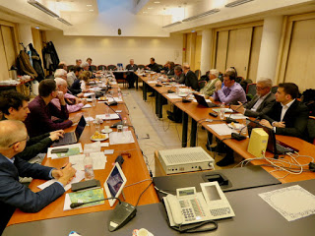
HSO Overview
Scientific Council of Space Research (ÜTT) renewed in late 2018 chaired by Academician László Pap having the functions among others:
  to advise the Minister of MFA in space-related issues
  to elaborate the National Space Strategy
  to strengthen the capabilities in space-related education, capacity building, industry and overall awareness raising
  to elaborate the accreditation principles and regulation
  to nominate delegates to ESA programme committees including EO
Council of Hungarian Space Research (MŰT) an other advisory board with representatives of governmental organisations, academic institutions, industry as well civil societies
Earth Observation is one of the key area of interest of the Hungarian space-related community
Liaison Report - Hungarian Space Office
operated by the Space Department of MFA
The Scientific Council of Space Research in action.
Meeting hosted by MFA in March, 2020
CEOS WGISS-50 | Virtual Meeting | 22-24 September 2020

Slide 4
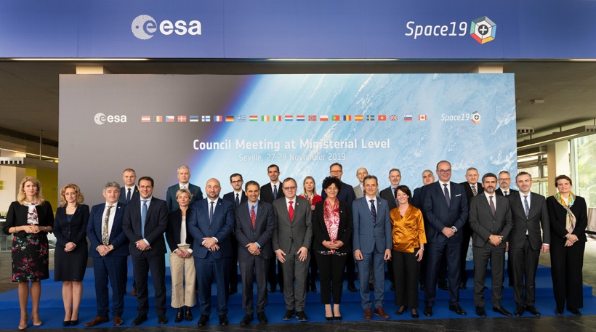
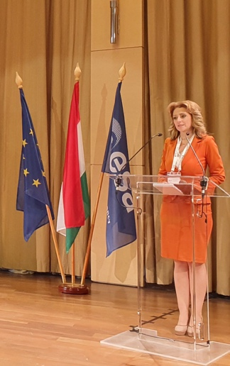
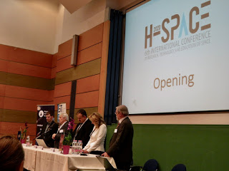
Some EO-related activities and actions having impact on EO as well (1)
At ESA’s Council Meeting on Ministerial Level (Space19+) MFA Minister Mr.Szijjártó announced the planned flight of the next Hungarian astronaut in cooperation with Roscosmos scheduled in 2024. (The flight of the first Hungarian astronaut Bertalan Farkas just 40 years ago was a driver for the upgrade from core team to Remote Sensing Centre at FÖMI^{x})
The establishment of the CarpathiaSat (Magyar Űrtávközlési Zrt) in August 2020 enables the realisation of the first Hungarian geostationary telecom satellite intended to be used by the public administration and for research in 2024 and beyond.
Some selected actions with HSO participation include:
  Innovate? Do it with Space!’ A joint event of ESA Business Incuba- tion Centre and Wigner Research Centre of HAS for Physics
  the 6th Int’l Conference ’H-Space’ on Research, Technology and Education of Space hosted by Budapest University of Technology and Economy (BME) February, 2020,
  ŰTT Meeting with focus on Curricula for Space Engineer and drafting the National Space Strategy March, 2020
  Next action: 2020 ESA-Hungarian Space Industry Day, October 2020
Liaison Report - Hungarian Space Office
operated by the Space Department of MFA
Delegates to ESA’s Council Meeting held
in Seville, November 2019. Source: ESA
Opening ceremony of H-Space 2020
Ministerial Commissioner
Dr. Orsolya Ferencz gave an update at the ESA-Wigner event
^{x}Since 2019 it became part of Lechner Knowledge Center Plc.
CEOS WGISS-50 | Virtual Meeting | 22-24 September 2020

Slide 5
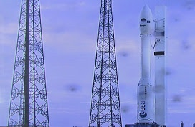

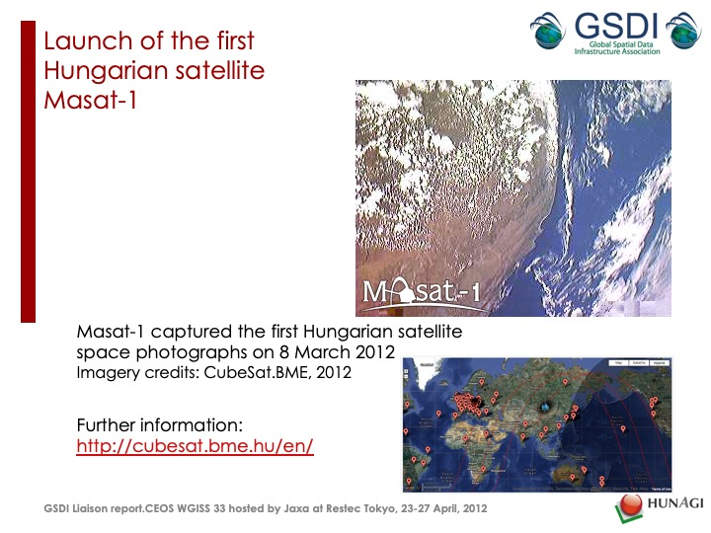
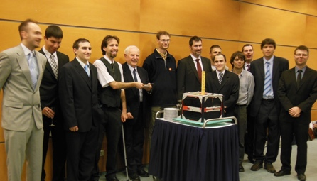


Some EO-related activities and actions having impact on EO as well (2)
Successes of the Hungarian Cube- and Microsatellites
Flashback
Masat-1 An EO CubeSat with lifespan of 1061 days.
Launched in Feb 2012. Its EO Mission was presented at WGISS-33
The sat was designed and operated by a student team of the Budapest University of Technology and Economy (BME) mentored by Dr. András Gschwindt. Details: https://www.masat.space/ http://cubesat.bme.hu
Present
SMOG-P the world’s smallest scientific, ‘PocketQube’ sat
Physical size: 5x5x5 cm, total weight 250g.
Primary mission goal: mapping the electromagnetic pollution around the Earth. Launch date: December 6, 2019. Contractor: Rocket Lab (USA)
Features: payload components include on-board spectrum analyser to measure the electro-smog, experimental dosimeter. The sat contains 20 temperature sensors to measure the thermal behaviour of the construction and other monitoring tools for providing housekeeping data as well as 2 magnetometers, 2 gyroscopes and 6 light sensors.
Planned lifetime was 3 months but it is still operational
Details: http://gnd.bme.hu/smog/files/publikaciok/gabor_eps2/The_Success_Story_of_SMOG-P_Gabor_Geczy.pdf
Follow-on: the launch of SMOG-1
Liaison Report - Hungarian Space Office
operated by the Space Department of MFA
Launch of Masat-1 and Celebration after the first year at BME
Rocket Labs’ Launch Complex at
Onenui in New Zeeland, where the SMOG-P and ATL-1, two Hungarian PocketQube sats were launched Pic taken by Aleksei.Source: Internet
Brendan Gully’s pic of the launch of the Electron rocket with payloads containing two Hungarian satellites.
Source: Gábor Géczy via HSO
Credit: https://brendangully.co.nz.
CEOS WGISS-50 | Virtual Meeting | 22-24 September 2020

Slide 6

ESA membership in the EO context - Hungary
Hungary is full member of ESA since 2015
Joined Earth Observation Envelope Programme in May 2019
With the new ESA Space Programme initiated with Space19+, Hungary has subscribed a record budget to ESA programmes
Within Earth Observation, Hungary has subscribed to the following programmes:
  FutureEO
    the core European EO programme, financing overall activities and Earth Explorer missions
    amount subscribed: 7 MEUR
  Copernicus Space Component (CSC)
    The optional programme financing the development and operation of Sentinel satellite constellations and corresponding ground segment activities
    amount subscribed: 7 MEUR
  A National Space Strategy is under elaboration and will be available soon in its first version
Liaison Report - Hungarian Space Office
operated by the Space Department of MFA
CEOS WGISS-50 | Virtual Meeting | 22-24 September 2020

Slide 7
Governmental EO developments - Hungary
Earth Observation Information System (FIR) backgrounds
  Large national operational project, partly funded from EU budget
  Consortium: Governmental Agency for IT Development,, Lechner Knowledge Centre, Ministry of Foreign Affairs and Trade, NISZ National Infocommunications Services Company
  A large number of governmental actors involved, representing a multitude of sectors: forestry, disaster management, water management, defense and security, agriculture, air traffic
  Time span: 2017-2020
  Aim: EO-derived information into governmental procedures supported by a centralized infrastructure
  IT, institutional, legislative and financial framework to be elaborated
  Hybrid IT infrastructure: supercomputer for fast, automated EO data processing and cloud for supporting administrative procedures
    Also fulfills the role of ESA Collaborative Hub / Copernicus Ground Segment
    Holds a full online archive of Sentinel data, along with ancillary institutional data sets
    Flexible infrastructure based on modular containerized instances (Kubernetes / Docker)
  Organization resulting from the project: Earth Observation Operations Centre (FOK)
Liaison Report - Hungarian Space Office
operated by the Space Department of MFA
CEOS WGISS-50 | Virtual Meeting | 22-24 September 2020

Slide 8
Governmental EO roadmap - Hungary
Earth Observation Information System (FIR)
  Status and roadmap:
    Final development milestone reached on 31 August 2020
    System under migration from ‚test’ to ‚operational’ state
    User Acceptance Testing in May 2020
    Earth Observation Operations Centre (FOK) under construction within the organizational structure of Lechner Knowledge Centre
    Legislative framework is under preparation, converging to consensus
    Full functionality to be reached in October 2020
    Launch of demo phase scheduled in November 2020
    Going public scheduled to 1st April 2021
Liaison Report - Hungarian Space Office
operated by the Space Department of MFA
CEOS WGISS-50 | Virtual Meeting | 22-24 September 2020

Slide 9






Earth Observation Information System
(FIR)
establishment of
Earth Observation data infrastructure and services
KÖFOP-1.0.0-VEKOP-15-2017-00050
CEOS WGISS-50 | Virtual Meeting | 22-24 September 2020

Slide 10

HSO report for
Governmental EO ecosystem and prime apps - Hungary
Legislative framework
International
relations
Web Portal
’eEarth’
Public administration
procedures
Agriculture
Hardware
infrastructure
Disaster Management
Protection against logwater
Operative
EO Center
Forestry
CEOS WGISS-50 | Virtual Meeting | 22-24 September 2020

Slide 11
Support of domestic remote sensing tasks
Real-color mosaic with country coverage
Quality control of downloaded space imagery
„Qualified” remotely sensed data
Tasks related to preprocessing
Preprocessing of optical imageries
Polarimetric preprocessing
Co-registered space imageries
Extended preprocessing
Indexing
Automatized processing
Discipline-oriented thematic processing (raster, vector)
Liaison Report - Hungarian Space Office
operated by the Space Department of MFA
CEOS WGISS-50 | Virtual Meeting | 22-24 September 2020

Slide 12








Governmental EO hardware architecture - Hungary
ESA
    CPU core: 1 128 core
    GPU core: 2 * 5120 CUDA cores, up to 7 TFLOPS
    Memory: 8 000 GB
    Disk capacity: 2 200 TB (2 200 000 GB)
    Archive capacity: 4 800 TB (4 800 000 GB)
Liaison Report - Hungarian Space Office
operated by the Space Department of MFA
Public administration
(PA)
PA CLOUD
PA HOSTING
WDC
GEANT
Citizens
SMEs
eEarth
CEOS WGISS-50 | Virtual Meeting | 22-24 September 2020

Slide 13
Improvements in public administration by EO - Hungary
Permission provision procedure for aerial remote sensing. Supervision of the use of remotely sensed data
Airspace assignment permission procedure
Timber use detecting and monitoring
Forest use permission procedure
Liaison Report - Hungarian Space Office
operated by the Space Department of MFA
Forest registration support
E-SUPPORTED PROCEDURES AND FLOWS IN PUBLIC ADMINISTRATION
Technical monitoring of hydraulic infrastructures having critical importance
Control for prevention of open space fires
Support of management of meteorological and other natural risks having impact on the agricultural production
Logwater mapping by remote sensing
Draugth survey using remote sensing
Thematic agricultural mapping
Logwater alert system
Defense preparadness staging
Control by remote sensing for area-based agricultural and regional development support
CEOS WGISS-50 | Virtual Meeting | 22-24 September 2020

Slide 14
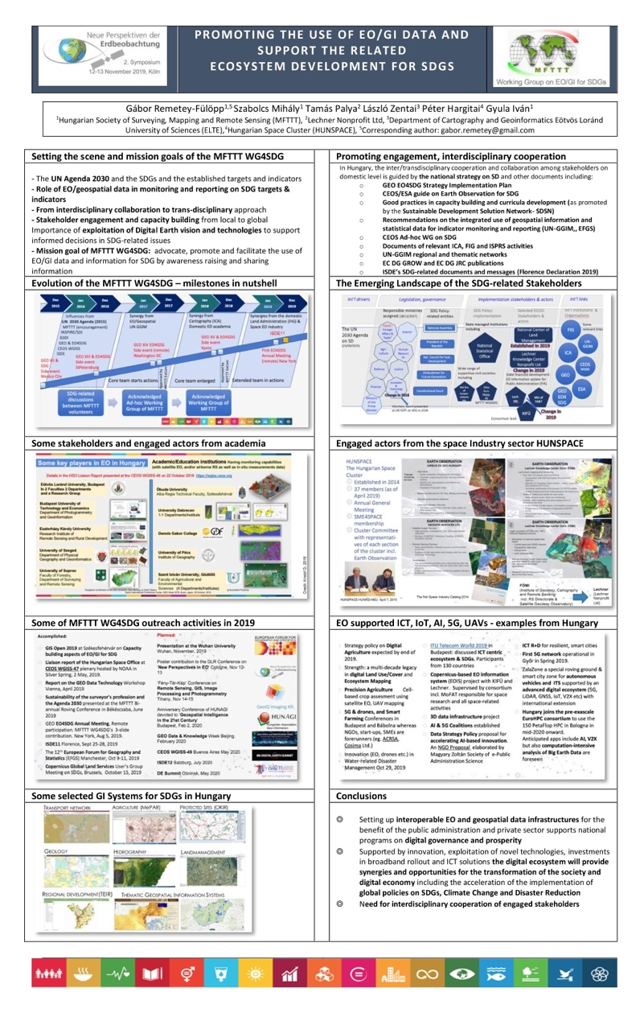
Recent activities of MFTTT WG4SDG, partner of GEO EO4SDG - an upgrade
The Hungarian Society of Surveying, Mapping and Remote Sensing (MFTTT)
is active in the field of Sustainable Development especially after the UN 2030
Agenda and its SDGs became known for the geospatial community in Hungary.
MFTTT recent activities in this field are twofold (https://www.mfttt.hu) :
Domestic actions include: awareness raising, to advocate engagement of stakeholders working with EO/geospatial data either as service provider, user, developer or solution provider in government, academia, industry or civil societies accomplishing SDG targets 17(16) and 17 (17).
In order to convince the decision makers especially in government on the role of EO/geospatial data and their integration with statistical information an MFTTT document has been drafted and will be disseminated.
The activities and accomplishments were summarized by Dr.Szabolcs Mihály, lead of MFTTT’s WG4SDG at the GISopen Conference on 3-4 September 2020
Actions in international relations include: sharing information on the developments, best practices, reporting and participations on Conferences, Symposia, workshops and - newly - remote meetings associated with SDGs (e.g. Copericus Global Land Services User Group, DLR’s New perspectives in EO, GEO WG4SDG, CEOS WGISS, ICA-ICCGIS, EFGS, ISDE and DE Summit).
Liaison Report - Hungarian Space Office
operated by the Space Department of MFA
CEOS WGISS-50 | Virtual Meeting | 22-24 September 2020
MFTTT poster at DLR EO Conf held in Cologne

