Slide 1
NOAA Agency Report
Nancy Ritchey
Archive Branch Chief, Data Stewardship Division
Thursday, 24 Sep, 2020
WGISS-50
Virtual

Slide 2
Agenda
Drivers for Change
Federal Data Strategy
NOAA Strategies
Next Steps

Slide 3
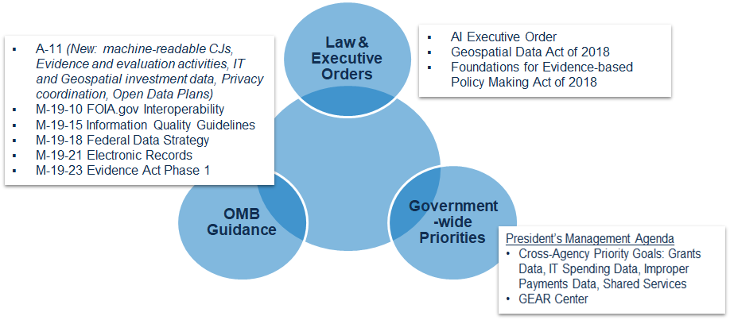
Strategic Drivers
Evolving Federal Data Landscape
Notes:
Many strategic drivers for the US Federal government to evolve the data landscape:
Law and Executive Orders, Government-wide Priorities and the Office of Management and Budget (OMB) guidance

Slide 4
Strategic Drivers
Evolving Federal Data Landscape
The Foundations for Evidence-based Policymaking Act
Chief Data Officer
Commerce Data Governance Board (CDBG)
Geospatial Data Act
DOC recognized leader
Federal Data Strategy
Annual Action Plans
Coordinated by CDGB
Changes to Information Quality Act; FOIA; Privacy
Technology advances
Big Data Program, Cloud Technologies
Partnerships & cultural changes
Commercial data buys
Laws and Executive Orders
Data
OMB Guidance
Government Wide Policies
Notes:
The Data Landscape is evolving quite rapidly: new legislation and federal policies provide both opportunities and challenges.
The Foundations for Evidence-based Policymaking Act was signed early 2019; among other requirements, the Evidence Act legislates a Chief Data Officer for the 23 “CFO Act” agencies, of which the Department of Commerce (DOC) is one.
The Evidence Act is also the impetus for the Commerce Data Governance Board, known as the CDGB, whose members are the DOC agencies. The CDGB has pushed the requirement for a CDO down to the DOC agencies, so NOAA needs one.
In addition, the CDGB coordinates Federal Data Strategy activities for the agencies, like the Data Management Maturity Assessment
As for the GDA: The DOC is a recognized leader in the geospatial community. Commerce leads 6 of the 17 National Spatial Data Infrastructure (NSDI) geospatial data themes and 60 of the 175 National Geospatial Data Assets. NOAA's count is 4 themes and 30 datasets.
There are substantial reporting and planning requirements in the GDA.
The Federal geospatial community is looking to align efforts with the activities of the Evidence Act and Federal Data Strategy.
NOAA has had at least three detailees working on the Federal Data Strategy. NOAA’s Data Strategy aligns with the Federal Data Strategy and the Evidence Act.
Other challenges include Information Quality Act (IQA) procedural revisions, regarding Influential Scientific Information (ISI) and Highly Influential Scientific Assessments (HISA); increased Freedom of Information Act (FOIA) filings; and changes to OMB’s approach to Privacy collections. These all impact the workload in addition to requiring an enterprise approach to the policy implications.

Slide 5
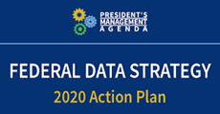
Federal Data Strategy
Mission: Fully leverage the value of federal data for mission, service, and the public good by guiding the Federal Government in practicing ethical governance, conscious design, and a learning culture.
Principles: The ten principles serve as guidance to agencies in the areas of: Ethical Governance, Conscious Design, and Learning Culture.
Practices: The 40 practices guide agencies on how to leverage the value of data, focusing on Building a Culture that Values Data and Promotes Public Use; Governing, Managing, and Protecting Data; and Promoting Efficient and Appropriate Data Use.
Annual Action Plan: Specify measurable activities to implement the practices and that are the priority for a given year, providing timeframes for implementation and identification of responsible parties.
Notes:
The goal of the Federal Data Strategy is to leverage the value of all federal data, not just environmental data. The 10 principles & 40 practices informed the development of practices, the 2020 Action Plan, and will also inform subsequent action steps for the Strategy. Agencies will implement the Federal Data Strategy by adhering to the requirements of the Action Steps in yearly Action Plans in accordance with OMB guidance.

Slide 6
Strategic Drivers
Federal Data Strategy
Notes:
NOAA has developed 6 new strategies in key science and technology (S&T) focus areas to guide the use of these new technologies, in order to develop advancements in the quality and timeliness of NOAA’s products and services across our mission areas.

Slide 7
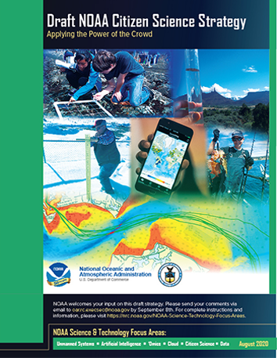
Strategic Drivers
NOAA Science & Technology Focus Areas
https://nrc.noaa.gov/NOAA-Science-Technology-Focus-Areas
NOAA’s 6 new strategies in key science and technology (S&T) focus areas will guide transformative advancements in the quality and timeliness of NOAA’s products and services across our mission areas.
Citizen Science
Notes:
NOAA has developed 6 new strategies in key science and technology (S&T) focus areas to guide the use of these new technologies, in order to develop advancements in the quality and timeliness of NOAA’s products and services across our mission areas. Implementing NOAA strategies will accelerate innovative advances and serve as force multipliers to solve tough problems and set the course to strengthen NOAA environmental S&T leadership for the coming decades
The NOAA Data Strategy is the foundation for all of the other strategies.

Slide 8
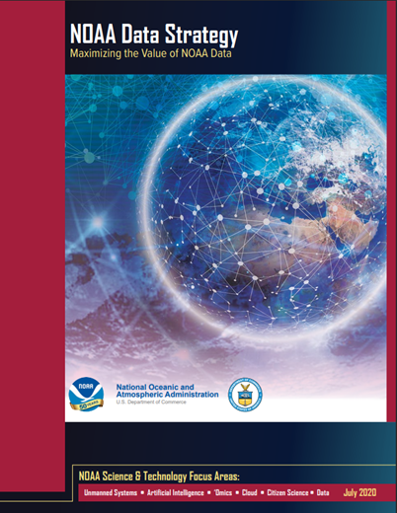
NOAA Data Strategy Overview
•Purpose:
The NOAA Data Strategy promotes the effective use of data by the agency, its partners, and the public.
•Scope:
The NOAA Data Strategy applies to all types of data including environmental, program and statistical data, as well as mission-support data including administrative, financial, performance, and workforce data.
•Vision:
A NOAA culture that values data as a strategic asset to understand the environment, create value for businesses, improve government efficiency, and provide quality services for the public.
Notes:
The NOAA Data Strategy aligns with the Federal Data Strategy and is the foundation for all the other NOAA strategies. Anticipate additional focus on data, governance, transparency, access, preservation and stewardship.
The purpose of the NOAA Data Strategy is to dramatically accelerate the use of data across the agency and with other key partners, maximize openness and transparency, deliver on mission, and steward resources while protecting quality, integrity, security, privacy, and confidentiality. The overall strategy is designed to serve as a framework for consistency that builds upon existing laws and regulations related to how NOAA uses and manages data, while being flexible and adaptable to external influences such as new policies, Executive Orders, stakeholder input, and new technologies that drive innovation within the agency.
The NOAA Data Strategy will improve the management and overall value of the NOAA data enterprise when emerging science and technology have dramatically expanded the agency’s data collections for the greater benefit to the agency, our partners, and the Nation.
NOAA Data Strategy Goals:
Goal 1: Align data management leadership roles across the organization.
Goal 2: Govern and manage data strategically to most effectively steward the US taxpayers’ investment.
Goal 3: Share data as openly and widely as possible to promote maximum utilization of NOAA data.
Goal 4: Promote data innovation and quality improvements to facilitate science and support data-driven decision making.
Goal 5: Engage stakeholders and leverage partnerships to maximize the value of NOAA data to the Nation.
https://nrc.noaa.gov/Portals/0/Final%20Data%20Strategy.pdf?ver=2020-07-02-122524-377

Slide 9
NOAA Data Strategy Goals
Align data management leadership roles across the organization.
Govern and manage data strategically to most effectively steward the US taxpayers’ investment
Share data as openly and widely as possible to promote maximum utilization of NOAA data
Promote data innovation and quality improvements to facilitate science and support data-driven decision making
Engage stakeholders and leverage partnerships to maximize the value of NOAA data to the Nation
Notes:
The goal is to increase emphasis on aligning data management across NOAA, establish governance, increase access, enable innovation, and engage partners in their use of the data.

Slide 10
NOAA Data Strategy Objectives
Consistent and transparent approach to data governance, stewardship, access, and use
Maximize the value of NOAA data via Open Data Plans
Achieve readiness for tomorrow’s data landscape.
Strong foundation, allows for flexibility and adaptability
Support critical emerging science and technology that have dramatically expanded the agency’s data collections:
AI & Machine Learning, Unmanned Systems, Omics
Align Data Management Leadership Roles
Share Data Open and Widely
Strategic Goals
Govern and Manage Data Strategically
Engage Stakeholders and Leverage Partnerships
Promote Data Innovation

Slide 11
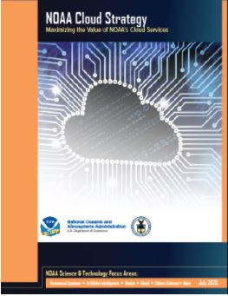
NOAA Cloud Strategy Overview
•Purpose:
Guide NOAA’s adoption and utilization of cloud services requiring a new mindset for modernizing NOAA’s IT environment
•Scope:
Provides a unified approach to migrating to the cloud, promotes a smart transition based on requirements, business cases and best practices, and enables broad sharing of solutions.
•Vision:
NOAA uses an accessible, scalable, secure, flexible, agile, cost-effective, efficient, highly reliable, and integrated suite of cloud computing products and services to fulfill its mission where Cloud solutions are driven by requirements and the business case.
Notes:
The NOAA Cloud Strategy aligns with the Federal Cloud Strategy and all the other NOAA strategies. NOAA will migrate suitable IT services to commercial cloud computing environments to reduce costs, improve efficiency, provide unlimited seamless scalability, and maintain high levels of security. Cloud represents a transformative technology that will not only improve general operational IT services, but also ensure many of NOAA’s functions across the entire value chain—from observations, data management, and numerical weather prediction to end-user products and applications— will better serve the public and more effectively enable us to carry out our mission.
NOAA’s cutting-edge innovation and strategic academic and industry partnerships for developing cloud applications are already demonstrating improvements in performance and skill in areas such as satellite data products and services, numerical weather prediction, ocean models, and big data analysis, storage, and dissemination. Cloud services will be further leveraged to expand benefits, such as: • Accelerated timeline to acquire new computing resources; • Increased security posture through security automation; • More accessible and monetizable NOAA data to customers, such as academia and industry; • Reduced transition time from research into operations; • Scalable infrastructure that supports scientific and HPC requirements; and • A more agile and innovative organizational culture.
https://nrc.noaa.gov/Portals/0/Final%20Cloud%20Strategy.pdf?ver=2020-07-02-122459-813

Slide 12
NOAA Cloud Strategy Goals
Enable innovation through rapid adoption of cloud-based services.
Drive smart migration to the cloud.
Ensure secure and broad access to cloud services.
Provide effective governance for cloud shared services.
Empower a cloud-ready workforce.

Slide 13
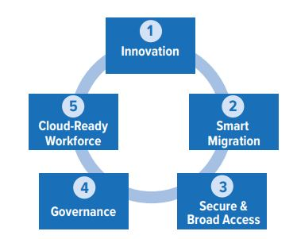
NOAA Cloud Strategy Objectives - 1 of 2
Leverage best practices and build partnerships to drive innovation that supports NOAA’s mission and meet stakeholder needs. Innovation is particularly critical to sustain and evolve NOAA’s capabilities.
Cloud migration decisions should be based on mission requirements and a sound business case, and informed by a suitability analysis to confirm that a cloud-based alternative is viable.
Expand access to NOAA’s data to unleash its full value, while simultaneously improving the security of the information systems and data supporting NOAA’s mission.

Slide 14
NOAA Cloud Strategy Objectives 2 of 2
Cloud governance, with substantial and multi-disciplinary NOAA-wide engagement, provides a strategic framework for cloud adoption and promotes consistency across implementations
Ensure that the workforce has the skills, competencies, authority, and information needed to apply cloud technologies that support NOAA mission across all Line and Staff offices

Slide 15
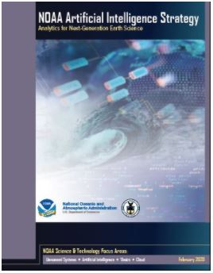
NOAA Artificial Intelligence Strategy Overview
•Purpose:
Dramatically expand the application of artificial intelligence (AI) in every NOAA mission area by improving the efficiency, effectiveness, and coordination of AI development and usage across the agency.
•Scope:
Directly improve the understanding, coordination, awareness, and application of AI across all of NOAA and to rapidly transition research results to improve services, strengthen and expand partnerships, and deliberately develop AI proficiency across the NOAA workforce
•Vision:
Through the NOAA AI Strategy, expansion of Artificial Intelligence is accelerated across the entire agency to make transformative improvements in NOAA mission performance and cost effectiveness.
Notes:
The NOAA Artificial Intelligence Strategy aligns with the NOAA Data Strategy and with all the other NOAA strategies.
The NOAA AI Strategy will dramatically expand the application of artificial intelligence (AI) in every NOAA mission area by improving the efficiency, effectiveness, and coordination of AI development and usage across the agency. As data exploitation capabilities continue to increase exponentially with improved data from a scalable consolidated satellite architecture, unmanned systems, and commercial data sources, AI methods will provide transformative techniques to enhance the quality and timeliness of NOAA science, products, and services
Artificial Intelligence involves techniques in machine learning and deep learning including neural networks, evolutionary computation, probabilistic and statistical methods. NOAA’s robust experience with AI applications across a range of mission areas is already demonstrating improvements in performance and skill at greatly reduced costs and compute time as the examples in this handout illustrate. Additional cost savings are shown in arenas as diverse as deep-sea exploration, habitat characterization, and processing of earth observations. By strengthening AI coordination, operational capabilities, workforce proficiency, and multisector partnerships, NOAA’s national and global leadership in AI will support science, public safety, and security. Example applications include: • Aerial and underwater surveys from ships and autonomous platforms to assess the abundance of marine mammal and fish populations; • Robotics for deep-sea exploration; • Quality control of weather observations; • Improving physical parameterization for satellite observations, ocean, and ice modeling, and the computational performance of numerical models; • Automating weather-warning generation; • Operation of unmanned systems for bathymetric mapping, habitat characterization, hydrologic, oceanographic, atmospheric, fishery, ecosystem, and geographic surveys; • Using machine learning to analyze satellite imagery for severe weather detection and prediction, oil spill and hazardous material trajectory, wildfire detection and movement, ecosystem health, and detection of potentially illegal fishing activity; and • Using machine learning for reliable and efficient processing, interpretation, and utilization of earth observations.
https://nrc.noaa.gov/LinkClick.aspx?fileticket=0I2p2-Gu3rA%3D&tabid=91&portalid=0

Slide 16
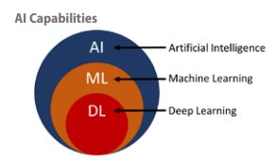
NOAA AI Strategy Goals
Establish an efficient organizational structure and processes to advance AI across NOAA.
Advance AI research and innovation in support of NOAA’s mission.
Accelerate the transition of AI research to applications.
Strengthen and expand AI partnerships.
Promote AI proficiency in the workforce

Slide 17
Next Steps
Establish NOAA Strategy Implementation Planning Teams
Develop specific actions per objective for each goal to include:
Resources
Timelines and Deliverables
Accountability
Measurable Results
Formal request for feedback and obtain cross-NOAA buy-in
Ensure alignment across all NOAA S&T strategic focus areas
Citizen Science

Slide 18
Next Steps for Data Strategy
Dept of Commerce Strategic Alignment and Coordination Activities:
Ensure alignment with Commerce Data Governance Board priority activities and plans:
Data Inventory
Maturity Assessment
DOC Open Data Plan
DOC Data Strategy

Slide 19
Summary
Multiple federal drivers pushing the entire government forward to leverage data as an asset
NOAA responded early on the Data Strategy, leveraging environmental data management skills, experience, and governance
Additional Science and Technology Strategy supporting NOAA’s vision followed.
Roadmaps for these strategies are being developed.

Slide 20
Questions
?

