Slide 1
National Aeronautics and Space Administration (NASA)
Agency Report
WGISS – 50
Andrew Mitchell
Earth Science Data and Information System (ESDIS) Project
Goddard Space Flight Center
Greenbelt, MD
24th of September 2020

Slide 2
NASA’s Earth Science Data Systems Program:
Major Components
Earth Observing System Data and Information System (EOSDIS) – Managed by the ESDIS Project
  Science Investigator-led Processing Systems (SIPS)
  Distributed Active Archive Centers (DAACs)
  Common Services/Tools
  Earth Science Data System Working Group (ESDSWG)
Data System Evolution
  ACCESS: Advancing Collaborative Connections for Earth System Science
  MEaSUREs: Making Earth System Data Records for Use in Research Environments
  Citizen Science for Earth System Science
  Science Portals/Machine Learning
  System Security Support and Small Sat. Data Buy
Standards and Interoperability
  CEOS (Committee on Earth Observation Satellites) Working Group on Information Systems and Services (WGISS)
  NASA-European Space Agency (ESA) Bilateral
  Partnership activities for Google and MSFT, etc…
Inter Agency ImPlementation and Advanced Concepts (IMPACT) Team
  Addresses satellite needs assessment working group (SNWG) requests for improved tools/services for federal agencies, dedicated user support and faster access/better management of data from airborne campaigns.
  Consolidates existing activities under a single project – Independent assessments, Data.gov, GCIS, USGEO, W3C, FGDC
Notes:
NASA’s Earth Science and Data Information System (ESDIS) Project develops and operates the science systems of the EOSDIS which is a coordinated series of long term global observations.
NASA's Earth Observing System Data and Information System (EOSDIS) is a key core capability in the Earth Science Data Systems (ESDS) Program. It provides end-to-end capabilities for managing NASA Earth science data from various sources—satellites, aircraft, field measurements, and various other programs.
NASA’s Earth Science Data Policy promotes usage of data by the community
No period of exclusive access
Data available at no cost to all users on a non-discriminatory basis, except where agreed upon with international partners

Slide 3
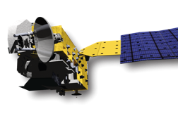
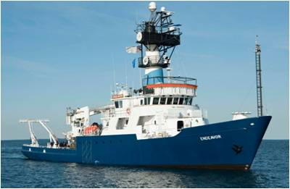
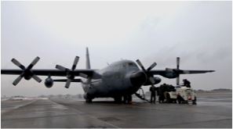
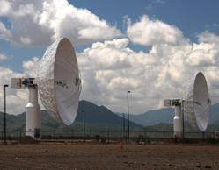
Earth Observing System Data and Information System
Users
EOSDIS
Research
distribute
Applications
Education
data downlink
subset
archive
capture and clean
process
Notes:
The EOSDIS provides end-to-end services from instrument data collection to science data processing to full access to NASA’s Earth science data holdings. It is a petabyte scale archive designed to receive, process and distribute several terabytes per day.
Role of EOSDIS
Data Management
Long Term Archive of Earth Science Datasets
Interoperable Distributed Data Archives
Science Data Processing
Both Comprehensive and Science Discipline specific data support
Online services for data discovery and data access
Near-Real Time Data Access
Earth Science Discipline-Oriented User Services
Earth Science Standards Office
Configuration Management and Metrics Systems
Network Data Transport to distributed system elements

Slide 4

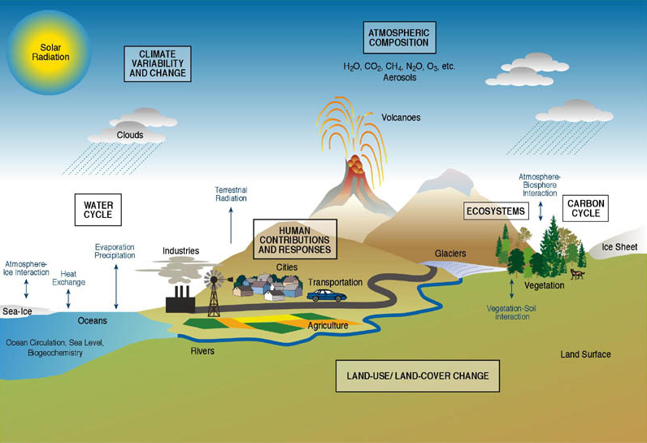
EOSDIS Comprises Data of the Whole Earth System
Notes:
Atmosphere
Winds & Precipitation
Aerosols & Clouds
Temperature & Humidity
Solar radiation
Ocean
Surface temperature
Surface wind fields & Heat flux
Surface topography
Ocean color
Cryosphere
Sea/Land Ice
Snow Cover
Land
Cover & Usage
Soil Moisture
Topography & elevation
Temperature
Human Dimensions
Population & Land Use
Human & Environmental Health

Slide 5















National Aeronautics and Space Administration
Discipline-oriented Data Centers
ASF SDC
SAR Products,
Sea Ice,
Polar Processes,
Geophysics
ASF SDC
SAR Products,
Sea Ice,
Polar Processes,
Geophysics
SEDAC
Human Interactions,
Land Use,
Environmental
Sustainability,
Geospatial Data
LP DAAC
Surface
Reflectance,
Land Cover,
Vegetation Indices
GES DISC
Global Precipitation,
Solar Irradiance,
Atmospheric Composition
and Dynamics,
Global Modeling
NSIDC DAAC
Snow and Ice,
Cryosphere,
Climate Inter-
actions, Sea Ice
PO.DAAC
Gravity, Sea Surface
Temperature, Ocean
Winds, Topography,
Circulation & Currents
CDDIS
Space Geodesy,
Solid Earth
OBPG
Ocean Biology,
Sea Surface
Temperature
LaRC ASDC
Radiation Budget,
Clouds, Aerosols,
Tropospheric
Chemistry
MODAPS/
LAADS
MODIS Level-1
and Atmosphere
Data Products
GHRC DAAC
Hydrologic Cycle,
Severe Weather Inter-
actions, Lightning,
Atmospheric
Convection
ORNL DAAC
Biogeochemical
Dynamics,
Ecological Data,
Environmental
Processes
www.nasa.gov
Notes:
DAACs were selected and established based on the Earth Science discipline expertise and heritage of their host organizations. They provide unique support and expert services to their user communities.
They also provide data and services to the research community for comprehensive, cross-discipline studies needed to understand Earth as an interrelated system.
DAAC Functions
Ingest Level 0 data from EDOS
Ingest higher level products produced by SIPS
Perform processing of higher level products in some cases
Archive assigned data sets
Export metadata to the Common Metadata Repository (CMR)
Provide user interfaces, tools, and services
Distribute data to users (primarily electronically)
Provide metrics data to ESDIS Metrics System (EMS)
DAACs ensure safe stewardship of NASA’s data

Slide 6









National Aeronautics and Space Administration
Science Investigator-led Processing Systems
Measurements of Pollution in the Troposphere (MOPITT)
Visible Infrared Imaging Radiometer Suite (VIIRS)
Atmosphere
MODIS Adaptive Processing System (MODAPS)
Ocean Data Processing System
(OCDPS)
Ozone Monitoring Instrument
(OMI)
Visible Infrared Imaging Radiometer Suite (VIIRS)
Land
Microwave Limb Sounder (MLS)
Visible Infrared Imaging Radiometer Suite (VIIRS)
Ocean
Ozone Mapping Profiler Suite (OMPS)
Ozone
Advanced Technology Microwave Sounder (ATMS) & Cross-track Infrared Sounder (CrIS)
Sounder
Tropospheric Emission Spectrometer (TES)
Advanced Microwave Scanning Radiometer for EOS 2 (AMSR-E/2)
SIPS perform forward processing of standard products, and reprocess data to incorporate algorithm improvements.
www.nasa.gov
Notes:
NASA’s Earth Science Mission Directorate selects investigators, forms Science Teams and conducts scientific peer reviews of the specifications for standard geophysical products from EOS instrument observations.
The algorithms and software for producing the standard products are the responsibility of the individual instrument/science teams. The standard products are produced under the direct control of Principal Investigators/Team Leaders (PIs/TLs).
The ESDIS Project supports data processing by providing Science Investigator-led Processing Systems (SIPS) for use by the PIs/TLs.
The SIPS are geographically distributed across the United States and are generally, but not necessarily, collocated with the PIs/TLs’ facilities.
Products produced at the SIPS are sent to designated Distributed Active Archive Centers (DAACs) for archive and distribution.

Slide 7
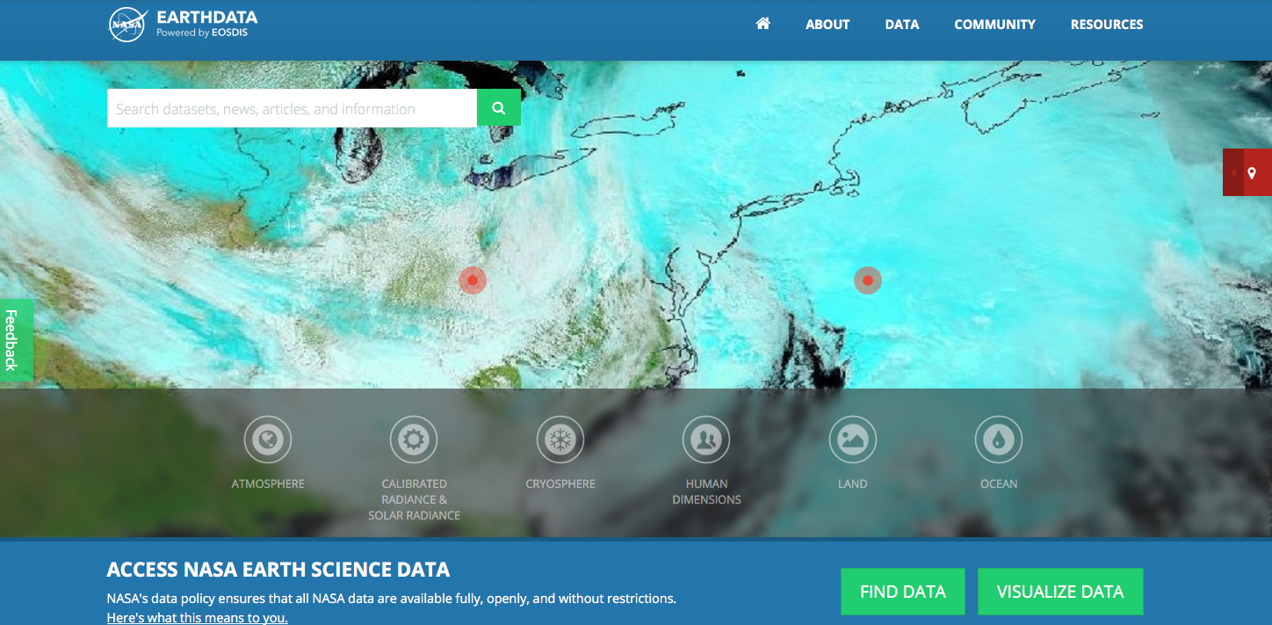
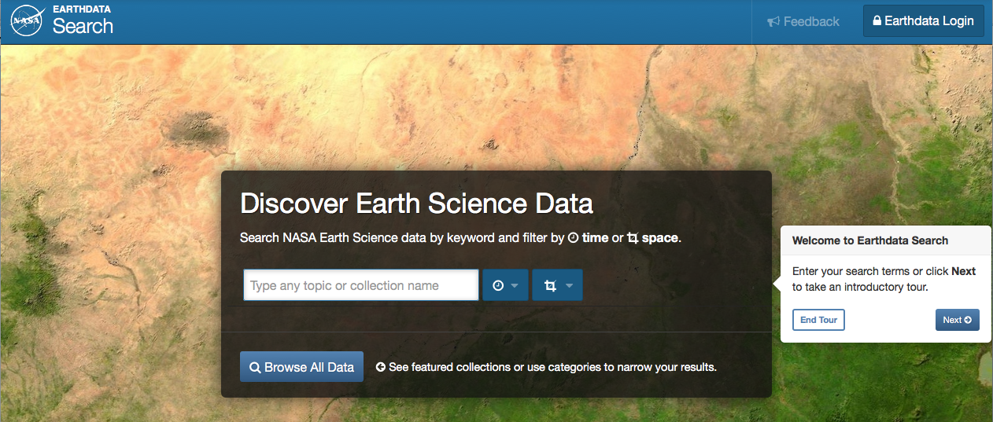
Looking for Earth Science data?
earthdata.nasa.gov
www.facebook.com/NASAEarthData
twitter.com/NASAEarthdata
search.earthdata.nasa.gov
Notes:
Earthdata Search facilitates discovery of data across all 12 DAACs (search.earthdata.nasa.gov)
Data are online and can be readily downloaded

Slide 8
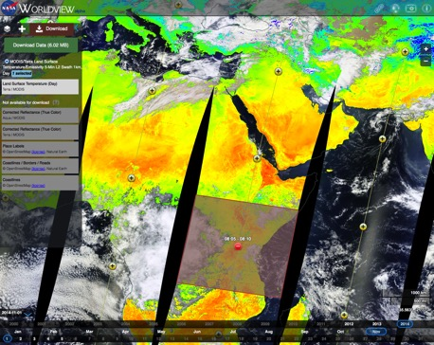
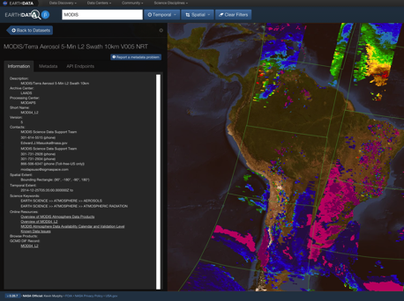
EOSDIS Data Access
Role Centralized Reusable Capabilities
Earthdata: The EOSDIS website https://earthdata.nasa.gov will increase visibility to the interdisciplinary use of data and demonstrate how data are used.
High Performance Data Search and Discovery
  Common Metadata Repository (CMR): Provide sub-second search and discovery services across the Sentinel and other EOSDIS holdings.
  Earthdata Search Client: Data search and order tool https://search.earthdata.nasa.gov
Imagery and Data Visualization Tools
  Global Imagery Browse Services (GIBS): full resolution imagery in a community standards-based set of imagery services
  Worldview: highly responsive interface to explore GIBS imagery and download the underlying data granules https://earthdata.nasa.gov/labs/worldview/
  Giovanni: Quick-start exploratory data visualization and analysis tool
Near Real-Time Capabilities: Provided by “LANCE” (Land Atmosphere Near real-time Capability for EOS) which produces products within < 3 hours of observation. Near real-time capabilities are co-located with the standard science production facilities.
EOSDIS Metrics System (EMS): collects and reports on data ingest, archive, and distribution metrics across EOSDIS
Earthdata Infrastructure (EDI DevOps): platform for requirement management, code development, testing and deployment to operations
User Support Tool (UST): user relationship management and issue resolution (Kayako)
Earthdata Log-in (User Registration System): provides a centralized and simplified mechanism for user registration and account management for all EOSDIS system components.
Notes:
EOSDIS is an interoperable system allowing users to select, view, interact and download data transparently from all of our data centers and sub systems without needing to worry about their location. This type of architecture has allowed us to add new interoperable technologies which has kept us able to evolve and become more efficient over time.

Slide 9
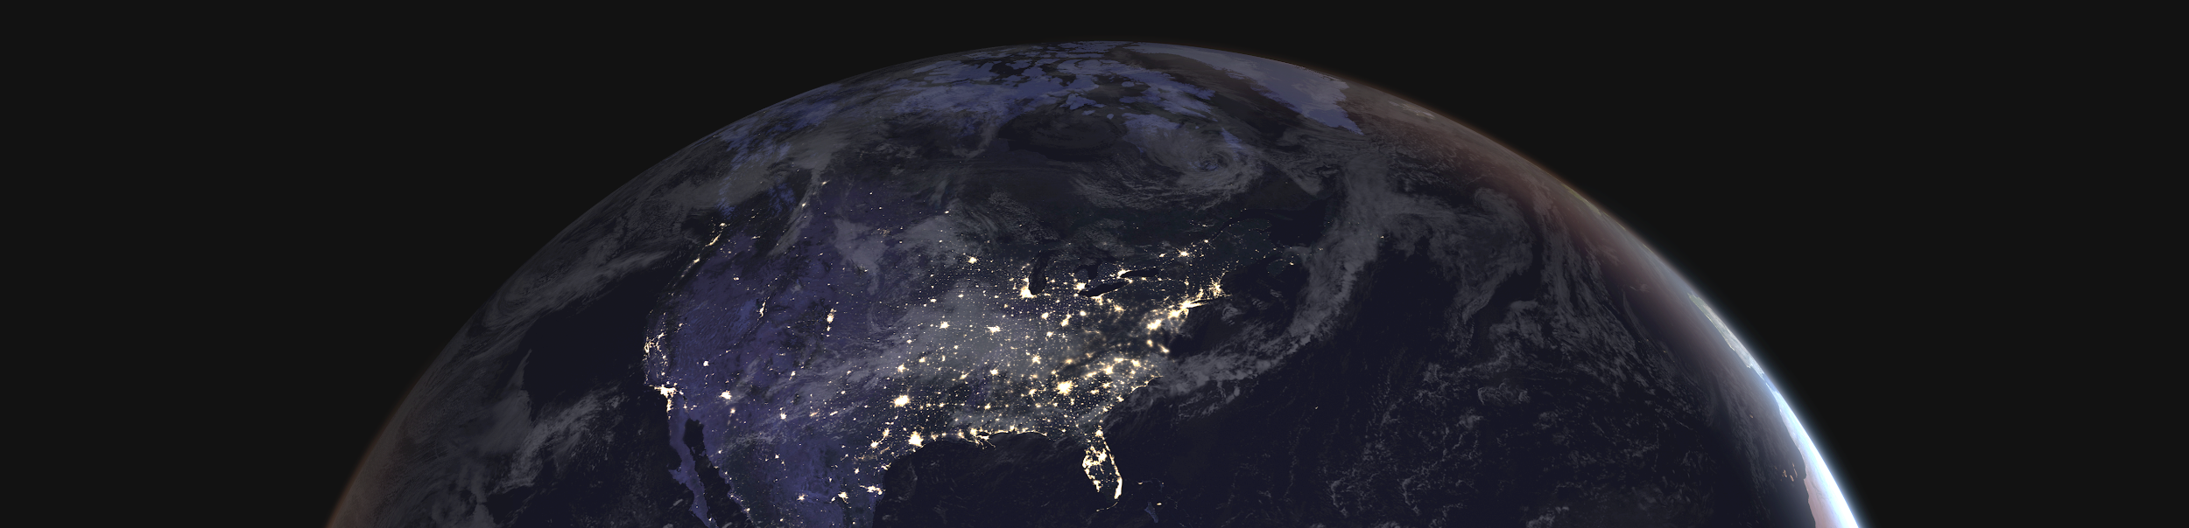
Improve the efficiency of NASA’s data systems operations – continues free and open access to data
Prepare for planned high-data-rate missions
Increase opportunity for researchers and commercial users to access/process PBs of data quickly without the need for data management
Transparent/extendable open source processing framework
Earthdata Cloud
Notes:
With the impending arrival of new, high-data-volume missions, the need to effectively archive and process significantly larger data volumes will require new data management technologies and architectures that are more cost-effective, flexible, and scalable than traditional on-premises systems.
To meet these needs, the Earth Science Data Systems (ESDS) Program has adopted a strategic vision to develop and operate multiple components of the Earth Observing System Data and Information System (EOSDIS) in a commercial cloud environment.
The Earthdata cloud migration breaks new ground both as the first and largest cloud project within NASA and because it necessitates transforming security policies and procedures that were written for on-premise systems to be applicable to the cloud environment.

Slide 10
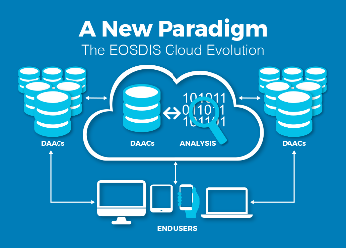
Earthdata Cloud Accomplishments
Designed and deployed a custom built cloud optimized platform (NGAP – NASA Compliant General Application Platform) which provides highly flexible cloud native infrastructure, NASA compliant IT Security controls, networking services, and business cost control in Amazon Web Services (AWS).
Developed and deployed a cloud optimized software, “Cumulus”, for performing Earth science data ingest, archive, and distribution capabilities to support all EOSDIS missions
Developed and deployed a customized “egress breaker” and “egress throttle”
Provided Earthdata Cloud access to 7 Distributed Active Archive Centers (DAACs) with NGAP to begin the process of data and tool migration to the cloud
Two key EOSDIS elements now running in Amazon Web Services (AWS) are the Common Metadata Repository (CMR) and Earthdata Search. The CMR is the central repository for NASA Earth science metadata and enables sub-second searches through the entire EOSDIS archive. Earthdata Search is the primary application developed by EOSDIS for data search and discovery. Global Imagery Browse Services (GIBS), which provides access to over 400 satellite imagery products that can be viewed using client applications such as EOSDIS Worldview, is expected to be the next EOSDIS application to evolve to the cloud.

Slide 11
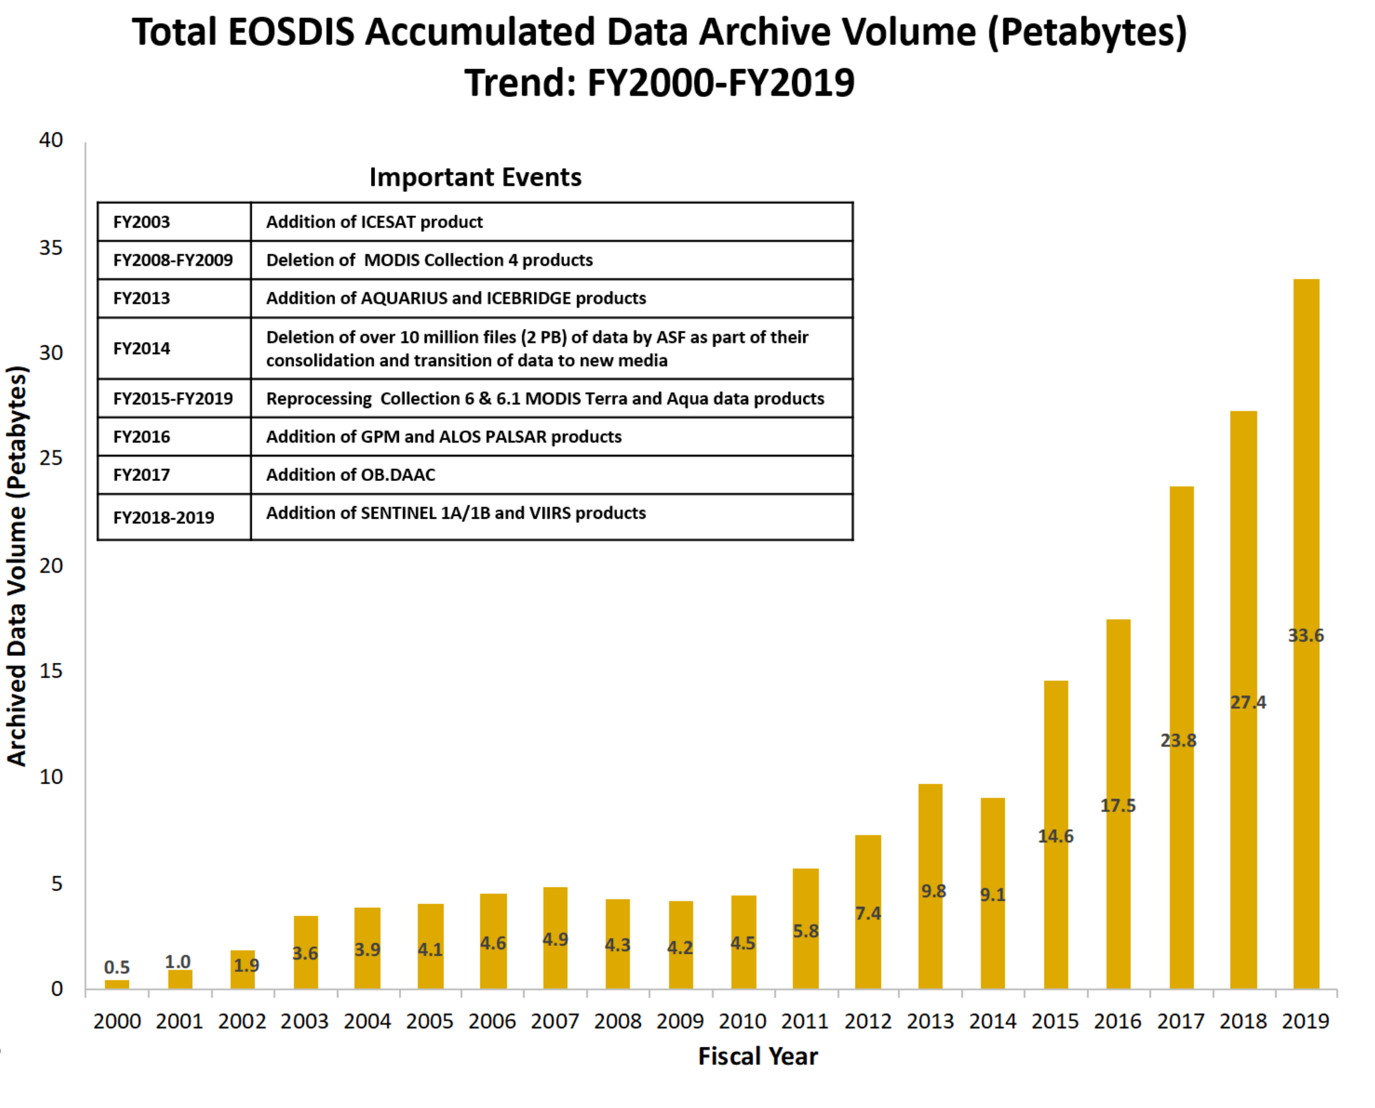
Volume changes
As data is acquired and reprocessed the collection both grows and shrinks
Multi-year datasets need to be summarized/evaluated over long time series
Products range in size from kb to 1 GB
Notes:
A petabyte is a lot of data:
1 PB is 20 million four-drawer filing cabinets full of text
1 PB is 13.3 years of HD-TV video
1.5 PB is the size of 10 billion photos on Facebook

Slide 12
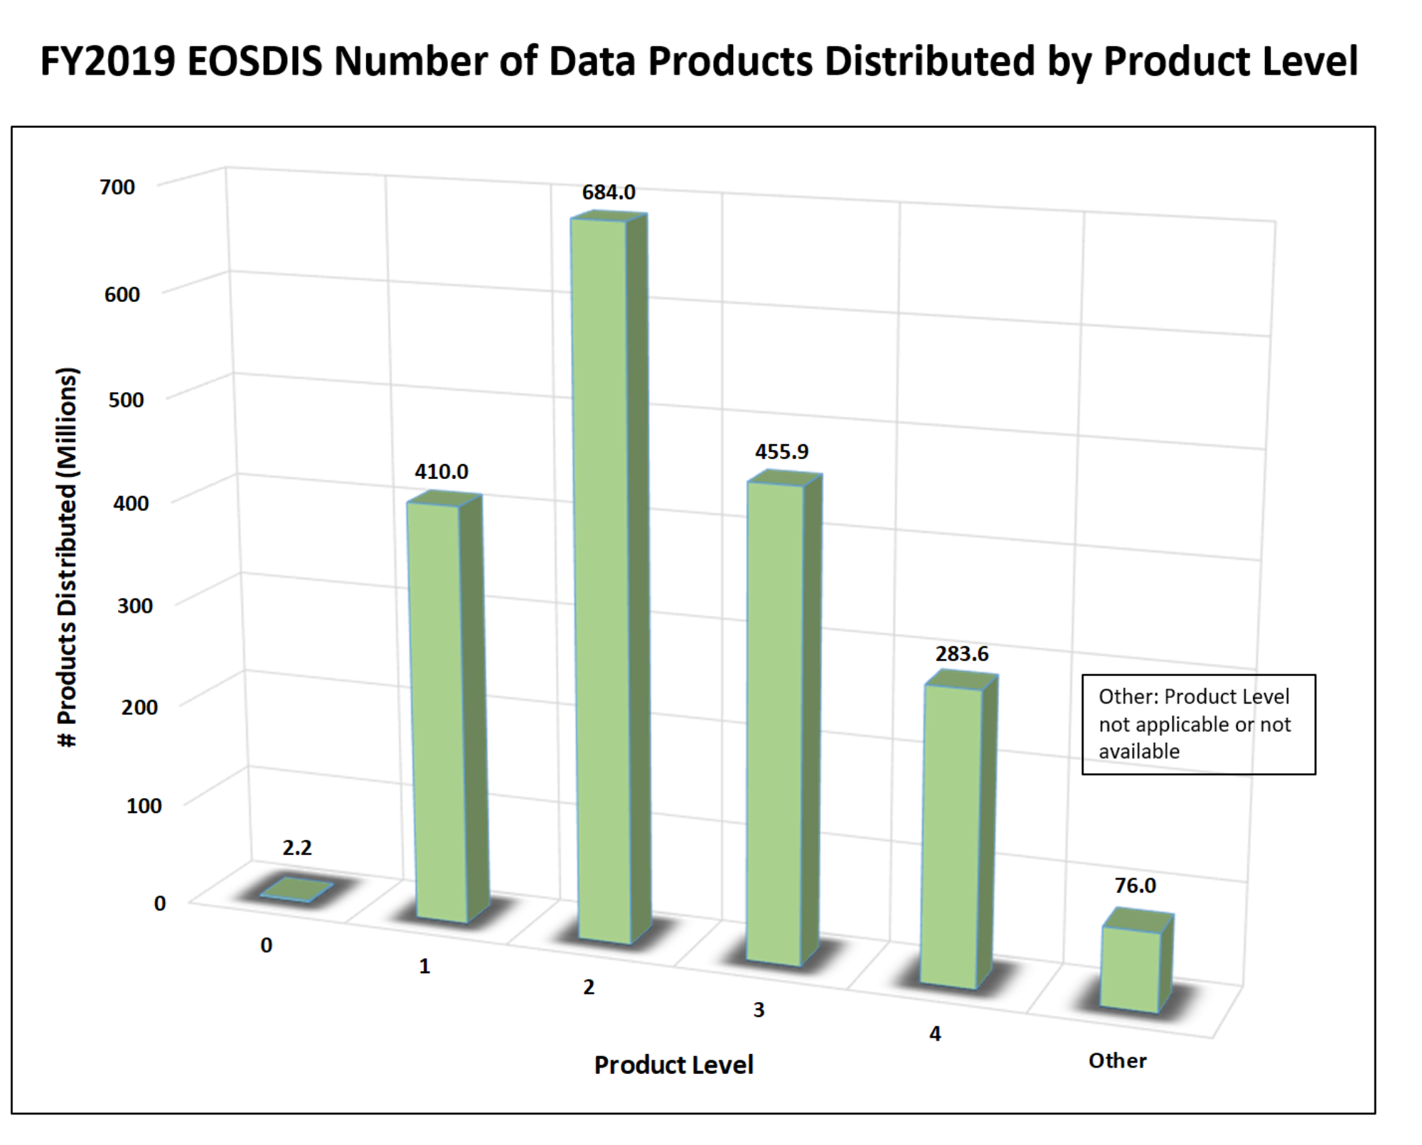
Support for a variety of parameters
EOSDIS data products are processed at various levels ranging from Level 0 to Level 4.
  Level 0 products are raw data at full instrument resolution.
  At higher levels, the data are converted into more useful parameters and formats.
  All EOS instruments must have Level 1 products. Most have products at Levels 2 and 3, and many have products at Level 4.
Products are formatted for use by the discipline community
  While use of standard formats is required by NASA, multiple formats still present issues to usage/interoperability
Individual files can have up to 800+ variables within a single file

Slide 13
    Velocity of data ingest and distribution
EOSDIS Yearly Total Data Volume (PB) and Number of Products (Billions) Distributed to End Users
(1 of 3)
FY2019 Number of Products Distributed by Discipline
Products whose discipline was not available or not applicable including some of the ancillary data
Total Volume Distributed: 36.6 PB
Total # of Files Distributed: 1,911.7 Million
Notes:
Velocity of data ingest and distribution increases
Other Products whose discipline was not available or not applicable including some of the ancillary data

Slide 14
FY2019 EOSDIS Number of Data Products Distributed by Country

Slide 15

NASA EARTH FLEET
NISAR 2020
TROPICS (6) 2020
LANDSAT-9 2020
SENTINEL-6A/B 2020, 2025
OPERATING & FUTURE THROUGH 2023
TSIS-2 2020
SWOT 2021
PREFIRE (2) 2022
MAIA 2022
GEOCARB 2022
PACE 2022
INVEST/CUBESATS
RAVAN 2016
RainCube 2018
CSIM 2018
CubeRRT 2018
TEMPEST-D 2018
CIRiS 2019
HARP 2019
CTIM*
HyTI*
SNoOPI*
NACHOS*
* Launch date TBD
GLIMR ~2026
TEMPO 2022
ICESAT-2 2021
GRACE-FO (2) 2023
CYGNSS (8) 2020
NISTAR, EPIC (DSCOVR/NOAA) 2020
ISS INSTRUMENTS
EMIT 2021
CLARREO-PF 2020
GEDI 2020
SAGE III 2020
OCO-3 2022
TSIS-1 2023
ECOSTRESS 2020
LIS 2020
SORCE 2020
CLOUDSAT 2021
TERRA >2021
AQUA >2022
AURA >2022
CALIPSO >2022
GPM >2022
LANDSAT 7 (USGS) ~2022
JPSS-2, 3 & 4 INSTRUMENTS
OMPS-Limb
LANDSAT 8 (USGS) >2022
OCO-2 >2022
(PRE) FORMULATION
IMPLEMENTATON
PRIMARY OPS
EXTENDED OPS
OSTM/JASON 2 (NOAA) >2022
SMAP >2022
09.10.19
SUOMI NPP (NOAA) >2022

Slide 16
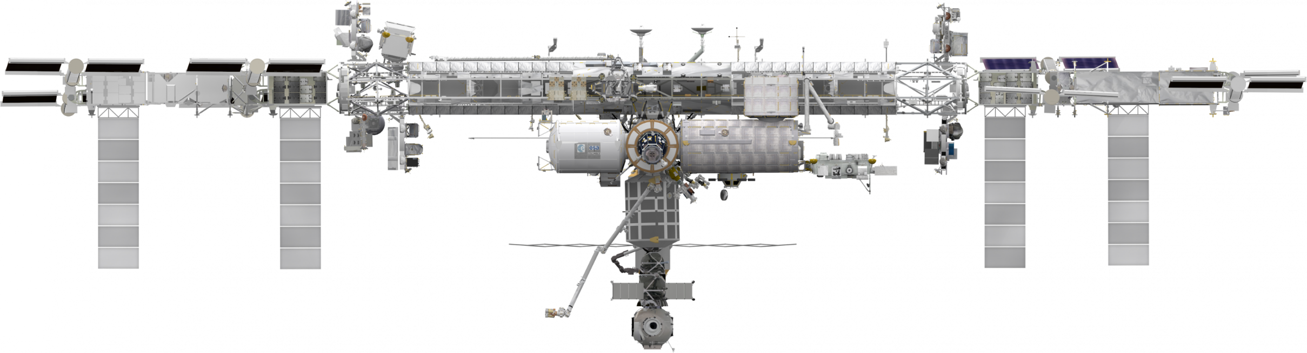
INTERNATIONAL SPACE STATION
EARTH SCIENCE OPERATING MISSIONS
EMIT (2021)
TSIS-1 (2023)
ELC-2
ELC-3
AMS
ESP-3
ELC-4
Columbus EF
JEMEF
ELC-1
SAGE III (2020)
OCO-3 (2022)
GEDI (2020)
ECOSTRESS (2020)
LIS (2020)
CLARREO-PF (2020)
External Logistics Carriers: ELC-1, ELC-2, ELC-3
External Stowage Platforms: ESP-3
Alpha Magnetic Spectrometer
Columbus External Payload Facility
Kibo External Payload Facility
(PRE) FORMULATION
IMPLEMENTATON
PRIMARY OPS
EXTENDED OPS
09.10.19
16

Slide 17










NASA EARTH FLEET
NISAR
SENTINEL 6 A/B
INTERNATIONAL COLLABORATIONS
GRACE-FO (2)
SWOT
OSTM/JASON 2 (NOAA)
(PRE) FORMULATION
IMPLEMENTATON
PRIMARY OPS
EXTENDED OPS
CALIPSO
CLOUDSAT
GPM
TERRA
AURA
AQUA
09.10.19

