Slide 1
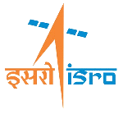
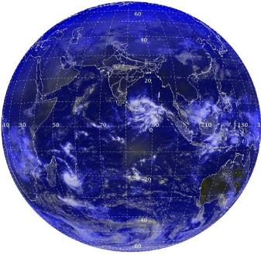



Recent Developments in Information Systems and Earth Observation Services
Geospatial Data and Services
Meteorology and Oceanographic Satellite Data Archival Centre
Indian Space Research Organisation (ISRO)
Agency Report
Presented in WGISS-50
Geospatial Analysis

Slide 2
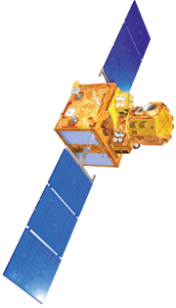




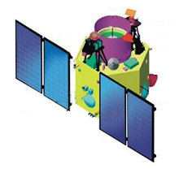




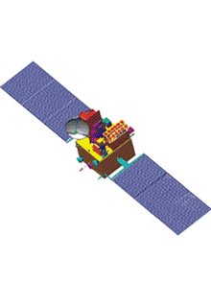

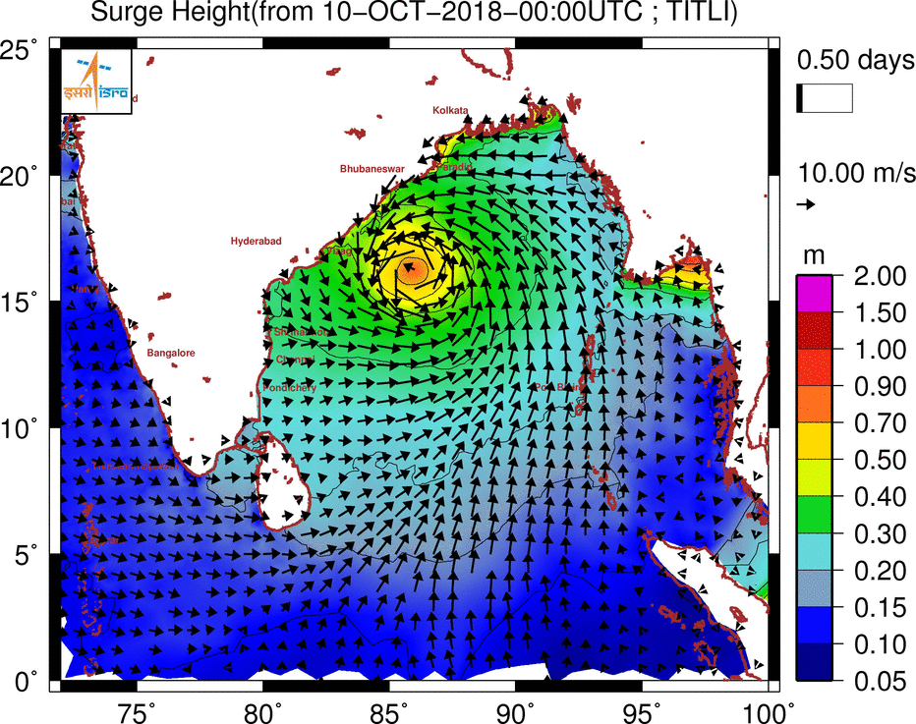

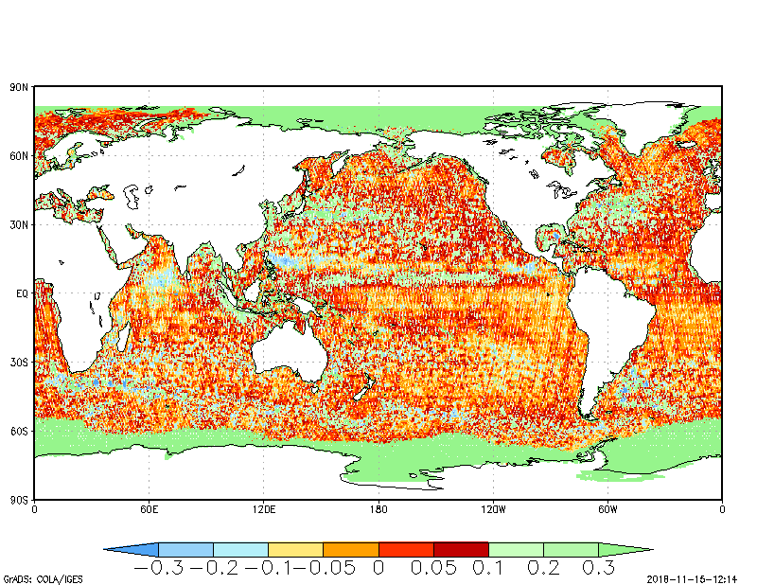


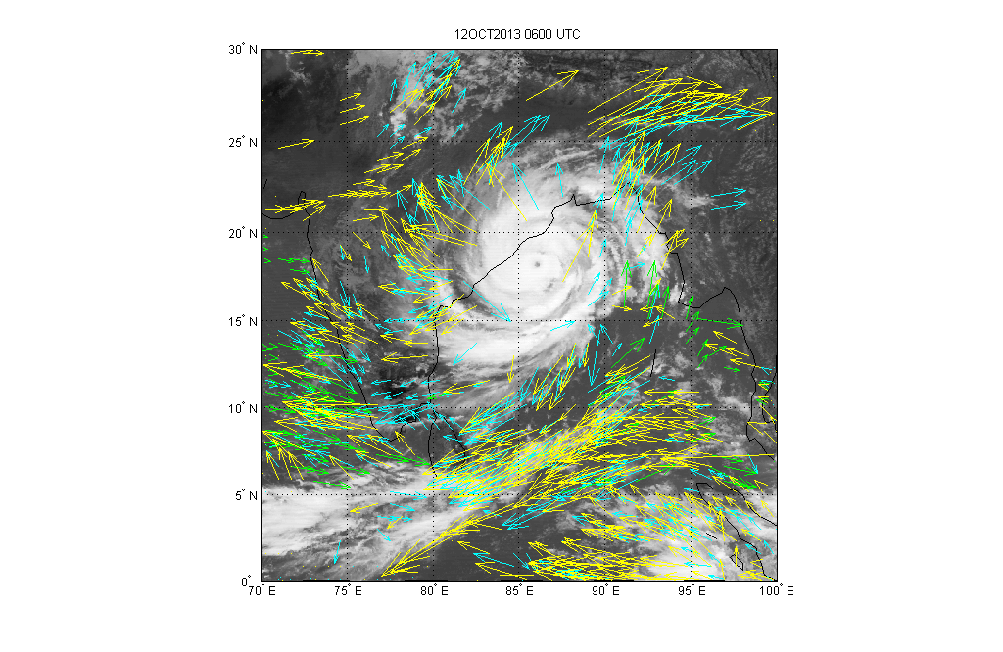


Current Operational Remote Sensing Capabilities
  Natural Resources Inventory & Disaster Management
Three tier imaging : 56 m / 23 m / 5.8 m
Revisit Capability : 03 / 11 / 03 days
RESOURCESAT- 2 & 2A
2.5 m Stereo imaging
1m PAN
Sub-meter PAN and 1.5 m Multi-spectral
Large Scale Mapping, Infrastru. Planning & Cartography
CARTOSAT-1, CARTOSAT-2 & CARTOSAT-2E
Ocean Color 360 m with 2 days revisit
Ocean Altimeter
Ocean Surface Winds
Ocean State Forecast
  Oceanography
OCEANSAT-2; SARAL; SCATSAT-1
  Weather and Climate
6 Channel Imager – 48 images per day
19 Channel Sounder – Atm. Profiles
Temp. & Humidity Profiles
Radiation Budget
Radio Occultation
INSAT-3D; INSAT-3DR; MEGHA-TROPIQUES
Notes:
The theme based constellation of Earth Observation satellites are used to cater to Earth Observation Applications requirements

Slide 3







14 Planned Missions
Continuity in Earth Observation Missions
Wide Swath imaging with improved spatial resolution
RESOURCESAT – 3
RESOURCESAT – 3A
Advanced stereo PAN & MX ; HR DEM
RESOURCESAT – 3S
LAND & WATER
RESOURCESAT – 3SA
RISAT-1A (Continuity to Risat-1)
RISAT-1B
NISAR (L& S Band SAR)
CARTO
HRSAT (3) – Phased in Orbit for daily revisit of AOI
Ocean Color & Wind vector – Continuity + SST
OCEANSAT - 3
OCEAN
OCEANSAT – 3A
GISAT-1 (Observation from GEO)
GEO
INSAT-3DS (Geo-imager & Sounder)
Notes:
14 Earth Observation missions are approved to provide continuity of existing missions and new satellites for new applications

Slide 4
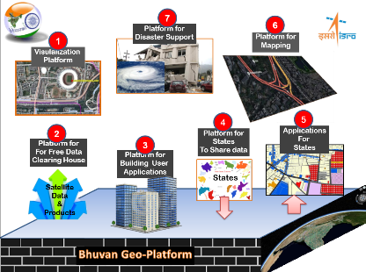
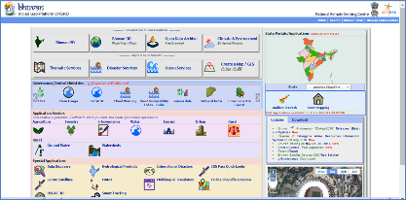
Bhuvan – Geospatial Platform of ISRO / INDIA
(https://bhuvan.nrsc.gov.in/)
Hosting 60 TB time series satellite data having spatial resolution of 360 m to 1 m
Interoperable 9000 + web services of 14 thematic maps, base layers
Open data (NOEDA) having data coarser than 23 m resolution, CartoDEM and Essential Climate variables (ECVs)
Timely Disaster Management Information Support for 6 types of natural disasters
Web GIS platform for visualization, mapping, data creation, data hosting & online analytics
30 state portals, State specific applications
182 e-governance and societal applications for state and central ministries and Departments
More than 90 M POIs from Controlled and Public crowd sourced info from 70+ active mobile apps
2018 – 1 m Satellite data (~ 60 % of country)
Realisation of Housing For All – Phase 2, Bioenergy Potential, Planning Portal, SUJALA - Watershed III, Tripura Forest, Property Tax Mapping and Geospatial Support for COVID-19
Notes:
Bhuvan is a geospatial platform of ISRO, providing Earth observation data and geo-spatial applications

Slide 5
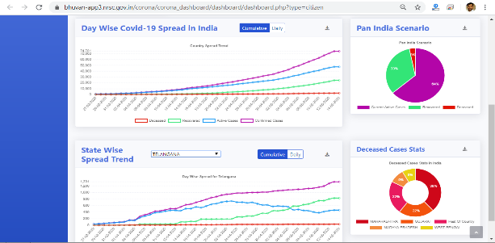
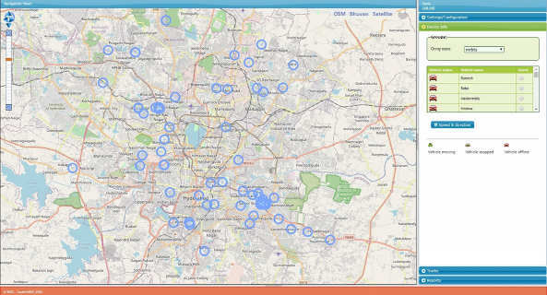
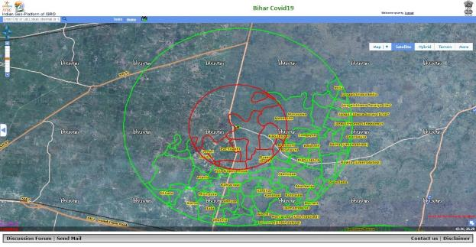
Support through Bhuvan during COVID-19
COVID-19 Dashboard
Geo-Spatial Applications Support
COVID 19 Dashboard
Citizen Reporting and Officer Reporting
Mobile Rythu Bazar Tracking
Home Quarantine Tracker
COVID-19 Containment strategy
Mobile Based Tracking
Planning & monitoring of containment zones
Notes:
This slide highlights some of he geo-spatial applications developed on Bhuvan for operational support to Government agencies during COVID-19

Slide 6
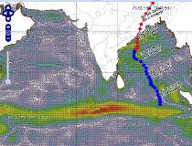
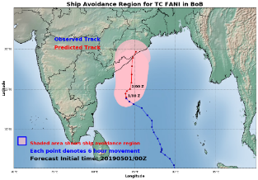
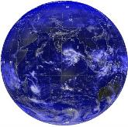
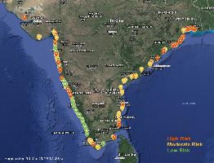
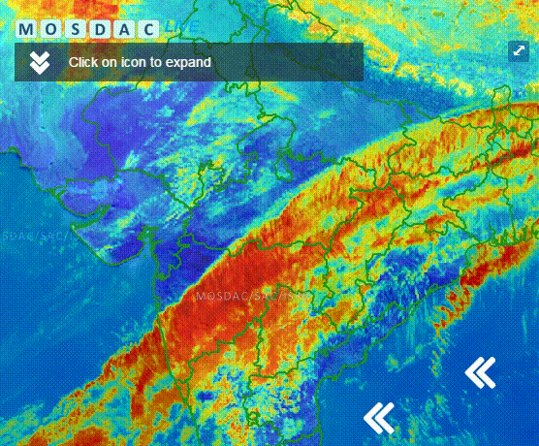
Meteorological and Oceanographic Satellite Data Archival Centre
(MOSDAC)
Indian Store-house for Meteorological and Oceanographic Data 8 Indian Satellite, 194 Products and 23 applications (INSAT-3D/3DR, SCATSAT-1, Megha-Tropiques, SARAL, Kalpana-1, INSAT-3A, Oceansat-2) GISAT, Oceansat-3 and INSAT-3S planned Total of 13 million products disseminated to 139 countries Weather and Ocean State Forecast Major Applications Automated Ocean Forecast to ships (Ocean-Eye) Cyclone Track and Intensity forecasting (SCORPIO) Nowcasting of Heavy rain and Cloud burst (Netra) Rip current forecast for 175 beaches Heat/Cold wave alerts Data Analytics and Visualization An Integrated data visualization system for Earth Observation, In-situ data & Forecast Information ( https://mosdac.gov.in/live )
Ocean Eye
Cyclone
https://mosdac.gov.in/sci/
https://mosdac.gov.in/scorpio
Rip Current Forecast
Advanced Satellite data Visualization
https://mosdac.gov.in/rip_current_forecast
Notes:
MOSDAC is ISRO’s data house for Indian Meteorological and Oceanographic Satellites.

Slide 7
Data Democracy Practices at MOSDAC
WMS
Satellite images, Vector data in png
Data Access Through Micro-services
THREDDS
Satellite data
HTTPS
Satellite data (Open Data)
Safe Beach Micro-service
  Get All INDIA Beaches
  Get nearest Beaches to the location (Location based service-LBS)
  Get Status of Beaches (Patrolled, Swimming, guarded)
  Get Safe beach Forecast available for respective beach.
Alert Dashboard Micro-service
  Get Alert status for INDIA
  Get Alert status for location (Location based service-LBS)
  Get location based on IP address
Weather forecast Micro-service
  Get 3-Hourly Weather Forecast for location (Location based service-LBS)
E-mail
Information/ Alert
RSS Feeds
Information/ Alert
Micro Services
Service | Metadata
WMS | Self Describing, GetCapabilities response returns a defined XML document providing information about the services
THREDDS | catalogue/enhanced catalogues files provide metadata about services
HTTPS | Html <meta> tag provides metadata about the html document, this is machine readable.
E-mail | User can request the metadata about service by sending blank mail to defined email address. (Currently this service is available only to authorized users.
RSS-Feeds | Metadata tags in RSS-Feeds
Micro Services | Service Registry
Notes:
This slide provides details of data democracy practices and available tools and protocols which could be used to access data from MOSDAC

Slide 8
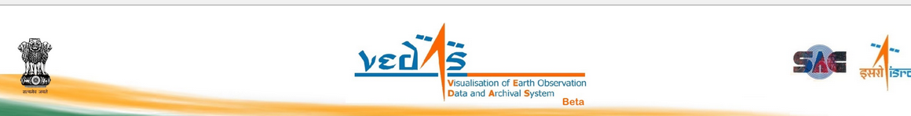
Salient features :
Satellite based geo-spatial data Archival and Dissemination
Data visualisation in 2-D and 3-D and graphical analysis on web
Spatial and Non-spatial search engine
Publish Web map services and metadata of all data
Geo-processing tools for analysis on web
Integrate Web Map Service from various sources
Providing platform for Research & training to Academia by providing data, domain knowledge and infrastructure
Website available at https://vedas.sac.gov.in
Thematic Data Visualisation & Dissemination
Agriculture
Forestry
Desertification
Wetland
Snow & Glacier
Coastal zone studies
Marine Ecosystem
Polar Science
Hydrology
Climate change
Planetary Science
....... .........
GIS Apps (Information Systems)
GIS based information systems for Urban; land & water resource planning, snow & glaciers, coastal zone management, socio-economic planning, hydrology, disaster management ..........
Administrative boundary
-National boundary
-State; Districts; Tehsil; Village; Cadastral
-Thematic boundaries
Base layers
-Road, Rail, River, Waterbody, Drainage, Settlements, Satellite mosaics, DEMs and more...
Notes:
VEDAS provides capability for analytics and visualization of Earth Observation data

Slide 9
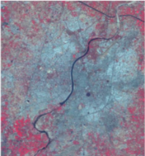
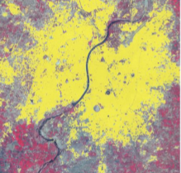
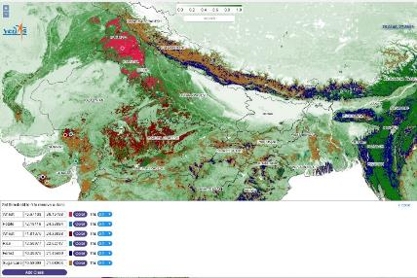
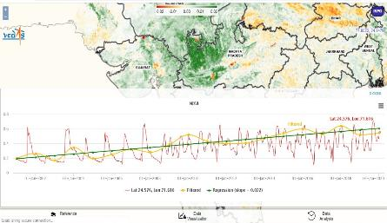
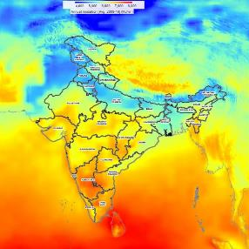

Demonstration of advanced data science techniques Big Data and Web based geospatial analysis AI applications (segmentation & prediction) of EO data Processing Platform for International Charter: Space and Major Disasters Geospatial Calculator for mathematical operations on muti-temporal and multi-resolution data Applications for taping potential of renewable energy
AI based Urban area extraction using LISS-IV data
Multi-temporal analysis and classification on VEDAS
Trend analysis of NDVI for Jan : 2001 - 20
Solar Energy Potential
Notes:
Some of the applications developed and available on VEDAS includes Agriculture monitoring, Satellite based estimation of Solar Energy potential, Urban area monitoring and Multi-temporal analysis and classification of satellite data.

Slide 10

Thank you

