Slide 1
Persistent Identifiers for ESA EO Data
WGISS#50 Virtual Meeting – 22-24 September 2020

Slide 2
Persistent Identifiers (PIDs) Implementation at ESA
The European Space Agency has selected:
  Digital Object Identifier (DOI) system/technology for PIDs
  CrossRef as Registration Agency for DOIs generated for ESA space data collections
ESA DOIs are generated and registered for space datasets (collections) at a specific processing level/product type, and not for individual products.
DOIs are generated and registered for datasets that are disseminated to users and archived for the long-term – not to validation data, experimental products, or near-real-time products that are disseminated to users but not archived for the long term.
ESA follows the CEOS Persistent Identifiers Best Practice for the implementation of DOIs, and conforms to the CrossRef member obligations, requirements and guidelines for metadata and DOI display.

Slide 3
Constructing ESA Digital Object Identifiers
ESA datasets DOIs are globally unique within the DOI system, and are constructed according to the following convention: 10.5270/SSS-xxxxxxx
10.5270 is the DOI prefix which uniquely identifies the Agency’s subset of DOIs. This DOI prefix was assigned by CrossRef to ESA.
SSS-xxxxxxx is the DOI suffix, generated internally at ESA:
  [SSS] default value is esa, which is used for datasets with multiple satellites IDs, non EO datasets, databases (e.g. ADAM - A surface reflectance Database for ESA's earth observation Missions); Satellite ID (mission code) is generally used for EO missions.
  [xxxxxxx] is a string of 7 random alphanumeric characters, composed of numeric digits (0-9) and lowercase letters (a-z).
Example (EOP): 10.5270/S5P-s4ljg54 – corresponding to the Sentinel-5P TROPOMI Level-2 Nitrogen Dioxide total column data set
Example (SCI): 10.5270/esa-dwuc9bs – corresponding to the Bepi-Colombo mission (https://doi.org/10.5270/esa-dwuc9bs)

Slide 4
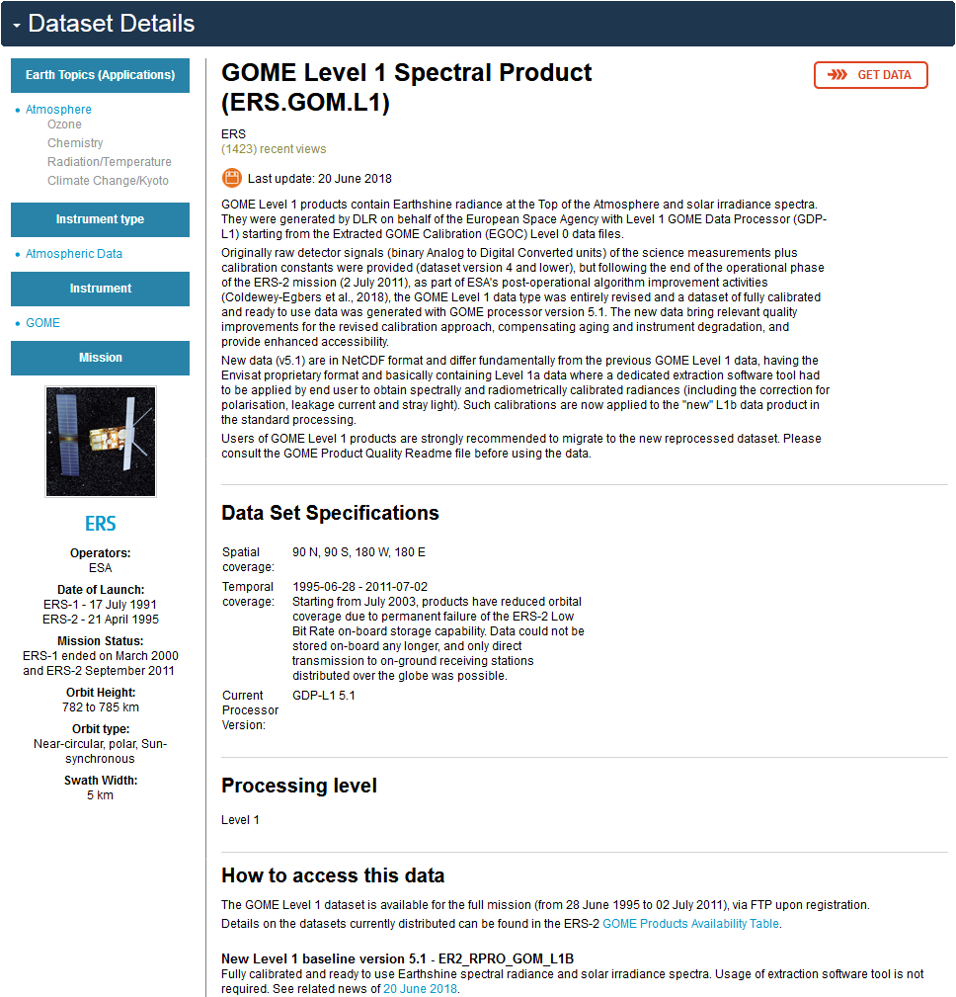

ESA EO Landing Pages
Each ESA generated and registered DOI leads to a landing page providing information on the dataset collection and a link to access the data.
Example: for ESA EO data collections the Landing Pages coincide with the dataset details page on the ESA EO Web Portal.
Data Citation guidelines:
[Producer], [Release Year], [Data collection long name]. [Version]. European Space Agency. https://doi.org/[DOI]
Example: ESA Earth Observation Programmes, 2018, GOME Level 1 Spectral Product. Version 5.1. European Space Agency. https://doi.org/10.5270/ER2-ua38y2m

Slide 5
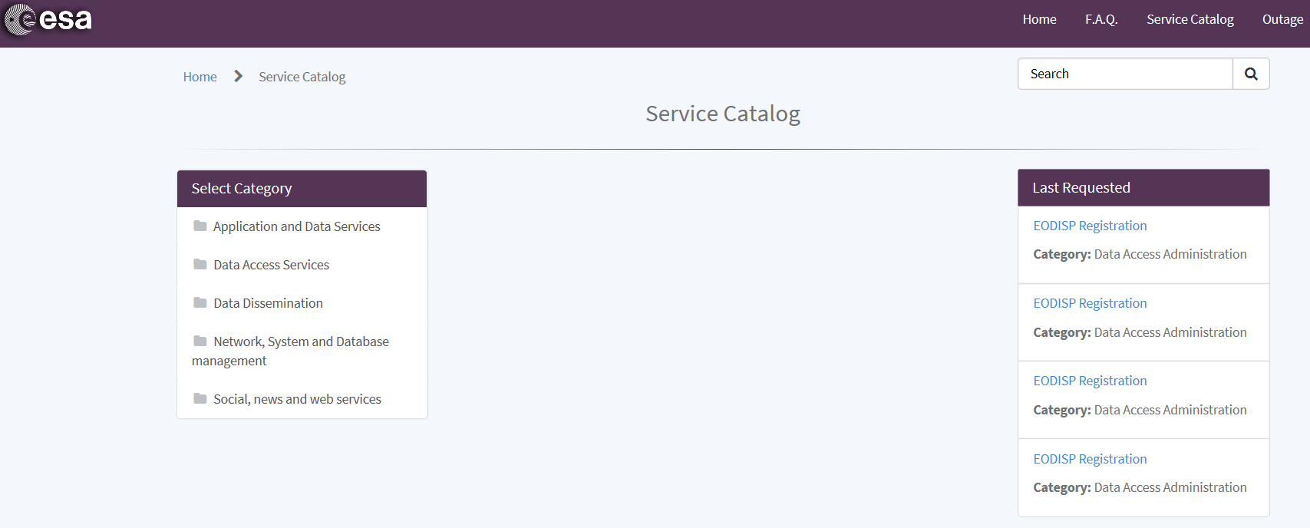
DOI generation and registration at ESA
DOI generation and registration for ESA Space Datasets is currently managed and implemented by the EO directorate in the frame of the Heritage Space (LTDP+) Programme.
DOI generation and registration processes have been extended and opened to other ESA directorates for their respective space datasets.
A DOI automated generation and registration service is available to authorised users ESA-wide through the Earth Observation TellUS service portal.
ESA EO TellUS Service Portal

Slide 6
ESA DOI Status and Next Steps
ESA registered so far 133 DOIs for its EO data collections:
  17 for Sentinels
  21 for Heritage Missions
  80 for various dataset campaigns (e.g. airborne)
  15 for Earth Explorer Missions
And 92 DOIs for its astrophysics, solar system and heliophysics missions.
DOI assignment and registration will continue throughout 2020-21 with targeted completion of assignment to all ESA EO data holdings.
Extension to other directorates, awareness raising campaigns (inside and outside EO), automated DOI Assignment Service evolution.
Notes:
Deploy the DOI Service on the TellUS platform – Requirements Document already approved and send to the maintainer

Slide 7


