Slide 1
AVHRR
Potential International Cooperation Activities and Partners
Stefan Wunderle¹, Mirko Albani², Helga Weber¹, Christoph Neuhaus¹
¹Remote Sensing Research Group, Institute of Geography
Oeschger Centre for Climate Change Research
University of Bern
Switzerland
²ESA – ESRIN Frascati
Italy

Slide 2
Overview
Objectives for 1km AVHRR data
  Exceptional long time series (1981 – 2020 ongoing) based on AVHRR sensor launched on different platforms (NOAA, MetOp).
  Unique source to retrieve Essential Climate Variables (ECV) to investigative climate variability over the last 40 years.
  Spatial resolution makes a difference. Comparison of coarse resolution AVHRR GAC data and 1-km AVHRR LAC data gives new insights on structural changes on land.
The basis for global land applications is the AVHRR data set, which covers the period from 1992 – 1999 (see figure on next slide).
In addition, there are many national data archives covering a longer period with high value for the retrieval of ECVs. The usage is today sometimes limited due to:
  Unknown accessibility
  Unknown responsibility
  Unknown format and data structure

Slide 3
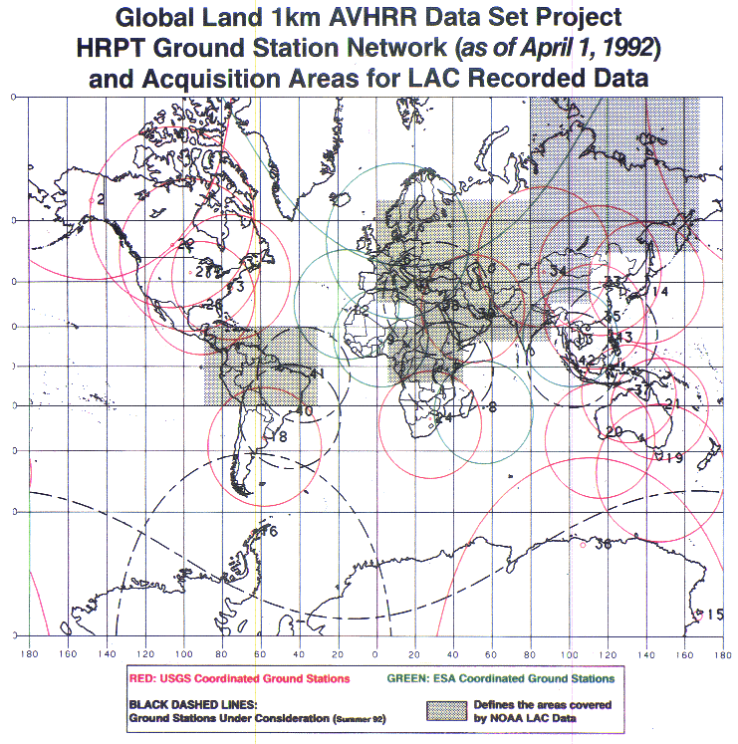
In addition to the global 1km land AVHRR archive (1992 - 1999), valuable data sets are archived with high value for ECV retrievals
Example of a few regional data archives
  Europe (University of Bern, DSRS, ESA)
  Canada – CCRS / CCMEO
  Australia – CSIRO
  China – CMA
  Argentina - GiDyC-Servicio Meteorológico Nacional
  Mongolia – Ulaanbatar
  South Africa – SANSA
EUMETSAT MetOp global archive: 2006 onwards.
AVHRR receiving stations contributing to global land 1km AVHRR data set. (https://lta.cr.usgs.gov/1km/hrpt_image)

Slide 4
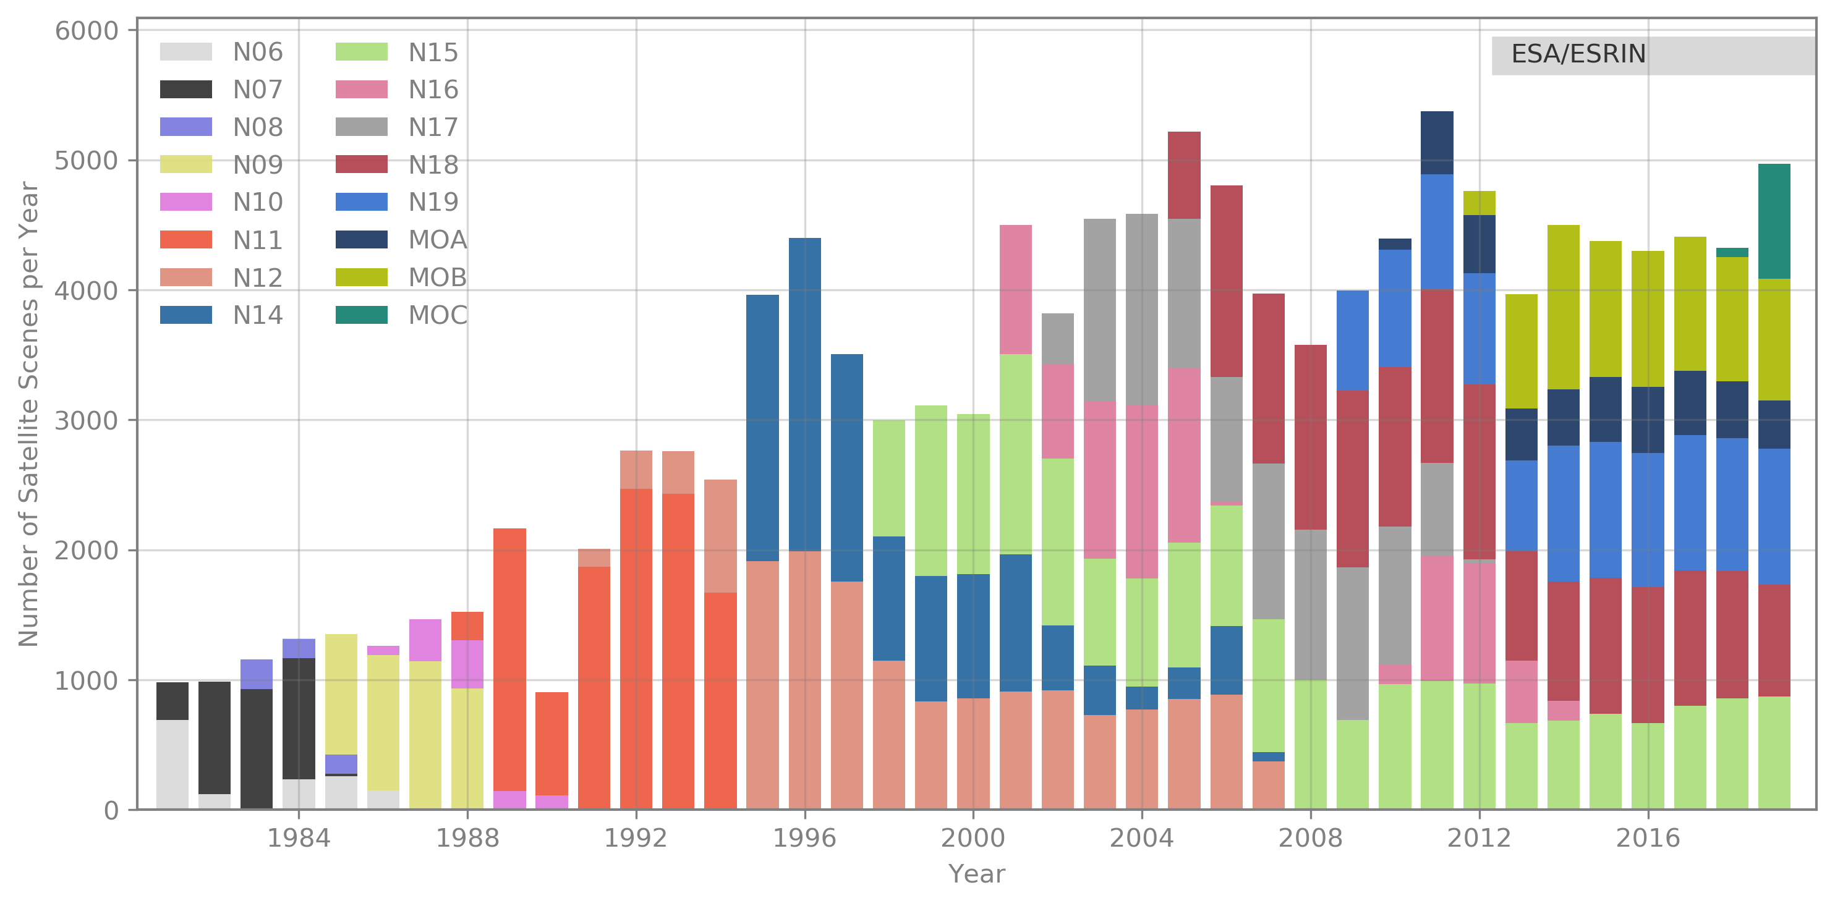
European 1-km AVHRR archive hosted at ESA includes data from University of Bern, Dundee Satellite Receiving Station and ESA holdings. Period: 1981 - 2019
Two-ten overpasses per day.
Dataset consists of more than 250.000 data products harmonized and consolidated through a dedicated ESA project (Heritage Space Programme).
All accessible free of charge via ESA dissemination services.
Archived for unlimited time by ESA.
Processing to Level-1c planned.

Slide 5
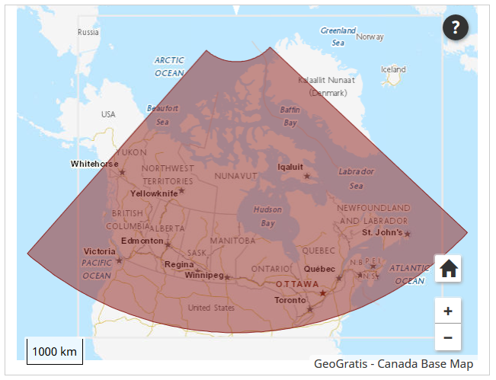
Canada – NRCan - CCRS
1981 – 2013 (+ AVHRR L1B LAC/HRPT received after that date); level 1c at CCMEO
These are open source data covered by WMO CGMS data distribution policy, they can be shared freely and without charge.
The Canadian sector is of high value to analyze changes of the environment.
The former developed pre-processing and retrieval of ECVs by A. Trishchenko and K.Klopenkov was of high quality and the standard for many other AVHRR processing chains.
Further development and processing was stopped some years ago but raw AVHRR data are available by NRCan.
https://open.canada.ca/data/en/dataset/9045136a-d6e7-a825-491d-ee5dc77a2620

Slide 6
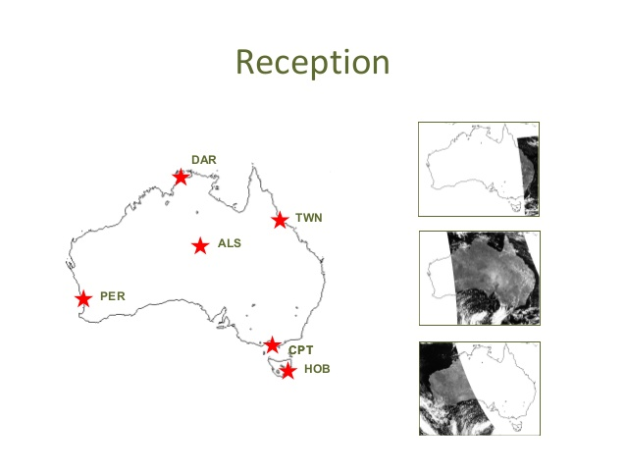
Australia
AVHRR reception based on 6 stations for continuous 1-km data set.
Multiple state and federal agencies have been acquiring the data in this manner with reception stations in Hobart, Melbourne, Perth, Alice Springs, Darwin and Townsville.
Since the early 1990s CSIRO has been merging these separate local data sets to produce a stitched archive which makes use of the redundancy arising from overlap between reception stations to produce a higher quality and consistently formatted data set with national coverage.
The assembly of this data set continues within CSIRO today, though it is likely to come to an end sometime this decade as the last of the AVHRR sensors has now been launched.
Data availability: 1981 (NOAA-7) onwards.
Ian Grant, Bureau of Meteorology, Australia
https://link.fsdf.org.au/dataset/advanced-very-high-resolution-radiometer-avhrr

Slide 7
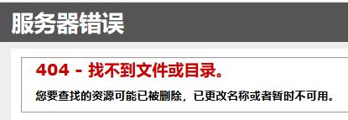
China
AVHRR-receiving stations for the global 1km land product (coordinated by USGS):
Beijing
Urumqi
Guanzhou
Agency for data access: National Satellite Meteorological Centre (NSMC)
Official contact: dataserver@cma.gov.cn
Searching for “AVHRR” on CMA web site results in
AVHRR 1-km data covering Himalaya-Hindukush of the period 1981 – 1992 would be of exceptional value for scientists to study the influence of climate change in this vulnerable region.

Slide 8
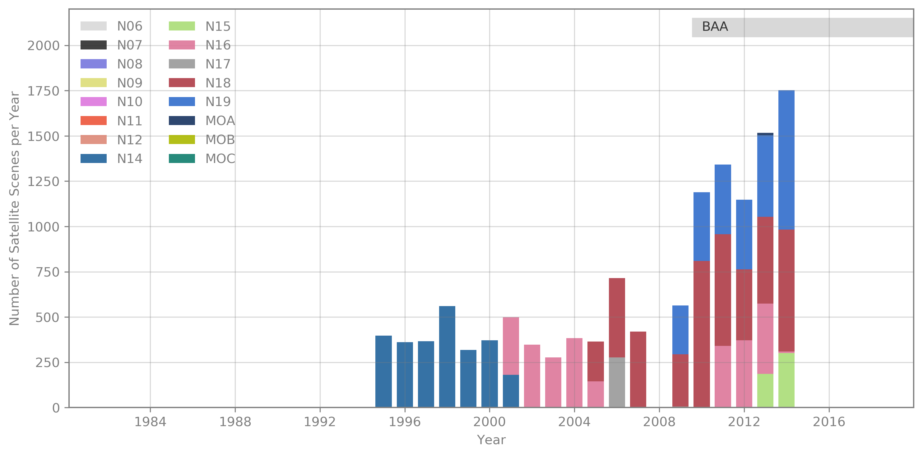
GiDyC-Servicio Meteorológico Nacional, Buenos Aires, Argentina
AVHRR BAA data
Source: Jefa Departamento Teledetección Y Aplicaciones Ambientales, GiDyC-Servicio Meteorológico Nacional, Buenos Aires, Argentina
Number of Scenes: 13.329
Satellites: N12, N14, N15, N16, N17, N18, MOA
Time Period: 1995 - 2014 (1995 - 2000 only evening overpasses)
Extent: roughly Lat=[-30,15] Lon=[-60,-15]
Format: QUO
Further info: BAA station data were included in the Global Land 1km AVHRR Data Project

Slide 9
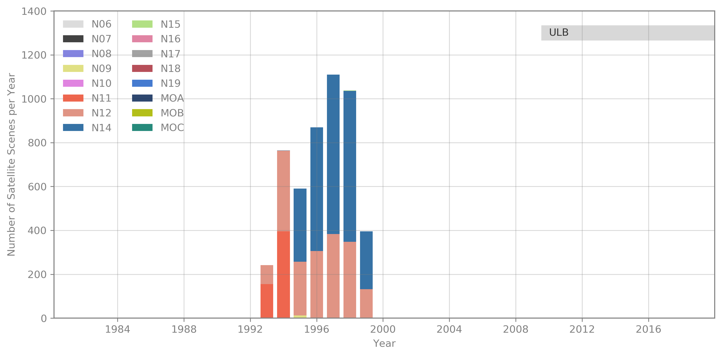
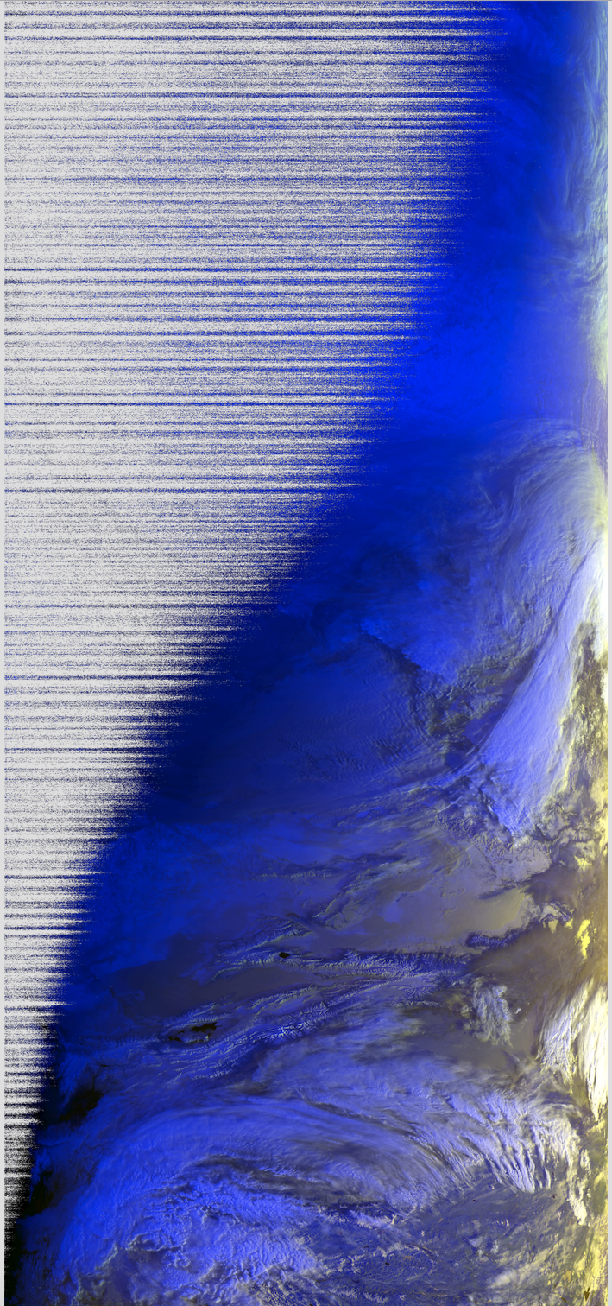
Ulaanbatar, Mongolia
AVHRR UBM data
Source: Remote Sensing Department, Information and Research Institute of Meteorology, Hydrology and Environment, Ulaanbatar, Mongolia
Number of Scenes: 5.016
Satellites: N09, N11, N12, N14, N15
Time Period: 1993 – 1999
Extent: roughly Lat=[20,70] Lon=[80,120]
Format: hmf (origin: dat, grid, lut)
Further info:- UBMx station data were included in the Global Land 1km AVHRR Data Project

Slide 10
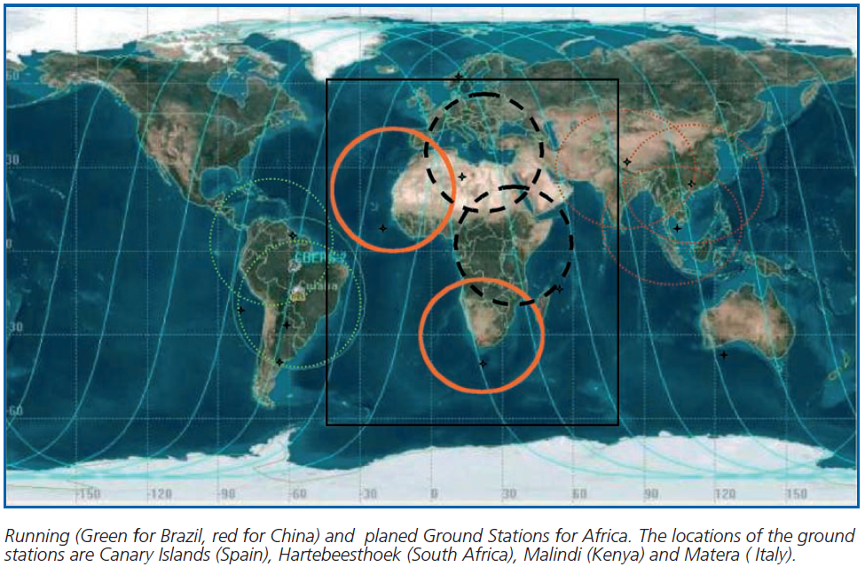
South Africa, Hartebeesthoek
1km NOAA AVHRR data received at Hartebeesthoek, South Africa (25°53' S 027°42' E)
1985 – 1998 (2003?) maintained by SAC – South African National Space Agency
In combination with Maspalomas, Matera and one station in Kenya can provide full coverage of Africa; yellow circle shows the reception area of La Réunion, which is included in the global AVHRR land data set archived at ESA
High value for climate studies to have access to AVHRR 1-km data from South Africa and one station in Kenya (1981 – 2020) for full coverage of Africa.
Contacts available at SANSA.

Slide 11
Summary and Next Steps
The 1-km AVHRR archive covering Europe from 1981 – 2019 is an exceptional example of a successful compilation of different data holdings (University of Bern, Dundee Satellite Receiving Station and ESA stations) and make the data set available for an unlimited time.
Several datasets are available worldwide constituting a unique asset for mankind
Next Steps (for discussion)
Inform the National Space Agencies with AVHRR data holdings about the consolidation procedure and the accessibility of the European data set. This may result in a similar activity and finally to an One-Stop-Shop for all users.
Liaise with AVHRR data holders in North America (Canada, USA), China, Mongolia, Africa (Hartebeesthoek (South Africa), Malindi / Nairobi (Kenya); Niamey (Niger)), Australia and South America (Argentina) to possibly start cooperation activities to ensure data consolidation/harmonization/archiving/discovery/access.

