Slide 1

CEOS Earth Analytics Interoperability Lab
Status and Availability
Committee on Earth Observation Satellites
Dr. Robert Woodcock, CSIRO, WGISS Chair
Dr. Brian Killough, Systems Engineering Office, NASA
CEOS SIT Technical Workshop 2020
WGISS 50 Virtual Meeting
22-24 September 2020
Notes:
The CEOS Earth Analytics Interoperability Lab (EAIL or “The Lab” for short) is a new initiative, an experiment mainly responding to demand from CEOS Projects related to the CEOS Future Data Architectures and Analysis Ready Data strategy

Slide 2

Why do we need an Interoperability Lab?
  A significant number of CEOS activities are now engaged in the CEOS ARD and FDA strategies and in integrated EO data analysis
  All recognize the broader implications
    ARD relates to Discovery and Access, Analytics & Cloud Data Formats
  Many are looking for advice or implementations
  Validating interoperability between multiple CEOS organizations and working groups is complex
Notes:
Interoperability work is relevant to all of CEOS and connected to LSI-VC, WGISS, WGCapD and the SEO. Plus specific projects (CEOS-COAST), and collaborators (GEO GLAM, GEO Aquawatch).
A significant number of these projects have contacted WGISS and SEO for assistance and advice in two main areas:
Integrated EO data analytics platform technology
Analysis Ready Data – formats, discovery, use
All involve multiple CEOS agencies, hence there is a strong need to interoperability. Most are also seeking a place to conduct experiments with newer technologies that aren’t always available from a CEOS agency (at least not yet).

Slide 3

WGISS
Interoperability Initiatives
  CEOS Interoperability Terminology
    Focus on ARD and Cloud
  CEOS Earth Analytics Interoperability Lab
  Best Practices (proposed) in:
    Jupyter Notebooks for EO Analytics
    Cloud data formats
    CEOS Data Discovery and Access in the Cloud
Notes:
Interoperability is a complex challenge with threads across multiple organizations, multiple technologies, multiple applications and algorithms.
WGISS has mature approaches for interoperable CEOS EO Data Discovery with the IDN, CWIC and FedEO deployed across the CEOS ecosystem.
These systems provide data discovery information onto GEO and UN SDGs.
In recent years, the FDA and ARD strategoes, along with the rise of Cloud computing has provided new opportunities.
Several CEOS agencies have trialed different approaches and new technologies to meet the growing demand.
With the experienced gained WGISS is embarking on several initiatives in interoperability to help develop Best Practices.
“The Lab” is one of the responses and you will hear about the others in separate WGISS 50 sessions.

Slide 4
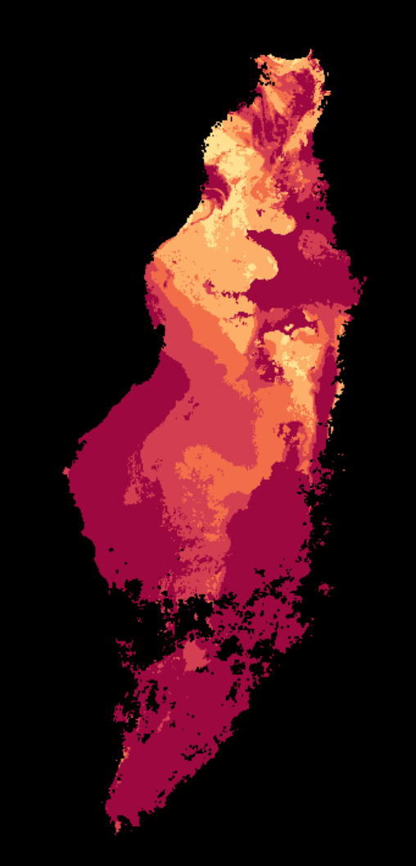
Current Status
The first Lab node is hosted by CSIRO and jointly operated by WGISS and SEO to provide:
  Examples of FDA components in active use
  A shared candidate ARD storage and access capability
  Connection to existing and emergent services for Discoverability and Access
  Collaboration on Analytics tools for integrated analysis using Jupyter Notebooks
  Jointly develop CEOS Best Practices via interop experiments
Goal: Validate and demonstrate interoperability approaches
Notes:
WGISS and SEO jointly proposed “The Lab” as an initiative at WGISS-49.
It was intended (and to some extent still is) as an experimental initiative.
Based on the queries being received there appeared to be a gap in the CEOS ecosystem for some of the projects, almost always related to interoperability and/or new technologies.
The proposal was to provide a temporary environment for these interoperability issues to be explored and validated by these projects.
It isn’t the goal of “The Lab” to provide an ongoing operational environment (though technically is certainly capable of doing so neither WGISS or SEO could financially support sustained operations at scale – based on demand though there is certainly going to need to be a conversation about this! (in a positive way))
The Lab provides a number of base technologies, ones common to many but not all CEOS technology explorations.

Slide 5

The Interest
Stronger interest than expected:
  CEOS COAST
    Paul DiGiacomo (NOAA)
  WGCV – DEMIX
    Peter Strobl (EC)
  WGDisasters Flood Pilot
    David Borges (NASA)
  CEOS Rice Monitoring Community
    Shin-ichi Sobue (JAXA)
This Photo by Unknown Author is licensed under CC BY
Notes:
Since WGISS-49 WGISS and SEO have been presenting the proposal for The Lab to other CEOS groups and projects.
The interest was much stronger than anticipated.
Several projects have already started work on requirements analysis, which you are hearing about in WGISS-50.
SEO and WGISS are now scrambling to get the EAIL operations in place to support these projects and has been attending multiple meetings across the Projects to help them (and us) navigate the path ahead.

Slide 6
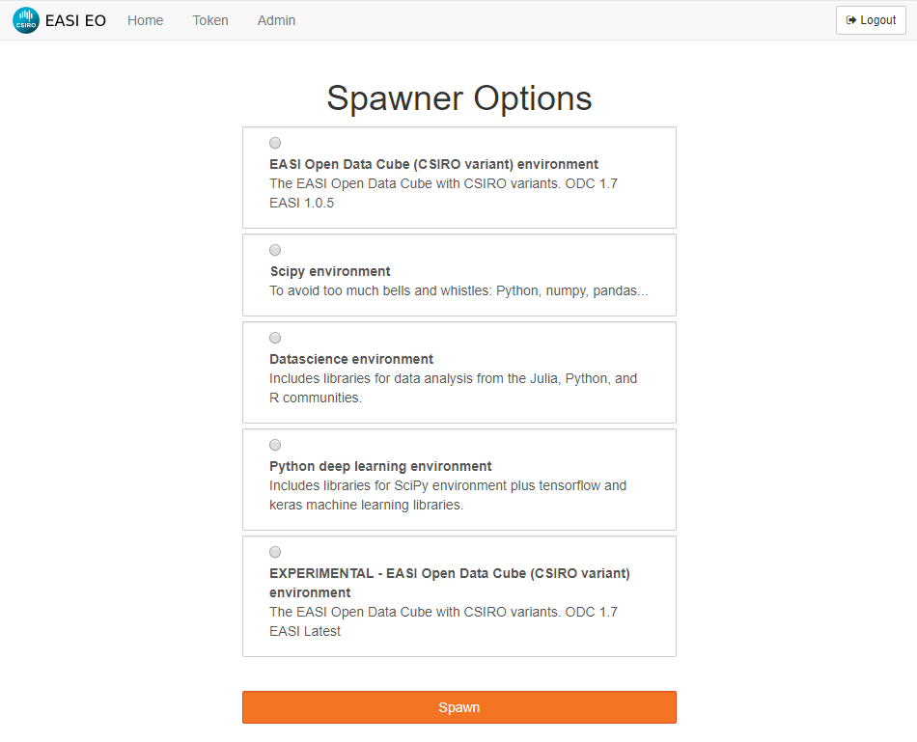
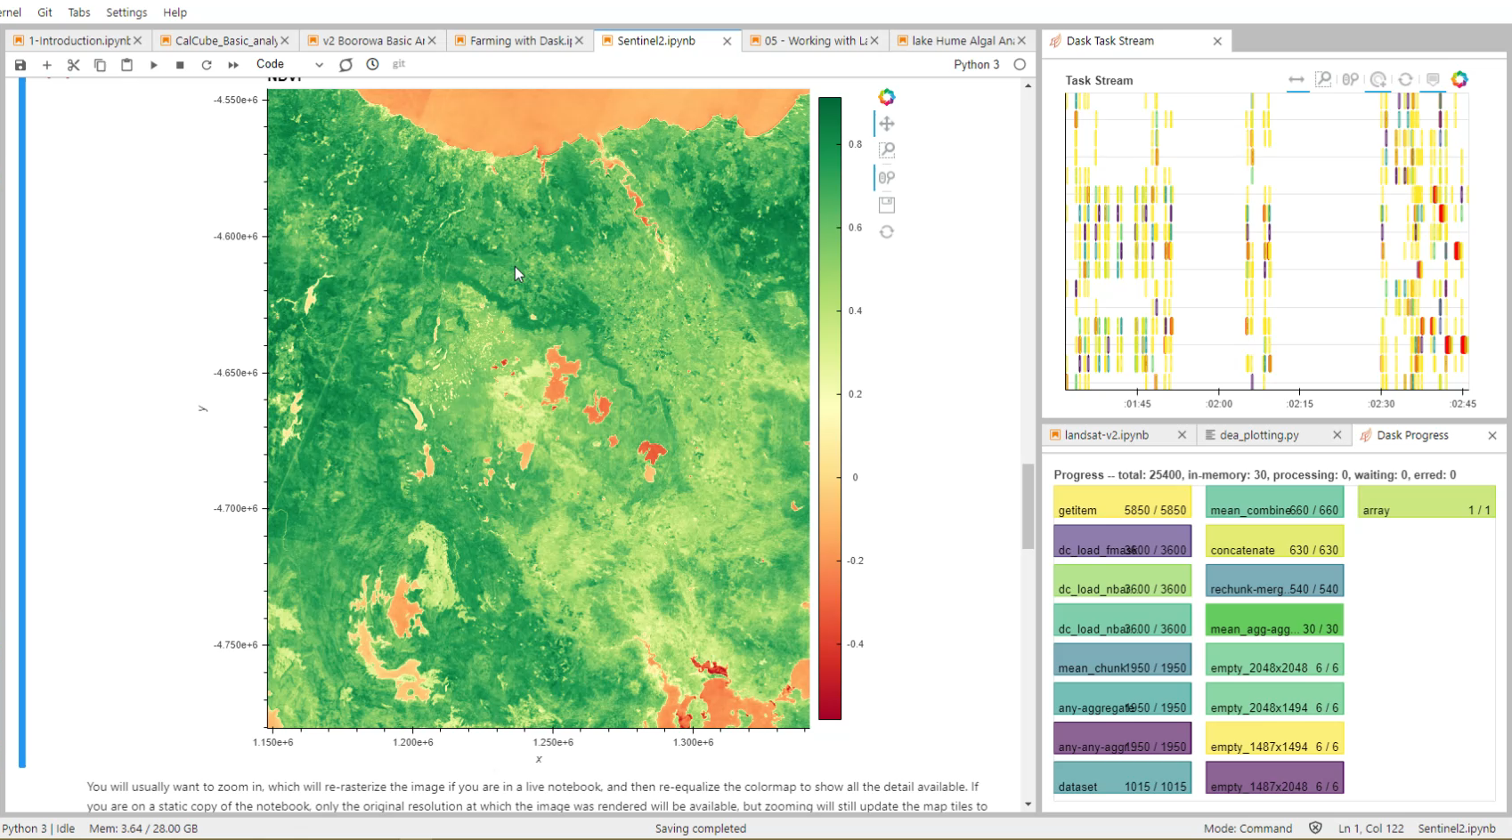


Features: Jupyter Labs
exploratory data analytics
WGISS Survey on use of Jupyter in CEOS agencies in progress
Customise per CEOS activity as necessary
Interactive visualisation: 2’ x 2’ region over Tasmania, 20m resolution, NDVI
Notes:
The initial deployment is based on CSIRO’s Earth Analytics Science Innovation Lab powered by the Open Data Cube.
It’s a similar technology stack to that used by Geoscience Australia for is Digital Earth Australia and Africa initiatives and CEOS Open Data Cube by the SEO.
It includes a number of technologies that are common across many CEOS technology exploration initiatives, and the broader trends in data science (particularly the PyData ecosystem).
Jupyter Lab provide advanced exploratory data analytics and visualization tools.

Slide 7
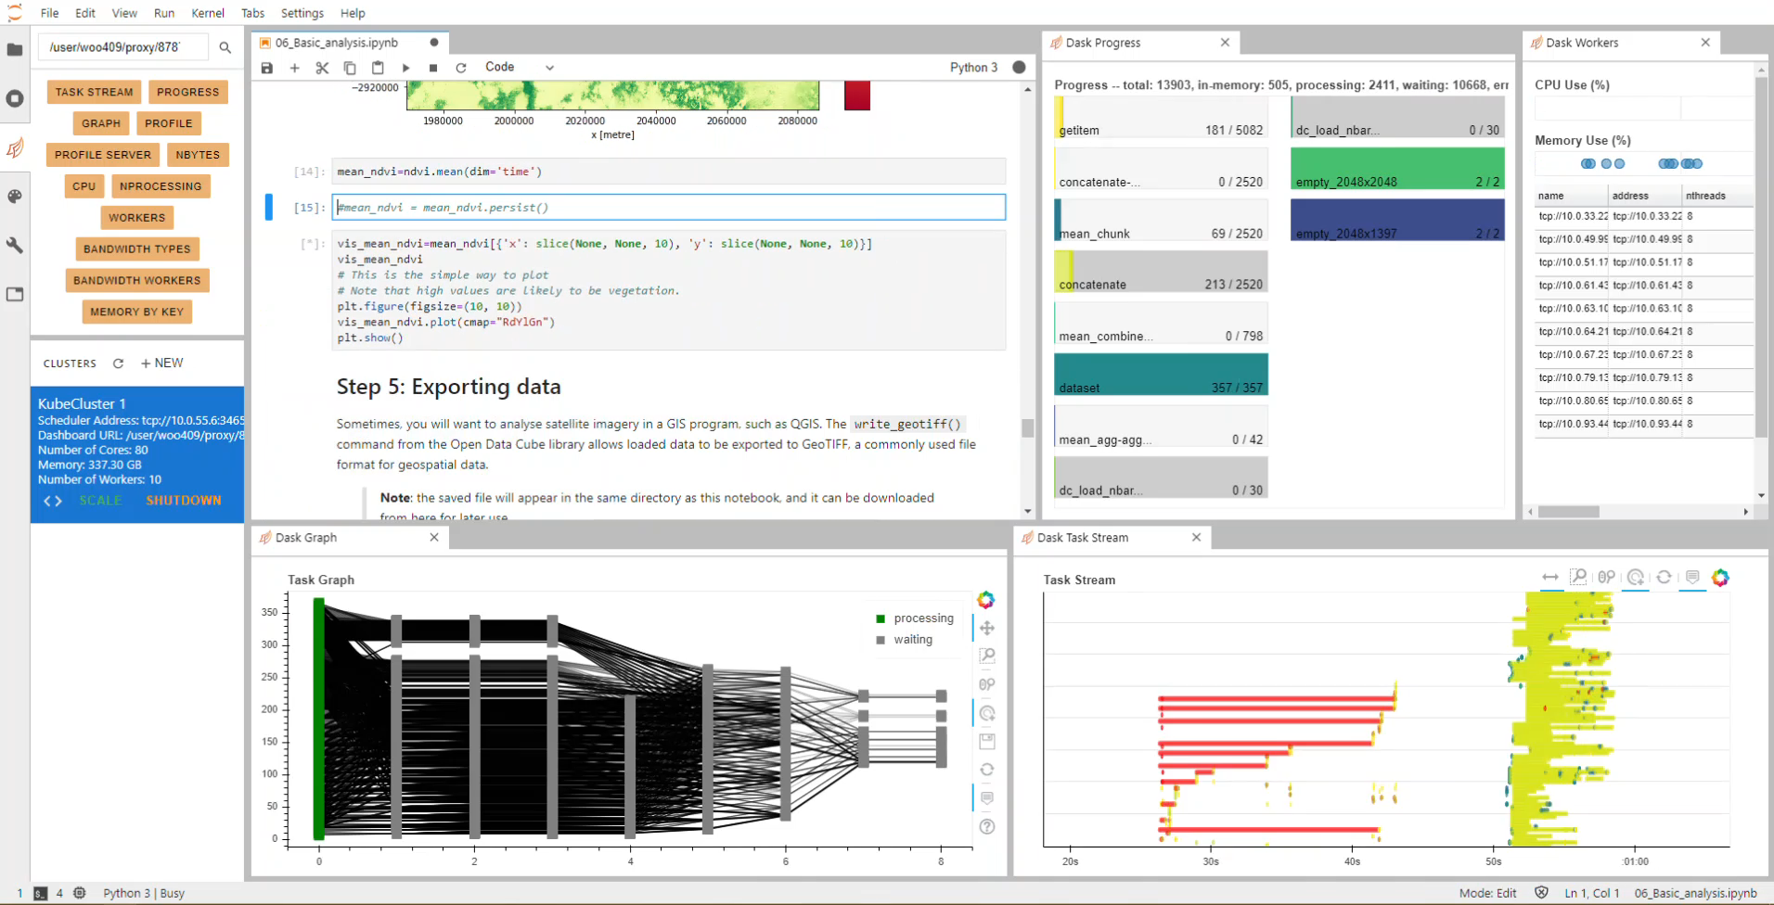
Features: Scalable Cloud Computing
Dask distributed computing
Argo Workflows
Notes:
A Dask cluster is provided for large scale data processing.
Argo Workflows provide even more robust and scheduled large scale or just routine workflow automation (and can of course combine with the Dask Cluster for analysis).
Both of these technologies scale on the Cloud

Slide 8
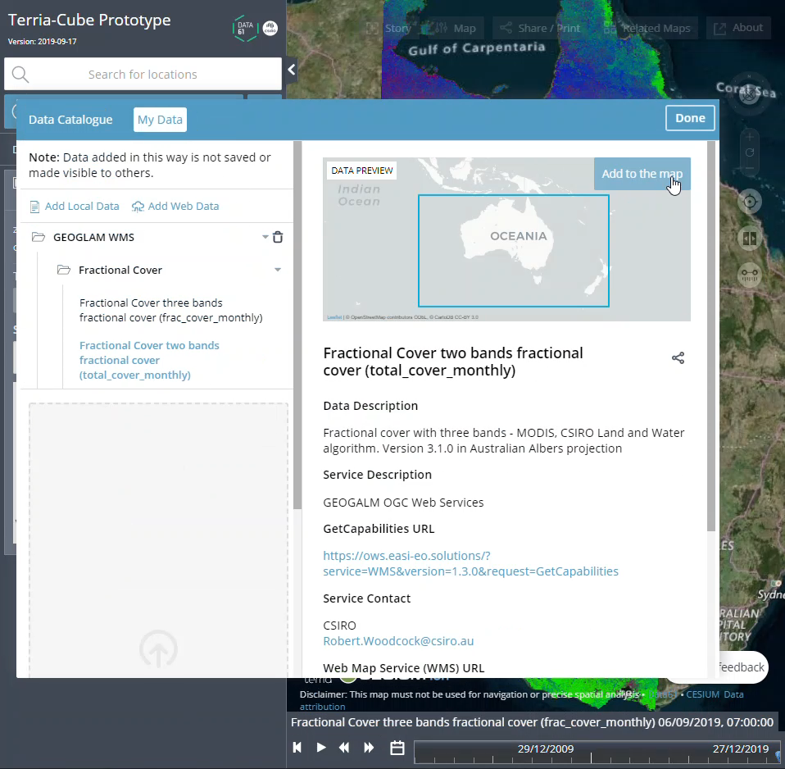
Features: Web Portal hosting
Multiple hosting for each CEOS project
OGC WMS and WCS
  On demand per-pixel analysis for cloud masks, NDVI, visualization, etc
Notes:
The Hub also provides OGC Web Services for WMS and WCS access to products.
It can also host Web Portal like the SEO CEOS Open Data Cube portal or in this screen shot a CSIRO Terria Cube portal.

Slide 9
Data Architecture and Pipelines
ESPA Ordering System
EASI Data Pipelines
GIS and Other data sources
Landsat
Archive
Inventory Management
Landsat ARD
Orders
Downloads
EAIL
S1 SAR Archive
Copernicus Open Access Hub
ARD preparation
Hosted
Data S3
Index
metadata
S2 L1C Archive
Direct Cloud
Direct Cloud
Archive
S2 L2 Archive
Notes:
Behind the scenes CSIRO is providing its data-pipelines system which uses Argo Workflows and Events to automate data management from across CEOS Agencies to the EAIL.
Currently this involves mixed use of both traditional Agency ordering systems (e.g. ESPA), CEOS Open Search (when granules are directly available) and direct Cloud access (e.g. to Digital Earth Australia archives hosted by Geoscience Australia on AWS).
The first two require downloading and re-hosting of the data with in the EAIL – we’re looking forward to more direct Cloud access with new released from CEOS Agencies

Slide 10
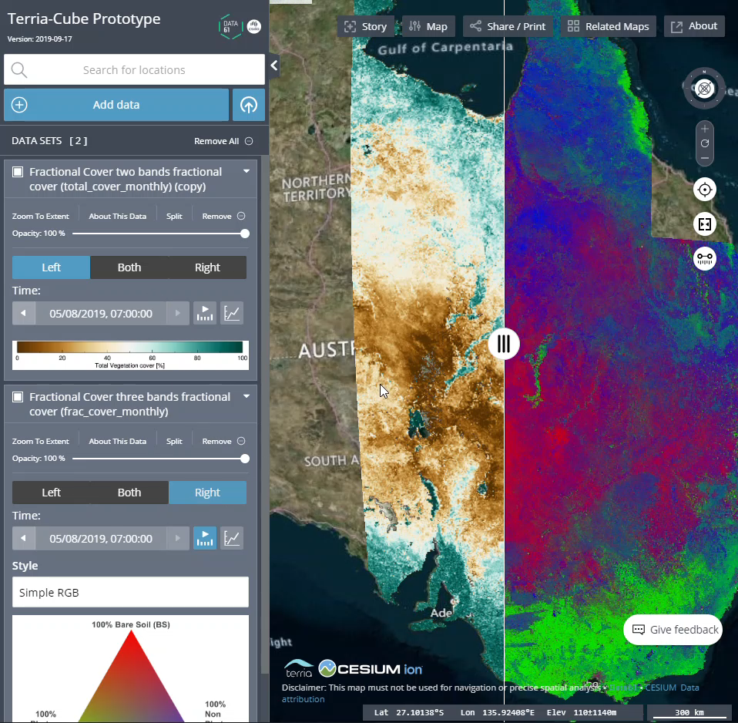
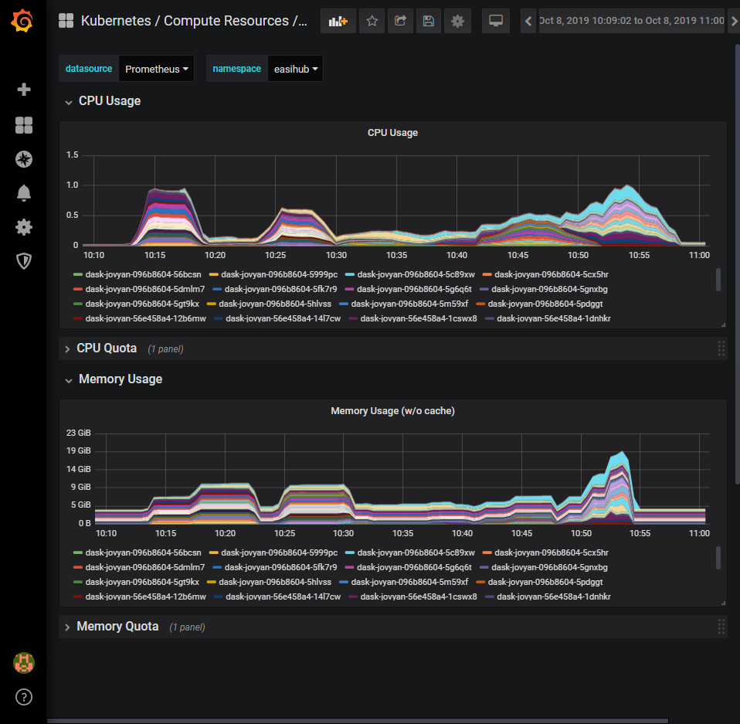










Earth Analytics Science & Innovation Hub
Apps/Services
Kubernetes
AWS
Jupyter
WMS
CEOS ODC
Monitoring
Replication
Failover
Scheduling
Compute
Network
Storage
Notes:
For those of you wanting deeper information on technical architecture.
CSIROs EASI Hub which powers the EAIL runs on Kubernetes and makes use of the AWS Cloud for resource provisioning.
Kubernetes provides all the container orchestration and scheduling control across Dask, Web Portal Deployments, Argo Workflows, etc.
It’s a Cloud Native environment.

Slide 11
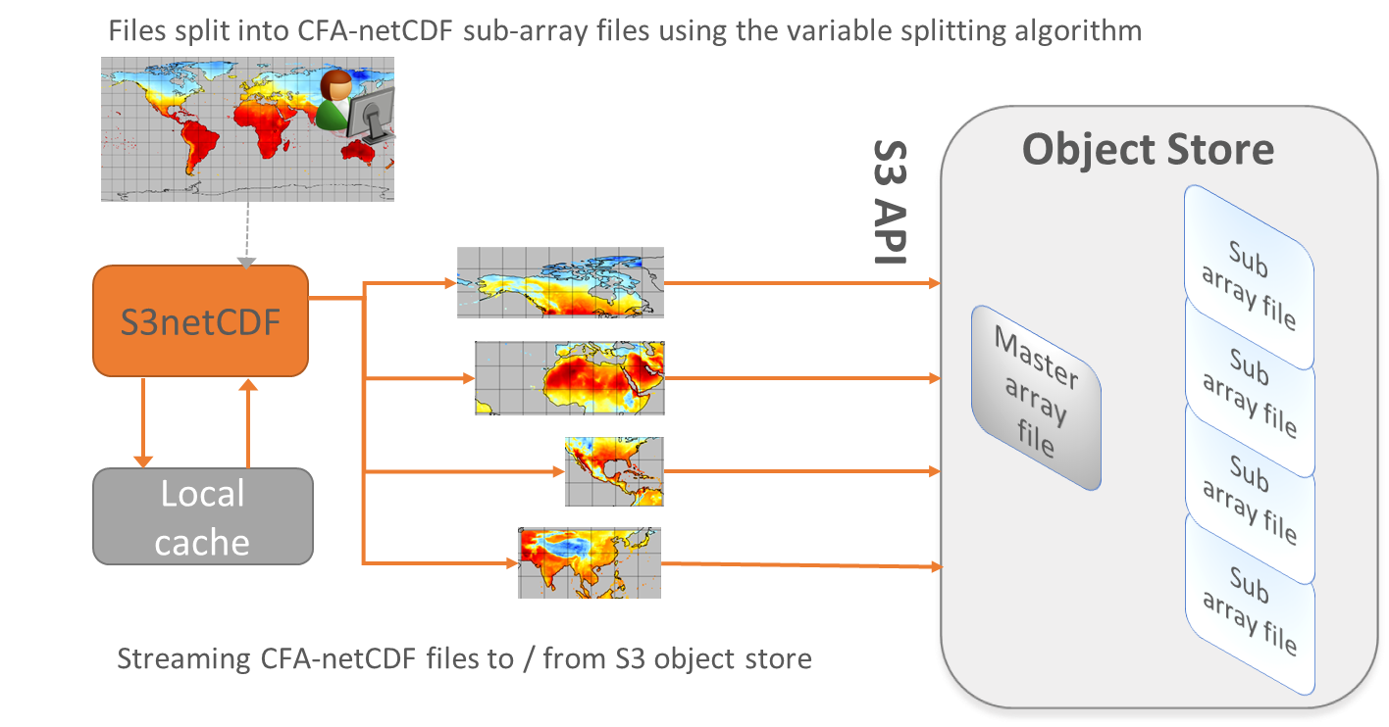
Cloud data formats – Best Practices
Direct data access
COGS –
  Cloud optimised GeoTIFFs (ready for Sentinel and Landsat)
NetCDF in the Cloud
Zarr – Cloud native array storage
Notes:
In addition to the apps, storage and compute infrastructure the EAIL also supports experiments in Cloud data formats.
COGS is readily available and supported via the Open Data Cube and associated python libraries (e.g. rasterio)
Zarr support is being developed by CSIRO in the Open Data Cube and available as an experimental environment for those interested (you can also do this via standard xarray zarr support).
It is anticipated other approaches (like S3netCDF) will be required for some interoperability experiments and these can be deployed when required.
One of the main advantages of the Lab is it is intended to be an innovation environment, not production, and has IT policies and expectations that match that role. There’s more flexibility in this environment.

Slide 12
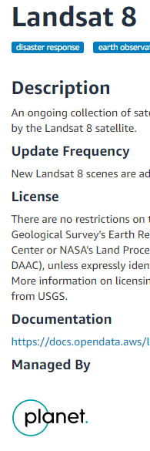
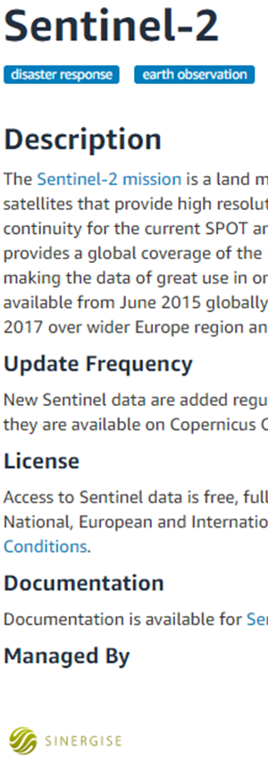

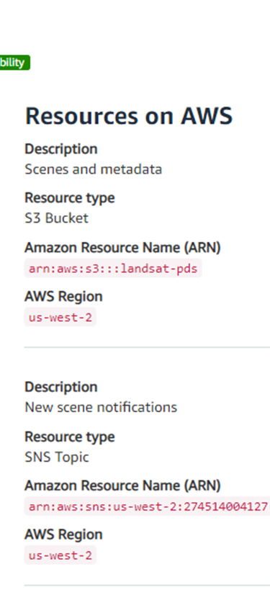
CEOS Data in Cloud – Developing Best Practices
Discovery issues:
Provenance
Location
  Provider
  Region
Cost to use
Hidden costs
Notes:
We also expect the Lab to be used to explore user requirements for data discovery, particularly Cloud data discovery and use.
Note how Discovery just became more challenging in the above snap shot from the AWS public datasets archive.
Neither of these are CEOS agency managed data sources
Integration of data would be across Regions
One is requestor pays
Mistakes can (and have) been made in the use of these datasets.

Slide 13
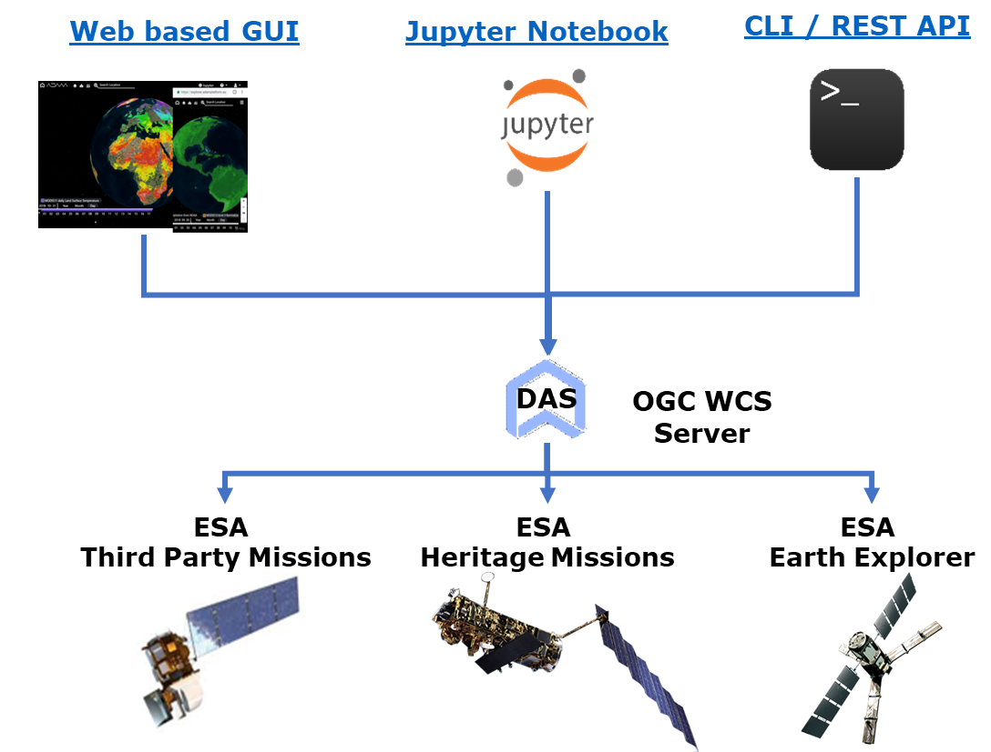
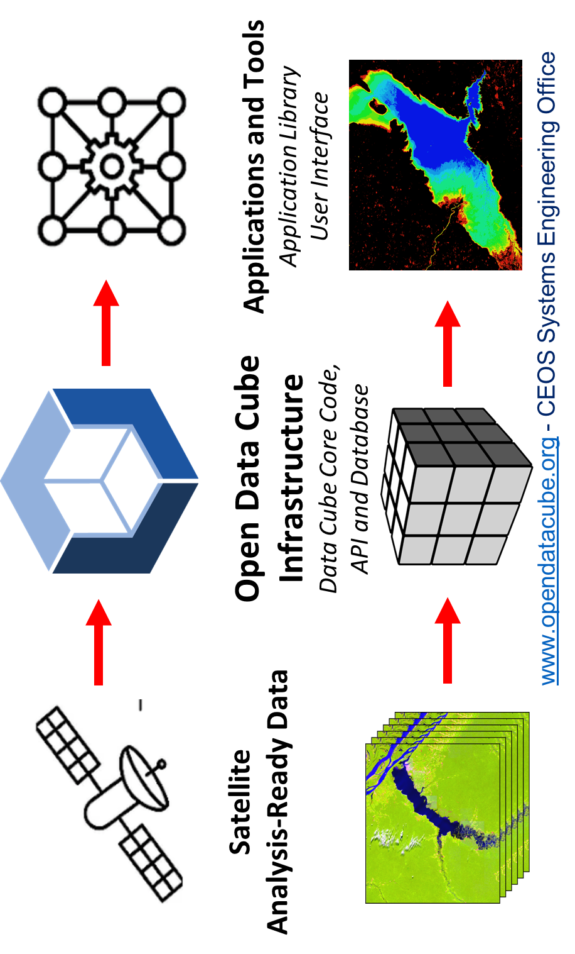
Additional nodes?
SEO EAIL with Open Data Cube
ESA Data Cube ecosystem
Other CEOS Agencies host a node:
Different technologies
Interoperability experiments
Supporting joint CEOS projects
Develop Best Practices
Storage
Infrastructure/resources
Compute
Notes:
Most CEOS FDA prototypes use a similar breakdown of the architectural layers for simplicity (ODC and ESA for example)
In practice they are federated service ecosystems with a variety of interface points at all levels available to users of all types – drawing that though is unhelpful to communication.
Unfortunately the simplified view also hides very important changes in the ecosystem when it comes to interoperability
We can see a few though – practically all CEOS FDA pilots include the three interface types shown:
Web based users interfaces – not just data discovery, view and download. Full analytics capabilities for common use-cases (e.g. NDVI, Carbon, Hazards). These are often themed (e.g. ESA Thematic Exploitation Platforms is an entire family of themed web portals with common with shared components and data sources.
Jupyter notebooks – Interactive data analysis directly available to users. Opens up a whole new range of possible applications
APIs – a much lower level interface to both the data and analytical capabilities. Allows for direct integration with other third party applications and development.
As such we are hoping that The Lab will become a set of CEOS agency nodes.
CEOS agencies are invited to consider setting up a EAIL Node using their chosen technology stacks and to contribute to the EAIL initiative on interoperability experiments.

Slide 14


Roadmap
Roadmap:
  WGISS+SEO deploy the lab
  Establish support and operations mechanism with SEO
  CEOS COAST et al:
    inventory of data, analytics, etc
  Define joint interop experiments for capabilities needed by these projects
  Populate EAIL with experimental data (or preferably direct access) and onboard projects
  Demonstrate and validate jointly in the Lab(s)
    Cookbook of Jupyter notebook examples
Notes:
At this stage WGISS and SEO (specifically CSIRO and NASA) have performed an initial deployment and are working on establishing support and operations mechanism.
WGISS, SEO, CEOS COAST, WG Disasters and the other projects mentioned early are also working on inventories of data, analytics, ARD, … needs which will be used to define the initial set of joint interoperability experiments.
Other CEOS Agencies are invited to participate in developing these experiments and conducting them with a view to developing WGISS best practice documents for CEOS

