Slide 1


Artificial Intelligence at the service of Geospatial Information

Slide 2
Agenda
MARKET ANALYSIS
AI4GEO PROPOSAL
FIRST RESULTS
VIRTUAL RESEARCH ENVIRONMENT FOCUS (video)

Slide 3
3D geospatial information market
01

Slide 4
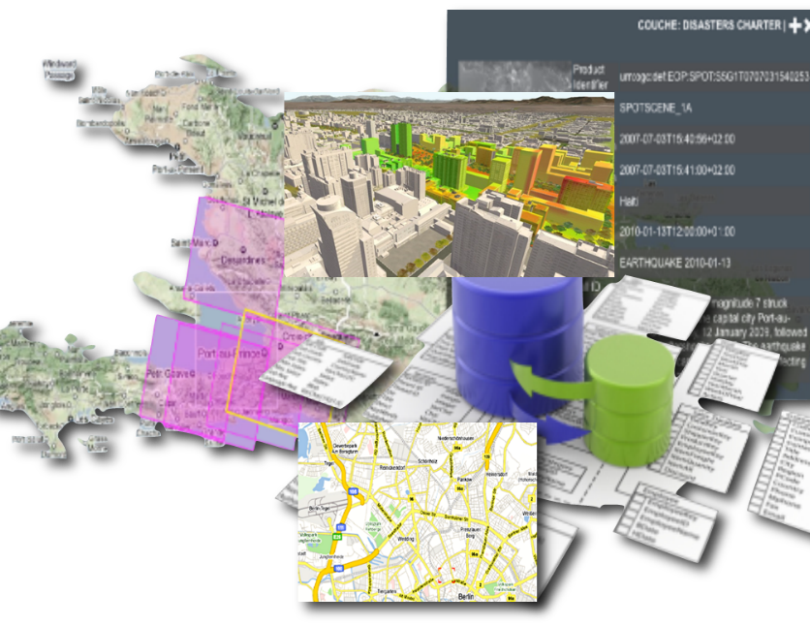

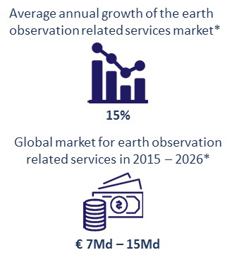



The availability of 3D Geospatial information is a key stake for many soaring sectors: Sustainable and Smart Cities, Ecological Mobility, Autonomous cars, Economic Intelligence and consumer markets
Its production is now possible and highly scalable thanks to the abundance of available data (Open Data and satellite constellations).
but manual interventions are still needed to guarantee a high level of quality, which prevents mass production.
« Data is the new oil » yes but the challenge is how to extract Valuable Information
« the future belongs to one who holds data » yes and no : the one who is able to correlate big heterogeneous datasets is the new king

Slide 5
AI4GEO Proposal
02

Slide 6

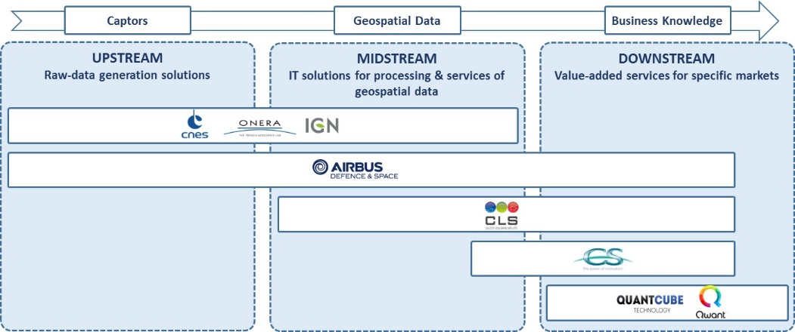
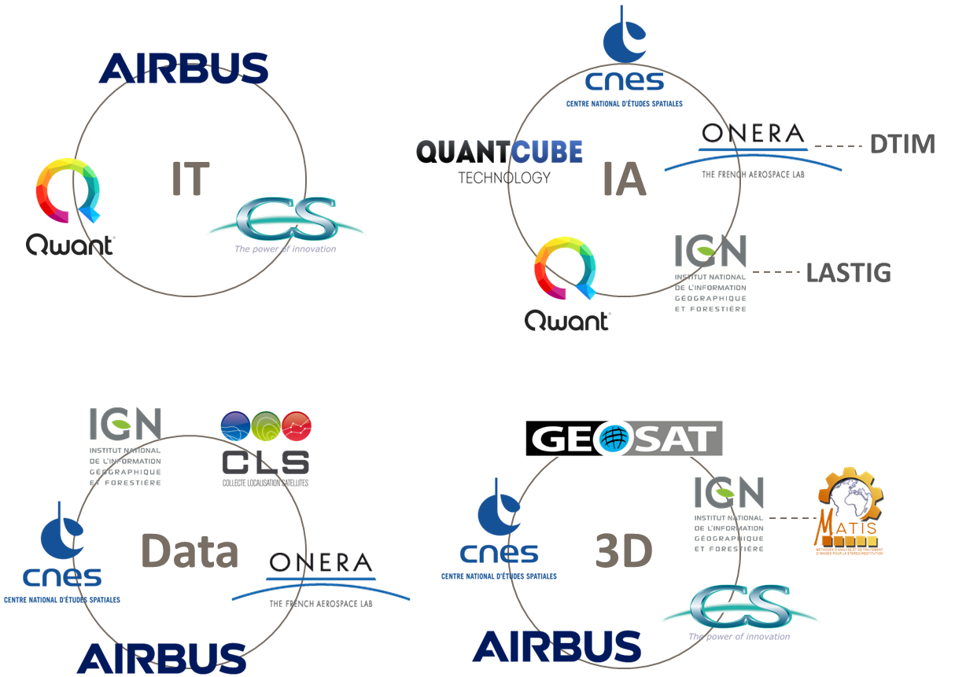
The AI4GEO project aims at developing an automated solution for producing 3D geospatial information and offer new added-value services leveraging innovative AI methods and Big Data technologies adapted to 3D imagery.
The AI4GEO consortium is constituted with Institutions and Industrial groups (Large and medium companies, SMEs) covering the whole value chain of Geospatial Information and providing complementary technical skills.
With a 4 years’ timeline, the project is structured around 2 R&D axes which will progress simultaneously and feed each other.
Deep-Learning, Cloud and Big-Data technologies
Highly parallelized processing codes

Slide 7
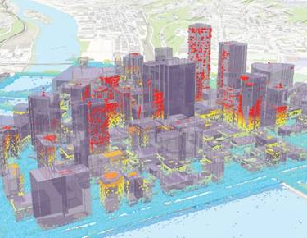

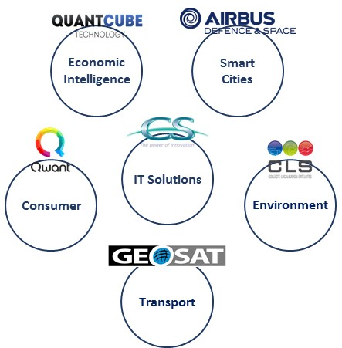
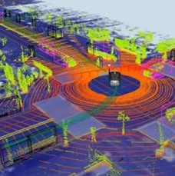
The first axis will consist in developing a set of technological bricks allowing the automatic production of qualified 3D maps and additional layers of information (3D objects and associated semantics)
The second axis will consist in deriving from these technological bricks a variety of services for different fields

Slide 8

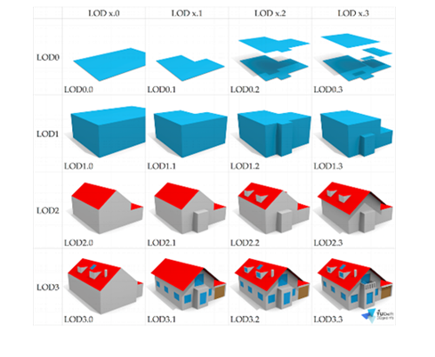
Technical objectives of the project, multiple axes of improvments
Urban (10 cities, worldwide) : LOD3.x, 90% buildings identified
Global (1 country): Land use, confidence score >90%, change caracterization, temporal activity
1 VPE + 1VPE + 1 virtual discover environment (high level VRE, no more code)
T0+48
T0+36
Urban (10 cities, worldwide) : LOD2,x THR, 90% buildings rebuilt
Global (5 districts, worldwide): Land use, confidence score >90%, change caracterization
1 VRE + 1 VPE cloud agnostic, higly scalable
T0+24
Urban (5 cities EU) : LOD1.2 THR, 85% buildings rebuilt
Global (2 districts EU): Land cover 15 classes, confidence score >85%, change detection
1 VRE + 1VPE
T0+12
Urban (1 city FR) : LOD1.0 THR, 80% buildings
Global (1 district FR): Land cover 10 classes
1 Virtual Research Environment + inputs datasets + Ground Truth

Slide 9
Ongoing Works, first results
03

Slide 10
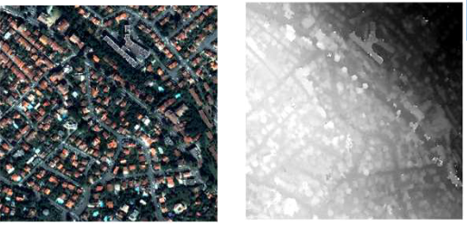
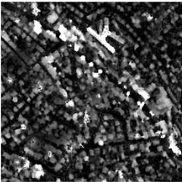
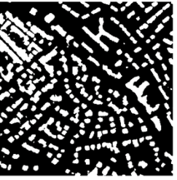
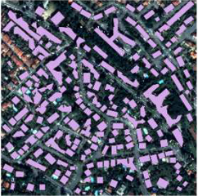
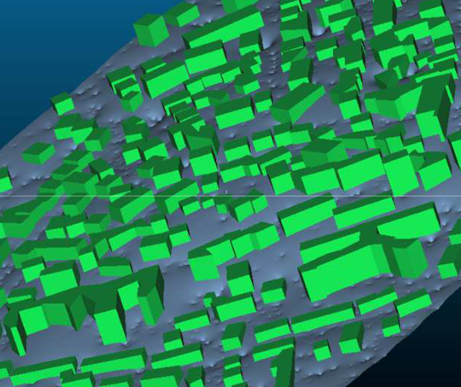
Ongoing works, first modules, first results
First processing chain to compute automatically LOD1 on urban target
DSM generator
DTM generator
Building extractor
Building regularization
Height estimator
Input Pleiades stereo images
Digital Surface model
Digital Terrain model
LOD0
LOD1

Slide 11
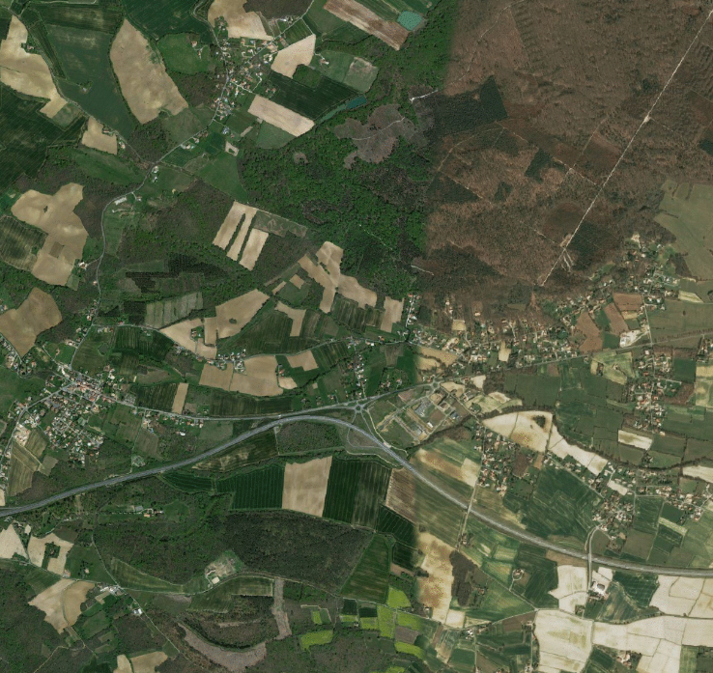
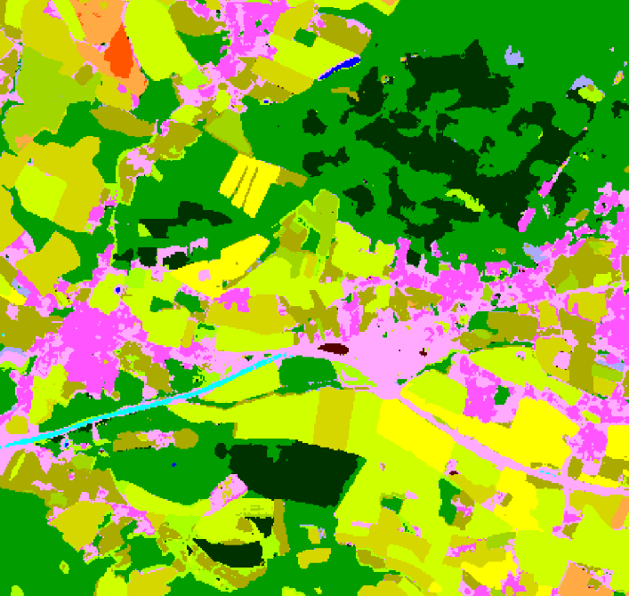
Ongoing works, first modules, first results
Iota2 processing chain integration,
producing large scale land cover maps
on Sentinel2 inputs
(http://osr-cesbio.ups-tlse.fr/~oso/)
Deep learning processing chain based on Pleiades is in development

Slide 12
VRE (slides + video)
04

Slide 13

VRE concept
Concentric architecture
Base image « batteries included » : all important tools available
Thematic overlay : Earth Observation specialized libraries, spacialized catalog, etc.
Project fine tuning : Look&feel, project libraries, specific tools, etc.
Objectives : reuse, development sharing
VRE base
Thematic
extension
project
contextualization

Slide 14

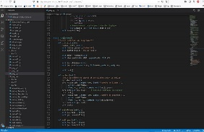
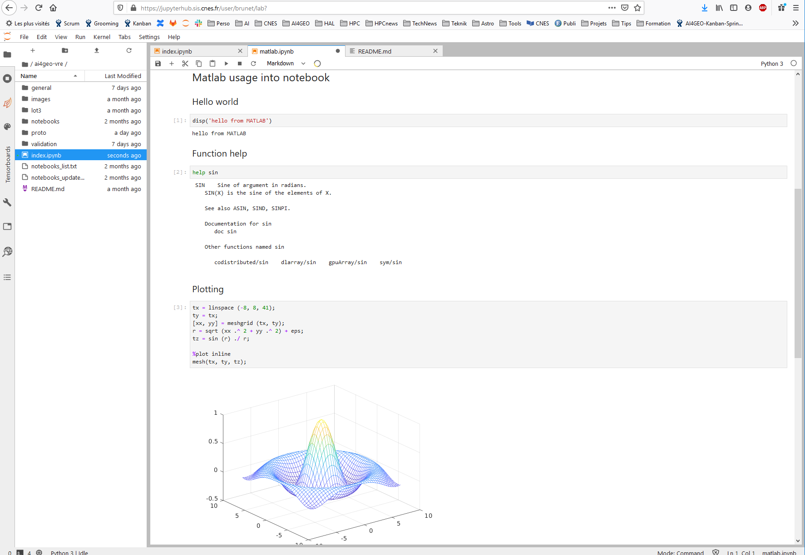
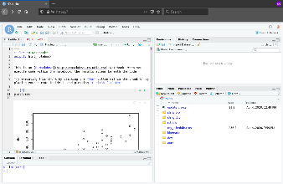
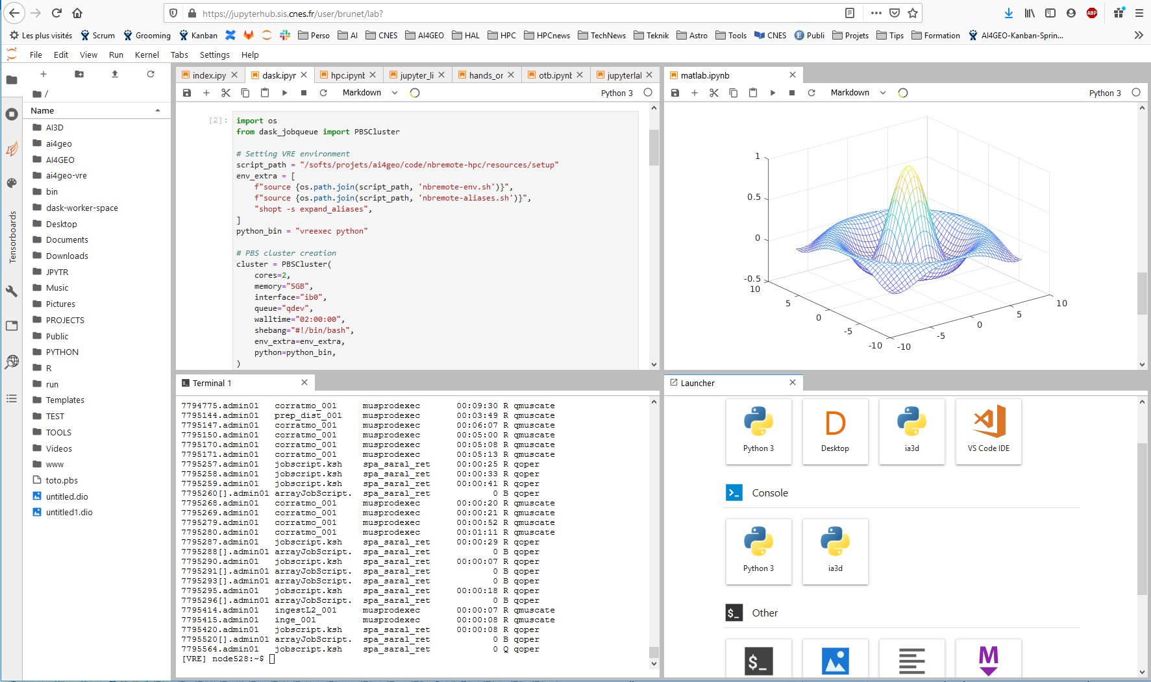
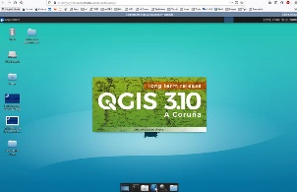
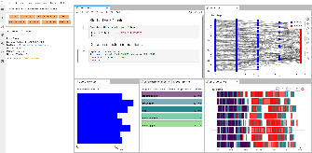
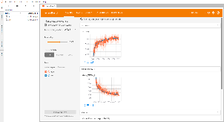
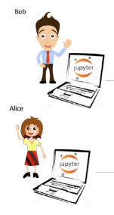






VRE (based on open source projects)
Currently deployed on CNES Computing Center
To come up : could be deployed on any Cloud provider
Multiple plugins integrated
VRE
Visual Studio Code
Matlab
R Studio
JupyterLab++
Bureau virtuel
Dask Board
Tensor Board
Data Services
Access to mutualized services
Catalog
Input data, Ground Truth
Based on JupyterHub, which is connected to our JobScheduler that spawns user VRE on one of the multiple compute nodes
Et bien d’autres…
My favorite super Tool
VRE will be connected to the future GeoDataHub service
Specific Tool
Datalake

Slide 15

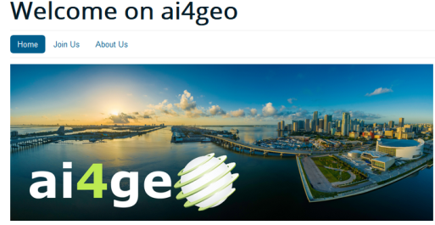
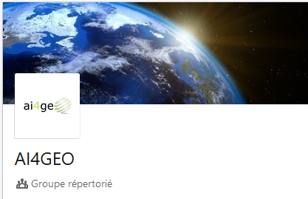

AI4GEO
Keep in touch!
https://www.ai4geo.eu

