Slide 1
Working Group on Information Systems & Services
WGCV-DEMIX on the EAIL
WGISS-50 Meeting (virtual) September 23, 2020
Peter Strobl,
European Commission, Joint Research Centre (EC-JRC)

Slide 2
Background
Terrain Mapping SubGroup (TMSG) of the WGCV reactivated end of 2019
First agreed activity is the DEM Intercomparision eXercise (DEMIX)
mandate for DEMIX:
perform a state of the art comparison of the major global (free&open) DEMs
provide recommendations on best available DEM options depending on domain and area to allow informed choices
DEMIX call for participation issued 5 May 2020
~ 40 participants registered; CAS, DLR, EC, ESA, JAXA, NASA, USGS + domain experts & industry
Kick-off meeting held with 26 participants on 26&30 June 2020
TMSG/DEMIX Subscription page: https://ec.europa.eu/eusurvey/runner/WGCV-TMSG_membership

Slide 3
Digital Elevation Inter-Comparison (DEMIX)
Expected Outcomes (t) threshold, (g) goal
Consistent and comprehensive DEM definitions and terminology (t)
Base (t) and extended (g) set of benchmarking metrics and respective algorithms (t) and open source tools (g)
Detailed comparison results on test areas (t) and aggregated wall to wall benchmarking results (g).
Recommendation of a reference DEM and consistent orthoimage (g)
Final report (t) and peer-reviewed publication (g)
Three sub-groups have been set-up:
terminology and analytical basis
algorithms and software – open source tool box
platforms and processing

Slide 4
Digital Elevation Inter-Comparison (DEMIX)
DEMIX to be performed in 4 phases
General agreement among main contributors (data owners) on approach & scope; Call for expression of interest to further partners (commercial tbd); circulation of JRC Workshop report & selection of base (△x, △y, △z) & extended (slope, aspect, morphology) testing methods and algorithms; Identification of suitable test areas (at least 1 per continent);
Cross-comparison of all participating data sets on test areas and, if feasible, identification of a reference dataset (at DGED L1). If available and where applicable cross-comparison to suitable orthorectified (reference?) imagery (Sentinel-2?); Workshop to exchange experiences from the test areas and agree on details of an eventual global roll-out;
Feasibility testing & potential global roll out of at least base tests & determination of suitable aggregation scale for reporting;
Calculation of agreed comparison metrics for all candidates and publication of results.
Timeline
Q2 2020 |  | Q3 2020 |  | Q4 2020 |  |  | Q4 2020 | Q1 2021 |  | Q2 2021
 | Phase I
 |  |  | Phase II
 |  |  |  |  | Phase III
 |  |  |  |  |  |  |  |  | Phase IV

Slide 5
Why EAIL?
Bring together:
CEOS Earth Analytics Interoperability Lab
CEOS DEMIX
Terrain Mapping community (e.g. Geomorphometry.org) an applications (almost everything!)
To:
Offer a cloud based platform for joint elaboration of one of the most fundamental geospatial (not just EO!) data sets to experts from a wide range of backgrounds
Collect all state-of-the-art global (&continental?) DEM data sets in an single, independent, globally accessible place
Provide access to reference tools for comparison and analysis
Test and implement new solutions for truly global data representation (e.g. DGGS) to seamlessly(!) include also bathymetry
Develop solutions for platform federation and platform agnostic access
Demonstrate power of cloud-based, collaborative analysis platforms and standardised data!

Slide 6
Available f&o global DEM Data Sets
Scope and Products to be included: All datasets which have an at least continental coverage and are available under a free & open data policy, including latest versions of
NASADEM (NASA, JPL, most recent decent of the SRTM product line, eventually also NGA’sTFRMv4)
AW3D30 (JAXA, f&o version of the Japanese ALOS based global DEM)
ASTER-GDEM, (METI, NASA)
TanDEM-X90, (DLR, free version for scientific of the TanDEM-X mission)
Copernicus DEM90 (EC/ESA, f&o version of WorldDEMTM, the commercial version of TanDEM-X procured by Airbus)

Slide 7
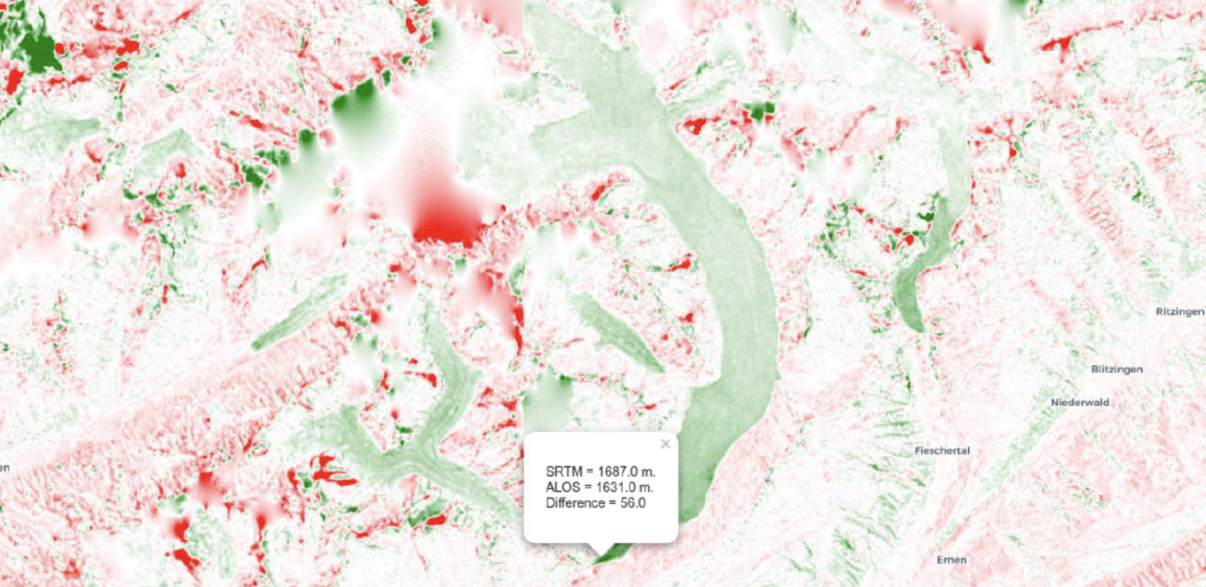
Thanks!

