Slide 1
FedEO Metadata Editor
Yves Coene (Spacebel s.a.), Andrea Della Vecchia (Randstad),
Damiano Guerrucci (ESA), Mirko Albani (ESA)
CEOS WGISS#50, Data Discovery and Access Session
22 September 2020

Slide 2
Outline
FedEO Evolution
Metadata editor overview
Future work
Conclusion

Slide 3





FedEO | Evolution
Preserving current discovery interfaces:
  OpenSearch (Atom responses)
  Embedded (XML) metadata records, e.g. ISO19139-2, OGC 10-157r4
Future version (ESE-ERGO) providing additional discovery interfaces:
  OGC API Features Core (OGC 17-069r3)
  OGC 17-047 (OpenSearch GeoJSON responses)
  Access to collection (OGC 17-084r1), service (OGC 19-020r1)
  and product metadata (OGC 17-003r2) in GeoJSON.
  STAC Catalog, STAC Collection, STAC API (v1.0.0)
Does support transactional interface:
  OpenAPI (read/write access: CRUD interfaces)

Slide 4
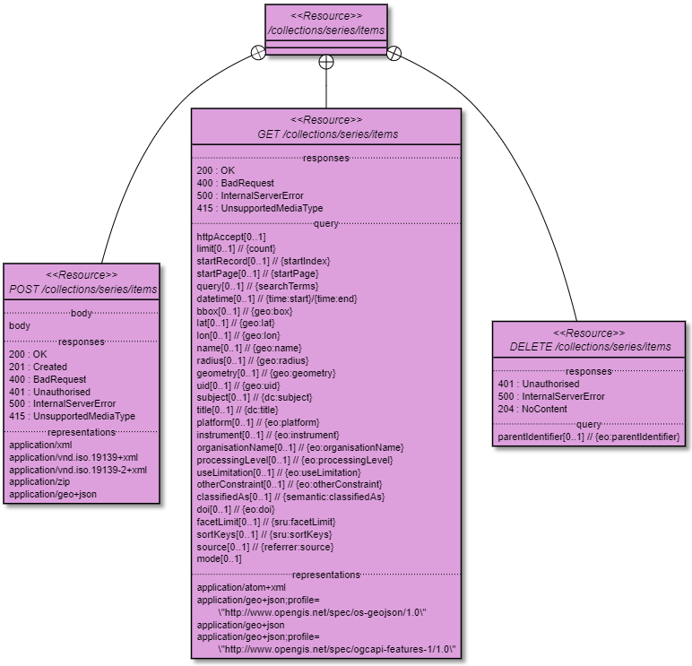
FedEO | Evolution
OpenAPI Definition
OGC API – Features Core
RESTful
“CRUD” interface
CRUD Create
Metadata Record
(POST)
Notes:
The forthcoming FedEO catalogue interface has a RESTful design, with resources (I.e. feature types) corresponding to “EO collections” (series), “EO granules” (datasets), “EO applications/services” (services). In addition to the Read interface (used by Opensearch requests) – GET method, also Creation (POST method), Update (PUT method) and Deletion (Delete method) of metadata records is supported for each of the feature types. The (Collection) Metadata Editor uses the feature type “series” and the associated CRUD interface shown on the slides. The payload of a POST can be any of the shown representations. It is future work to use the same mechanism for the feature type “services” to allow management of service/application metadata records in ISO and GeoJSON representations.

Slide 5
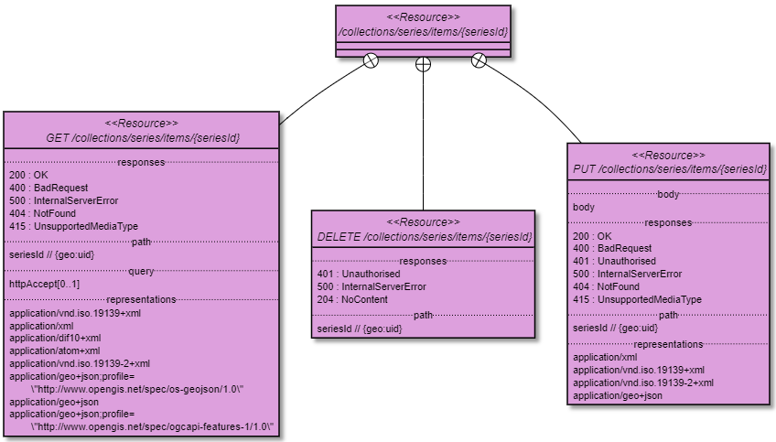
FedEO | Evolution
CRUD Update
Metadata Record
(PUT)
OpenAPI Definition
OGC API – Features Core
“CRUD” interface
CRUD Read
Metadata Record
(GET)
CRUD Delete
Metadata Record
(DELETE)

Slide 6
Metadata editor
Metadata editing: work in progress
  Software as a service (online)
  Collection metadata: ISO19139-2 / OGC 17-084 (GeoJSON)
Integration with
  ESA Thesauri, GCMD Vocabularies
  (science keywords, platforms, instruments)
  0 to n metadata catalogues
User roles
  Anonymous (no persistent workspace, no catalogue write access)
  Registered user (persistent workspace)
  Administrator (add users, add catalogues, …)

Slide 7
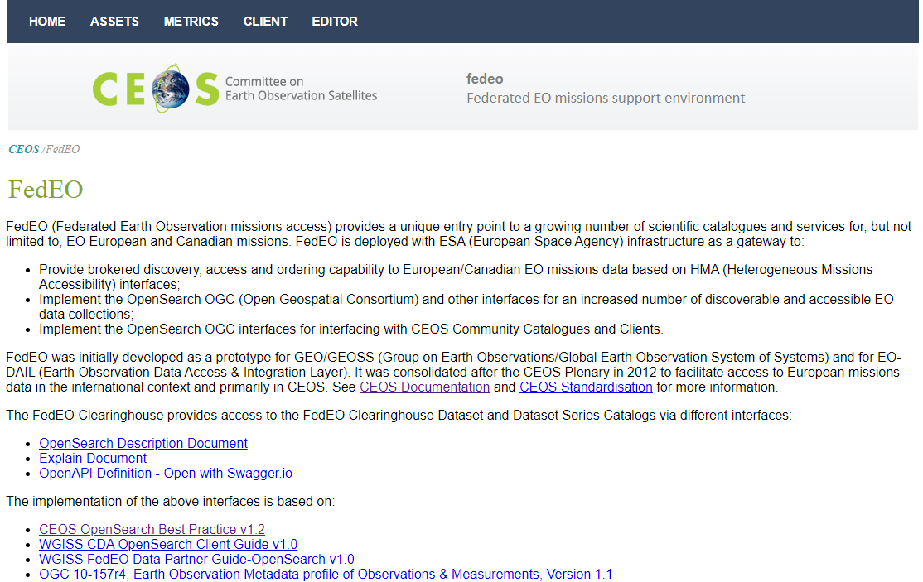
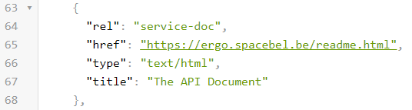
Metadata editor
API Landing Page provides access to readme page (rel=“service-doc”)
Readme page provides access to “Metadata editing” capability.

Slide 8
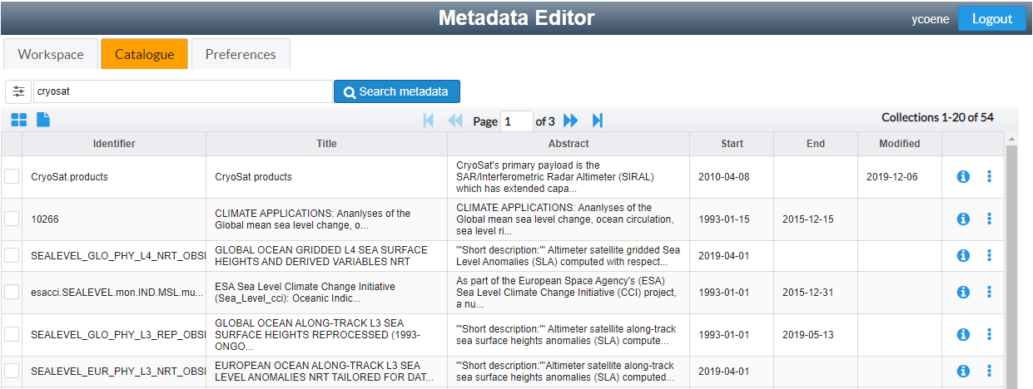
Metadata editor
Create new metadata records or start from a record in one of the connected OpenSearch catalogues or residing on your local harddisk.

Slide 9
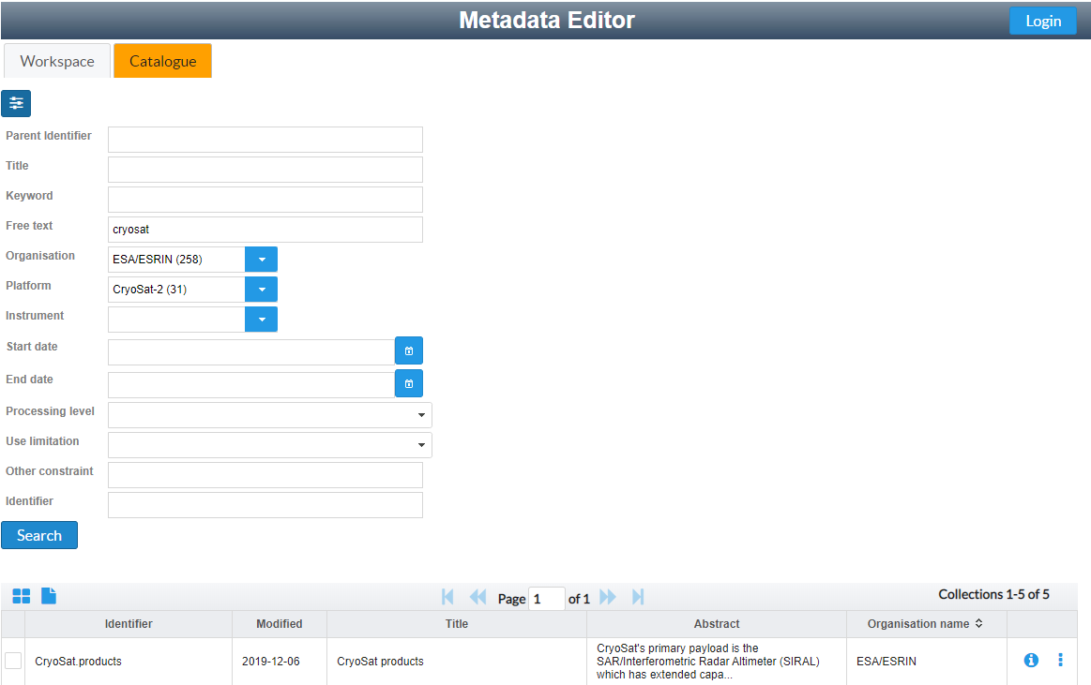
Metadata editor
Search records using free text search or any advertised OpenSearch parameter.

Slide 10
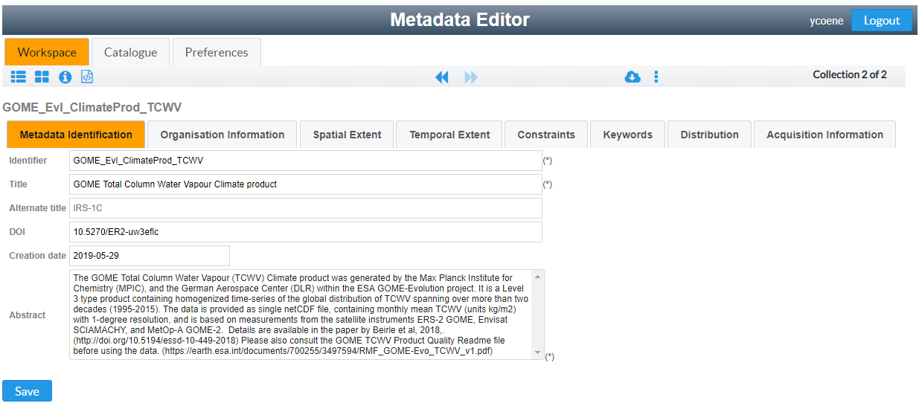
Metadata editor
Edit records in your private online workspace

Slide 11
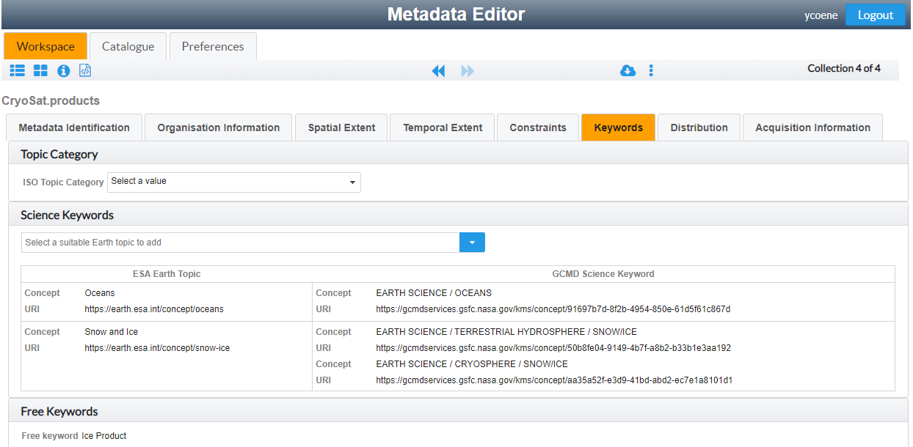
Metadata editor
Insert/update ESA controlled thesauri keywords and get equivalent GCMD science keywords automatically.

Slide 12
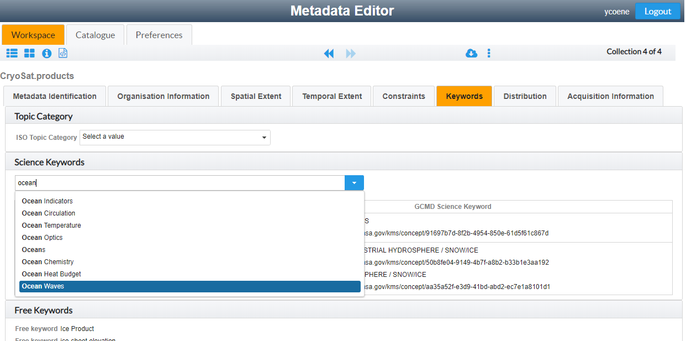
Metadata editor
Find science keywords in ESA thesauri

Slide 13
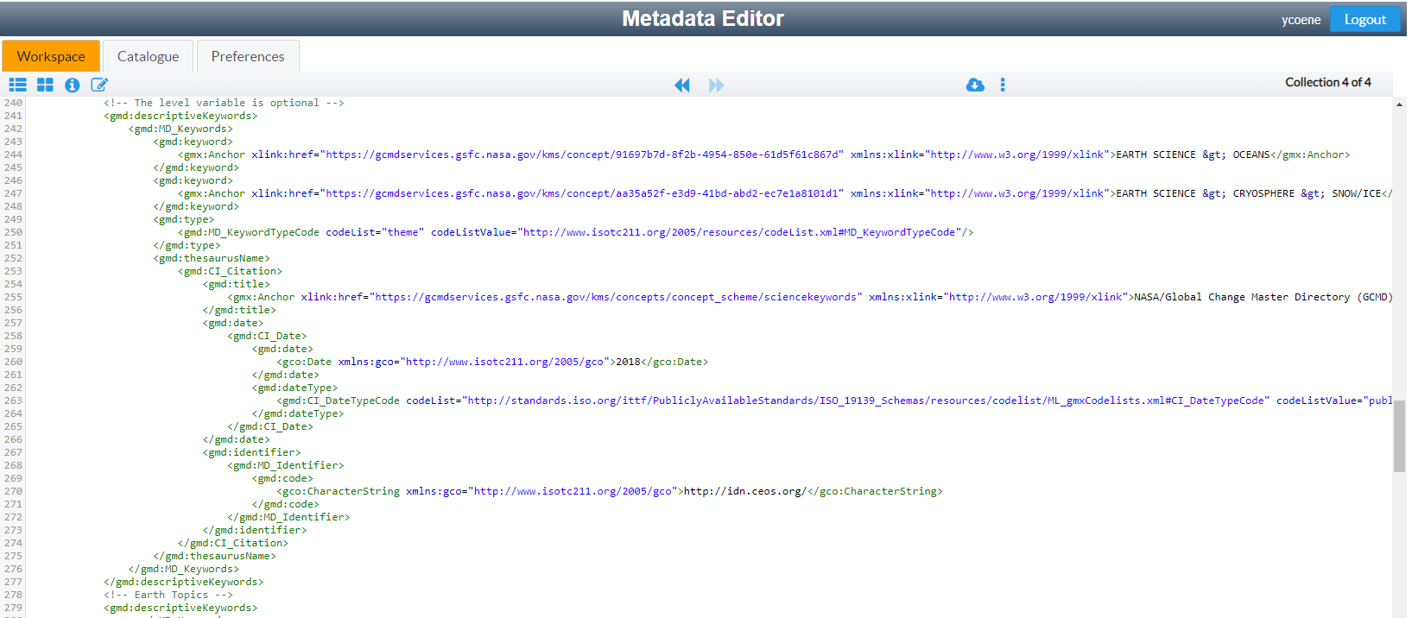
Metadata editor
View encoding of metadata. Multiple formats to be supported. Currently ISO19139-2 subset supported. GCMD controlled keywords inserted.

Slide 14
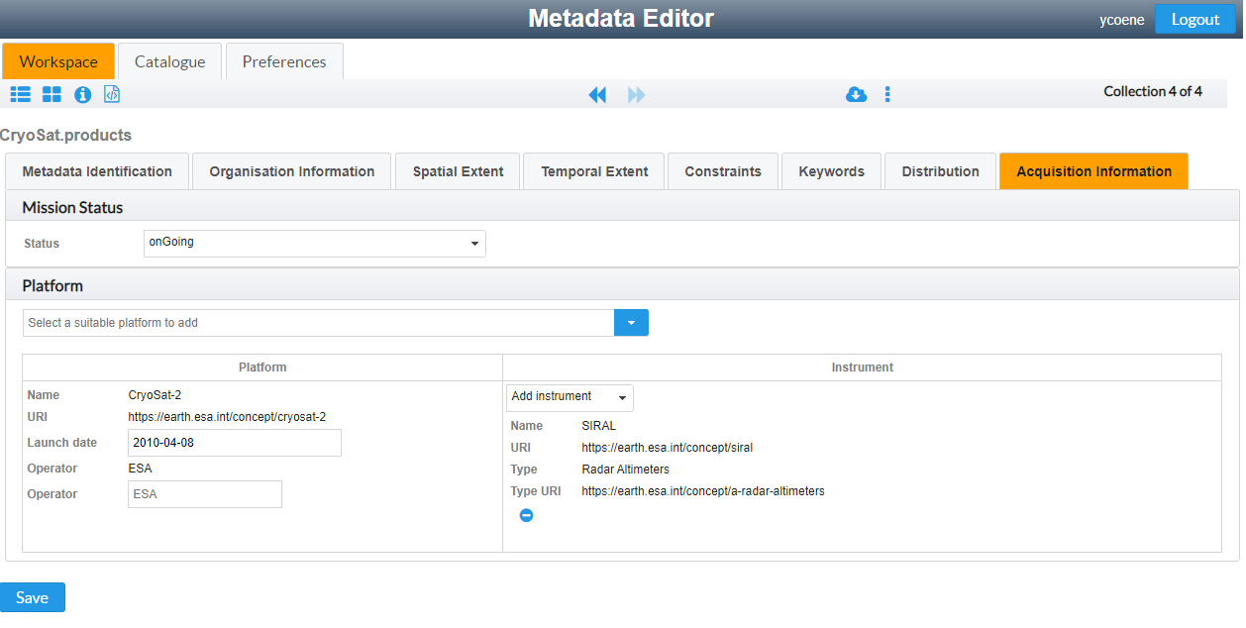
Metadata editor
Annotate metadata records with ESA controlled vocabularies (platforms, instruments. Proposes only instruments “hosted” by platform.
Automatic insertion of equivalent GCMD platform/instrument keywords in metadata.

Slide 15
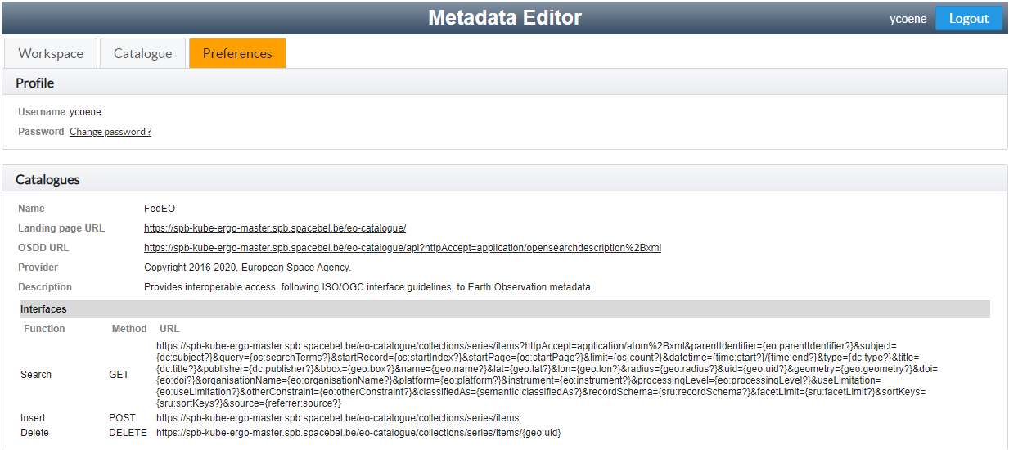
Metadata editor
Allows user to select “current catalogue” (if applicable)
Editor requests catalogue authentication and remembers for duration of session when attempting to copy records to catalogue.

Slide 16
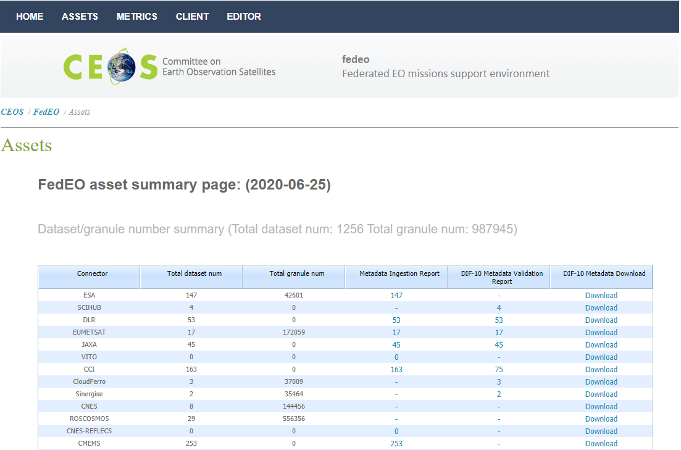
Metadata editor
Updated/new metadata records become available via “assets” page providing DIF-10 download possibility.

Slide 17
Future work
Iteration-2 of ESE-ERGO: Additional requirements to be implemented including:
  OGC 17-084 (GeoJSON) support – multiple views of same metadata record.
  Higher-level support for “offering” encoding (in Distribution section).
Support service/application metadata
  Agree with CEOS WGISS SLT how to support service discovery in Opensearch OSDD: extend “CEOS-BP-003” with rel=“service” ?
  Create initial service metadata record content automatically from on-line capabilities (WMS, WMTS, WCS, WPS, …)
  Support multiple views: ISO and OGC 19-020r1
  Ensure INSPIRE (service) metadata compliance.
  Supporting linking service metadata records to collection metadata records (srv:operatesOn).
Notes:
See http://ceos.org/document_management/Working_Groups/WGISS/Interest_Groups/OpenSearch/CEOS-OPENSEARCH-BP-V1.2.pdf
CEOS-BP-003 - rel attribute of the URL in OSDD [Recommended] CEOS recommends the use of rel attribute of Url element in OSDD in the following manner:
● rel=”collection” to advertise collection level search query URL
● rel=”results” (default) to mean granule level search query URL

Slide 18
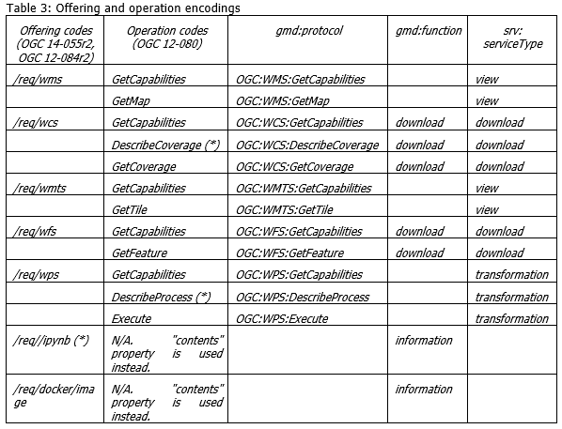
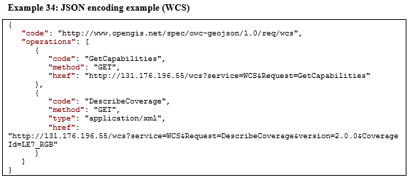
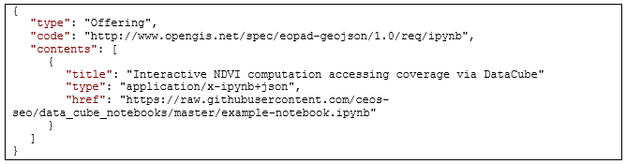
Future work
Support OGC “offering” encodings in ISO and GeoJSON metadata representations
Agree with CEOS WGISS SLT on “offering codes” (e.g. Jupyter notebooks) if missing in OGC 14-055r2 (distributionInfo/*/transferOptions/*/onLine/*/linkage).
Notes:
OGC 14-055r2 Offering encoding applies to both Collection metadata and service/application metadata and is described in OGC 17-084r1 and OGC 19-020r1. The same info is to be encoded in the equivalent ISO metadata encodings, taking into account INSPIRE Technical Guidance. Additional offering types/codes are to be supported to encode OGC API style interfaces, Jupyter Notebooks (by reference or by value), Docker containers etc.

Slide 19
Conclusion
Advantages
  Facilitates collection metadata creation and maintenance.
  Simplifies integration with ESA and GCMD thesauri.
  Takes care of syntactical issues and minimal info for DIF-10 export feasibility.
  Exploits OpenSearch interfaces and RESTful interface with Catalogues.
Current status
  Work performed under ESA ESE-ERGO technology project.
  Metadata editor software being validated/extended.
Next steps
  Completion of project Phase 1 expected September 2020.
  Publication as open-source at end of Phase 2 of the project (2021)

Slide 20
More info and references
http://ceos.org/ourwork/workinggroups/wgiss/access/fedeo/
https://wiki.services.eoportal.org/tiki-index.php?page=ESE-ERGO

