Slide 1

Jupyter Notebooks Survey Results, Discussion on participation and Developing a Best Practice
CEOS WGISS 50 - Virtual Meeting
Wednesday 23rd Sept 2020
Esther Conway (UKSA - NCEO – CEDA)

Slide 2
29
Pixalytics Ltd | Satellite Applications Catapult | US Naval Research Laboratory
UK Hydrographic Office | CEDA - NCEO | NASA/JPL/PODAAC
JAXA | German Aerospace Center | NASA/JPL
Telespazio VEGA UK | CNES | NASA
NCEO University of Sheffield | Farallon Institute | NASA
Jet Propulsion Laboratory | RSAC c/o European Space Agency | Assimila
Comisión Nacional de Actividades Espaciales (Argentine Space Agency) | ORNL DAAC | NASA
NASA/ASDC | National Snow and Ice Data Center | NASA/Ocean Biology Distributed Active Archive Center (OB.DAAC)
CSIRO | Friedrich-Schiller University Jena | Gabonese Agency for Studies and Space Observations (AGEOS)
Total Responses as of Friday, June 26, 2020
More anticipated by Virtual Meeting
Action: Collaboration and developing a Community of Interest – Who else do we want to reach ?

Slide 3
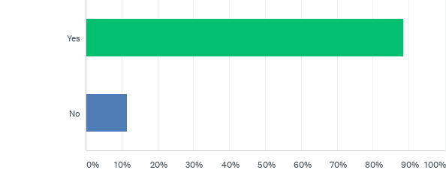
Q4: Do you or the institutions you support currently use Jupyter Notebooks.
Action: Collaboration and developing a Community of Interest – Who else do we want to reach ?

Slide 4
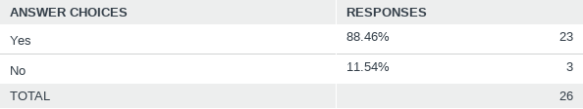
Q4: Do you or the institutions you support currently use Jupyter Notebooks.

Slide 5
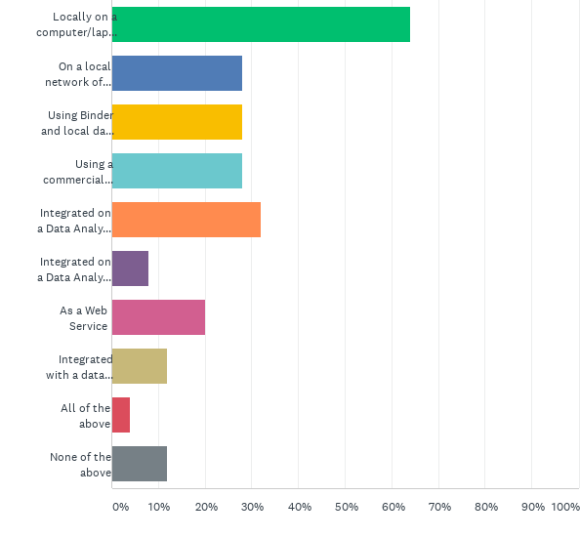
Q5: How do you currently run Jupyter Notebooks?

Slide 6
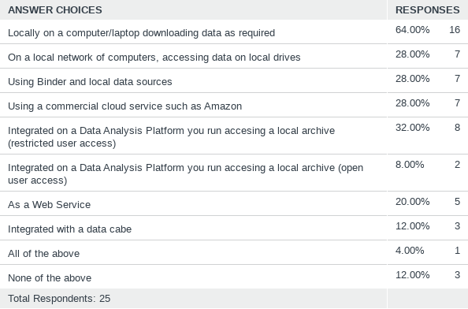
Q5: How do you currently run Jupyter Notebooks?
Action: Training Capabilities (online access to Jupyter Notebooks and Data)

Slide 7
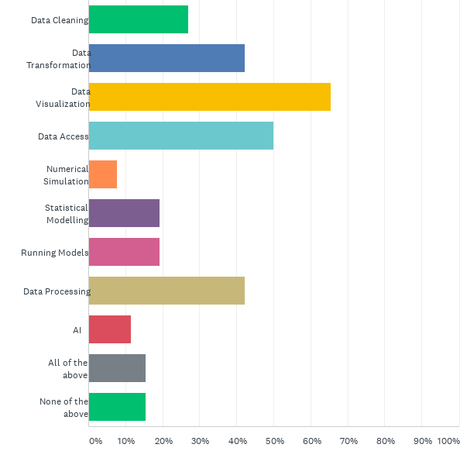
Q6: What are you using Jupyter notebooks to do?

Slide 8
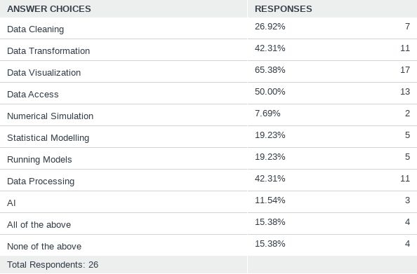
Q6: What are you using Jupyter notebooks to do?

Slide 9
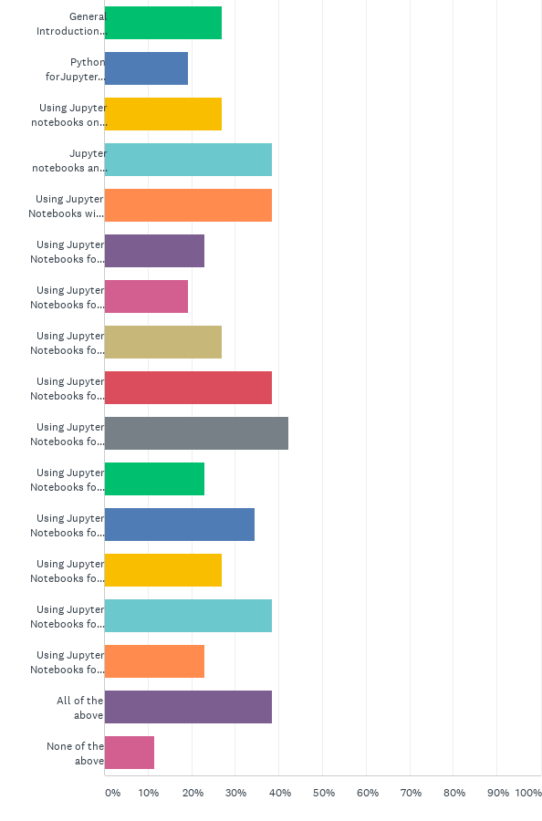
Q7: Would you interested in attending a webinar or training session on the following topics (tick all that apply)?

Slide 10
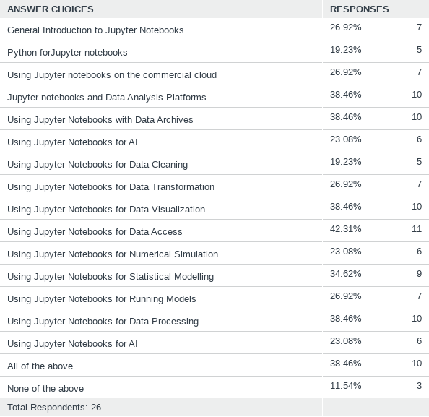
Q7: Would you interested in attending a webinar or training session on the following topics (tick all that apply)?

Slide 11
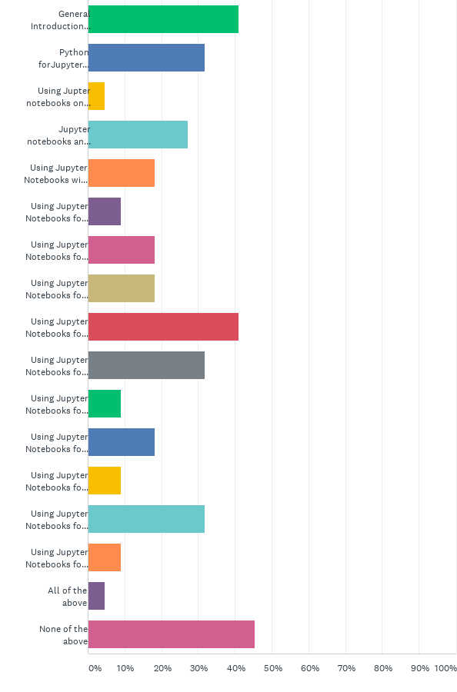
Q8: Could you contribute to a webinar or training session on the following topics (tick all that apply)?

Slide 12
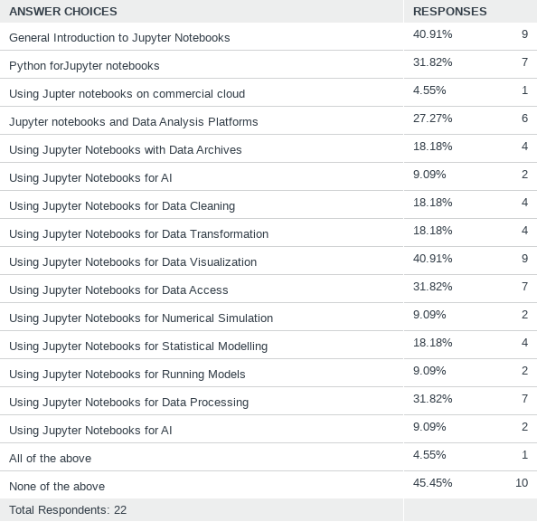
Q8: Could you contribute to a webinar or training session on the following topics (tick all that apply)?
Introduction to Jupyter Notebooks
Tech Expo Webinars

Slide 13
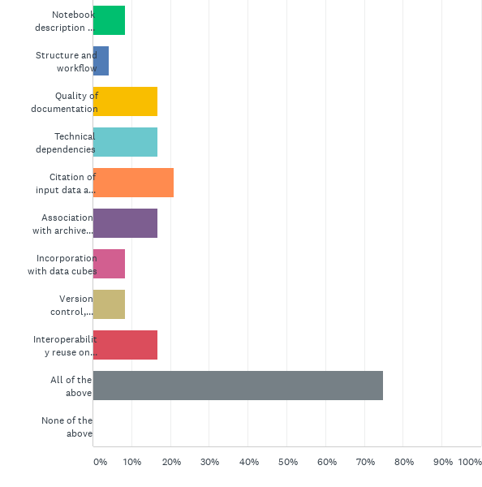
Q11: Do you you think the CEOS community would benefit from best practice advice on any of the following area?

Slide 14
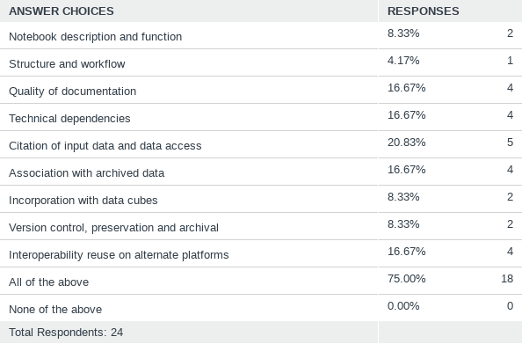
Q11: Do you you think the CEOS community would benefit from best practice advice on any of the following area?

Slide 15
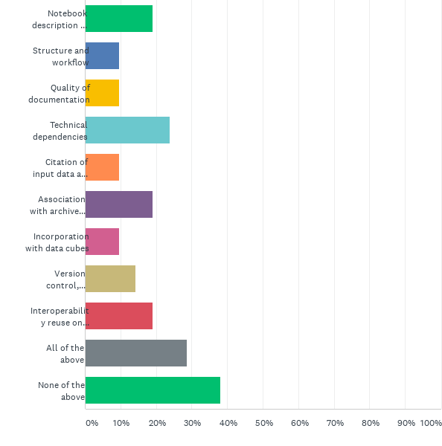
Q12: Would you or another representative from your agency be willing to contribute to the development of best practice in any of the following areas?

Slide 16
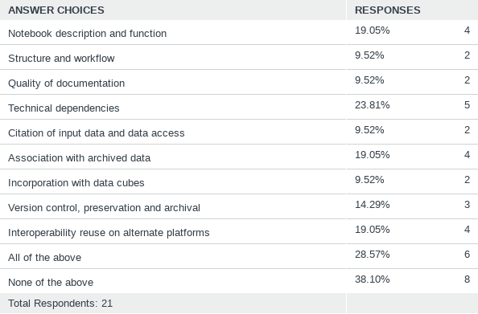
Q12: Would you or another representative from your agency be willing to contribute to the development of best practice in any of the following areas?
Best Practice Document

Slide 17
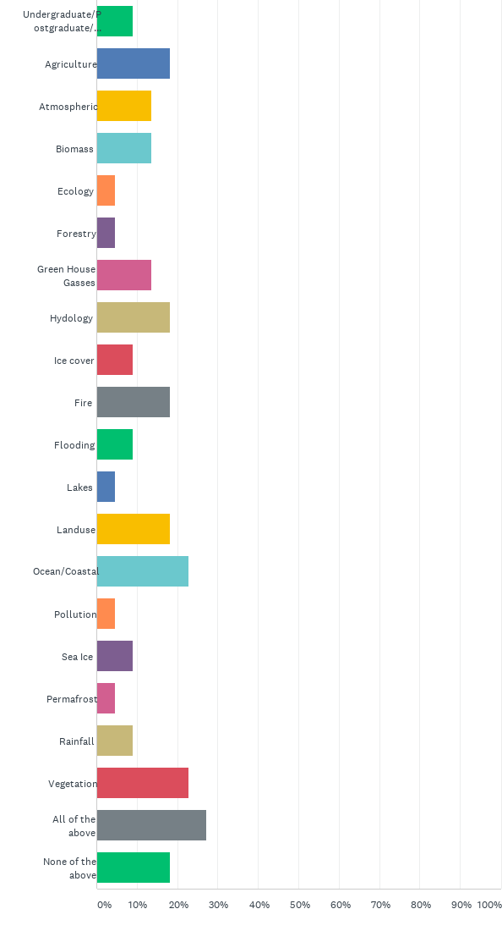
Q14: Do you support any of the following application domains that might also benefit from the reuse or adaption of high quality archived Jupyter notebooks (please tick all that apply)

Slide 18
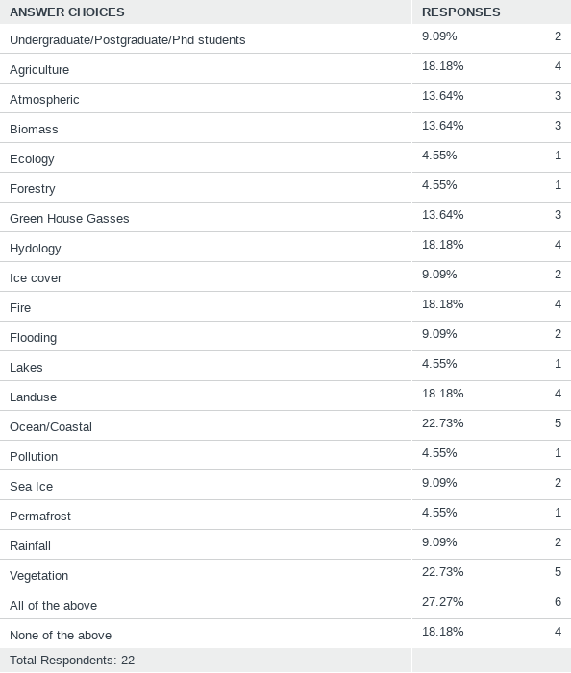
Q14: Do you support any of the following application domains that might also benefit from the reuse or adaption of high quality archived Jupyter notebooks (please tick all that apply)
Preservation and CEOS repository
Domain Specific /CapD Webinars

Slide 19
Actions !
CaoD , GEO ?, CODATA ?, WGISS
Data Discovery and Access
Collaboration and developing a Community of Interest
Training Capabilities (online access to Jupyter Notebooks and Data)
Data Interoperability and Use
Best Practice Document
Tech Expo
Introduction to Jupyter Notebooks
Data Preservation and Stewardship
CaoD/WGISS
Preservation and CEOS repository
Domain Specific /CapD Webinars
Tech Expo Webinars
Tech Expo

Slide 20
Any other comments?
Contact Us !
esther.conway@stfc.ac.uk

