Slide 1
Federated Earth Observation (FedEO)
Yves Coene (Spacebel), Andrea Della Vecchia (Randstad),
Damiano Guerrucci (ESA), Mirko Albani (ESA)
CEOS WGISS#50
22 September 2020

Slide 2
Outline
FedEO current metrics and DIF-10 export status
ESA PDGS Collaborative Environment
FedEO evolution activities (ESE-ERGO)
  Web interface FedEO Metrics
  API evolution
  Metadata editor
Future FedEO evolution activities (EOVOC)
  schema.org
  online/offline implementation

Slide 3
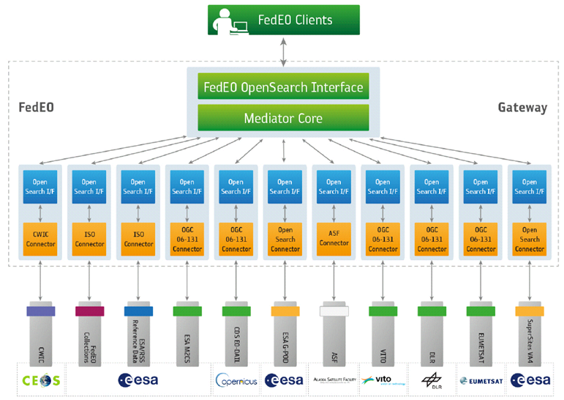
FedEO: Federated Earth Observation Gateway System
FedEO = Federated Earth Observation missions access
The FedEO system provides a unique entry point to a growing number of scientific catalogues and services.

Slide 4
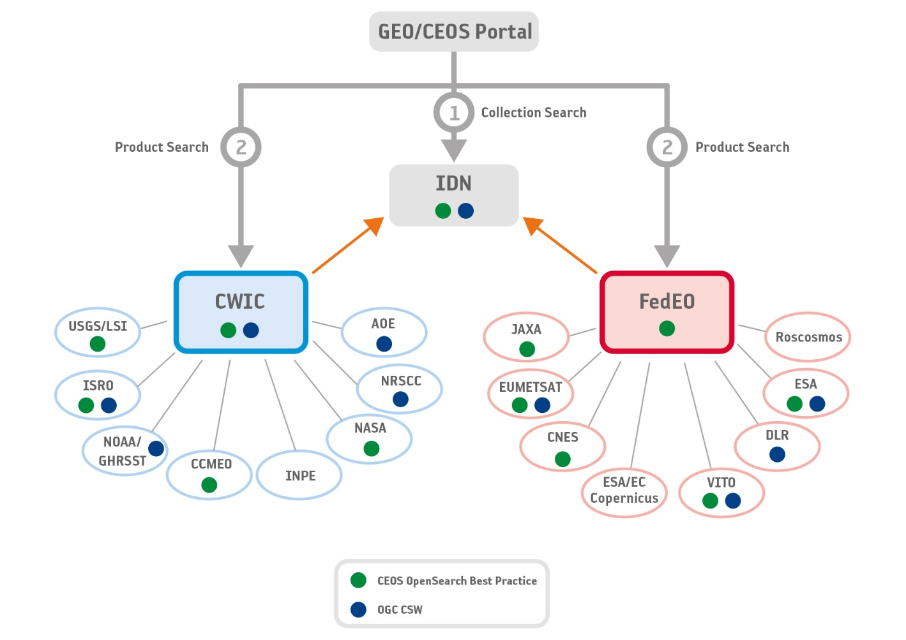
WGISS Connected Data Assets

Slide 5
FedEO Metadata Mediator
Automatic Procedure – Available on FedEO reference environment, on Operational environment at ESA since Oct 2019
Partner Metadata repository
Metadata Import
Harvester tool
Metadata Preparation
Metadata Mediator
IDN
Complementary
Information
gcmd keyword
Metadata Preparation
IDN guideline for Information Content completeness and consistency (HERE)
ESA Thesauri Service
FedEO Collection Catalogue
FedEO Gateway
ISO to DIF-10
DIF-10 Validator
(HERE)
DIF-10 Validation
Metadata Export
DIF-10 Encoding
IDN
repository

Slide 6
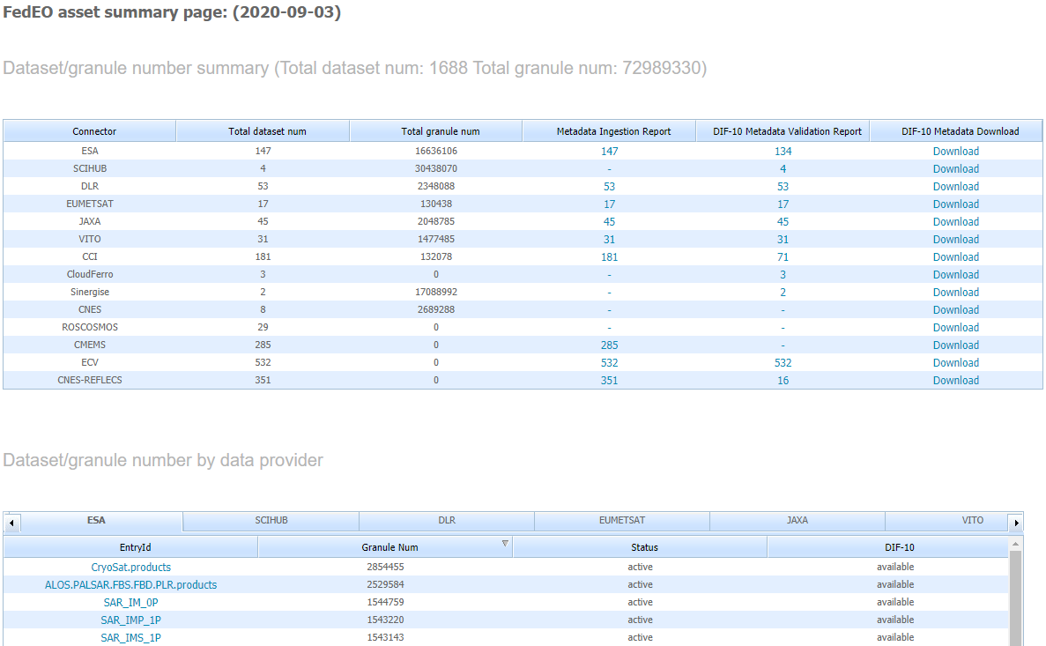
DIF-10 Metadata Export
http://geo.spacebel.be/opensearch/asset/index.html
Most of harvested collections are ready for being ingested into IDN, e.g.
EUMETSAT 17/17
ESA 134/147
DLR 53/53
VITO 31/31
JAXA 45/45
ECV 532/532
Some effort still required on CCI (71/181), CMEMS (0/285), CNES (16/351)
DIF-10 collections are ready for being ingested in to IDN, from
https://fedeo.esa.int/asset/index.html
Notes:
Copernicus MEMS has recently made changes to their collection metadata which require updates at FedEO site. Analysis is underway.

Slide 7
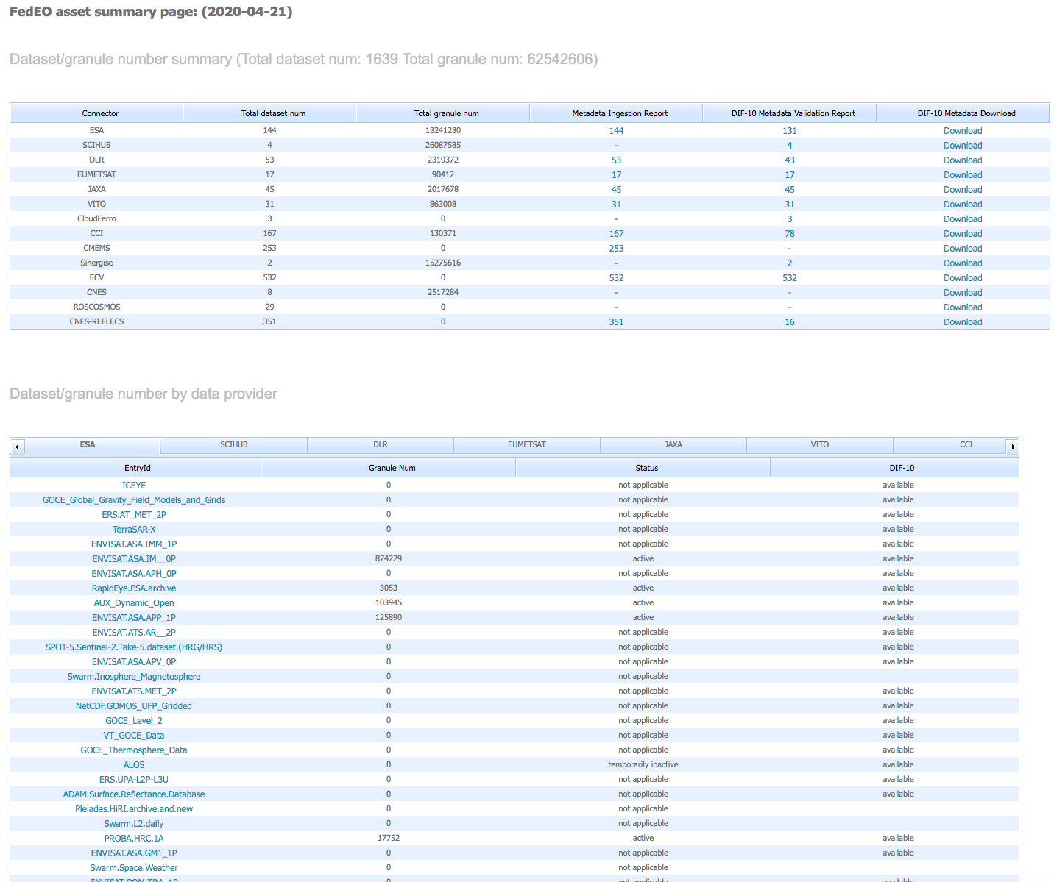
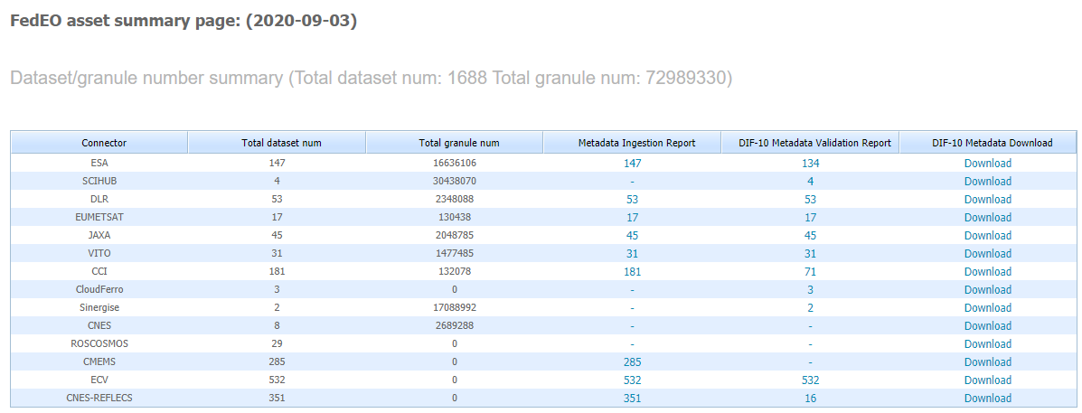
Metrics evolution
62 million to 72 million granules (+16%) since WGISS-49

Slide 8
ESA PDGS Collaborative Environment
To provide the ESA PDGS with a set of interoperable and federated services permitting the users to:
Access to missions/platforms information supported by a common ontology
Discovery and, if possible, direct access to EO and in-situ data:
  Copernicus Missions (e.g. Sentinels)
  Third Party Missions - TPMs (e.g. SPOT, Landsat, …)
  Heritage Missions - HMs (e.g. ERS-1/2, ENVISAT, …)
  Earth Explorer – EEs (e.g. SMOS, Cryosat, SWARM, …)
  International repositories (e.g., NASA CMR, CEOS IDN)
Discovery and access to exploitation services (e.g. datacube):
  Browse/visualization tools for time series analysis
  EO data extraction, resampling and reprojection
Hosted Processing for authorised users/communities (e.g. CAL/VAL)

Slide 9

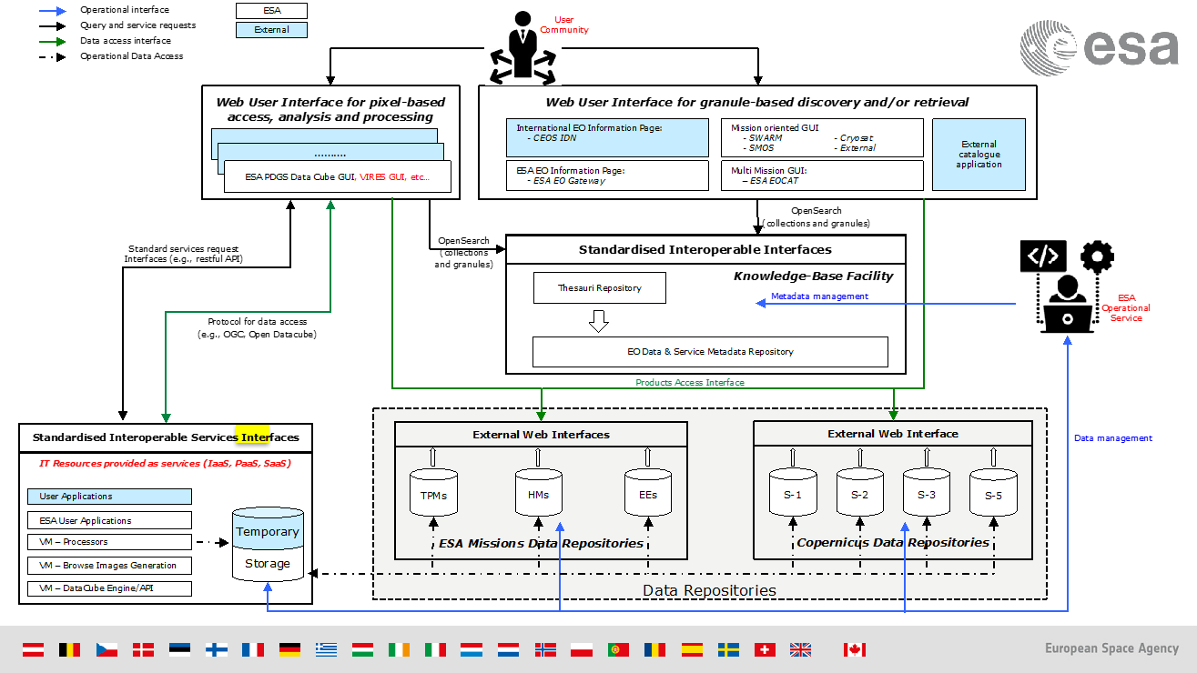
ESA Catalog
ESA Catalog:
is the centralised metadata repository of ESA Collaborative Environment
reuses same FedEO SW
manages collections Digital Object Identifiers (DOIs)
is part of CEOS WGISS Data Asset via FedEO
Details of connected ESA Catalog

Slide 10
FedEO Evolution – ESE-ERGO
ESA GSTP Project “ESE-ERGO” (Dec ‘19 – Jul ‘21) aims to:
Adoption of OpenAPI, also encouraged by OGC, as standard interface for its services, in combination with JSON and GeoJSON
Analyse and adopt new international guidelines and standards to improve gateway/catalogue functionalities, performance and interoperability. This includes:
  Emerging GeoDCAT-AP specification to publish EO metadata
  OGC 13-026r9 to introduce enhanced functionalities (e.g., flexible string search, results ranking, links to EO external services)
  OGC 17-047 to provide a JSON based encoding response from OpenSearch interface (e.g., quicker catalogue response, ease User interface development)
Transition to an internal metadata model of which other metadata models are views, to allow more flexibility and to align to similar approaches applied by NASA (e.g., Unified Metadata Model – UMM/-C/-G/-S/-JSON). This includes:
  Recent OGC guidelines, in cooperation with CEOS/NASA, about collection and product metadata model based on GEO-JSON(-LD) encoding (e.g., OGC 17-084, OGC 17-003r2)
  Generalization of the concept of catalogue entry in order to consider granules (/products), collections (aggregation of granules/products) and services related to both of them (e.g., remote processing, datacube, etc…) seamlessly (e.g., GeoDCAT-AP, ISO 19115-1 & ISO 19115-3, etc…)
Web-based metadata management tool to allow authorised users to add/modify collection catalogue entries
CEOS Data Metrics collection

Slide 11
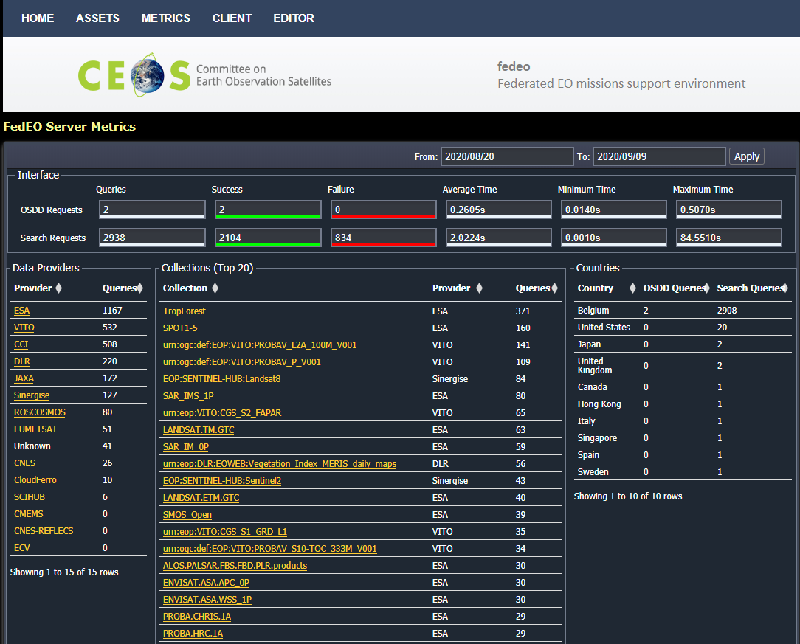
(1) Web interface FedEO Metrics
CEOS data access metrics
Ongoing work, part of evolution activities (ESE-ERGO): https://ergo.spacebel.be/metrics/
Web interface deployed in test environment.
Not yet in operational use.

Slide 12
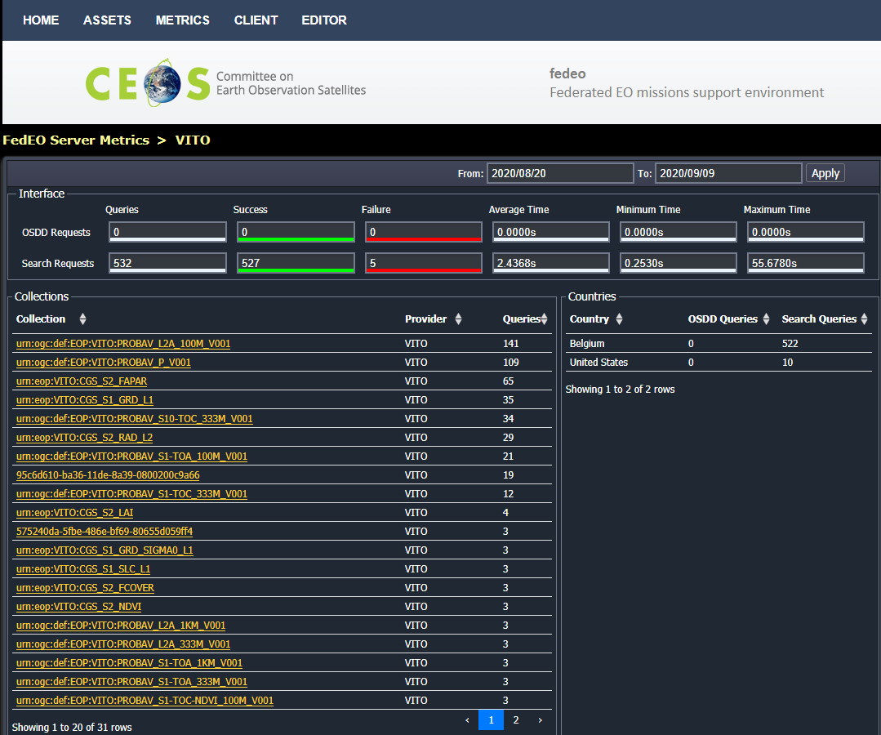
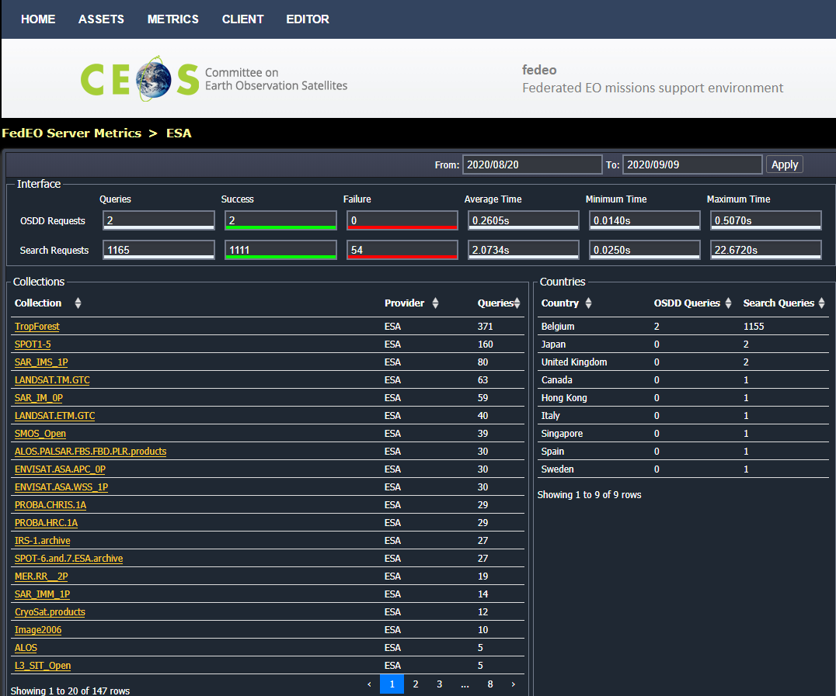
Web interface FedEO Metrics

Slide 13
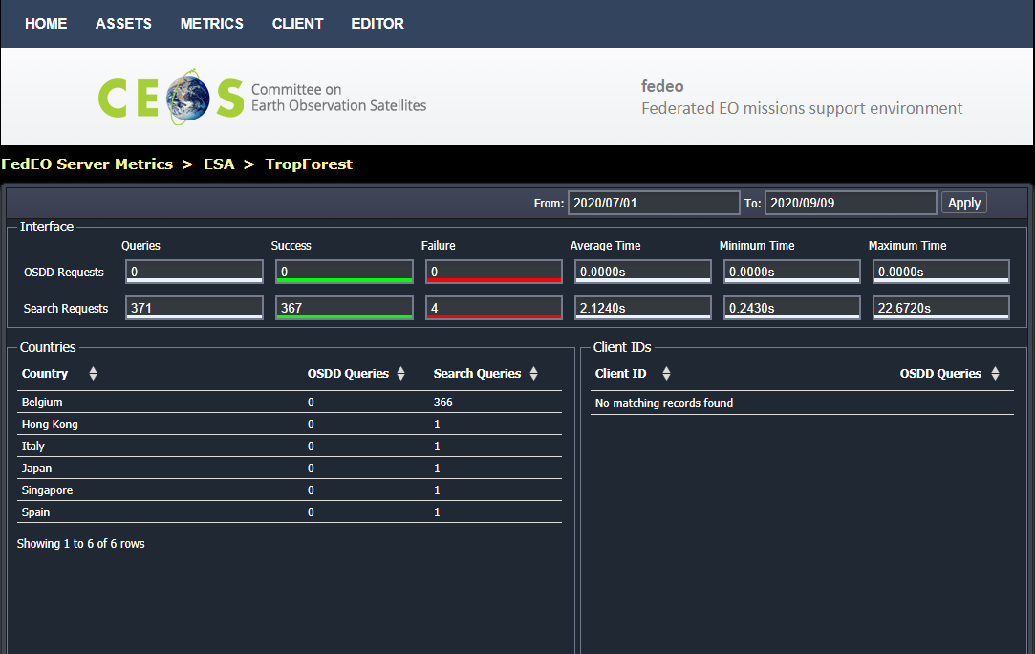
Web interface FedEO Metrics

Slide 14
Web interface FedEO Metrics
May need to define/implement additional metrics
  Metrics for alternative protocols like STAC ?
  Have metrics per media type (Atom, GeoJSON, ..) to get info about user preferences, preferred formats ?

Slide 15





(2) FedEO API Evolution
Preserving current discovery interfaces:
  OpenSearch (Atom responses)
  Embedded (XML) metadata records, e.g. ISO19139-2, OGC 10-157r4
Future version (ESE-ERGO) providing additional discovery interfaces:
  OGC API Features Core (OGC 17-069r3)
  OGC 17-047 (OpenSearch GeoJSON responses)
  Access to collection (OGC 17-084r1), service (OGC 19-020r1)
  and product metadata (OGC 17-003r2) in GeoJSON.
  STAC Catalog, STAC Collection, STAC API (v1.0.0)
New transactional interface:
  OpenAPI (read/write access: CRUD interfaces)

Slide 16
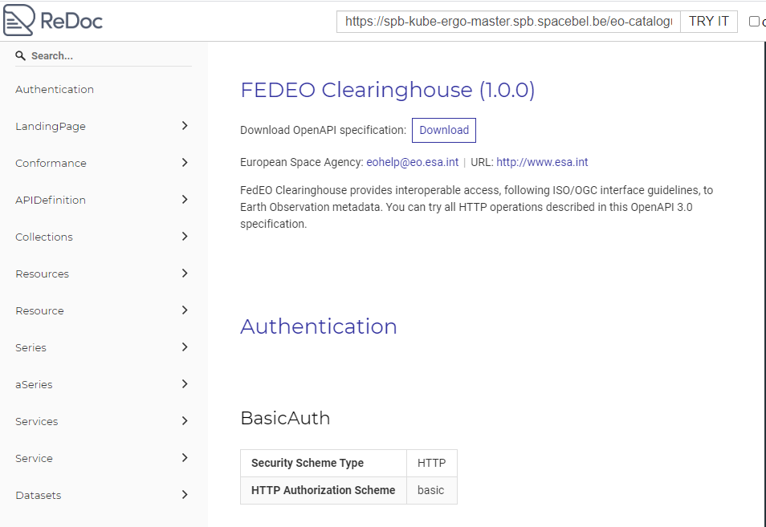
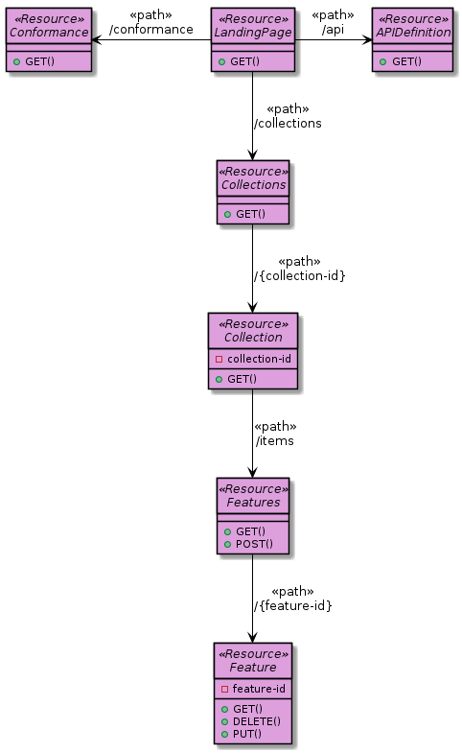
(2) FedEO API Evolution
API aligned with OGC API – Features and

Slide 17
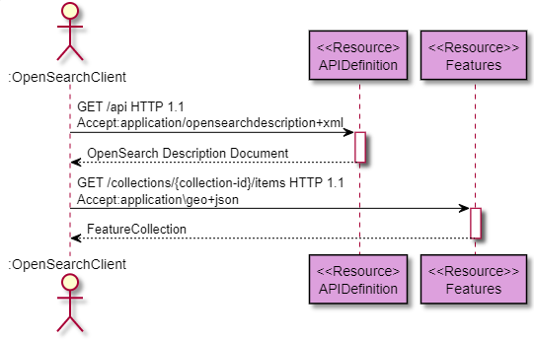
(2) FedEO API Evolution
OpenSearch (OSDD) accesses OGC API features API (using content negotiation)
Multiple response formats
Additional queryables planned: faceted search, eo:doi, sorting, …

Slide 18
(3) Metadata editor
Metadata editing: work in progress
  Software as a service (online)
  Collection metadata: ISO19139-2 / OGC 17-084 (GeoJSON)
Integration with
  ESA Thesauri, GCMD Vocabularies
  (science keywords, platforms, instruments)
  0 to n metadata catalogues
User roles
  Anonymous (no persistent workspace, no catalogue write access)
  Registered user (persistent workspace)
  Administrator (add users, add catalogues, …)

Slide 19
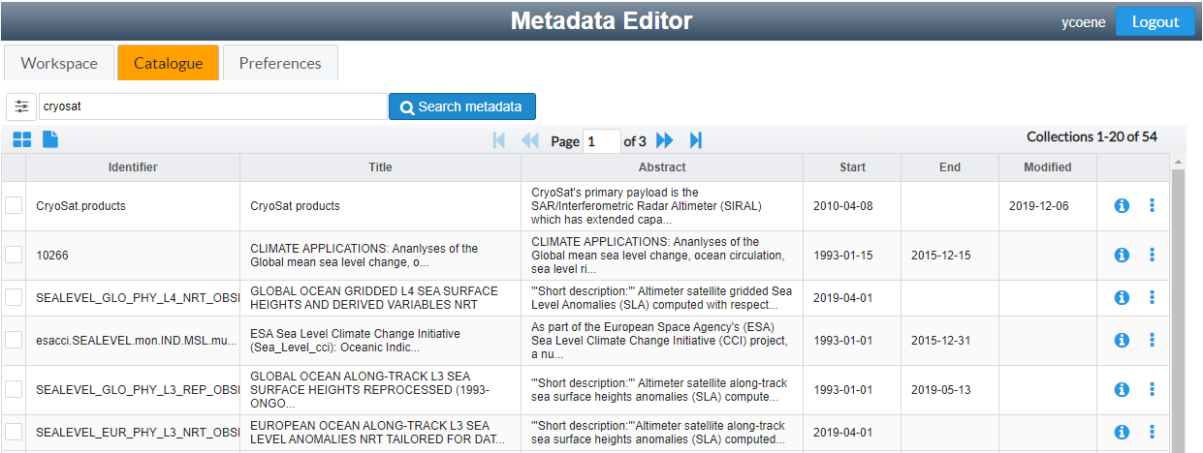
(3) Metadata editor
Create new metadata records or start from a record in one of the connected OpenSearch catalogues or residing on your local harddisk.

Slide 20
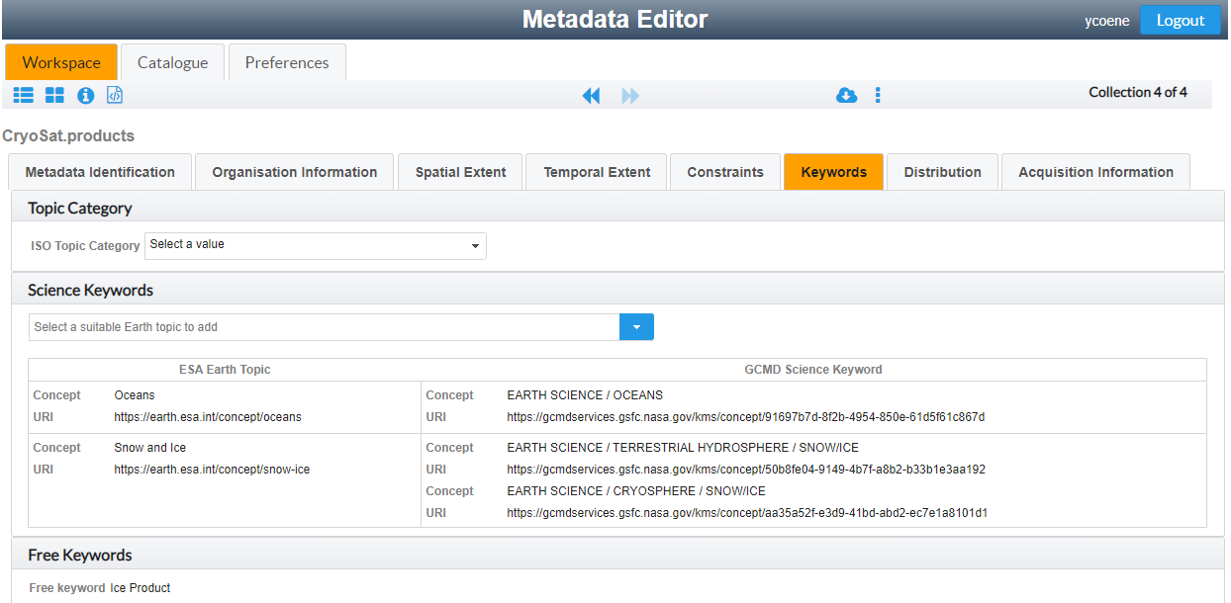
(3) Metadata editor
Insert/update ESA controlled thesauri keywords and get equivalent GCMD science keywords automatically.

Slide 21
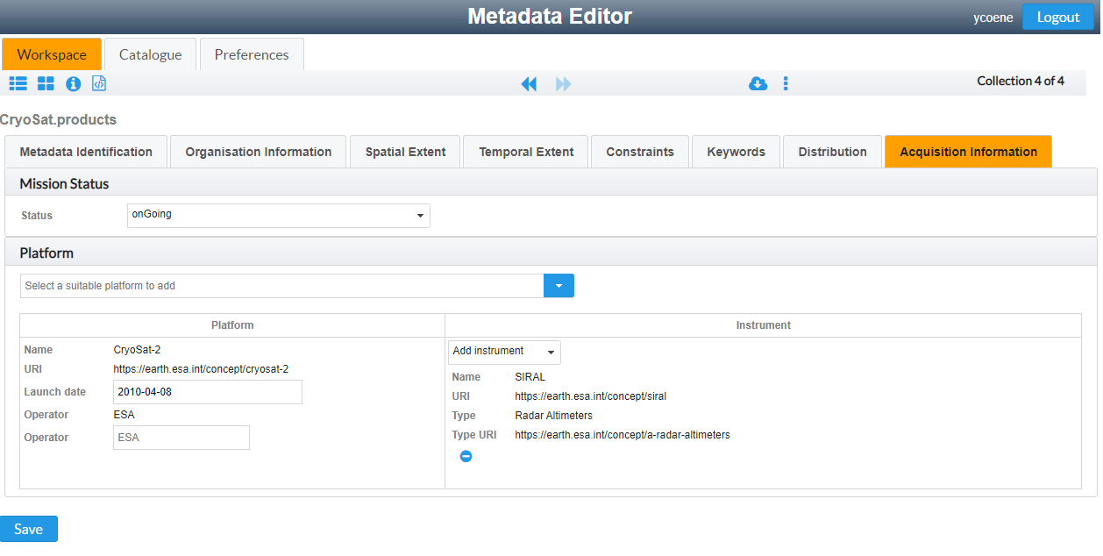
(3) Metadata editor
Annotate metadata records with ESA controlled vocabularies (platforms, instruments. Proposes only instruments “hosted” by platform.
Automatic insertion of equivalent GCMD platform/instrument keywords in metadata.

Slide 22
Future FedEO Evolution – EOVOC
ESA GSTP Project “EOVOC” (oct ‘20 – apr ‘22) objectives:
Obj1: Propose and standardise the use of Schema.org for representing EO collections, products and services, and facilitate discovery of this information through the large search engines. Taking into account:
  Google Dataset Search Tool Capabilities White Paper, CEOS.WGISS.GDSTC Issue 1.0, September 2019.
  CEOS OpenSearch Best Practice, Issue 1.2, Annex C “Search-engine-friendly Catalog”,
  OGC GeoJSON-LD metadata encodings (OGC 17-084r1, OGC 17-003r2, …).
  GeoDCAT-AP
  Schema.org representation DCAT-AP by JRC (https://github.com/ec-jrc/dcat-ap-to-schema-org)
  ESIPFed/science-on-schema.org, "Schema.org Publishing Guidelines for the Geosciences", V1.1.0
  https://www.w3.org/TR/vocab-dcat-2/#dcat-sdo.

Slide 23
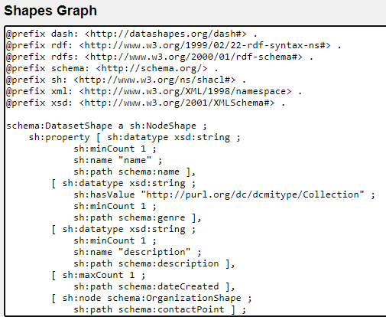
Future FedEO Evolution – EOVOC
Consider W3C SHACL for validating implementations.

Slide 24
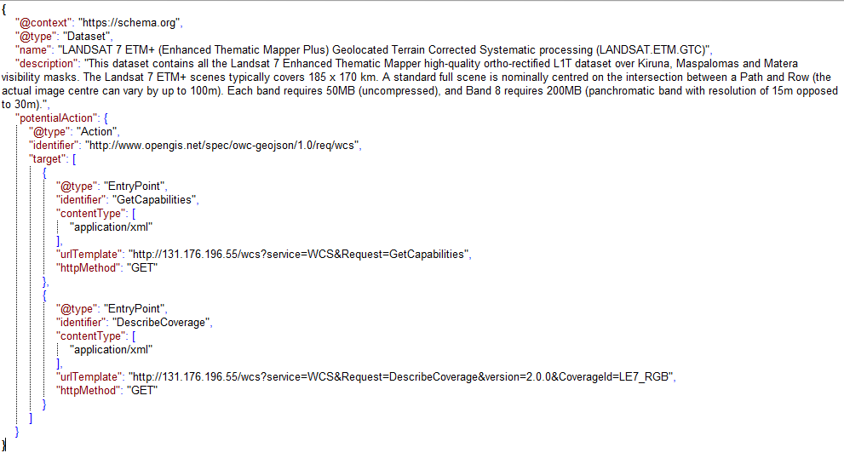
Future FedEO Evolution – EOVOC
Proposed schema.org encoding also to consider encoding of search interface endpoints and other offerings using “potentialAction” and (Search)Action objects.

Slide 25
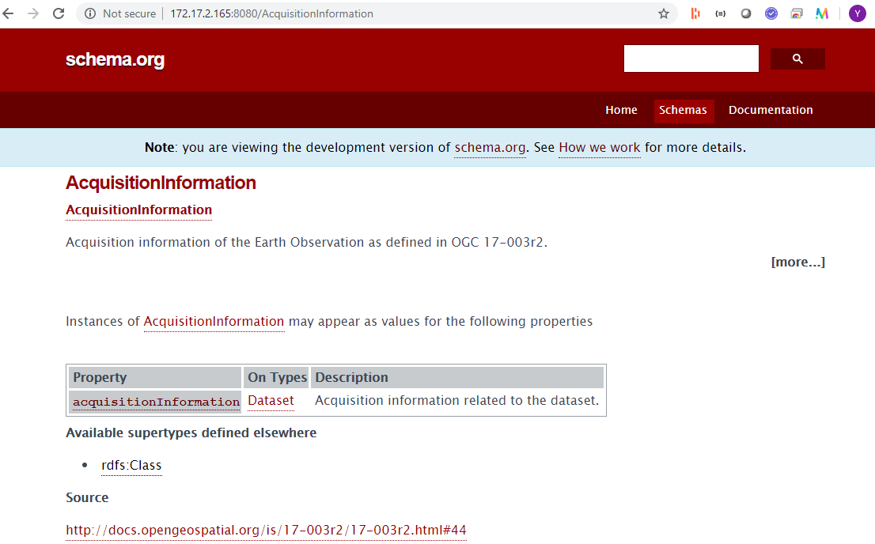
Future FedEO Evolution – EOVOC
May require extension (https://schema.org/docs/extension.html) of schema.org when existing vocabulary is insufficient.
Notes:
The schema.org toolset can be reused to document extensions to schema.org (for EO) using the similar Web pages as the original schema.org web site.

Slide 26
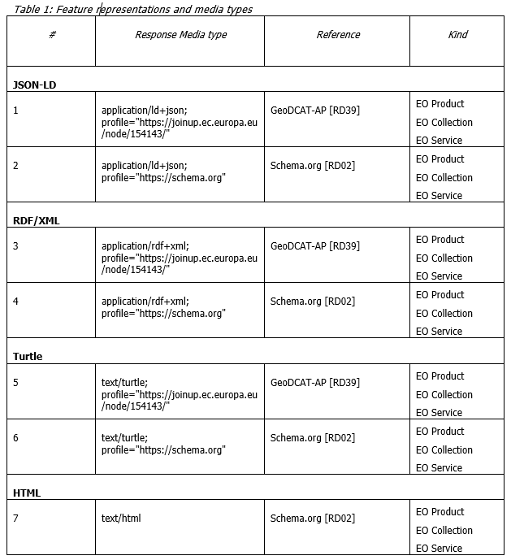
FedEO Evolution – EOVOC
Obj2: Online and offline implementations
of proposed encodings.
  Additional FedEO API response media types
  (linked data)
  Provide access to Google crawler to encodings

Slide 27
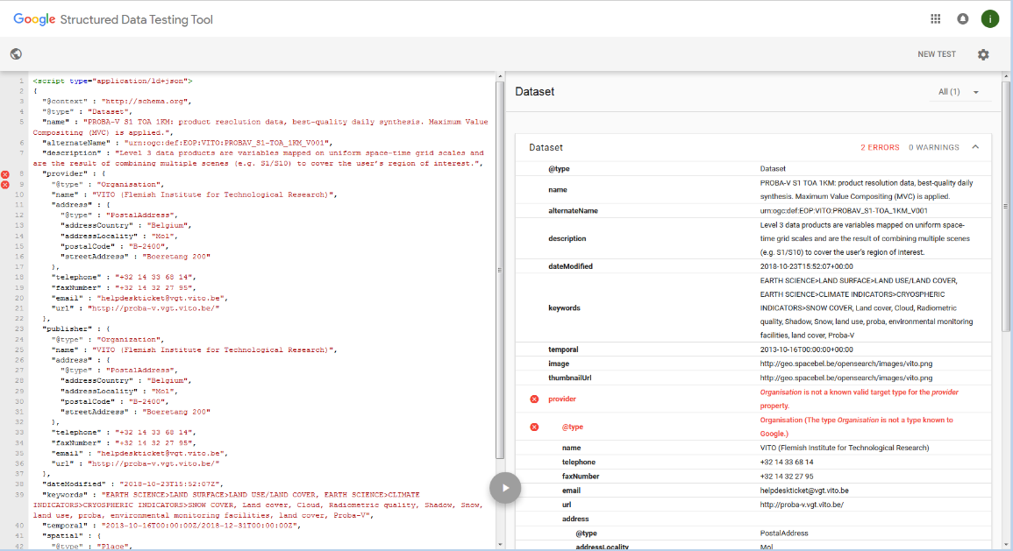
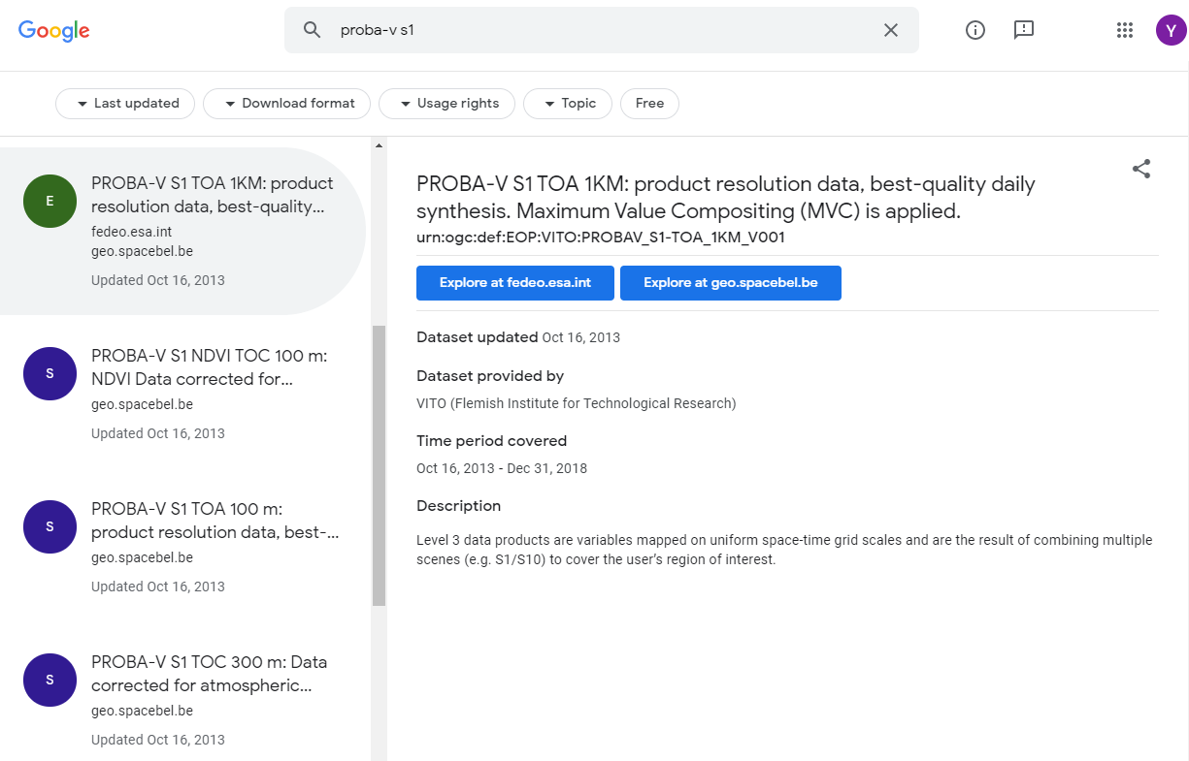
FedEO Evolution – EOVOC
Online implementation is expected to improve Google Dataset search results for EO collections from FedEO Partners.

