Slide 1

CEOS Executive Officer Report
Committee on Earth Observation Satellites
Kerry Ann Sawyer, CEOS Executive Officer
CEOS WGISS-50
Virtual Meeting
22 September 2020

Slide 2
Overview
CEOS 2020-2022 Work Plan
CEOS Online Deliverables Tracking Tool
Highlights from SIT Technical Workshop 2020
Connections to GEO (via WGISS)

Slide 3
CEOS 2020-2022 Work Plan
The expected outcomes for 2020-2022 reflect the ongoing and emerging priorities of CEOS, as characterized by its internal decision-making and external commitments. They are intended to focus on improved Earth observation (EO) systems coordination and enhanced data access for key global programs and initiatives.
Yes, July!

Slide 4
CEOS Priorities – A Reminder
Ensure that climate observation requirements identified by the Global Climate Observing System (GCOS) – and implications of the Paris Climate Agreement – are addressed.
Ensure, in the context of the Sendai Framework for Disaster Risk Reduction 2015-2030, that CEOS Agency data are made available in support of disaster risk reduction and that CEOS continues engagement with UN agencies and authorities.
Ensure that space-based Earth observations support the success of the next decade of the Group on Earth Observations (GEO), and that CEOS engagement in GEO governance and leadership is enhanced.
Proactively engage in global discussions on the critical challenges that face society, including attaining the 2030 Agenda for Sustainable Development.
CEOS operates on a best-efforts basis. Responsible CEOS Entities are expected to accomplish the Objectives/Deliverables identified in this document and the Online Tracking Tool to the best of their abilities.

Slide 5
Important Notes
136 Deliverables for 2020-2022
53 Existing/Carried over from Previous Work Plan
83 New
+ 10 CEOS Services

Slide 6
Next Steps – Road to Plenary
60 Deliverables have 2020 Completion Dates
  12 due 2020 Q1/Q2
  11 by 2020 Q3
  37 by 2020 Q4
Request updated status on following WGISS Deliverables
  DATA-18-02
  FDA-18-01
  DATA-17-04
  DATA-18-01
  DATA-20-01
  VC-20-08
  SDG-20-07

Slide 7
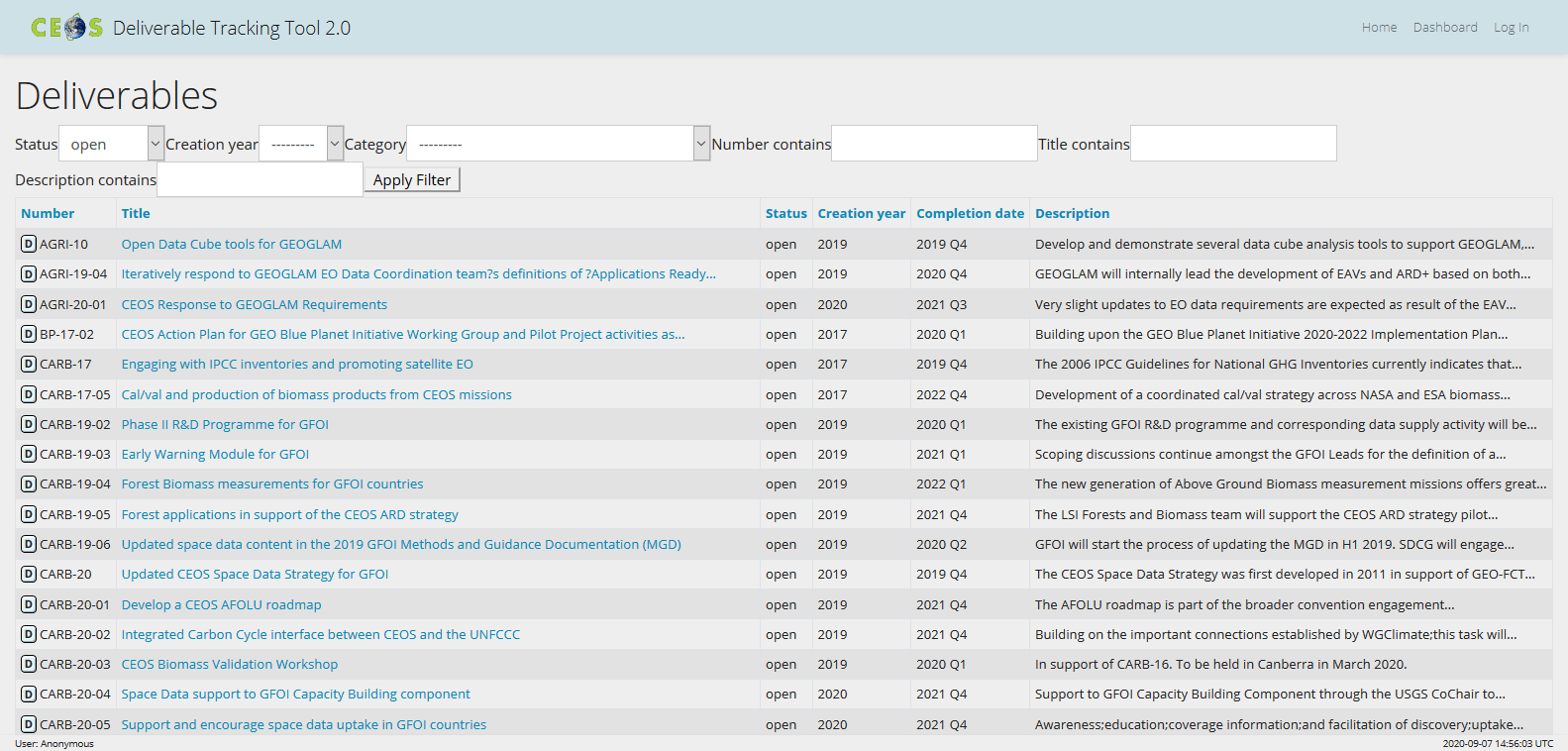
CEOS Online Deliverables Tracking Tool

Slide 8
Deliverables Tracking Tool
Still Work in Progress but main data are available online
Removed “Resources” Field
Need to identify no more than three/four responsible entities per Deliverable that can update information in the database
Require standardization with the listing of Responsible Entities and Contributing Entities
Will be preparing a Deliverables Database “Users and Access Guide”
CEO will be contacting CEOS Entities directly to facilitate information updates

Slide 9
Key Relevant Discussion Points and Actions for WGISS from SIT TW 2020
SIT Chair Team will continue with its engagement plan for CEOS Working Teams via Working Team All-Hands calls (NEXT scheduled for 10 November 2020)
CEOS COAST proposal for formal AHT status (tomorrow)
SDG AHT proposal for one-year extension with transition plans for future
WGCapD CEOS Branded Webinars (next session)
WGDisasters seeking endorsement on: WGDisasters Strategy; Recovery Observatory Demonstrator Implementation Plan; GEO-LEO-SAR Flood Pilot Implementation Plan (tomorrow)
WGISS Earth Analytics Interoperability Lab (don’t need to say more…)
WGCV seeking endorsement on CEOS Biomass Validation Protocol
New Chairs for WGCV and WGClimate at Plenary
CEOS ARD Strategy: Evaluating datasets against CARD4L PFS, new PFS under development; discussions on “ARD Beyond Land” (ocean/coast/inland waters/atmosphere)
CEOS Agencies are requested to organize submission of use cases for climate data records
Endorse GHG Roadmap V2.4and Commitment of resources
Agree to launch AFOLU Roadmap development and commit resources and alignment and synergy between GHG and AFOLU roadmap
GEO community sees a need for ARD on the cloud and is calling for appropriate production, coordination, and documentation, and the use of key technologies such as STAC
Consideration by CEOS Principals to have the Open Earth Alliance (OEA) Community Activity as the coordination mechanism for data cube projects

Slide 10

CEOS 2020-2022 Work Plan
GEO Work Programme 2020-2022
There is still a disconnect between the GEO 2020-2022 Work Programme and the CEOS 2020-2022 Work Plan Deliverables, evidenced by the lack of identification of connections in the recent call to CEOS entities for new Deliverables
Aspiration

Slide 11

CEOS and GEO Priorities
Ensure that space-based Earth observations support the success of the next decade of the Group on Earth Observations (GEO), and that CEOS engagement in GEO governance and leadership is enhanced.
Proactively engage in global discussions on the critical challenges that face society, including attaining the 2030 Agenda for Sustainable Development.
Ensure that climate observation requirements identified by the Global Climate Observing System (GCOS) – and implications of the Paris Climate Agreement – are addressed.
Ensure, in the context of the Sendai Framework for Disaster Risk Reduction 2015-2030, that CEOS Agency data are made available in support of disaster risk reduction and that CEOS continues engagement with UN agencies and authorities.
United Nations 2030 Agenda for Sustainable Development
Climate Change, with specific emphasis on the Paris Agreement
Sendai Framework for Disaster Risk Reduction
GEO Engagement Priorities

Slide 12
GEOSS Data, Information, and Knowledge Resources
This Foundational Task will analyze the current state and trends (including needs and gaps assessments) with respect to Earth observing systems (both remote sensing and in situ).
Satellite Observations Component
  Support GEO’s efforts to promote uptake of Earth observations by providing evidence of the unique and complementary value of satellite data to successful delivery of GEO Work Programme activities. Promote uptake of satellite observations into space agency repositories, data aggregators and cloud storage for use in analyses and global policy reporting, closely linked with the GEO Knowledge Hub. Advocate production of integrated multi‐satellite Analysis Ready Datasets.
  Support algorithm and model development, and advocate integration of information from in situ, airborne and space‐based observations through data assimilation and models.
WGISS SEO WGCV SIT

Slide 13
Thank you

Slide 14
Q1/Q2 2020 Due Dates - Overdue

Slide 15
Q4 2020 Due Dates – A Little Breathing Room

Slide 16
Q4 2020 Due Dates – A Little Breathing Room

