Slide 1
Technical Content and Information Preservation
WGISS#49 Virtual Meeting – 21-23 April 2019

Slide 2
Context and Background
Technical Content
Information technology is changing rapidly and this change also affects digital data from Earth Observation missions. Risks include the corruption of the bit-stream, obsolescence of the file format, extant hardware and operating environments that make data unreadable on the physical and logical level. On the other hand, insufficient documentation regarding the data, the inability to discover the data, or service compatibility can also prevent their re-use.

Slide 3
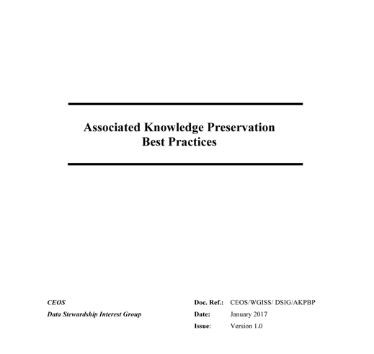
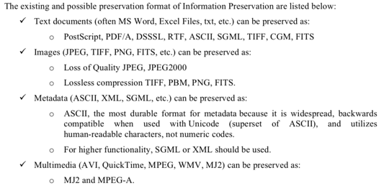
Context and Background
To Be Updated
Provide recommendations and best practices for the preservation of Earth Observation (EO) Associated Technical Information.

Slide 4
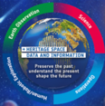
Technical Content and Information preservation at ESA

Slide 5
Technical Content and Information preservation – New topic for next WGISS#50 meeting
Few tips for discussion on Technical Content and Information Preservation:
Preservation processes
Metadata and format definition and use
Platform for Long Term preservation (Open source and/or licensed)
Provenance and linked network
Artificial Intelligence applications (e.g. natural language processing and machine learning to find reference to data in papers and link them to the ESA archives and to automate the keyword creation)
Software and Tools Long term preservation

