Slide 1
Persistent Identifiers for ESA EO Data
WGISS#49 Virtual Meeting – 21-23 April 2019

Slide 2
Persistent Identifiers Implementation at ESA
The European Space Agency uses the Digital Object Identifier (DOI) system for its persistent identifiers.
CrossRef was selected as the Registration Agency for registering DOIs for the ESA data collections.
ESA DOIs are associated to collections and at a specific product processing level/product type or auxiliary files, and not to individual products/scenes.
DOIs are assigned to data sets that are publicly disseminated and archived for the long-term – not to auxiliary data, experimental products, on-demand processing, or near-real-time products that are disseminated, but not archived.
ESA conforms to the CrossRef member obligations, requirements for metadata and DOI display guidelines.
Notes:
CrossRef was selected – facilitated by a contract that was already in place.

Slide 3
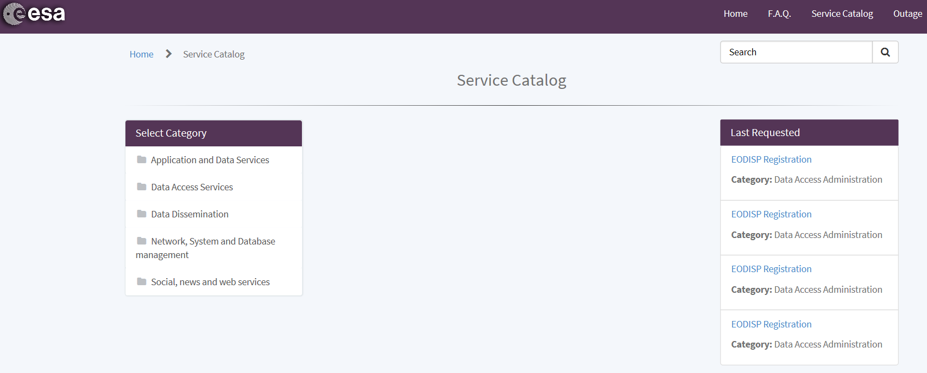
DOI Assignment at ESA
DOI assignment/registration to ESA Space Datasets is done by the EO directorate and open for use to other ESA directorates (e.g. Science).
DOIs are currently assigned manually. A DOI Automated Service will be available by June through the Earth Observation TellUS service portal.
Notes:
- Currently, all ESA DOI related activities are performed manually.
- In the next few months an ESA DOI Service will be developed, in order to support all DOI related activities, to generate, register and manage DOIs. This will be a more automatized system.
- All DOI requests shall go through the TellUS Service Catalogue.

Slide 4
Constructing ESA Digital Object Identifiers
The DOIs for the ESA are globally unique within the DOI system, and are constructed according to the following convention: 10.5270/SSS-xxxxxxx
10.5270 is the DOI prefix, and represents the number that uniquely identifies the Agency’s subset of DOIs. This DOI prefix was given by CrossRef to ESA.
SSS-xxxxxxx is the DOI suffix, generated internally by ESA:
[SSS] represents the 3 characters with the convention:
The default value is esa and it is used for datasets with multiple satellites IDs, non EO datasets, databases e.g. ADAM (A surface reflectance Database for ESA's earth observation Missions), etc…
Satellite ID (mission code) for the EO missions.
[xxxxxxx] is a string of 7 random alphanumeric characters, composed of numeric digits (0-9) and lowercase letters (a-z)
Example: 10.5270/S5P-s4ljg54 – corresponding to the Sentinel-5P TROPOMI Level-2 Nitrogen Dioxide total column data set
Example: 10.5270/esa-91oxxtk – corresponding to the S5P-NPP Level 2 Cloud products of Suomi-NPP VIIRS Clouds, regridded to TROPOMI resolution

Slide 5
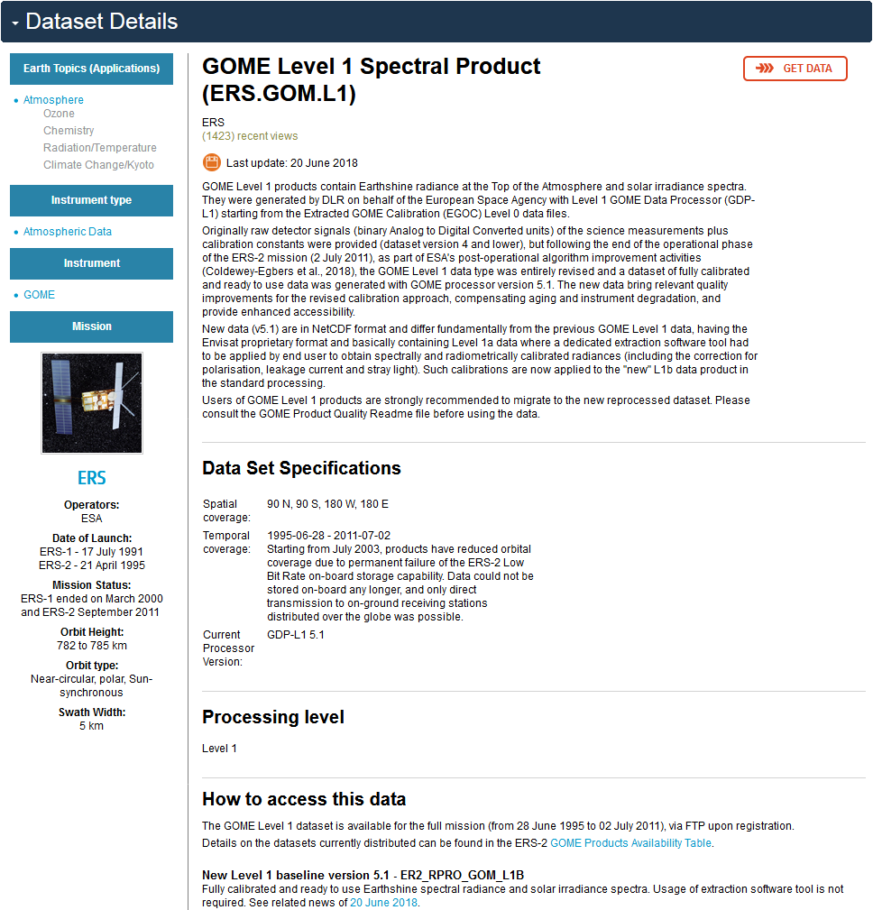
ESA EO Landing Pages
Each ESA assigned and registered DOI leads to a landing page, where information on the dataset collection and a link to access the data, is provided.
ESA EO data collections Landing Pages coincide with the Dataset Details page on the ESA Earth Online Web Portal.
Data citation guidelines:
[Producer], [Release Year], [Data collection long name]. [Version]. European Space Agency. https://doi.org/[DOI]
Example: ESA Earth Observation Programmes, 2018, GOME Level 1 Spectral Product. Version 5.1. European Space Agency. https://doi.org/10.5270/ER2-ua38y2m

Slide 6
ESA DOI Status and Next Steps
Since July 2018, ESA registered 40 DOIs for its EO data collections:
12 for Sentinels
13 for Heritage Missions
7 for various campaigns
8 Earth Explorer
Since April 2019, ESA registered 58 DOIs for its astrophysics, solar system and heliophysics missions.
DOI assignment and registration will continue throughout 2020 with targeted completion of assignment to all ESA EO data holdings.
Extension to other directorates and awareness raising campaigns (inside and outside EO).
Automated DOI Assignment Service transfer to operations and evolution with API.
Notes:
Deploy the DOI Service on the TellUS platform – Requirements Document already approved and send to the maintainer

