Slide 1
Persistent Identifier Implementation at ISRO
Committee on Earth Observation Satellites
Nitant Dube
Space Applications Centre, ISRO, India
WGISS-49
April 23, 2020

Slide 2
Overview
CWIC (Production)
MOSDAC
NRSC
Open Search
Open Search
CSW
Metadata
Metadata
20 DIFs are registered in IDN
5 DIFs are registered in IDN

Slide 3
Persistent Identifier Implementation
ISRO uses DOI for assigning Persistent Identifiers to its data products.
DOI based Persistent Identifiers provide following advantages:
Persistent citations in scholarly materials, this helps end users to retrieve metadata and data from the link available in the metadata.
Long term actionable reference for satellite images, this enables discovery and re-use.

Slide 4
Persistent Identifier Implementation
DOI naming convention
https://doi.org/10.19038/SAC/10/3A-CCD-AOD
Base identifier for ISRO
Data Center (MOSDAC)
Identifying ISRO centre
Unique Product ID

Slide 5
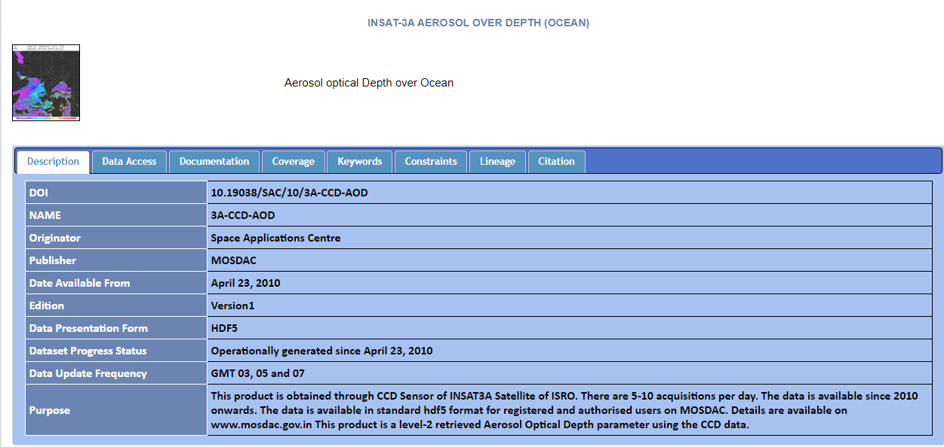
MOSDAC Status
All products (total of 202) available on MOSDAC has DOI assigned to them
Each assigned DOI has associated Landing pages

Slide 6
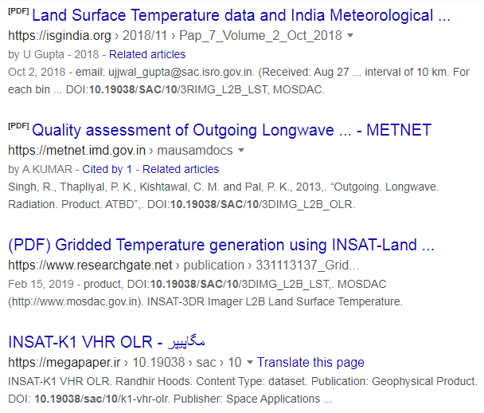
Future Plans
DOI based automatic discovery of References using Web crawling
Google Search result of 10.19038/SAC/10
Landing Page
DOI
Web crawling
Product Citation Database

Slide 7
https://mosdac.gov.in/satellite-catalog
nitant@sac.isro.gov.in
Thank you!

