Slide 1
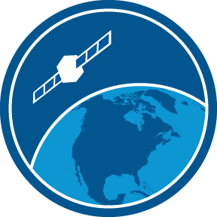
NOAA CoastWatch/OceanWatch/PolarWatch ARD Preparation and Product Interoperability
Veronica P. Lance
And the
NOAA CoastWatch/OceanWatch/PolarWatch Team

Slide 2
Outine
What is NOAA CoastWatch/OceanWatch/PolarWatch (a.k.a CoastWatch)?
What is the “value chain” and how does CoastWatch fit in?
What ocean/coastal/inland water observations can we get from satellites?
How does CoastWatch serve data products to it’s users?
What are some “value-added” products/services available through CoastWatch?
How are we aiding in the use of satellite data for applications, decisions and social benefit?
What are our future directions, challenges, and opportunities?

Slide 3
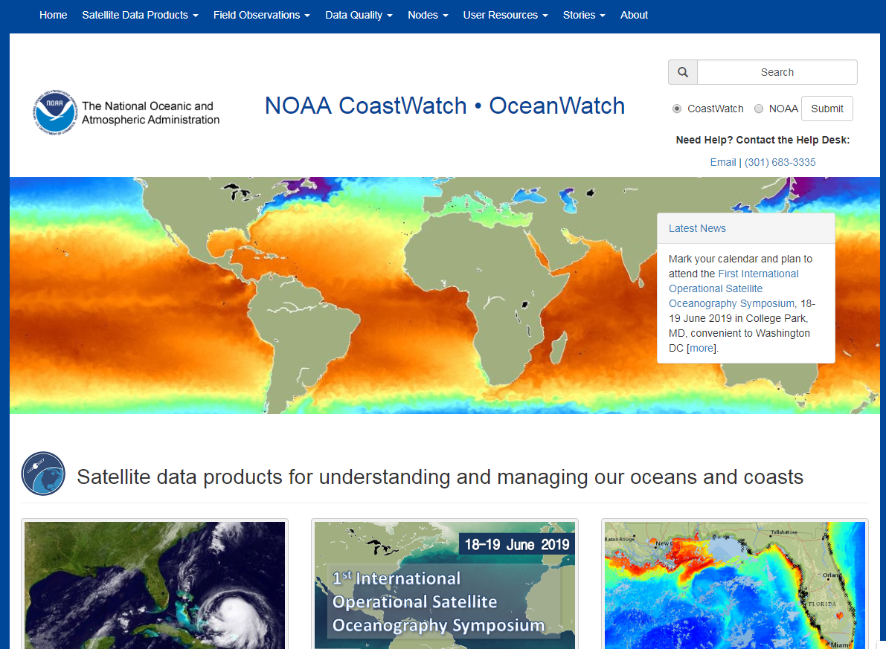
NOAA CoastWatch, OceanWatch & PolarWatch
helping applications and missions that assess, understand, manage and protect ocean and coastal resources to benefit from satellite remote sensing observations
CoastWatch.NOAA.gov

Slide 4
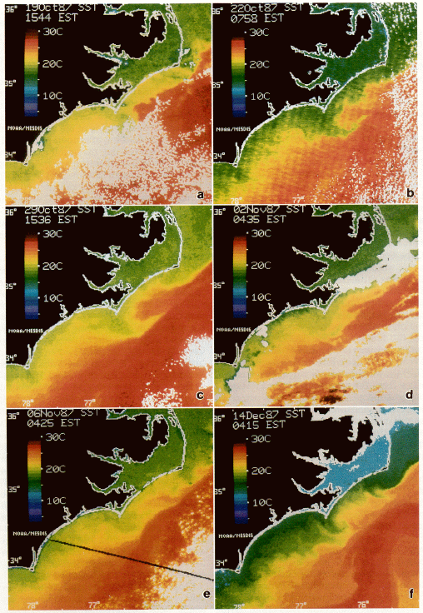
History of NOAA CoastWatch
1987, Unprecedented HAB in NC. - Satellite SST points to likely source.
Toxic Karenia brevis (known as red tide) showed up unannounced and unexpected in Coastal NC during a beautiful autumn season in 1987.
The NOAA Beaufort Laboratory went into action exploiting NOAA’s AVHRR satellite SST for the evidence to explain the transport of cells from Florida via the Gulf Stream into colder coastal waters near Cape Lookout and to track the progression of the event that persisted until a major winter storm and that impacted people, fish, marine mammals, birds, the commercial shellfish industry and the local economy.
NOAA CoastWatch was born out of this event.
We were awarded a NOAA Heritage Grant to document our story for NOAA’s 50th.
“Today, the total public health impacts from HABs range from a low of $18 million to a high of $25 million, averaging $22 million over a six-year interval.” (NOAA/NOS/NCCOS)
Fig 2. SST imagery from AVHRR, NOAA-9 and NOAA-10
Tester et al., 1991 Limnology and Oceanography, 36(5), 1053-1061

Slide 5
Value Chain of Data, Products, Information, Knowledge
Data (~from bytes to geophysical parameters)
Data Products (~from swath/granule to merged, mapped, anomalies, etc.)
Information (such as combine data types, outside information, get the full picture)
Knowledge (to inform actions)
“ANALYSIS READY DATA”
User needs
Observations
Data
Information
Knowledge
Products

Slide 6
Our Users
Users across all of NOAA’s Offices
Weather Service (NWS)
Fisheries (NMFS)
Ocean Service (NOS)
Scientific Research (OAR)
Data and Information (NESDIS)
Non-NOAA Users
Other Federal, State agencies
Commercial Sector
International partners
Academia
General public
Intermediate and downstream users
Operational, mission/application-oriented
Near real time
Delayed, environmental context, trends, etc.
Various levels of sophistication about knowledge of satellite data, computational resources, etc.
“Power users” (often want L1, L2)
Experts in other fields but novice to satellite data (L3, L4 easier to use)
Casual users browsing to answer anecdotal curiosities (online viewer only)

Slide 7
CoastWatch helps users access and use satellite data
Provide access to curated datasets with data servers
Develop tools and tutorials to help users access and use data
Provide training and hands-on assistance
Find or create products in response to users needs
Work directly with users on developmental projects
Increasing Assistance to User
CoastWatch HelpDesk: CoastWatch.Info@NOAA.gov
User forum in development

Slide 8
Ocean (Water) Parameters from SPACE
From NOAA and non-NOAA satellites/sensors
Sea Surface Temperature
Ocean Color
Altimetry
Ocean Vector Winds
Synthetic Aperture Radar
Sea Ice
Surface Salinity
NRT and Science Quality, RAN or Delayed
Level 2, Level 3, Level 4; sensor fusion
And model output from multiple parameter inputs
NetCDF CF formats for internal,NOAA and .gov level interoperability
CoastWatch data are totally free and open – no registration required
(results in benefits and challenges)

Slide 9
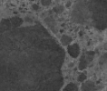
CoastWatch/OceanWatch Data
>1
Timeline of Satellite Oceanographic Data Products
Petabyte
1987
1998
2001
2005
2012
2016
2020
Data are from NOAA and non-NOAA sources
Notes:
History of two POES satellites and SST / band products growing to include GOES, OrbView-2, Terra, Aqua, DMSP, SeaWinds, SMAP, Jason-2/3, Cryosat, S-1,S-2,S-3, etc.
Much appreciation for the JPSS Program that contributed satellites,sensors,data, and support for this activity.

Slide 10
CoastWatch “Value Added” Products Example: VIIRS Hi-Res Sectors Co-Located for Ocean Color and SST

Slide 11
CoastWatch “Value Added” Products Example: : Hi-Res Sectors for OLCI S3 (=VIIRS x9)

Slide 12
TurtleWatch

Slide 13
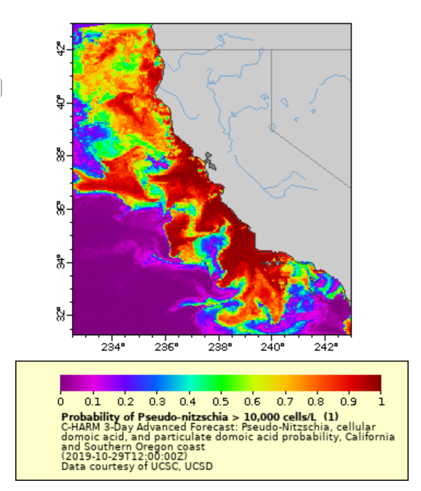
C-HARM 3-Day Advanced Forecast: Pseudo-nitzschia, cellular domoic acid, and particulate domoic acid probability, California and Southern Oregon coast
Observations: SST and Chlorophyll
Application: Human health, wildlife health, shellfish aquaculture, etc.
Courtesy: Dale Robinson, West Coast Node;
Developed by Kudela et al.. UC Santa Cruz, etc.

Slide 14
Multiple satellite inputs - model output: e.g., Seascapes Product
https://coastwatch.noaa.gov/cw/satellite-data-products/multi-parameter-models/seascape-pelagic-habitat-classification.html

Slide 15
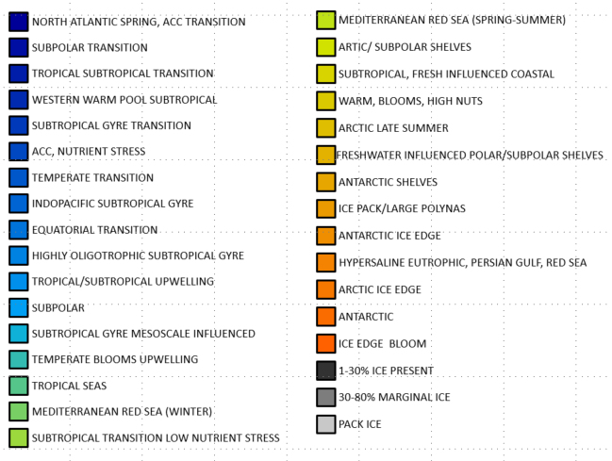
Multiple satellite inputs - model output: e.g., Seascapes Product
US and global Marine Biodiversity Observation Network (MBON) scientists (Kananaugh, Muller-Karger and others) partnered with US Integrated Ocean Observation System (IOOS), NOAA/OAR/AOML and NOAA/NESDIS/STAR (NOAA CoastWatch/OceanWatch)
https://coastwatch.noaa.gov/cw/satellite-data-products/multi-parameter-models/seascape-pelagic-habitat-classification.html

Slide 16
Roadmap to Discovery
2019
Data Product
NetCDF
DM Plan
CF, ACDD
Archive
Data.gov
ISO
X
Access

Slide 17
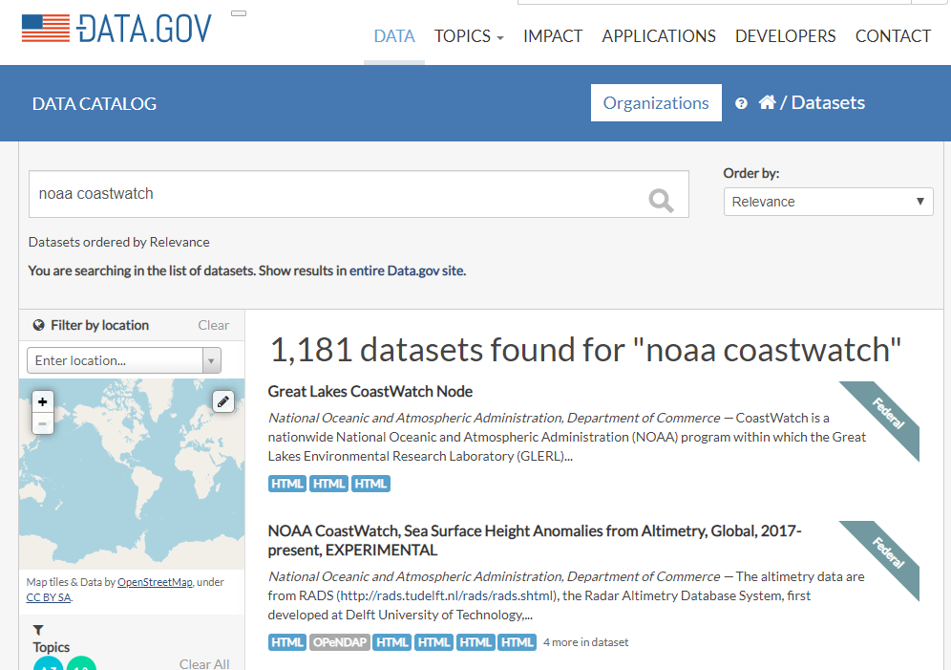
Roadmap to Discovery
2019
Data Product
NetCDF
DM Plan
CF, ACDD
Archive
Data.gov
ISO
X
Access

Slide 18
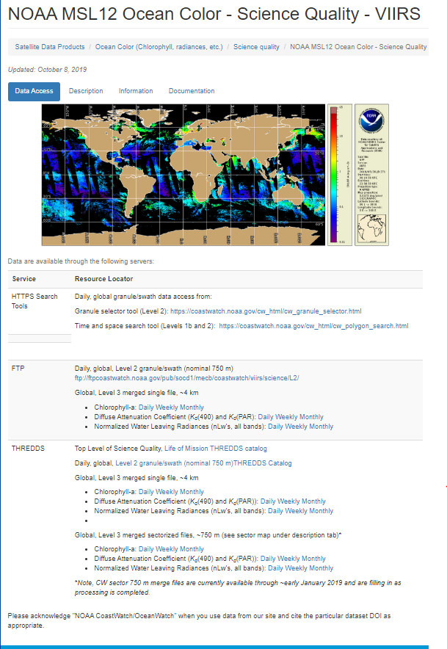
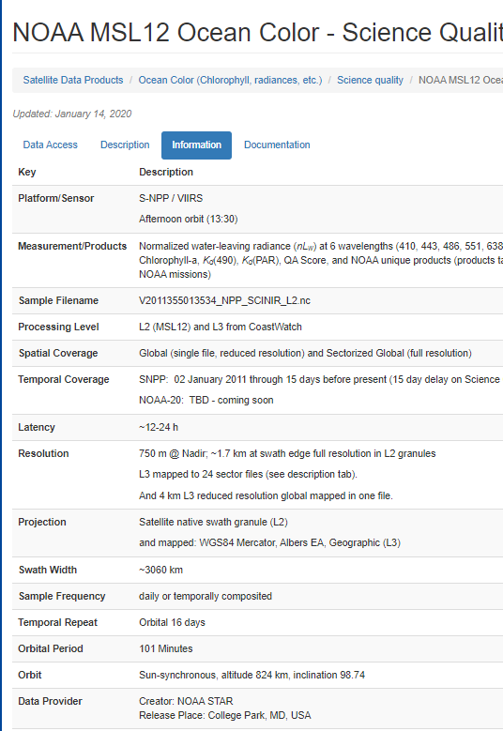
Data Access
Direct Access
Website (product pages/links)
HTTPS
ERDDAP
THREDDS
FTP
Mode as available (NRT vs. Science)
Description text
Standardized tabular product information
Documentation
NetCDF CF

Slide 19
Through interactive tools
Near Real-time Data Search
Mapped Products (L3)
Granule and Daily
Interactive
Granule Display
Limited Near Real-time and Science Quality (product dependent)
L1/L2 products
Interactive map display
Spatial Data Search
Limited Near Real-time and Science Quality (product dependent)
L1/L2 products
Interactive map display
NOAA CoastWatch Data Portal – “all-in-one”

Slide 20
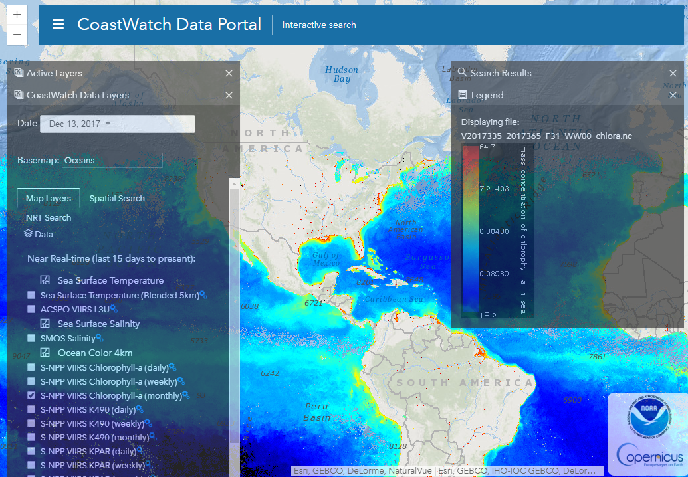
CoastWatch Data Portal
https://coastwatch.noaa.gov/cw_html/cwViewer.html
Visualize
Layer
Probe
Subset
Time
Space
RESTful URL
Live connection to data monitor
Download
Per file
Data cart
Automate pulls

Slide 21
CoastWatch Data Portal
Mapping API
WMS
ERDDAP & THREDDS
Imagery (tiles)
User Interface
Services
Data on Spinning Disk
NetCDF Data

Slide 22
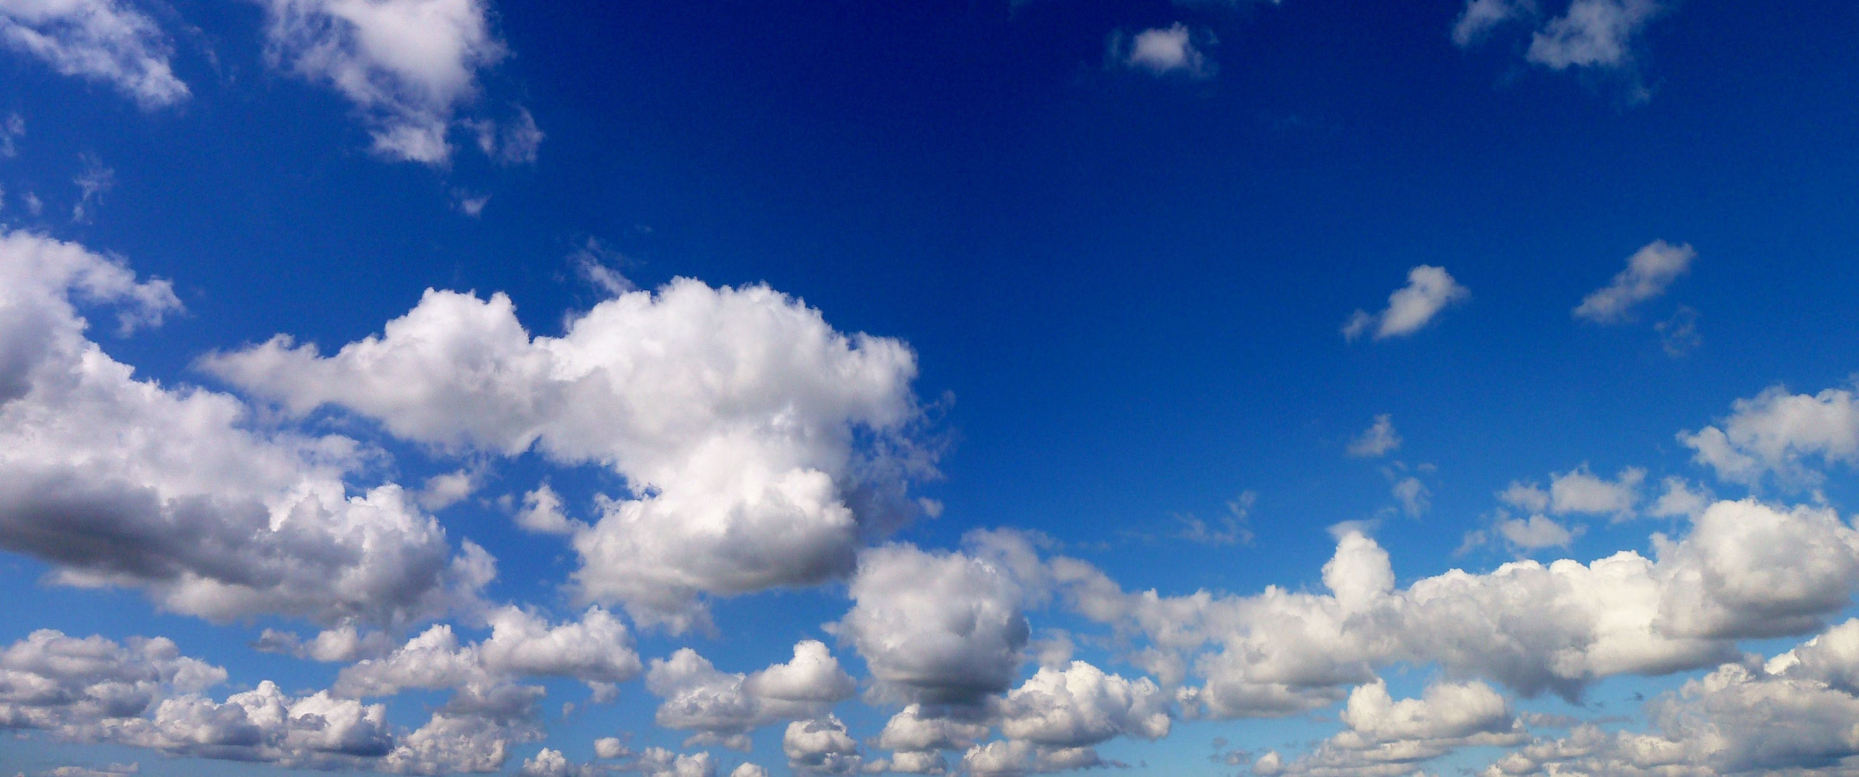
CoastWatch Data Portal
UI
Services in the cloud
Data in the cloud

Slide 23
CoastWatch Data Portal
ESRI ArcGIS Javascript API v3.29 (with early bootstrap/calcite)
PZI of global geographic datasets; Color palette, data range, opacity adjustable
Spatial / temporal search for L1/L2 datasets
Access to global/view/custom ROI subset of NetCDF data
Allows viewing datasets from multiple dates
Leverages information and data access services of THREDDS / ERDDAP
Pseudo tile server by making small tile requests of TDS WMS
Easily configurable to add new dataset.
Online user instructions and short video tutorials
https://coastwatch.noaa.gov/cw_html/cwViewer.html

Slide 24
CoastWatch Data Portal – in development
Update to either OpenLayers or ESRI v4.x Map and SceneView
Implement “thematic” curated data portals pre-populated with select “recommended” subset of data products.
Add more online training tutorials
https://coastwatch.noaa.gov/cw_html/cwViewer.html

Slide 26
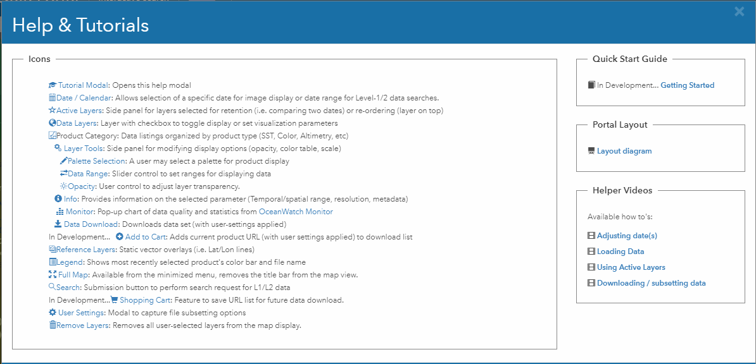

Slide 27
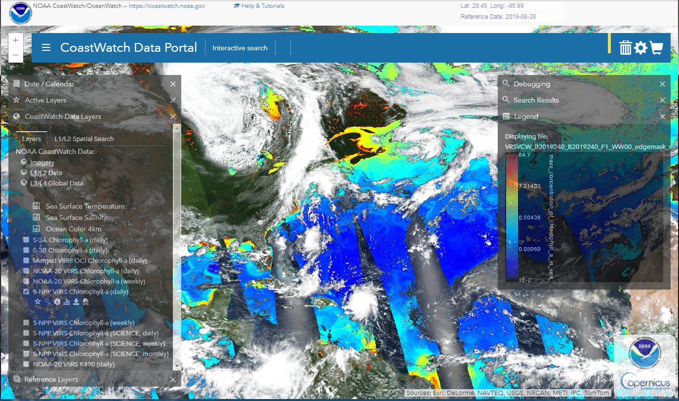

Slide 28
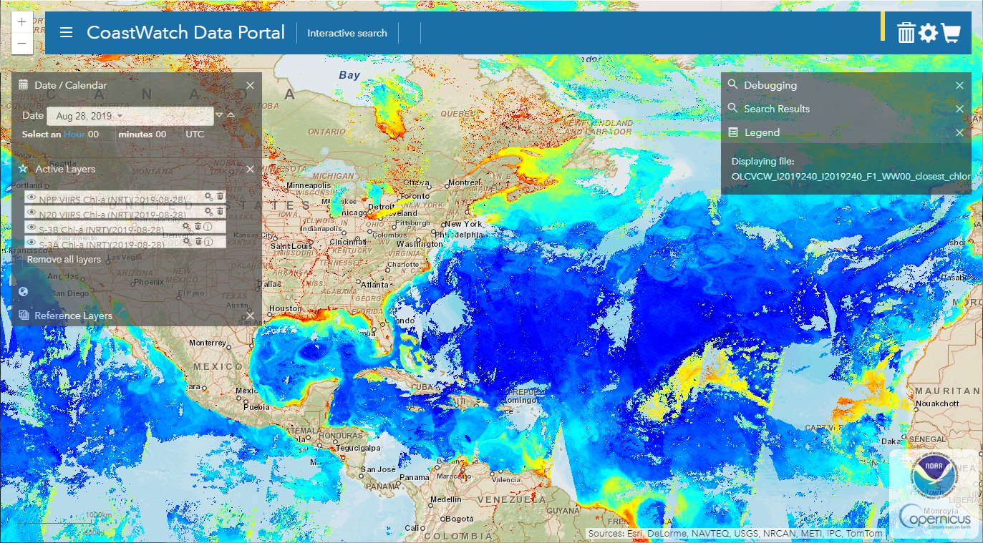

Slide 29
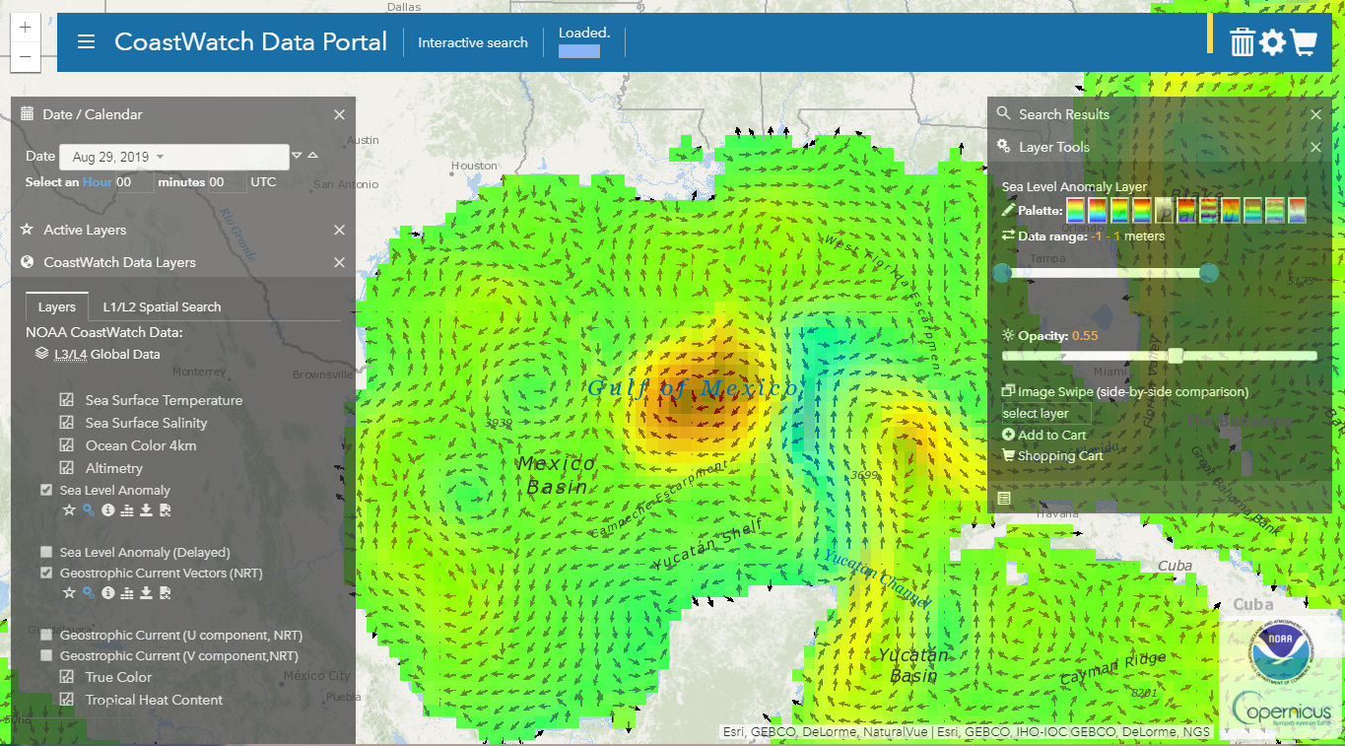

Slide 30
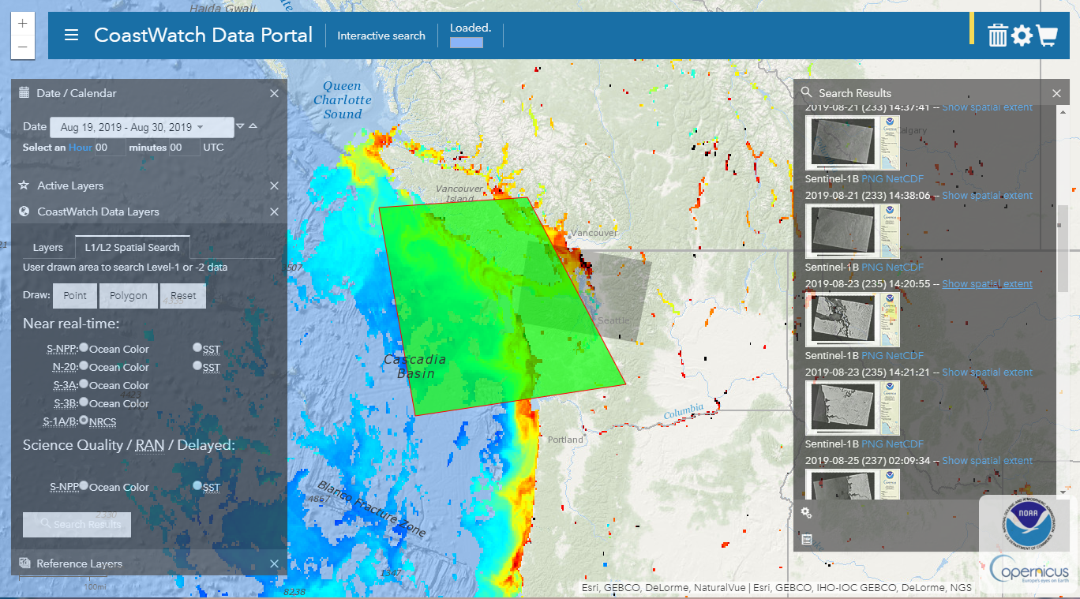

Slide 31
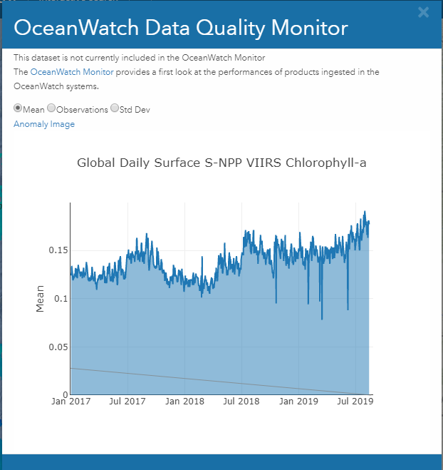
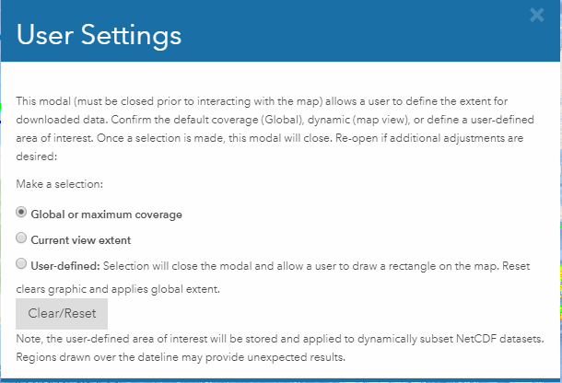

Slide 32
Ocean Monitor
Maps
Timeseries
Hovmöller Diagrams
Reference Data Sets
https://www.star.nesdis.noaa.gov/socd/om/

Slide 33
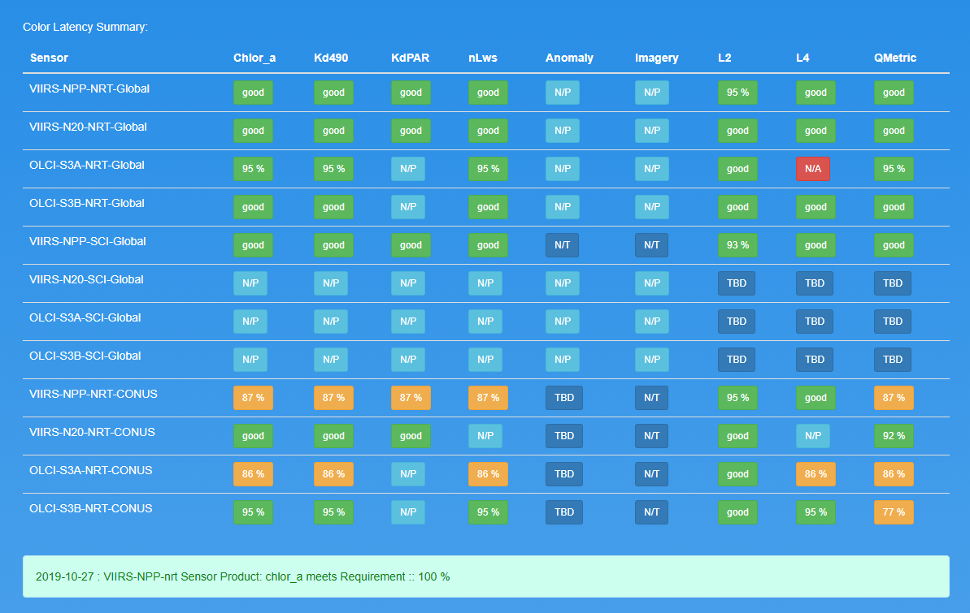
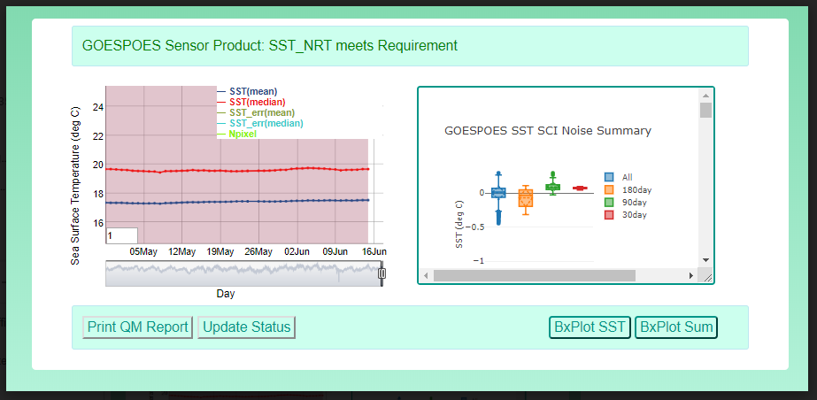
Data Performance Tracking
Monitors data
availability
stability
Quantitative, statistics
https://www.star.nesdis.noaa.gov/sod/mecb/coastwatch/NRT-QA/QM_Reports.html

Slide 34
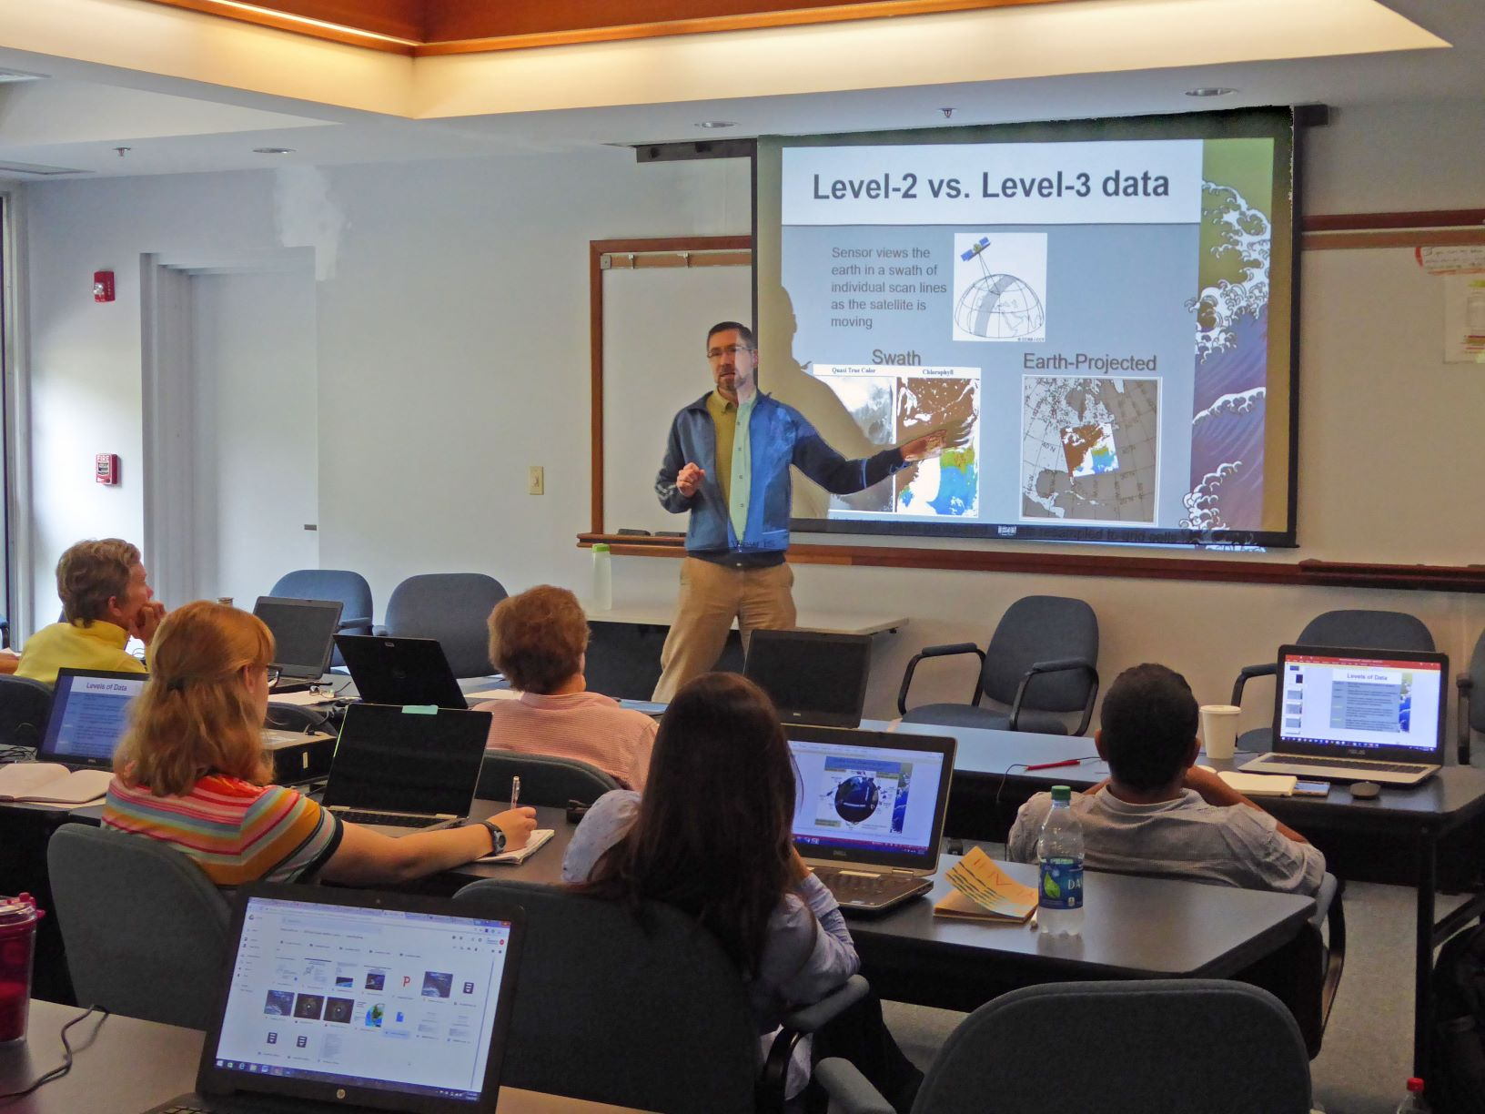
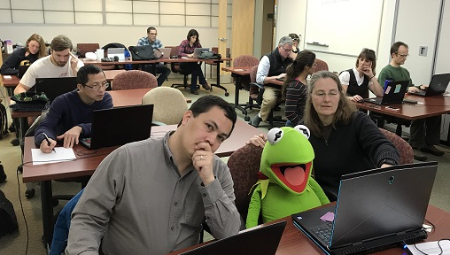
NOAA CoastWatch Satellite Training
Coastwatch.info@noaaa.gov
https://coastwatch.noaa.gov/cw/user-resources/satellite-data-training-courses.html
Recent and Upcoming Courses
San Juan PR - 5 to 7 February 2020 at the University of Puerto Rico
Anchorage, AK - 7 to 9 April, Alaska Fisheries Science Center Virtual Class
Charleston, SC. – Summer 2020 (?) - in association with Hollings Marine Laboratory

Slide 35
NOAA CoastWatch Future Directions
Challenges & Opportunities:
Knowing our users while respecting privacy (what they use, how they access, etc.)
Fully mine and exploit data access logs (no required “registration” process)
Data product database development including key users
Proactively and systematically asking permission for users to be identified for specific purposes
Establish an online user forum
Overcoming language barriers to make satellite data products more understandable
Increasing the number of in-person, hands-on training classes
Improve online self-learning materials (“Learning Portal”)
Develop university (at UMD?) course and/or curriculm
Improve user experience on website, data portal; transition to cloud-based
Data visualization
Data searches and access
Quality tracking
Themed portals
Event tracker
Develop or identify new value added products, derived products, L4 analysis products, etc.
that serve specific or multiple applications
transition them to operations
In situ databases and satellite matchups
Grow the definition and implementation of “moderate assurance”
Quantification
Infrastructure IT requirements
Conveying benefits/limitations of datasets (both content and technical) to users
Document history of CoastWatch

Slide 36
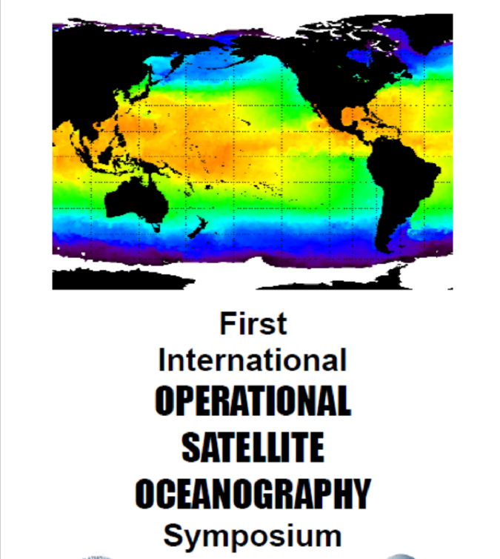
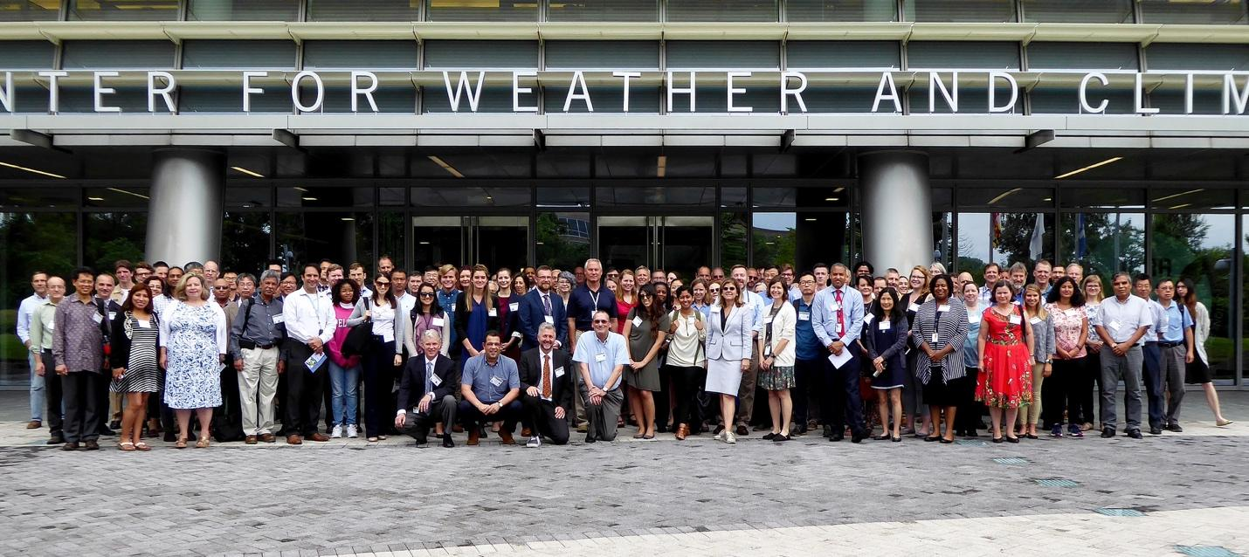
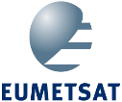
First International Operational Satellite Oceanography Symposium
2nd In’tl OSO Symposium
Spring 2021
Germany
18 to 20 June 2019
National Climate and Weather Prediction Center
College Park, MD USA

Slide 37
Data Portal Tutorial Animation
Downloading and subsetting data
https://coastwatch.noaa.gov/cw_html/cwViewer.html

Slide 38
Questions?
CoastWatch.NOAA.gov
CoastWatch.Info@NOAA.gov
SUBSCRIBE
to our monthly newsletter and stay informed of all the latest news about NOAA CoastWatch!

