Slide 1
Report and Progress on WGCV Cooperation with WGISS
C. Ong/A. Kuze
CSIRO/JAXA
WGISS #49
Virtual
21-23 April, 2020

Slide 2
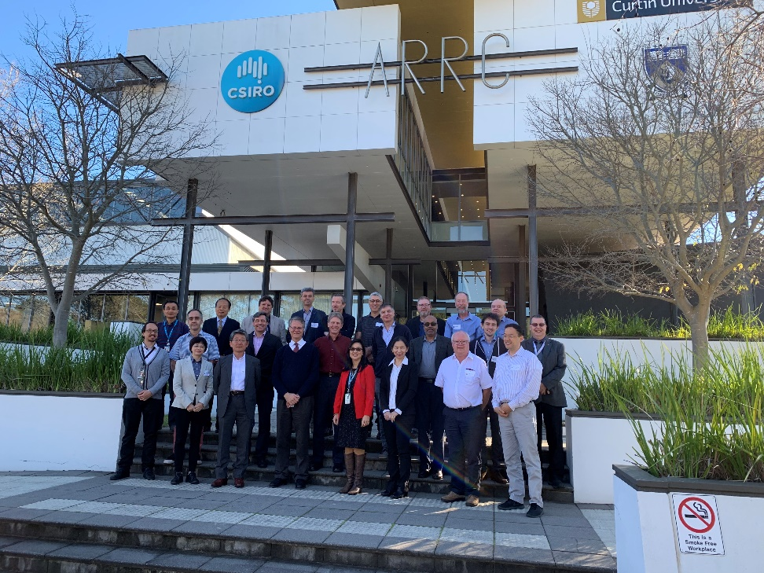
WGCV overview
WGCV includes members from CEOS agencies as well as the Chairs of six subgroups
Subgroups allow inclusion of a wider range of researchers
Atmospheric Composition
Land Product Validation
Infrared and Visible Optical Sensors
Microwave
SAR
Terrain Mapping
Task groups address cross-cutting topics covered by multiple sub-groups
General topics include
Validation metrics
Protocols
Traceability
Prelaunch and post-launch characterization
WGCV-45 meeting hosted by
CSIRO in Perth, Australia

Slide 3
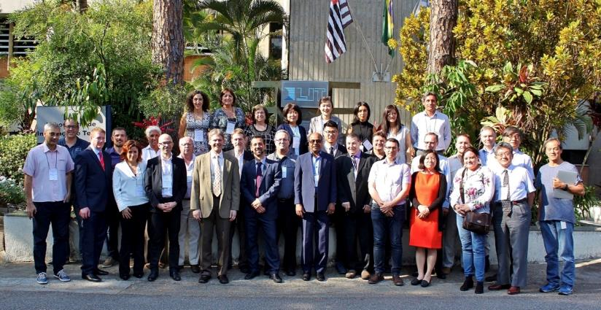
Joint WGISS/WGCV Session Reminder
Four topics discussed in April 2018 with leads identified from WGISS and WGCV
Data Formats and Interoperability in the framework of FDA
Robert Woodcock (WGISS), Medhavy Thankappan (WGCV)
Quality Indicators in Discovery Metadata
Michael Morahan (WGISS), Nigel Fox (WGCV)
CEOS Data Cubes and CEOS Test Sites Data Access in support of WGCV Activities
Robert Woodcock (WGISS), Greg Stensaas (WGCV)
Standardization and Best Practices (e.g. ISO 19159-3)
Richard Moreno (WGISS), Cindy Ong (WGCV)

Slide 4
3. CEOS Data Cubes and CEOS Test Sites Data Access in support of WGCV Activities
Objective: Data Cubes (or similar stacking of data over time for specific locations) test cases
Identification of tool – MEA GUI
Case histories selection – RadCalNet, ACIX, LPV Supersite
Demonstration with RadCalNet & ACIX, LPV?
Resolve challenges with consistencies between LPV supersites
Access to WGCV users as beta testers
Data Formats, processing, etc.
WGCV cal val portal & site info
CV-9, CV-14

Slide 5
3. CEOS Data Cubes and CEOS Test Sites Data Access in support of WGCV Activities
Actions from November meeting (Albani, della Vecchia, Goryl, Ong)
Andrea/Paolo Castracane to implement link between CEOS CAL/VAL portal (new version) and ESA Heritage Missions Data Cube (HMDC). Due by end January 2020
Completed.
Maybe useful to have a little user guide and, select few key users to review & suggest additional requirements for new activities (see point 4);
Philippe to provide list of RADCALNET users to be added as users in the ESA HMDC (account needed to get access to RADCALNET data) – Andrea/Mark Bouvet to discuss during workshop. Due by end January 2020
In progress;
Philippe/Cindy to provide list of high priority missions to be made available as predefined set over the four RADCALNET Sites in the HMDC. Due by end December 2019
In progress: Based on users: Landsat 8, Sentinel-2A/B, Sentinel-3A/B, Terra ASTER MODIS, GF, FY and ZY series?, PRISMA?, DESIS?, HISUI?, commercial?
Philippe/Cindy to define scope and requirements for new potential activities related to:
Inclusion/integration of additional satellite missions data (e.g. Third Party Mission (TPM) missions) in the HMDC over RADCALNET sites.
In progress: see above
Exploitation of HMDC to support additional WGCV projects (e.g. BRIX2, DEMIX)
Exploring potential to start with TERN supersites
DEMIX potential to explore collation of disparate datasets (from different locations, different resolutions, etc.)
Philippe to discuss internally
Closed

Slide 6
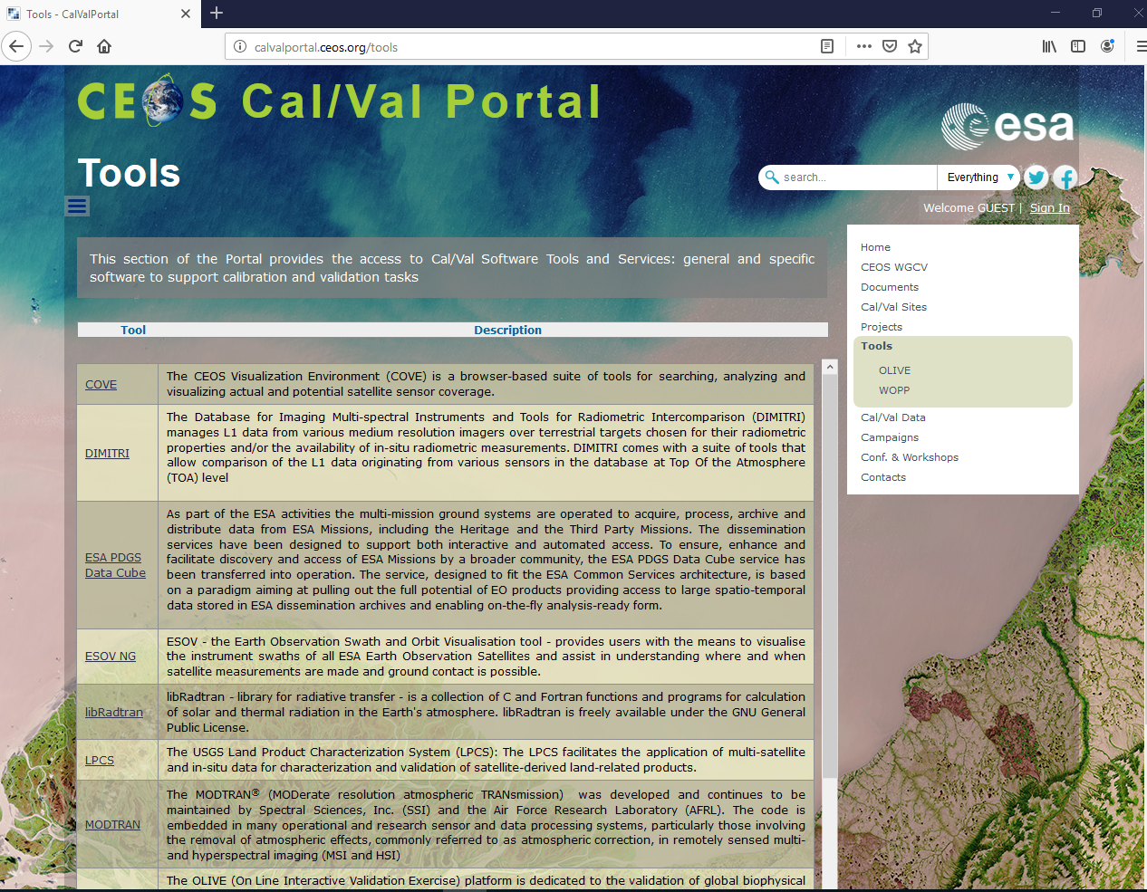
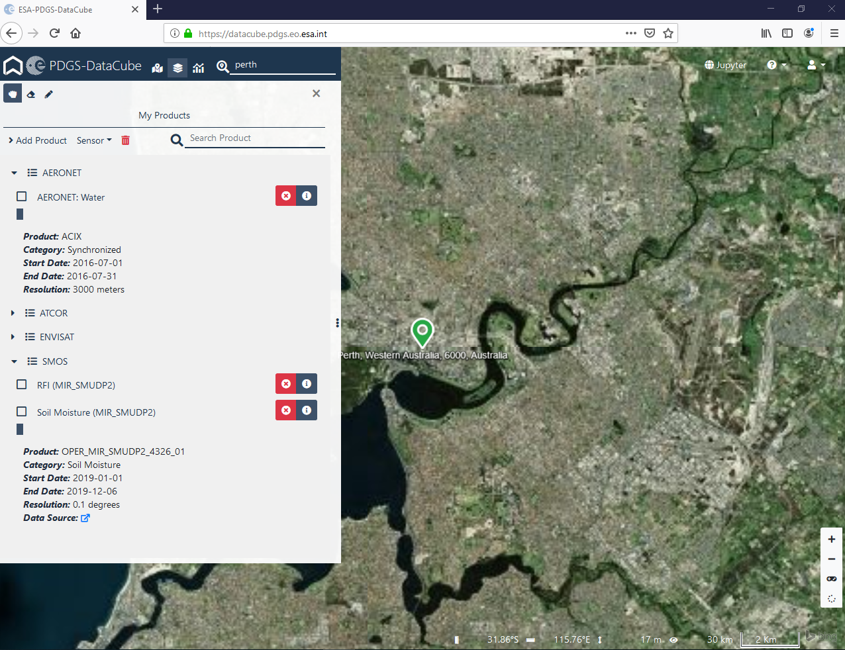
Link between ESA Heritage Missions Data Cube and calval portal

Slide 7
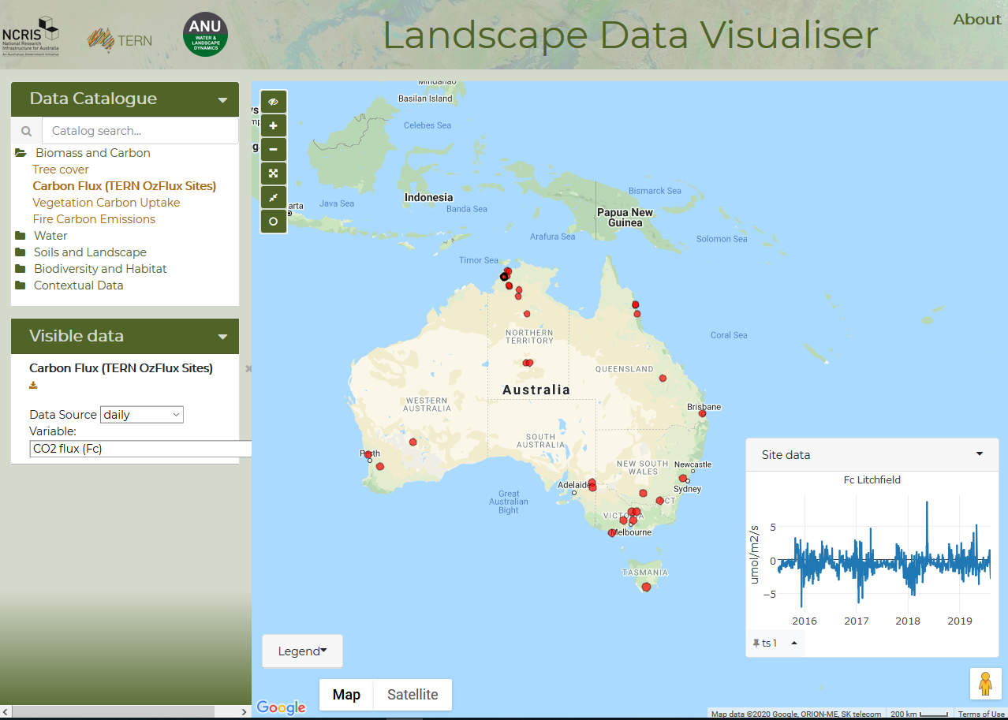
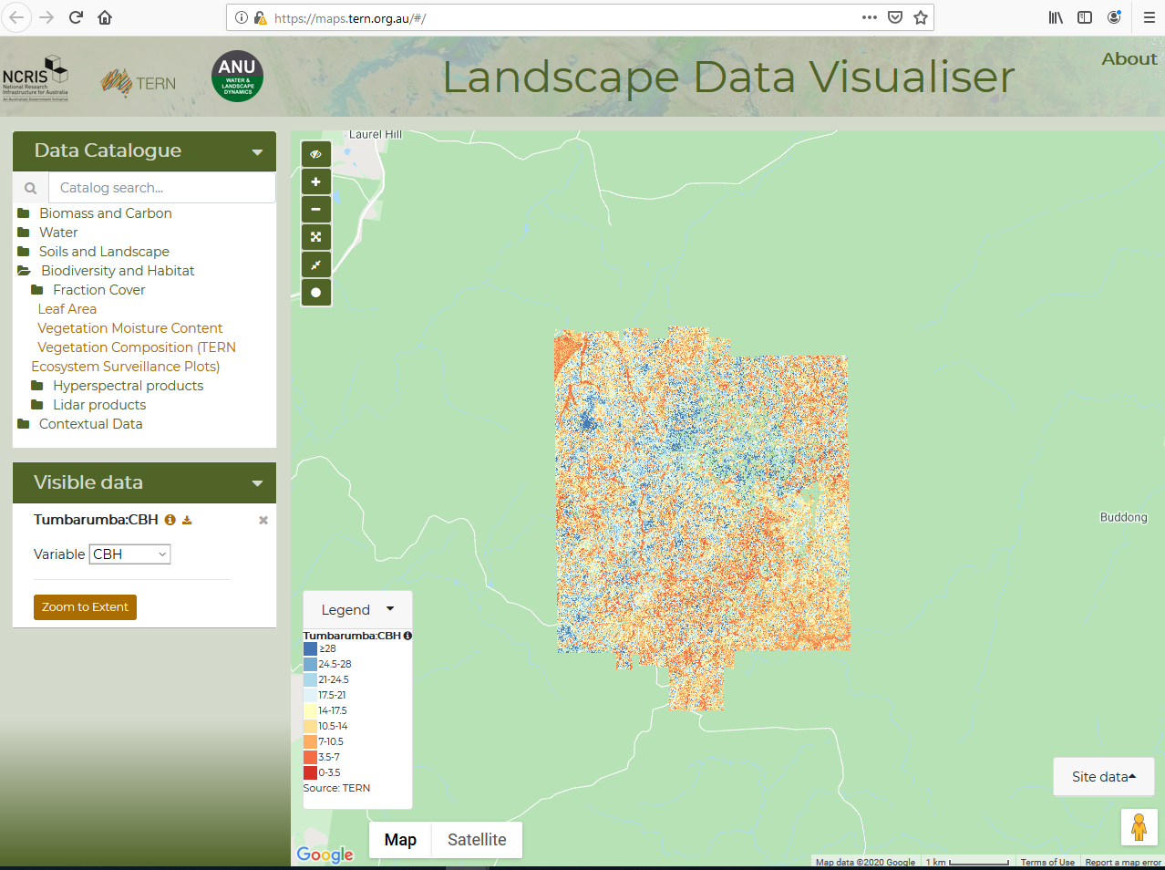
Prototype with subset of supersites: TERN

Slide 8
4. Standardization and Best Practices
Objective: Contribution on CEOS Best Practice/White Paper
ISO SAR standards
Standard published
Engagement challenges
Data Management Principles
Maturity Matrix
Evaluation of different methods/principles
ARD metadata
Evolved into task 1?
Embedding, tagging of required QI parameters

Slide 9
Maturity Matrix Plan within CEOS WGCV
Background:
WGCV’s collaboration with WGISS is to complement the WGISS maturity matrix which focussed on data management with Quality aspect;
WMO’s maturity matrix provides a strong platform to work from;
ESA is currently conducting the Earthnet Data Assessment Pilot (EDAP) project which potential can be adapted;
Current focus and next steps:
Coordination and discussions among international partner (ESA, USGS, CSIRO, NPL (IVOS), NASA (JPPG)) to iterate towards a commonly agreed approach;
Discussion at VHR-RODA (Nov 2019) in ESRIN – NASA agreed to test EDAP approach and provide feedback to evolve to a common approach;
Finalise discussion and presentation at virtual WGCV 47 (July 2020)
Merging Matrix CEOS WGCV/WGISS at next joint WGCV/WGISS meeting (????)

Slide 10
Maturity Matrix Plan within CEOS WGCV
WGISS MM
Combined MM
WMO MM
EDAP MM
VHR
RODA
Common MM
JACIE
USGS/Other MM/input
Data management
Data Quality
JACIE
Sept 2019
VHR-RODA
November 2019
WGCV -47
July 2020
Next WGCV / WGISS
????
Adapted from Goryl, ESA

Slide 11
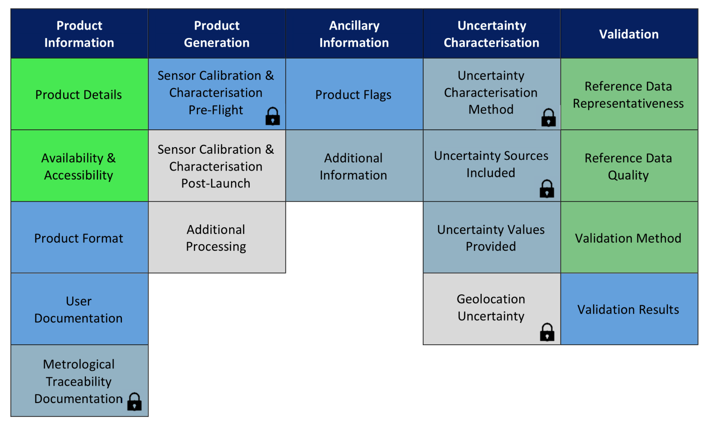
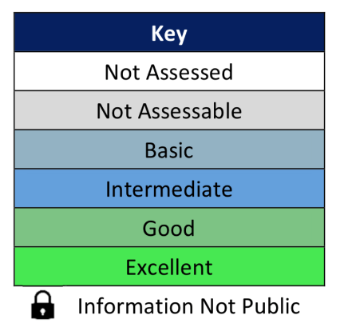
Common framework for mission quality assessments
Example of Product Quality Evaluation Matrix
Quality Assessment Guidelines document then provides criteria for how to grade each category.

Slide 12
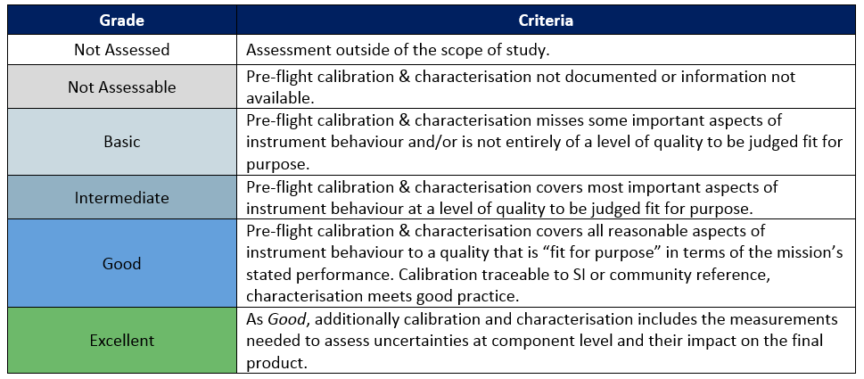
Common framework for mission quality assessments
Grading Criteria example: Sensor Calibration & Characterisation Pre-flight

