Slide 1
Standardised access to EO cloud service providers
Matthias Schramm / TU Wien
WGISS 49 | April 22, 2020

Slide 2
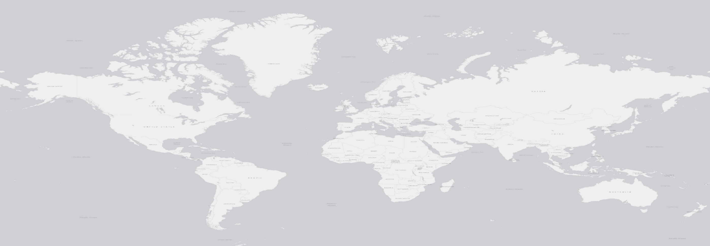
Current communication

Slide 3
openEO API
openEO API: standardised communication between clients and back-ends
Instances implemented at back-ends‘ premises
→ comparability of process chains
Clients
Back-end 1
Back-end 2
Back-end 3
Back-end 4
Drivers
Single environments , unique contracts
No generally accepted standard
Data format, process catalogues, processing capabilities
→ Limited interoperability
Clients
openEO API
Standardised communication interface
instance
instance
instance
instance
Back-end 1
Back-end 2
Back-end 3
Back-end 4
Drivers
Notes:
A vastly increasing volume of freely available EO data led to a paradigm shift in data managing and processing procedures towards cloud computing approaches that ‘bring processes to the data’. New market players and EO data services appeared, customised to their user community.
Speed and momentum of this new development prevented service providers from developing generally accepted standards, leading to an insufficient interoperability between the EO platform (Figure 1).
openEO is a standardised access point API to various EO service providers [2]. The interface can connect to diverse back-end infrastructures, serving as templates for additional service providers. A set of standardised contracts is provided to the users, reflecting examples to from all stages of EO data processing.
Using openEO , former many-to-many communication strategies can be realised as many-to-one (Figure 2). A uniform way to connect to various back-ends allows a switch between environments with little to no effort.

Slide 4
Communication via openEO API

Slide 5
openEO: communication interface
Different clients ←→ distinct back-ends
No adaptation of processes to constraints of back-end infrastructure / software layers / virtual environments
Template for additional front-ends / back-ends
Processes of all aspects of EO data life cycle
Querying / accessing EO data → processing → data distribution / retrieval
https://processes.openeo.org
Can be extended to additional back-ends / front-ends / contracts
Clients
openEO API
Standardised communication interface
instance
instance
instance
instance
Back-end 1
Back-end 2
Back-end 3
Back-end 4
Drivers

Slide 6
openEO: communication interface
Communication:
Translation to JSON process graphs
HTTPS requests to access points at back-end
Translation to local requirements
Execution by back-end
Visualisation / Download → new HTTP request
Execution
Batch job, processed on request
On-demand web services
OGC WMS, OGC WCS, XYZ tiles
Synchronous execution
Clients
openEO API
Standardised communication interface
instance
instance
instance
instance
Back-end 1
Back-end 2
Back-end 3
Back-end 4
Drivers

Slide 7
Virtual Data Cube view
Independently of local data structure
Parameter model
Spatial, temporal, band related dimensions
Range of independent dimensions back-end specific
At least 2 spatial dimensions
Features represented as cells of distinct scalar values
+ Meta-database
Data representation
Dimensions’ discretisation and semantic back-end specific; data types of spatial, temporal and band related dimensions predefined
Spatial dimensions: numbers
Temporal dimensions: date-time
Bands: strings of the band names; defined by back-end
Spatial dimensions in EPSG coded coordinate systems
Discretisation depends on back-end
View bases on Strobl et al., 2017 (doi:10.2760/383579)

Slide 8
Virtual Data Cube view
Data organisation
EO data structure depends on back-end
e.g. granules, collections of GRIB or NetCDF files, collection of arrays in an array database
Locally required access commands translated into data cube compatible form
Definition specific data format only for download
At least available: NetCDF, GeoTIFF, PNG
Infrastructure
No infrastructure for data cube itself needed
Front-end terminal
Process execution
Processing capacity + data storage to be provided by back-end
Translation between cube related contracts and back-ends’ local syntaxes managed by openEO API
View bases on Strobl et al., 2017 (doi:10.2760/383579)

Slide 9
Virtual Data Cube view
Access and Analysis
CEOS OpenSearch Best Practice Document, v 1.2
Data extent in two granularity levels
Granules: limited areas and single overpasses
observation periods within seconds
temporal aggregations of such data
Collections: series of products
Provided as virtual geospatial data cube
Processes cover aspects from all domains of processing EO raster data
Data query: aiming compatibility with …
SpatioTemporal Asset Catalog (STAC)
OGC API - Features - Part 1: Core
→ (partial) compatibility with these APIs
View bases on Strobl et al., 2017 (doi:10.2760/383579)

Slide 10
Virtual Data Cube view
Interoperability
Used standards foster comparability between back-end services
Data cube design
Common processes
Communication via HTTP REST Level 2
Data availability / structures not influenced by virtual data cube
→ True interoperability between back-ends not guaranteed by using openEO API
View bases on Strobl et al., 2017 (doi:10.2760/383579)

Slide 11
Communication via openEO API

Slide 12
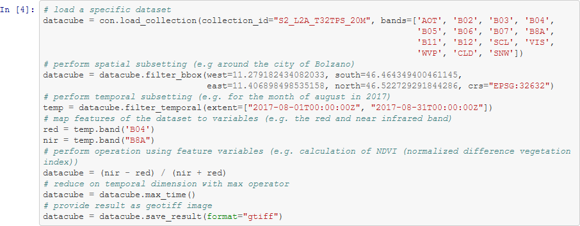
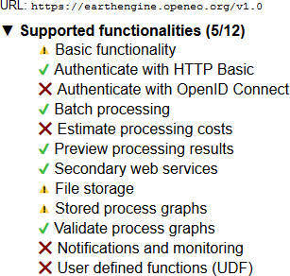
Source code
https://github.com/open-eo/
Repositories
Jupyter examples
https://processes.openeo.org/
https://hub.openeo.org/

Slide 13
More information
https://openeo.org/
https://github.com/Open-EO/
@open_EO
https://www.youtube.com/channel/UCMJQil8j9sHBQkcSlSaEsvQ
https://openeo-chat.eodc.eu/channel/public
https://zenodo.org/communities/openeo
This project has received funding from the European Union’s Horizon 2020 research and innovation programme under grant agreement No 776242. This publication only reflects the author's views; the European Commission is not responsible for any use that may be made of the information it contains.
matthias.schramm@geo.tuwien.ac.at
Notes:
+ EU Funding
+ Matthias Schramm
Richtige links auch

