Slide 1
CEOS COASTAL OBSERVATIONS & APPLICATIONS STUDY TEAM (CEOS-COAST)
Committee on Earth Observation Satellites
Paul M. DiGiacomo, NOAA, CEOS-COAST Chair
CEOS WGISS-49
Virtual Meeting
22 April 2020

Slide 2
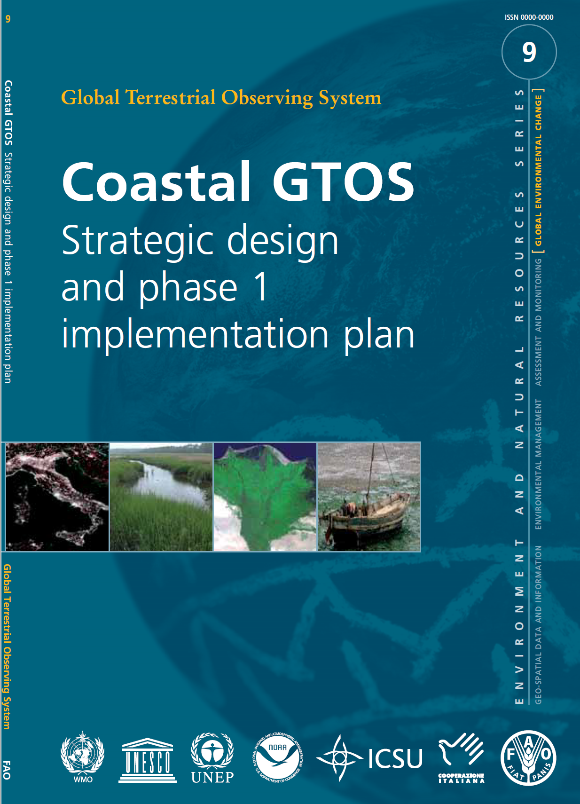
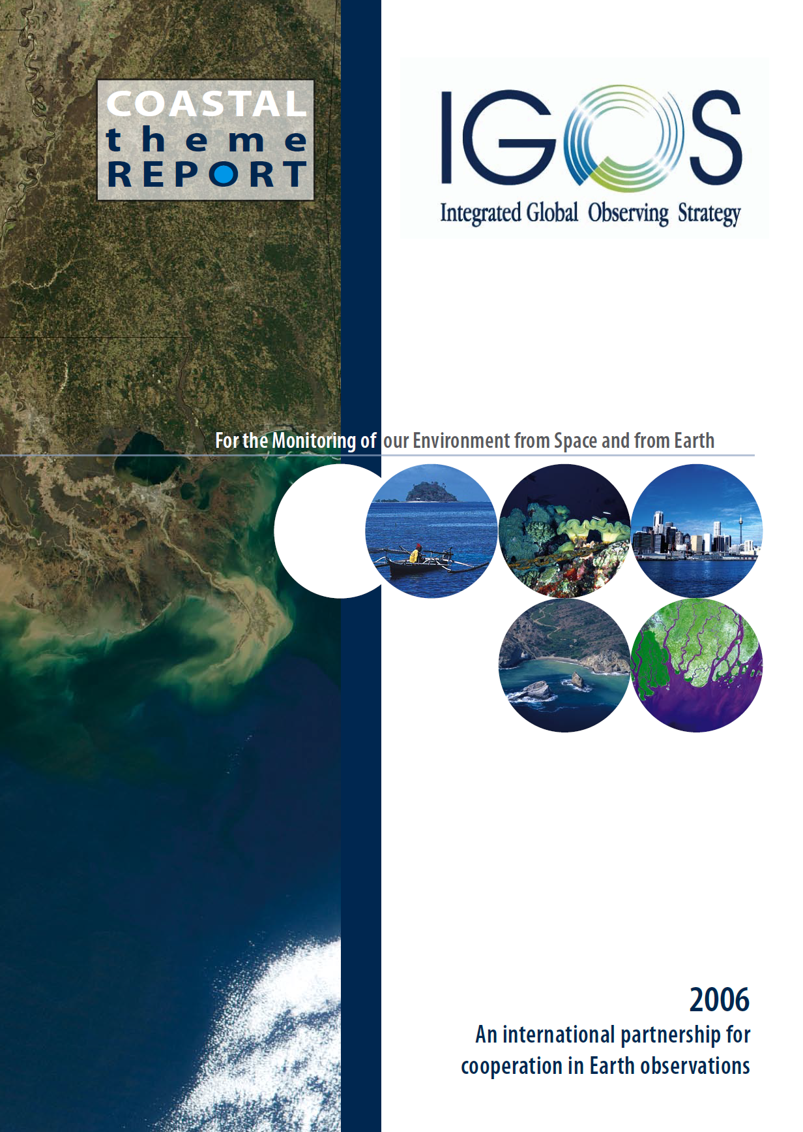
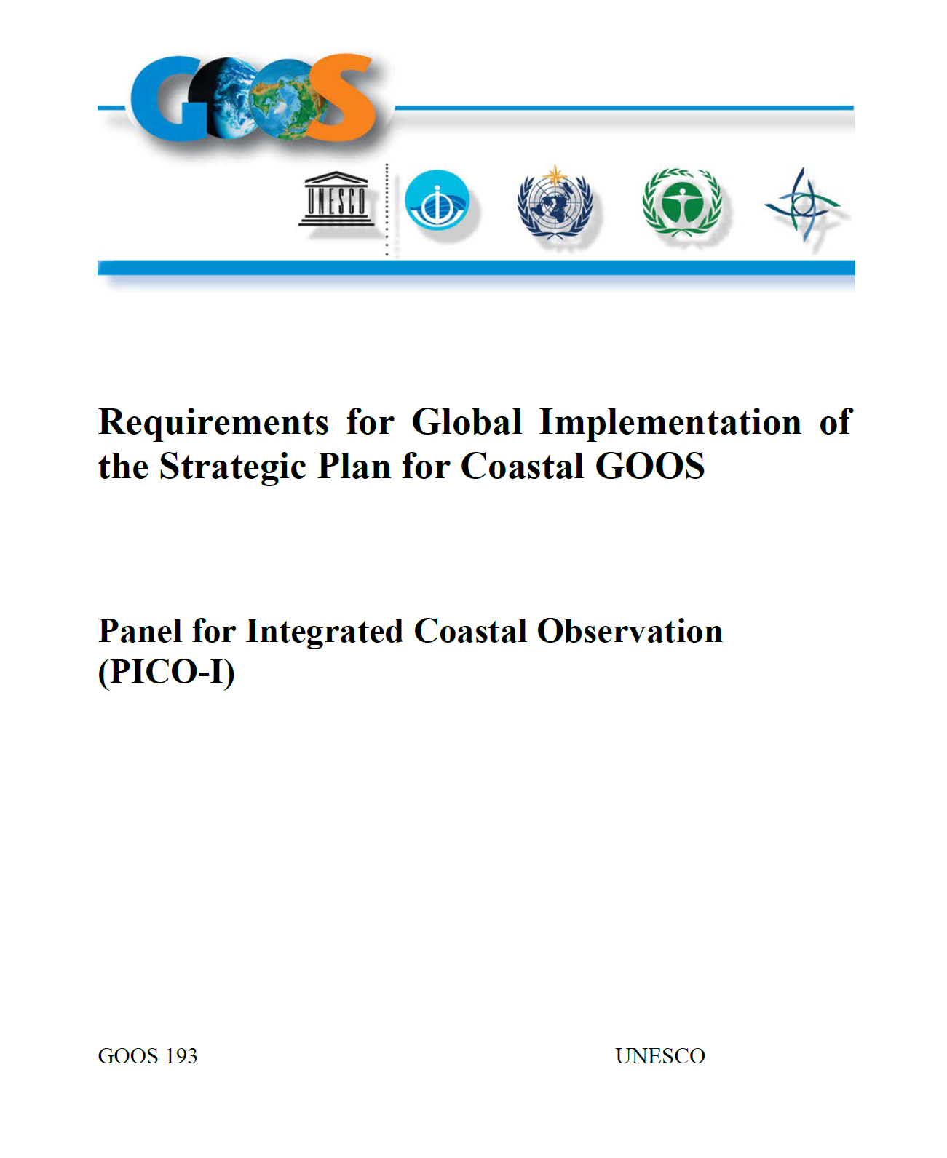
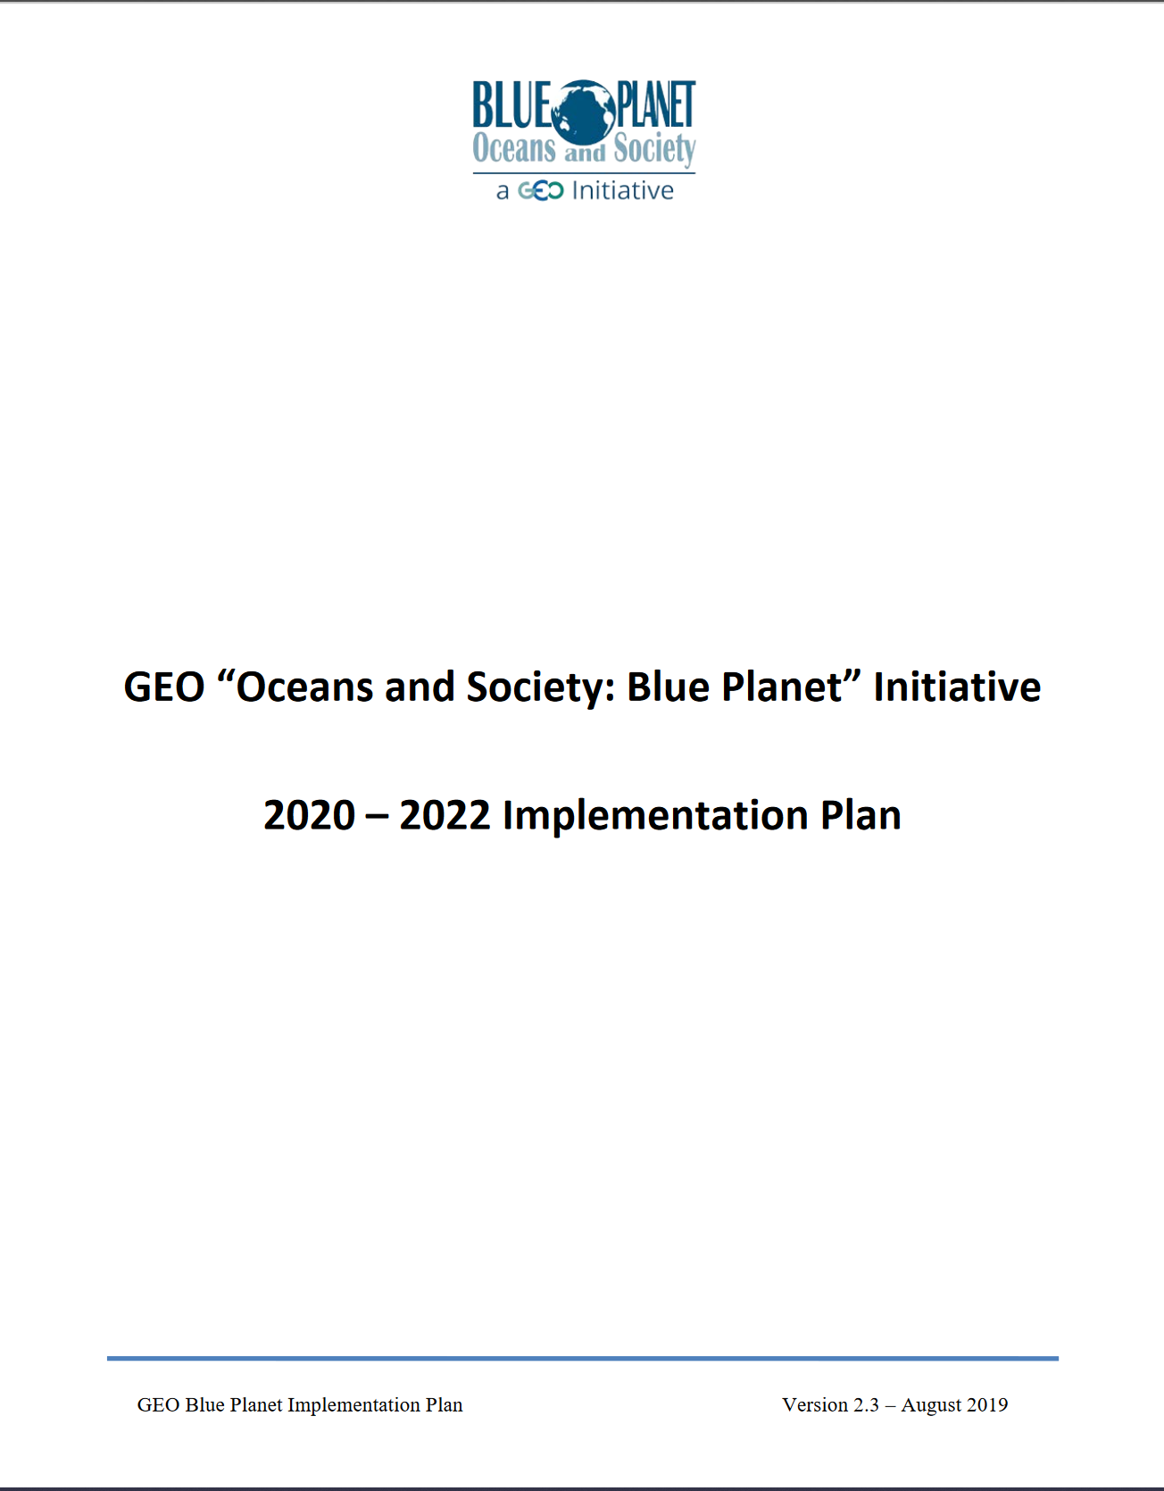
Previous Coastal
Observing Plans
Coastal GTOS, 2005
e.g., deltaic systems;
urbanization and changes
in coastal land use/cover
IGOS Coastal Theme, 2006
e.g., land-sea interface;
coastal populations &
ecosystems at risk
Coastal GOOS, 2012
eutrophication/hypoxia;
pathogens; HABs; benthic
habitats; flooding; acidification,
fisheries; integration
GEO Blue Planet, 2019
e.g., island flooding, hazards,
marine debris, aquatic diseases,
coral reefs, fisheries

Slide 3
CEOS-COAST Study Team
CEOS Coastal Observations and Applications Study Team – will define & execute a CEOS Coastal Strategy (multi-phase approach):
Bridges land and aquatic observations within CEOS, helping to integrate across multiple CEOS entities and domains, both thematic and technical. Cross-cuts the interfacial nature of the coastal zone, including anthropogenic and atmosphere impacts
Identify and implement pilot project(s) that leverage CEOS capabilities across the WGs, VCs and agencies, including the Analysis Ready Data (ARD) framework (to be) demonstrated for terrestrial (CARD4L/LSI-VC) and oceanic (COVERAGE) applications.
The Study Team will highlight the broader utilization of Earth observations for greater societal benefits within coastal zones and enable CEOS to engage with external stakeholders such as IOC/GOOS, UN Environment and high visibility activities such as the UN Decade of Ocean Science for Sustainable Development (2021-2030).
COAST Study Team Initiation & Approach:
Approved at 33rd CEOS Plenary in Vietnam (October 2019)
Virtual monthly meetings
CEOS-SIT Side Event (March 2020)
Supporting off-line work via GoogleDocs Collaboration Site and email

Slide 4
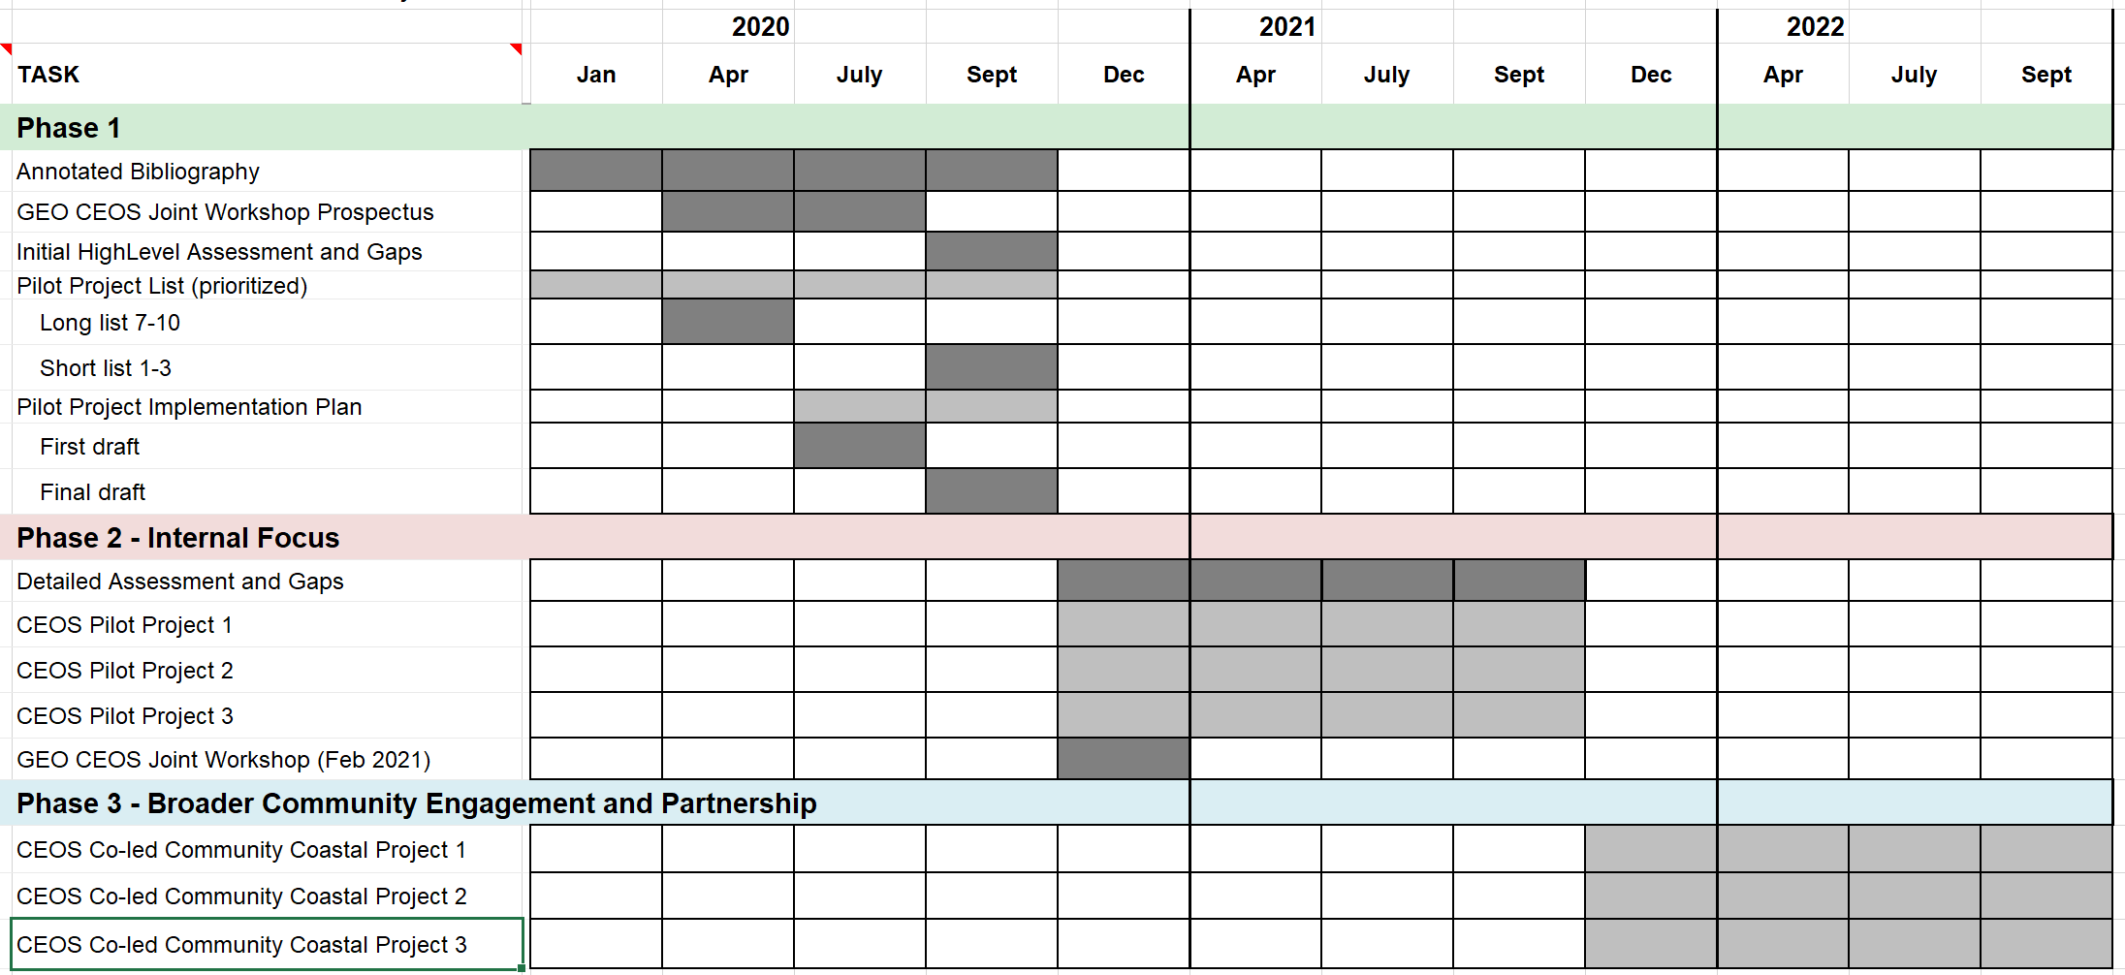
CEOS-COAST Study Team
Stood up in late Fall 2019 and have convened five times since January
~35 members, broadly representing both land and aquatic domains
Multiple CEOS entities - WGs (e.g., WGISS, Disasters), VCs (e.g., LSI, OC, SST), et al.
Multiple space agencies, national and international organizations
2 GEO Initiatives and the GEOSEC

Slide 5
CEOS-COAST Study Team
Phase 1 Deliverables
Compile an Annotated Bibliography and Project Database (accomplished; ongoing)
Compile, vet, and prioritize a Candidate List of Pilot Projects organized under four themes (in progress):
Coastal Characterization & Mapping
Coastal Disasters/Hazards
Coastal Ecosystems/Water Quality/Habitat
Cross-cutting Products, Tools, and Services
Implementation Plan for selected Pilot Project(s)
Joint GEO-CEOS COASTAL Workshop Prospectus
(workshop tentatively planned for Spring-Summer 2021)

Slide 6
COAST perspective on ARD
Successful identification, formulation and implementation of trans-boundary Analysis Ready Data (ARD) will be one of the unifying factors & primary engines that drives the COAST effort forward (NB: existing non-ARD will also be included in this effort)
A significant challenge, however, is bridging and coordinating geophysical satellite data across the land-sea (~aquatic) interface, as well as in situ and diverse biological (and ultimately socio-economic) data sets
To advance the COAST ARD efforts, we plan to leverage current capabilities and plans of the CEOS SST-Virtual Constellation (VC), see next slide, likewise associated ARD models, support and lessons from WGISS/SEO, CARD4L, GHRSST, COVERAGE et al.

Slide 7
SST-VC ARD Proposals
Review and summarize the state of ARD across the Virtual Constellations
Focusing on data formats and metadata structures, variables, services for ARD implementation
Availability of uncertainty measurements, transformation capabilities, and data quality flagging
ARD storage, cloud optimization, and data recipes
Focus first on the SST and OC VC. Add other VCs to the review in the second half of the year.
Assess CEOS-COAST needs and support project implementation
Engage ARD efforts of other CEOS partners (e.g., land )
Identify current gaps and future improvements with regard to dataset interoperability across the interdisciplinary VC products
Report or review presentation by April 2021 or similar

Slide 8
CEOS-COAST & WGISS
Next steps include:
Upcoming CEOS-COAST group telecons in May, June & July 2020
Per the four CEOS-COAST themes, identification and integration of “top-down” and “bottom-up” requirements and drivers
Side meeting/discussions of the Cross-cutting Products, Tools, and Services theme team to identify associated needs, gaps, and priorities for foundational COAST Information Systems & Services (WGISS!)
Detailed articulation of priority pilot efforts and implementation plan development and submission: Summer/Fall 2020

