Slide 1
WGISS Carbon Portal Progress - Links to Open Data Cube Liping Di April 22, 2020

Slide 2
Outline of the talks/Demo
Major progresses since WGISS-48
Live demo of links to Open Data Cubes (ODC)

Slide 3
Major activities and progress since WGISS-48
Beta version of CWIC Carbon Portal (Version 0.9) was released and demonstrated at WGISS-48
Major activities and progress since WGISS-48
Links to Open Data Cube
Function additions and improvements
Exploration of support to other CEOS/GEOSS Initiatives

Slide 4
Links to ODC
New requirement from the carbon science community: Linking to Open Data Cube (ODC)
Analyzed the new requirements and inputs to design the implementation approaches
Tested ODC API and designed metadata and data exchange interfaces with ODC
Designed and released the architecture (white paper) on portal links to ODC
Implementation
Enabled metadata harvest from ODC at both collection and granule levels
Interoperability in data search, access, and analytics
Notes:
All filter features are implementing by keyword search, not preset list manually.

Slide 5
Function additions and improvement
Testing and bug fixing
Tested and evaluated the released portal
Fixed bugs
New functions and improvement
Daily Image Generating
Image Generating Task Management
Hierarchical Layer Management
Improved controls for Comparison and Animation

Slide 6
Support to other CEOS Initiatives
Communicated with CEOS WGISS leadership on the possibility to repurpose the portal to support other CEOS/GEOSS initiative
Discussed with Dr. Paul Digiacomo of NOAA on possibility to support CEOS Coastal initiative and CEOS/GEOSS blue ocean initiative
Understand the requirement
Further discussions are needed.

Slide 7
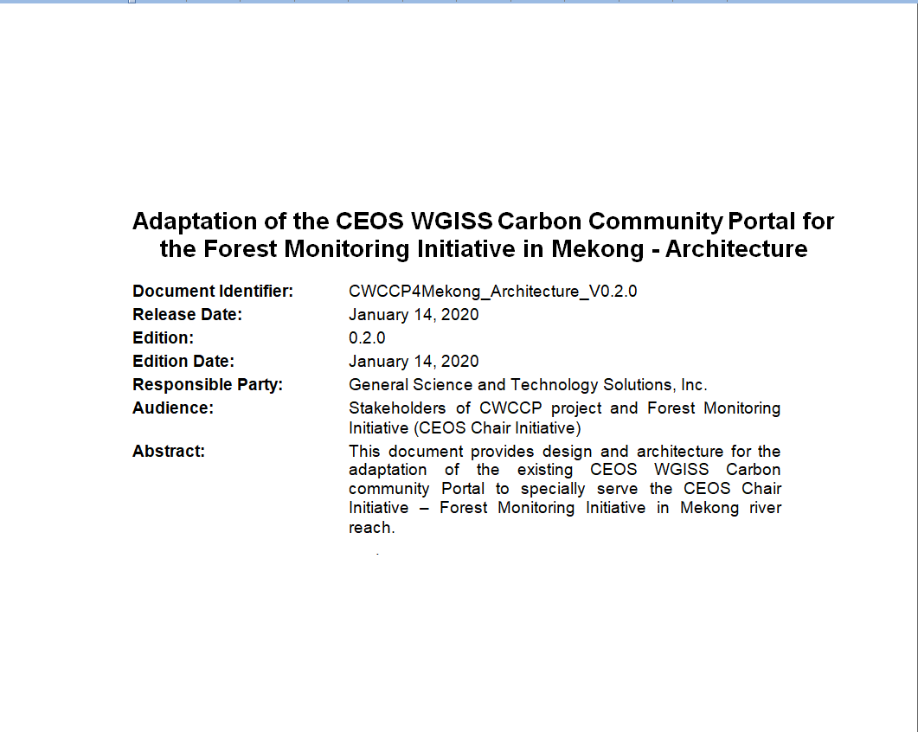
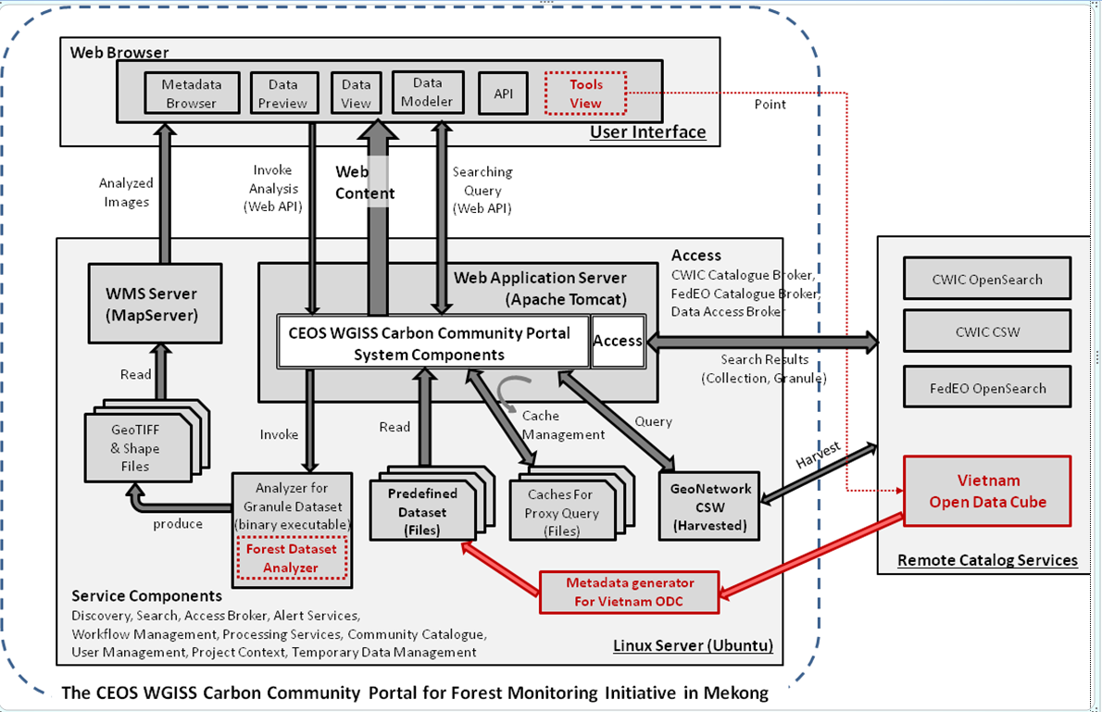
Links to ODC
An architecture design white paper was released in January 2020
Five view design: enterprise view, information view, computational view, technology view, engineering view
Overall architecture
Added metadata harvest
Added data broker

Slide 8
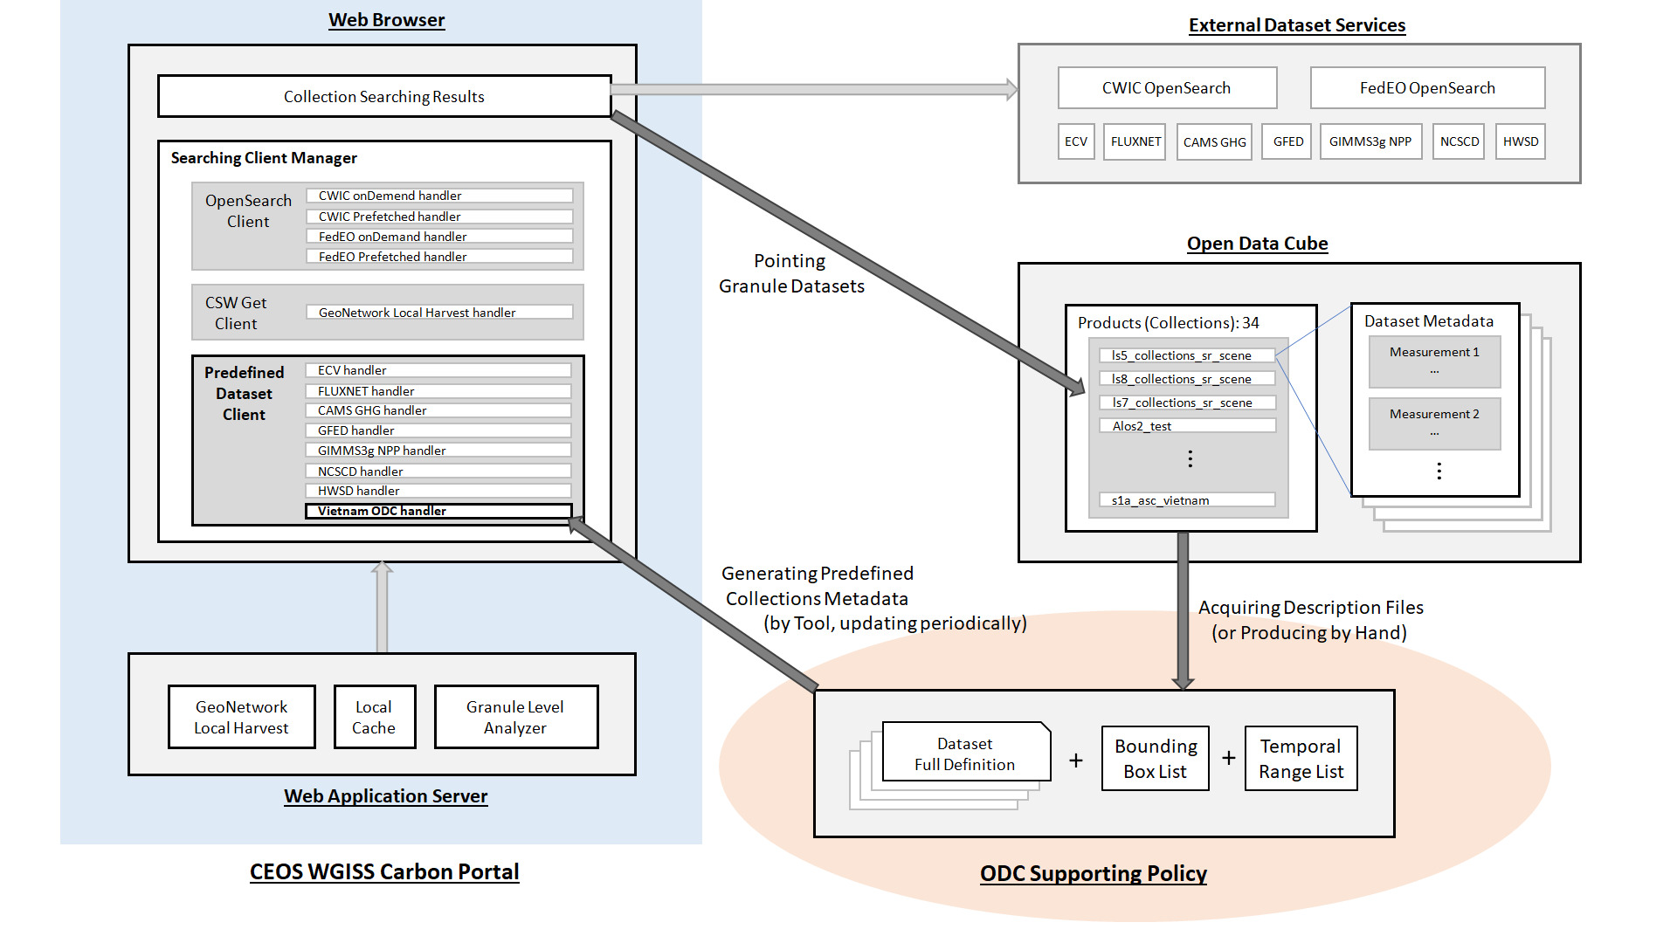
Links to ODC
Links to ODC
Data collections
Granules

Slide 9
Implementation of links to ODC
Implementations started with Vietnam Open Data Cube (datacube.vn)
Deployed at gis.csiss.gmu.edu/carbon/mekong/
Not function due to the inaccessibility of datacube.vn
Implementation with Africa Regional Data Cube (http://52.54.26.108/)
Deployed at gis.csiss.gmu.edu/carbon/africa/
Data collections searchable
Granules accessible
Data broker for customized access, rendering, and analytics

Slide 10
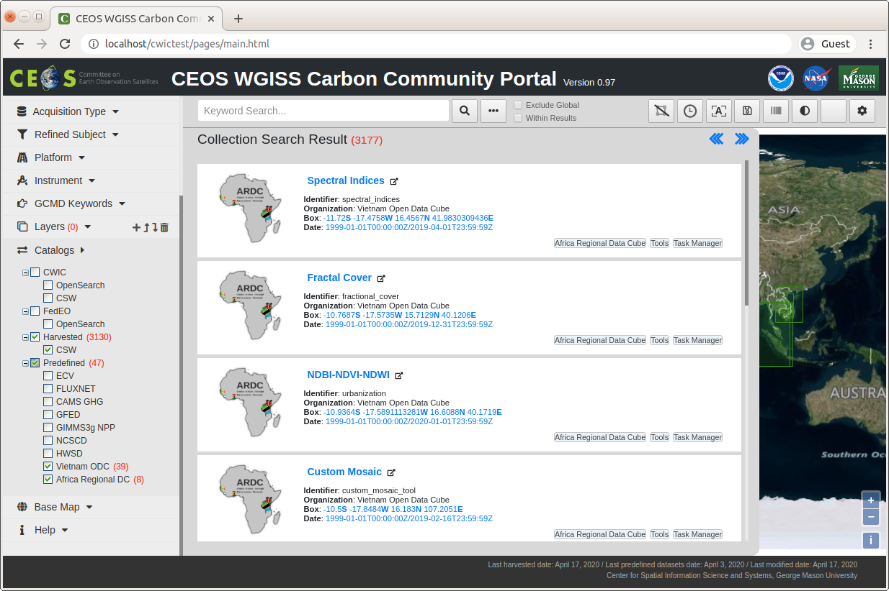
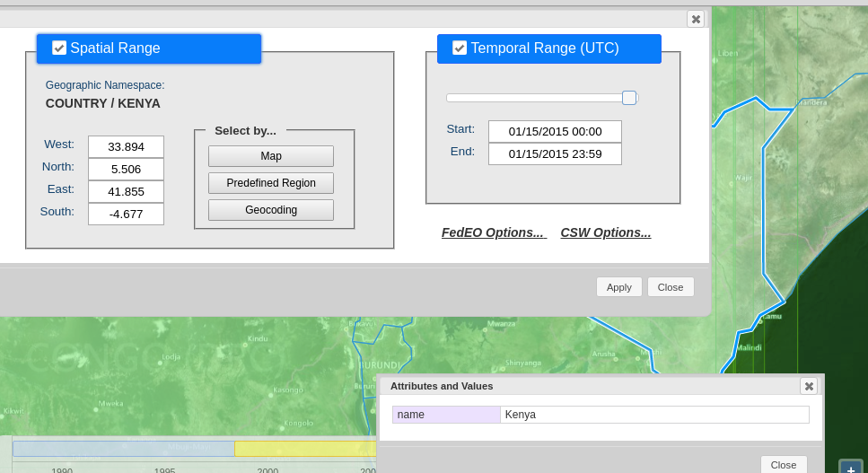
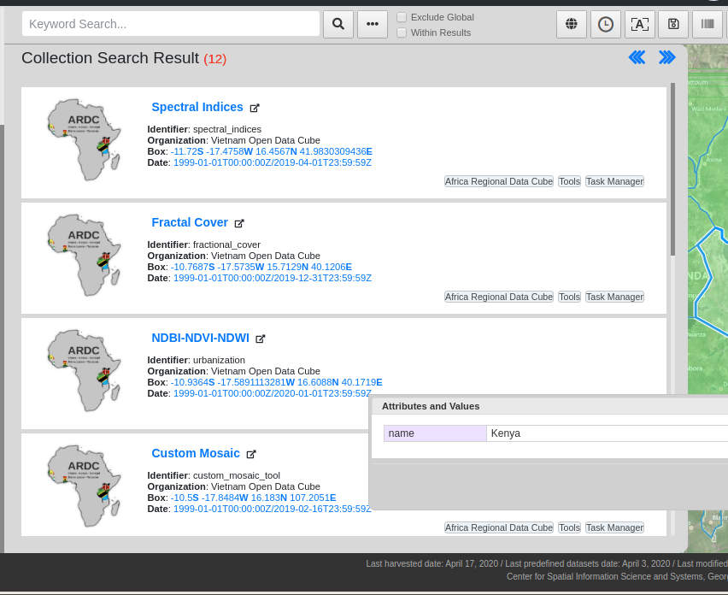
Open Data Cube Connectivity
Function improvement – Increasing Open Data Cube Connectivity
Appended 8 Tasks datasets from Africa Reginal Data Cube
Totally 47 collection datasets from Open Data Cube
Integrated Open Data Cube metadata
Support searching consistency
Totally 47
Vietnam ODC
& Africa Regional Data Cube
Totally 12 Results
Spatial and Temporal Constraints

Slide 11
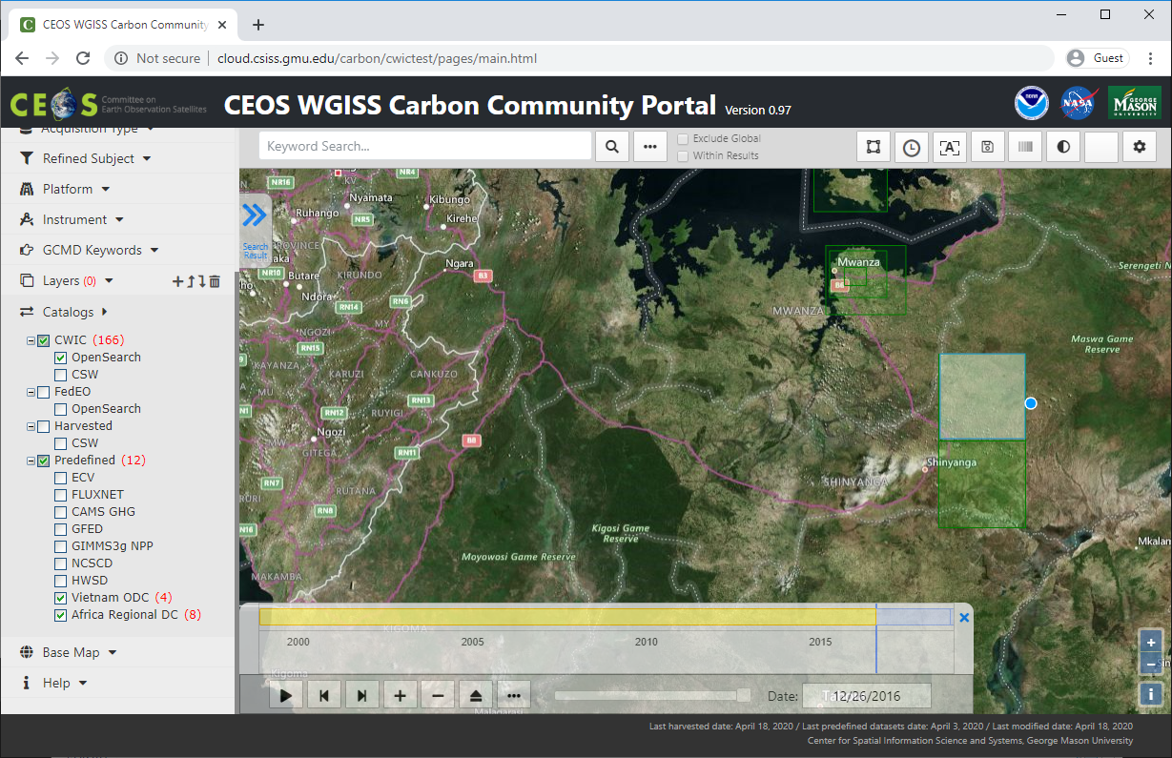
Visualization of Open Data Cube Datasets
Function improvement – Visualization from Data Cube Datasets
Generating Images supported by Open Data Cube
Example:
Spatial Constraint – Bounding Box, West 33.5, East: 34.0, South: -3.5, North: -3.0
Temporal Constraint – April 15, 1999 to Dec. 26, 2016
Results: 8 for Africa Regional Data Cube
Spatial
Constraint
Temporal Constraint
Totally 8 results

Slide 12
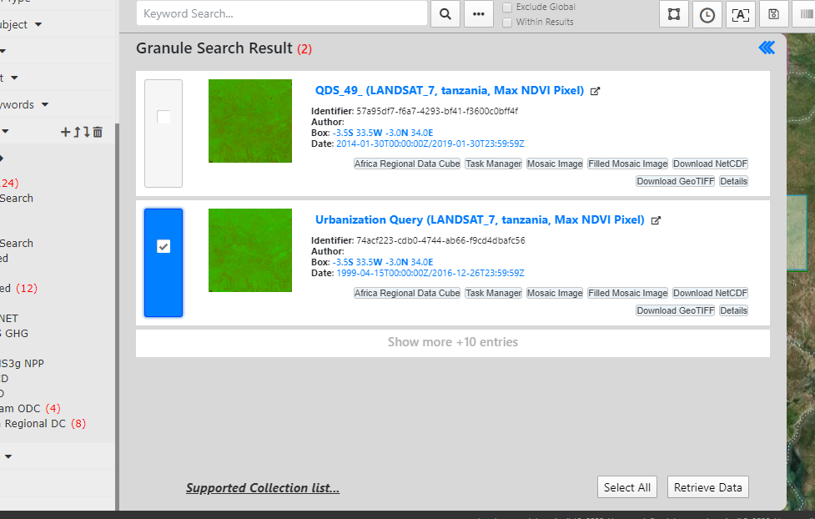
Example of ODC Interoperation - Search: collection & granule
Example (Africa ODC):
Select NDBI-NDVI-NDWI dataset
Totally 2 (or more) granule level response
Select “Urbanization Query” data
Invoke Get File query
Select
NDBI-NDVI-NDWI
Totally 2
granule level results
Select Urbanization Query Data
Click
Retrieve Data
button
Click
Get File button

Slide 13
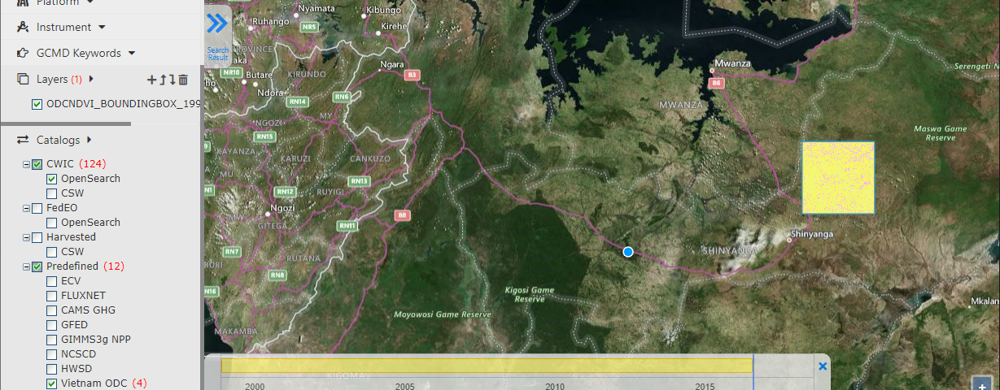
Example of ODC Interoperation - Visualization: rendering & view
Example (cont. Africa ODC):
Showing progress bar and then showing image file name
Click “Add Layer” button
Showing an image layer in the map
Generating progress bar
and its completion
Added an image layer
Click Add Layer button

Slide 14
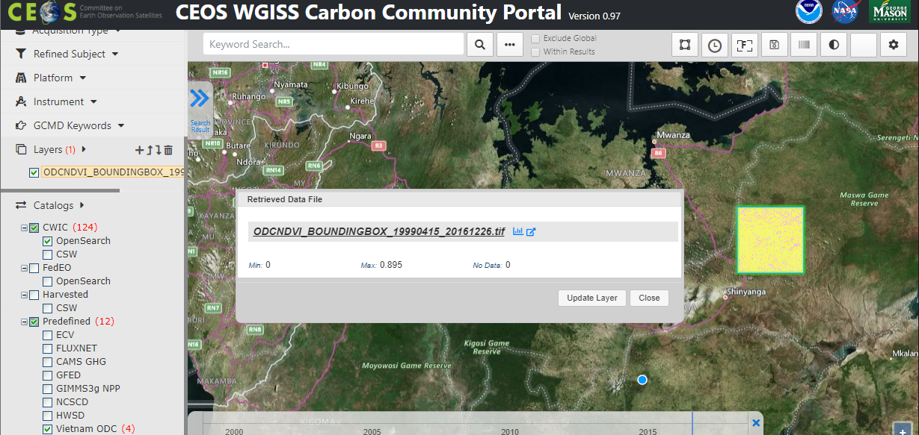
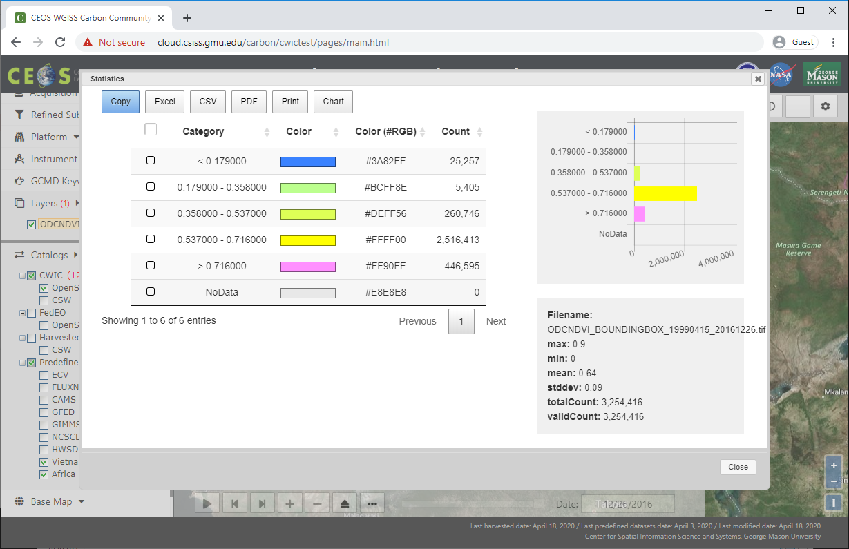
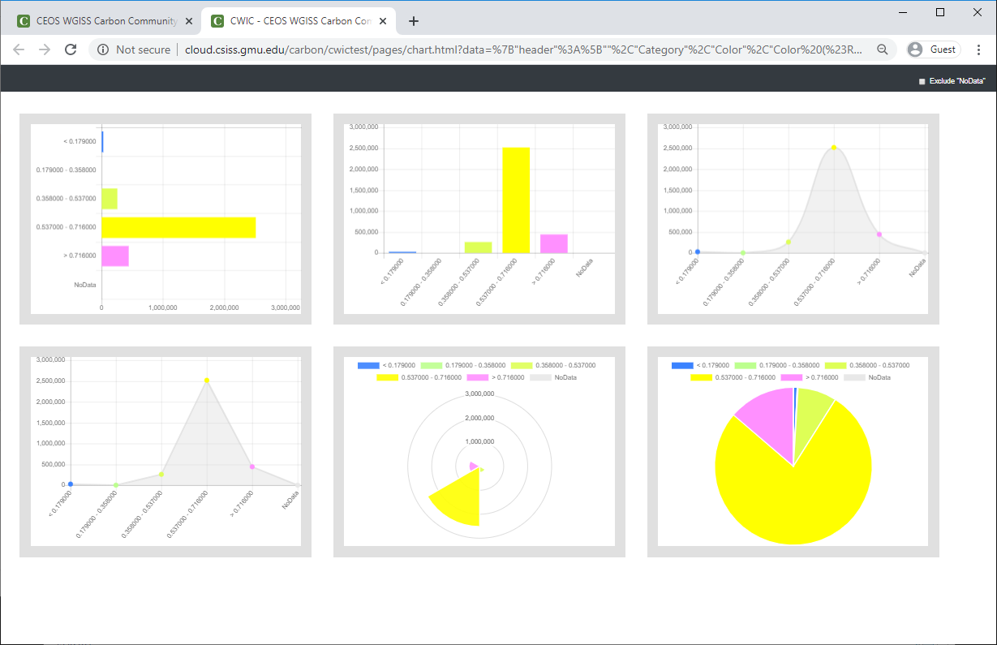
Example of ODC Interoperation - Customized access and analytics
Example (cont. Africa ODC):
Click the layer text (become highlights)
Click “Disk Icon” then Data file popup window will be showing
Click “Chart Icon” for statistical information
Click “Chart” button for Showing Analytic Chart
Click Disk Icon
Select a layer
Click
“Chart Icon”
Data file Popup
Click
“Chart” Button
Statistical Information Popup
Chart Window

Slide 15
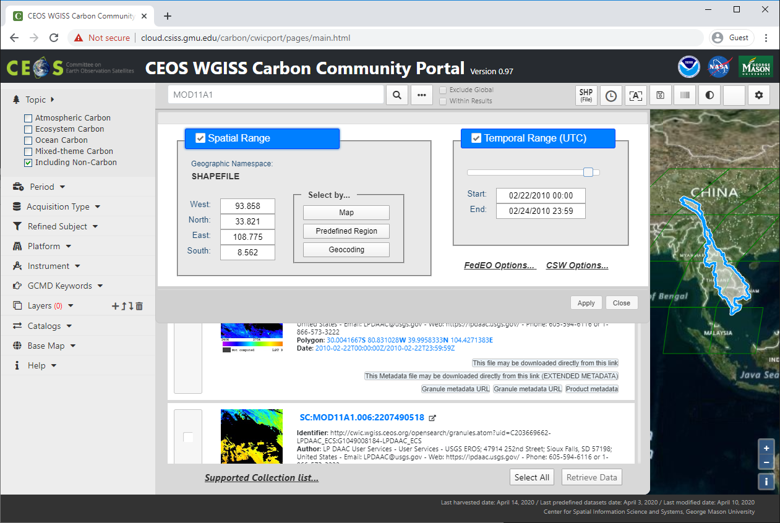
Carbon Portal (v0.97) Improvement - Daily Image Generating
Progress
Function improvement –Daily Image Generating
Improved to generate images from granule level entries
Generating time slicing multiple images
Can be comparing between daily variation
Can be applied to animated visualization
Upgradable to weekly or monthly functions
Set Temporal Range
To 2 or more dates
https://e4ftl01.cr.usgs.gov//MODV6_Dal_E/MOLT/MO
https://e4ftl01.cr.usgs.gov//MODV6_Dal_E/MOLT/MO
https://e4ftl01.cr.usgs.gov//MODV6_Dal_E/MOLT/MO
https://e4ftl01.cr.usgs.gov//MODV6_Dal_E/MOLT/MO
1st date
https://e4ftl01.cr.usgs.gov//MODV6_Dal_E/MOLT/MO
https://e4ftl01.cr.usgs.gov//MODV6_Dal_E/MOLT/MO
https://e4ftl01.cr.usgs.gov//MODV6_Dal_E/MOLT/MO
https://e4ftl01.cr.usgs.gov//MODV6_Dal_E/MOLT/MO
2nd date
…
Period: Daily
https://e4ftl01.cr.usgs.gov//MODV6_Dal_E/MOLT/MO
https://e4ftl01.cr.usgs.gov//MODV6_Dal_E/MOLT/MO
https://e4ftl01.cr.usgs.gov//MODV6_Dal_E/MOLT/MO
https://e4ftl01.cr.usgs.gov//MODV6_Dal_E/MOLT/MO
n^{th} date

Slide 16
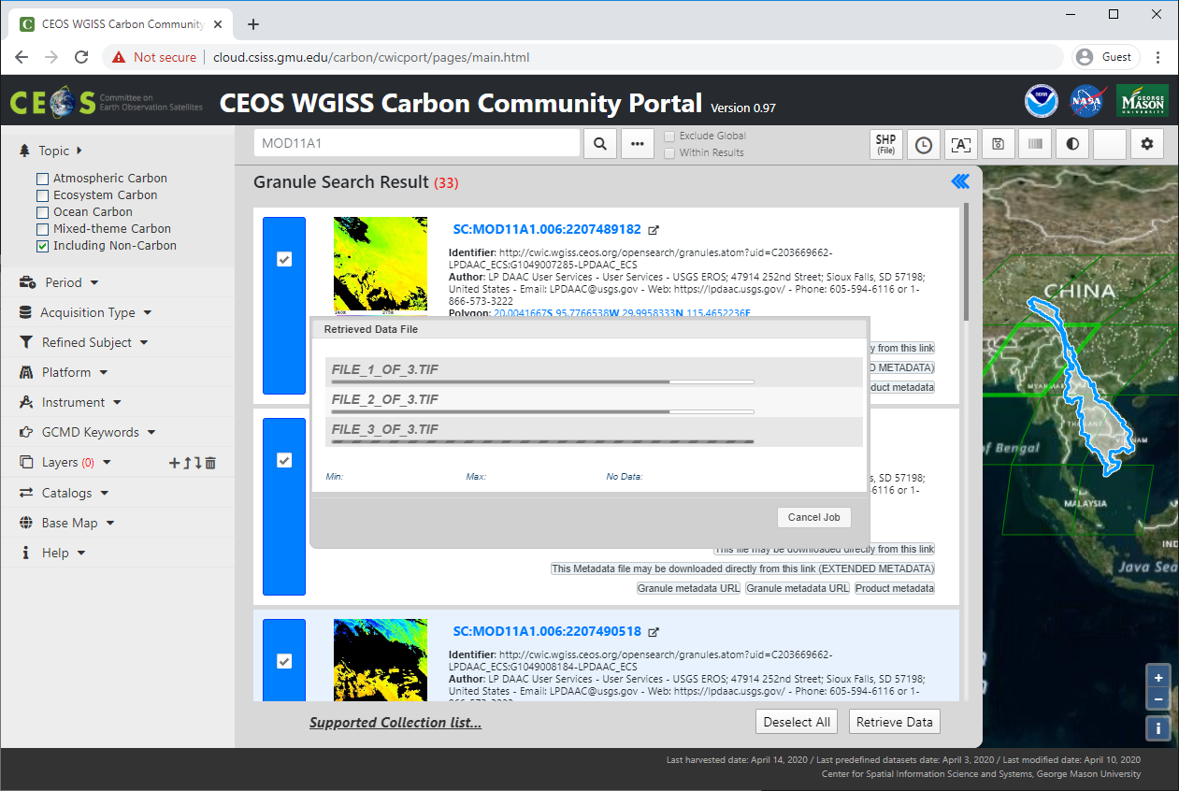
Carbon Portal (v0.97) Improvement - Image Generating Task Management
Progress
Performance improvement – Image Generating Task Management
Task management from asynchronous query tasks
Restricting maximum number of tasks at a time
Control from user’s unintended heavy task loads
Set 2 for maximum task
Can be adjustable after performance tuning
Generating Task
Management
Maximum 2 tasks at a time
waiting
Finish All

Slide 17
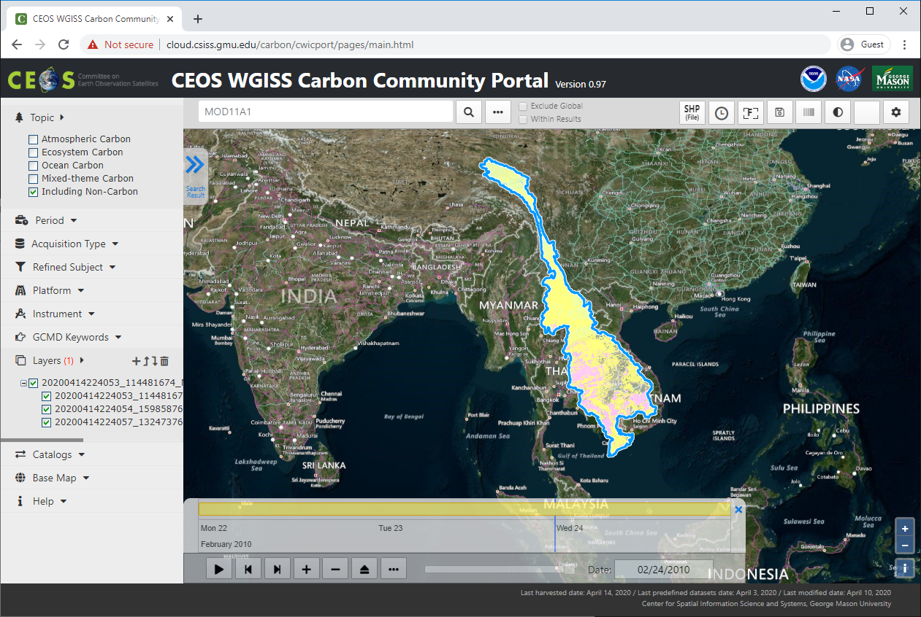
Carbon Portal (v0.97) Improvement -Hierarchical Layer Management
Progress
User Interface improvement – Hierarchical Layers and Layer Group
Support Layer Group
For single request but multiple replies query case
Correspond for supporting daily images
Layer Visibility can be turning on or off per each child layers
Downloading, showing statistical information from each daily image
Layer Group and
Hierarchical Layers
Showing All
Checked Layers
Statistical
Information
per Each Image

Slide 18
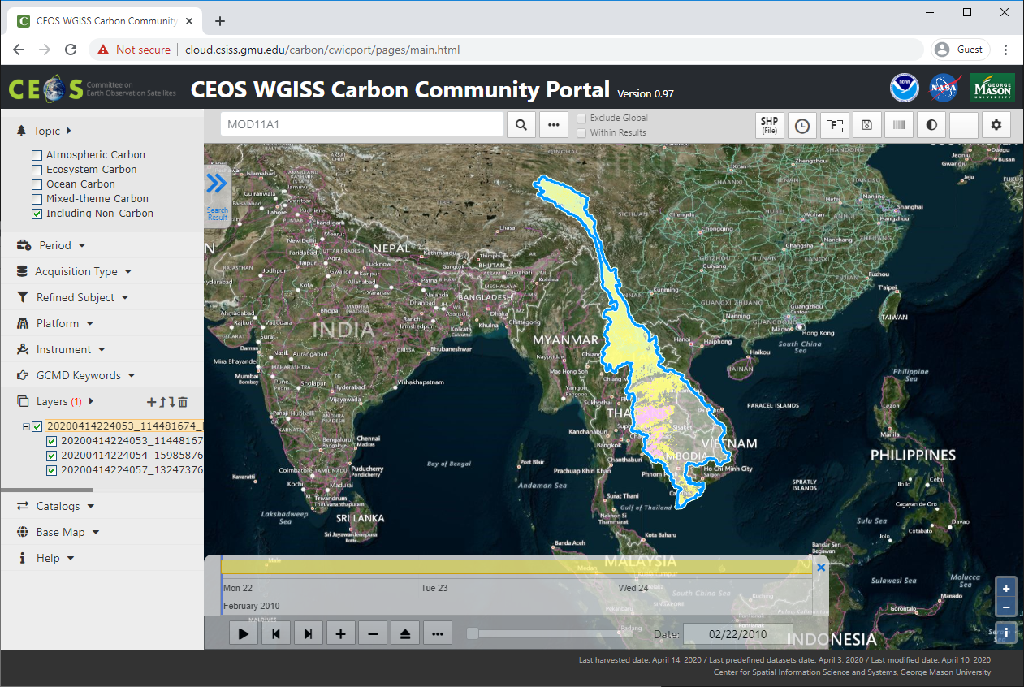
Carbon Portal (v0.97) Improvement - Comparison and Animation
Progress
User interface improvement – Comparison and Animation
For showing variation visually from each daily images
Press Play button for showing animation
Merge Timeline option for showing only selected date layer or not.
Slide bar can change current time
Play
Button
Slide Bar
Merge Timeline

