Slide 1
JASMIN Jupyter Notebook Service - Challenges and Opportunities
Philip Kershaw, CEDA Technical Manager
Matt Pryor, JASMIN DevOps
Centre for Environmental Data Analysis, RAL Space, STFC
Bryan Lawrence, Jonathan Churchill, Matt Pritchard, Victoria Bennett
Notes:
The abstract pattern can be removed or repositioned if required. Be careful to ‘Send to Back’ so that it does not obscure any important information.

Slide 2
Overview
What is JASMIN?
Jupyter services in the context of JASMIN’s cloud and the evolution of data analysis environments
[follow-up from presentation for WGISS-47]

Slide 3
What is JASMIN?
Large-scale computing platform for data-intensive science
at Rutherford Appleton Laboratory in Oxfordshire
for the UK environmental science community and international collaborators
Operated by STFC* on behalf of NERC⁺
Architecture: CEDA & Scientific Computing
Physical infrastructure: Scientific Computing
User services: CEDA
*Science and Technology Facilities Council ⁺Natural Environment Research Council

Slide 4
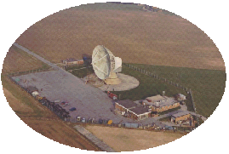
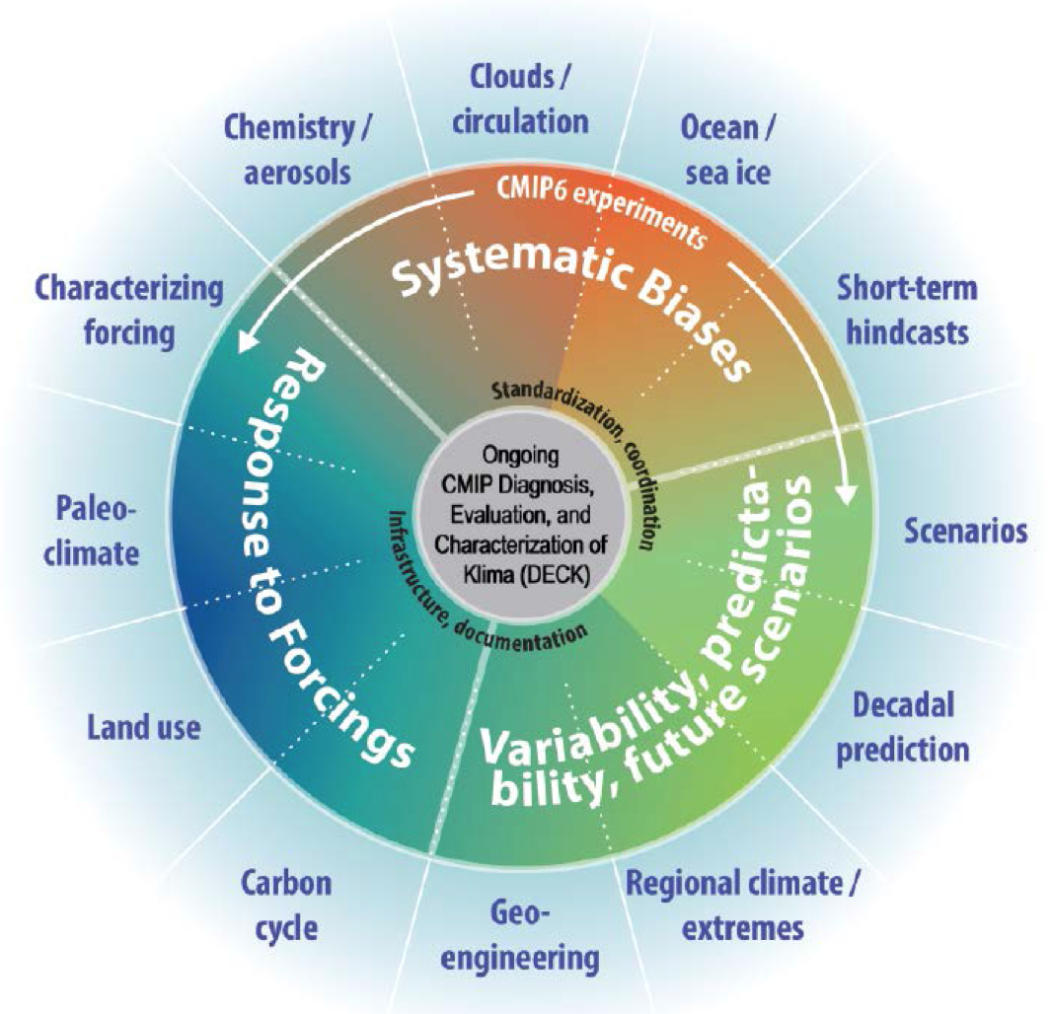
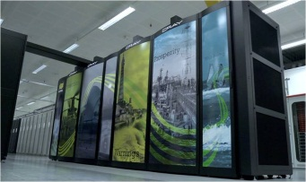
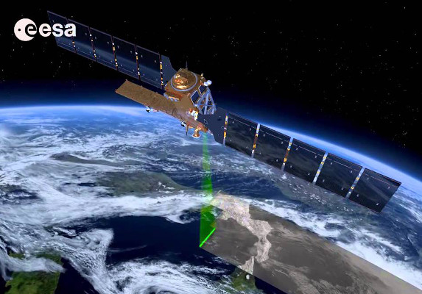
JASMIN: the missing piece
^{CMIP6}
^{JASMIN}
^{Data!}
European contribution to HiresMIP alone is expected to exceed 2 PB
MetOffice supercomputer
^{Sentinel Data}
JASMIN (STFC/Stephen Kill)
ARCHER supercomputer (EPSRC/NERC)
Notes:
Urgency to provide better environmental predictions
Need for higher-resolution models
HPC to perform the computation
Huge increase in observational capability/capacity
But…
Massive storage requirement: observational data transfer, storage, processing
Massive raw data output from prediction models
Huge requirement to process raw model output into usable predictions (post-processing)
Hence JASMIN…

Slide 5
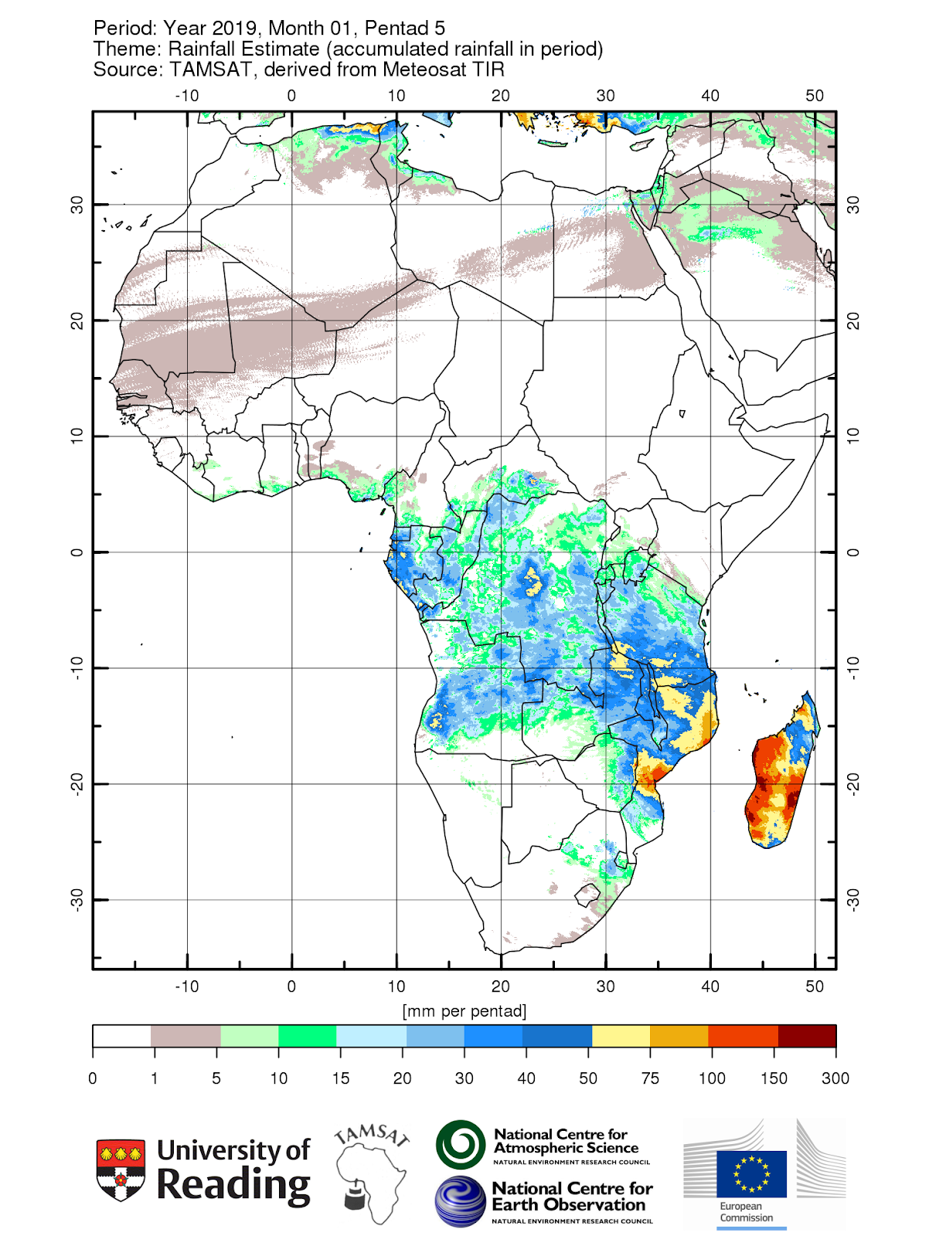
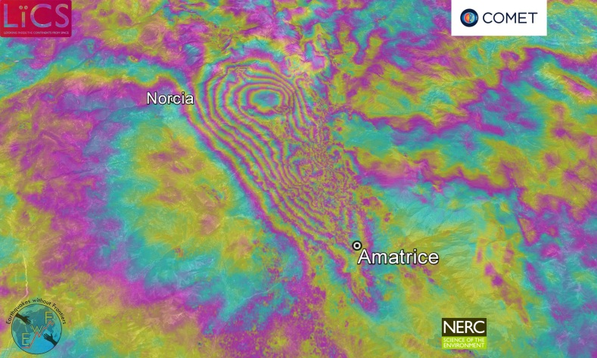
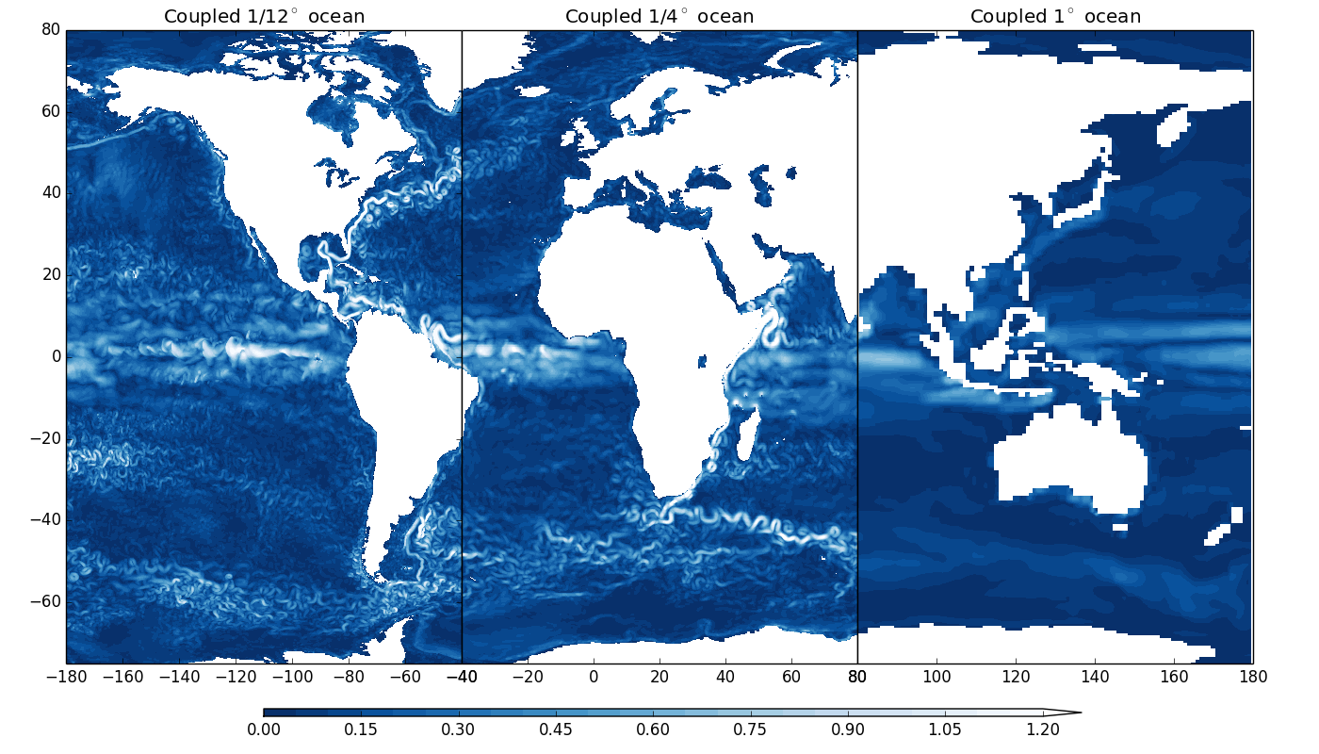
What is JASMIN used for?
Enabling climate services –
allows insurance for >1million
African farmers
Earthquake monitoring
Improving resolution of climate models
Analysing biases in biodiversity data
Access to over 13PB of environmental
data held in the CEDA Archive
… and many more applications
Notes:
Monitor all earthquake and volcano zones from space in near real time Extract meaning from 100’Tbytes of Climate models Remove Observational Bias from “Citizen Science” projects Ingest , store and manipulate Pbytes of data from 10;s of science communities allowing them to share and expose that data flexibility
All on one platform.
This is what we’ve built in the UK with JASMIN. A Big Data “Super Data” cluster for all environmental science data analysis.

Slide 6
JASMIN as a Data Commons
Data Processing
Data Production
Data Analysis
User managed cache
Group Workspaces
External Access
Discover and access
Disseminate externally
CEDA Curated Data Archive
External Data
Providers
Ingestion

Slide 7
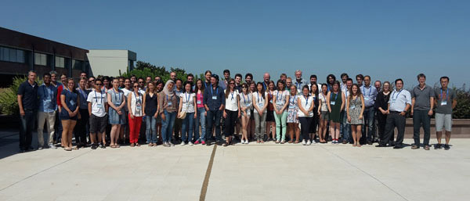
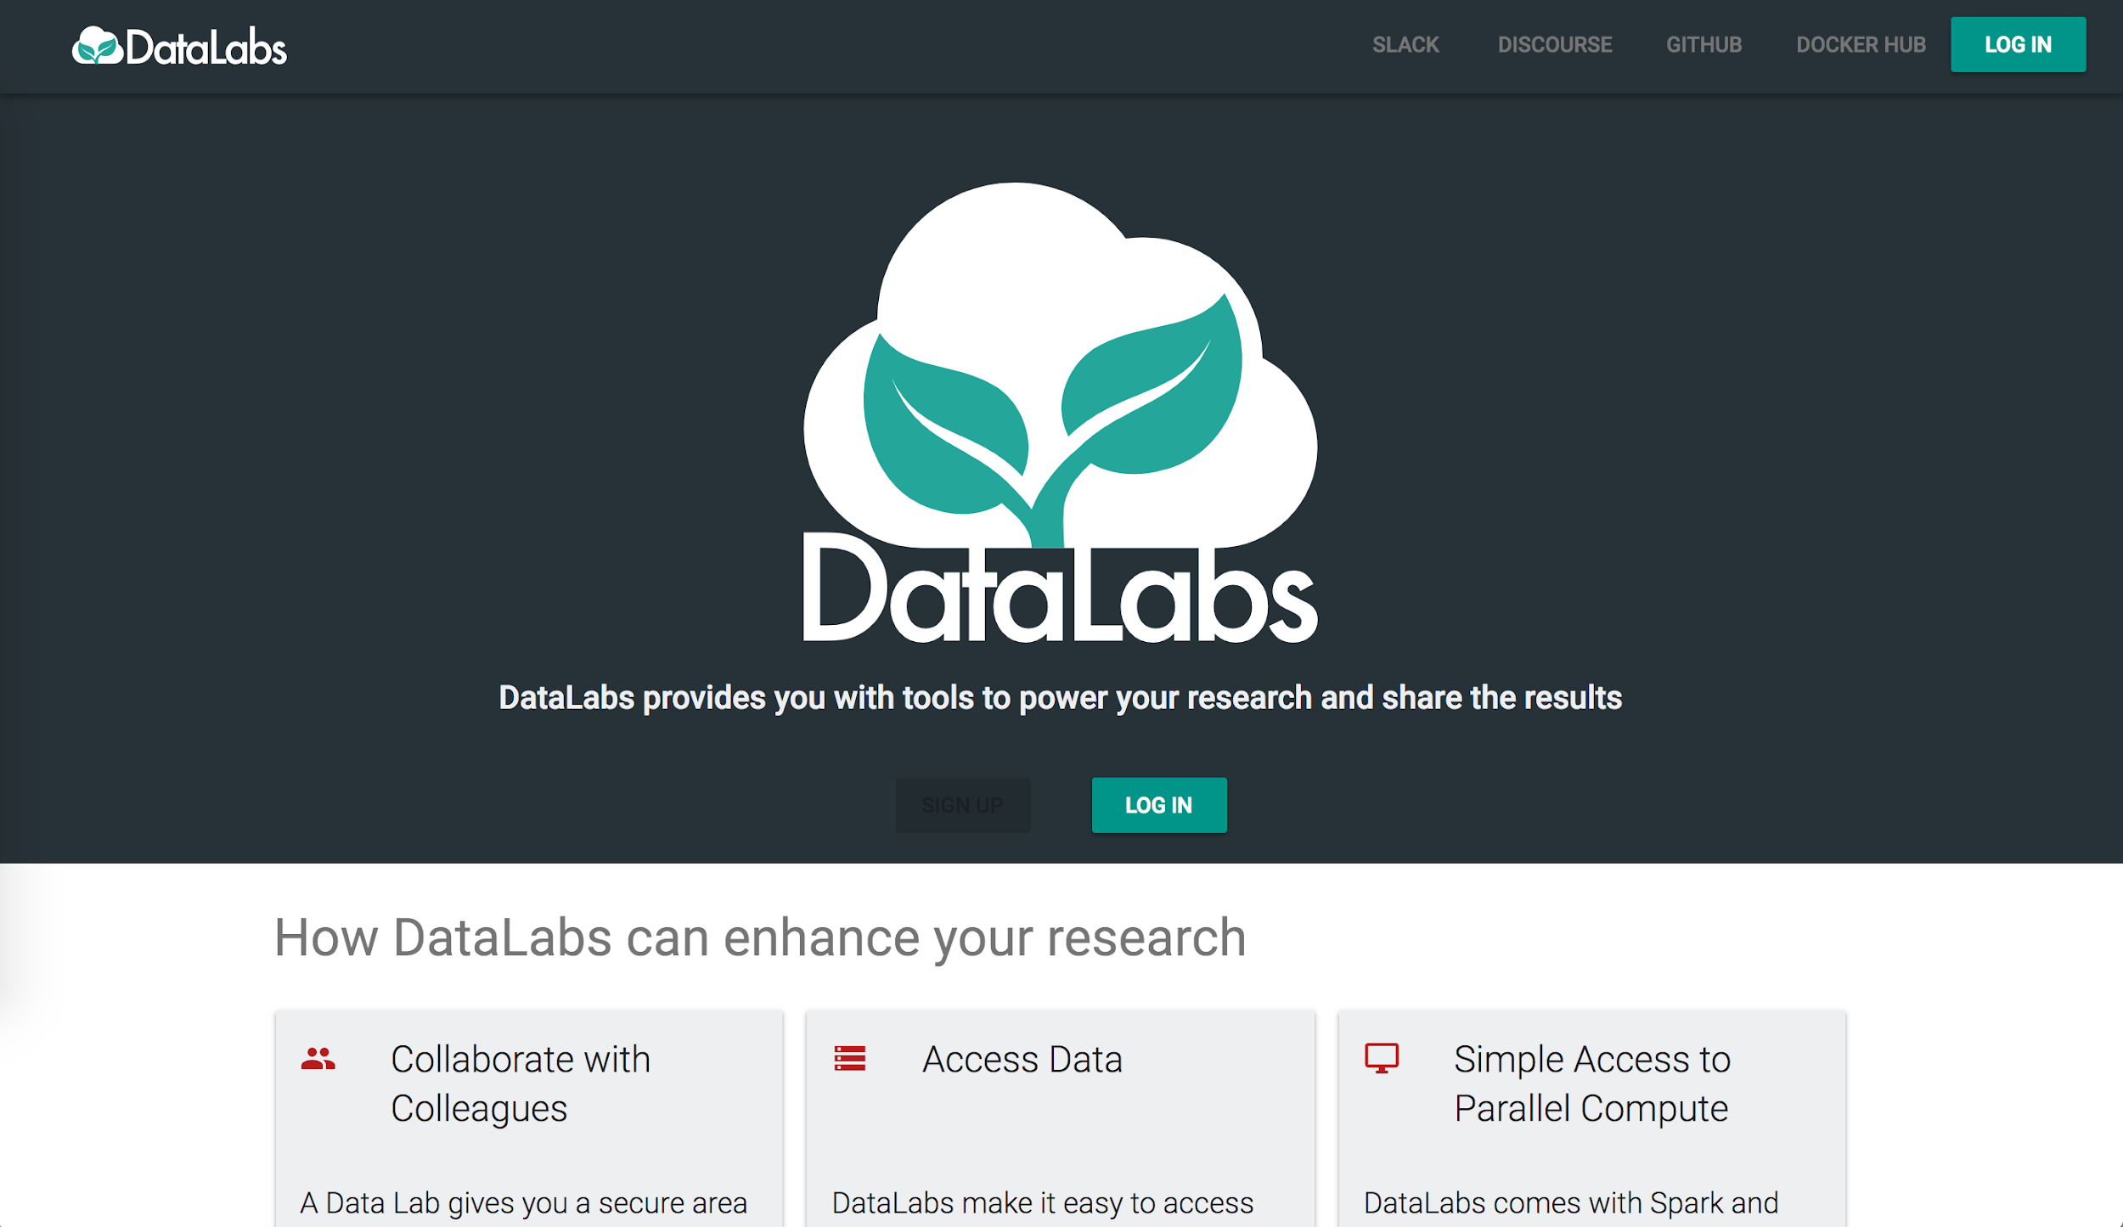
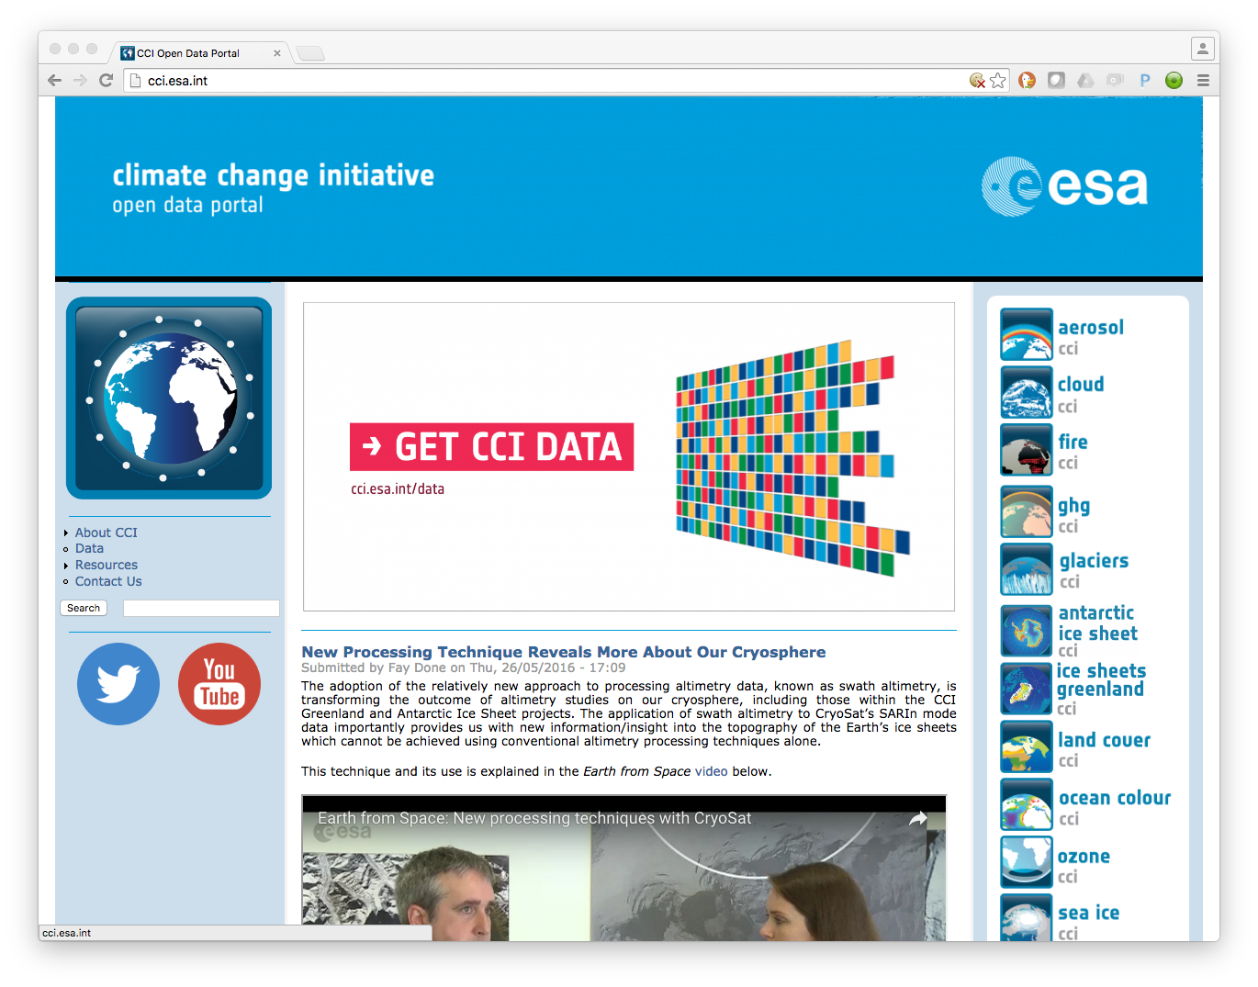
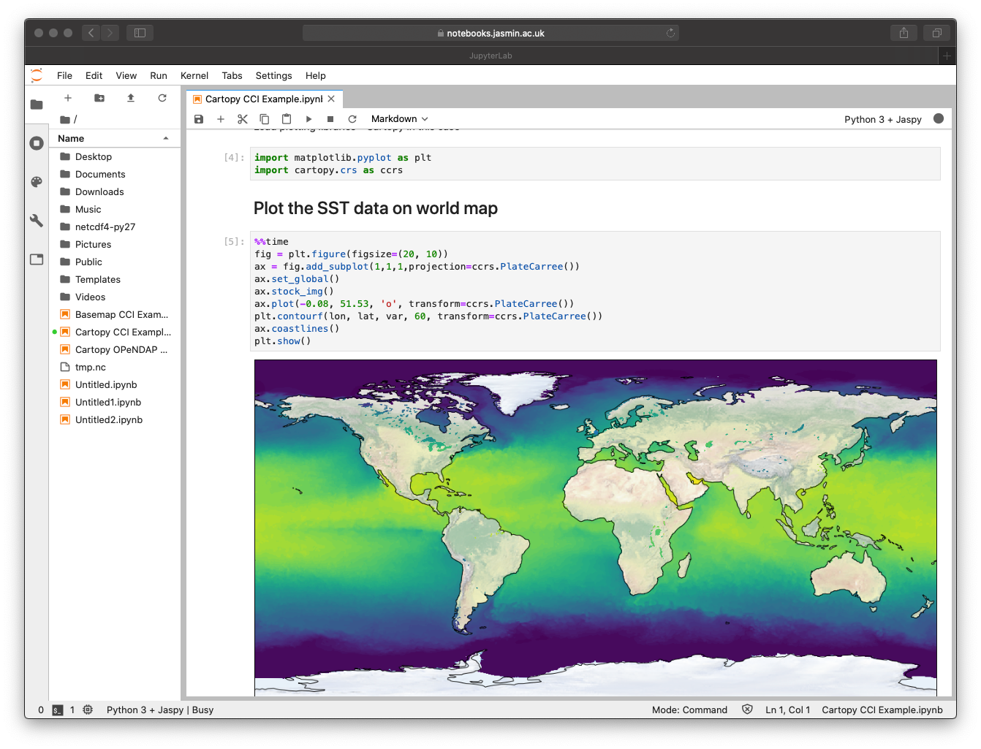
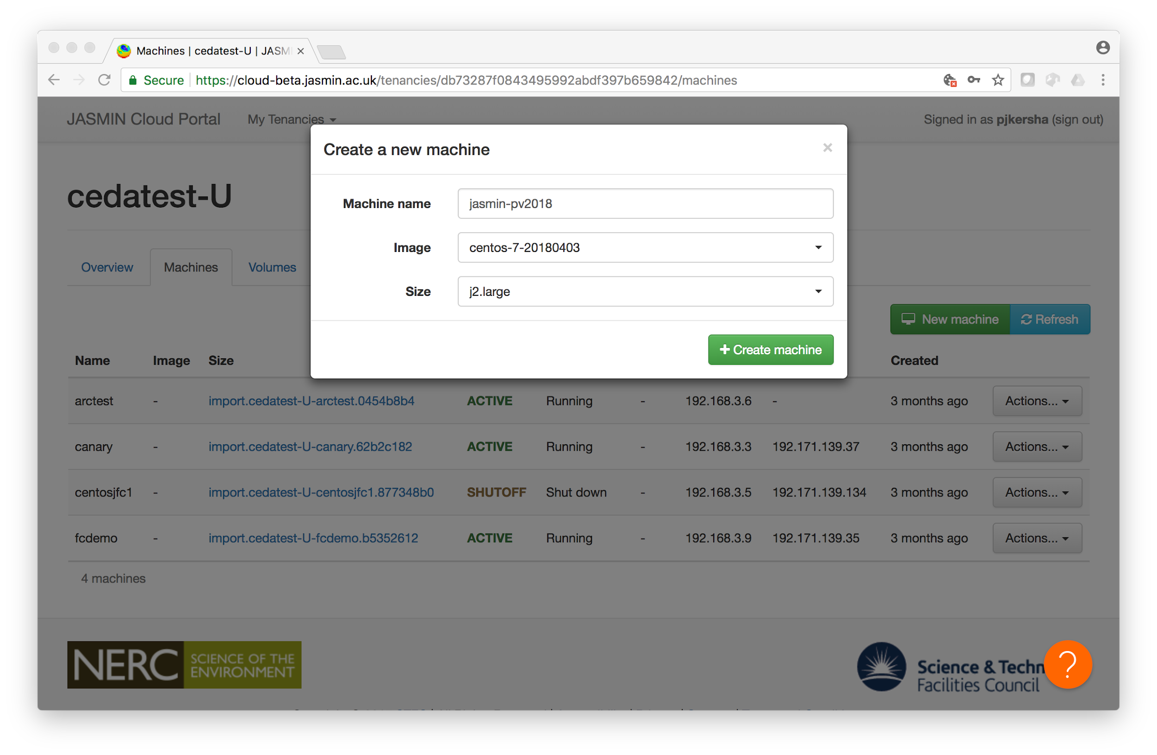
Jupyter and the evolution of JASMIN Data Analysis Environments
JASMIN users
Virtual Research Environments
(Jupyter Notebooks, NERC DataLab, …)
User provisioned Web Portals and Services
JASMIN user
Jupyter Notebook Service
Managed Environment
Scientific Analysis VM
JASMIN Analysis Platform
Lotus batch computing
Attendees at ESA Summer school, using OPTIRAD environment hosted on JASMIN – Credit ESA
Cluster-as-a-Service
OpenStack API
Cloud Service
CEDA Curated Data Archive
Group Workspaces
Cloud Portal
Developers

Slide 8
JASMIN Jupyter offerings …
Cluster-as-a-Service
JASMIN Notebook Service
PaaS environment
Dynamically deploy from pre-defined infrastructure recipes or appliances
Notebook access through Pangeo recipe
Instances of CaaS are deployed on a per project basis
SaaS environment
Generic service available for all JASMIN users
Direct POSIX access to data (archive and group workspaces) but more restricted functionality

Slide 9
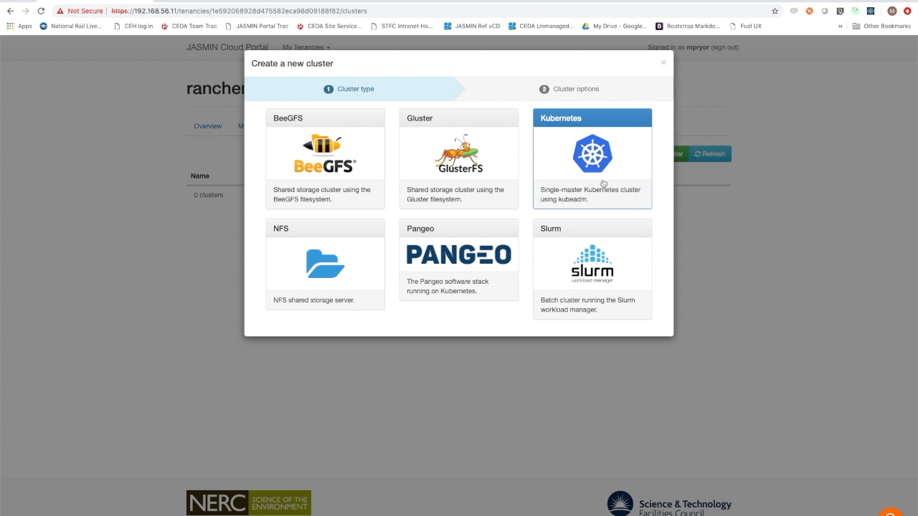
Pangeo with Cluster-as-a-Service

Slide 10
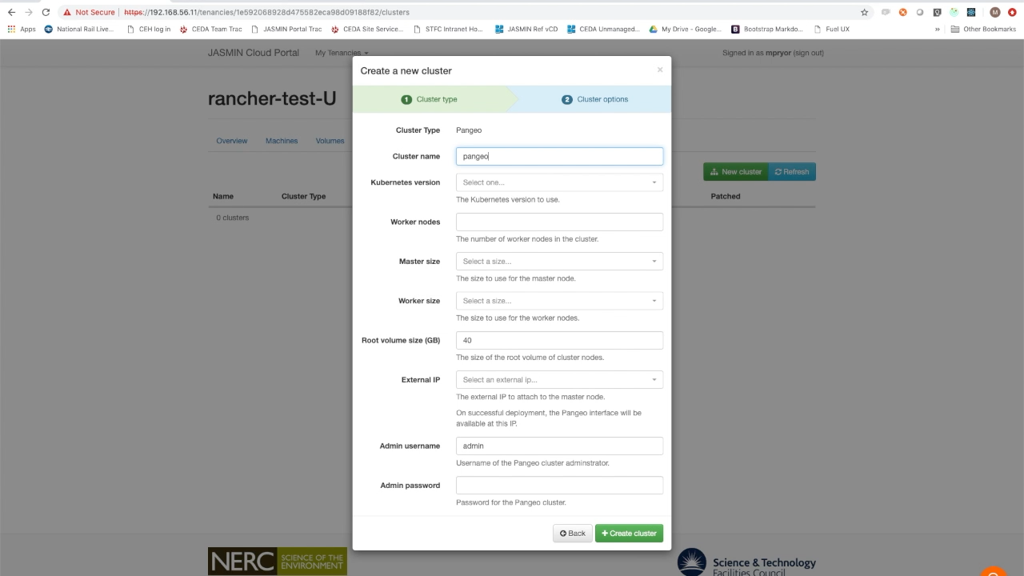
Pangeo with Cluster-as-a-Service

Slide 11
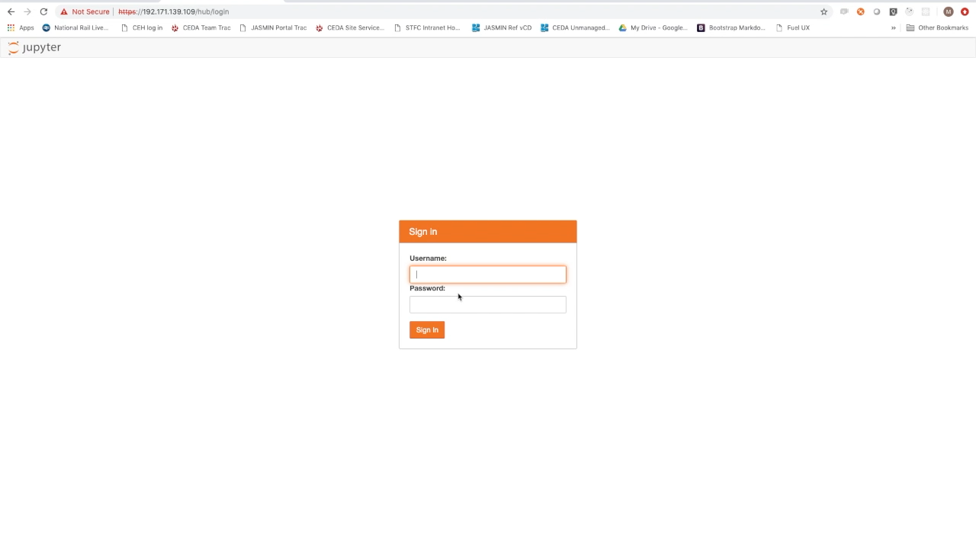
Pangeo with Cluster-as-a-Service

Slide 12
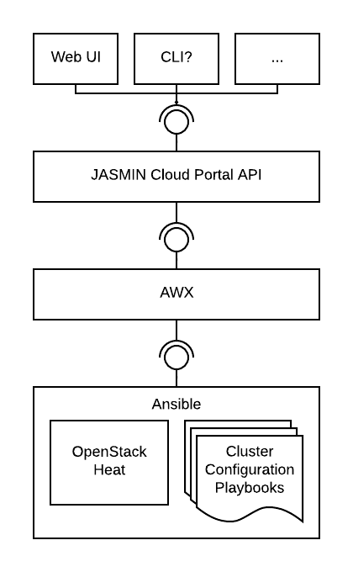
Cluster-as-a-Service behind the scenes
Driven with Ansible Playbooks and OpenStack Heat templates
Playbooks managed by AWX (Ansible Tower)
Supports updates and patching to existing clusters

Slide 13
Pangeo with Cluster-as-a-Service– deployment architecture
Pangeo Instance with Cluster-as-a-Service
Helm charts
Pod
Pod
Pod
Pod
Pod
Control Plane
Kubernetes Cluster
JASMIN Cloud Tenancy
JASMIN OpenStack Cloud
HTTP Access
HTTP Access
Bare metal
CEDA Curated Data Archive
Group Workspaces
Notes:
Clair
GitLab
harbor

Slide 14
JASMIN Notebook Service
New service - launched 19th March
Available for JASMIN users directly from https://notebooks.jasmin.ac.uk
Seeing fast uptake by users
Implemented with OAuth 2.0 sign-in + 2FA for better security
Fixed kernel with jaspy – standard suite of packages to suit JASMIN user community based on Conda
Future Dask capability likely to be via Dask Gateway
Notes:
Suite

Slide 15
Notebook Service deployment
Service directly mounts shared high-performance POSIX disk by launching containers with the correct UID/GIDs.
Jupyter Notebook Service
Container Registry
[Harbor]
Helm charts
Pod
Pod
Pod
Pod
Pod
Control Plane
Kubernetes Cluster
Container Continuous Integration Pipeline
[GitLab]
Bare metal
POSIX Access
POSIX Access
Security scan container images [using Clair]
CEDA Curated Data Archive
Group Workspaces
Notes:
lair
GitLab
harbor

Slide 16
More about storage and Data Access
Initiatives in the community such as Pangeo have used Xarray with Zarr as an interface to store and access data efficiently with object stores
Benefits for users with Jupyter environments
JASMIN has diversified storage to include dedicated object store (5PB) and is …
Piloting writing subset of CMIP6 climate model dataset to JASMIN object store using
- Xarray and zarr and
https://github.com/cedadev/S3-netcdf-python (in-house development)

Slide 17
Early findings and thoughts for the future
Notebooks are in demand through the two service offerings on JASMIN
Pangeo (deployed from Cluster-as-a-Service)
General notebook service - notebooks.jasmin.ac.uk
It’s early to draw conclusions yet
Data access and cloud continues to be an important factor –access semantics: POSIX, Object store
Users largely want services ready-made, batteries included
How could we standardize notebook experience across multiple platforms in the wider community?
Pip installable recipes or otherwise agreed environments
This could be challenging

Slide 18
Thank you!
Website: www.jasmin.ac.uk
Twitter: @cedanews
Email: support@ceda.ac.uk
JASMIN CaaS Pangeo Jupyter demo:
https://www.youtube.com/watch?v=pUQp3ZCWVH4

