Slide 1
ESA FedEO STAC
A. Della Vecchia, D. Guerrucci, M. Albani (ESA)
Yves Coene (Spacebel)
CEOS WGISS#49
21th April 2020

Slide 2
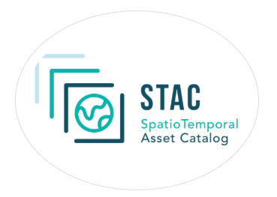
Outline
Work performed
Future work
Conclusion

Slide 3
Work performed
Proof of Concept
Use of STAC for static browsing of FedEO EO Collections and EO Granules
Partial implementation of STAC
On-top-of OGC 13-026r8 / OGC 17-047 OpenSearch interface.
Use “Statistics” in STAC Catalogs instead of current .CSV files / asset HTML pages.
Exploit OpenSearch (GeoJSON) faceted search results to show dynamic “non-empty” STAC subcatalogs and metrics information.
Reused STAC Client software
Limits STAC version that can be implemented …
STAC-BROWSER – https://github.com/radiantearth/stac-browser
Rocket - https://rocket.snapplanet.io/

Slide 4
Work performed
4 STAC Specifications:
ESA FedEO STAC Prototype
STAC Item based on OGC 17-003 metadata
STAC Catalog
STAC Collection
STAC API (future work). OpenSearch used instead.
Used to provide “views” on EO Collection and EO Granule metadata residing in the OpenSearch Catalogue.
Implemented on-top-of OpenSearch end-point.

Slide 5
STAC
STAC resources derived from OGC API Features Core
To be built on-top-of (FedEO) OpenSearch interface with GeoJSON responses.

Slide 6
OGC API Features | Collections (OGC 17-069r3)
GeoJSON metadata organized according to (feature collections)
Collections (“series”) – OGC 17-084
Granules (“datasets”) – OGC 17-003
Services & Applications (“services”) – OGC 19-020r1
4 Collections as defined in OGC API - Features

Slide 7
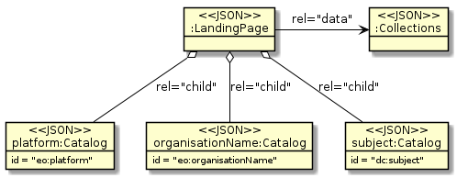
STAC Catalog - Browse Collection hierarchies
Organise EO Collections and EO Products according to different facets (i.e. OpenSearch queryables):
Browse by platform (e.g. according to SKOS hierarchy)
Browse by organisationName
Browse by science keyword (e.g. according to SKOS hierarchy)
Virtual STAC Catalogs
representing sets of “EO Collections”

Slide 8
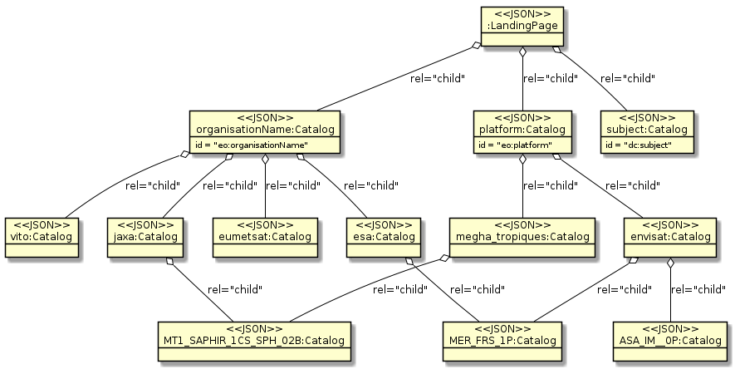
STAC Catalog - Browse EO Collection hierarchies
Example: same EO Collections appearing in multiple STAC child catalogs.
Browse by “organizationName”
Browse by “platform”
Virtual STAC Catalogs
representing sets of “EO Collections”
STAC Catalogs
representing an “EO Collection”

Slide 9
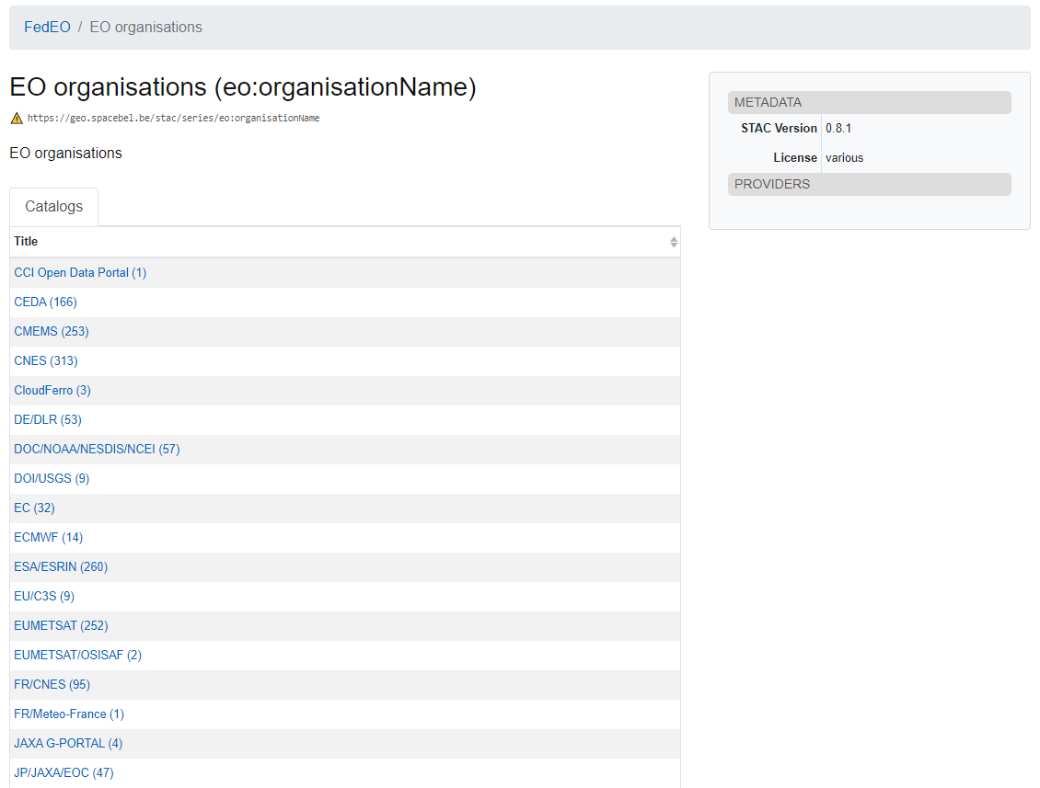
Example: browse by organization (STAC Browser)
Metrics information (#collections)

Slide 10
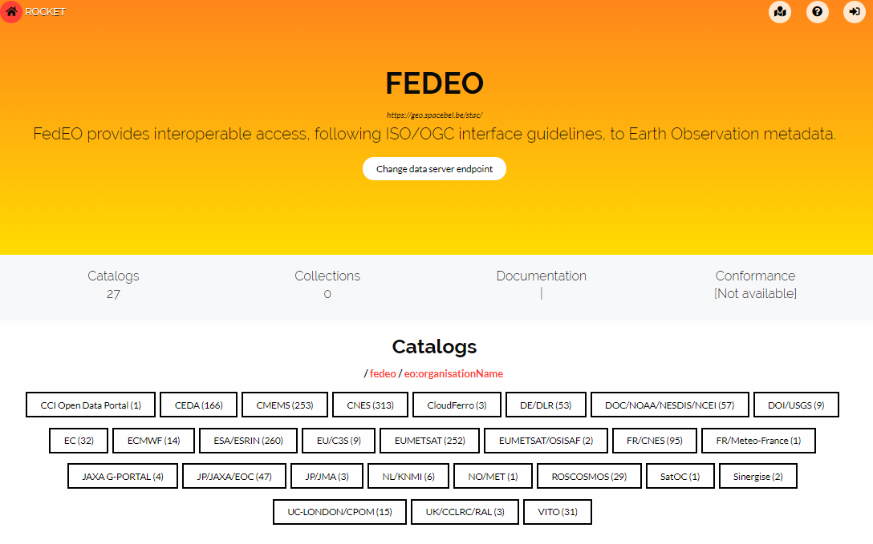
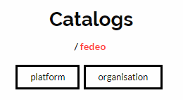
Example: browse by organization (Rocket)
Rocket Client: https://rocket.snapplanet.io/home?_url=https:%2F%2Fgeo.spacebel.be%2Fstac%2F

Slide 11
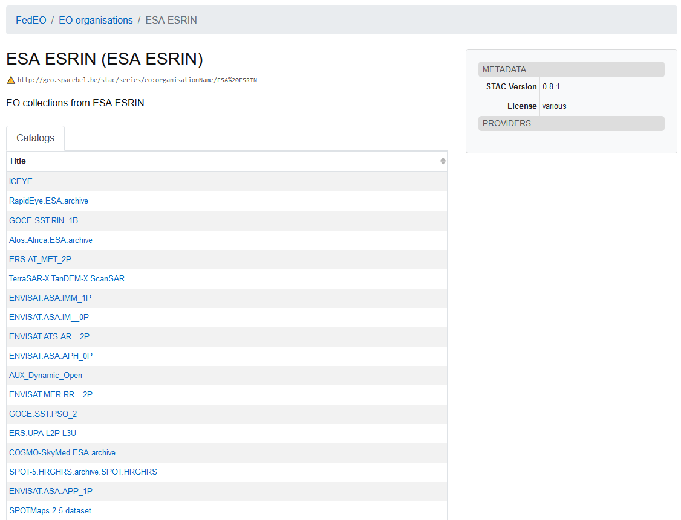
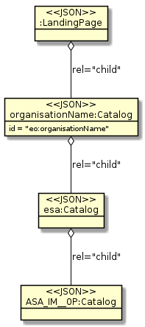
Example: browse collections by organisation

Slide 12
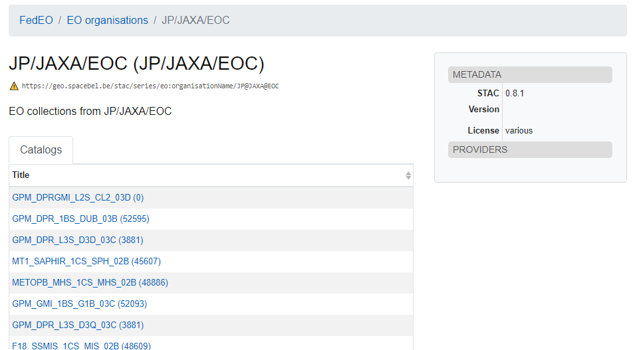
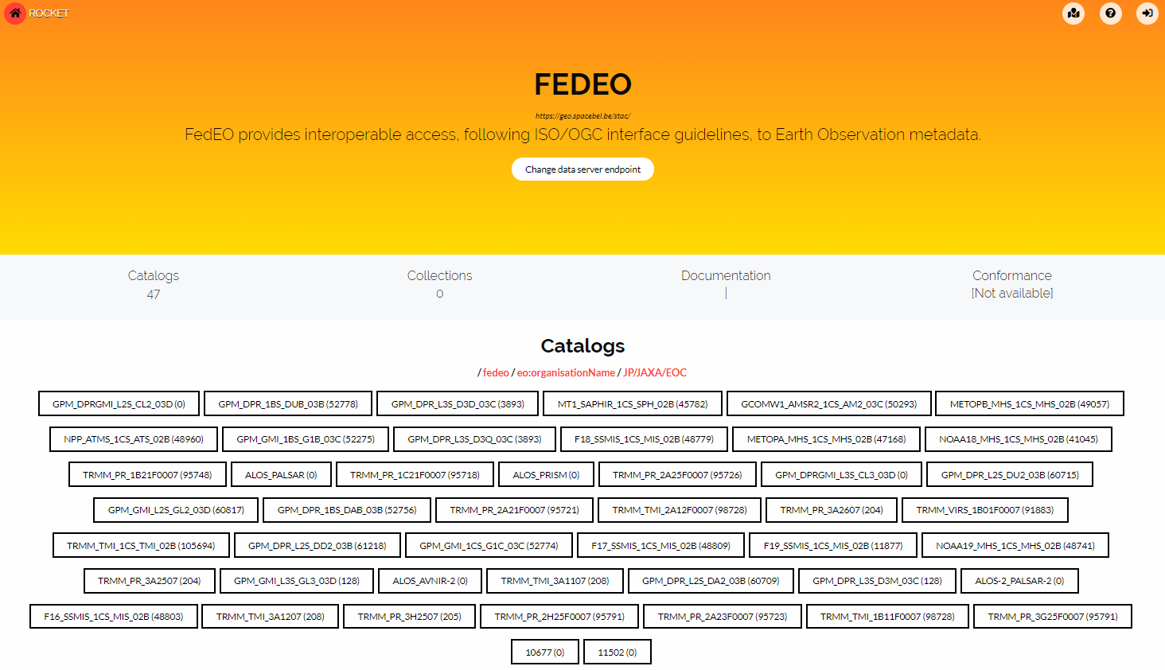
Example: browse collections by organisation
Metrics information (#granules)

Slide 13
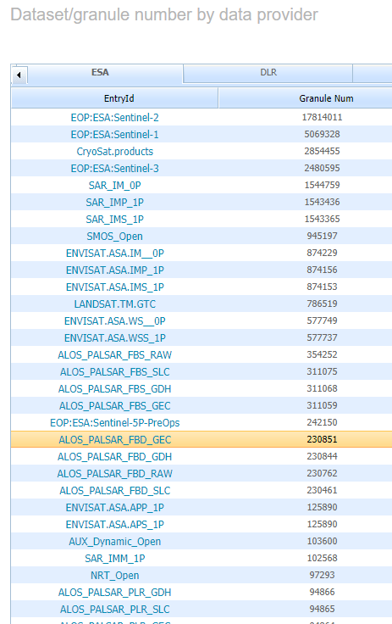
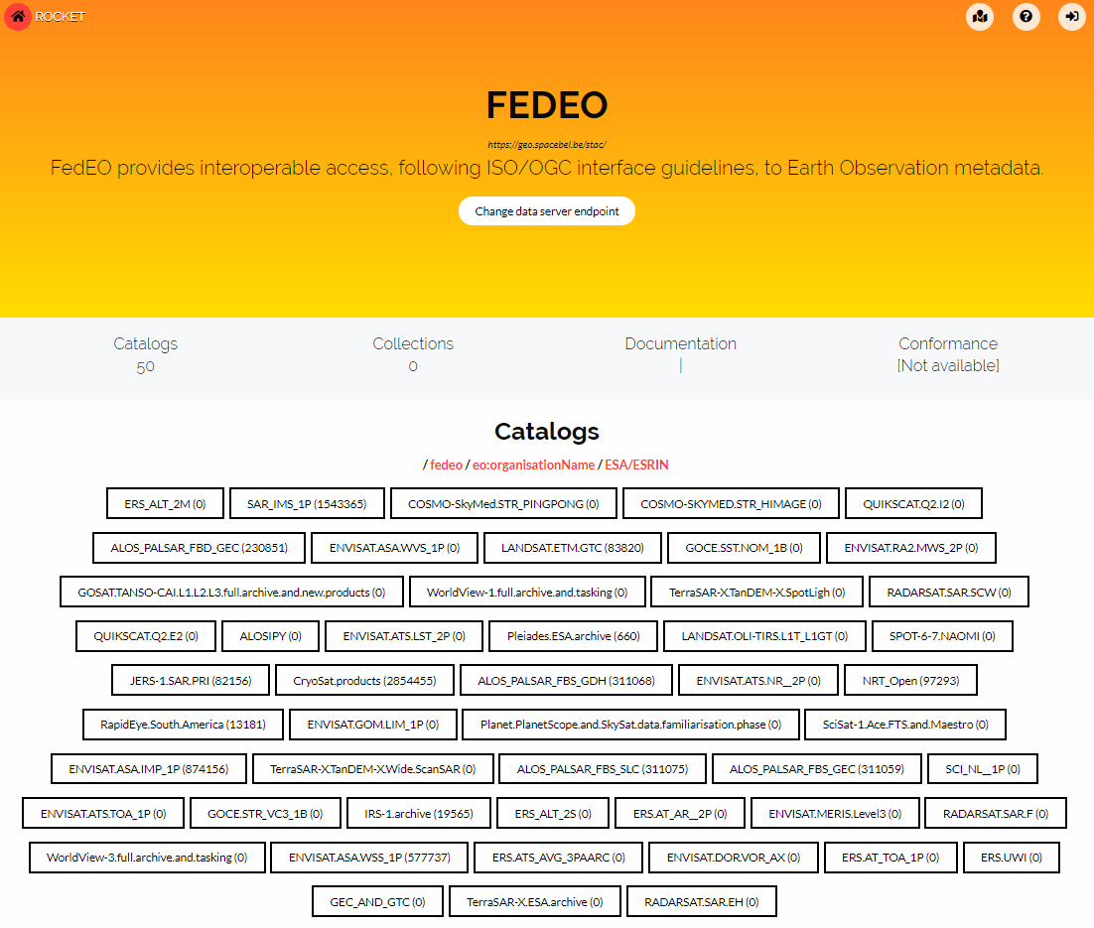
Metrics information (#granules)

Slide 14
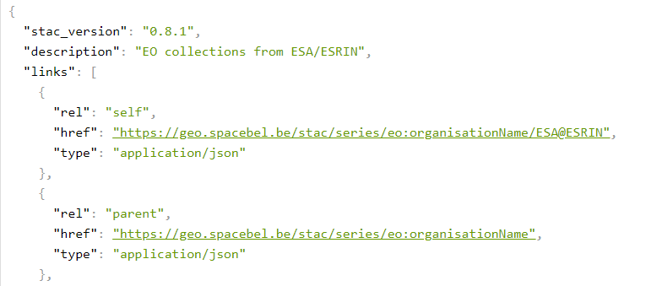
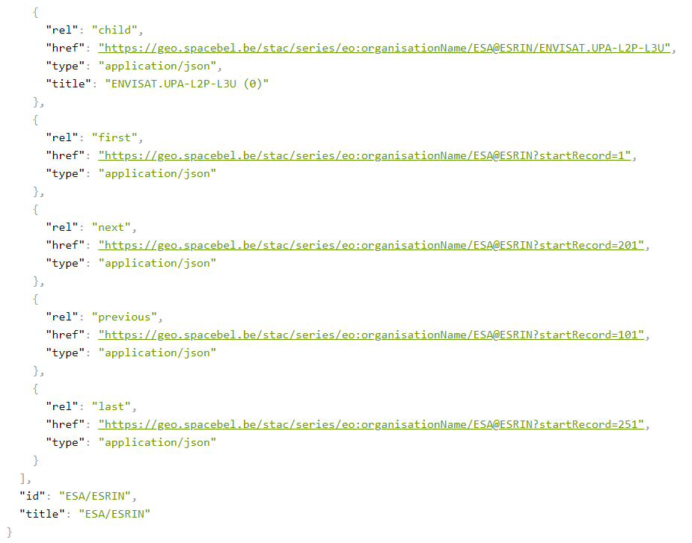
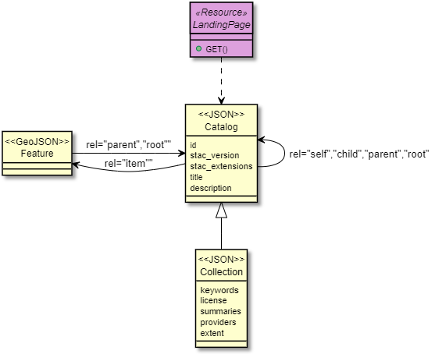
Extensions
Server-side Paging
To allow for unlimited number of “children” or “items” in catalog
Not understood by STAC-BROWSER
"first“, "previous"
"next", "last"

Slide 15
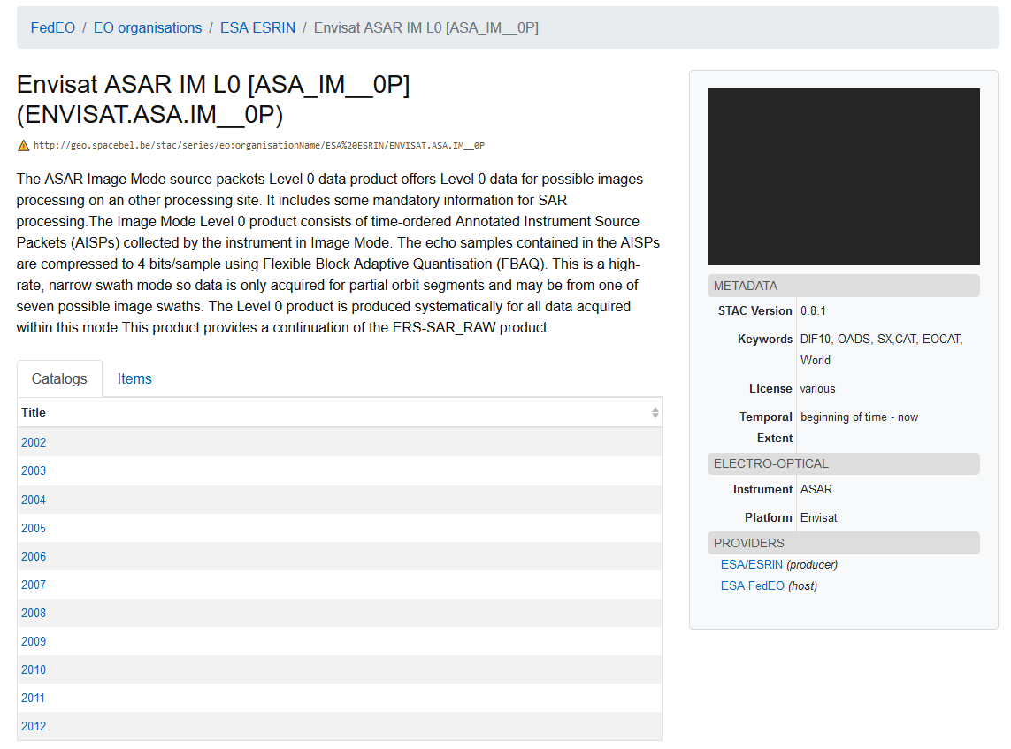
Example: browse granules by date
Metrics information to be added (#granules) via OpenSearch faceted search response (OGC 19-020r1)

Slide 16
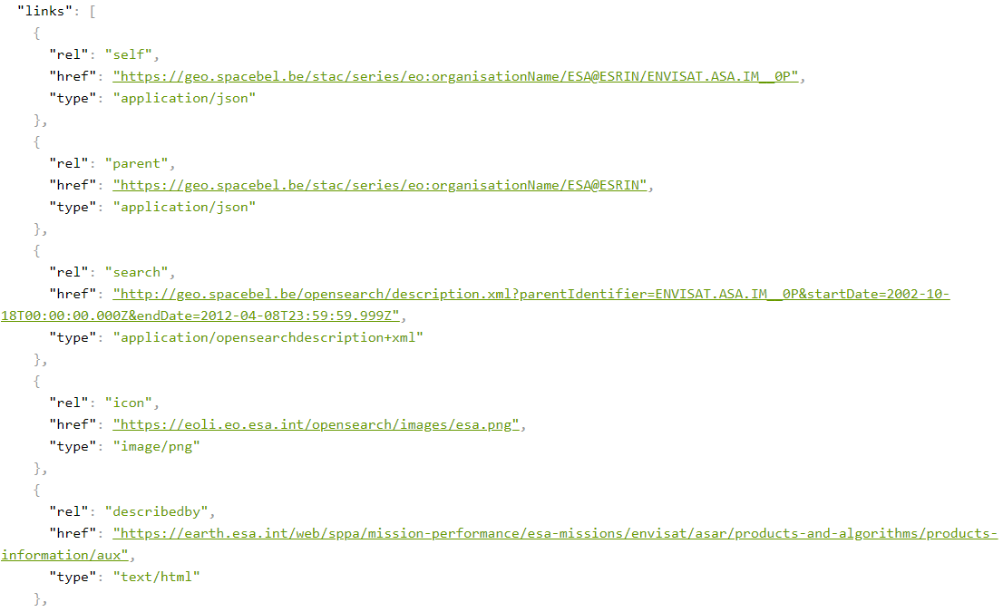
Extension
Additional (Collection) links
rel=“search” (OpenSearch OSDD)
rel=“alternate” (ISO, DIF-10, ..)
rel=“describedby”

Slide 17
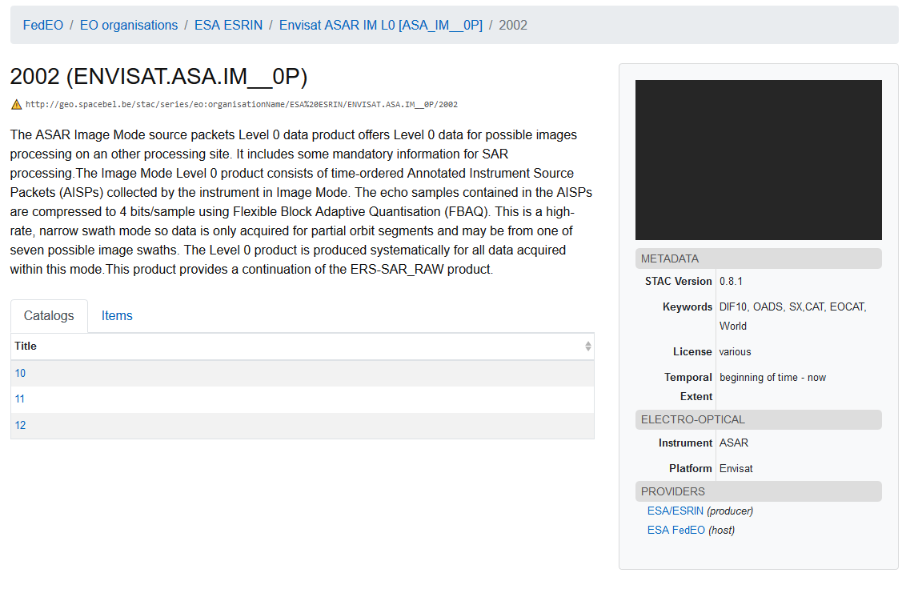
Example: browse granules by date

Slide 18
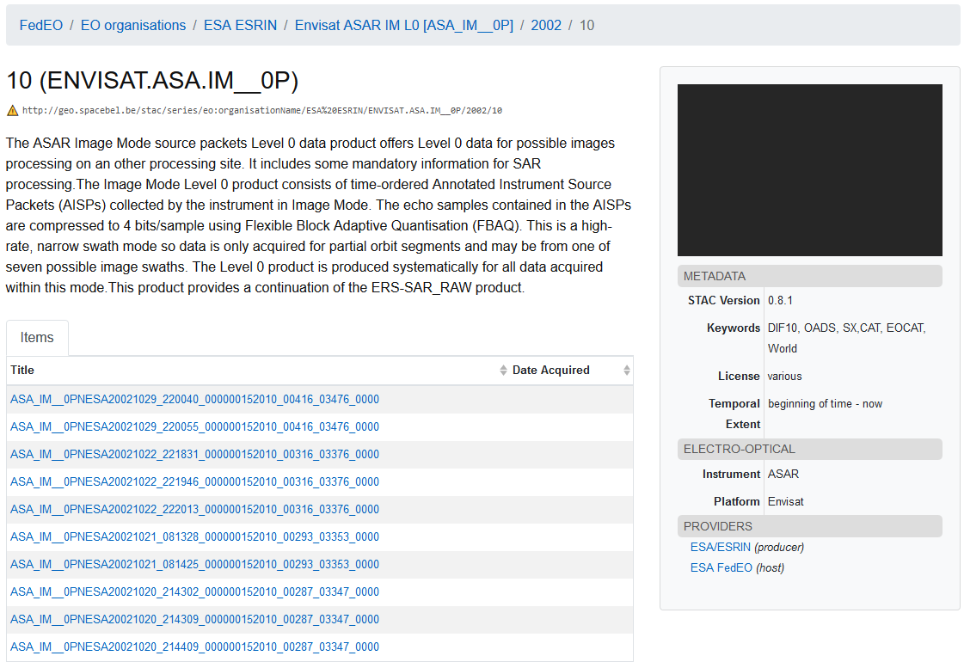
Example: browse granules by date

Slide 19
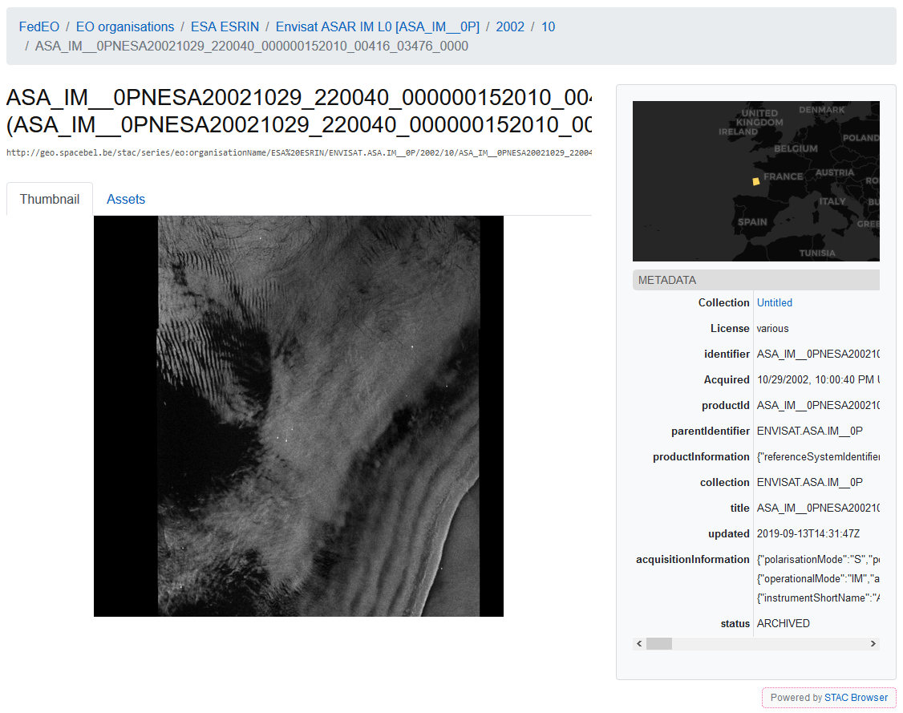

Slide 20
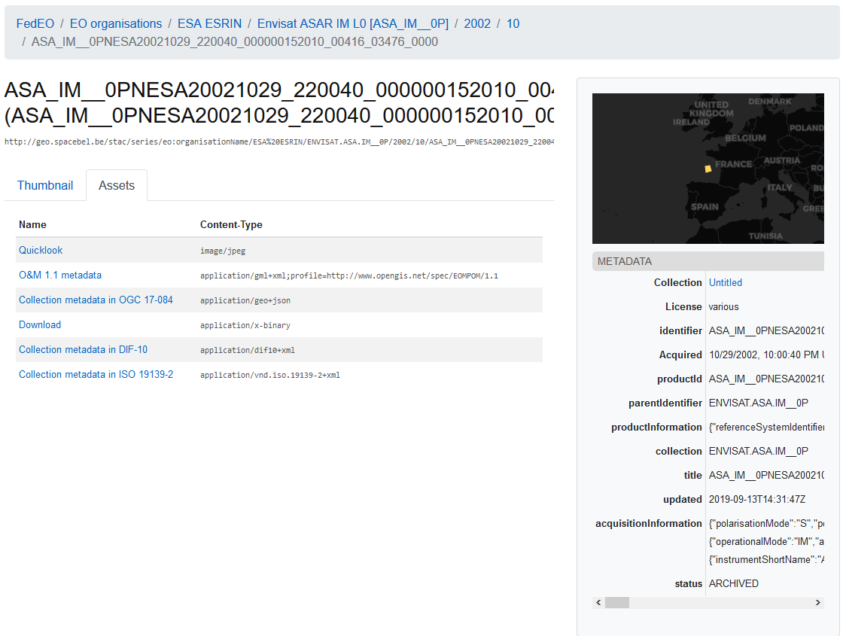
Access to assets
Quicklook
Download URL
Granule metadata
OGC 10-157r4
Collection metadata
DIF-10
ISO
OGC 17-084

Slide 21
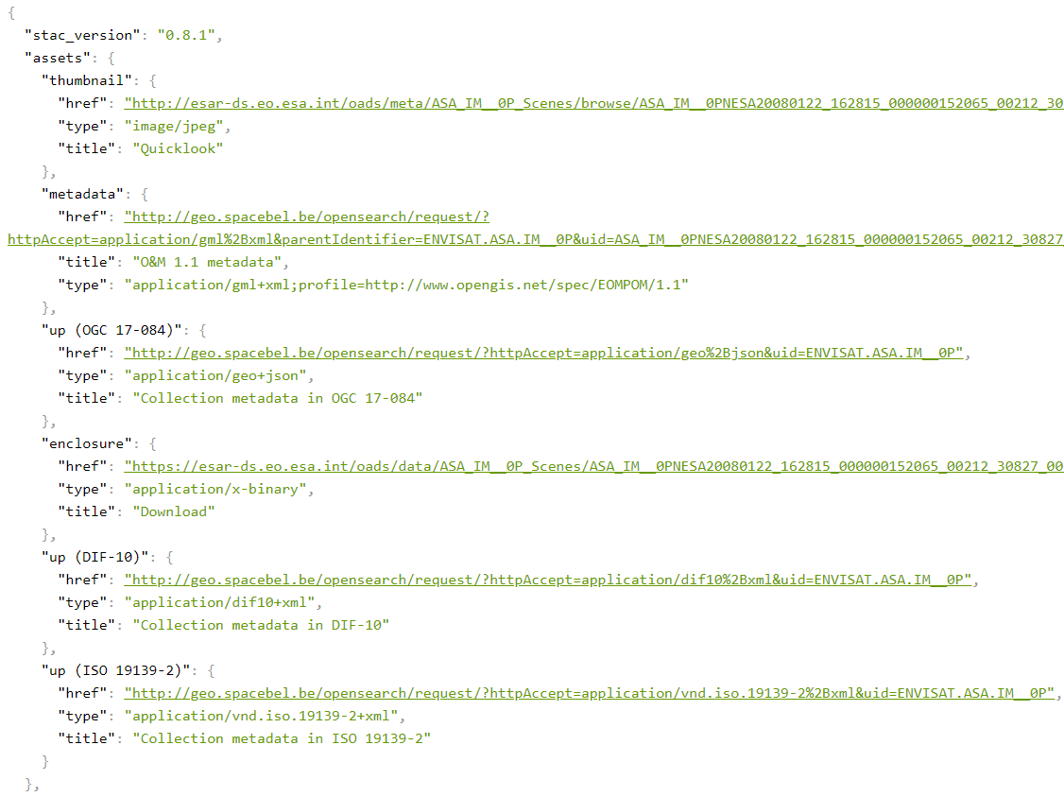
Extension
assets property is a dictionary
Additional (item) assets
Granule metadata
Multiple metadata formats?
Should use new “role” attribute
Collection metadata (as STAC collection has no assets)

Slide 22
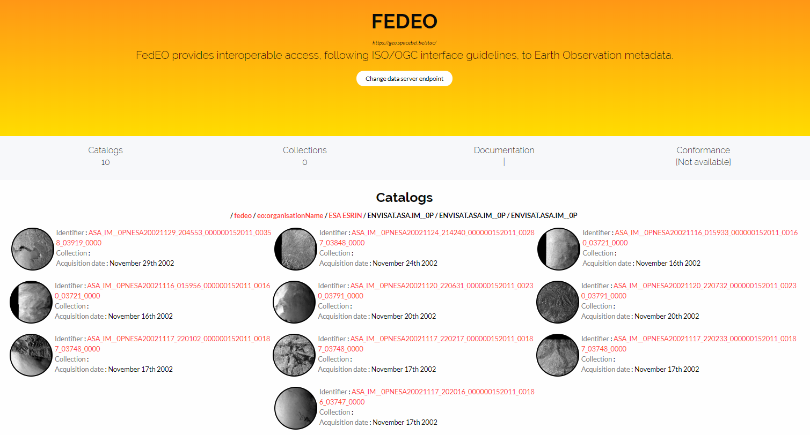
Other STAC Client: Rocket
“items” belonging to a “Collection”

Slide 23
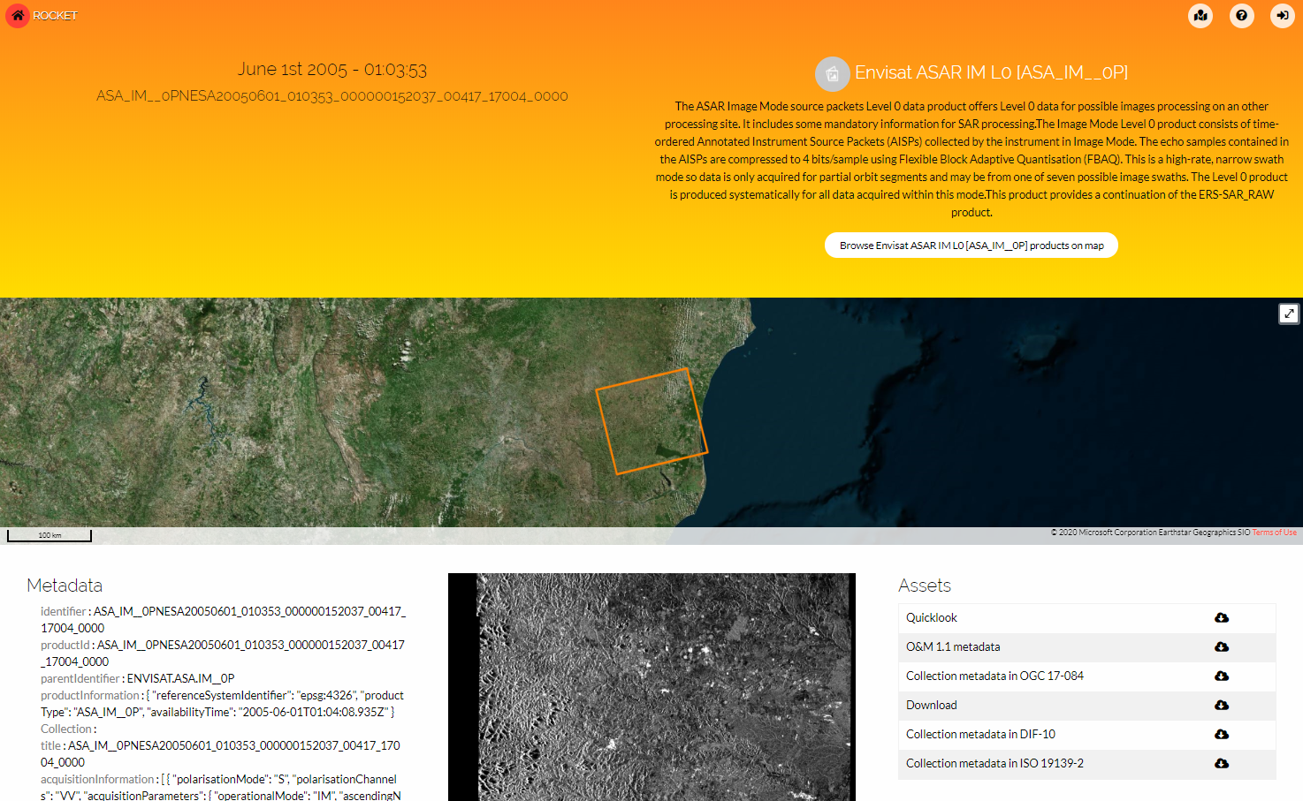
Access to assets (Rocket)
Assets
Binary product
Quicklook
Metadata formats

Slide 24
Future work
Align with latest STAC specification (when client is available), e.g. modified asset encoding etc.
Use “statistics” to include machine-readable metrics information per EO Collection
Products organized by date (support date-related faceted search to avoid empty links)
Revision of OpenSearch API implementation (Align with OGC API Common / Features)
Add other resources as implemented for STAC sprint in November 2019 (See https://databio.spacebel.be/eo-features/)
Support for STAC API
Upgrade STAC-BROWSER when newer version becomes available supporting more recent STAC version fixing reported paging issue, extent encoding etc.
Contribute server-side paging extension to client implementation (TBC)
Implement (generic) SKOS thesaurus supported navigation/drill-down combined with {semantic:classifiedAs} queryable matching concept and narrower concepts in metadata [next slide].

Slide 25
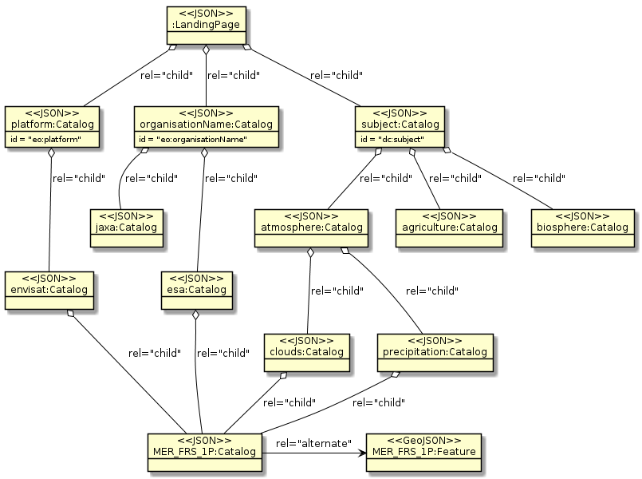
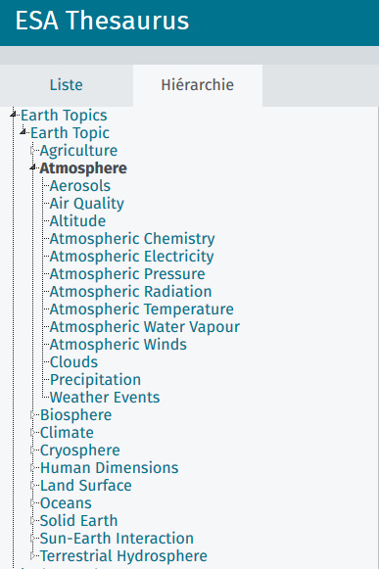
Browse EO Collection trees – SKOS thesauri
Future work: organize browsing in STAC Catalogs along the SKOS vocabulary structures (e.g. Earth Topics)

Slide 26
Conclusion
Partial implementation of STAC
Drill-down via EO collections to EO products requires organization in smaller groups e.g. by date, geographical area to be useful (i.e. to avoid “paging”)…
Co-existing with EO OpenSearch and OGC GeoJSON metadata specifications
Proposed extensions:
STAC Catalog/Collection objects (JSON) with possibility for pagination.
Assets (e.g. metadata) allowed for Collections/Catalogs. Alternatively, rel=“alternate”, “via” can be used.
More work required to evaluate current STAC version.

Slide 27
More info
Contacts:
yves.coene@spacebel.be
Andrea.Della.Vecchia@esa.int
URL:
API: https://geo.spacebel.be/stac/
STAC-Browser: https://geo.spacebel.be/?t=catalogs
Rocket: https://rocket.snapplanet.io/home?_url=https:%2F%2Fgeo.spacebel.be%2Fstac%2F

