Slide 1
WGISS CWIC Report 21 April 2020 Min Minnie Wong Diane Davies

Slide 2
CEOS WGISS Integrated Catalog (CWIC)
The CWIC Project provides a way for the world’s satellite Earth observation data providers to make their data collections searchable using common standards.
CWIC is part of the WGISS Connected Data Assets System (CDA also includes International Directory Network (IDN), FedEO (Federated Earth Observation Gateway).
CWIC integrates the CEOS Agencies’ data collections which are connected via the supported WGISS standards: OGC CSW 2.0.2 and CEOS OpenSearch Best Practices
CWIC allows independent clients to search and access the unrestricted data from thousands of collections and hundreds of millions of inventory records.

Slide 3
CWIC Background
CWIC Purpose: To provide a consistent search interface to help users find and access satellite data made available by CWIC data partners through the use of the WGISS-supported standards - the Open Geospatial Consortium (OGC) Catalogue Services for the Web (CSW) 2.0.2, and the CEOS OpenSearch Best Practices.
The CWIC software translates data searches done via Open Geospatial Consortium (OGC) Catalog Services for the Web (CSW) or CEOS OpenSearch into the format understood by each of CWIC’s data partners and then translates the search results back into the format understood by the original search tool.

Slide 4
CWIC Data Partners
NASA (National Aeronautics and Space Administration)
NOAA (National Oceanic and Atmospheric Administration)/GHRSST
USGS (United States Geological Survey)/LSI
INPE (National Institute of Space Research – Brazil)
CCMEO (Canadian Center for Mapping and Earth Observations)
ISRO (Indian Space Research Organisation)/MOSDAC and NRSC
AOE CAS (Academy of OptoElectronics Chinese Academy of Science)
NRSCC (National Remote Sensing Center of China)
EUMETSAT (European Organisation for the Exploitation of Meteorological Satellites)

Slide 5
Architecture WGISS Data Assets

Slide 6
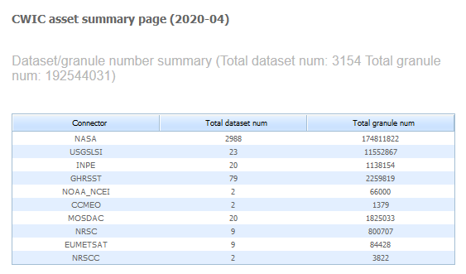
CWIC Data Asset Summary
Total data collections: 3154
Total granules: 192 million
https://cwic.wgiss.ceos.org/asset/index.html

Slide 7
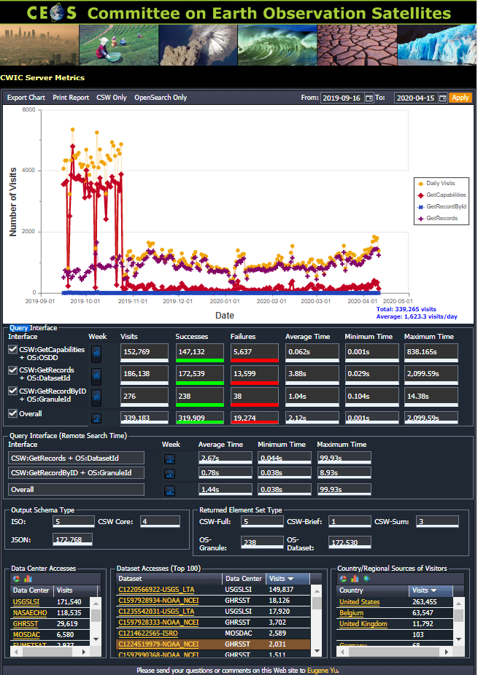
CWIC Connector Access Metrics
Visits of CWIC connectors
More than 330K visits between September 2019 to April 2020
Average daily visits is more than 1.6K
https://cwic.wgiss.ceos.org/cwicmastermetrics/

Slide 8
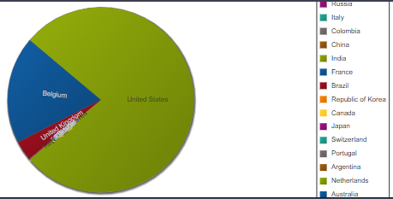
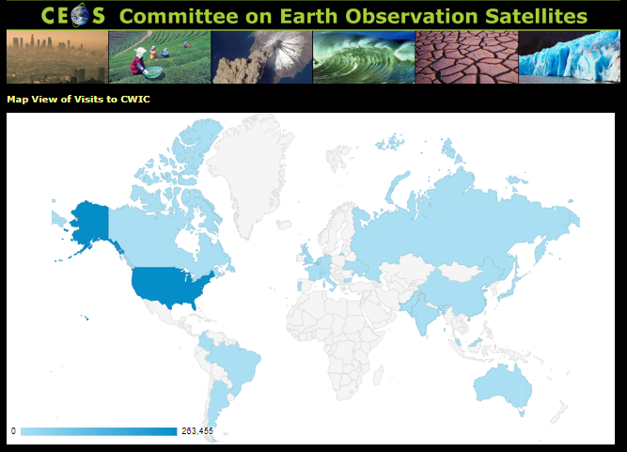
CWIC Access
Distribution of users by country
USA, Belgium and UK are the top three.

Slide 9
Evolution of CWIC: Transition Plan
Most CWIC data partners have already adopted or are in the process of adopting OpenSearch as the standard for dataset and granule discovery.
Discontinue support for the Catalogue Service for the Web (CSW) standard in CWIC as utilization metrics are low.
Retirement of CSW support late June/early July.
We will contact data partners during the course of the year to work with them on the transition.

Slide 10
Evolution of CWIC: Transition Plan
Work with data partners to ensure their native, publicly available OpenSearch compliant implementations provide granule searches within a dataset.
NASA OpenSearch UI validation tool (https://opensearch-ui.earthdata.nasa.gov/validations/index) can be used to validate and point to issues that might make the transition more difficult.
The CWIC technical POCs will help with validation results interpretation and approaches to increase the compliance score and ensure that the transition will be as seamless as possible.
NASA will continue to implement a testing and notification workflow which will inform CWIC data partners of issues identified during testing.

Slide 11
Current CWIC Architecture

Slide 12
Future CWIC Architecture

Slide 13
Data Partner Highlights
NRSCC
NOAA
EUMETSAT
CCMEO

Slide 14
Data Partner Highlights
National Remote Sensing Center of China (NRSCC)
Moving off CSW to OpenSearch by the end of April.
NOAA
Plan to change GHRSST data partner name to NOAA or similar.
Plan to start investigating issues with current OpenSearch implementation in June.

Slide 15
Data Partner Highlights
EUMETSAT CMR/CWIC Status Report
16.04.2020
Dr. Uwe Voges (con terra GmbH)

Slide 16
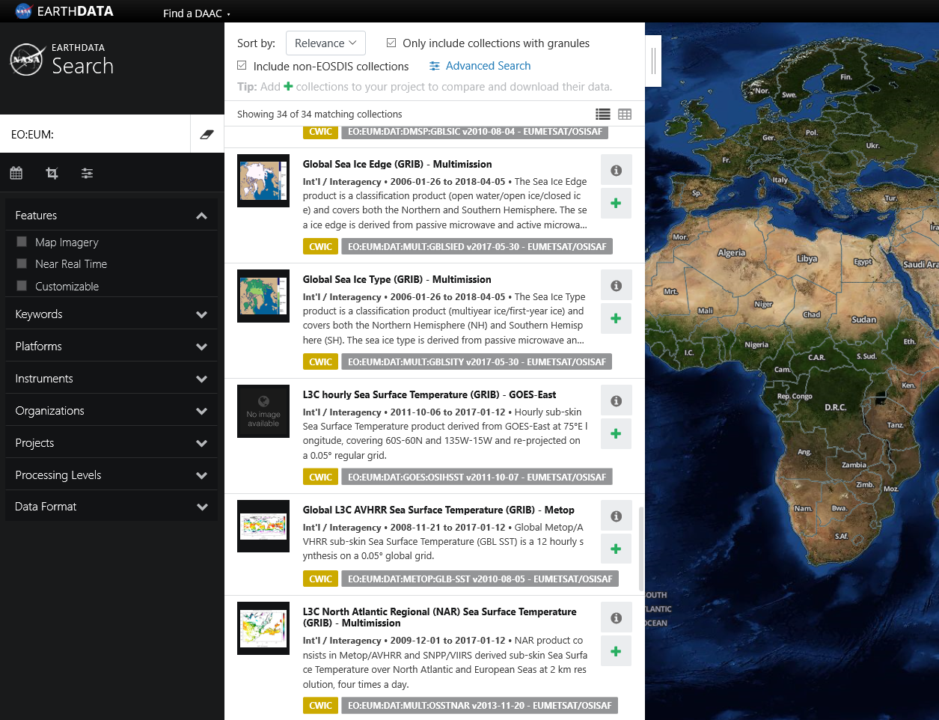
EUMETSAT Collections provided to CMR/CWIC
We provide 34 collections to CMR/CWIC
For all search and download access to products (granules) in the EUMETSAT archive (currently not the Online Store) is provided via CWIC

Slide 17
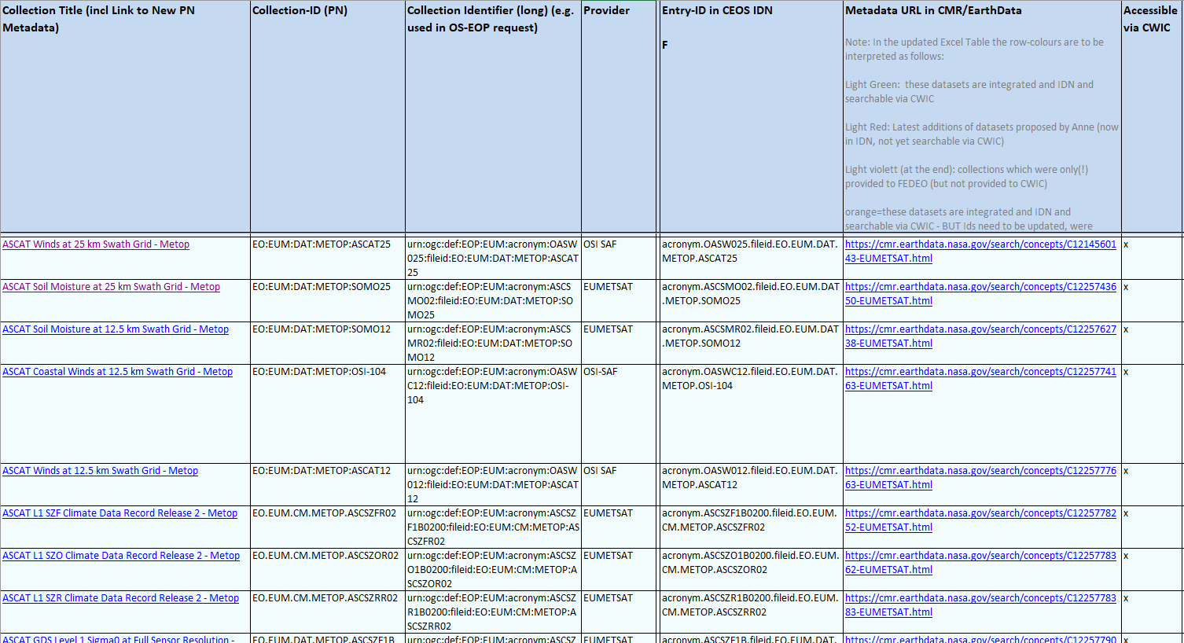
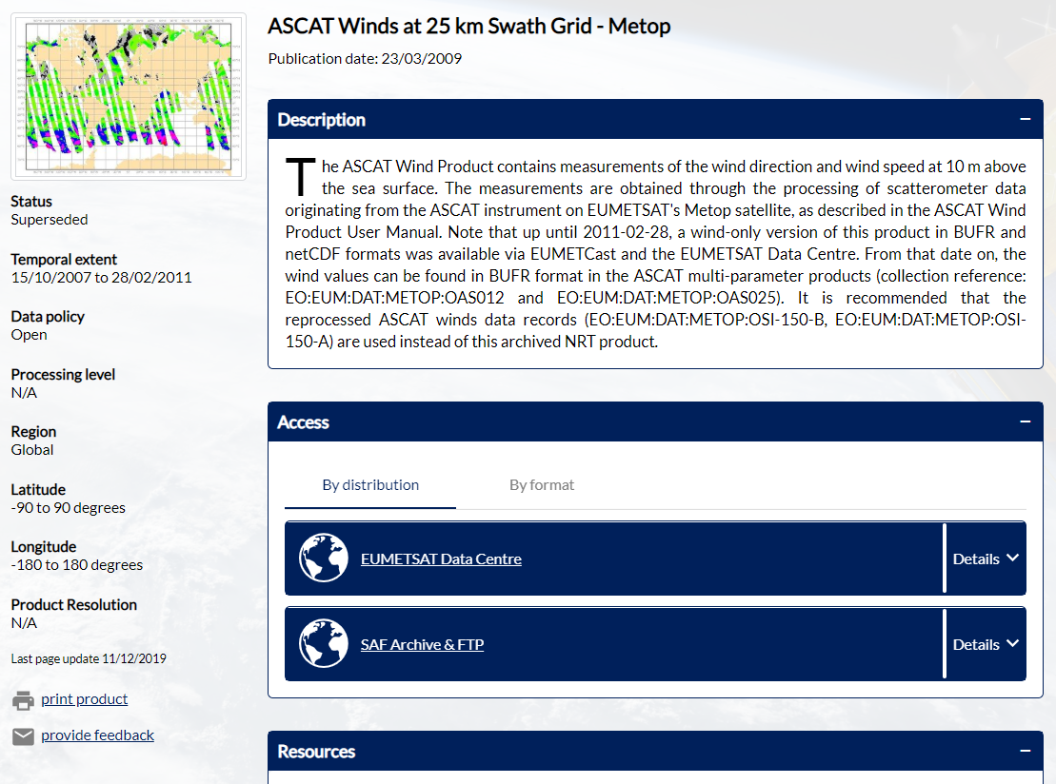
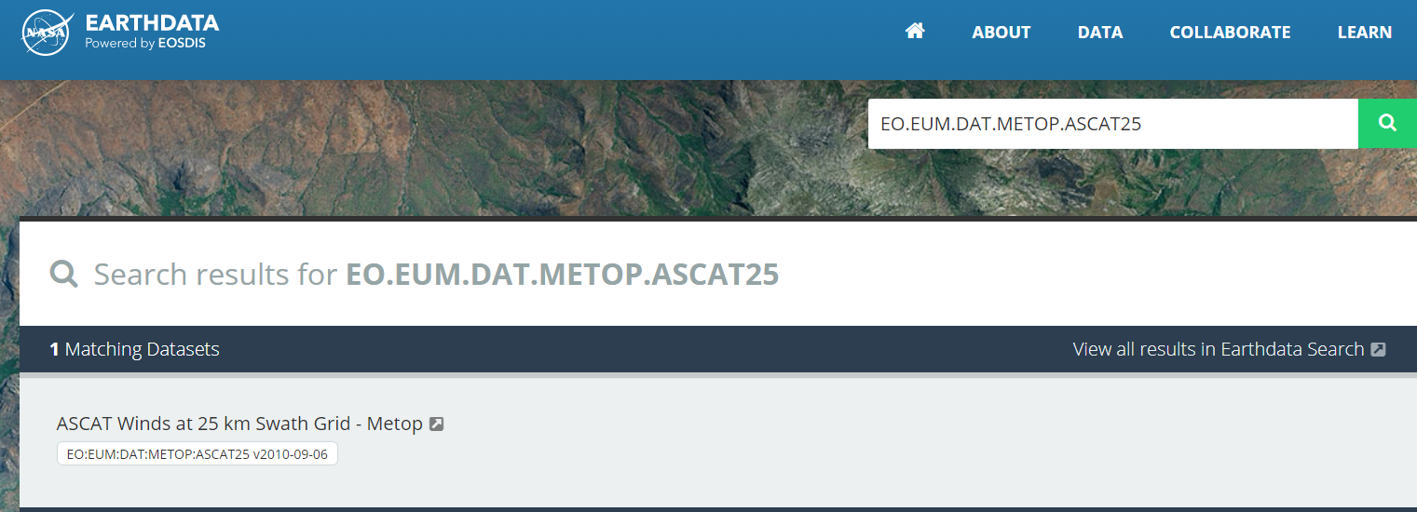
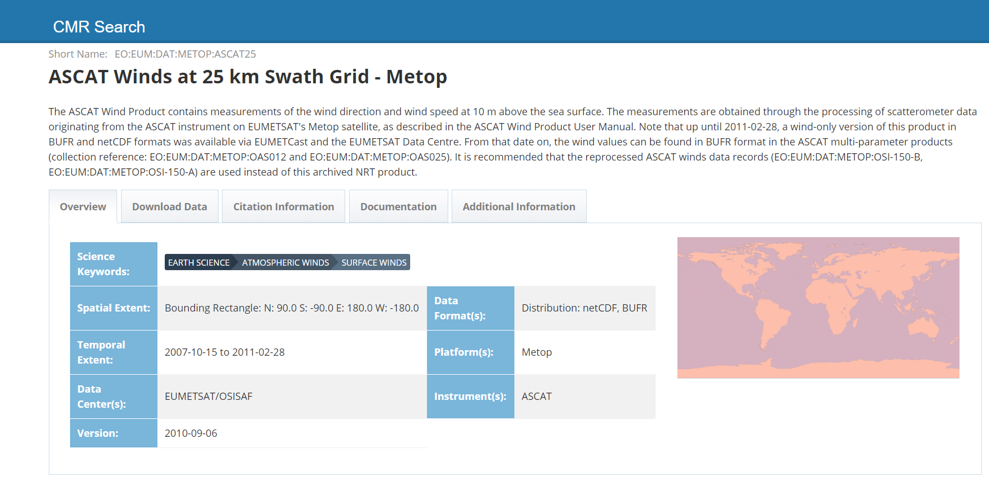
EUMETSAT Collections provided to CMR/CWIC
Collections documented in Excel sheet…
… including links to navigator.eumetsat.int
https://earthdata.nasa.gov/search?q=EO%3AEUM%3ADAT%3AMETOP%3AASCAT25

Slide 18
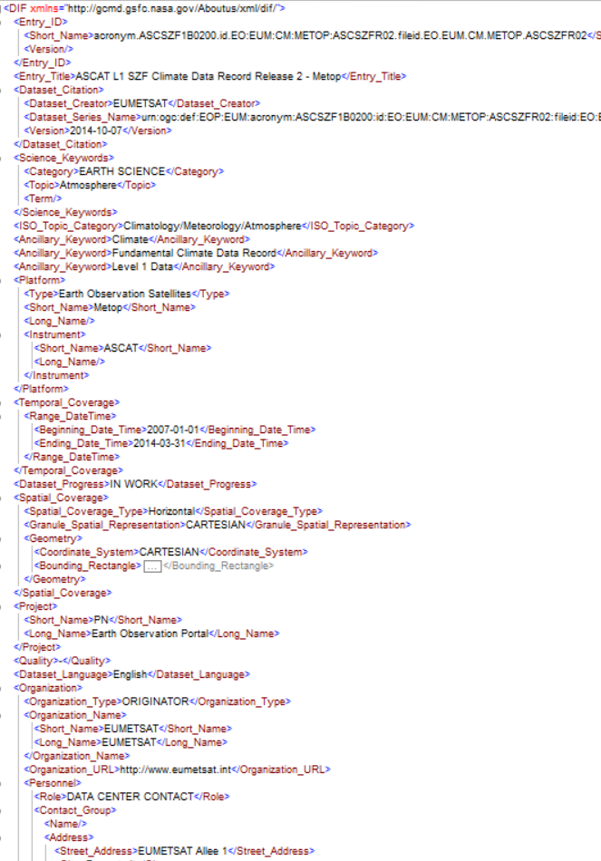
EUMETSAT Collections provided to CMR/CWIC
For collection metadata we´re using the XSD for DIF Version 10.2 b: 10_x_dif_v10_2

Slide 19
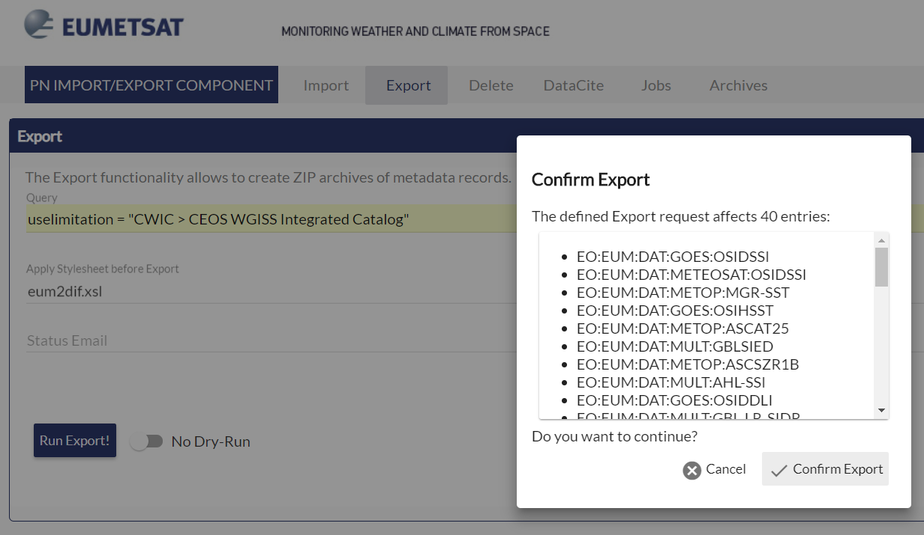
Provision of EUMETSAT Collection MD to CMR/CWIC
Workflow for DIF10 metadata provision at EUMETSAT:
Assignment of EUMETSAT collections to CMR/CWIC
We manage an Excel sheet (see before) where we list all collections assigned to CWIC (and FedEO).
From time to time a review takes part: is collection list up to date, what has to be added or dropped.
Tagging CWIC collections in New PN
Aligned with Excel sheet we tag CWIC collections (see right)
Export DIF-10 metadata for CWIC collections
New PN Administrator provides a Metadata Export Function
..lets filter metadata for CWIC by providing the filter statement: useLimitation="CWIC…."
Use eum2dif XSLT upon export
Add the collection identifier as options (parameter extension) for parentIdentifier to OSDD of CWIC/EOPOS adapter! (not yet automated)
Send DIF-10 metadata to Michael Morohan :-)

Slide 20
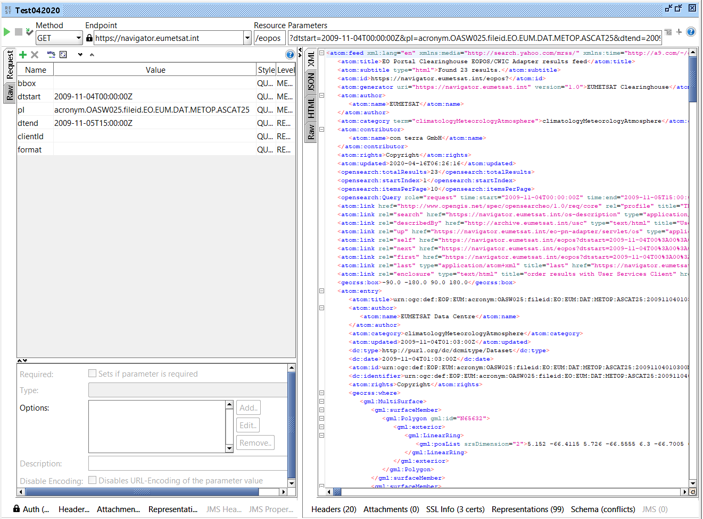
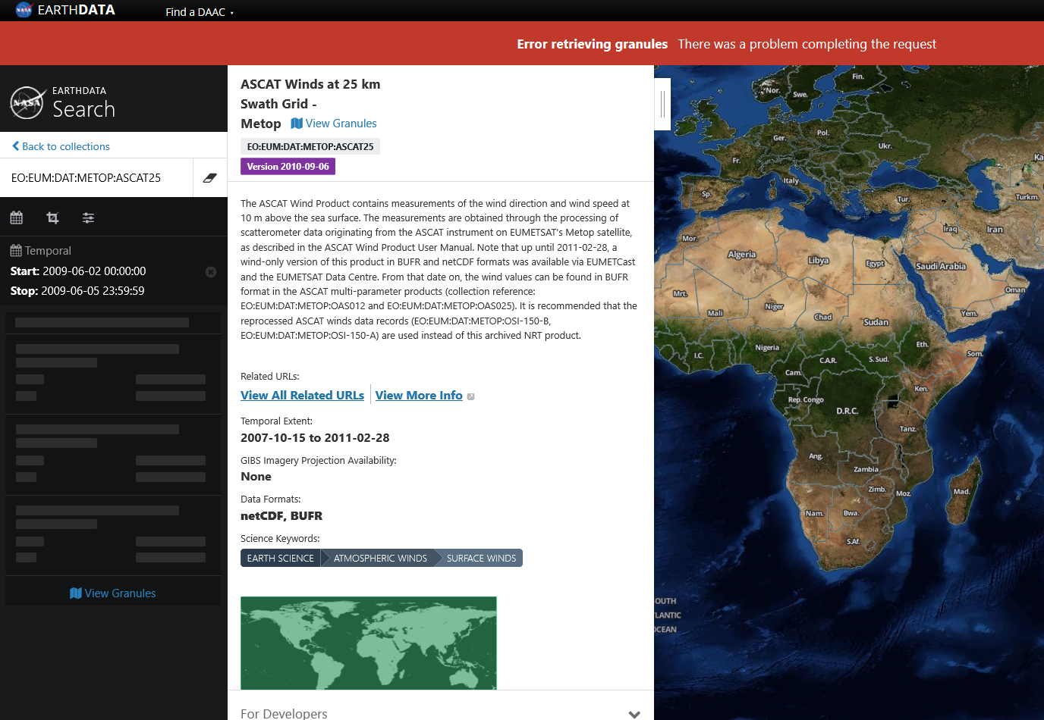
EUMETSAT Collections for CMR/CWIC
Search on Collections was tested (e.g. SOAP-UI)
Search on collections not more possible from within Earthdata Search client

Slide 21
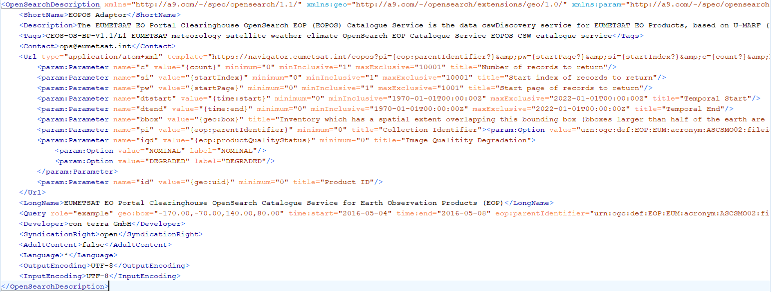
EUMETSAT OpenSearch-EO (1.1) Interface - OSDD
OpenSearch-EOP interface adapted to V 1.1 (backwards compatible!)
http://navigator.eumetsat.int/os-description
OSDD

Slide 22
EUMETSAT OpenSearch-EO (1.1) Interface - Request
Search Operation
Treat as equivalent:
optional parameter left empty (key present but value absent)
key/value pair for the optional parameter removed (both key and value are absent)
Exceptions codes aligned with OpenSearch-EO 1.1
Request
use startIndex over startPage
all string based search parameters follow the default behavior: "exact search“
Examples:
http://navigator.eumetsat.int/eopos?dtstart=2015-09-04T00:00:00Z&pI=urn:ogc:def:EOP:EUM:acronym:OAS025:fileid:EO:EUM:DAT:METOP:OAS025&dtend=2015-09-06T15:00:00Z
http://navigator.eumetsat.int/eopos?bbox=-70.00,10.00,-20.00,13.00&dtstart=2015-09-04T00:00:00Z&pI=urn:ogc:def:EOP:EUM:acronym:OAS025:fileid:EO:EUM:DAT:METOP:OAS025&dtend=2015-09-06T00:00:00Z&c=2
https://navigator.eumetsat.int/eopos?dtstart=2009-11-04T00%3A00%3A00Z&pI=acronym.OASW025.fileid.EO.EUM.DAT.METOP.ASCAT25&dtend=2009-11-05T15%3A00%3A00Z

Slide 23
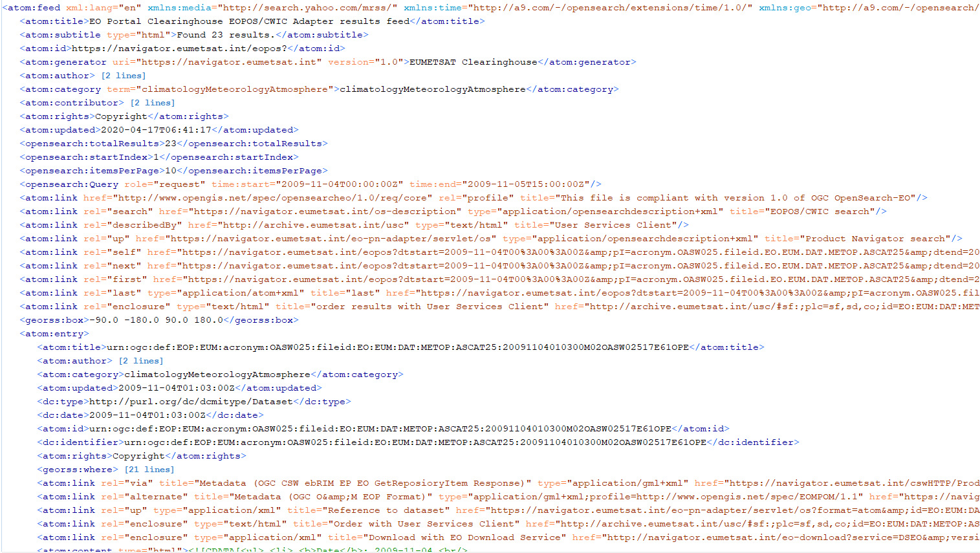
EUMETSAT OpenSearch-EO (1.1) Interface - Response
Feed
added SpecReference to atom:feed
georss:box
query example: all mandatory parameters included (TBD)
Entry:
type (genre) of the entry (here: http://purl.org/dc/dcmitype/Dataset)
GeoRSS where (MultiSurface/Polygon)
csw:GetRepositoryItemResponse
OGC EOP O&M (10-157)
ATOM entry of dataset (aka collection)
EUMETSAT USC Order Client
EUMETSAT EO Download Service

Slide 24
Current developments
Prospects for further developements
When EUMETSAT Online Data Access (OLDA) becomes operational -> possibly provision of EO products from Cloud Storage

Slide 25
CCMEO Data Provider Status : RCM OpenSearch
Patrick King
April 16, 2020

Slide 26
RCM Mission Characteristics
RCM consists of 3 SAR C-Band satellites
These satellites were launched on June 12, 2019 in one mission from the Vandenberg Air Force base on a Space-X Falcon-9 rocket
Collectively, these satellites have a revisit time of 4 days
Provides daily coverage of 90% of the world to Canadian and International users
Publicly available imagery can be discovered through the Natural Resources Canada EODMS system

Slide 27
RCM Imagery
RCM Image Product discovery is available to vetted ( security cleared, from an EODMS search ) and public users ( via OpenSearch and an EODMS search )
Subsequent to an OpenSearch query, the image can be ordered interactively through EODMS
Images are not affected by weather as opposed to optical images (eg. Landsat) whereby cloud cover has a significant impact on image quality.
Images are captured during the day or night.
Radarsat-1 and Radarsat-2 imagery is currently discoverable through CCMEO OpenSearch.
Support for RCM is currently being implemented and requires a software port to a different architecture and database technology
Postgres queries will be used to substitute for Oracle based queries

Slide 28
RCM Products
RCM products are distinguished by beam mode type :
Low Resolution 100m
Medium Resolution 50m
Medium Resolution 30m
Medium Resolution 16m
Low Noise
Various polarizations are supported :
HH, VV, HV, VH
VV+HV
HH+HV
HH+VV
Compact Polarization
The above products are publicly discoverable through CCMEO OpenSearch and can be ordered through EODMS - https://www.eodms-sgdot.nrcan-rncan.gc.ca/index_en.jsp
Vetted users can discover higher resolution products ( 3m)

Slide 29
RCM Beam Modes

Slide 30
CCMEO RCM OpenSearch Implementation
OpenSearch search parameters :
SearchTerms (“RCM”, “Radarsat-1”, “Radarsat-2” – data set choice)
time:start? (temporal range limited to 10 days)
time:end?
geo:box? (latitude or longitude extent limited to 50 degrees)
startPage (cannot be used with StartIndex or count)
startIndex (cannot be used with StartPage)
count (cannot be used with StartPage)
Key response elements :
Atom :
For Browse Image : <link rel=“icon">
For Product order : <link rel="enclosure”>
For Scene Metadata : <content type="text">
GeoRSS :
For Browse Footprint : <georss:polygon>

Slide 31
CCMEO RCM OpenSearch Implementation (con’t) : Temporal Search Example
HTTP Request : http://ceocatprod1t.ccrs.nrcan.gc.ca/cgi-bin/opensearch_r1.sh?q=RCM&dtstart=2020-01-11T00:00:00Z&dtend=2020-01-17T00:00:00Z&startIndex=1&count=50&format=atom
HTTP Response :
<?xml version="1.0" encoding="UTF-8"?>
<feed xmlns="http://www.w3.org/2005/Atom" xmlns:opensearch="http://a9.com/-/spec/opensearch/1.1/" xmlns:georss="http://www.georss.org/georss" xmlns:geo="http://a9.com/-/opensearch/extensio
ns/geo/1.0/" xmlns:time="http://a9.com/-/opensearch/extensions/time/1.0/">
<title>CCMEO RCM Satellite Scenes</title>
...
<entry>
<title>RCM scene</title>
<link href="https://www.eodms-sgdot.nrcan-rncan.gc.ca/rcm/rcm-098378.jpg" rel="icon"/>
<link href="https://www.eodms-sgdot.nrcan-rncan.gc.ca” rel="enclosure" type="application/cgi"/>
<id>imageid_239161</id>
<updated>2020-01-17T07:02:50-04:00</updated>
<georss:polygon>22.1240349 91.828207 22.6198777 91.9330457 22.4657325 92.7703707 21.9696015 92.6624089 22.1240349 91.828207</georss:polygon>
<content type="text">
RCM Scene Parameters ---> Acquisition date : 2020-01-16 23:48:07.024 Orbit : 26588 ImageOrDatasetId : 239161 Beam Type : Low Resolution 100m Beam : SC100MA Station : P TransmitPolarization : HH ReceivePolarization : VV
</content>
</entry>

Slide 32
Other CWIC usage
The US National Science Foundation (NSF) EarthCube program is using CWIC to support Earth Science research in the NSF community
CyberConnector: Provide the Earth Science modeling community live discovery of remote sensing images through CWIC for model validation and verification
EarthCube Data Discovery Hub: Provide general capability for discovering EarthCube resources. It has harvested CWIC metadata and ingested into its system.
Note: EarthCube is an NSF cyberinfrastructure program to develop web-based e-science infrastructure for NSF-wide geoscience community.

