Slide 1
IDN Update
CEOS WGISS-49
Remote Meeting, April 20 to 23, 2020
Michael Morahan
IDN Coordinator
Michael.P.Morahan@nasa.gov

Slide 2
Outline
CEOS/IDN Collaborations
draft Metadata Management Tool (dMMT) Update
IDN site updated for New IDN Search Portal
Future of GCMD, DocBuilder, and Search3 Portals
KMS API Change
GCMD Keyword Releases
UMM-S/-T Status

Slide 3
I. CEOS/IDN Collaborations

Slide 4
New ESA FedEO Collections
115 new FedEO Collection records ingested into IDN (CMR) test server.
  Missions (Platforms) of Collections: COSMO-SKYMED, CartoSat-1, Deimos-1, ENVISAT, Sentinel-1/2/3/5P, ERS, GOCE, GOSAT, GeoEye-1, IKONOS, IRS-1, JERS-1, Landsat-8, OceanSat-2, PROBA, QUIKSCAT, ResourceSat-1/2, SAR, SMOS, SPOT-1/2/3/4/5/6/7, SciSat-1, SeaSat, TerraSAR-X, WorldView-1/2/3
  One problem: several of the records were missing the granule OpenSearch Description Document link.
Can we move forward to ingest the FedEO metadata collection records into the public system?

Slide 5
WMO/OSCAR vs. GCMD Keywords
WGISS-48-21: WMO/OSCAR database comparison of Platform and Instrument keywords with GCMD Keywords.
  Bulk of the mismatches are Upper case vs. Mix case or Numeral vs. Letter of the Mission (Platform) ShortName values.
  Possible solutions:
    Can the WGClimate group use the GCMD Keywords?
    Request to WHO/OSCAR to add GCMD Keyword universally unique identifiers (UUIDs) to their mission (platform) entries.

Slide 6
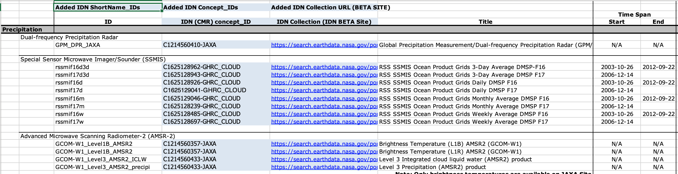
WGISS-48-06: Are virtual constellation (VC) datasets in the IDN
Review IDN holding to match VC dataset Collections
  IDN provided the ShortNames, Unique Ids, and direct IDN links to matching records
  Notified CEOS providers of VC collections missing from the IDN holdings.

Slide 7
II. draft Metadata Management Tool (dMMT) Update

Slide 8
Draft Metadata Management Tool (dMMT) Overview
Non-NASA users will be able to:
  Generate/Review/Submit collection and service (future) metadata
  Edit their published metadata
  Request to delete draft/submitted/published metadata
  Search for published metadata
  Follow the status of metadata (Status categories: In Work, Submitted, Approval, and Done)
  Receive email notification of the status of their metadata.

Slide 9
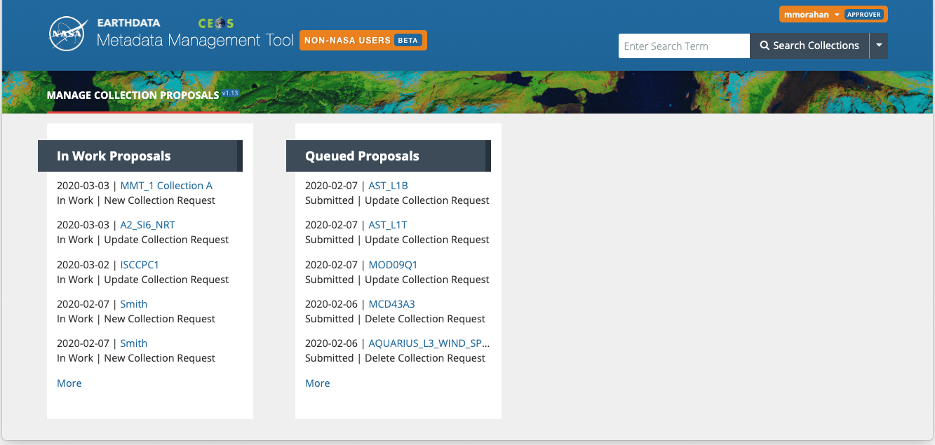
Updated dMMT with CEOS Logo

Slide 10
dMMT Pathfinder Testing
dMMT Pathfinder Testing occur between March 6-20
Pathfinder Testing Partners: Indian Space Research Organisation (ISRO) and Southern Ocean Observing System (SOOS) US
Testing Scope:
  the application's functionality, usability and workflow, and the User Guide's comprehensiveness and completeness.
Testing Results:
  Overall, the application's functionality work well except for some automatic email notifications.
  Successfully, creation/submit/approval/publish/deleted records to the IDN (CMR).

Slide 11
III. IDN site updated for New IDN Search Portal

Slide 12
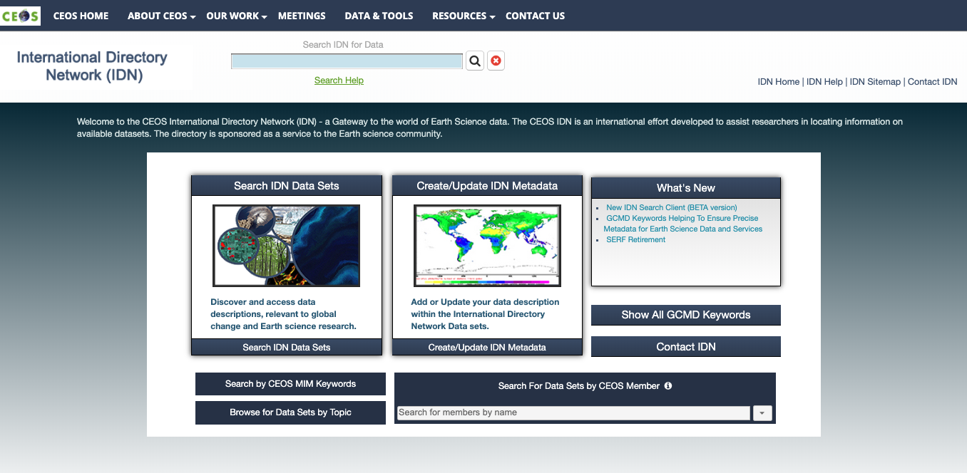
IDN Site

Slide 13
Direct link to the IDN Search Portal
Click to search New IDN Search Portal

Slide 14
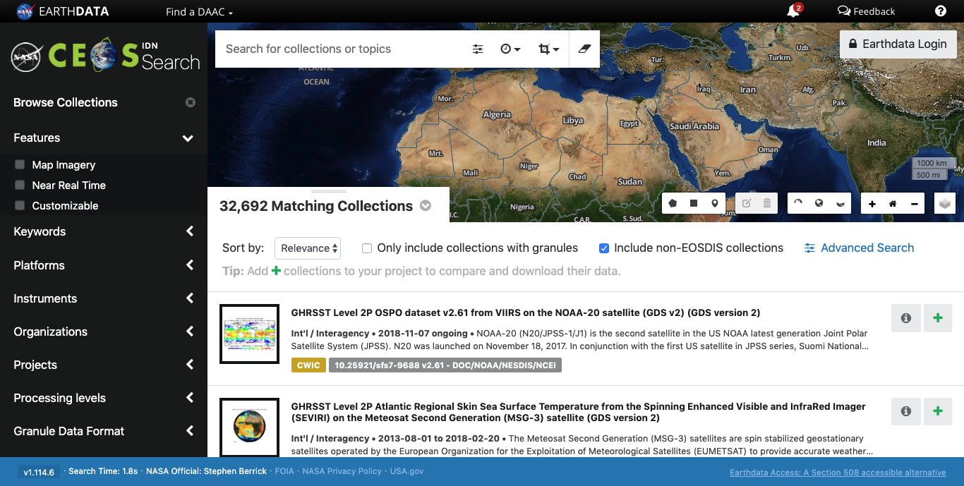
Direct link to the IDN Search Portal

Slide 15
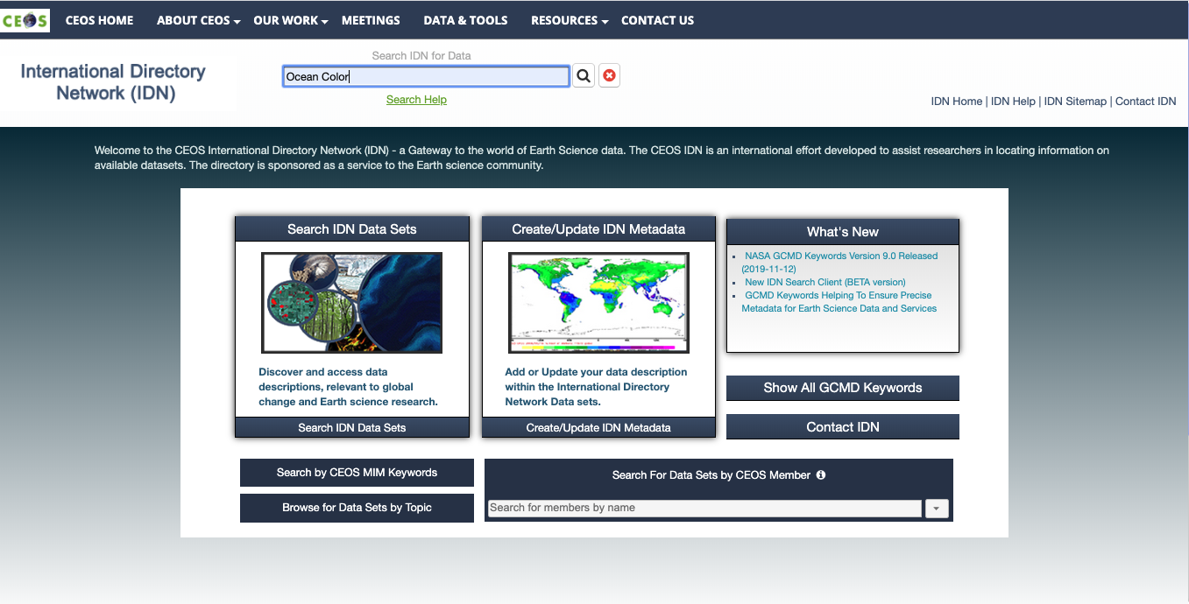
IDN Free-Text Search
Free-Text Search to IDN Search Portal

Slide 16
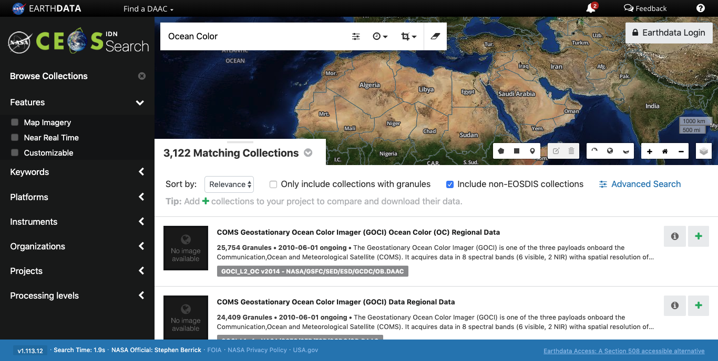
IDN Free-Text Search

Slide 17
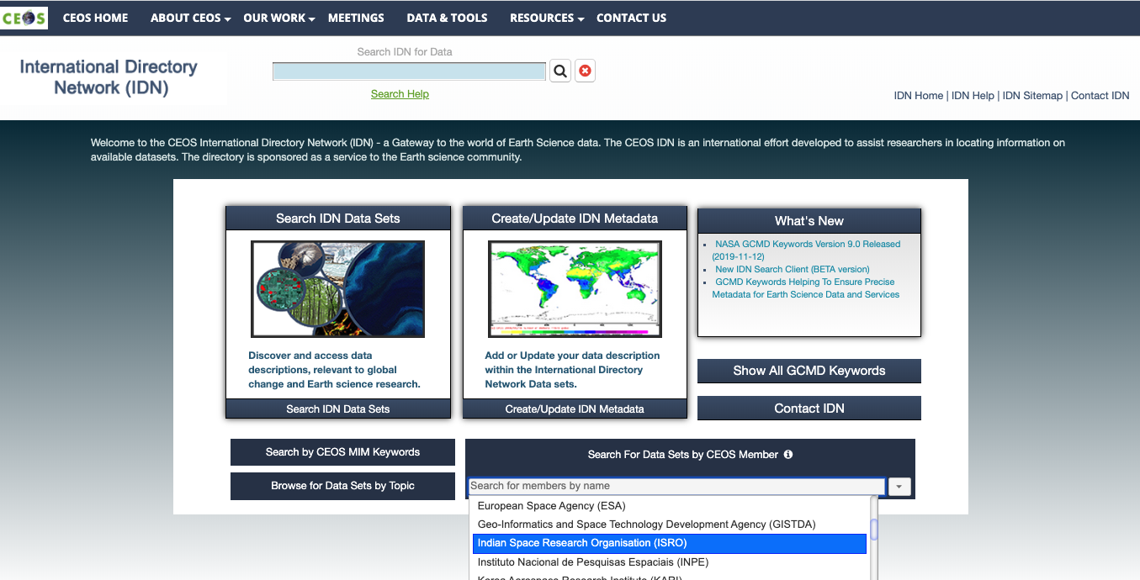
Search for CEOS Members’ Data Sets
Click
Scroll and select provider

Slide 18

Search for CEOS Members’ Data Sets

Slide 19
Search by CEOS MIM Keywords
Click to search by
CEOS Measurements

Slide 20
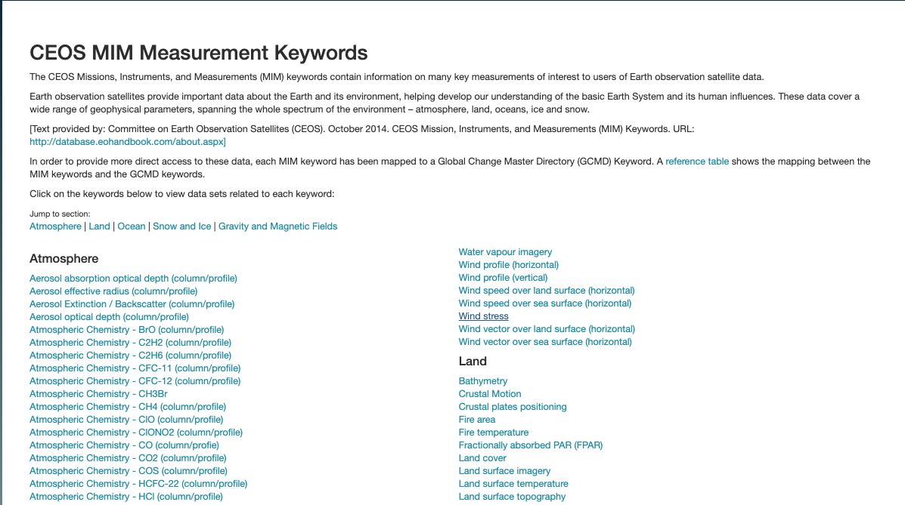
Search by CEOS MIM Keywords
Click
Measurement

Slide 21

Search by CEOS MIM Keywords

Slide 22
Link to the dMMT Client
Click to access dMMT and metadata documents

Slide 23
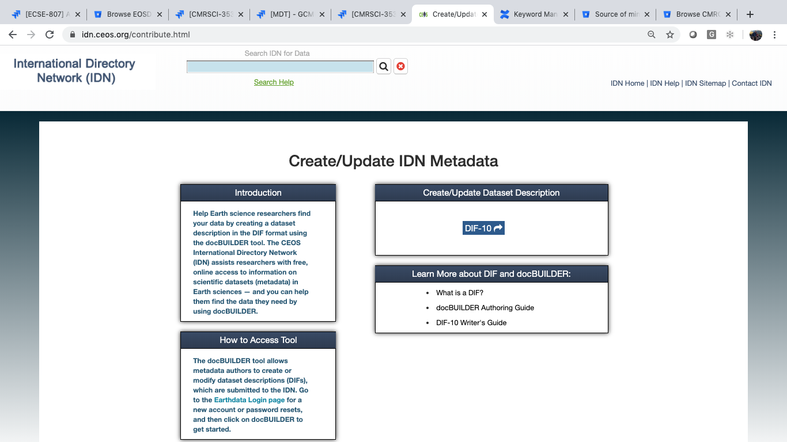


Link to the dMMT Client (Future)
Help Earth science researchers find
your data by creating a dataset
description using the draft Metadata Management Tool (dMMT). The CEOS
International Directory Network
(IDN) assists researchers with free,
online access to information on
scientific datasets (metadata) in
Earth sciences — and you can help
them find the data they need by
using the dMMT.
dMMT
Click to access dMMT client
dMMT User’s Guide
Unified Metadata Model - Collection (UMM-C)
The dMMT allows metadata authors to create or modify dataset descriptions,
which are submitted to the
IDN. Go to the Earthdata Login page for a new account or password resets, and then click on dMMT to get started.
DIF and docBUILDER
* Retirement scheduled for May 2020 *
docBUILDER
What is a DIF?
DIF-10 Writer’s Guide

Slide 24
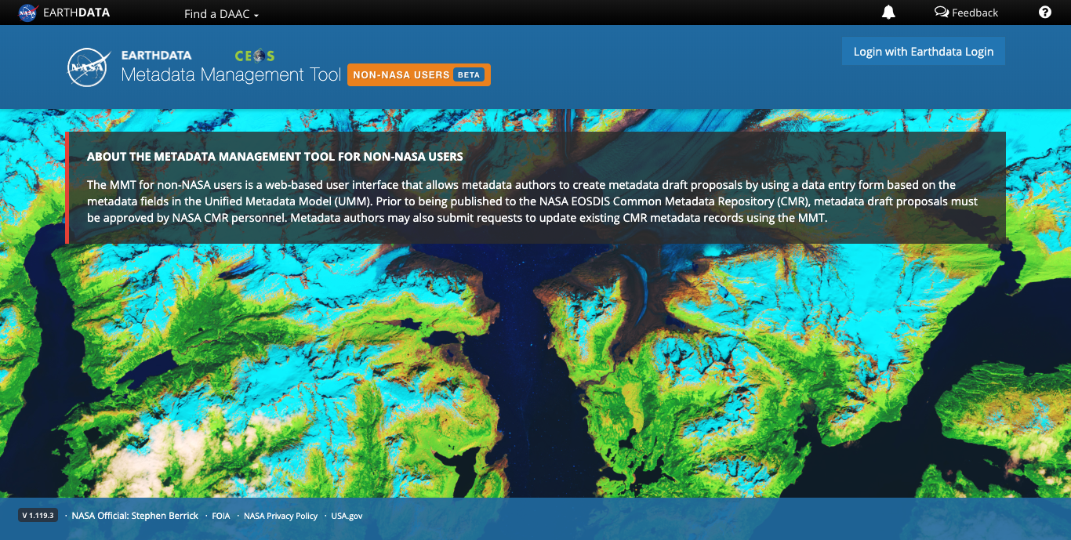
Link to the dMMT Client

Slide 25
IV. Future of GCMD,
DocBuilder and Search3 Subset Portals

Slide 26
Future of GCMD and docBUILDER
GCMD
  Retirement Announcement was emailed out on February 18, 2020
  Alert added to the GCMD site on February 18, 2020
  GCMD web site will be redirected to the IDN site by April 2020
docBUILDER (Metadata Creation tool)
  Retirement Announcement was emailed out on February 28, 2020
  By May 2020, docBUILDER will be replaced with the draft Metadata Management Tool (dMMT)
  docBUILDER and dMMT will have an overlap period before the retirement.

Slide 27
Future of Collection Subset Portals
GCMD Collection Subset Portals
  Retirement Announcement was emailed out on February 28, 2020
  Possible Subset Portals to be converted into EarthData Search client (EDSC) Portals and maintained by their organizations:
    Antarctic Master Directory (AMD)
      National Antarctic Data Centers Portals for AMD will be consolidated into the one portal.
    Southern Ocean Observing System (SOOS)
  All other GCMD Collection Subset Portals will be retired.

Slide 28
V. Keyword Management System (KMS) API Change

Slide 29
KMS API Change
KMS API URL change
  Announcements (March 6, 2020)
    Posted on the GCMD and IDN pages
    Send to CEOS IDN Interop email list
    Alerts on GCMD Keyword Homepage and Forum
  Announcements with the new URL will be sent out.
  New URL: https://gcmd.earthdata.nasa.gov/kms
  Update KMS API Documentation on the IDN Site

Slide 30
VI. GCMD keyword releases

Slide 31
NASA GCMD Keyword Release
NASA GCMD Keywords Version 9.0 Released (2019-11-12)
  Consists of two new keyword schemes:
    Measurement Name
      preliminary set of (~100) keywords that represent an observable property, usually geophysical, geo-biophysical, physical, or chemical.
    Granule Data Format
      represent the format of the data that is distributed by the data center.
    New Keyword Schemes URL: https://gcmdservices.gsfc.nasa.gov/static/kms/

Slide 32
NASA GCMD Keyword Release
NASA GCMD Keywords Version 9.1 Released (2020-01-09)
  Consists of 5 new keyword schemes:
    Projection Name
    Projection Authority
    ChainedOperations
    Operations
    ProjectionDatumNames.
  These new keyword schemes are in support of NASA's Unified Metadata Model for Services (UMM-S).

Slide 33
VII. UMM-S/-T Status

Slide 34
UMM-S/-T Status
UMM-S (Services)
  Documents:
    UMM-S Model: https://wiki.earthdata.nasa.gov/download/attachments/49448405/UMM-S_V1.2_20190812.doc?version=1&modificationDate=1565706321493&api=v2
    UMM-S Schema (Latest version): : https://git.earthdata.nasa.gov/projects/EMFD/repos/unified-metadata-model/browse/service/v1.4
UMM-T (TOOLs)
  Document:
    UMM-T Schema (initial version): https://git.earthdata.nasa.gov/projects/EMFD/repos/unified-metadata-model/browse/tool/v1.0
Work on implementing the new UMM-S/-T schemas will commence in May

Slide 35
Questions
  Please provide questions/comments to:
  michael.p.morahan@nasa.gov (KBR)
  valerie.dixon@nasa.gov (NASA)
  christopher.s.lynnes@nasa.gov (NASA)

Slide 36












This work was supported by NASA/GSFC under Raytheon Co.
in partnership with

Slide 37
Background Information

Slide 38
Additional Information: draft Metadata Management Tool (dMMT) Update

Slide 39
dMMT Pathfinder Testing
dMMT Pathfinder Testing Kick-Off email sent out (March 5)
Scope:
  In Scope: Evaluation of 1) the application's functionality, usability and workflow, and 2) the User Guide's comprehensiveness and completeness.
  Out of Scope: Testing the application's performance, security or other system level requirements. These tests are being done by EED-2 team.

Slide 40
Supporting Documentation
Documents
  Draft MMT (dMMT) Pathfinder Test Plan
    https://wiki.earthdata.nasa.gov/display/MMT/Draft+MMT+%28dMMT%29+Pathfinder+Test+Plan
  Draft Metadata Management Tool (dMMT) User's Guide
    https://wiki.earthdata.nasa.gov/display/CMR/Draft+Metadata+Management+Tool+%28dMMT%29+User%27s+Guide
  UMM-C model
    https://wiki.earthdata.nasa.gov/display/CMR/CMR+Documents

Slide 41
Pathfinder Test Partners:
Test Partners:
  Indian Space Research Organisation (ISRO)
  European Space Agency (ESA)
  Southern Ocean Observing System (SOOS)
Thank you for your support!

Slide 42
Pathfinder Test Results
ISRO testing
  Discovered an approver email notification issue.
  ISRO received the notification of updated collection record
  Successfully, creation/submit/approval/publish/deletion of records to the IDN (CMR)

Slide 43
IDN Metrics: New, Updated, Deletes, and IDN Views.

Slide 44
Dataset Curation Metrics- (February 2019 – February 2020)
 | New | Updated | Deleted
Feb-19 | 35 | 181 | 38
Mar-19 | 209 | 373 | 288
Apr-19 | 194 | 1091 | 67
May-19 | 95 | 183 | 17
Jun-19 | 126 | 599 | 92
Jul-19 | 3325 | 559 | 153
Aug-19 | 107 | 1112 | 132
Sep-19 | 364 | 1258 | 69
Oct-19 | 341 | 349 | 350
Nov-19 | 243 | 470 | 243
Dec-19 | 190 | 3592 | 203
Jan-20 | 174 | 664 | 90
Feb-20 | 90 | 1227 | 94
Total | 5493 | 11658 | 1836

Slide 45
New IDN Search Portal Metrics
(December 1, 2019 – March 26, 2020)
Page views | Sessions
1278 | 295

