Slide 1
EO Datacube ESA Initiatives
and
their context
CEOS WGISS-49 21/04/2020

Slide 2
The functional contributing element
Front-End / Analytics (GUIs, Browsers, Virtual Labs, TEPs , AI / ML)
API (OGC WCS/WMS)
Value-added Information Data Cubes (level 3 and higher)
Computation/Transformation Algo. / Plug-in
Satellite Data/Layer Access (level 1+2)
Satellite ARD Generation Processors
for systematic pre-generation* or as Datacube plug-ins for on-demand/on-the-fly generation
for pixel alignment and time series calibration
* Mandatory for some datacube engines

Slide 3
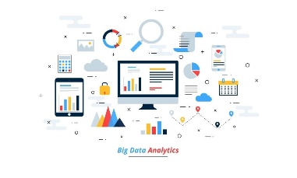
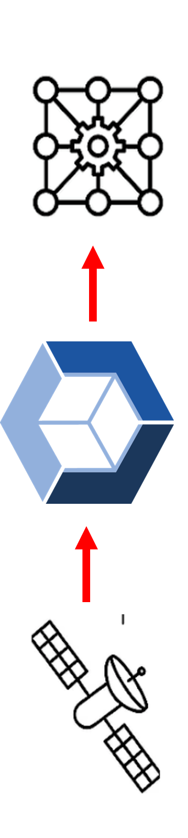
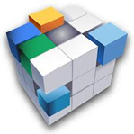
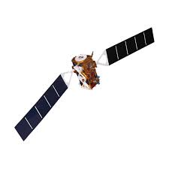

Simplified service viewpoint
  Browser Front-End
  Analytics tools (Labs)
Information Layer Cubes (L-3+)
Satellite Layer Access (L1/2)
European Industry Service
  DIAS(es)
  AWS
  Etc..
  Heritage Mission Cloud
ESA Pixel Based Data Access
ESA Service

Slide 4

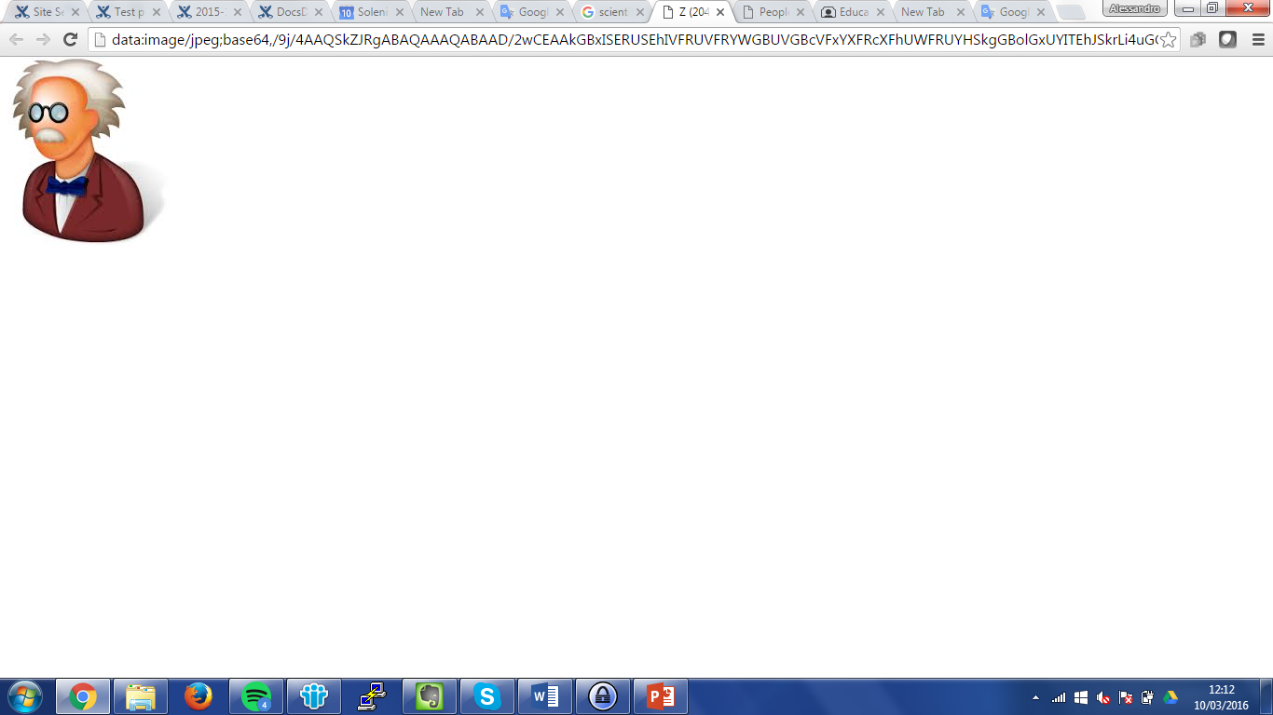





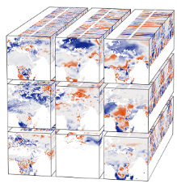


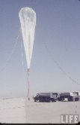




The EO Information Factory context
Business users
Scientists
Value-adders
Data Cube Federation
Algos.
Toolboxes
Data
Value-adders
ICT
EO / non-EO Data Owners
SNAP,
OTB,
…..
Cloud
Providers

Slide 5





Euro Data Cube
An ESA initiative for a European Industry Service

Slide 6




Satellite Resources
&
Auxiliaries
The EO Information Factory
Solution
Decision
Making
6
Notes:
High level diagram or where EDC stands.
Satellite Resources & Auxiliaries – data, cloud infrastructure
Euro Data Cube – various services to access, process and analyze the data
Solution – applications build by added value providers
OK here I removed “The Middle Tier’ , that’s may be true but too IT terminology close to terms like “Solution” or “Decision Making”. How do you enable a solution and decision making ?
Answer is because you are able to derive value-added information from raw data, How/where : the EO Information factory

Slide 7




























GeoDB
Algorithms
Apps
on-the-fly &
batch processing
multi-temporal
analysis (xarray)
vector data
service
hosted app engine
jupyter Notebooks
DATA
SERVICES
Access to full archives
Analysis Ready Data
Data
CLOUD
EO commercial
in-situ sensor
GIS data
Thematic
data
04/21/2020
Notes:
General concept of the Euro Data Cube:
-works with large volumes of data, which are hosted on various clouds (DIAS et al)
-Euro Data Cube is on top of the cloud infrastructure, providing services for data processing (on-the-fly processing, batch processing, multi-temporal analysis, vector data service. Very important fact being is that it provides access to _complete_ data archives – Sentinel-1,-2,-3,5p, Landsat, MODIS, etc.
-Euro Data Cube also offers hosted app execution and Jupyter Notebooks for data scientists
-users can contribute their algorithms, applications and data
-the data can be served via standard APIs, including OGC standard one

Slide 8
GeoDB
Algorithms
Apps
on-the-fly &
batch processing
multi-temporal
analysis (xarray)
vector data
service
hosted app engine
jupyter Notebooks
DATA
SERVICES
Access to full archives
Analysis Ready Data
Data
CLOUD
EO commercial
in-situ sensor
GIS data
Thematic
data
04/21/2020
Notes:
General concept of the Euro Data Cube:
-works with large volumes of data, which are hosted on various clouds (DIAS et al)
-Euro Data Cube is on top of the cloud infrastructure, providing services for data processing (on-the-fly processing, batch processing, multi-temporal analysis, vector data service. Very important fact being is that it provides access to _complete_ data archives – Sentinel-1,-2,-3,5p, Landsat, MODIS, etc.
-Euro Data Cube also offers hosted app execution and Jupyter Notebooks for data scientists
-users can contribute their algorithms, applications and data
-the data can be served via standard APIs, including OGC standard one

Slide 9
EDC Data Offer – from raw to ARD
Open Data (global and full archives)
Commercial data (on-demand, payable)
Sentinel-1 GRD
Sentinel-2 L1C and L2A*
Sentinel-3 OLCI and SLSTR
Sentinel-5P
Landsat-5, 7, 8
MODIS
DEM
*L2A global from 2017 onwards
**Landsat-5 and Landsat-7 limited to Europe
Airbus Pleiades and SPOT
PlanetScope
(coming soon) European Space Imaging
Climate variables (on-demand)
Copernicus Climate Change Service (C3S)
Copernicus Marine Service
Copernicus Land Monitoring Service
Copernicus Atmosphere Monitoring Service
ECMWF Mars archive
WorldBank Development Indicators
ESA Climate Change Initiative
Notes:
On-the-fly access to Sentinel-1 GRD almost in line with CEOS specifications (terrain flattening coming soon; speckle filtering requires post-processing)
Largest archive of Sentinel-2 L2A data, with Sen2Cor reprocessing back to June 2017 right now and back to beginning of 2017 in a few weeks.

Slide 10
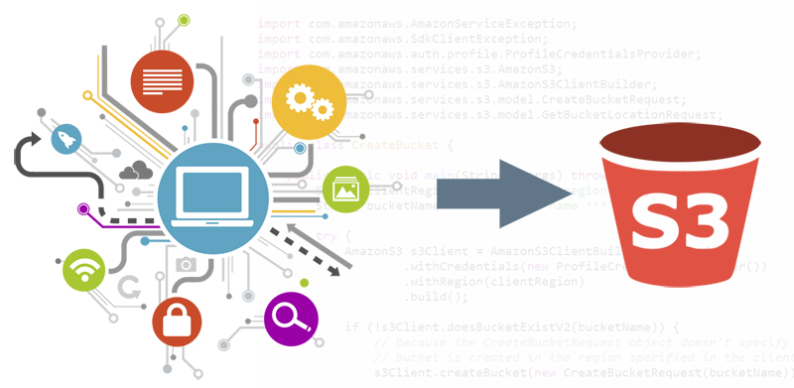
Bring your own data
Raster data
Vector data
Self-serve for COGs (in near future zarr)
Customizable for other formats
Data residing on AWS (EU-1 or US-West-2), Mundi, CreoDIAS
Full Sentinel Hub functionality
Can be used for:
Satellite imagery
Derived products
geoDB – managed PostgreSQL/PostGIS database
READ/WRITE/QUERY
Share with other users

Slide 11
Euro Data Cube services
Fully operational
EDC Sentinel Hub – Cloud API for Pixel Based Access
EDC Batch Processing – Large scale data pre-processing
Operational end of April
EDC xcube – xarray based access to the data
EDC geoDB – access to non-EO data (vector database)
EDC EOxHub Workspace – hosted applications and Jupyter Notebooks
Everything one needs for for analysis, forecasting and decision making

Slide 12
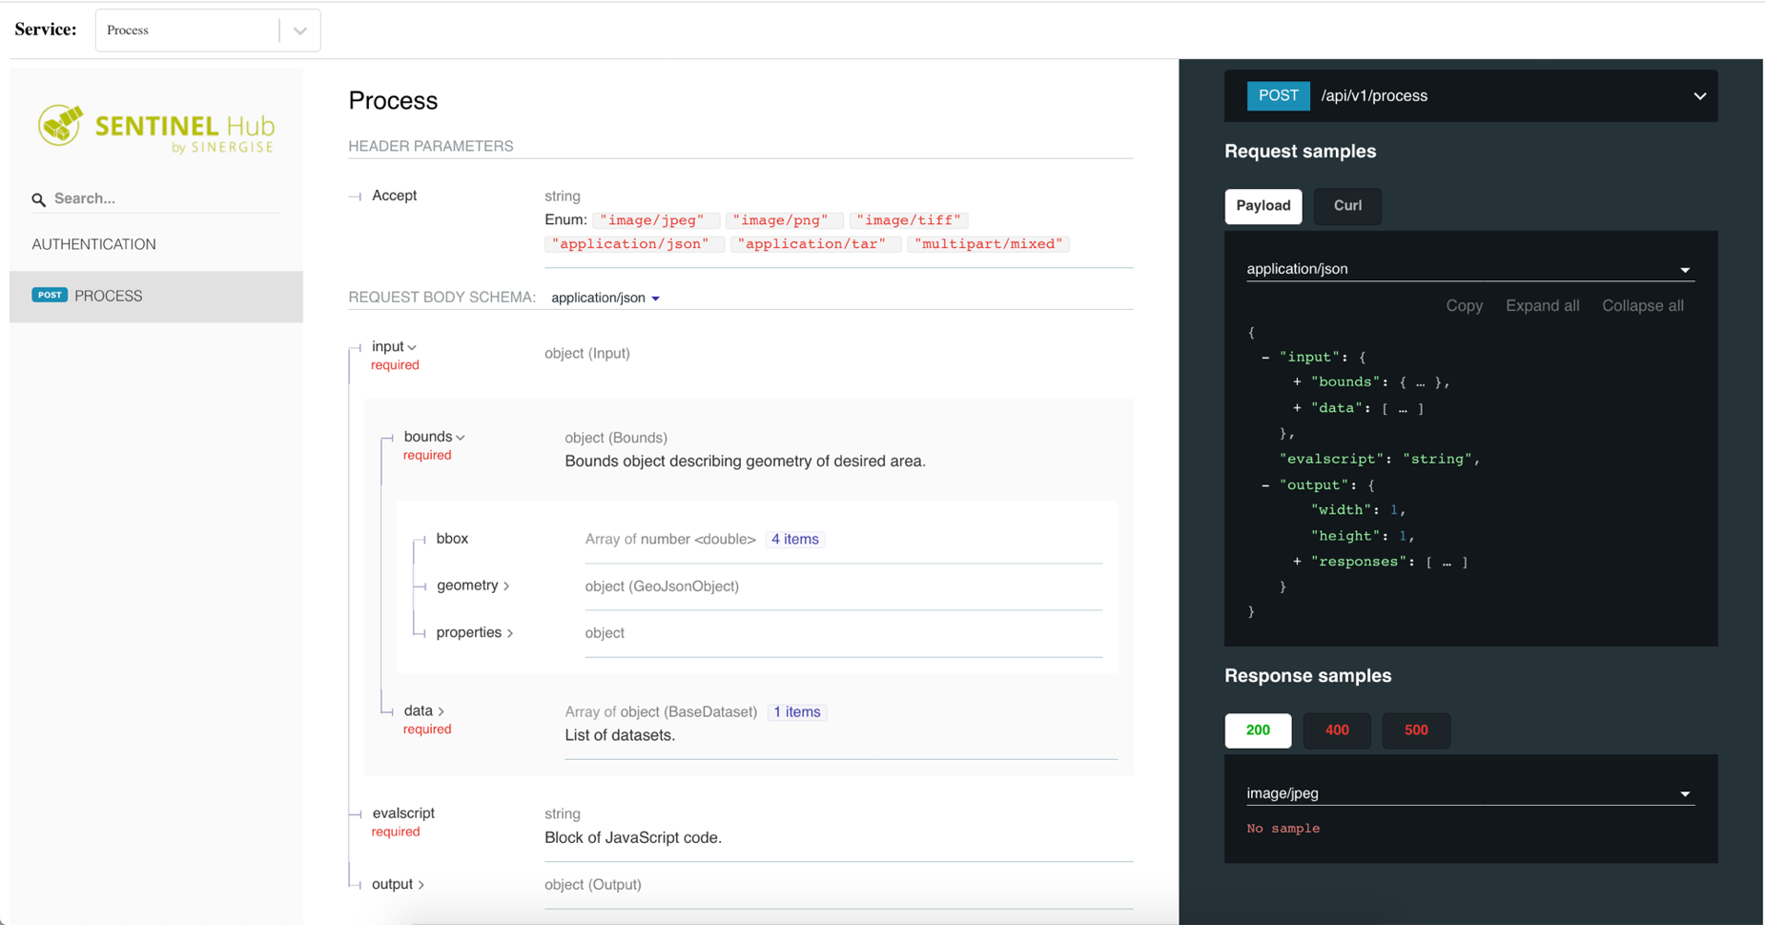
Operational and self-serving APIs
Notes:
the APIs are well documented and with examples
-there are some that are OGC compliant and some that are proprietary, going beyond the current capabilities of OGC standards
-they are operational and self-serving (I think this is important point as most other services are far from this)

Slide 13
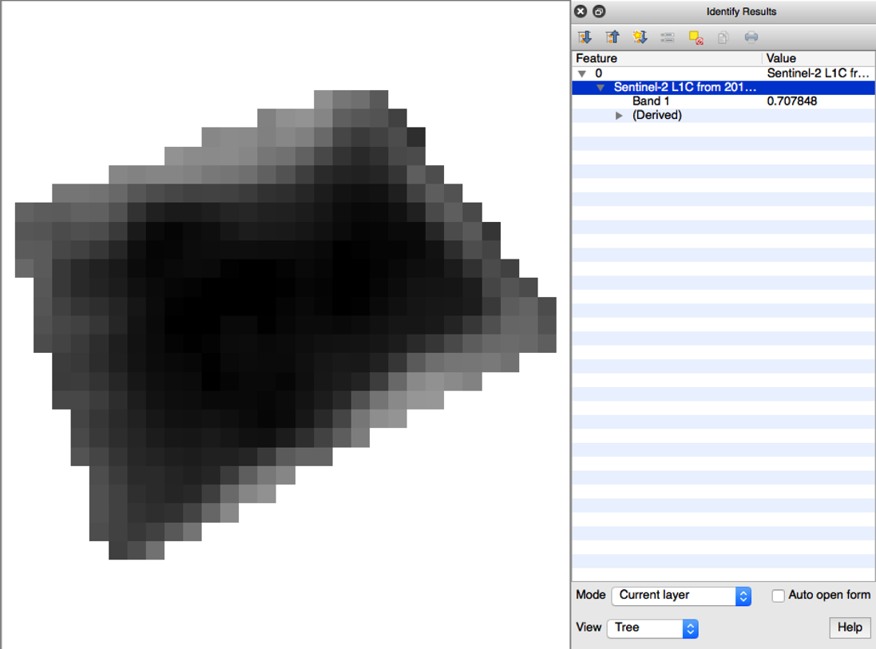
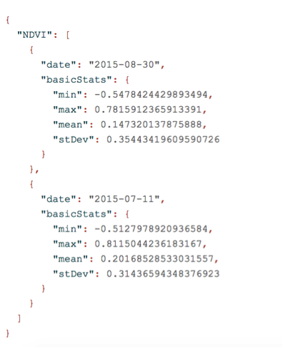
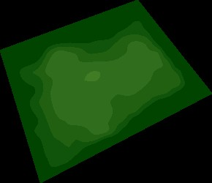
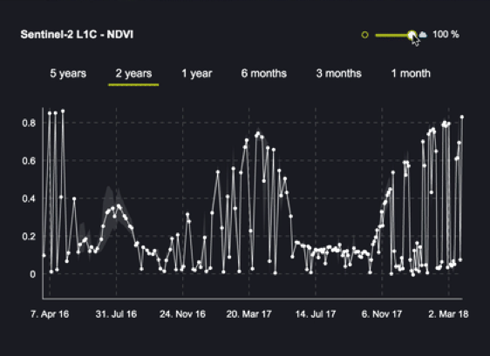
Notes:
Users can get access to original pixel values, visualizations, statistical analysis and more

Slide 14
Integration within the Euro Data Cube
Sentinel Hub and Batch Processing
xcube and geoDB
EOxHub Workspace and Markeplace
PlanetScope data
Support
Marketing
04/21/2020
Notes:
for the success of the project the cooperation between partners was essential as we had to combine strengths of one another.
E.g. Sinergise was very strong with on-the-fly data access. But we knew that not everything can be solved on-the-fly and that people need customization and configurability – so xarray based xcube was chosen.
And then introduction of additional data – commercial dataset, essential to have an insider on-board.
And all of the technology is not useful if it is not supported and if people do not know about it.

Slide 15
Standardization activities
Objectives:
  Reach well established communities e.g. QGIS / ArcGIS …
  Developers “Ease of use” e.g. OGC APIs
  Enable federation / interoperability & max. usage (e.g. ESA NoR, ODC, Pangeo)
Current status highlights:
  OGC version 1 interfaces in production
  OGC WCS 2 in prototype use
  COGs widely supported
  STAC API coming in May
  Integration activities between EDC and ODC
  Sentinel-2 L2A processing in Africa (in cooperation with GA) and worldwide (in cooperation with AWS)
Notes:
"What do the OGC interfaces bring to the EDC operational service?"
The first argument is of course general interoperability. By providing WMS and WCS interfaces off-the-shelf software like QGIS or ArcGIS can load the data. For QGIS for example we're about to release a first version of the EDC plugin to be demonstrated at the SRR.
This interoperability is arguably of limited benefit to users. Thus the second step and ultimately argument is ease of use. I truly believe that the new OGC APIs are the right step in this direction. Particularly the user centric Data Access and Processing API (DAPA) as currently explored in Testbed 16 or the Environmental Data Retrieval (EDR) API are of great interest.

Slide 16
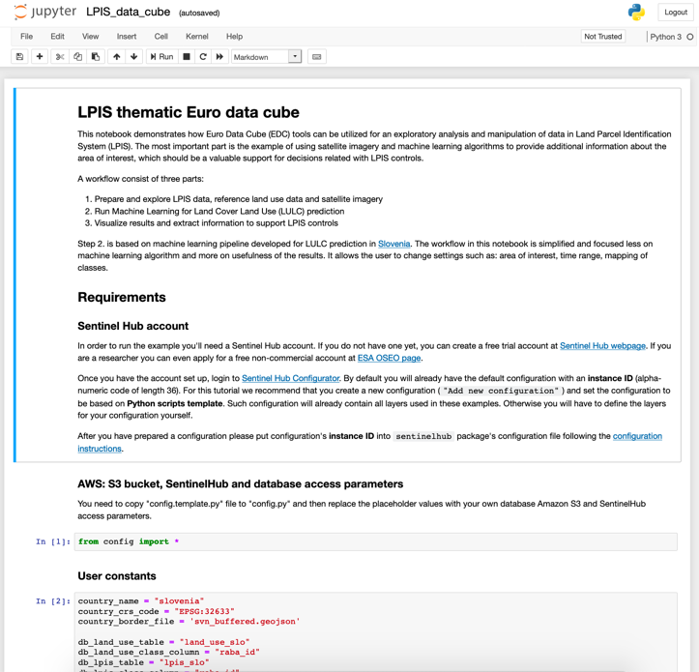
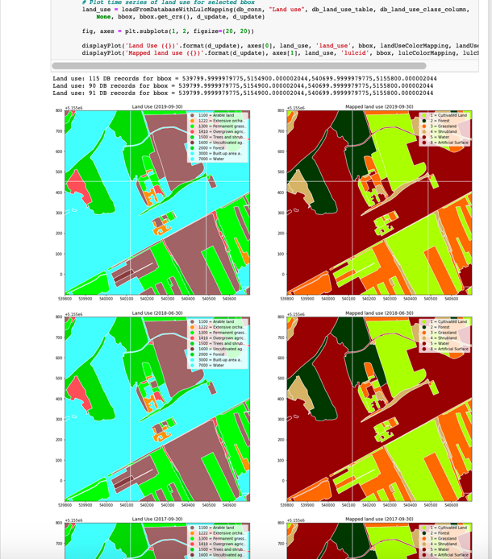
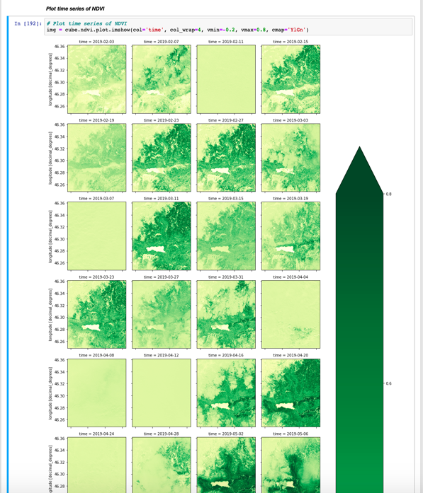
LPIS/IACS use-case
Jupyter Notebook with start-to-end basic example of crop/land cover classification, which can be used for basic area monitoring tasks
Notes:
An open-source example, implemented fully in Jupyter Notebook, which allows someone to execute all classical steps of machine learning for crop classification and compare this with the available data provided by users, to support ”Checks by monitoring” process.
https://eurodatacube.com/marketplace/notebooks/contributions/EDC_Usecase-LPIS_Crop-Type-Classification.ipynb

Slide 17
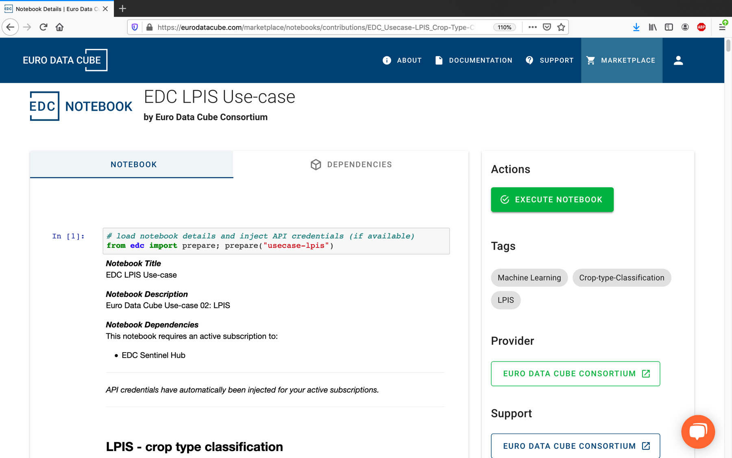
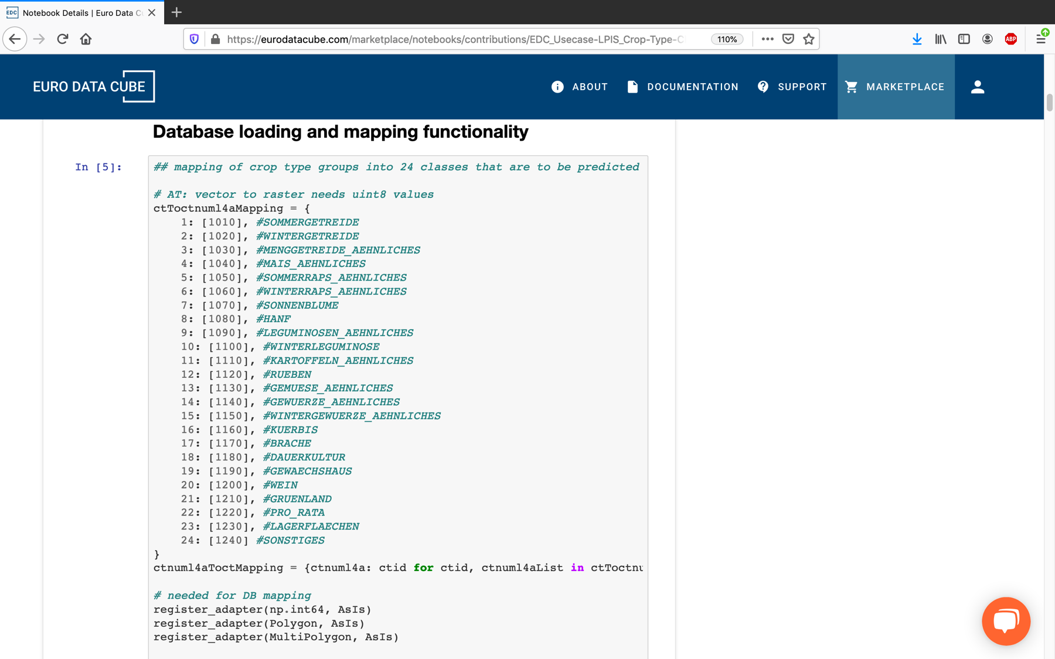
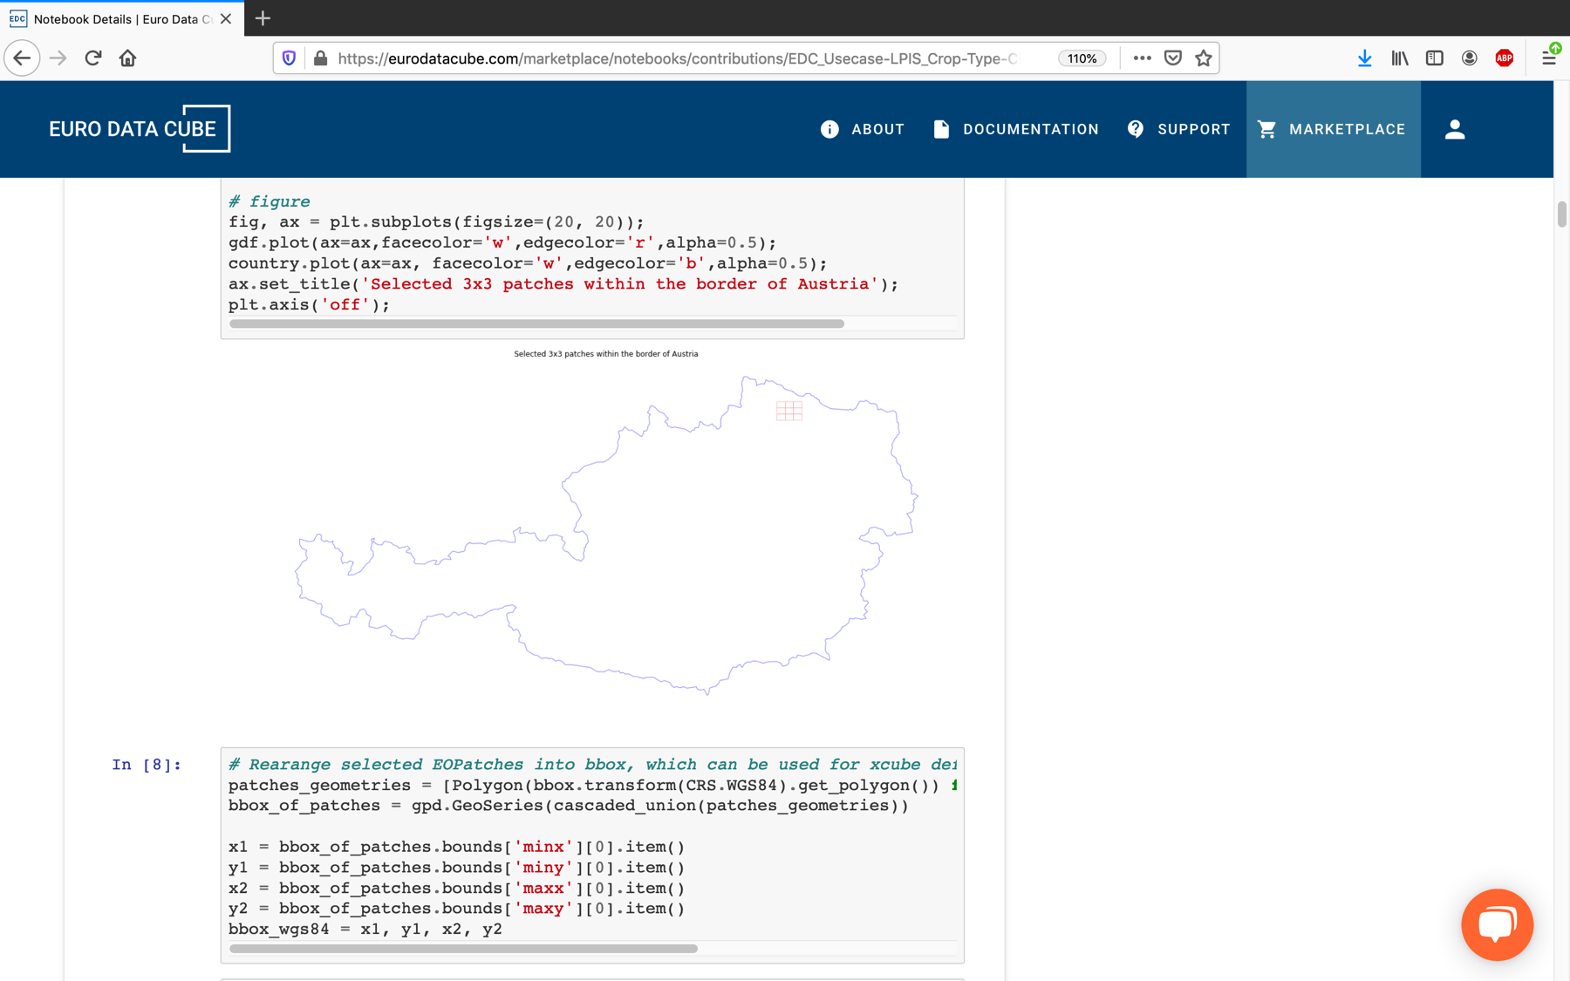
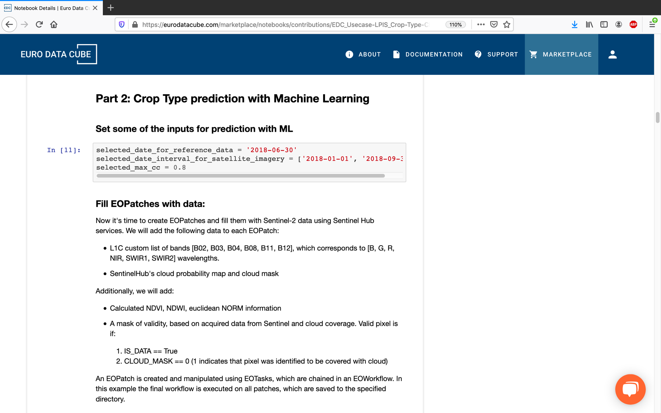
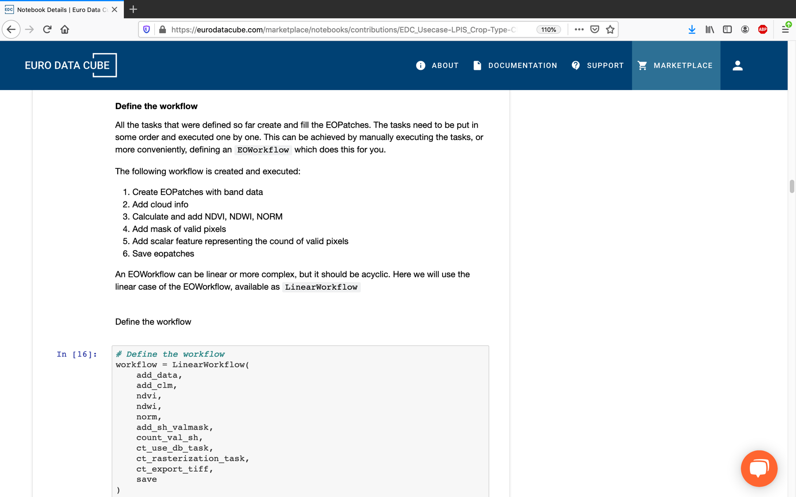
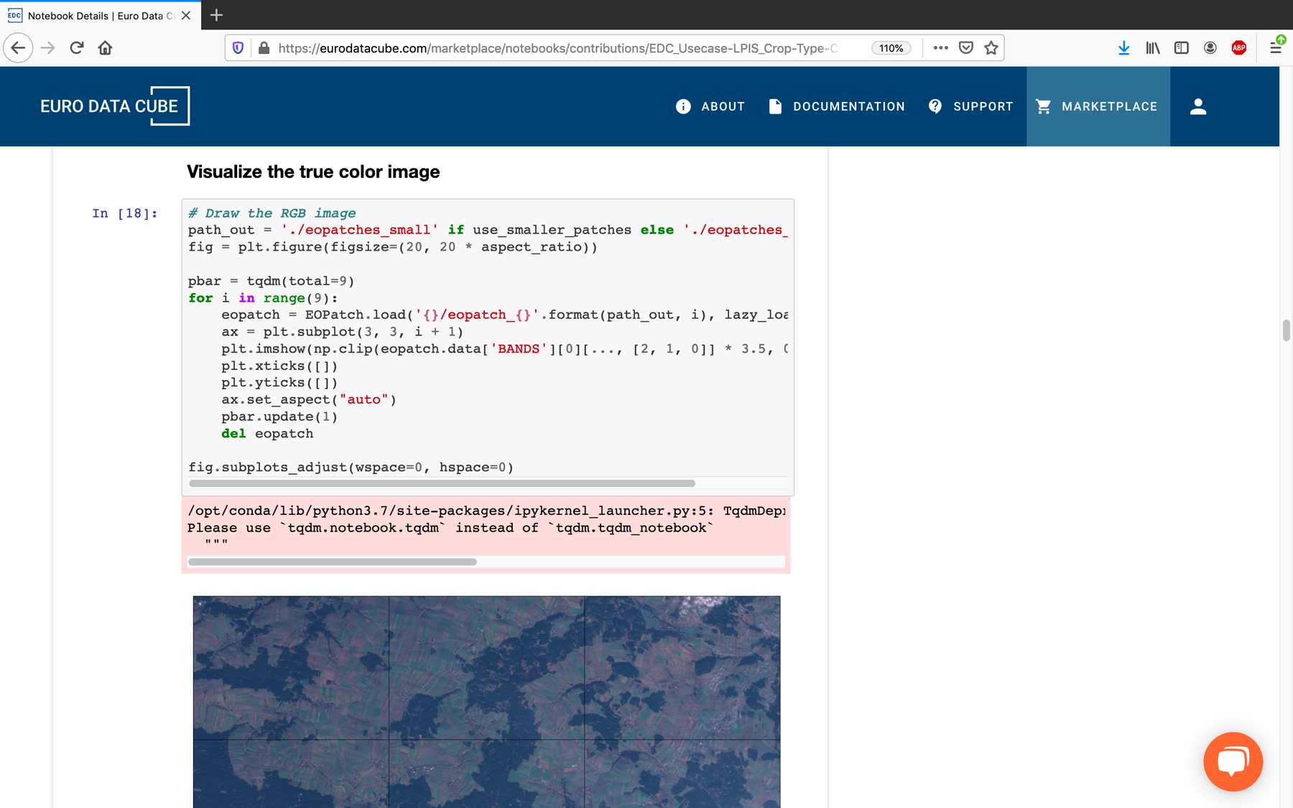
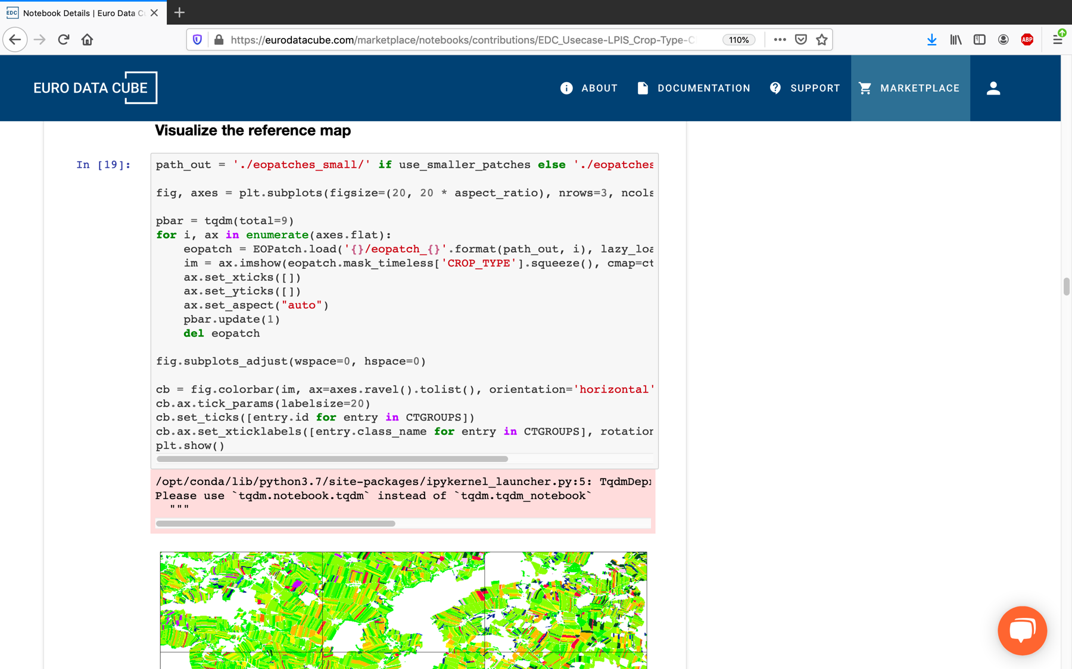
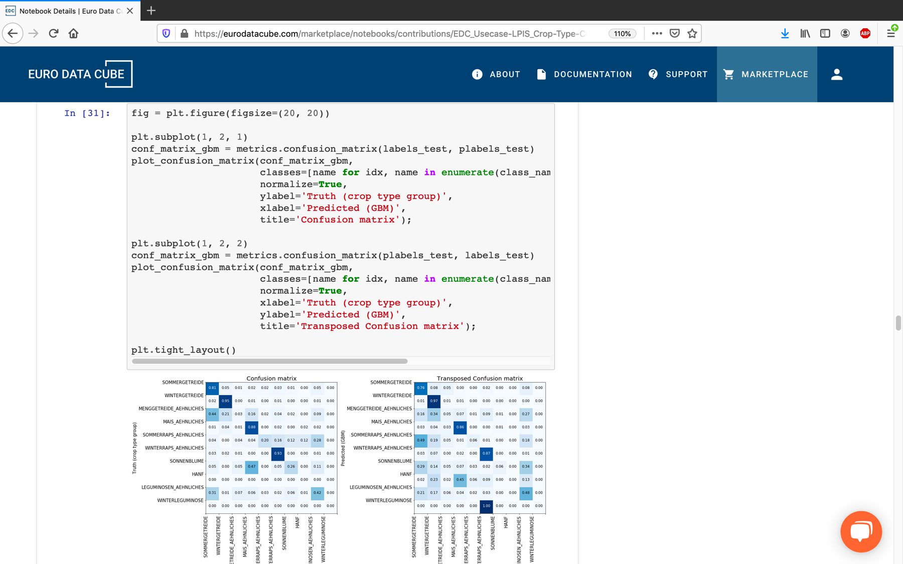
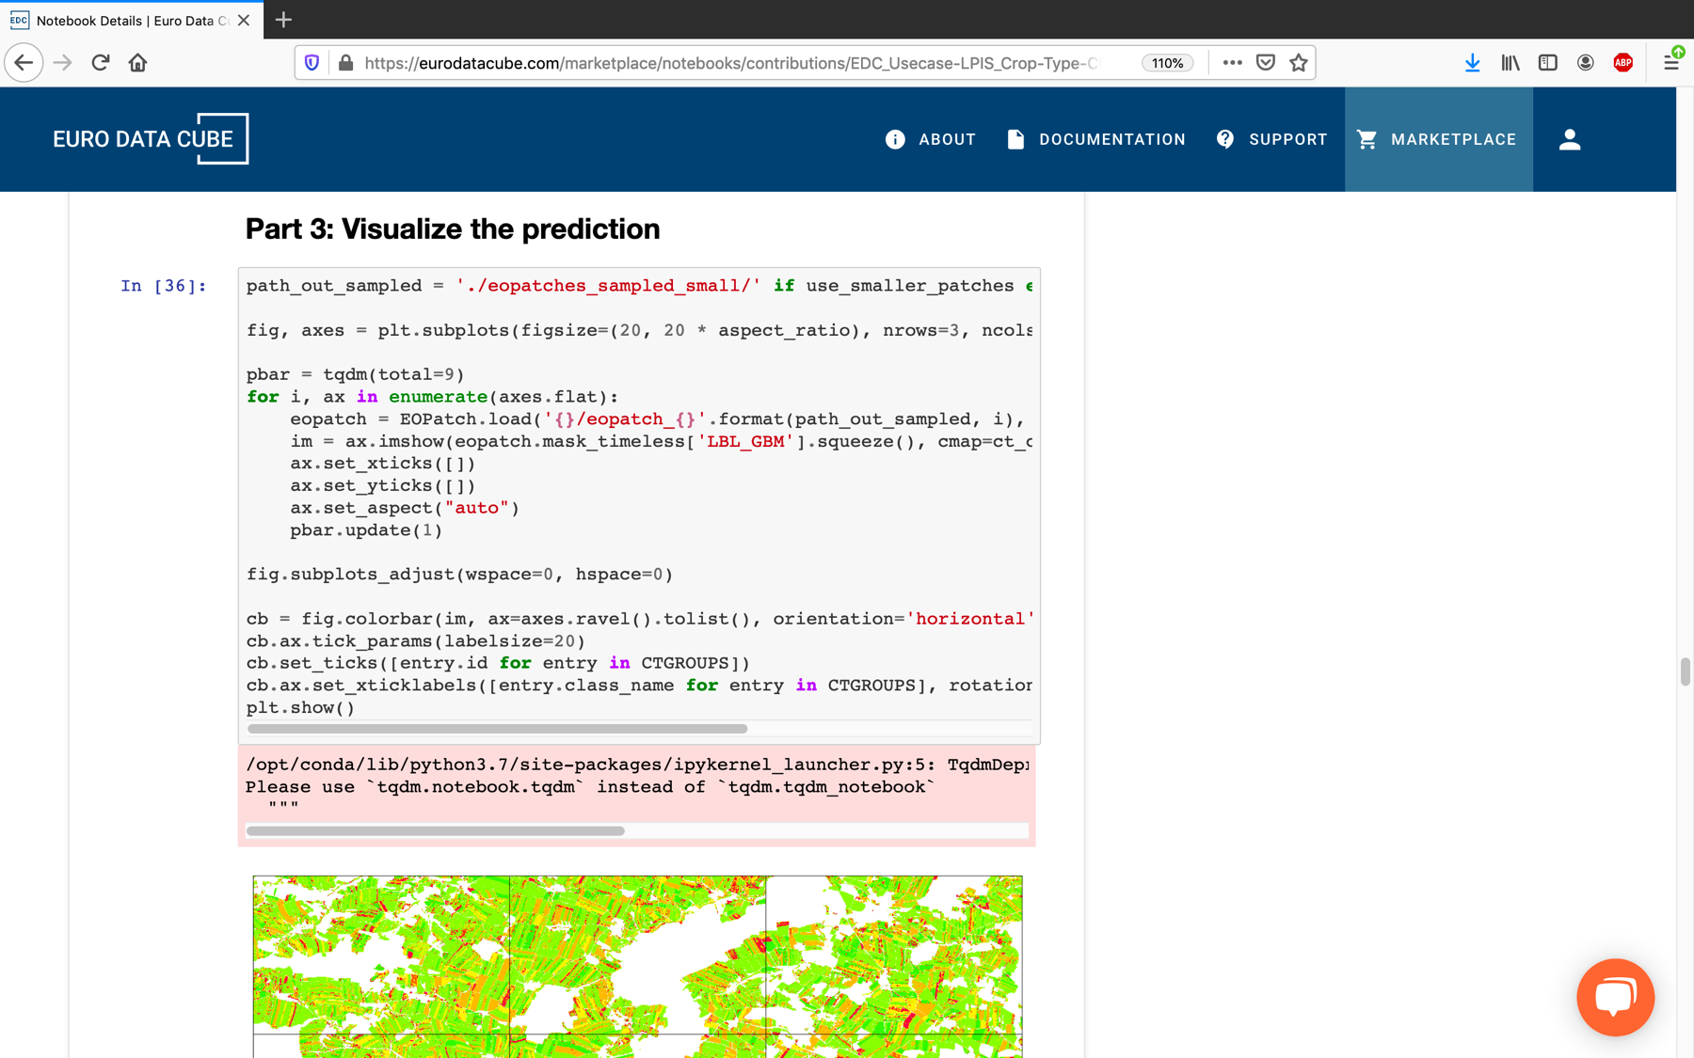
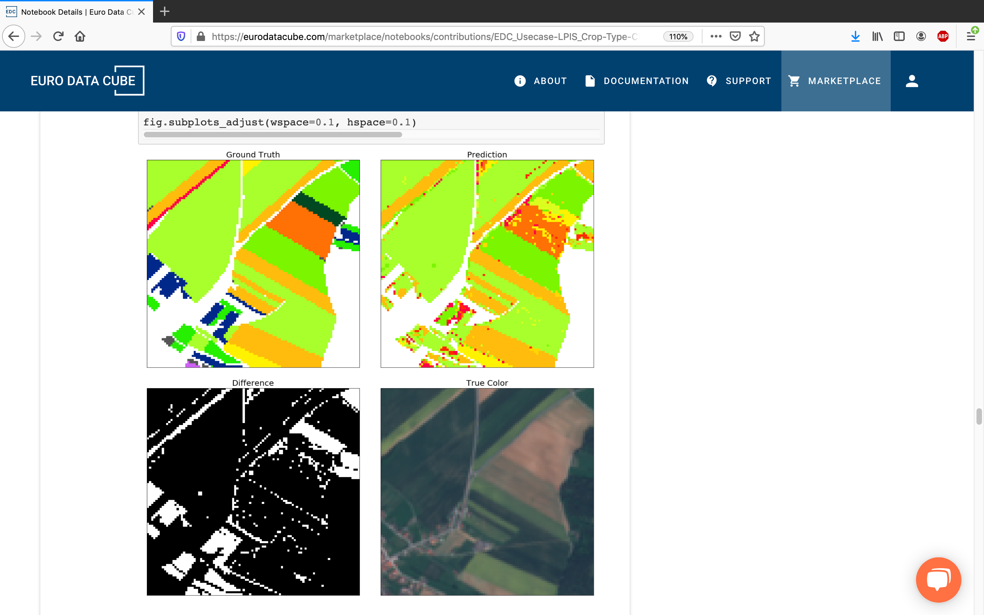

Slide 18
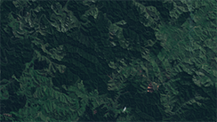
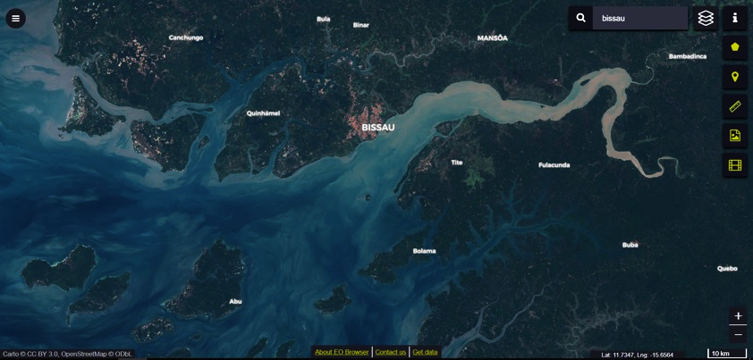
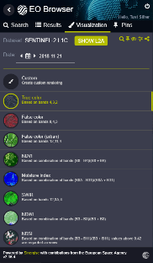




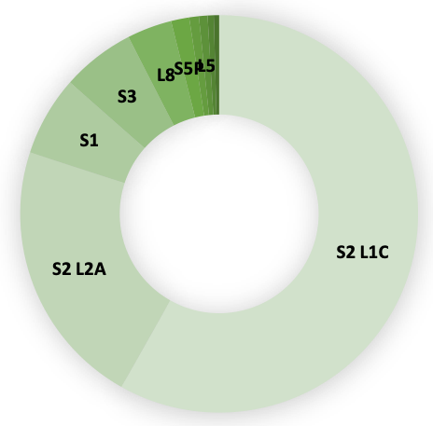
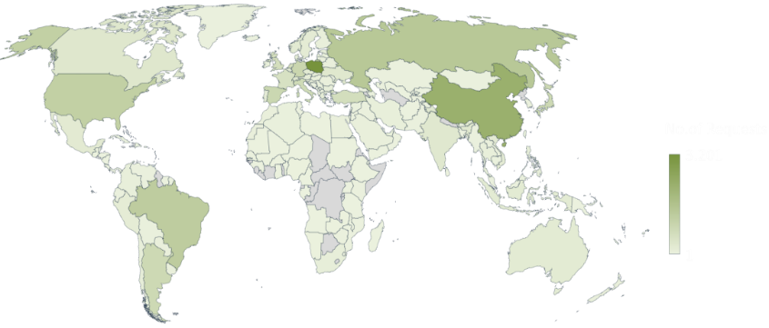

Statistics – February 2020
Cloud API
EO Browser
79 k
registered users
38 k
monthly visitors
200 M
processed requests
40 M
processed requests
15 PB
of satellite imagery
Open-source and free to use
500 TB
added every month
4 Sentinel missions
3 Landsat missions
MODIS
Envisat
Visitors from 159 countries

Slide 19
Coming soon...
New use-cases
  Earth Challenge 2020
  GeoRice
  Urban TEP
STAC-compliant catalogue service
Global cloud mask for Sentinel-2
Deeper integration with ODC

Slide 20
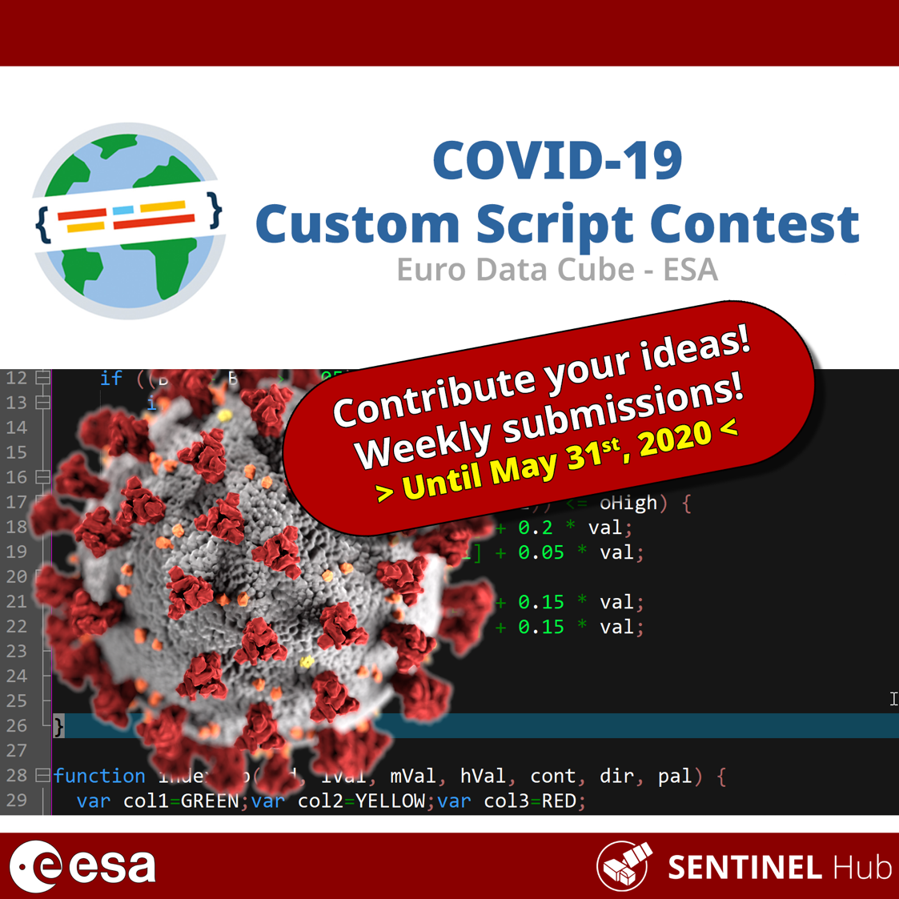
Notes:
One of the use-cases is COVID-19 Custom Script Contest, where we were able to organize, in one week, a publicly shared data cube with several PB of open data and close to 100.000 sq. km of commercial data.
People can access these through EO Browser (no programming knowhow needed), API, Jupyter Notebook, etc.

Slide 21
ESA PDGS Pixel Based Data Access
CEOS WGISS #49
21/04/2020

Slide 22
ESA PDGS Pixel Based Data Access Objectives
Brings the users to the data
Provides standardised and harmonised interfaces to manage EO and in-situ data
Innovative, and complementary, approach to access and visualize data
Permits on-the-fly pixel based processing and bulk asynchronous processing
Integration into ESA Collaborative Environment

Slide 23
ESA PDGS Pixel Based Data Access Service
Global
Regional
Local
Pixel

Slide 24


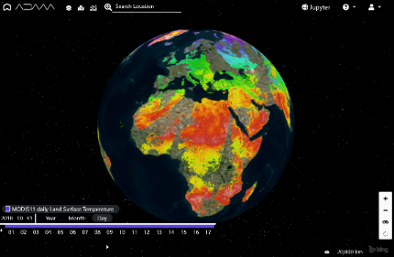
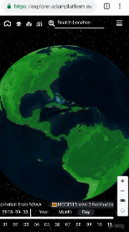
Access Interfaces
explorer
Jupyter
APIs
https://datacube.pdgs.esa.int
https://jupyter.pdgs.esa.int
Jupyter notebooks
rely on adamapi
User centric
Data access
E-collaboration
For scientist
Coding environment
Processing resources
Results publication and / or download
For developers
APIs
OGC interfaces

Slide 25
ESA DataSet
Third Party Missions: Landsat-5/7, Tropforest, SPOT 1-5, IKONOS-2, SeaSat
Heritage Missions: (A)SAR, (A)ATSR from ENVISAT, ERS-1, ERS-2
Earth Explorer: SMOS L1, L2 (Soil Moisture, Ocean Salinity), L3 (Sea Ice Thickness)

Slide 26
Authentication & Authorization: ESA SSO

Slide 27
Next Steps
Licencing and maintenance 2020 + 2021
Full support to Heritage Mission
Interface with ESA EO Catalogue
WMS / WMTS prototype
….
….
- Processing Capabilities (To be Confirmed)

Slide 28
Interface with ESA EO Catalogue
Background
ESE-ERGO (Dec’ 19 – June ’21), shall improve current EO-CAT, offering Product, collection and service cataloguing, according to 13-026r9 (for OGC services, e.g. WCS), OGC TB15 19-020r1, GeoDCAT-AP, UMM-S/T
AIM
External clients, after metadata discovery from EO-CAT, will be connected/redirect to ESA PDGS Data cube, either to service, or specific WCS for discovered collection

Slide 29
WMS / WMTS prototype
Background
WCS is an access and visualization service: unlikely from WM(T)S previews are generated on-the-fly
WM(T)S is a standard protocol for serving pre-rendered or run-time computed georeferenced map tiles over the Internet
AIM
Support existing visualization services through WM(T)S
Notes:
evitare usi impropri, e poco efficienti del WCS, quando un client richiede semplicmeente visualizzazione dinamica di una immagine

Slide 30
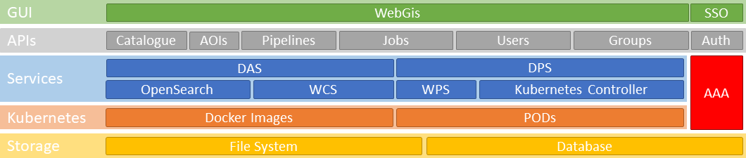
Processing Capabilities
Extending the service with processing capabilities
  Math/statistical operators
  Data preparation pipelines
    ARD generation
    L0 to L1 generation
    …

