Slide 1
WGCapD & WGISS Synergies, Intersections, and Opportunities to Collaborate
Nancy D. Searby, PhD
WGCapD Chair
CEOS WGISS-49 Meeting
21-23 April 2020

Slide 2
WGCapD Overview
Formed in 2011
Pursues a variety of activities based on the four pillars of the Data Democracy Initiative Mission and aims to unify CEOS efforts toward:
Providing wider and easier access to Earth observation data
Increasing the sharing of software tools (open source software & open systems interface)
Increasing data dissemination capabilities and transferring relevant technologies to end users
Providing capacity building, education, and training (including awareness and outreach) to enable end users to gather the information they need, to produce decision-making information, and to increase communication on achieved results
Mission
Increase the capacity of
institutions in less
developed countries for
effective use of Earth
observation data for the
benefit of society and to
achieve sustainable
development.

Slide 3
Objectives & Members
Establishing effective coordination and partnerships among CEOS Agencies offering Earth observation education and training
Facilitate enhancement of international education and training in Earth System Science and the observation techniques, data analysis, and interpretation skills
Exploit the cumulative capabilities of CEOS Agencies
Partner with locally-based and managed regional partners to increase effectiveness and decrease duplication of efforts
Focus on user needs for data and capabilities to inform actions/plans for delivering the appropriate data and training for the effective use of Earth Observation data
Working with CEOS entities to address data accessibility
Work closely with CEOS entities to increase data accessibility, especially in under-served communities
Publicize resources, datasets, and software made available to under-served communities
Promote the use of dissemination systems to effectively reach areas that lack consistent internet access or redundant systems in case of emergencies
Organize workshops and training activities to provide individual and institutional capacity to effectively use available Earth Observation resources
Leadership
Chair: Dr. Nancy D. Searby
Vice-Chair: Dr. Pham Thi Mai Thy
Participants
CNES, CRECTEALC, CONAE, CSA, DLR, EC, ESA, EUMETSAT, GEOGLAM, GODAN, IRD, ISRO, CAS, ISA, JAXA, KSA, NASA, INPE, NSRDA, NOAA, OSGF, SANSA, SWF, RCMRD, ROSCOSMOS, UKSA, University of Jena, UNOOSA, UNRCAP, USGS, VLab, VNSC, WMO

Slide 4
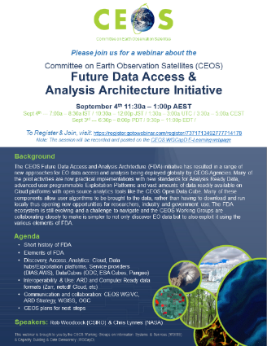
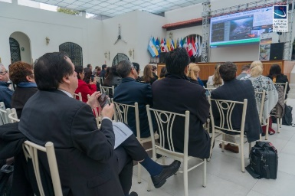
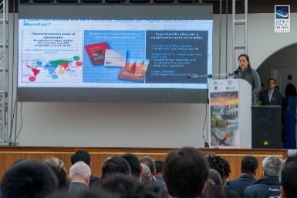
WGCapD Activities
E-Learning (Global)
Organize free E-Learning courses and webinars for participants around the globe
Webinars:
MOOCs:
Workshops (National & Regional)
Organize free training workshops for participants around the globe
EO Training Workshops
Thematic Training Workshops
Regional Workshops
GEO – AmeriGEO & AfriGEO
Southeast Asia
Future Data Architecture
Sustainable Development Goals
SAR trainings
Forest monitoring
Land Cover Land Use Change
Flooding
Etc.
Echoes in Space: Introduction to Radar Remote Sensing

Slide 5
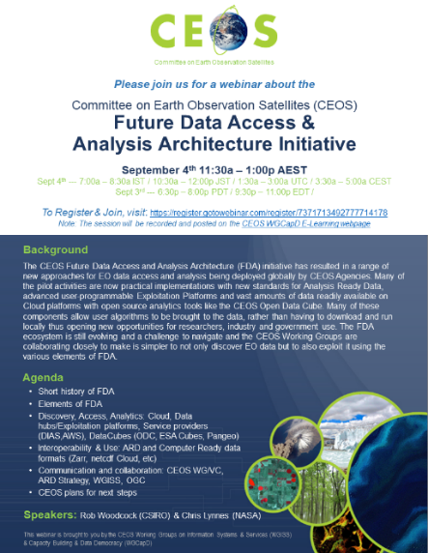
WGCapD-WGISS Past Collaborations
Past Collaborative Activities:
FDA-05: Future Data Architecture Awareness Webinar: http://ceos.org/meetings/future-data-access-analysis-architecture-initiative/ (Sept 2019)
24 Attendees, representing…
11 countries: India, Philippines, Malaysia, Nigeria, Vietnam, USA, Australia, Myanmar, Thailand, Indonesia, and China
19 Organizations: NESAC, University of the Philippines, Universiti Teknologi Malaysia, Teqbridge Limited, Vietnam Academy of Science and Technology, Stamina4Space, NASA, Swinburne University of Technology, AFRIGIST, VNSC-VAST, CSIRO, NOAA, CDE, Science Systems and Applications Inc., ISRO IIRS, CMRIT, SCGI, LAPAN, Fudan University
Video on CEOS Website

Slide 6
Future WGISS-WGCapD Collaborations
Planned Deliverables:
CB-45: Jupyter Notebooks Awareness Webinar – explore hosting a Jupyter notebooks awareness webinar in 2020-2021.
WGCapD POC: Kent Ross, NASA
Contributors: Robert Woodcock, CSIRO; Brian Killough, SEO
Due: Q1 2021
Proposed timeline:
Send and close out a questionnaire regarding Jupyter notebook repositories in Q2 2020 (Chris has drafted a Google Form for this purpose)
Summarize questionnaire results in late Q2, early Q3 2020
Clarify awareness webinar target audience and needs in late Q2, early Q3 2020
Plan awareness webinar content, instructor and logistics in early Q3 2020
Target scheduling of awareness webinar for early Q4 2020 (October or early November)
Final training report deliverable Q1 2021

Slide 7
Future WGISS-WGCapD Collaborations
Planned Deliverables:
CB-47: Metadata Standards Tiger Team – selection and definition of metadata standards for the exchange and processing of learning objects. WGCapD is identifying a Tiger Team to work on this.
WGCapD POC: Robert Eckardt, University of Jena
Contributors: TBD
Due: Q1 2021
Opportunities for Collaboration:
Follow-on FDA webinar focused on specific FDA types
CB-53: Collaborative Feasibility Study - 10-week dual capacity building feasibility study focused around data cube algorithm creation (focused in Vietnam, Mexico)
WGCapD POC: Kent Ross, NASA, Kenton.W.Ross@nasa.gov
Contributors: Sergio Camacho, CRECTEALC, sergio.camacho@inaoep.mx; Pham Thy, VNSC, ptmthy@vnsc.org.vn
Due: Q4 2020 or Q1 2021

Slide 8
Contacts & Resources
Points of Contact:
Chair: Dr. Nancy Searby (NASA)
nancy.d.searby@nasa.gov
Vice Chair: Dr. Pham Thy (VNSC)
ptmthy@vnsc.org.vn
WGCapD-9’s Virtual Annual Meeting March 10-12, 2020
Resources:
Training Calendar – https://training.ceos.org/
Best Practices for Conducting Trainings – http://ceos.org/document_management/Working_Groups/WGCapD/WGCapD-Best-Practices_V2.0.pdf
http://ceos.org/meetings/wgcapd-9/

