Slide 1
WGDisasters Report
Committee on Earth Observation Satellites
David Borges
WGDisasters Secretariat
CEOS WGISS-49
Virtual Meeting
21 April 2020

Slide 2
WGDisasters Terms of Reference (2019)
Mission Statement
WGDisasters ensures the sustained coordination of disaster-related activities undertaken by the CEOS Agencies and acts as an interface between CEOS and the community of stakeholders and users involved in risk management and disaster reduction.
Primary Objectives
Support efforts of Disaster Risk Management (DRM) authorities in protecting lives
Foster increased use of EO in support of DRM
Support Implementation of the UN Sendai Framework for Disaster Risk Reduction
Raise awareness of the benefits of using satellite EO in all phases of DRM

Slide 3
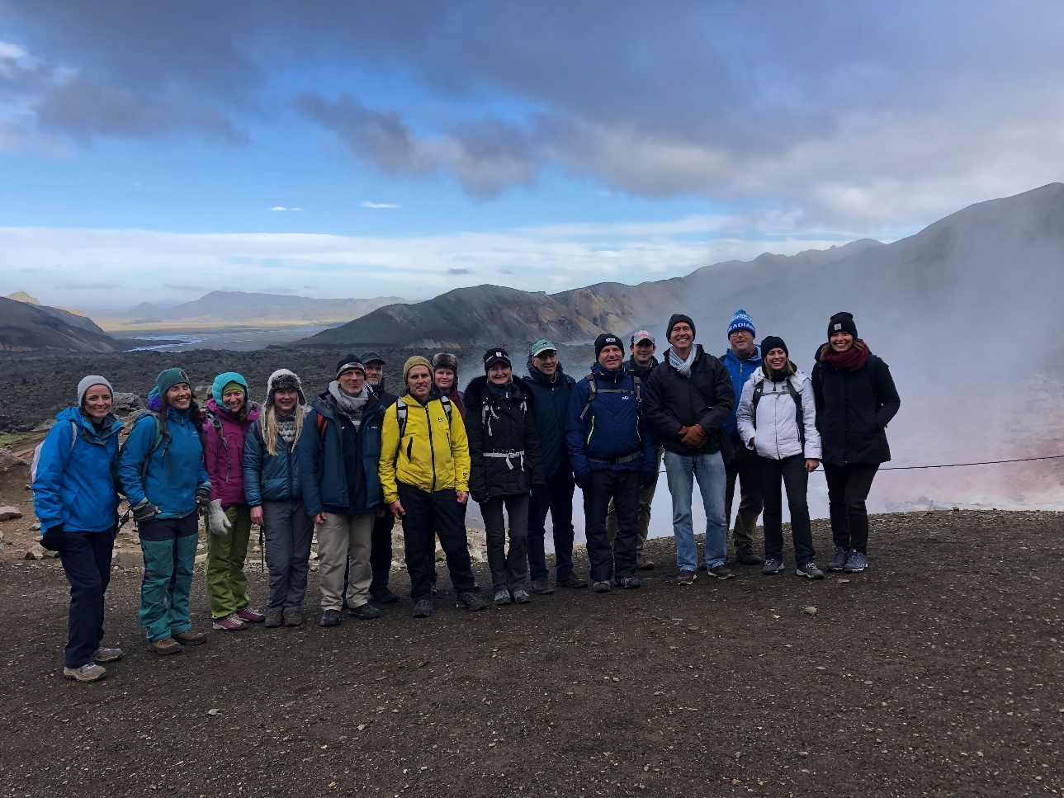
WGDisasters Activities Overview
Working Group Activities
Volcano Demonstrator
Seismic Hazards Demonstrator
Landslide Pilot
Recovery Observatory
GEO/LEO/SAR Flood Pilot
GeoHazards Lab
GEO-DARMA Initiative
GEO GSNL Imitative
EO4DRM Community Activity
New Activities
CEOS COAST
GEO DRR-WG

Slide 4
GeoHazards Lab Initiative
Geohazards Lab:
A platform with federated resources to provide data access and an online processing and e-collaboration environment to exploit EO data to assess geohazards and their impact
Supports and complements the CEOS WG Disasters activities (on-going pilots, follow-on activities and the RO), GSNL and users from the broader geohazards community.
Maximize use of EO techniques and cloud processing by the EO expert community
Achieve acceptance of EO products by the non-EO scientific community and decision makers
Landslide Pilot
Seismic Hazards Demonstrator
Volcano Demonstrator
Geohazards Lab
Recovery Observatory
CEOS WG Disasters
Notes:
Geohazards Lab is an initiative to enable greater use of EO data and derived products to asses geohazards and their impacts –with a primary focus on hosted tools and services to exploit satellite data in cloud environments.

Slide 5
Tracing Data to Decisions: EO Process Vision
Policy & Programs
Sustainable
Decisions
Informed, Timely
Data Feeding Decisions
Decisions Driving Needs
Assess effectiveness of WG activities relative to user needs across this spectrum
WGISS Collaboration Focus Areas:
ARD Strategy / PFS
Cloud Migration Good Practices
Private Sector Engagement
Determine joint Work Plan Deliverables for collaboration areas in 2021
WGD End Users
Knowledge
Sendai: EO/Statistical Integration
Early Warning, Response, Capture Use
WGD User Interface
Platforms / Portals
GEO Knowledge Hub
ESA TEP, Etc.
WGD WP Elements
Applications Ready Data
InSAR, Derived Products
Intercomparable time series
WGD DCT
Commercial / Proprietary
Data Provision
Coordination & Tracking
Credit:
Whitcraft / GEOGLAM
CEOS Agencies
Data & Observations
Analysis Ready Data (ARD)
L0-L3 Raw and Pre-Processed Data

