Slide 1

CEOS Executive Officer Report
Committee on Earth Observation Satellites
Kerry Ann Sawyer, NOAA, CEOS Executive Officer
CEOS WGISS-49
Virtual Meeting
21 April 2020

Slide 2
Overview
CEOS 2020-2022 Work Plan
Review of proposed CEOS Work Plan
  Highlights of links to GEO and other external stakeholders
  Updates/requests/issues for specific CEOS Deliverables requiring Principal attention
Timeline for endorsement of Work Plan
Relevant Outcomes of SIT-35 to WGISS
Key Takeaways from CEOS-GEO Bilateral Meeting Relevant to WGISS

Slide 3
CEOS 2020-2022 Work Plan
BLUF*: DELAYED
*Bottomline up front
BTGN*: CEOS Entities are still accomplishing activities in the absence of a physical Work Plan
*But the Good News
AEBN*: Request finally shared with CEOS Entities to update information
*And Even Better News

Slide 4
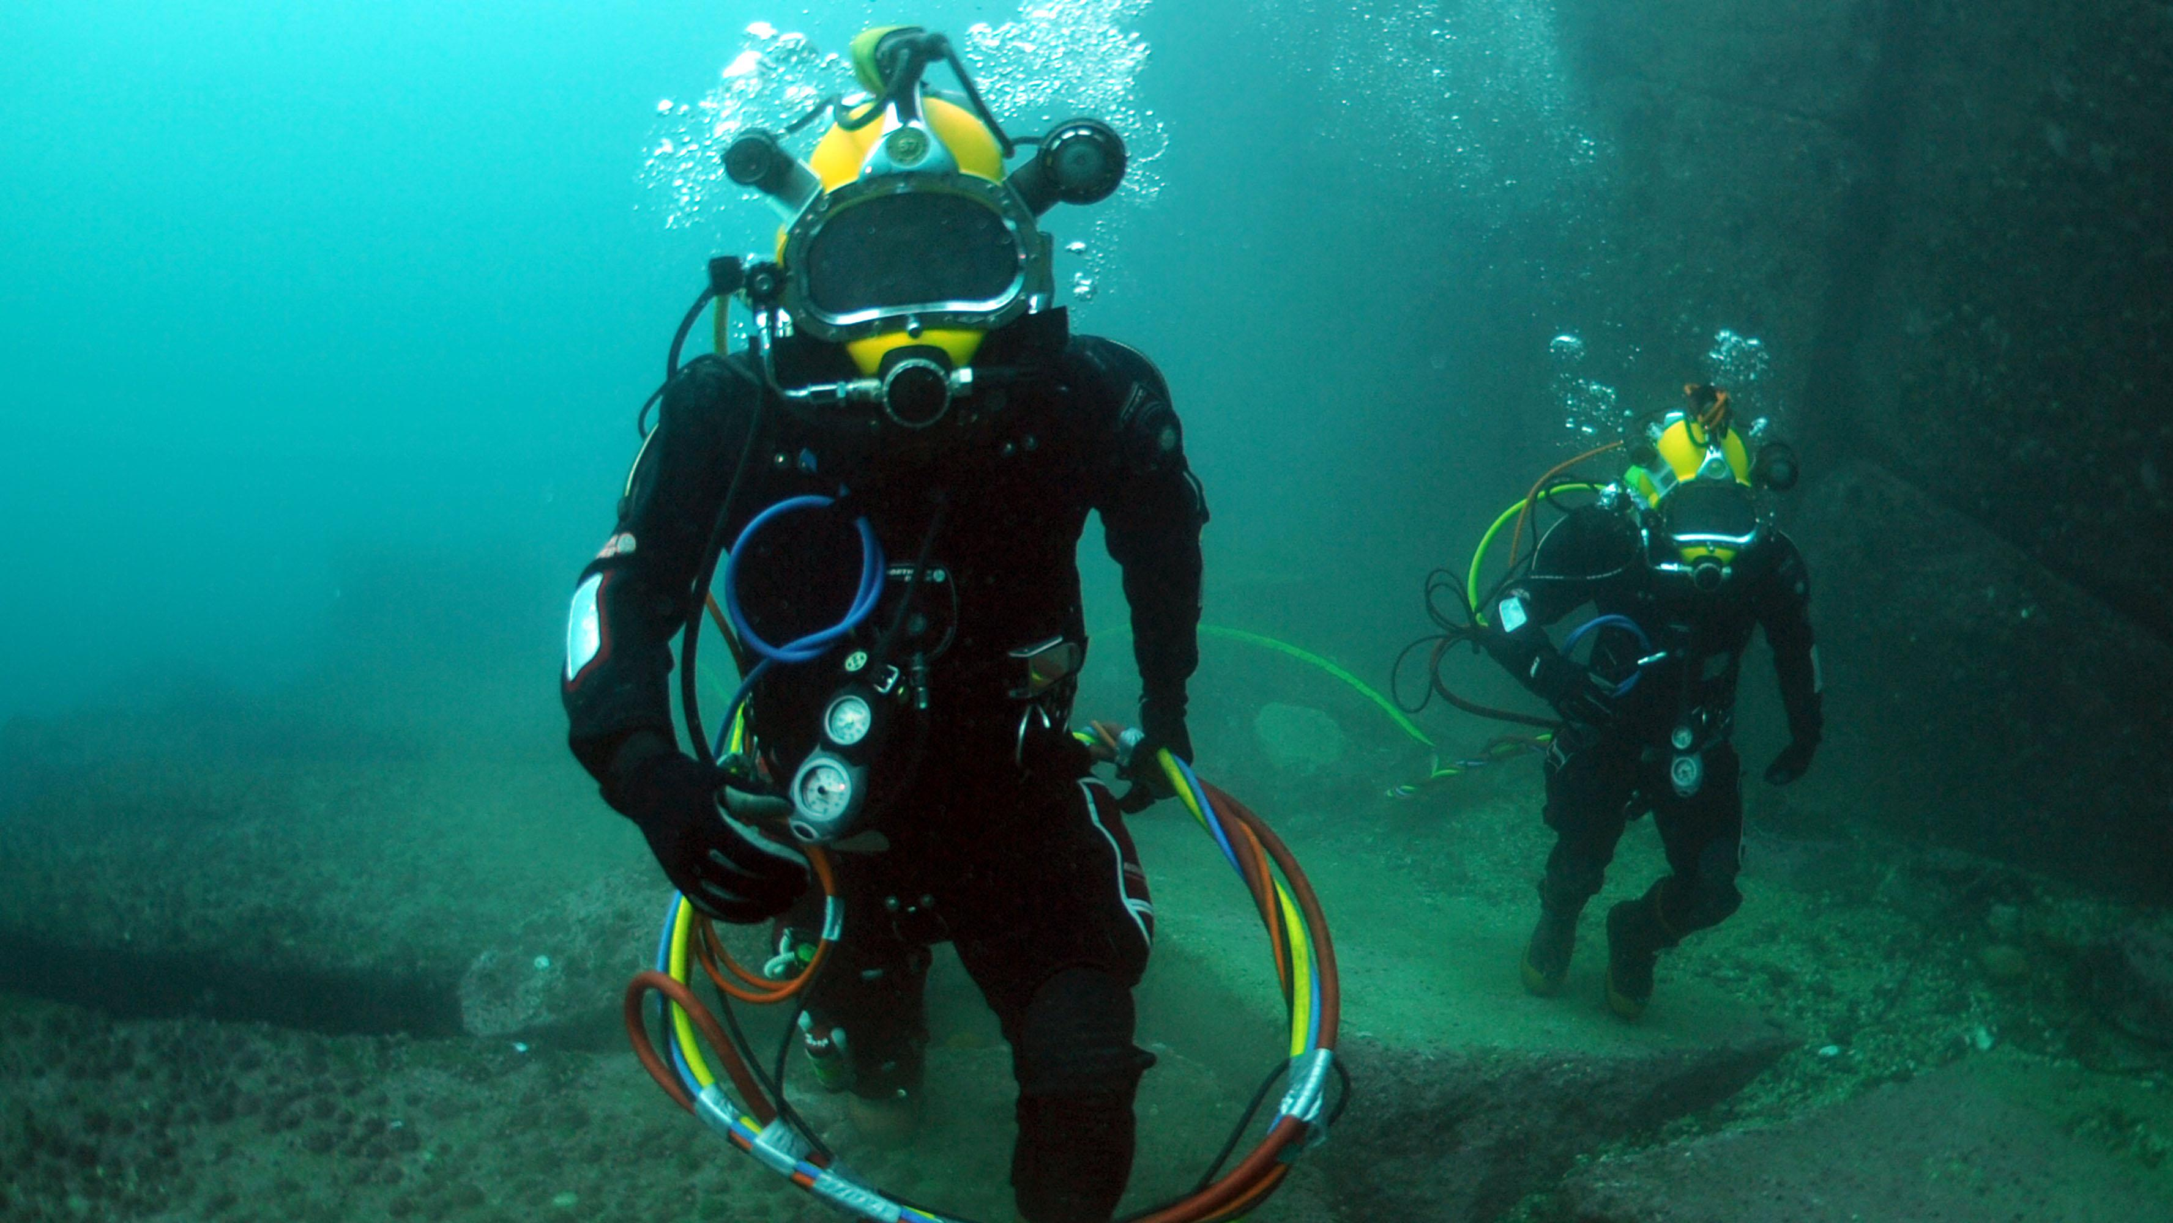
The CEOS Work Plan and “Working Teams”
Climate Monitoring, Research and Services
Data Discovery, Access, Preservation, Usability and Exploitation…
Capacity Building and Data Democracy
Carbon Observations, Including Forested Regions
Support to Other Key Stakeholder Initiatives
Observations for Agriculture
WGs/VCs/ AHT/Experts
CEO
Observations for Disasters
Data Quality
Advancement of the CEOS Virtual Constellations
CEOS Services
Observations for Water

Slide 5
Key Details of 2020-2022 CEOS Work Plan
149 Deliverables (64 Existing, 85 New!!)
CEO Proposals for Refined CEOS Work Plan
  Update Renaming/Renumbering Convention to facilitate tracking and “statusing” of Deliverables
    XX(XX)-YY-01 (2 to 4-character identifier-2-digit year-2-digit number, beginning at 01 for each year)
    For example: CARB-20-01
  Separate category for CEOS Services
    Routine actions and services of CEOS such as the CEOS Newsletter, the Missions, Instruments, and Measurements Database, the Essential Climate Variables Inventory, and other organizational actions with annual and concrete deadlines
Utilizing the CEOS Online Tracking Tool to full effect
  Challenges to encouraging CEOS community to “self-update” the online tool
  Will prepare a “users guide” as an Appendix to the Work Plan detailing required actions of various users of the online tool
  Will facilitate a streamlined Work Plan with less duplicate information

Slide 6

Breakdown of Deliverables
The “Deep Dive”
Climate Monitoring, Research, and Services (6) | Existing | New
 | 4 | 1
 |  | CMRS-20-01
Carbon Observations, Including Forested Regions (11) | Existing | New
 | 6 | 5
 |  | CARB-20-01
Observations for Agriculture (1) | Existing | New
 | 1 | 0
Observations for Disasters (12) | Existing | New
 | 6 | 6
 |  | DIS-20-01
Observations for Water (1) | Existing | New
 | 1 | 0
Data Quality (10) | Existing | New
 | 6 | 4
 |  | CV-20-01
Capacity Building and Data Democracy (31) | Existing | New
 | 8 | 24
 |  | CB-20-01
Data Discovery, Access, Preservation, Usability (11) | Existing | New
 | 10 | 1
 |  | DATA-20-01
Advancement of the CEOS VCs (39) | Existing | New
 | 10 | 29
 |  | VC-20-01
Support to Other Key Stakeholder Initiatives (21) | Existing | New
 | 7 | 14
 |  | SDG-20-01
CEOS Services (6) | Existing | New
 | 5 | 1

Slide 7
New Number | Old Number | Title | Creation Year | Completion Date | Responsible CEOS Entities | Person Responsible
DATA-17-02 | DATA-9 | ECVs/CDRs Discovery and Access through WGISS Systems | 2017 | 2020 Q2 | WGISS WGClimate | Andrea Della Vecchia Yonsook Enloe Michael Morahan
DATA-17-04 | DATA-11 | Technology Exploration webinars and workshops | 2017 | 2019 Q4 | WGISS | Chris Lynnes
DATA-18-01 | DATA-13 | Develop a White Paper on Single Sign-On (SSO) authentication. | 2018 | 2019 Q4 | WGISS | Marco Leonardi
DATA-19-01 | DATA-15 | Explore emerging trends and disrupting technologies (e.g. Artificial Intelligence), evaluate advantages / drawbacks for adoption in Earth observation and identify most relevant use cases. Summarise analysis in the form of white papers. | 2019 | 2020 Q4 | WGISS | Chris Lynnes
DATA-18-02 | DATA-16 | CEOS data holdings reported and accessible in GEO and other international relevant contexts | 2018 | 2019 Q4 | WGISS | Andrea Della Vecchia Yonsook Enloe Michael Morahan
DATA-19-02 | DATA-17 | Mekong Data Cube | 2019 | 2019 Q4 | CEOS Chair GEOGLAM SDCG for GFOI SEO | Vu Anh Tuan
FDA-17-02 | FDA-2 | Collaborative development of CEOS Data Cube technology | 2017 | 2021 Q4 | SEO | Brian Killough
FDA-18-01 | FDA-8 | Establish a common description of Future Data Architecture functional blocks and identify interfaces and interoperability approaches | 2018 | 2020 Q2 | WGISS | Robert Woodcock
FDA-18-03 | FDA-10 | Finalise inventory of Software and Tools available or used at CEOS agencies for EO data exploitation and use focusing on Open Source but remaining as broad and inclusive as possible and implement a mechanism for discovery and access. | 2018 | 2019 Q4 | WGISS | Iolanda Maggio
FDA-19-01 | FDA-14 | Facilitate discovery and access for end users to data analytics and processing tools and services through the WGISS Connected Data Assets Infrastructure. | 2019 | 2020 Q4 | WGISS | Andrea Della Vecchia Yonsook Enloe Michael Morahan Robert Woodcock
DATA-20-01 | DATA-XX | CEOS Glossary of Terms Related to Analysis Ready Data, Future Data Architectures, and Interoperability | 2020 | 2020 Q4 | WGISS | Rob Woodcock
 | DATA-2 | Full representation and accessibility of CEOS Agencies datasets through WGISS Standards and Connected Data Assets Infrastructure (I.e. IDN, CWIC, FedEO). | 2014 |  | WGISS | Andrea Della Vecchia Yonsook Enloe Michael Morahan

Slide 8
Next Steps
CEO to update the CEOS Online Tracking Tool with updated information provided by CEOS entities (which was provided in a very timely manner by CEOS entities!)
Update explanatory paragraphs in the Work Plan and refine, keeping information concise and on point
  CEO sent requests to each CEOS entity on 20 April (just yesterday, or earlier today if you are in Australia)
Update tables in Work Plan for all 149 Deliverables, reflecting new renumbering convention
Draft for entity review by 15 April 2020 10 May 2020
Virtual endorsement by 15 May 2020 24 May 2020

Slide 9
SIT-35 Outcomes

Slide 11
Key Relevant Discussion Points and Actions for WGISS
Engaging the private sector early before ARD standards are defined, and promoting complementarity between government and private sector datasets should be considered.
CEOS should identify representatives on each of the new GEO Working Groups (see next slide). SIT-35-10
GEO Secretariat flagged strong interest in CEOS support on data cube instances and SDGs.
SIT Chair Team will continue with its engagement plan for CEOS Working Teams via: Working Team All-Hands calls; the new VC reports to CEOS SEC; and informal working telcons with VC Co-Leads.
CEOS community is encouraged to utilize the CEOS Deliverables Tracking Tool fully in updating their Deliverables in order to help support the sustainability of the CEOS Work Plan.

Slide 12
Request to WGISS
SIT 35-10
The GEO Secretariat is requesting GEO Members and Participating Organizations nominate individuals to participate in the four GEO Working Groups (Capacity Development Working Group (CD-WG), Climate Change Working Group (CC-WG), Disaster Risk Reduction Working Group (DRR-WG), and the Data Working Group (Data-WG)) that were created under the GEO Engagement Priorities Coordination and GEOSS Data, Information and Knowledge Resources Foundational Tasks of the 2020-2022 GEO Work Programme.
In 27 March email, CEOS Entities were asked to identify experts to participate in the four GEO Working Groups on behalf of CEOS. As discussed during our virtual SIT-35 meeting, we agreed representatives from WGCapD, WGISS, and WGDisasters would be best suited to participate in the CD-WG, Data-WG, and DRR-WG, respectively.
WGISS has not yet responded to this request to participate in the Data-WG but NASA and ISRO have nominated reps.
ACTION: Does WGISS wish to nominate a representative?
The Data Working Group (Data-WG) is working with the GEO community and with external stakeholders to address data policy, data ethics and data governance issues related to the collection and use of Earth observations. Recognizing the value of open Earth observation data, GEO Principals endorsed the GEO Data Sharing Principles which promote ‘Open Data by Default.’ This group will help GEO advance open data policies, thereby improving the uptake of Earth observations for the benefit of all stakeholders.

Slide 13
Key Takeaways from CEOS-GEO Bilateral Meeting

Slide 14
General Information
Meeting Particulars:
Date: 3-4 February 2020
Location: WMO Building, Geneva, Switzerland
Participants: Gilberto Camara, Doug Cripe, Steven Ramage, Craig Larlee, Florian Fraziskakis, Sara Venturini, Ian Jarvis, Wenbo Chu, Paola de Salvo, Theodora Mills, Alex Held, Adam Lewis, PG Diwakar, Jonathon Ross, Andreia Siquiera, Flora Kerblat, Ivan Petiteville, Brian Killough, Kerry Sawyer
Objective: Provide the opportunity for CEOS and GEO leadership to interact and exchange information and views on strategic and working levels to ensure that the short- and medium-term GEO and CEOS Work Plans /Programmes are aligned and that synergies are optimized.
“CEOS is not really a PO [Participating Organization] but more like a brother” to GEO.

Slide 15
Key Takeaways, Actions, Outcomes
CEOS needs to fully support the Canberra Declaration, specifically Declaration 12 – Recognize and further encourage the proactive efforts of the GEO community, including space agencies, to make Earth observations collected from space ready for analysis and easier to use through artificial intelligence, data analytics, and visualization technologies.
Work with GEO Secretariat to explore a definition of a “well-managed collection of Analysis Ready Data (ARD) in the commercial cloud” and expand ARD beyond land in the context of the broader CEOS ARD Strategy.
Contribute to the GEO Secretariat’s planned workshop on Data Cubes (DCs) and Discoverability. The translation from ARD to DataCube: standardization of ideas and trajectory – “Towards a common vision of DataCubes”
One code, many platforms, common representation of data analystics, need consistency by all providers – “WGISS/Woodcock agrees.”
Requests to CEOS from GEO:
  Produce data cubes as organized sets of cloud-optimized files with a catalogue; challenge because no agreed definition of DC
  Develop OSS tools for creating DCs
  Engage with OGC and GEO to conceive and develop web services for DCs
  Engage with OGC and GEO to design a common API for EO DCs and advance some measure of interoperability with CEOS and OGC (challenge though because of costs associated to change APIs)

Slide 16
Key Takeaways, Actions, Outcomes – con’t
CEOS noted we will be taking a much more proactive approach to engaging with UNFCCC and IPCC to promote changes to frameworks and protocols to ensure new satellite data can be used in national reporting.
Participate in a workshop on Land Degradation Neutrality (hosted by the Secretariat of the UN Convention on Desertification) to highlight the value of ARD.
There is still a disconnect between the GEO 2020-2022 Work Programme and the CEOS 2020-2022 Work Plan Deliverables, evidenced by the lack of identification of connections in the recent call to CEOS entities for new Deliverables.
GEO Secretariat agreed GEOSS Water Strategy was now defunct and there was little value in CEOS continuing to respond to it.
GEO Secretariat welcomed CEOS’s focus on coasts, noting complex issues around stakeholders in coastal zones.

Slide 17

Thank you!

