Slide 1


WGISS - 48
Hosted by
VIETNAM NATIONAL SPACE CENTER (VNSC)
Vietnam Academy of Science and Technology (VAST), Hanoi VN
October 8 - 11, 2019

Slide 2
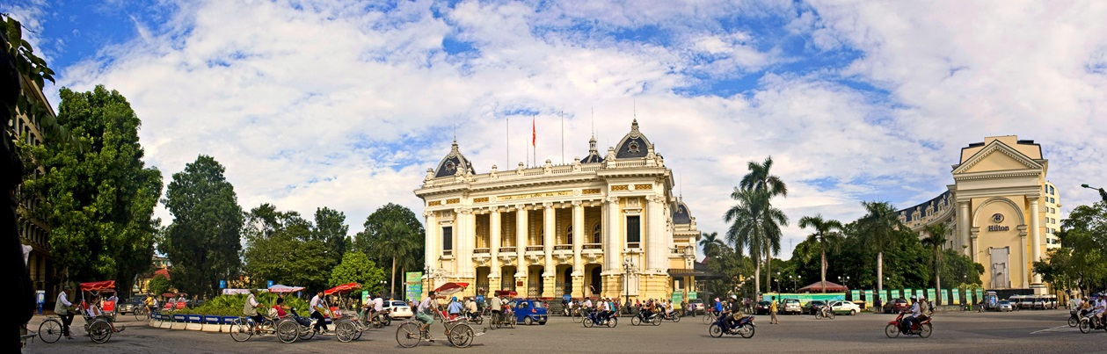
Workshop Location:
VNSC Building (A6), VAST Campus
18B Hoang Quoc Viet str., Cau Giay dist., Hanoi 100000
  Hanoi is Vietnam’s capital, located on the Red River delta in northern Vietnam, the location and terrain create favorable conditions for developing politic, economy, culture and science and it is also an important traffic hub of Vietnam. Hanoi is famous for its centuries-old architecture and rich culture with influences from Southeast Asia, China and France. There are currently over 4,000 monuments and landscapes in Hanoi, in which over 1000 national monuments and landscapes are ranked with hundreds of temples, pagodas, architectural structures and other famous landscapes. Noi Bai International Airport is just 30 kilometres away from the city as well as from our meeting venue, Vietnam Academy of Science and Technology.

Slide 3
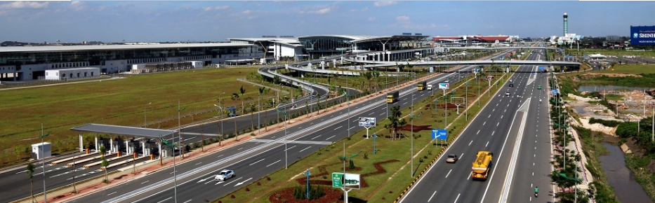
Airport in Hanoi
The major airport is :
  Noi Bai International Airport (HAN), which has international and domestic flights from Hanoi and is 30 kilometers from VNSC’s Headquarters.

Slide 4
Airport Transfer: HAN to the city of Hanoi
Via Taxi: Taxis are easily accessible from the Airport. The estimated fare is approximately $15 each way, but please consult your taxi cab operator for exact fare amounts
You may find the Grab App useful for hailing cabs:
Itunes - https://itunes.apple.com/sg/app/grab-app/id647268330?mt=8
Google Play - https://play.google.com/store/apps/details?id=com.grabtaxi.passenger&hl=en
Via Bus: You can choose among several city buses and an airport bus but the route sometimes is not very convenient and should be checked very carefully.

Slide 5

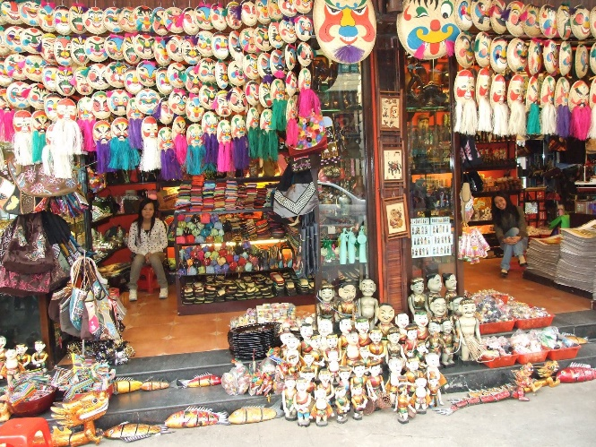
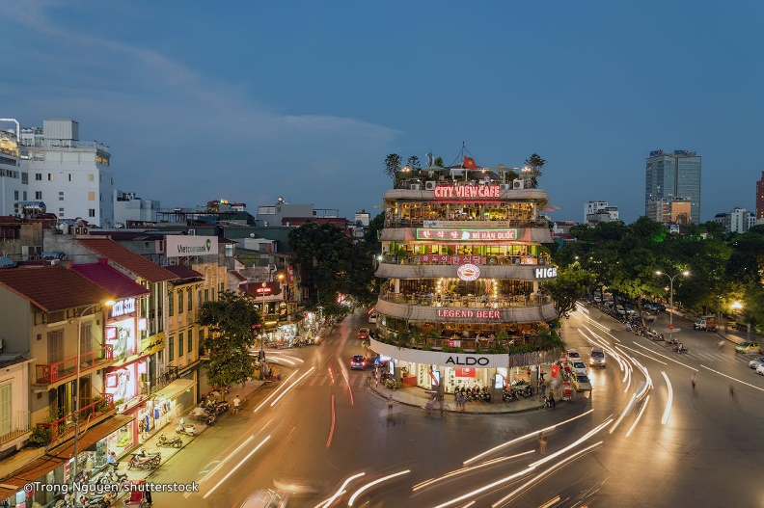
Getting Around Downtown Hanoi
Hanoi Old Quarter
On Foot:
Hanoi Old Quarter is pedestrian-friendly, as there are many shops, restaurants, and entertainment options within minutes of Hoan Kiem lake. Every weekend streets around Hoan Kiem lake are blocked for walkers.
West lake area is also worth a visit.
Local Transit:
There are several transit options available for moving about the city with ease, such as taxi, bus, bike rental, etc.

Slide 6
Accommodation Options
Hanoi Marvellous Hotel & Spa (Old Quarter area)
No 55 Đuong Thanh Street, Hoan Kiem district, Hanoi, Vietnam
Phone: +84 24 3755 5888
Website: www.hanoimarvelloushotel.com
Hanoi Daewoo Hotel (CEOS Plenary 2019 venue and close to VNSC office)
360 Kim Ma Street, Ba Dinh District, Hanoi, Vietnam
Phone: +84 243 8315000
Website: http://www.daewoohotel.com/en
And many other options around Hanoi
Notes:
http://www.zephyrhotel.com.vn/ - another good option

Slide 7
Tentative WGISS-48 Agenda
 | Monday 7 Oct | Tuesday 8 Oct | Wednesday 9 Oct | Thursday 10 Oct | Friday 11 Oct
09:00-12:00 |  | WGISS Discussions | WGISS Discussions | WGISS Discussions | WGISS Discussions
12:00-13:30 |  | Lunch | Lunch | Lunch | Lunch
13:30-15:30 |  | WGISS Discussions | WGISS Discussions | WGISS Discussions | WGISS Discussions
15:30-17:30 |  | WGISS Discussions | WGISS Discussions | WGISS Discussions | WGISS Discussions Adjourn
18:00 | WGISS Exec Meeting |  | No-Host Dinner

Slide 8
POC of VNSC for WGISS-48
pnplinh@vnsc.org.vn
+84 903511818

Slide 9

See you all at WGISS-48 in Hanoi!

