Slide 1

WGISS Working Group on Information Systems & Services
CHAIR
SUMMARY
Committee on Earth Observation Satellites
Mirko Albani, ESA, WGISS Chair
WGISS-48 Meeting
Ha Noi (Vietnam), Hosted by VAST/VNSC
8-11 October 2019

Slide 2


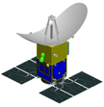



Vietnam Academy of Science and Technology
VIETNAM NATIONAL SPACE CENTER
INTRODUCTION TO
Vietnam National Space Center

Slide 3
Plenary Sessions
Committee on Earth Observation Satellites

Slide 4
Reports
WGISS Chair: Feedback from 2019 SIT TW, potential actions/deliverables for WGISS
SEO: Report on COVE and ODC, data pipeline and format open questions
CEO: CEO 2020 vacancy, CEOS 2020-21 Work Plan
WISP: will be covered by Secretariat & SEO, end WISP project
ISO 19165-2: Draft International Standard ballot initiated, final version published next year
ISO TC 211: several standards under development, possible cooperation with WGCV

Slide 5

GEO
GEO Work Programme 2020-22 approval at GEO Plenary
Finalization of Draft Implementation Plans for Work programme Tasks and Activities
Announcement on nomination procedure for Task Teams and Working Groups associated with Foundational Tasks after WP approval.
Action Item for WGISS Exec: await announcement and submit WGISS PoC candidature as agreed.

Slide 6
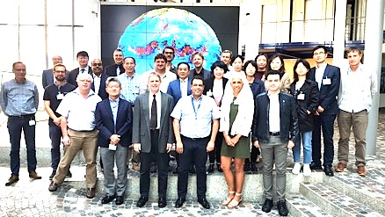
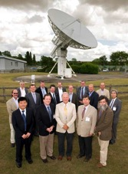
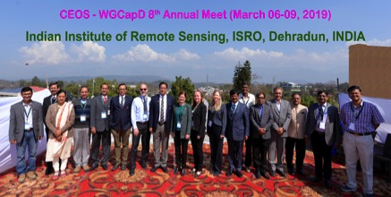
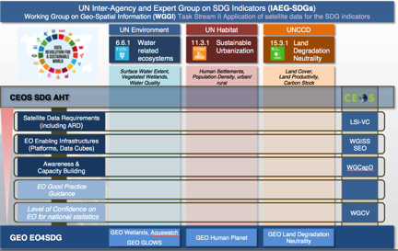
Cooperation with Other Groups
WGCV
WGClimate
WGCapD
SDG AHT
Notes:
QUI AGGIUNGERE OUTCOMES

Slide 7





Agency Reports

Slide 8




CEOS 33rd Plenary

Slide 9
Data Discovery and Access Session
Committee on Earth Observation Satellites

Slide 10
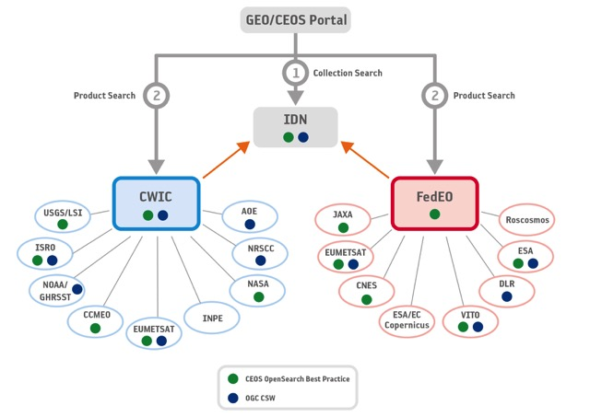
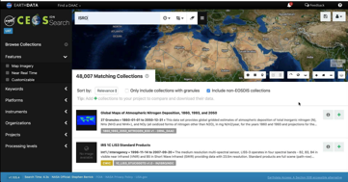
WGISS Data Assets
Improve user search; CEOS branding, same look & feel

Slide 11
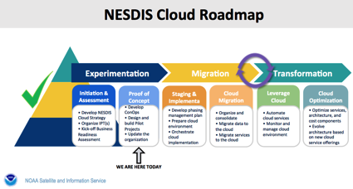
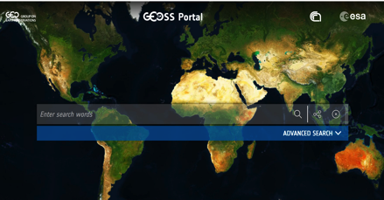
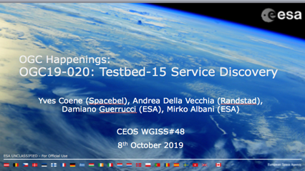
Data Discovery and Access

Slide 12
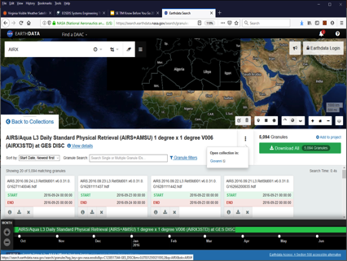
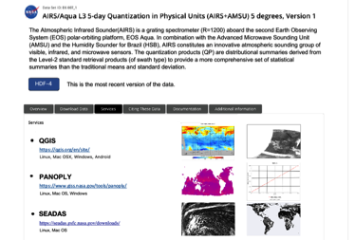
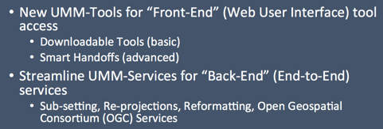
Tools and Services
Worth to share information on services & tools discovery/access at WGISS (CDA), OGC, GEOSS, CEOS Agencies
  Dedicated workshop/session at WGISS#49
  New subgroup to be formed under Interoperability & Use

Slide 13
Data Interoperability and Use
Committee on Earth Observation Satellites

Slide 14
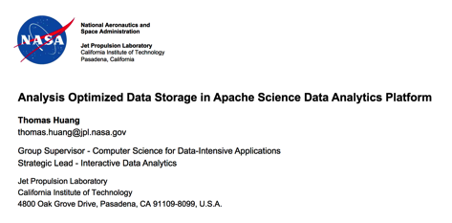
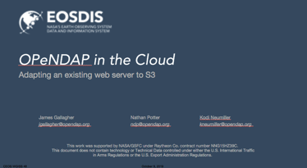
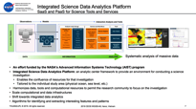
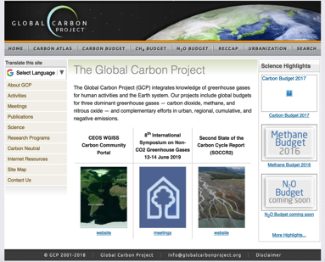

Interoperability and Use

Slide 15
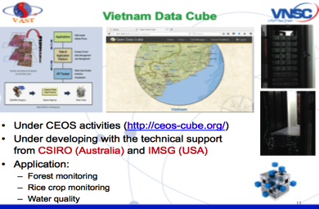
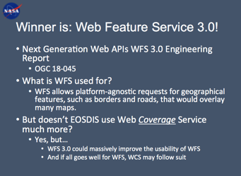
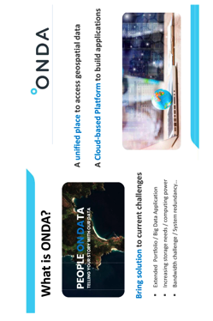

Interoperability and Use

Slide 16
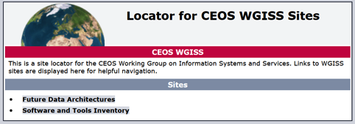
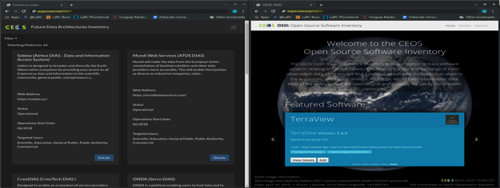
Inventory of FDA Elements and OSS
Should be made visible on CEOS Web Page at http://ceos.org/data-tools/
Define governance and process to keep it alive/updated
Coordinate and integrate with ongoing SLT work on UMM-S/UMM-T and with discovery/access through WGISS CDA

Slide 17
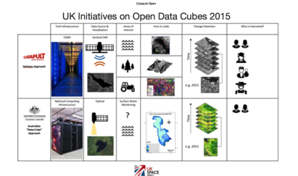

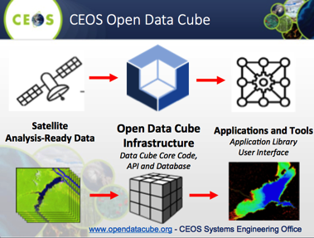

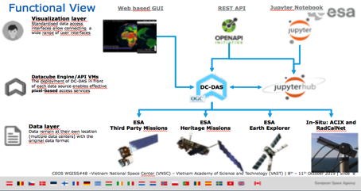
Data Cubes

Slide 18
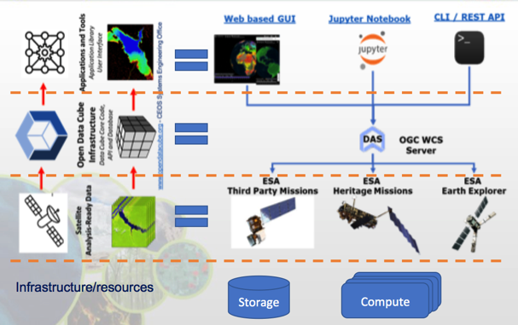
Data Cubes Convergence/Similarities

Slide 19
Data Cubes Interoperability
Three types of interoperability
CEOS data source to Data Cube
  How all DCs interact with source CEOS data and discovery services
  DC data preparation services?
  Algo to Data?
Data Cube APIs
  Do we want interoperability at this level?
  What does it mean to have a standard EO API? Pangeo, openeo?
  R/Python?
Data Cubes exposed via OGC Standards
  Analytics as WPS – similar issue to EO algorithm API
Roadmap:
  For each, explore what is common (e.g. xarray, Cloud optimised formats)
  Define interoperability for each type (e.g. expose common algorithms as end points, or expose a detailed API, or just common cloud-based data and ARD spec)
  OGC Testbed input
Tiger Team to look into that: Rob/Andrea/Damiano/Bryan/Philippe/Valerie/Michael/Chris/Grega

Slide 20
Data Preservation and Stewardship Session
Committee on Earth Observation Satellites

Slide 21
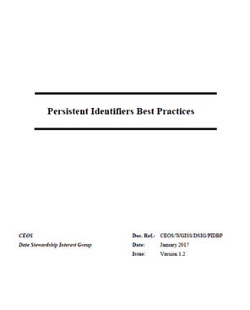



Persistent Identifiers
Comments discussed, new version of PID Best Practice will be produced and circulated for review to WGISS-all. Approval at next WGISS meeting.
Discussion at next WGISS on DOI assignment to SW, lessons learned and possible new use cases

Slide 22
Preservation Session Topics
NOAA Maturity Matrix: Data Stewardship Maturity Questionnaire/Rating/Tool
  → Demo at next WGISS, possible reuse for VCs and CEOS data stewardship maturity self-assessment
SKOS use at ESA and ESA Thesauri
Earthnet Data Assessment Pilot: contribution to WGISS Maturity Matrix as joint WGCV/WGISS activity
RDA FAIR: Improvement of WGISS Maturity Matrix, final issue by end Feb 2020.
AVHRR: Longest time/geographical European coverage

Slide 23
Technology Exploration Session
Committee on Earth Observation Satellites

Slide 24
Technology Session Topics
Blockchain
SELFIE
Knowledge Graph
Linked Data
OGC APIs
STAC
OGC APIs and STAC to be further addresses in FDA Papers Family
Blockchain to be further analyzed for EO use cases

Slide 25
Concluding Remarks

Slide 26



Slide 27

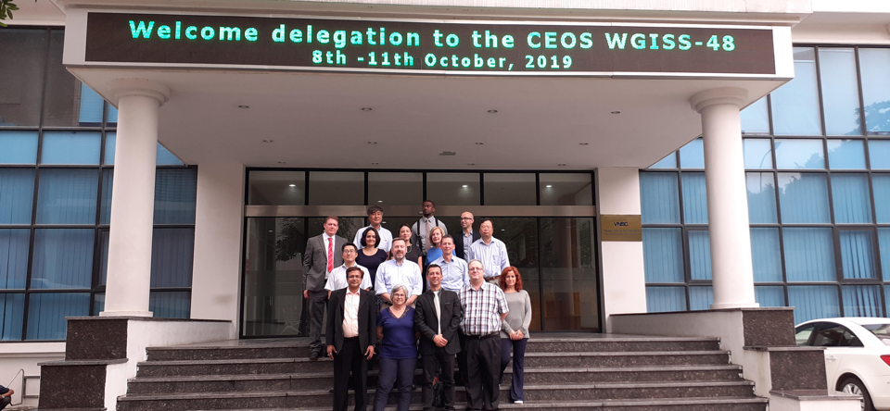

WGISS-48, VNSC – Ha Noi,
8-11 October 2019

Slide 28


Handover
Incoming Chair
Dr. Robert Woodcock - Commonwealth Scientific and Industrial Research Organization (CSIRO)
Incoming Vice Chair
Dr. Makoto Natsuisaka - Japan Aerospace Exploration Agency (JAXA)

Slide 29
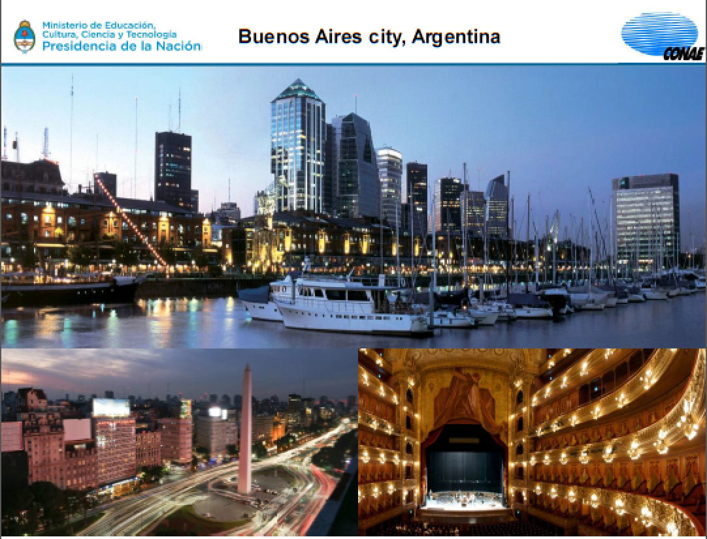
See you all at WGISS-49 in Buenos Aires!

