Slide 1

CEOS AHT on Sustainable Development Goals (SDG AHT)
Committee on Earth Observation Satellites
Alex Held, CSIRO, Co-lead & SIT Vice Chair
Marc Paganini, ESA, Co-lead
Flora Kerblat, CSIRO, Executive Secretary
Argyro Kavvada, NASA, GEO EO4SDG
Executive Secretary
CEOS WGISS-48
VAST Campus, Hanoi, Vietnam
8-11 October 2019
Notes:
AHT SDG History
CEOS 30 Plenary, Oct 2016: Creation of the SDG Ad Hoc Team (SDG AHT) for a year
CEOS 31 Plenary, Oct 2017: Renewal for a 2nd year
CEOS 32 Plenary, Oct 2018: Renewal for a 3rd year with the action to propose a way forward (SIT-34)
CEOS 33 Plenary, Oct 2019: Way forward proposed (amongst 5 AHT options provided SIT-33)
AHT SDG Organisation
2 current co-leads : CSIRO (A. Held), ESA (M. Paganini)
+ Executive secretariat from CSIRO (F. Kerblat, away Aug 18-Jan 19)
Need to confirm a 3rd co-lead
Today ~45 members (mailing list),
including associate members or observers (e.g. UNOOSA)
The AHT SDG shall assess, showcase and promote EO contribution to SDG Targets and Indicators
Coordinate the efforts of CEOS agencies and channel CEOS support to the SDG process (EO showcases, promotion material, etc.) through GEO
Provide a forum for sharing/communicating EO best practices in support to the SDGs (in collaboration with GEO).
Analyse opportunities for better uptake of satellite-based EO in support to SDGs Targets and Indicators, in part via enhanced engagement of CEOS agencies within the GEO initiatives and flagships.
Engage with relevant authoritative SDG stakeholders inside (e.g., IAEG-SDGs & WGGI, UNSD, UN GGIM, Custodian agencies) and outside the UN system (e.g., GPSDD, IISD, WBG, Foundations).
Use CEOS assets and bodies (WGCapD, AHT FDA, SEO, etc.) to build and strengthen EO capacities at all levels of the SDGs implementation.

Slide 2

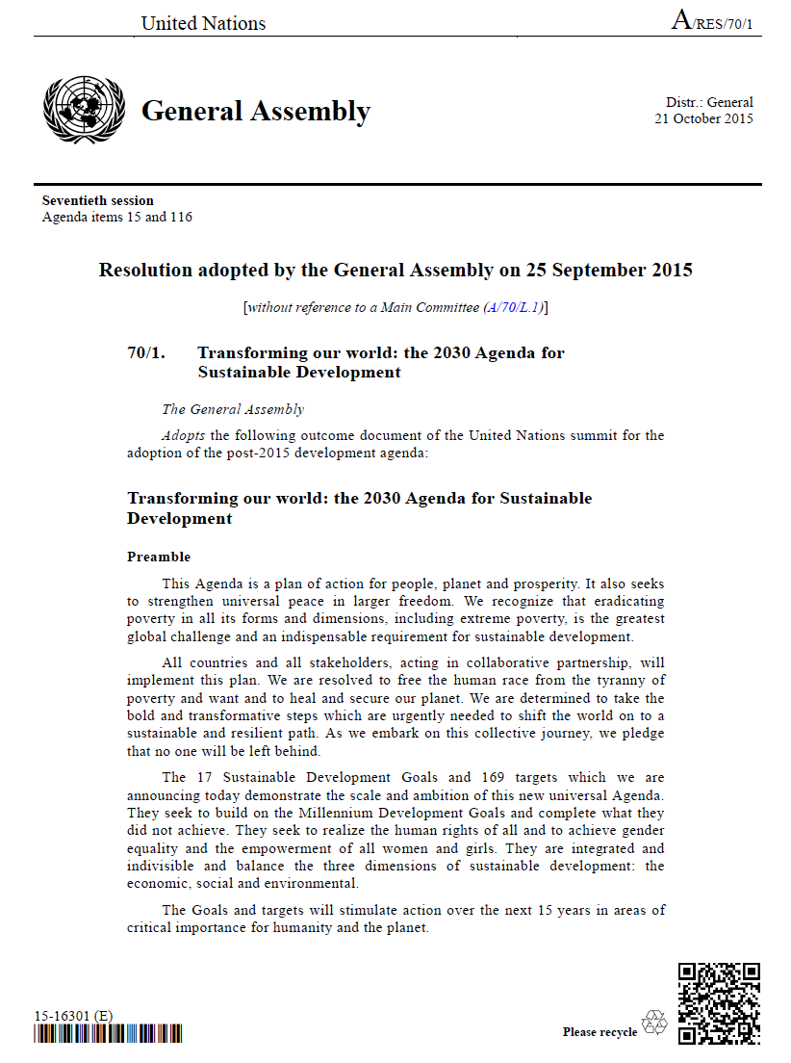

Transforming our World: The 2030 Plan for Global Action
Article 76:
… We will promote transparent and accountable scaling-up of appropriate public-private cooperation to exploit the contribution to be made by a wide range of data, including Earth observation and geo-spatial information, while ensuring national ownership in supporting and tracking progress.
Notes:
EO has a strong role to play in the execution and implementation of the three global agenda’s:
United Nations Sustainable Development Goals
Paris Agreement on Climate Change
Sendai Framework on the reduction of risks related to disasters
Extract of the UN Resolution 70/1 “Transforming our world: the 2030 Agenda for Sustainable Development” ratified by the UN General Assembly at the Sustainable Development Summit in New York on the 25th September 2015
2030 agenda for sustainable development or the SDGs
Integrate the principles of sustainable development into country policies and programs
The SDGs are the follow-on of the Millennium Development Goals for the last 15y (2000-2015)
From Rio+20 to post 2015 SDGs: Guided by the priorities agreed at the Rio+20 conference (June 2012)
The new Sustainable Development Goals (SDG) have been ratified by the UN General Assembly on on the 27th September 2015 at the UN Sustainable Development summit
Ambitious: 17 Goals and 169 targets, Universally applicable
Drivers: reduction of poverty and inequality; economic growth and job creation; sustainable use of resources; restoration of ecosystems
The SDG will drive the UN agenda and its member states on development for the next 15 years
SDGs will guide new norms through which we understand and communicate about development and health of planet
Guide allocation and distribution of resources
Governments decide how to incorporate the SDGs and targets into national planning processes, policies and strategies
Countries need to build their own SDGs, translating global targets into national targets
Each government sets its own national targets guided by the global level of ambition but taking into account national circumstances
2030 Agenda for Sustainable Development: 17 goals, 169 targets, 232 Indicators
New norms to integrate the principles of sustainable development into country policies and programs
The 2030 Agenda for Sustainable Development clearly stressed the importance of Earth observation to inform the SDG Targets and Indicators.

Slide 3


Mobilising the data revolution
Sustained data for sustainable development
The monitoring of the MDGs taught us that data are indispensable elements of the development agenda.
Despite improvement, critical data for informed policy making on development are still lacking.
New technology is changing the way data are collected and disseminated.
Data should be open, easily accessible and effective for decision-­‐making.
A World That Counts: Mobilising the Data Revolution
for Sustainable Development, Nov. 2014
UN SG Independent Expert Advisory Group on data revolution for sustainable development
Global Action Plan for Sustainable Development Data launched at UN WDF in Jan 2017 .
modernizing NSOs is essential to achieving the 2030 SDGs.
Integrating geospatial and statistical data is a necessity.
First UN World Data Forum
on Sustainable Development
Data
15-18 January 2017
Cape Town, South Africa.
Notes:
Mobilizing the data revolution for the benefit of our societies
Data are indispensable elements of the development agenda
New technology is changing the way data are collected and disseminated
“Data and evidence are the foundation of development policies and effective program implementation”
One of the major lessons learned from the 2015 Millennium Development Goals (MDGs) has been the importance of data in the development agenda.
Despite some significant improvement, critical data for informed policy making on development policies were still largely lacking especially in the developing world.
A report requested by the UN Secretary General to analyse the data gaps and challenges, was published in November 2014 with the title “A World That Counts: Mobilising the Data Revolution for Sustainable Development”. The report stressed the importance to have a UN-led effort that would mobilise the data revolution for all. The report also recognized that new technology (including geospatial data and Earth Observations) is changing the way data are collected, analysed and disseminated.
In January 2017, The UN organized the first World Data Forum (WDF) on Sustainable Development Data.
The major outcome of the WDF is “the Cap Town Global Action Plan for Sustainable Development Data” officially adopted by the UN Statistical Commission at its 48th session in March 2017.
First of all, the Global Action Plan for Sustainable Development Data recognizes that the implementation of the UN SDGs requires the collection, processing, analysis and dissemination of an unprecedented amount of data and statistics, at multiple levels and by a large range of stakeholders.
The Global Action Plan features six strategic areas, each associated with objectives and key actions.
To be highlighted is the necessity to enhance capacity building in countries facing high data challenges, to modernize the national statistical systems, to encourage NSOs to embrace open data initiatives, to mainstream new technologies and new data sources in the activities of the NSOs, and to integrate geospatial data (and Earth Observation data) into statistical production programmes at all levels.

Slide 4




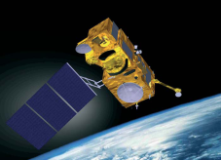




Sentinels Fleet
>15 TB per day
Advent of steady satellite data streams
High Performance Computing Infrastructures
Mobilise the data revolution
for the benefits of all
leaving no one behind
Building on ICT advances

Slide 5
Commonly stated obstacles to the scaling-up and operational use
of EO in the global sustainable development agenda
  Not enough
  “fit for purpose” products
  Needs for continuity of observations and
  long-term
  EO programs
  Restrictive data access policies
  (including cost)
  Frequency of observations insufficient to track changes at appropriate scales
  Lack of
  analysis ready data
  Capacity building and training
  Lack of standardisation of EO data processing methodologies
  Lack of
  clear and solid
  user-oriented methods and guidelines
  Difficulties to discover, access and process EO data
  Insufficient solid track records of successful case studies

Slide 6
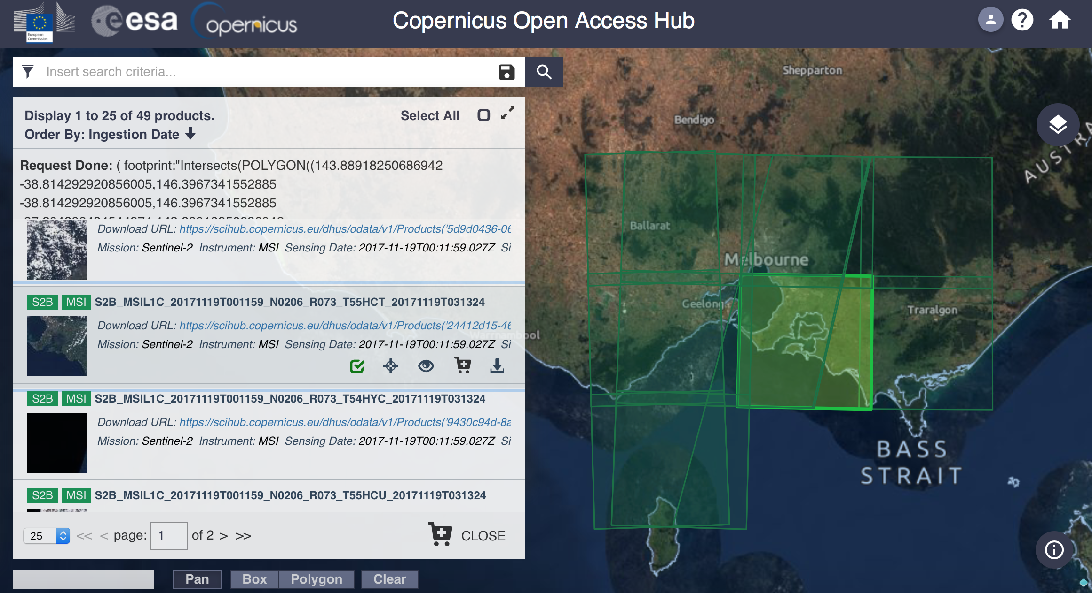
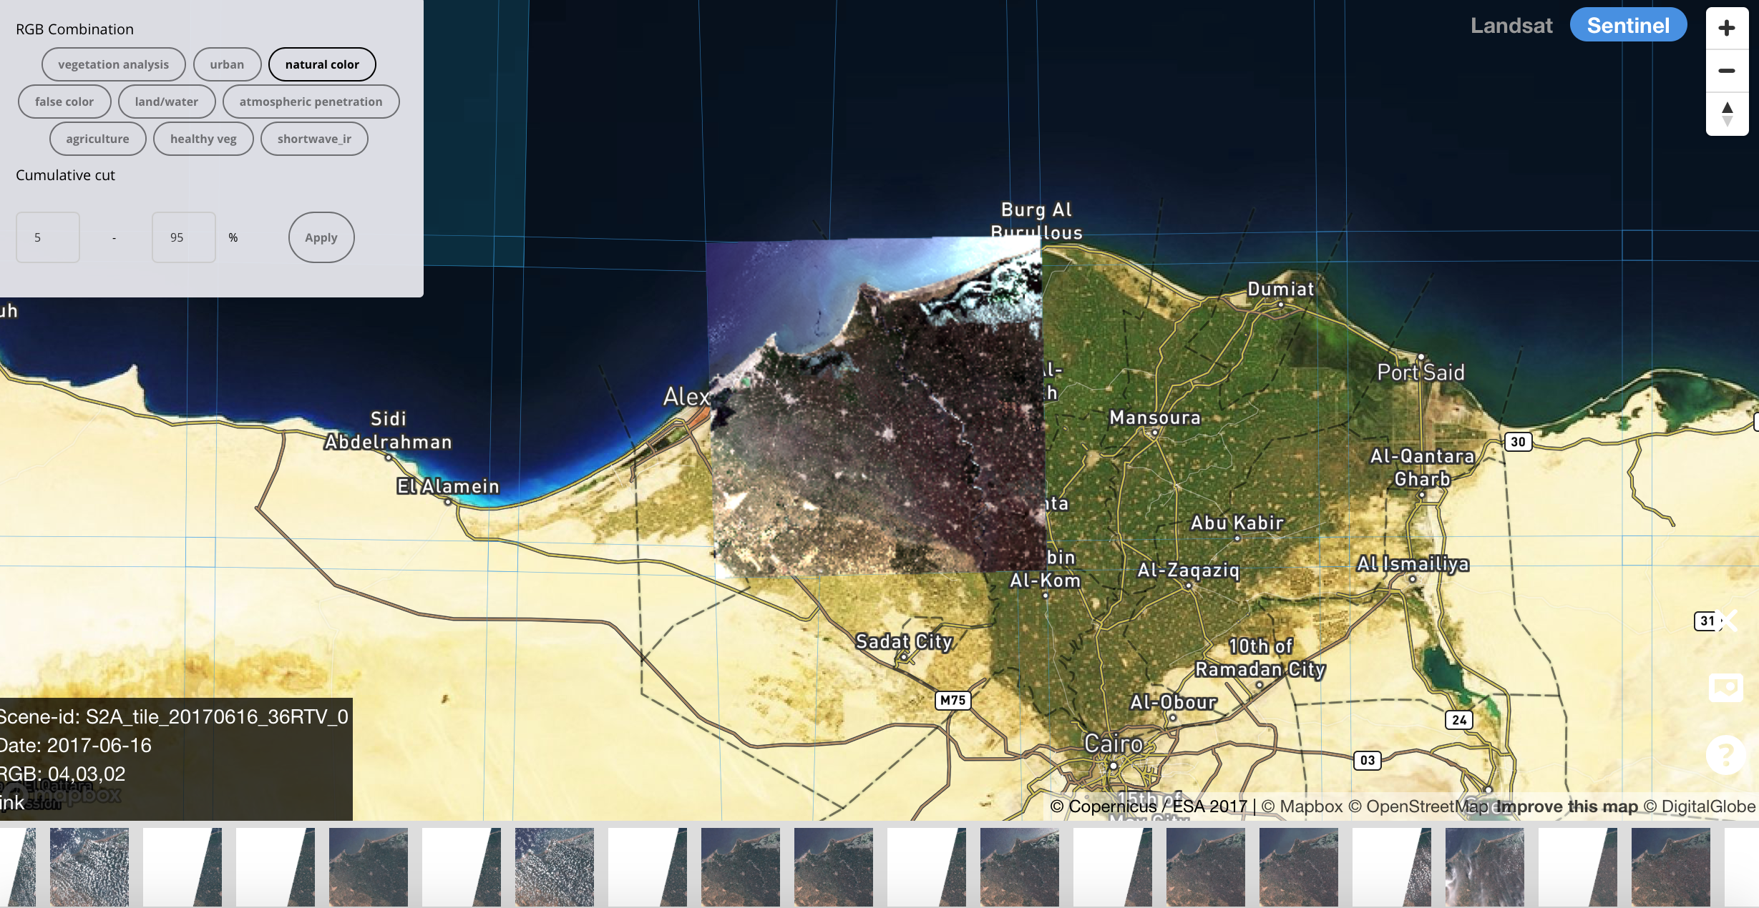
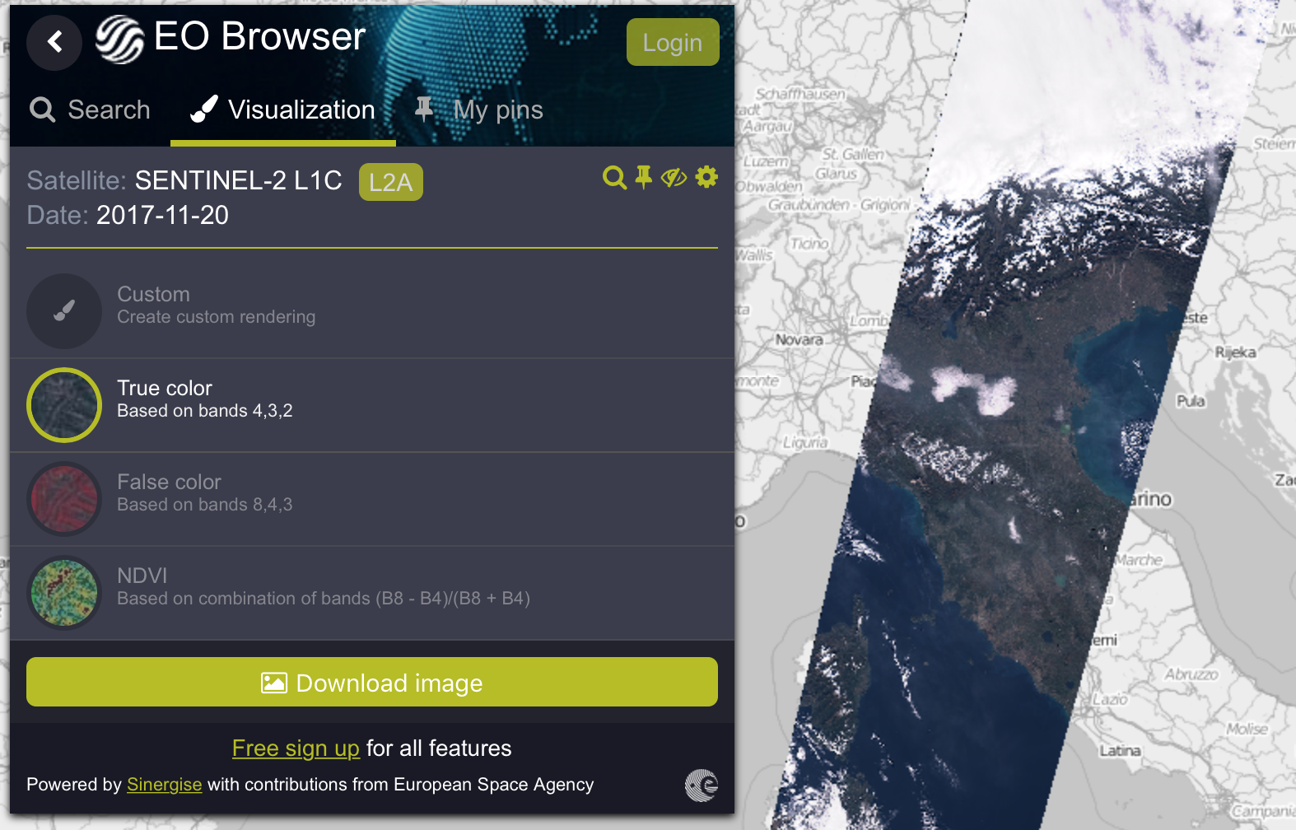

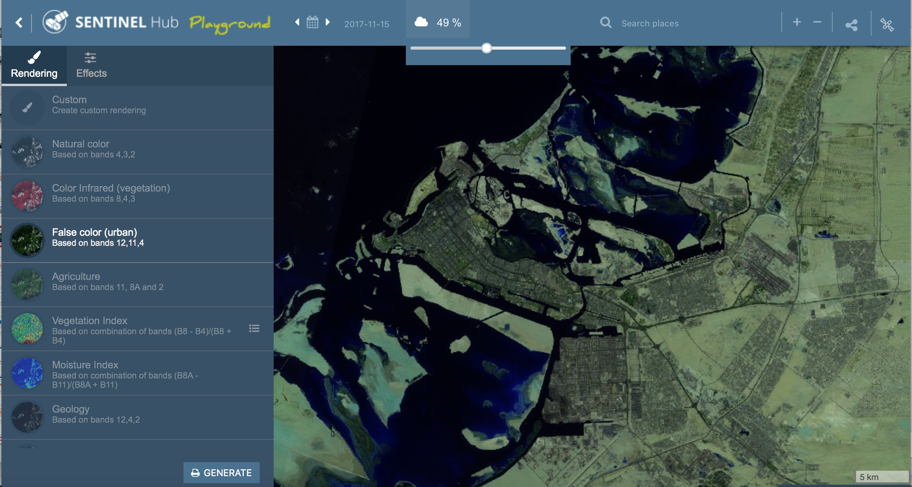
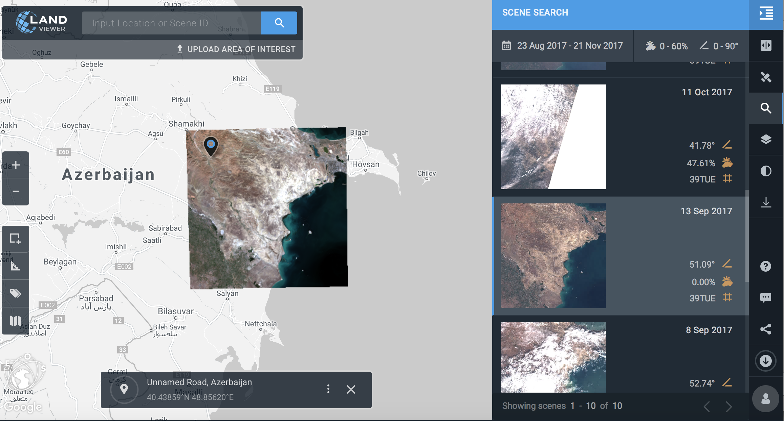
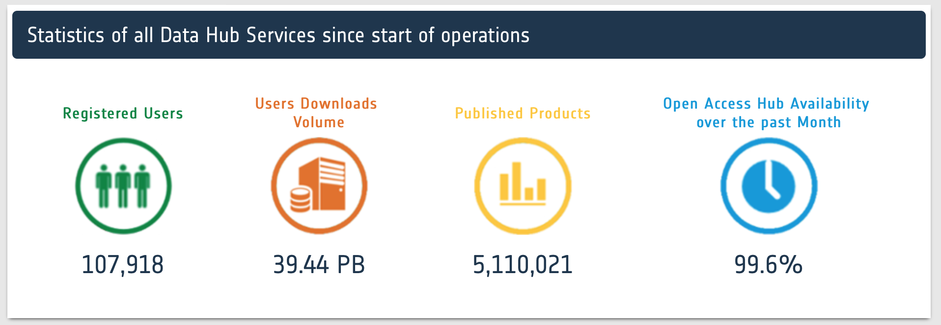
Proliferation of platforms for EO data access and visualisation
RemotePixelViewer
GEOSS Portal
EOBrowser
LandViewer
Sentinel Hub
Notes:
S2 on Amazon S3 / AWS
S1 & S2 on Google Earth Engine

Slide 7











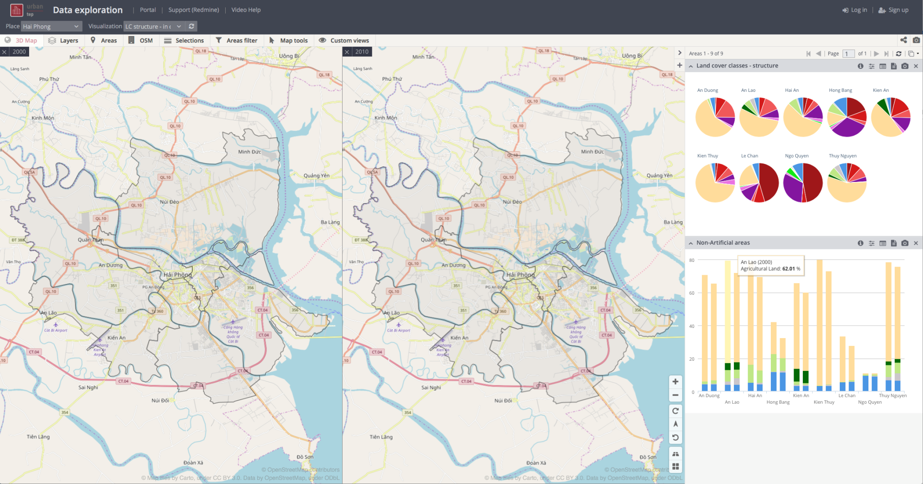
Collaborative “big data” exploitation platforms
The power of the Cloud
The power of
Partnerships
“Bringing the users to the data”
Simplify the extraction of information from EO data
Enable large scale exploitation of EO data
Stimulate innovation with EO data
Platforms as enabling technology
Service
providers
Satellite data
Remote access for expert users
{api}
Toolboxes
knowledge & algorithms
Ancillary data
(land use, DEM, soil,…)
User knowledge & algorithms
User data
Mobile data collection citizen science
tools
Data Analytics
Processing &
Storage Capacities
User generated results
Notes:
How can we as a community facilitate satellite data discovery, access, processing, analytics and extract the value of satellite for all?
How can we do it in sustained and cost effective manner?
Alone the amount of data to be managed is far too high for many countries, for many organisations.
We must act collectively.
And here comes the importance to also mobilise the ICT revolution for the benefits of all.
We must harness the power of the cloud by developing these EO data exploitation platform on cloud computing infrastructures that would faciliate the discovery of data, the access, the extraction of information. They can also enable large scale exploitation. It can also stimulate innovation and business opportunities.
This is already happening as we have seen with GEE and AWS but many other initiatives of EO platforms are also taking place both at private and public levels. In Europe we are developing the Copernicus Data and Information Access Services (DIAS) to enable easy access to Copernicus data and services
It is not only about satellite data. It is also about bringing other datasets on these platforms to be able the data anlaytics and statistics.
But it also about partnerships, about mutualising the cost of these platforms, about engaging all actors to share their data, their tools, their
It is also about connecting to the citizens, to crowd sourcing information that is such an important source of information.

Slide 8
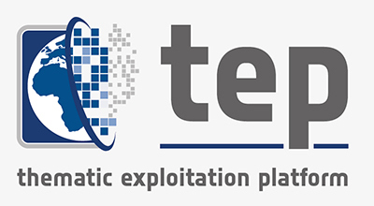
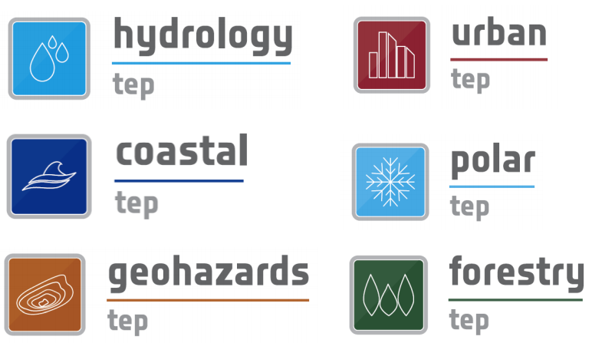

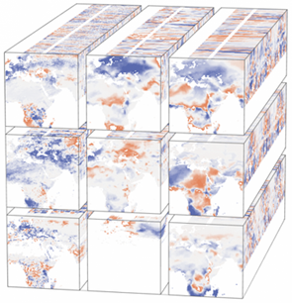
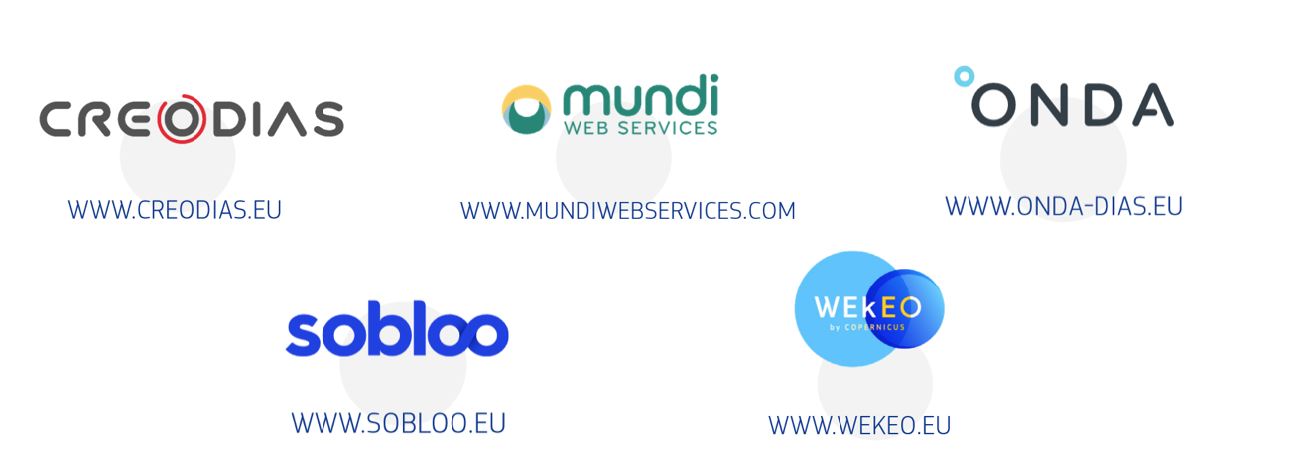
Proliferation of EO exploitation platforms

Slide 9


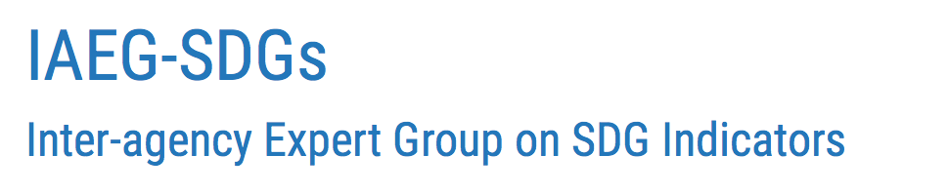
GEO Initiative on SDGs
(EO4SDG)
CEOS Ad-hoc team on SDGs (SDG AHT)
CEOS and the SDG landscape
UN Habitat
UNCCD
UNEP
WBG
GPSDD
UN Statistical Division
WG on Geo-spatial Information (WGGI)
UN Specialized Agencies
National Statistical Offices
Line Ministries
SDG Stakeholders
UN ISDR
WHO
FAO
ADB
Radiant Earth
Global Datasets
Mainstream in National Systems & Processes
EO enabling Infrastructure
Tools
& Platforms
Good Practices Guidance
Capacity Building
EO
Knowledge Sharing Hub

Slide 10
SDG-AHT 2019-2021 workplan
Activities and Deliverables
Satellite Data Providers
Information Providers
End Users
 | # | Activity Title | Activity Deliverables | Target Audience |  |  | CEOS bodies support
SHORT TERM ACTIVITIES (2020) | 1 | Satellite Data Requirements | Technical Notes on “Satellite Data Requirements” (one TN for each SDG indicator) | X |  |  | LSI-VC (3 indicators)
 | 2 | EO Enabling Infrastructures | Technical Notes on EO enabling infrastructures for SDG indicators (one TN for each SDG Indicator) |  | X |  | WGISS, SEO
 |  |  | CEOS Community Portal on SDG for EO data discovery and access (based on WGISS IDN/CWIC/FedEO) |  | X | X | WGISS
 | 3 | EO Capacity Building | Capacity building webinars/training (organized by SDG indicator) |  | X | X | WGCapD WGISS
 |  |  | Support to EO4SDG MOOCs on SDGs (one MOOC per SDG goal) |  | X | X
MID TERM ACTIVTIES (post 2020) | 4 | EO Good Practices Guidance | EO Good Practice Guidance for SDG indicators (one GPG for each SDG indicator) |  | X |  | LSI-VC (CARDL)
 |  |  | R&D agenda on improved methods for SDG indicators (one R&D Agenda for each SDG indicator) | X
 | 5 | EO Demonstration Cases | Collection of EO Demonstration Cases for SDG indicators. (one per SDG indicator) |  | X | X
 |  |  | Deployment of EO workflows for SDGs on the CEOS Data Cube |  | X | X | SEO
 | 6 | EO Quality Standards | EO Quality Standards for SDG indicators (one guideline per indicator) |  | X |  | WGCV/LPV

Slide 11
Streamlining of
CEOS activities on SDGs
As a demonstration of the effectiveness of the streamlining measures,
the SDG AHT proposes
to start with the 3 SDG indicators
that are most ready to integrate EO in their processes.
These 3 indicators are also the
3 primary indicators selected by the IAEG-SDGs WGGI
for the Task Stream on satellite Earth Observation data for the SDG indicators
SDG 6.6.1
Water related
Ecosystems
SDG 11.3.1
Sustainable
Urbanization
SDG 15.3.1
Land Degradation Neutrality

Slide 12

SDG-AHT 2019-2021 workplan
Activities and Deliverables
UN Inter-Agency and Expert Group on SDG Indicators (IAEG-SDGs)
Working Group on Geo-Spatial Information (WGGI) Task Stream II Application of satellite data for the SDG indicators
UN Environment
UN Habitat
UNCCD
6.6.1 Water
related ecosystems
11.3.1 Sustainable Urbanization
15.3.1 Land Degradation Neutrality
Surface Water Extent, Vegetated Wetlands,
Water Quality
Human Settlements,
Population Density, urban/rural
Land Cover,
Land Productivity,
Carbon Stock
CEOS SDG AHT
Satellite Data Requirements
Satellite Data Requirement Sub-team
LSI-VC
EO Enabling Infrastructures
Enabling Infrastructure Sub-team
WGISS
SEO
EO Capacity Building
Capacity Building Sub-team
WGCapD
WGISS
EO Good Practice Guidance
Water Sub-team
(e.g. GA/CSIRO, EC,
NASA, JAXA, ESA)
Urban Sub-team
(e.g. EC, NASA, DLR,
ESA, SANSA)
LDN Sub-team
(e.g. CSIRO, ESA, EC,
SANSA, NASA)
LSI-VC
EO Demonstration Cases
SEO
EO Quality Standards
WGCV
LPV
GEO EO4SDG
GEO Wetlands
AQUAWATCH
GEO Human Planet
GUOI
GEO LDN

Slide 13
SDG-AHT and WGISS collaboration
Review of the EO-enabling infrastructures (software toolboxes, cloud processing platforms, EO data processing and analytics tools including data cubes) available in CEOS agencies and which can facilitate the uptake of satellite observations by SDG stakeholders
Development of a CEOS SDG Community Portal for discovery of and access to satellite ARD and EO data sets, based on WGISS Connected Data Assets. (IDN/CWIC,FedEO)
Capacity Building webinars/training on advanced satellite-based methodologies for SDG indicators, including the use of EO enabling infrastructures
Notes:
Implement a prototype SDG Data Access portal to facilitate the discoverability and accessibility of satellite ARD and EO datasets.
Approach: prototype developed by WGISS in cooperarion with CEOS AHT-SDG and GEO SDG (requirements and use cases).

Slide 14
Alex Held (CSIRO, SDG AHT Co-lead and SIT Chair)
Marc Paganini (ESA, SDH AHT Co-lead)
Flora Kerblat (CSIRO, SDG AHT Executive Secretary and SIT Chair team)
Please contact us: sdg-leads@lists.ceos.org

