Slide 1
Working Group Climate
Jörg Schulz, EUMETSAT, WGClimate Chair
Albrecht von Bargen, DLR, WGClimate Vice-Chair
WGISS-48
CEOS Working Group Reports
Hanoi, Vietnam
11 October 2019

Slide 2
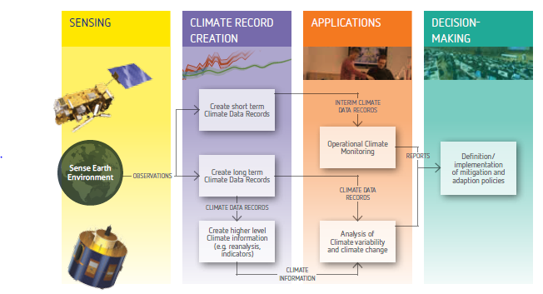
The Architecture for Climate Monitoring from Space
http://ceos.org/document_management/Working_Groups/WGClimate/WGClimate_Strategy-Towards-An-%20Architecture-For-Climate-Monitoring-From-Space_2013.pdf

Slide 3
Major objectives of WGClimate
Provision of a structured, comprehensive and accessible view as to what Climate Data Records are currently available;
Creation of the conditions for delivering further Climate Data Records, including multi-mission Climate Data Records, through best use of available data to fulfil GCOS requirements;
Optimisation of the planning of future satellite missions and constellations to expand existing and planned Climate Data Records;
Coordinate activities of CEOS and CGMS defining and implementing an integrated global carbon observing system;
Oversee the implementation of the CEOS Carbon strategy;
Provide systematic reporting to UNFCCC/SBSTA;
Provide interface to GCOS, WCRP, (and GEO on climate).

Slide 4
Achievements since SIT - 34
CGMS-47, Sochi, Russia:
Achieved formal endorsement for WGClimate leadership change;
Achieved formal endorsement of the greenhouse gas monitoring constellation white paper;
Achieved formal endorsement of WGClimate GHG Task Team and updated TOR;
Closed all open actions on CGMS side. Reminded CGMS agencies to participate in WGClimate;
Aligned and synchronised CGMS HLPP with CEOS work plan;
Achieved formal endorsement of the Resolution on Progress on Implementation of the Architecture for Climate Monitoring from Space at WMO Congress-18;
Finalised and delivered the space agency statement to SBSTA-50, Bonn, Germany;
Participated in dialogue on Systematic Observations with the SBSTA chair that also included IPCC, WMO and WCRP (outcomes still to be delivered by the UNFCCC Secretariat);
Worked hard on population and verification of ECV Inventory #3, launched gap analysis but are behind schedule…
Published an article on WGClimate in the CEOS newsletter.
Notes:
Noting the significant progress that has been made in observing the Earth globally and synoptically with higher temporal, spectral and spatial resolutions, which before the advent of satellites was all but impossible,
Noting also the essential nature of combining space-based observations for climate monitoring with ground-based observations in an integrated observing system,
Convinced of the pivotal role of satellite data to contribute to scientifically sound, evidence-based policy- and decision-making for sustainable development,
Noting that space-based observations will be vital for the successful implementation of the Paris Agreement,
Having assessed progress made on the implementation of the Architecture for Climate Monitoring from Space (hereafter/thereafter referred to as “Architecture”) as provided in the Annex to the present resolution,
Taking note that the Architecture provides an overall framework for assuring that the space-based component of the WMO Integrated Global Observing System will provide vital observations and products for climate monitoring in line with user requirements,
Noting further that the Architecture has been reviewed by GCOS, CEOS, CGMS and by the Joint CEOS/CGMS Working Group on Climate,
Appreciates the progress made with the implementation of the Architecture and confirms its importance,
Considers favourably the significant contributions made by CEOS and CGMS satellite operators in the implementation of the Architecture,
Endorses the approach taken for the implementation of the Architecture;
Requests the Secretary-General to take appropriate action through the WMO Space Programme and in partnership with WMO Members for the further implementation of the Architecture including through its effective integration in the development of the Global Framework for Climate Services;
Urges CEOS and CGMS satellite operators to maintain their efforts towards full implementation of the space-based climate observing system component in accordance with the Vision for WIGOS in 2040.

Slide 5
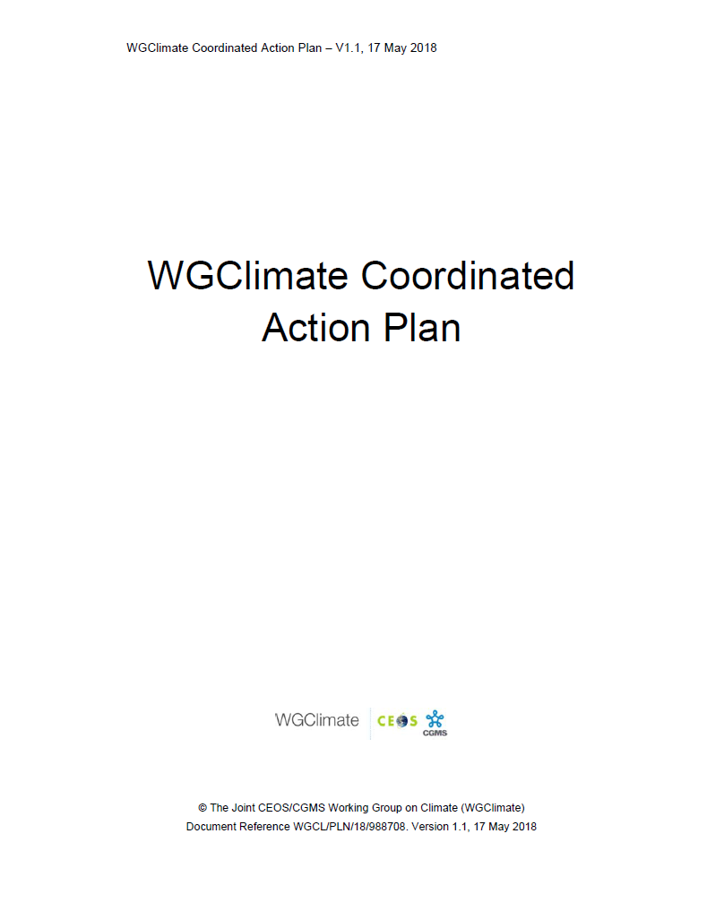
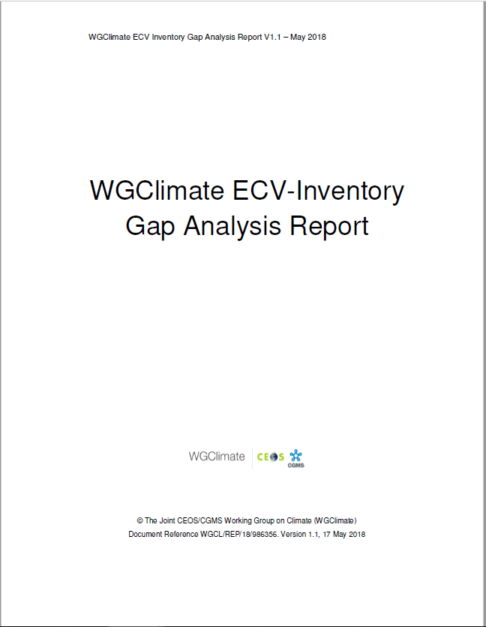
GCOS ECV CDR Inventory – Set up and Benefits
Action Plan & Creation of conditions to deliver CDRs
ECV Inventory
Gap Analysis & Recommendations
ECV Inventory fully describes current and planned implementation arrangements (ECV-by-ECV) within the Architecture;
Content fully verified and updated annually with approval from CEOS and CGMS;
Informs space agency planning, improves availability and interoperability of climate data records;
Feeds material for all future responses of the space agencies to the GCOS IP;
Is used by Climate Services to chose CDRs, e.g. Copernicus Climate Change Service;
Users can download the ECV Inventory content for own analysis, find direct access points to CDRs in the Inventory, get access to WGClimate gap analysis results and planned actions.
2018
2018

Slide 6
ECV CDR Inventory and Gap Analysis
http://climatemonitoring.info/ecvinventory
Successful round of inputs in 2019:
Inventory covers contributions to 35 out of 53 GCOS ECV (37 being accessible by satellite);
Inputs on previous gaps in ECVs: above-ground biomass, sea-surface salinity, lightning (previous gaps), and permafrost (new ECV);
Significant amount of newly planned CDRs from ESA CCI+ and EC-Copernicus Climate Change Service;
New / stronger contributors: KMA / JAXA and JMA;
Worked with ~200 responders (64 + 6 replacements newly registered).
Total number of data records worked on |  | Available data records for gap analysis
1396 records | 976* inherited (#2) | 943 | 649 existing | 1300 records
 |  |  | 294 planned
 | 420 new (#3) | 357 | 172 existing
 |  |  | 185 planned
*(913 published + 63 non finished/verified from Cycle #2)

Slide 7
ECV CDR Inventory and Gap Analysis
ECV Inventory contains:
72% CDRs
28% ICDRs
CDR length:
27% < 10 years
73% >= 10 years
33% >= 20 years
18% >= 30 years
Maximum length possible: ~50 years.

Slide 8
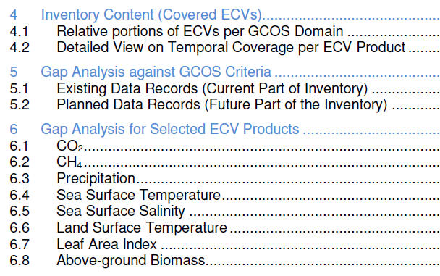
ECV CDR Inventory and Gap Analysis
Automatic assessment
Statistical analysis tools and graphical display
Statistical analysis tools and graphical display on the web interface ;
Analysis of delta to version #2;
Detailed analysis per ECV / ECV Product:
Assesses progress for 8 ECVs addressed last year;
Selected 13 additional ECVs (5 atmosphere, 5 land, 3 ocean) not addressed before that are specifically part of 2016 GCOS-IP actions;
Postponed 2 land (FAPAR, Glaciers) and 1 atmosphere (lightning) due to missing support.
Notes:
Revisit set of ECVs / ECV Products targeted by the previous gap analysis (CO2, CH4, Precipitation, Land Surface Temperature, Leaf Area Index, Above-Ground Biomass, Sea Surface Temperature, Sea Surface Salinity) and assess evolution, cross-referencing with the Recommendations and Actions

Slide 9
Interactions with WGISS
Metadata alignment for IDN registration of ECV data records (WGISS Action DATA-9: Facilitating discoverability and accessibility of ECV Products and space-born CDRs relevant for the CEOS Carbon Action via WGISS Interoperability Systems & Standards (FedEO/CWIC/IDN, OpenSearch));
After the WGClimate #10 in March 2019, WGISS analysed ECV Inventory 2.0 (available on climatemonitoring.info) to assess the overlap and adequacy of information to be potentially harvested from the ECV Inventory to fulfil part of the requirements of the IDN database;
4 issues for detected, not all of them have been resolved;
WGISS Carbon Portal and how to use and further evolve it. Received a presentation at WGClimate #11 and liked the tool and see lots of potential to use it for all CEOS Carbon Activities to create a shopping window for the related data – will discuss this further at WGClimate #12 in Q1/2020;
May work together on analysing automation potential for ECV Inventory population.

Slide 10
WGISS ACTION DATA-9 – Issues Left
ISSUE-1: Geographic extension provides free text, not convention seems to be adopted, not machine readable – Solved in Inventory 3.0;
ISSUE-2: Platform/instrument information merged (see Column AJ of ECV spreadsheet, row 3 NOAA-10-HIRS/2). – This seems is only an Excel export problem
ISSUE-3: Platform and instrument names (column AJ) may be slightly different from GCMD vocabulary – Can provide you a dump of the WMO/OSCAR database that contains the names we used
ISSUE-4: Multiple organisations may appear in a single column, but separator is not consistent or not always separating different organisations. Similarly to ISSUE-2, it is not clear how to split the several collection organization in column N (e.g., NASA – NOAA – EUMETSAT – CNES, etc.) - requires a change to our web interface that may be implemented only for v4 (should contain drop-down list of Agencies would make our life easier, also for our own reporting.
ISSUE-5: WGClimate has no resources at the moment to address this, proposed postponement of the Action by 6 months.

Slide 11
ECV Inventory Population
Automation Analysis
Need to analyse automation of ECV Inventory population from existing agency common metadata repositories to estimate potential savings in human resources:
Need to map which ECV questions can be covered by metadata repositories (ECV Inventory is not only a metadata base but provides a logical representation of information on CDRs traceable to GCOS guidelines, etc. to facilitate test against it);
Need to analyse if and how ECV Inventory questionnaire would need to be adapted to facilitate automation;
If useful may start with a demonstrator from one agency having large shares in the Inventory, e.g., NASA;
If a solution is found need to see how we can carefully test and implement as ECV Inventory update is continuous;
Should consider CEOS work plan action(s) in next update at end of 2019. Do we have resources for this?

