Slide 1
WG Capacity Building & Data Democracy (WGCapD)
Committee on Earth Observation Satellites
SP Aggrawal, ISRO and Lauren M. Childs, NASA
WGCapD
WGISS-48
CEOS Working Group Reports
Hanoi, Vietnam
11 October 2019

Slide 2
Objectives & Members
1. Establishing effective coordination and partnerships among CEOS agencies offering EO education and training
Facilitate education and trainings
Exploit the cumulative capabilities of CEOS Agencies
Partner with local & regional partners to increase effectiveness and decrease duplication
Focus on user needs for data and capabilities to inform action
2. Working with CEOS entities to address data accessibility
Work closely with CEOS entities to increase data accessibility
Publicize resources, datasets, and software
Promote the use of dissemination systems to effectively reach areas that lack consistent internet access
Organize workshops and training activities to provide individual and institutional capacity to effectively use EO resources
Members
CONAE, CNES,
CRECTEALC,
CSA, DLR, DOI, EC,
ESA, EUMETSAT,
GODAN, ISRO-IIRS,
INPE, IRD, JAXA,
NASA, NOAA,
RCMRD,
ROSCOSMOS,
SANSA, SWF,
GEOGLAM, UK
Space Agency,
UNOOSA, USGS,
VNSC-VAST,
WMO/CGMS

Slide 3
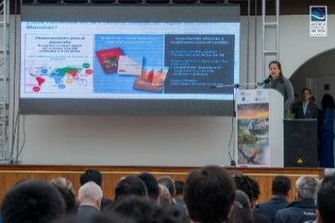
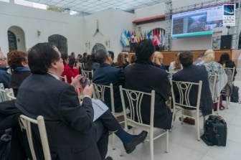
WGCapD Activities
E-Learning
Organize free E-Learning courses and webinars for participants around the globe
Webinars:
MOOCs:
Workshops
Organize free training workshops for participants around the globe
EO Training Workshops
Thematic Training Workshops
Regional Workshops
GEO – AmeriGEO & AfriGEO
Southeast Asia
Future Data Architecture
Sustainable Development Goals
SAR trainings
Forest monitoring
Flooding
Etc.
Echoes in Space: Introduction to Radar Remote Sensing

Slide 4
Accomplishments:
Webinars & MOOCs Supported
CB-41
Collaboration between AHT-SDG and WGCapD to organise SDG-related training and capacity building related to the use of space-based EO to meet the data challenges of the 2030 Agenda for Sustainable Development
SDG Awareness Webinar
Dec 19, 2018
CB-29
Webinar series (5 nos) on Geospatial Technology for Wildfire Management supported by ISRO-NASA-ECMWF
Webinar Series
Oct 1-29, 2019
CB-28
Conduct global capacity building courses through a multi-lingual MOOC on radar backscatter
Introduction to Radar Remote Sensing MOOC
Sept 16, 2019 to present

Slide 5
Accomplishments:
FDA-5 Joint WGISS-WGCapD Deliverable
FDA-5: FDA awareness building and outreach
FDA Awareness Webinar conducted on Sept 4, 2019
24 Attendees, representing…
11 countries: India, Philippines, Malaysia, Nigeria, Vietnam, USA, Australia, Myanmar, Thailand, Indonesia, and China
19 Organizations: NESAC, University of the Philippines, Universiti Teknologi Malaysia, Teqbridge Limited, Vietnam Academy of Science and Technology, Stamina4Space, NASA, Swinburne University of Technology, AFRIGIST, VNSC-VAST, CSIRO, NOAA, CDE, Science Systems and Applications Inc., ISRO IIRS, CMRIT, SCGI, LAPAN, Fudan University
Video posting to CEOS Website this week

Slide 6
Accomplishments:
Trainings & Workshops Supported
CB-33-1: Provide SAR and other EO data training in support of VNSC Chair initiative – Workshop in Hanoi, Vietnam: Feb 20-22, 2019
CB-39: Provide hands-on training on forest monitoring and Orfeo Tool Box for AEM – Training in Guadalajara, Mexico: Feb 26-28, 2019
CB-32: Provide regional hands-on training in LCLUC topics in GEOSS regions – Training in Johor Bahru, Malaysia: July 25-27, 2019
CB-40: Provide hands-on training for flood monitoring for Vietnam School of Earth Observation – Training in Quy Nhon, Vietnam: Sept 8-14, 2019
CB-33-2: Provide hands-on SAR and other EO training disaster applications – Land Subsidence Training in Vietnam: Sept 23-29, 2019

Slide 7
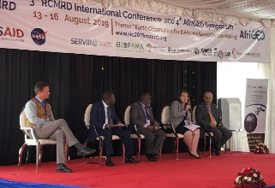
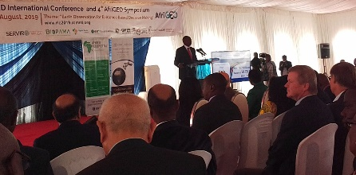
Accomplishments:
Regional Events Supported
CB-35: Provide CB support to AmeriGEO Week 2019 in Peru – Supported Event & 2 Trainings on Water SDGs in Lima, Peru: Aug 9-13, 2019
CB-36: Provide CB support to AfriGEO Symposium 2019 in Nairobi, Kenya – Supported training on SAR data for forestry change: Aug 13-16, 2019

Slide 8
Accomplishments:
Infrastructure & Documentation
Training Calendar
CB-37: CB White Paper
https://training.ceos.org
Calendar is live
21 fields
Current content sources: EUMETSAT and WMO training calendar sites
NASA and DLR training calendars are in progress and will “feed” the master CEOS training calendar
Looking for:
Feedback on structure & format
Additional sources of training events
Ad hoc training events to add
White paper describing approaches for capacity building networks supported by others, e.g. UN, can work together
Completed & submitted to SIT
Submitted & approved for peer-review publication in the Journal of Space Policy
POCs:
Andrew Lubawy, SEO
Andrew.M.Lubawy@ama-inc.com
Lauren Childs-Gleason, WGCapD
Lauren.M.Childs@nasa.gov

Slide 9
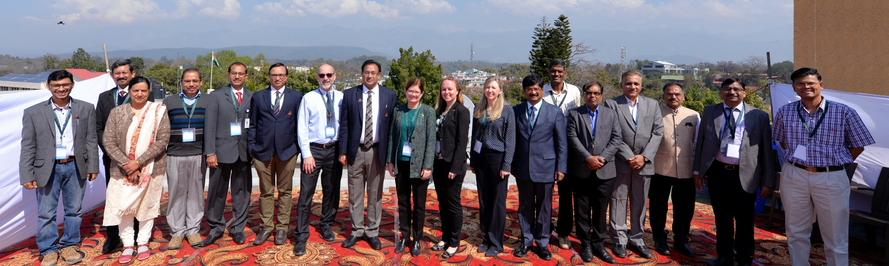
WGCapD-8 Annual Meeting March 6-9, 2019 Dehradun, India
WGCapD-9 Annual Meeting
March 10-12, 2020
Mountain View, California
Thank You
Chair: Dr. Prakash Chauhan (ISRO)
Vice Chair: Dr. Nancy Searby (NASA)
& WGCapD Members

