Slide 1
OGC API - Features A resource oriented alternative to WFS Presented to CEOS WGISS-48, 2019-10-10
George Percivall
CTO, Chief Engineer
Open Geospatial Consortium
percivall@ogc.org
Copyright © 2019 Open Geospatial Consortium

Slide 2
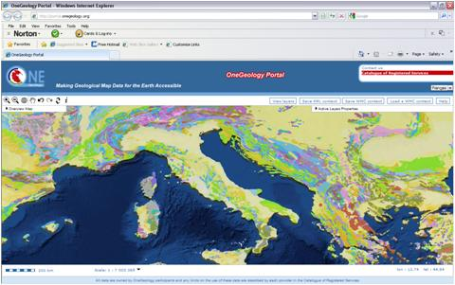
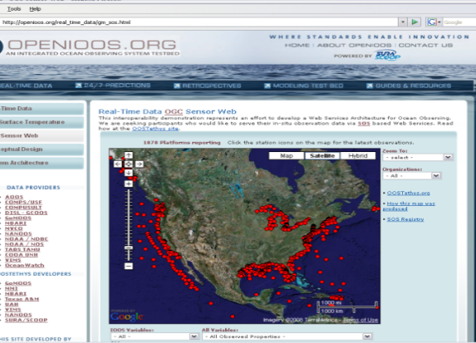
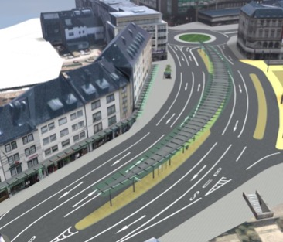
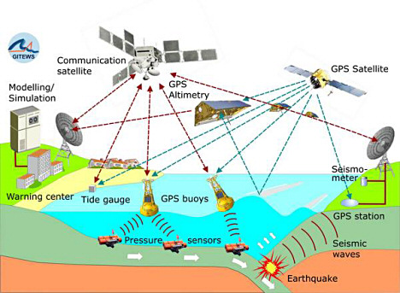
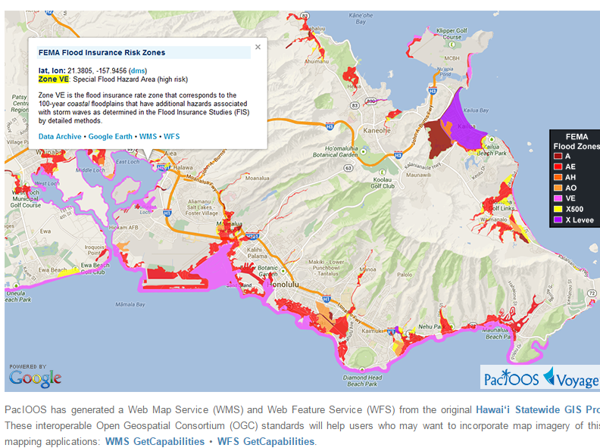
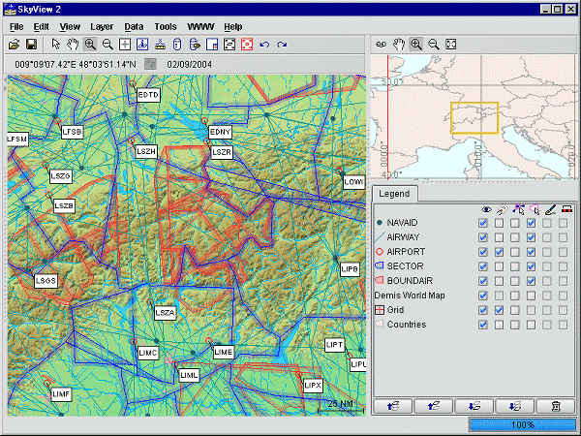
Millions of Geospatial Datasets on >200K Servers
Web Map Service (WMS)
Web Map Tile Service (WMTS)
Web Feature Service (WFS)
Web Coverage Service (WCS)
KML, GML, GeoPackage
GeoTIFF, NetCDF, HDF
OneGeology.Org
OpenIOOS.Org
CityGML
http://oos.soest.hawaii.edu/pacioos/voyager/news/2013/
DigitalGlobe
Eurocontrol
Emergency /
Disaster Management
Meteorology, Hydrology, Ocean Monitoring
Aviation Flight Information / Safety
Source of statistics: GeoSeer spatial data search engine: https://geoseer.net
Notes:
2

Slide 3
OWS and API Innovation
OGC is advancing new standards while simultaneously maintaining the OGC Standards Baseline
The OGC API approach is based on technologies that did not exist during development of initial OGC Web Services (OWS).
OGC will continue to maintain the approved OWS Standards, e.g., WFS, Version 2, while developing and maintaining new standards based on using approaches for APIs and OGC building blocks
This approach is consistent with the OGC Innovation Statement from 2014 that anticipates OGC addressing the innovator’s dilemma of maintaining the current OGC standards baseline while simultaneously developing standards to support evolving and potentially disruptive technologies, community needs and market trends. ”

Slide 4
OGC/W3C Best Practices for Spatial Data on the Web
Web principles for spatial data
Use globally unique persistent HTTP URIs for spatial things
Make your spatial data indexable by search engines
Link resources together to create the Web of data
Key spatial aspects
Use spatial data encodings that match your target audience
Provide geometries on the Web in a usable way
Provide geometries on the Web at the right level of accuracy, precision, and size
Choose coordinate reference systems to suit your user’s applications
State how coordinate values are encoded
Describe relative positioning
Access
Use appropriate relation types to link Spatial Things
Provide information on the changing nature of spatial things
Expose spatial data through 'convenience APIs‘
Metadata
Include spatial metadata in dataset metadata
Describe the positional accuracy of spatial data
https://www.w3.org/TR/sdw-bp/

Slide 5
OGC API Standards Development
Modular API building blocks; spatially enable Web APIs in a consistent way
Spatial Data on the Web Best Practices
Leverages OpenAPI
Focus on developer experience and usability
Modular building blocks for access to spatial data that can be used in data APIs,
Open development; Public GitHub, Early implementations, In-depth validation
OGC API - Features
OGC API - Coverages
OGC API - Map Tiles
OGC API - Processes

Slide 6
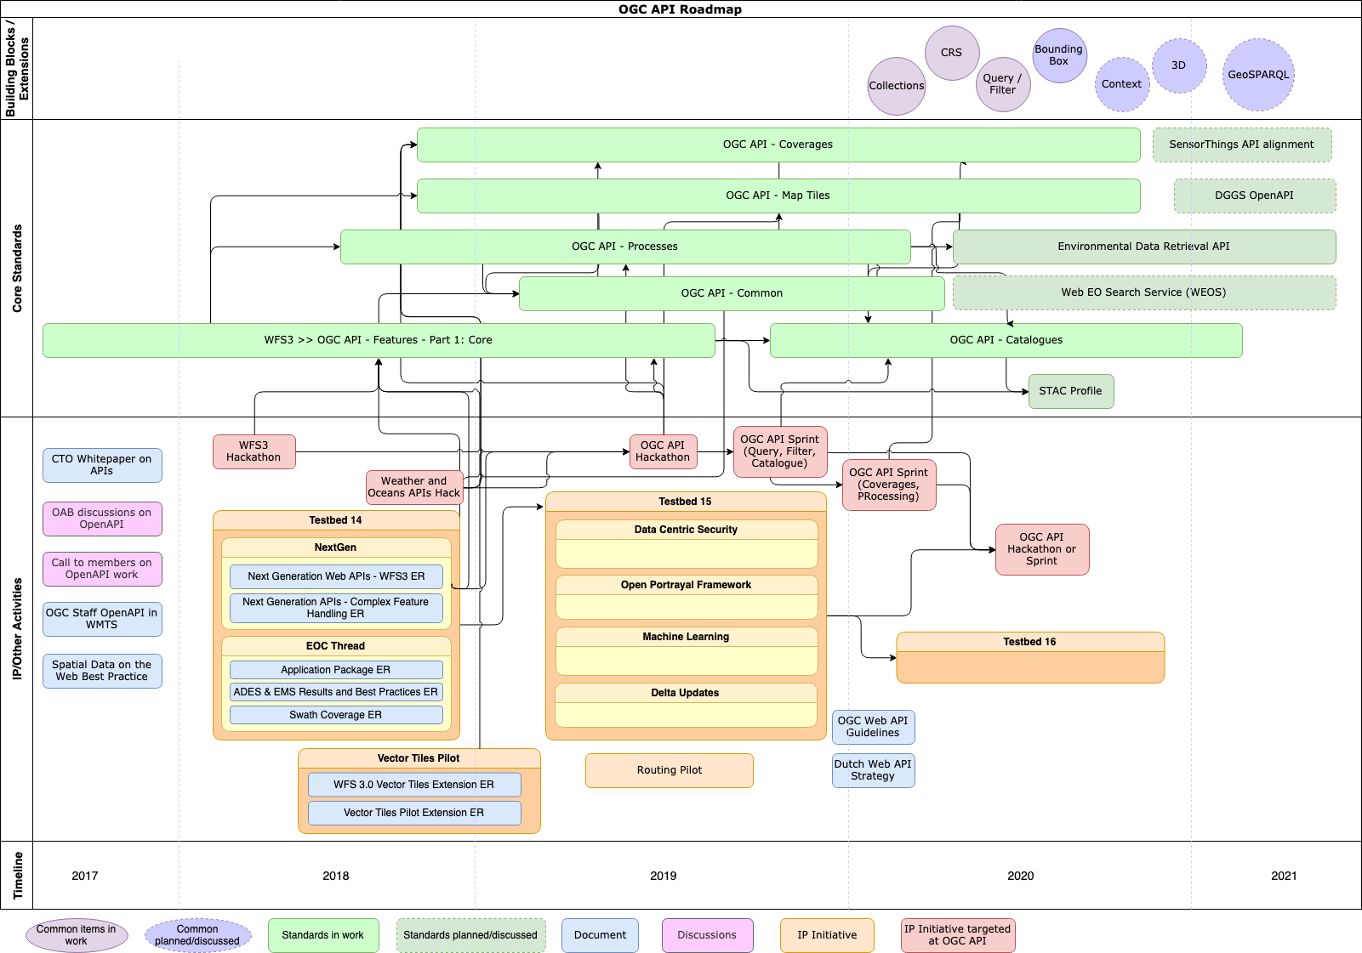
OGC API Roadmap

Slide 7
OGC - API Features: Access to collections of features
GET /collections
Lists geospatial data collections that can be queried; describes basic information about the collection, e.g., id, description, spatial and temporal extents of all the data contained
GET /collections/buildings/items?bbox=160.6,-55.95,-170,-25.89
Requests all data in collection "buildings" that is in the New Zealand economic zone.
Response format (typically HTML or GeoJSON feature collection; GML is supported) determined using HTTP content negotiation. Data returned in pageable chunks.
Core specification supports a few basic filters, in addition to the bbox filter
GET /collections/{collectionId}/items/{featureId}
Returns single 'feature' - (a building, a stream, a county, etc.); typically described by a geometry plus other properties. Provides a stable URL to link to the ‘spatial thing'

Slide 8
OGC API Features - Implementations
OpenAPI definition examples
first example (ogcapi-features-1-example1.yaml)
generic example uses path parameters to describe feature collections and all features.
second example (ogcapi-features-1-example2.yaml)
does not use path parameter for collections; explicitly provides information about feature collection 'buildings' (paths /collections/buildings etc.), schema of the building features (schema buildingGeoJSON), and filter parameter for building features
Servers
interactive instruments, CubeWerx Inc., GeoServer, pygeoapi, jivan, sofp, STAC, nls-fi
Clients
go-wfs3-client, ogr/gdal WFS 3.0 client driver, OWSLib WFS 3.0 client, STAC
https://github.com/opengeospatial/ogcapi-features

Slide 9
OGC API Companion/Advisory Documents
OGC Web API Guidelines
OGC API Common
Principle #1 – Don’t Reinvent
Principle #2 – Keep It Simple and Intuitive
Principle #3 - Use Well-Known Resource Types
Principle #4 – Construct consistent URIs
Principle #5 – Use HTTP Methods consistent with RFC 2616
Principle #6 – Put Selection Criteria behind the ‘?’
Principle #7 – Error Handling and use of HTTP Status Codes
Principle #8 – Use of HTTP Status Codes
Principle #9 – Use of HTTP Header
Principle #10 - Content Negotiation
Principle #11 - Pagination
Principle #12 – Processing Resources
Principle #13 – Support Metadata
Principle #14 – Consider your Security needs
Principle #15 – API Description
Principle #16 - Use IANA well-known identifiers
Principle #17 - Use explicit geospatial relations
Principle #18 - Support W3C Cross-Origin Resource Sharing
Principle #19 - Resource encodings
Principle #20 - Good APIs are testable from the beginning
API landing page
API definition
Declaration of Conformance.
HTTP
Web caching.
Support for cross-origin requests
Encodings .
Coordinate reference systems
Link headers
Collections metadata
Resource Collection metadata.
Resource Collections
Parameters.
https://github.com/opengeospatial/oapi_common/blob/master/19-xxx.html
https://github.com/opengeospatial/ogc-web-api-guidelines

Slide 10
OGC API - Features and Catalogues Sprint, Nov 2019
Extensions for OGC API – Features and OGC API - Catalogue
Organized jointly with the SpatioTemporal Asset Catalog (STAC)
Query and Filter Operations
Will bring OGC API - Features to similar capability as WFS
Dates: Tuesday, 5 November to Thursday, 7 November, 2019
Location: IQT CosmiQ Works, Arlington, VA, USA.
Apply to attend here: https://forms.gle/ELu3nbXQ16yLuu2S9
Majority of time will be spent in collaboration between participants in active coding
https://www.opengeospatial.org/events/191105apisprint

Slide 11
ESIP/OGC API-Coverage/Grid Analytics Sprint, Jan 2020
Extensions to OGC API - Coverages and OGC API - Processes
Methods to be available as building blocks for reuse in all OGC APIs
Coverage analytics
As in OGC Geospatial Coverages Data Cubes Community Practice
Analytics using either OGC WCS Processing Extension (WCS-P) and/or OGC Web Processing Service (WPS).
Consider: Jupyter notebooks and Python scripting language; Array Databases, e.g., ISO/IEC 9075-15 SQL/MDA (Multi-Dimensional Arrays); GeoXarray and ZARR API;
Also OGC NetCDF, DAP/OPeNDAP, and RDF Data Cube with Geo-Spatial Extensions
Sprint Co-located with 2020 ESIP Winter Meeting
6/Monday and 7/Tuesday, January 2020 in Bethesda, MD, USA
Registration: https://2020esipwintermeeting.sched.com/info

Slide 12
OGC Geospatial Coverages Data Cube Community Practice
Data Cube Implementations
OpenDataCube (Previously Australian Geoscience Data Cube)
EarthServer-2 project
Rasdaman
Advanced geospatial Data Management platform (ADAM)
EOX Sentinel-2 cloudless
Sentinel Hub
ESA EO Data Cube Facility
Requirements Categories
Information model
Geospatial Coverages
Data Preparation
Analytics and Queries
Interoperability
APIs and Encodings
WCS, WCPS/WPS
Final Review by editors at the OGC TC, Toulouse, FR, 18 November 2019

Slide 13
George Percivall
percivall at ogc.org
@percivall

