Slide 1
Data and Information Provenance in NCA4
Reid Sherman | GCIS Lead, National Coordination Office | Straughan Environmental, Inc.
October 11, 2019

Slide 2
Why we need Traceable Provenance
Increase credibility
Enable reproducibility
Inform decisions
Demonstrate integrity
Conform to modern scientific standards
Reproducible research
Government transparency
Locate customizable data and information

Slide 3
The ideal for traceable provenance
Traceable Sources
Traceable
Data
Traceable Processes
Traceable
Tools

Slide 4
Standard practice
Notes:
IPCC Working Group 1 Report

Slide 5
NCA4 Provenance

Slide 6
Surfacing information sources
Traceable Accounts
Sources linked with publication metadata
Figures have data and processes documented

Slide 7
Traceable Accounts
Process Description
For each Key Message:
Description of Evidence Base
Major Uncertainties
Description of Confidence and Likelihood

Slide 8
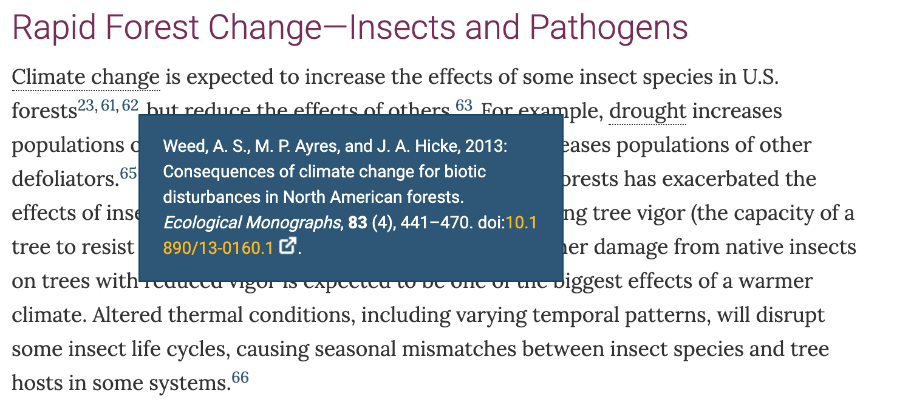
Citations
Notes:
175 out of 182 have a DOI or at least URL in Forest Chapter.

Slide 9
Citations in GCIS

Slide 10
Figure Metadata

Slide 11
Figure Metadata
Notes:
Point of contact; more details next

Slide 12
Figure Metadata
Notes:
Get dataset or datasets (or citations to source). Also includes Analysis Methods and Tools

Slide 13
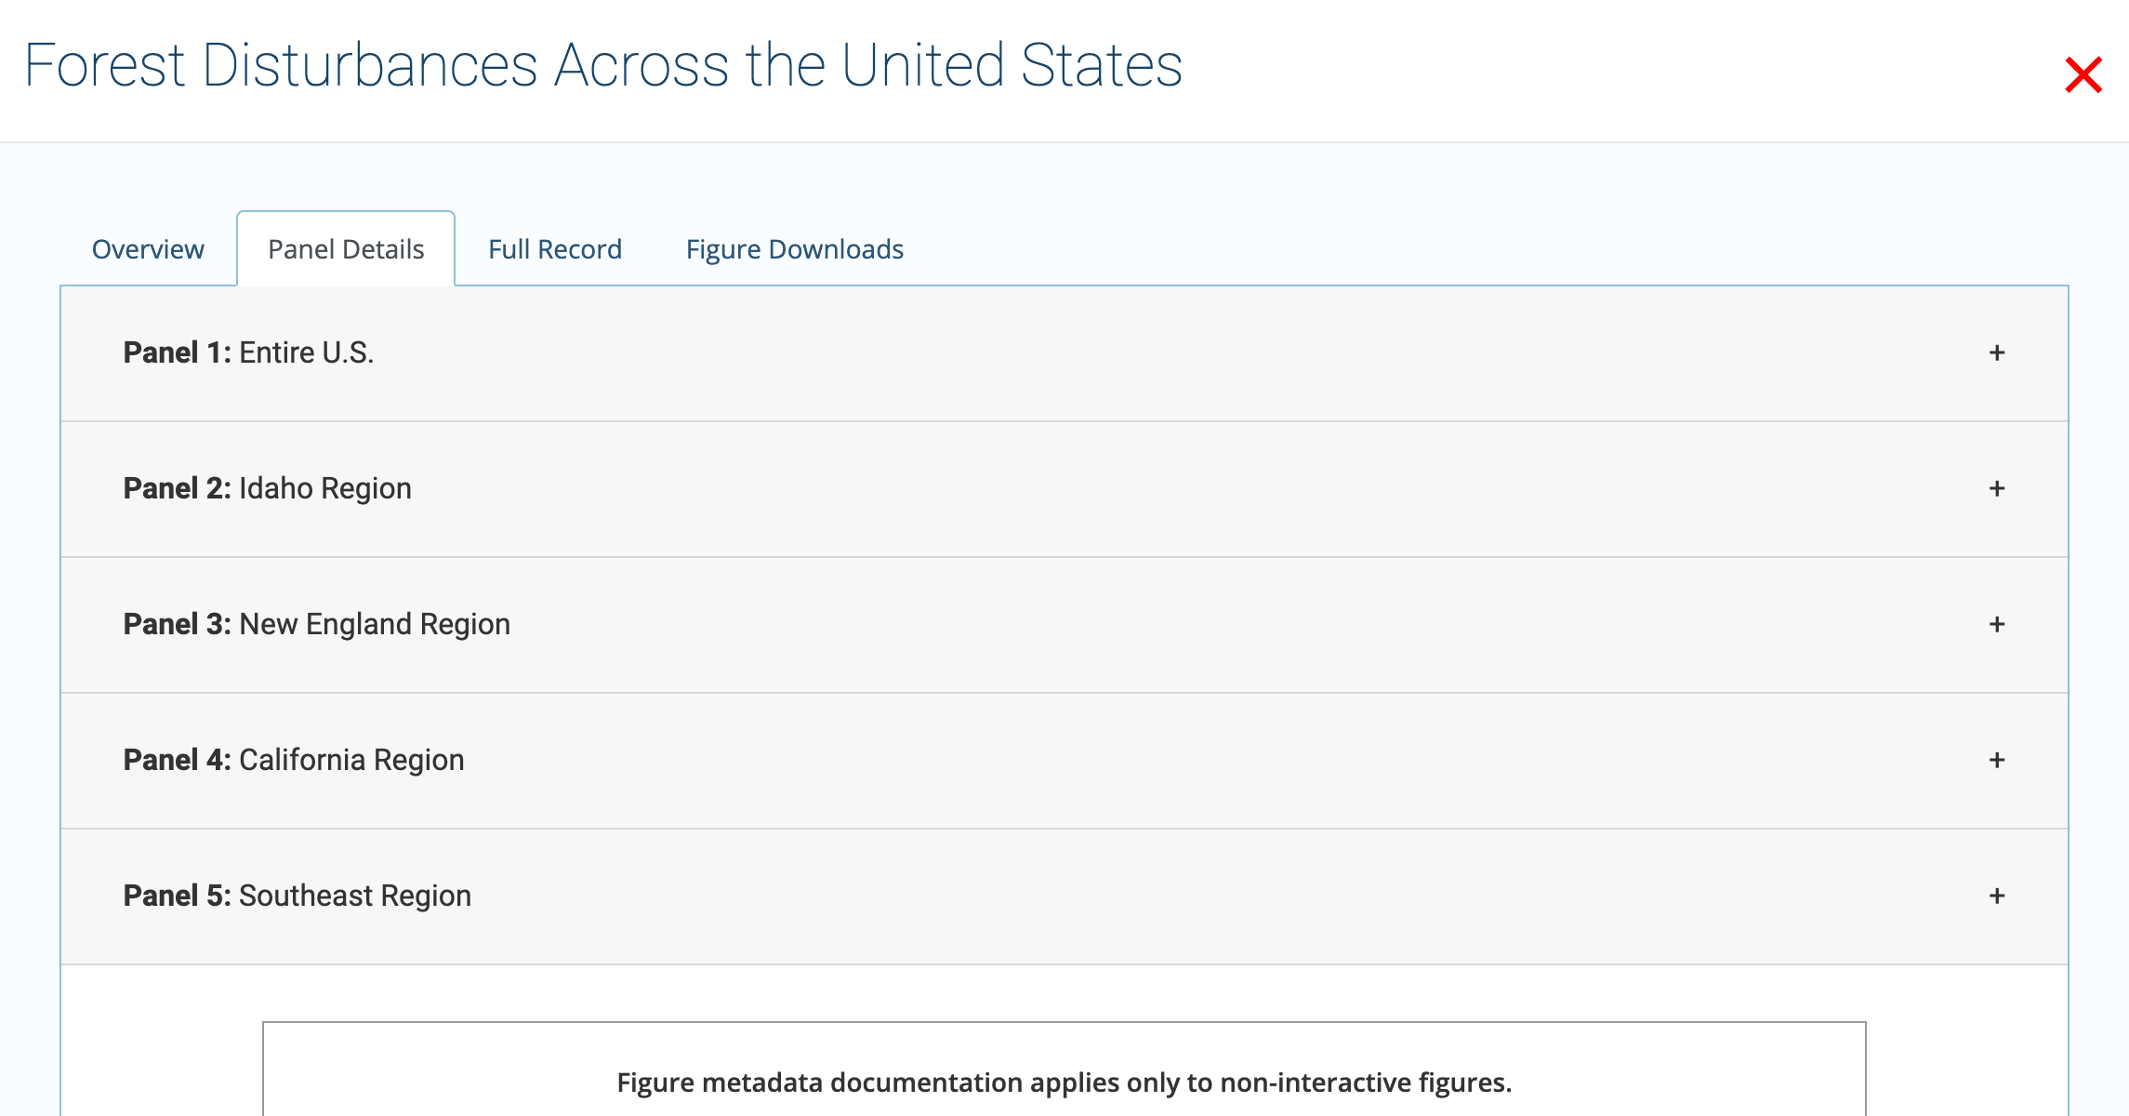
Figure Metadata
Notes:
Get details separated out (and downloadable image) for each panel in a figure

Slide 14
Connections across time
Notes:
Each report’s provenance is connected to the same database of records, so that users can see connections across publications: for example, you can see that one person was the same person that contributed to one report and also wrote an article or was the editor on a book, etc.

Slide 15
Planning for NCA5

Slide 16
GCIS planned improvements
Establishing metrics to measure our metadata quality
Improving ingestion from report authors
Implementing navigation through topical keywords
Improving our data model and technology
Notes:
Ingestion can nudge to select from curated list for high-quality metadata;
Keywords are attached and surfaced, but no additional functionality yet

Slide 17
Acknowledgments
USGCRP Global Change Information System Team
Amrutha Elamparuthy – Data Manager
Reuben Aniekwu – Research Coordinator
[Kathryn Tipton] – Software Engineer
Zach Landes – Software Engineer
NOAA Technical Support Unit – North Carolina Institute for Climate Studies

Slide 18
data.globalchange.gov Reid Sherman rsherman@usgcrp.gov

