Slide 1
Blockchain and Earth Observation
Antonio Romeo
10/10/2019

Slide 2
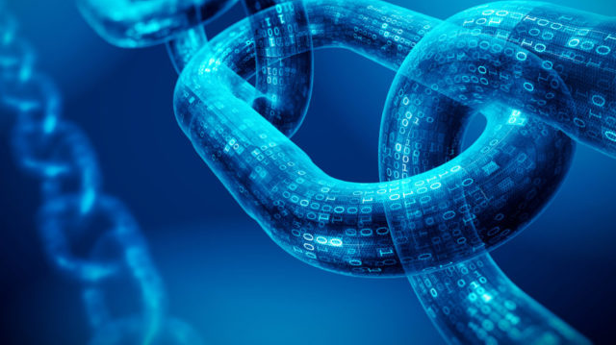
Summary
Blockchain Overview
Blockchain and EO

Slide 3
Blockchain Overview
Blockchain and EO

Slide 4
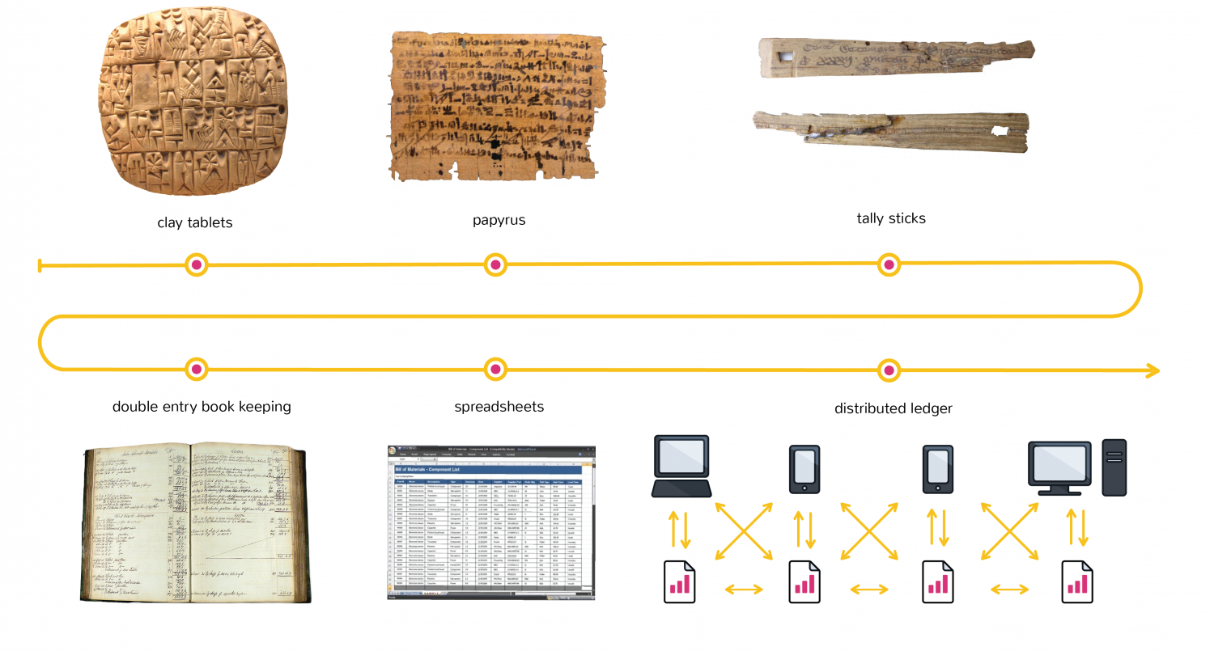
What is Blockchain?
Open distributed ledger that can record transactions between two parties efficiently and in a verifiable permanent way

Slide 5
Main concepts
Peer-To-Peer: No central authority to control or manipulate it.
Distributed: The ledger is spread across the whole network which makes tampering not so easy.
Cryptographically Secured: Cryptography is used for the security services to make the ledger tamper-proof .
Add-Only: Data can only be added in the blockchain with time-sequential order.
Consensus: This gives blockchain the ability to update the ledger via consensus. No central authority is in control of updating the ledger. Instead, any update made to the blockchain is validated against strict criteria defined by the blockchain protocol and added to the blockchain only after a consensus has been reached among all participating peers/nodes on the network.

Slide 6






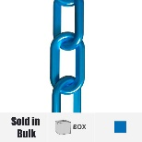


How does Blockchain work?
A user requests for a transaction
A block representing the transaction is created
The block is broadcasted to all the nodes of the network
The transaction is executed and validated
The block is added to the chain
All nodes validate the block and the transaction

Slide 7

Blockchain benefits
Immutable
Shared and distributed
More secure of traditional methods
Allows for faster settlement

Slide 8
Blockchain limitations
Data modification may require forking the chain
Vulnerability to 51% attack
Private key dependant, if it is lost user data cannot be accessed
Inefficient and energy consuming: verification requires a Proof of Work (PoW) which is a computational intensive task done by all nodes in the network.
Storage: all nodes have a replica of the whole chain (Bitcoin chain size 200GB)

Slide 9
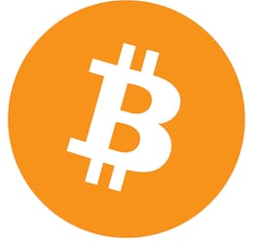


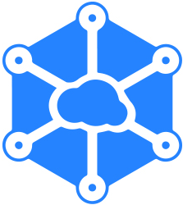
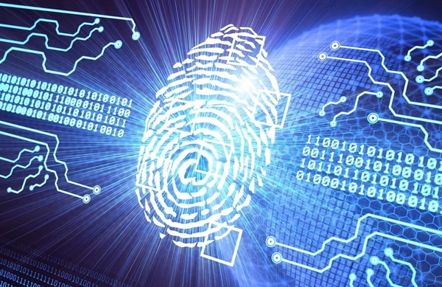

Blockchain applications
Cryptocurrency
Smart contracts
Notary
Distributed cloud storage
Digital identity
Supply chain communications & Proof of Provenance

Slide 10
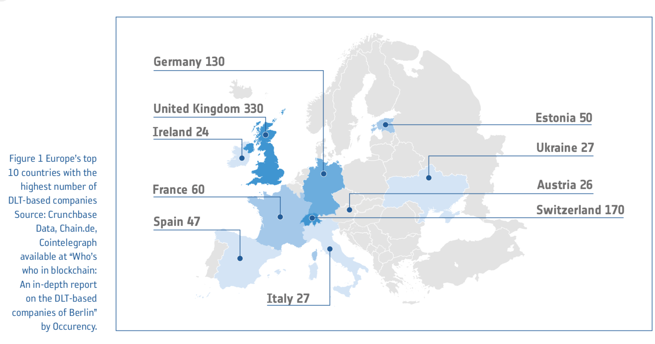

European Countries Interest in Blockchain
€80m to EU projects
Notes:
Carina da far vedere come sta crescendo interesse sia in industrie che in organizzazioni come ogc ec e iso

Slide 11
Blockchain Overview
Blockchain and EO

Slide 12
What’s going on?
ESA
  Blockchain include in the European Space Technology Master Plan in 2017
  White Paper BLOCKCHAIN AND EARTH OBSERVATION issued on April 2019
  GSTP, Phi-Lab and EOP-S activities on Blockchain
OGC
  Crypto Spatial Coordinates
  FOAM protocol to report location data on Ethereum
ISO
  11 standards under development
Notes:
Ho messo questa per introdurre il paper e anche la possibilita di avere fonti sul topic

Slide 13
Blockchain 4 EO Use Cases
EO data and information product integrity, traceability, automated certification & auditability
Supply chain tracking in the EO upstream segment
Digital Identity solutions
EO data access and trading
Intellectual Property Rights (IPR)
Incentives in community collaborations
Digital representation of assets
Identified in the ESA White Paper

Slide 14
EO data and information product integrity, traceability, automated certification & auditability
It includes organising, arranging and tracking distributed processing in the cloud, and building trust in algorithms and data processing chains, in particular the authentication of provenance and certification of data and processes.
It involves:
The use of blockchain data structures to validate EO data and metadata (data acquisition time/date etc.) provenance, by providing a trust anchor that any third party can use in case of a dispute
The use of blockchain data structures to verify the steps of processing, archiving and dissemination of the data from Ground Segment to the end-users
The use of blockchain data structures to give the operators to audit the mission products archive.

Slide 15
Supply chain tracking in the EO upstream segment
The use case concerns the analysis of existing frameworks for using blockchain-based registers for COTS supply management, as used already on a pilot basis in other industry sectors (i.e. automotive).
Benefits:
Part authentication -> transparency between manufacturers sellers and finance services
Speed up the processing of export/import and banking documentation
Reduce the settlement period between different parties in the supply chain
Notes:
Some info is needed in order to keep track of which data collection / data set has been assigned and registered with a DOI.

Slide 16
Digital Identity solutions
Integration of Digital Identity frameworks with blockchain for use in decentralised networks.
Key Digital Identity frameworks:
international standardisation efforts led by industry for the easier exchange of digital identity credentials between different entities/devices in the decentralised ecosystem,
European initiatives such as eIDAS (electronic IDentification, Authentication and trust Service)

Slide 17
EO data access and trading
The use case includes the exploration of novel concepts for EO data digital licenses which are
programmable
self- executing
based on
user’s profile
identity
tasks undertaken in the online/ platform environment
They may result in the development of EO data rental and trading schemes based on tokenisation of assets.

Slide 18
Intellectual Property Rights (IPR)
The use case reflects Blockchain applications for copyright protection.
creators can publish works on blockchain creating a quasi- immutable record of initial ownership
encode smart contract functionality to license the use of their works
For the EO sector the key point of value-adding interest is the
ability to register copyright products in online registers
track the use of IP elements (e.g. software and data products)
develop new ways of attributing use, and exchange of value for the use of copyright-protected content

Slide 19
Incentives in community collaborations.
This use case is based on blockchain-specific functions that can enhance trust frameworks among the participants in the collaborative networks.
Blockchain benefits:
encourages community collaboration without intermediaries
protect the ownership of encrypted/shared data, or software elements
provides accountability for item use
maintains integrity of the resource pool
Devising frameworks for interacting among network participants via a tokenised system can also facilitate the ingestion of verifiable data sources to the pool of shareable resources, and revenue sharing schemes.

Slide 20
Digital representation of assets
This use case is to demonstrate how EO can bridge and connect the physical environment to digital ledgers, in the context of Distributed Applications and smart contracts.
In particular how EO can support the formulation of structured data flows in a variety of
asset management
risk management
environmental management
logistics
insurance domains

Slide 21
Thank you

