Slide 1

GEO Work Programme and WGISS Contribution
WGISS
Committee on Earth Observation Satellites
Mirko Albani – European Space Agency (ESA)
WGISS-48
Hosted by VAST/VNSC, Ha Noi, Vietnam
8-11 October 2019

Slide 2

GEO Work Programme 2020-22
Version 2.2 issued in July 2019, will be approved at GEO Plenary in November 2019.
GEO Work Programme Content:
GEO Flagships: implement reliable, continuing services in response to policy mandates from international organizations, conventions, agreements or other bodies.
GEO Initiatives: within defined domains, they help to transition innovative results/prototypes from research community into Earth observation-based products and services to support a wide range of users.
Regional GEOs: engagement of countries and organizations within their region, coordination of GEO activities within their region and initiation of new ones.
GEO Community Activities: range from communities of practice, to early-stage projects or pilots, to well-established services. Entry point for new activities.
Foundational Tasks: implements critical activities, provides selected technical services to the GEO community, and supports GEO governance bodies.

Slide 3
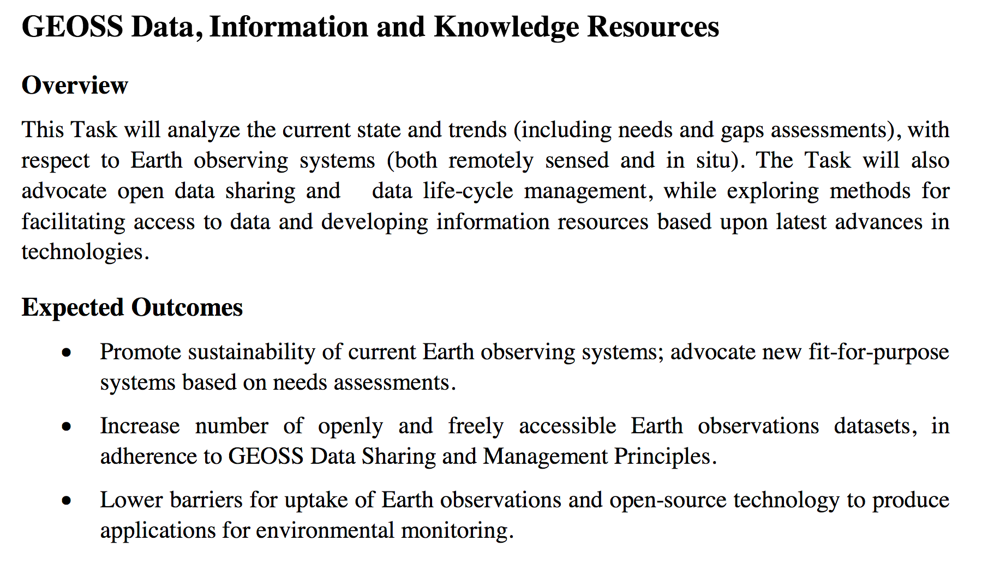
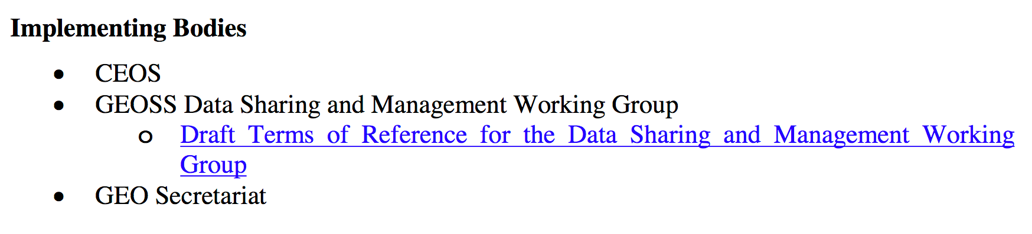
GEO Foundational Tasks

Slide 4
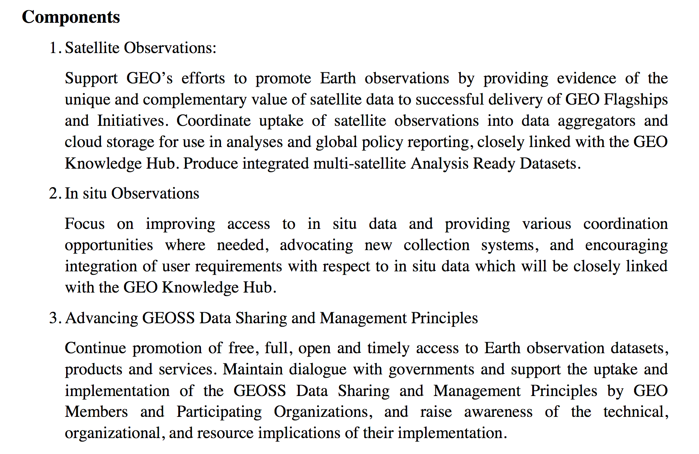
GEO Foundational Tasks
* Space Agencies Repositories added in point 1 above after WGISS request. In that case WGISS can contribute through the WGISS CDA (Y.Enloe as contact point, TBC)
WGISS Contribution to Data Management Principles through membership in the DSMWG (M.Albani, R.Moreno)

Slide 5
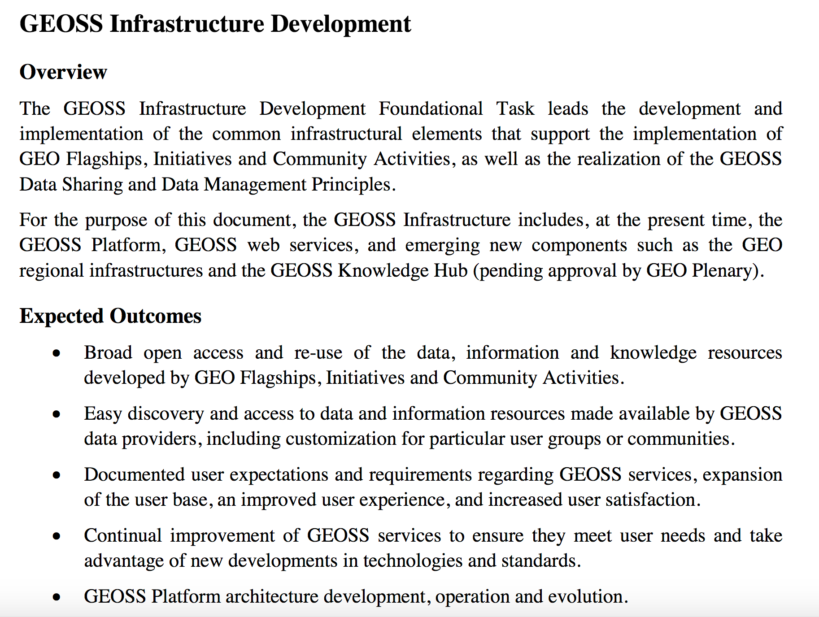
GEO Foundational Tasks

Slide 6
GEO Infrastructure Development Task
Components
GEOSS Platform Operations
Support GEO Community data and information needs
GEO Knowledge Hub Development
GEONETCast Operation
GEOSS Platform Documentation
GEOSS Infrastructure Evolution
Open-source Solutions
Implementing Bodies
GEOSS Infrastructure Development Task Team
GEOSS Platform Operations Team
GEOSS Infrastructure Evolution Working Group
GEONETCast Operations Team
GEO Secretariat
Potential WGISS contributions highlighted in green
SIT Chair has already proposed R.Woodcock as CEOS representative in the GEOSS Infrastructure Development Task Team.
M.Albani and A.Mitchell, as former members of the GEOSS Evolve Initiative, should be member of the GEOSS Infrastructure Evolution Working Group.

Slide 7
Next Steps
Approval and circulation of final version of the GEO Work Programme 2020-22 after GEO Plenary
Finalization of Draft Implementation Plans for Work programme Tasks and Activities https://www.earthobservations.org/gwp2020_dev.php
Announcement on nomination procedure for Task Teams and Working Groups associated with Foundational Tasks will be formally done after WP approval at GEO Plenary.
Action Item for WGISS Exec: await announcement and submit WGISS PoC candidature as agreed.

