Slide 1
Working Group on Information Systems and Services (WGISS)
Committee on Earth Observation Satellites
Iolanda Maggio, EMSS Team
WGISS#48
RDA FAIR Model and Way Forward for Finalization of WGISS Maturity Matrix
Hosted by VAST/VNSC, Ha Noi, Vietnam
8-11 October 2019

Slide 2
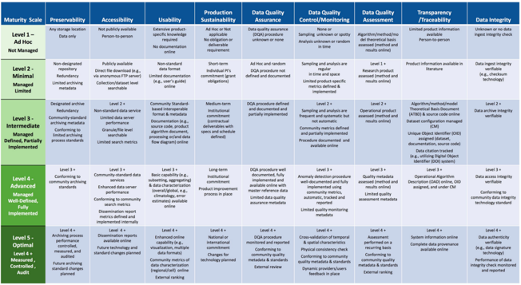
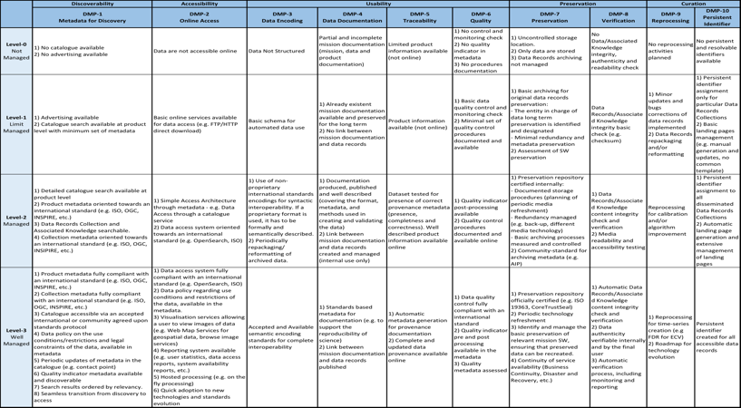
Starting Points
GEOSS DMP-IG
Maturity Matrix for Long-Term Scientific Data Stewardship
CEOS-WGISS Data Management and Stewardship Maturity Matrix
Notes:
Capability Maturity Model Integration (CMMI) is a process improvement training and appraisal program and service administered and marketed by Carnegie Mellon University (CMU) and required by many DoD and U.S. Government contracts, especially in software development. CMU claims CMMI can be used to guide process improvement across a project, division, or an entire organization. CMMI defines the following maturity levels for processes: Initial, Managed and Defined.
CMMI currently addresses three areas of interest:
Product and service development — CMMI for Development (CMMI-DEV),
Service establishment, management, — CMMI for Services (CMMI-SVC), and
Product and service acquisition — CMMI for Acquisition (CMMI-ACQ).
Climate Data Record Maturity Matrix (CDRMM): Bates and Privette, 2012
TECHNOLOGY READINESS LEVELS (TRLs): Standard which measures the maturity of new technologies
Scientific Readiness Levels (SRL): FOR SPACE APPLICATIONS

Slide 3
New WGISS Needs
Improve the GEOSS Data Management Principles (DMP) – Implementation Guidelines (IG)
Include FAIR Principles in GEOSS DMP-IG and WGISS Data Management and Stewardship Maturity Matrix
Joint Activity – Task 4 with WGCV to improve the quality area in WGISS Data Management and Stewardship Maturity Matrix
Notes:
Capability Maturity Model Integration (CMMI) is a process improvement training and appraisal program and service administered and marketed by Carnegie Mellon University (CMU) and required by many DoD and U.S. Government contracts, especially in software development. CMU claims CMMI can be used to guide process improvement across a project, division, or an entire organization. CMMI defines the following maturity levels for processes: Initial, Managed and Defined.
CMMI currently addresses three areas of interest:
Product and service development — CMMI for Development (CMMI-DEV),
Service establishment, management, — CMMI for Services (CMMI-SVC), and
Product and service acquisition — CMMI for Acquisition (CMMI-ACQ).
Climate Data Record Maturity Matrix (CDRMM): Bates and Privette, 2012
TECHNOLOGY READINESS LEVELS (TRLs): Standard which measures the maturity of new technologies
Scientific Readiness Levels (SRL): FOR SPACE APPLICATIONS

Slide 4
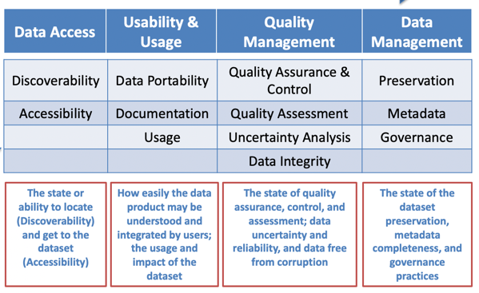
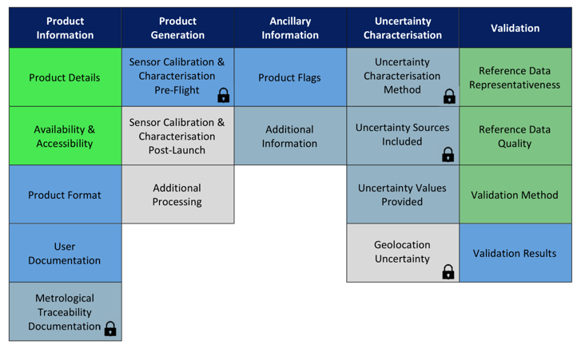
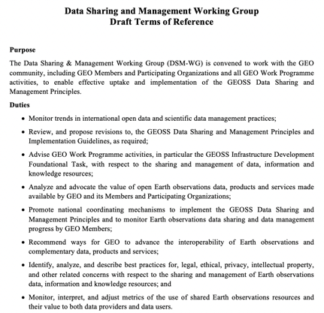
New players
RDA FAIR Maturity Model
WMO Stewardship Maturity Matrix for Climate Data (SMM-CD)
DSDMWG Data Sharing and Data Management Principles working groups
EDAP
Notes:
Capability Maturity Model Integration (CMMI) is a process improvement training and appraisal program and service administered and marketed by Carnegie Mellon University (CMU) and required by many DoD and U.S. Government contracts, especially in software development. CMU claims CMMI can be used to guide process improvement across a project, division, or an entire organization. CMMI defines the following maturity levels for processes: Initial, Managed and Defined.
CMMI currently addresses three areas of interest:
Product and service development — CMMI for Development (CMMI-DEV),
Service establishment, management, — CMMI for Services (CMMI-SVC), and
Product and service acquisition — CMMI for Acquisition (CMMI-ACQ).
Climate Data Record Maturity Matrix (CDRMM): Bates and Privette, 2012
TECHNOLOGY READINESS LEVELS (TRLs): Standard which measures the maturity of new technologies
Scientific Readiness Levels (SRL): FOR SPACE APPLICATIONS

Slide 5
Proposal for improvement of the GEOSS DMP IG using the Maturity Matrix
Not exhaustive AREAS to be supported:
DMP-1: Discoverability: e.g. Automatic Dissemination Reports
and Future Technologies and standard changes planned
DMP-6: Quality: e.g. Data uncertainty and reliability, Data Integrity
DMP-9: Review and Reprocessing: e.g. introducing and improving
the Sustainability concepts.

Slide 6
WGISS-WGCV Task 4 - First Analysis
EDAP aims to assess satellite mission data quality in the QA4EO context.
EDAP approach aims to define a product quality evaluation matrix (EDAP Quality Assessment Guidelines).
EDAP does not consider some Data Management aspects in particular Data Integrity, Preservation and Governance.
EDAP wrt WMO SMO does not consider Usage i.e. an index of citations or references.
WMO SMM serves the Climate Datasets.
WGISS SMM is dedicated to the EO datasets.

Slide 7
Possible improvements for WMO SMM CD
Introduction of the FAIR (Findable, Accessible, Interoperable, Reusable) Data Principles in Data Access and Usability & Usage in particular for Discoverability, Accessibility and Portability
Uncertainty Analysis: to better define the level achieved the following aspects (from EDAP) could be considered: Uncertainty Characterisation Method, Metrological Traceability Documentation, Uncertainty Sources, Uncertainty Values
Quality Assessment: to better define the level achieved the following aspects could be considered: Reference Data Representativeness & Quality, Validation Method, Validation Results.
The WMO SMM apparently does not explicitly include any arguments concerning Product Generation (i.e. from EDAP Sensor Calibration Characterization Pre-flight, Sensor Calibration Characterization. Post-Launch, additional Processing) and Ancillary Information (Product Flags, Additional Information), in general SMM DC representation seems poor regarding the product details and on processes that generate products. Probably Document is the general placeholder for all these information.

Slide 8
Possible improvements for WGISS DMSMM
DMP-6 Quality seems mainly related to Quality assurance and Control i.e. it provides an indication of the quality checks and quality control procedures over the product. It doesn’t explicit mention Validation and Uncertainty Characterization of the product itself (see e.g. the two categories in EDAP Uncertainty Characterization and Validation). These two important aspects i.e. Validation and Uncertainty Characterization should be considered.
DMP-9 Reprocessing it could account for a wider meaning including general processing and calibration activities see e.g. EDAP Product Generation items.
Introduction of the FAIR (Findable, Accessible, Interoperable, Reusable) Data Principles in the WGISS SMM items in particular for Discoverability: DMP-1 Metadata to discover, Accessibility: DMP-2 Online access, Usability: DMP-3 Data Encoding and DMP-5 Traceability

Slide 9
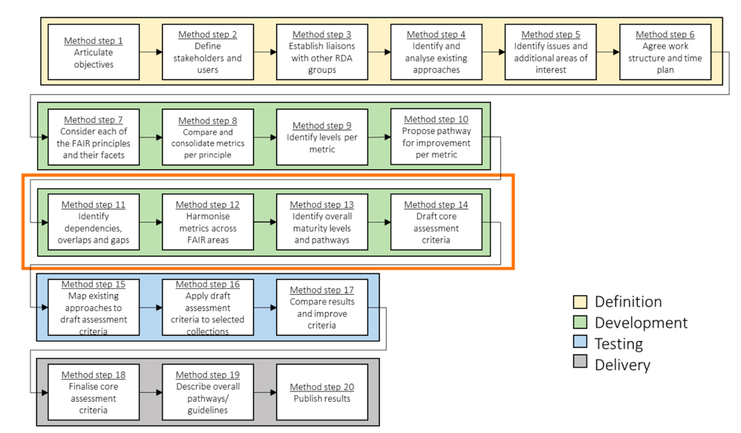
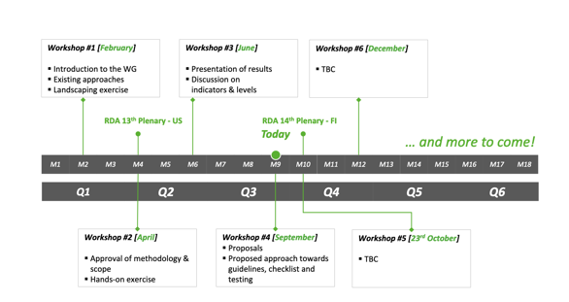
Possible improvements for WGISS DMSMM from RDA FAIR Maturity Model

Slide 10
Possible improvements for WGISS DMSMM from RDA FAIR Maturity Model
FINDABLE
ACCESSIBLE

Slide 11
Possible improvements for WGISS DMSMM from RDA FAIR Maturity Model
INTEROPERABLE
REUSABLE

Slide 12
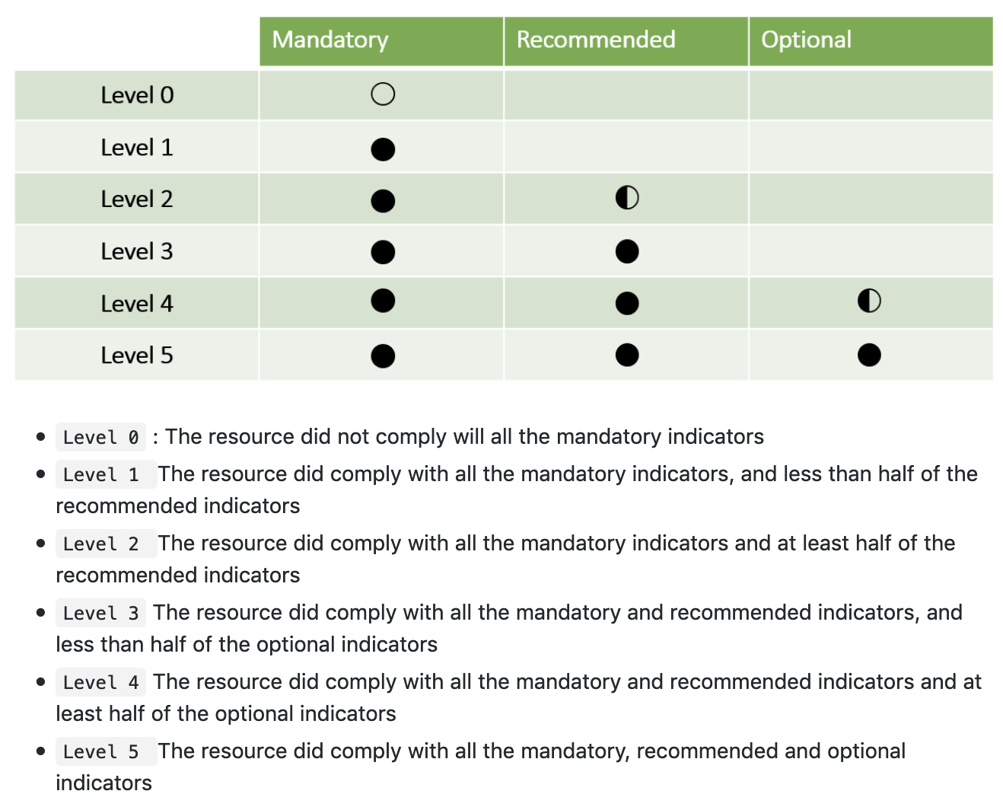
Possible improvements for WGISS DMSMM from RDA FAIR Maturity Model

Slide 13
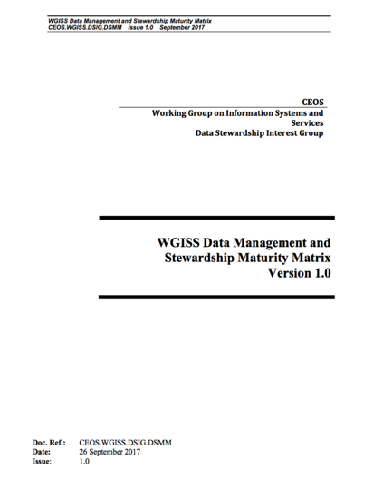
WGISS Data Management and Stewardship Maturity Matrix - White Paper

Slide 14
Way Forward
Finalise the WGISS-WGCV Joint Activity Task 4 analysis and implement the Quality improvements ------ Due Date: by the next WGISS-WGCV Joint Meeting
Follows evolution in DSDMWG Data Sharing and Data Management Principles working groups ------ Due Date: Periodic Reports generation and circulation
Follows evolution in RDA FAIR Maturity Model ----- Due Date: Periodic Reports generation and circulation
Implement FAIR Final Indicator ----- Due Date: after RDA indicator finalization
Provide input to Data Management Principles – Implementation Guidelines ----- Due Date: When requested by GEOSS

