Slide 1
Long Lasting PiqlFilm Technology Pilot Project
Mirko Albani – European Space Agency (ESA)
WGISS-48
Hosted by VAST/VNSC, Ha Noi, Vietnam
8-11 October 2019

Slide 2
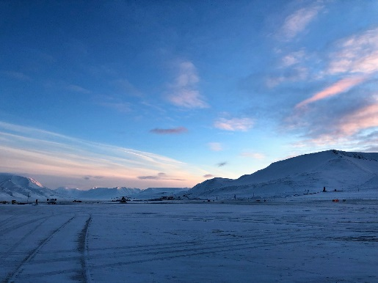
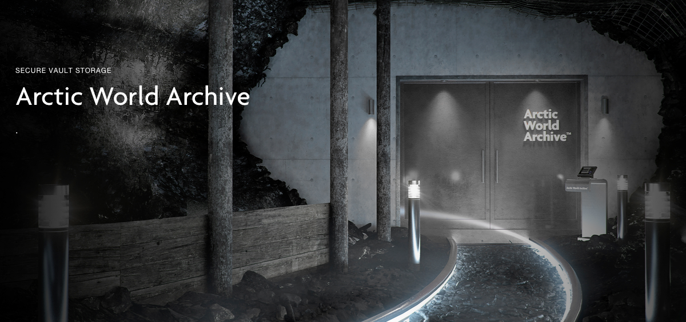
Piql Proof of Concept
ESA has conducted a proof of concept with Piql, a provider of digital preservation services, having the goal to test their film technology to preserve a variety of different Earth Observation assets (i.e space data, documents).
Objective for ESA was to evaluate whether Piql film technology can be suitable for long term preservation (hundreds of years) of digital data and documents.
A sample of ESA EO material was transcribed on Piql film and is now stored in the Arctic World Archive (Svalbard, Norway) with a guaranteed longevity of several hundreds years and securing access to the material for future generations.

Slide 3
Technology: the Piql Film
Piql film technology has the following main advantages:
It cannot be hacked, cannot be affected by electromagnetic pulses, and virus cannot infect it.
Data cannot be manipulated.
Piql Film can preserve any digital file in any file format of any size, and can maintain the same quality as the original files.
Each film reel can contain 120 GB of data.
The reading technology uses off-the-shelf technologies (camera, optics, illumination) to perform data retrieval from the film.
The film went through several longevity tests proving to keep the same mechanical and optical properties for more than 500 years, when stored under right environmental conditions (i.e. less than 21 Celsius degrees and between 20-50% Relative Humidity).
→ These conditions are achieved in the Arctic World Archive located in Svalbard (Norway).

Slide 4
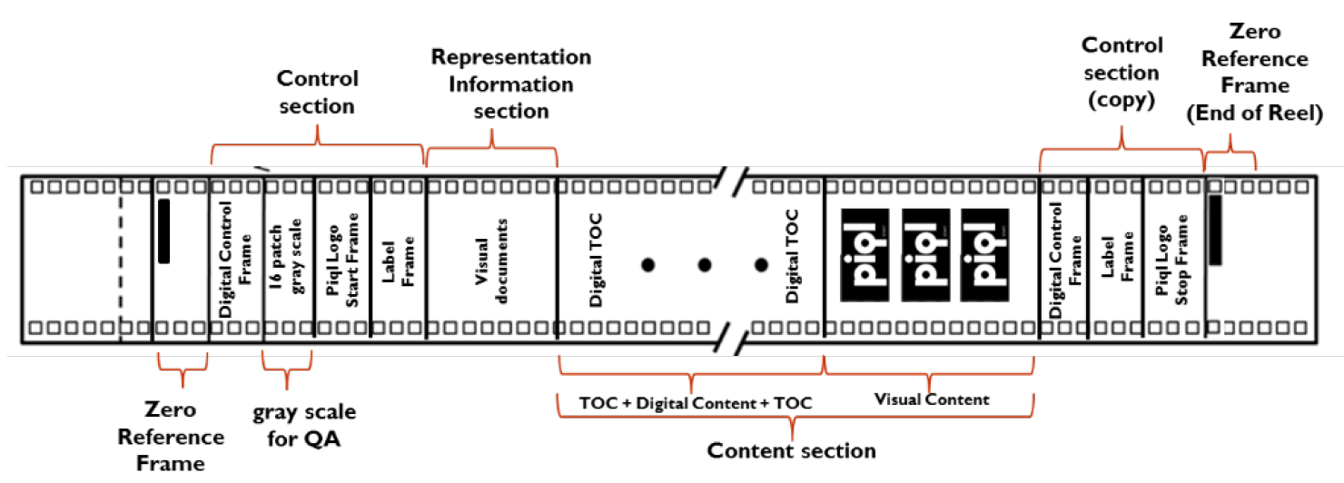
Technology: the Piql Film
The storage on film is achieved in three formats:
Digital: The data is preserved in binary form on the film.
Visual: The data is rendered as images and preserved on film as visual images.
Hybrid: The data is preserved in both digital and visual form. This feature provides data redundancy and can facilitate readability in the future.
Content section: it is where the data and metadata are written; it includes digital Table of Content.

Slide 5
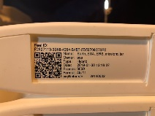
Proof of Concept
ESA data consisted of three ERS and ENVISAT products (SAR, ATSR, MERIS) and several associated information files in different formats (e.g. Power Point, PDF, MP4, JPEG, TIFF, GIF, PNG, and PostScript) which were saved on PIQL film.
The total size of the ESA saved material was 12GB, about 6000 frames
on the film. The content was written in hybrid mode (digital and visual).
The ability to store images in human readable form allows putting any metadata that provides readability and understandability in the future. This self-contained feature avoids dealing with the migration challenges caused by digital obsolescence.
Several file format were used in the PoC: recommended data file formats to preserve on film are open source standards, license free and widely accepted by international archivist community.
ESA film reel was then deposited in the Piql Arctic World Archive (abandoned coal mine) located in Svalbard (Norway) during a ceremony held in February 2019.

Slide 6
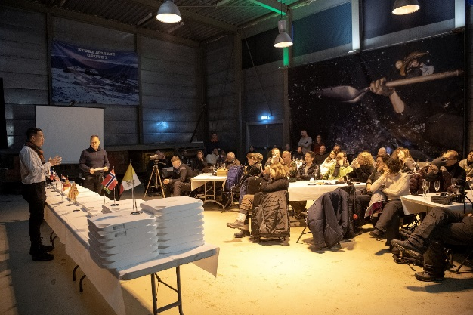
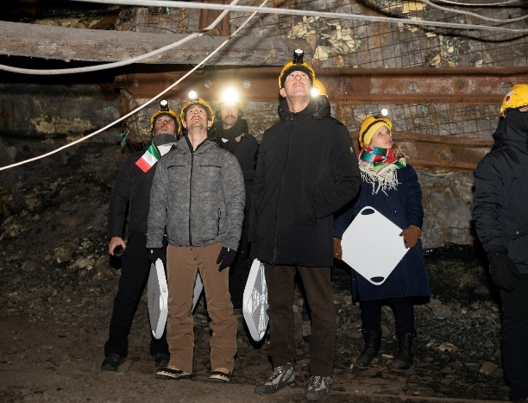
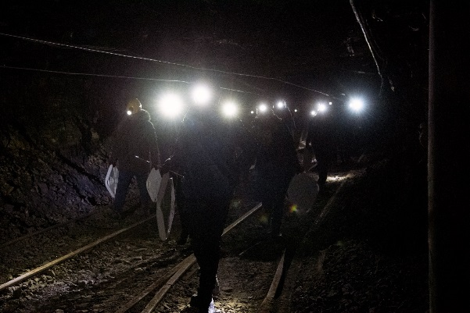
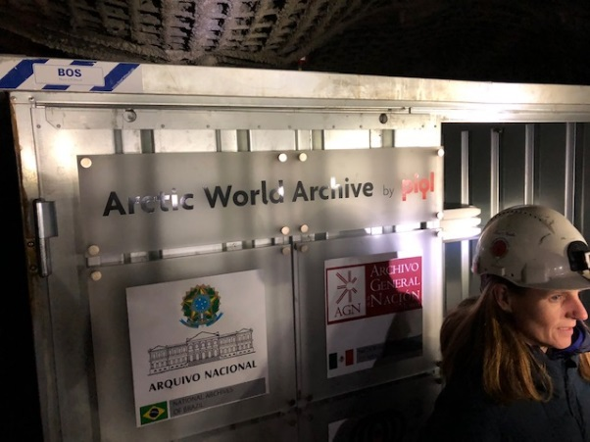
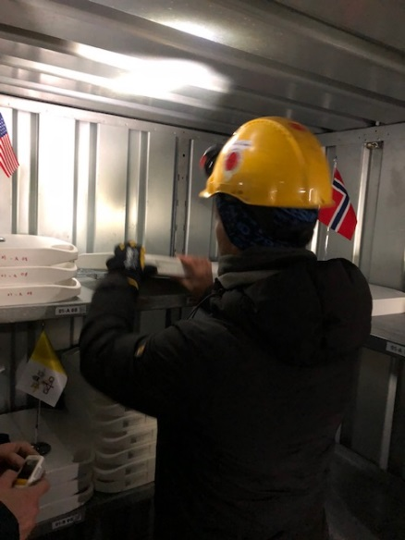
Picture Event

Slide 7
Next Steps
Project with PIQL being continued and extended to cover the following main objectives:
Assessment of feasibility, advantages and disadvantages of storing ESA heritage missions data on PiqlFilm technology extending the analysis performed during the proof of concept to:
  ERS, ENVISAT and GOCE heritage EO missions instruments.
  SOHO, GIOTTO, EXOSAT and SMART-1 heritage Science missions instruments.
Definition of metadata model and specification of end to end procedure for storage of ESA heritage missions data on PiqlFilm.
Imprinting of selected sample data and information from ERS, ENVISAT and GOCE missions, and of Science missions on PiqlFilm reels.
Deposit of PiqlFilm reels in the Arctic World Archive and storage for a 10 years timeframe (minimum).
Provision of final pilot project report and of recommendations on possible way forward for extension to a higher volume of data and a wider set of missions and instruments.

Slide 8


