Slide 1
Persistent identifier for EO data
CNES

Slide 2

Outline
DOI at CNES: current situation
DOI in the context of Data Terra French Research Infrastructure

Slide 3




CNES DOI Server
DAP WG #3 - PID at CNES – Common DOI server
Achats
180 euros / year
DOI CNES Prefix
Suffix = unique suffix within projet 1
Project 1
Project 2
DOI creation:
Prefix/ProjectPrefix/Suffix
Web services
CNES DOI Central Server
Project 3
Web services / MMI
Prefix = CNES DOI prefix
ProjectPrefix = Prefix assigned by project

Slide 4
CNES DOI Server - MMI
DAP WG #3 - PID at CNES – Common DOI server

Slide 5
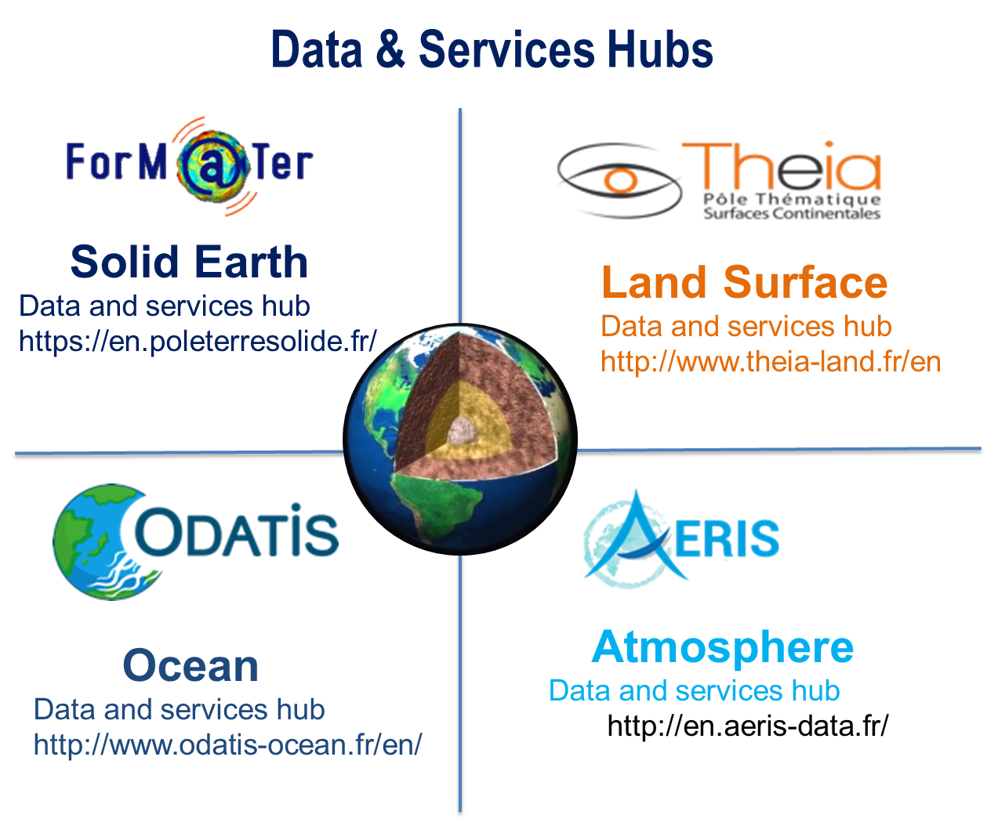
French « Data Terra » Research Infrastructure
French context: data in Data Hubs/SDI
  THEIA, FORM@TER, ODATIS, AERIS
    Each is a federation of data centers
    Each are involved in ESFRI and ENVRI FAIR
  ‘Earth System’ Research Infrastructure
  Space data & in-situ
Rules applied : Interpole « Good practices for citation »
https://www7.obs-mip.fr/wp-content-aeris/uploads/sites/18/2017/05/INTERPOLE_GUIDE_CITATION_V1.0_ENG.pdf
  Takes into account CEOS PID best practices
    With Interpoles specificities eg fragments
    Only data sets and collections
    At Data center level
    Assigning several DOI (with different prefixes) for the same data sets is forbidden
  ENVRI FAIR ? GO FAIR ?

Slide 6
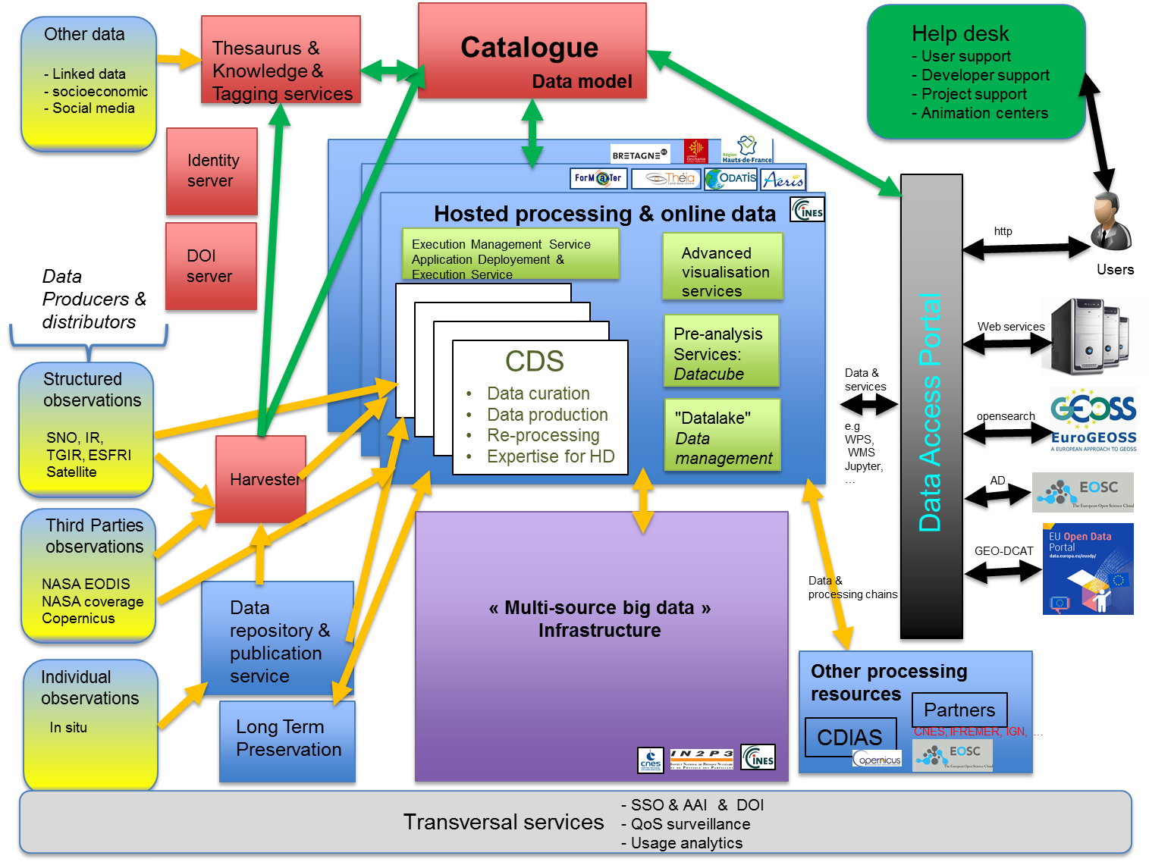
Data Terra architecture

Slide 7
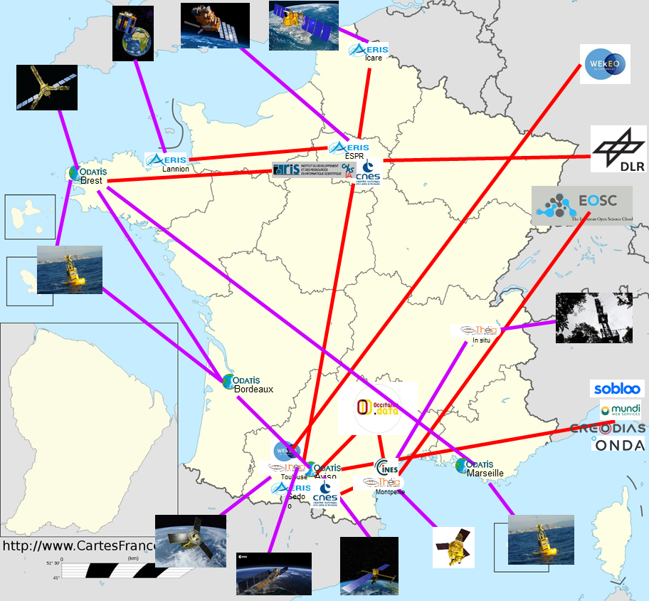
Data Terra – A continuum of infrastructures

Slide 8
CNES & France EO & environnemental data
Situation
  DOI as solution for persistent identifier
  Technical / organizational choices not frozen. Eg. Role of Data Terra RI
Objectives
  allow concise, accurate and reliable referencing over time of data & data used for a paper/experiment
    Target: scientific article, website or in the body of an electronic message.
  Bibliometric measurements
  Requested by
    FAIR, GO FAIR, EOSC, ENVRI FAIR & European research in general
Rules & specificities
  DOI at data center level
  Provided by the Data Hubs/SDI
    E.g. Seanoe : https://www.seanoe.org/

