Slide 1
NOAA Persistent Identifiers
Kenneth Casey, PhD for Don Collins
Deputy Director, Data Stewardship Division
NOAA/NESDIS National Centers for Environmental Information (NCEI)
Thursday, 10 October 2019
WGISS-48
Hanoi, Vietnam

Slide 2
Persistent Identifier approaches and processes
NOAA Data and Publication Citation Procedural Directive (PD) defines basis for Persistent Identifiers (Digital Object Identifiers)
PD assigns responsibilities for Working Group oversight and role of data stewards (data) and librarians (publications) for creating and managing DOIs
Working Group adjudicates questions and recommends improvements to implementation processes

Slide 3
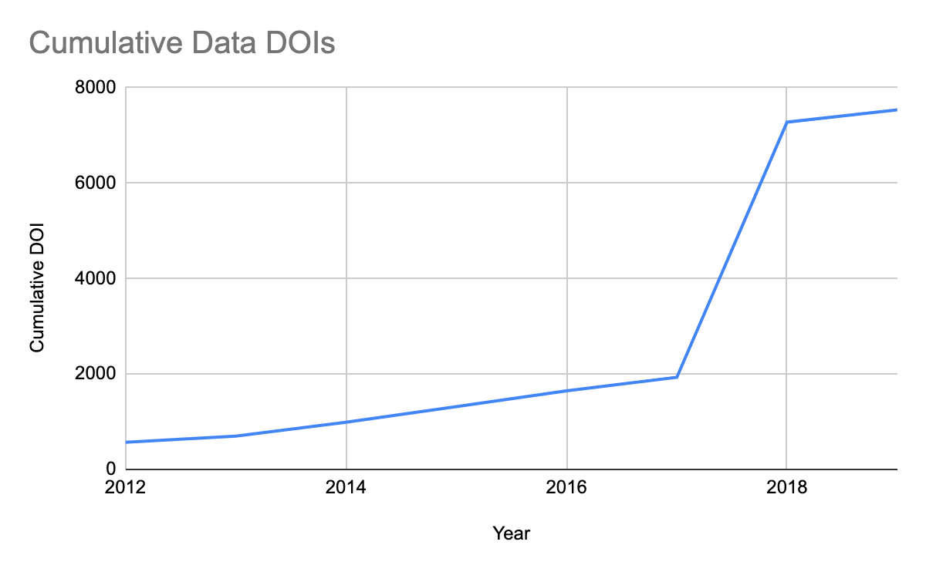
Persistent Identifier approaches and processes
Track and report metrics
>7500 Data DOIs since NOAA started minting Data DOIs in 2012
Received 1074 transferred DOIs when CDIAC closed
Average* of ~280 DOIs/year
*Excludes ~5000 DOIs in 2018 for special project to support WDS Paleoclimate

Slide 4
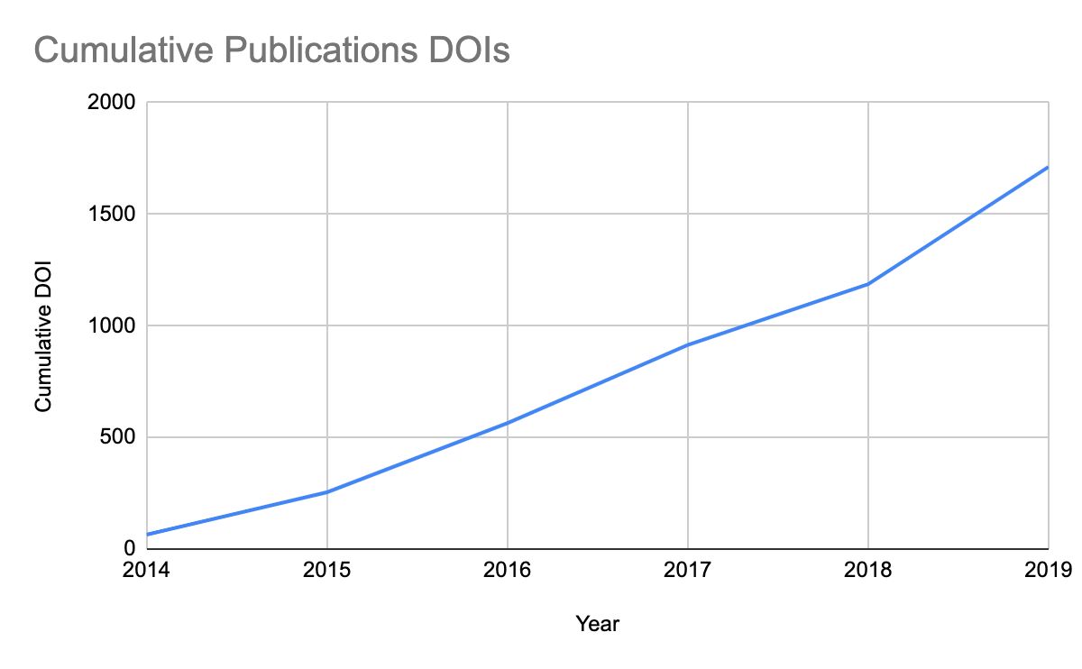
Persistent Identifier approaches and processes
Track and report metrics
>1700 Publication DOIs since NOAA started minting Publication DOIs in 2014
Average of ~285 Publication DOIs/year

Slide 5
Persistent Identifiers for Docs and Software
NOAA Central Library responsible for publications, including NOAA Tech Memos, Cruise Reports, other NOAA publications
NCEI responsible for data and documentation that may augment or accompany data in archival data collections
NOAA does not have a centrally-managed software repository and does not currently create a DOI for NOAA-created software

Slide 6
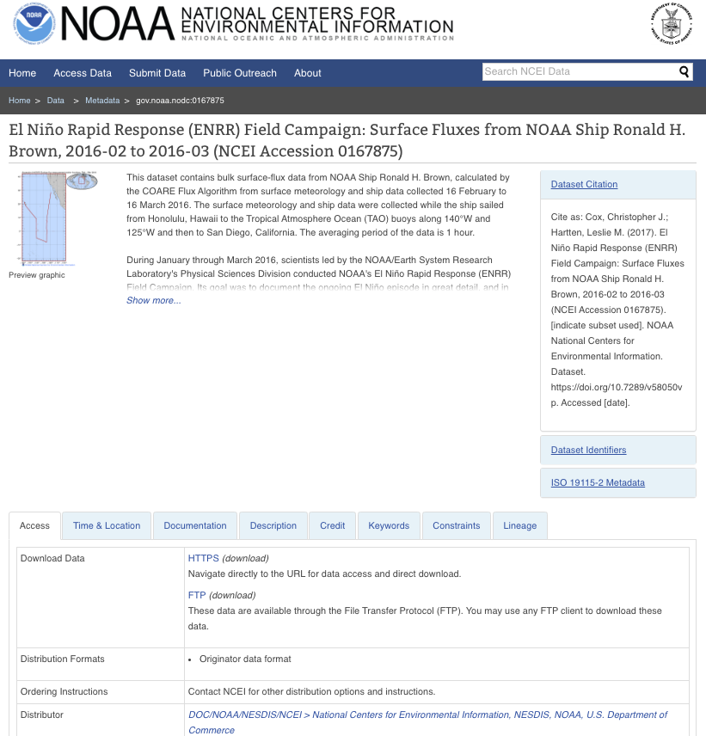
Landing page approach
Data DOIs link directly to a uniformly-presented landing page presenting the content of ISO 19115 metadata for the data collection
Metadata provides two-way cross-references between DATA and PUBLICATIONS when those linkages are known and documented

Slide 7
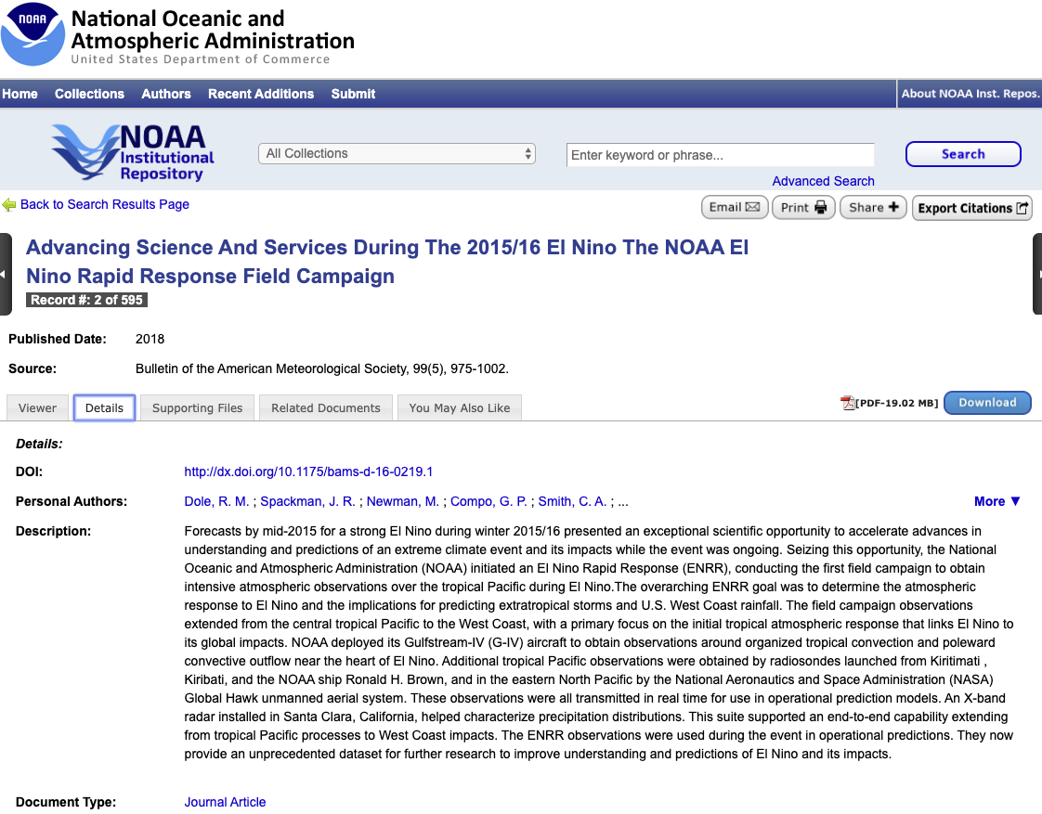
Landing page approach
Publication DOIs link directly to the NOAA Institutional Repository landing page for the publication
Metadata provides two-way cross-references between PUBLICATIONS and DATA when those linkages are known and documented

Slide 8
Lessons Learned
Important to have a publicly-accessible policy statement to underpin the process and basic requirements
Review and maintain the policy statement to keep up with and manage expectations
Be prepared (via a team or Working Group) to field and resolve nuanced questions about the process and policy interpretation
Communicate updates and changes widely and quickly

Slide 9
Other Notable Points
NOAA changed DOI vendors which affected the DOI prefixes used for NOAA data and publications and the process for managing and reporting DOI metrics
Management and monitoring of DOI minting processes across NOAA due to license limits
Challenges for managing metadata for data that have a pre-existing DOI from a non-NOAA source

Slide 10
Question for WGISS
Event-based DOIs for cruises have been requested, but not adjudicated. Do other repositories mint DOIs for events?

